Slide 1
The Six Building Blocks
A Team-Based Approach to Improving Opioid Management in Primary Care
Celebrating Success and Making a Plan for Sustainability
  This work was funded by the Agency for Healthcare Research & Quality (R18HS023750), and the National Center For Advancing Translational Sciences of the National Institutes of Health (UL1TR000423). Additional funding comes from a WA OCH subcontract and a WA DOH subcontract (HED23124) of Cooperative U17CE002734, funded by the CDC. Its contents are solely the responsibility of the authors and do not necessarily represent the official views of CDC or the WA State Department of Health.

Slide 2
Celebrating some of your successes! (EXAMPLE, UPDATE WITH YOUR CLINIC’S SUCCESSES)
You championed, led, tested, assessed, adjusted, and persevered! As a result:
Guideline-concordant policies are in place
Care teams are using a patient agreement to educate patients about the policy and risks
You implemented EHR templates to support your work
You figured out how to track, measure, and monitor the results of this work!

Slide 3
The data speak for themselves
 | Baseline | End of project
Patients who receive care in your organization (approximately) | Add data
Patients on long-term opioid therapy
Patients with an MED ≥ 50
Patients with an MED ≥ 90
Patients co-prescribed a sedative
Patients with a Treatment Agreement
Providers who can prescribe opioids
Providers who do prescribe opioids
Providers signed up for the PDMP
Delegates signed up for the PDMP
Providers waivered to prescribe buprenorphine
Notes:
And as you know as you provided this data for us… your numbers are trending in the right direction. AND YOU HAVE THESE NUMBERS! Think about what a success that is!

Slide 4
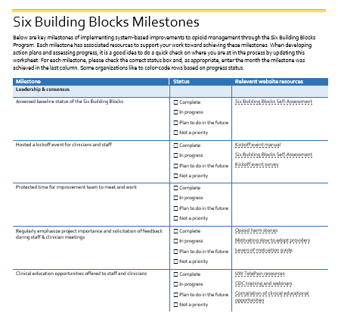
Next steps
Baseline areas of reported struggle (EXAMPLE: replace with results from Kickoff Survey):
  Time consuming
  Demanding patients
  Complex patients on legacy prescriptions
  Lack of consistent policies, etc.
  Hard to track patients
  Limited referral resources
Milestones check: additional activities? (EXAMPLE: replace with milestones your site has not yet achieved)
  Clinical and patient engagement education?
  Patient education?
  Opioid alternatives?
Notes:
We looked back at what your clinicians and staff had to say was difficult at the start of this project. Here is what they said…. What do you think they would say now? Should we make a plan to address any existing issues?
We have been tracking your progress toward achieving identified milestones. It seems like you might still have opportunities to work on the following milestones… Can we help you make a plan?

Slide 5

Making a Sustainability Plan
Things to consider when planning for sustainability
Engagement
Adaptability
Education
Culture
Measurement
Infrastructure
Staffing
Source: How To Build Sustainability Into the Innovation Process | AHRQ Health Care Innovations Exchange
Notes:
You have done amazing work through this project. Now we’d like to talk about what you want to consider to keep your achievements sustainable.
The concepts I want to walk through come from How To Build Sustainability Into the Innovation Process | AHRQ Health Care Innovations Exchange
All of this can be found in the Sustainability handout.

Slide 6

Engagement
Continue to keep leadership, staff, and clinicians engaged by:
  Sharing data and promoting success stories
  Checking in
  Continuing to adapt and improve
How will this continue to happen? (When? Who?)
Who will check in? When?
Who will investigate if things aren’t working?
If you identify a needed change, who will lead development and testing of changes?
Keep in mind it will be important to continue to involve those doing the work.
Notes:
Sharing data and promoting success stories (both about patients and about improved work life) to remind everyone of the value of the work.
Checking in to ensure the processes are still working and that any new changes are in fact improvements.
Continuing to adapt and improve in response to feedback. Ensure there are compelling reasons for any changes and that changes are supported.

Slide 7

Education
Continue to educate staff and clinicians by:
  Integrating opioid management into regular training
  Including opioid management training in onboarding
  Continuing to provide educational opportunities
  Continuing to adapt and improve in response to new evidence-based guidelines.
Who will oversee opioid management education and training?
How will you identify training needs?
What are approaches to reminding staff about processes?
How will you stay up to date on new evidence?
Who will lead future improvements and small cycle tests of change?
Notes:
Integrating opioid management training into regular staff meetings, trainings, newsletters, etc. Training is not “one and done”.
Including opioid management training in onboarding. Make sure new staff understand the key opioid policies and processes and why they are important.
Evidence-based medicine evolves. Continue to provide opportunities for staff and clinicians to receive education on opioid management. See the Clinical Education Opportunities resource for ideas.
Continue to adapt and improve in response to new evidence-based guidelines. Educate clinicians and staff about the compelling reasons for any changes and involve them in developing and iterating new workflows to support the changes

Slide 8
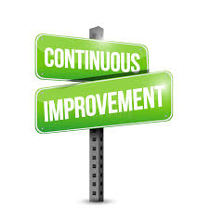
Culture
If possible, integrate opioid management into a culture of continuous improvement at your organization.
Do you have a Quality Improvement team that will continue to meet?
One way to make improvement a part of the culture is to make measurement a regular part of clinic activities.

Slide 9

Measurement
By continuing to monitor and share quality improvement data with key stakeholders (e.g., leadership, involved staff and clinicians), you are able to:
  Encourage continual buy-in for the processes.
  Identify if there is an issue that needs further investigation.
What’s your plan?
What will you measure?
Who?
How often?
Who will see the data?

Slide 10

Infrastructure
“Hardwire” your changes.
You’ve done much of this already by writing policies and workflows and updating your EHR templates.
You might also consider including opioid management tasks in job descriptions.
Are key processes written down?
Is someone responsible for reviewing these documents and determining if they need adjusting or further training is needed?
Are their roles that could use a job description update?
How will you maintain leadership support for key positions?
Notes:
Identify ways to “hardwire” your changes. You’ve done much of this already by writing policies and workflows and updating your EHR templates. You might also consider including opioid management tasks in job descriptions.
What’s your plan? Are key processes written down? Is someone responsible for reviewing these documents and determining if they need adjusting or further training is needed?

Slide 11

Staffing
Redundancy for key roles
What are the key roles that need back-up?
Who could be that back-up?
How will you keep them informed/involved?
Notes:
Your team has been instrumental in keeping this work moving forward. But what if one of you leaves? It is important to have a back-up for key roles.
What’s your plan? What are the key roles that need back-up? Who could be that back-up? How will you keep them informed?

Slide 12
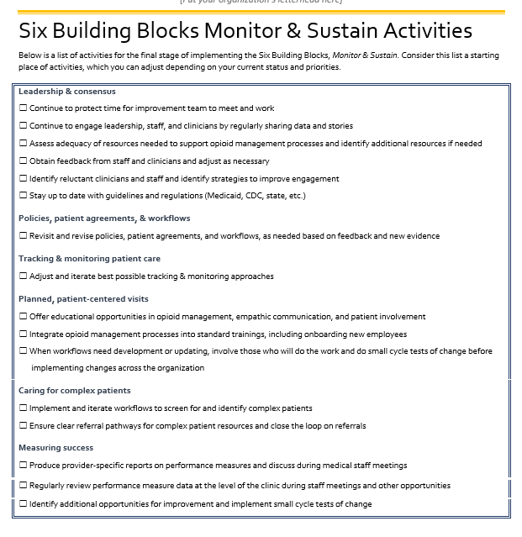
Resources
Monitor and Sustain Activities checklist
Sustainability handout
Clinical education opportunities

Slide 13
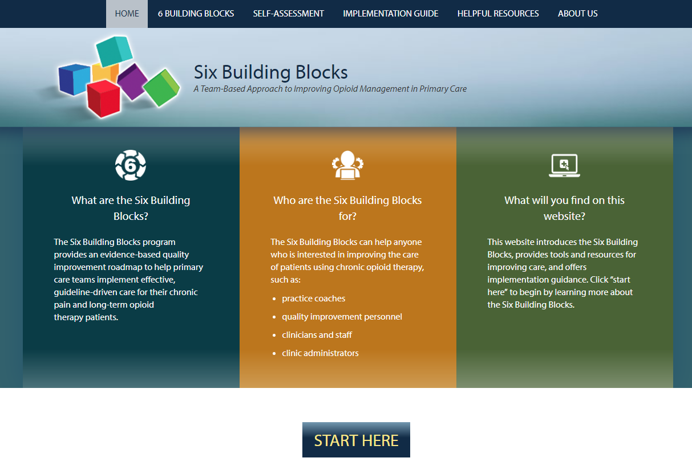
Additional resources at:
www.improvingopioidcare.org

Slide 14
Well Done!!!!
Notes:
Formal recognition of your participation coming in the mail.

