Slide 1

Wellbeing in TACOMA!
Faculty Development
Kerry Watrin MD, Program Director
Tacoma Family Medicine
Sept 2nd, 2015

Slide 2
Objectives
Review Literature prevalence of Wellbeing, Burnout and Depression in Residency
Review one residency’s PGY-1 experience since the 2011 Duty hour changes
Reflect on how this may be appropriate to individual residencies

Slide 3
Question??
How does your residency monitor for resident wellbeing?
  A) Advising system
  B) Informal Survey
  C) Standardized Surveys
  D) Other

Slide 4
Oh my Gosh!!
Be Careful what you ask for
  “How would you best describe your burnout level?” one question self rating end of July 2015
    Results of self rating
Number and % of 21/24 Resident respondents | Wording of rating
0 (0%) | Nil, I’m loving my job and I’m excited to go to work everyday
9 (43%) | A little stressed, but nothing I can’t handle
11 (53%) | I’m starting to get to the end of my rope, but hanging in there. I can’t keep this up much longer though
1 (4%) | Horrible, I’m dreading going to work everyday and I need a break

Slide 5
Resident “burnout” survey
Concerns/Causes
Mostly “not me”
Other people
  Good vs bad people
Workload
Processes
  Clerical Burden
  Clinic Inefficiencies
Restrictive Rules
  Duty Hours Rules
  Medicaid Precepting
Future looks ominous
Solutions
More 1/1 coaching
Outside residency mental health resources
Curriculum on handling stress
Have someone else do it
Help with clerical duties
Trim some curricular elements
Better workflows
On the clock admin time
Clearer expectations

Slide 6
“Stress Mindsets”
Stress
  Arises when something you care about is at stake
Mindset
  Core belief = theory of the way the world works
Stress is enhancing vs Stress is debilitating mindsets:
  Both have evidence
  Mindset is a distinct variable in the stress response
  More negative outcomes in debilitating mindset
  Teaching “resilience” vs “stress avoidance”
Notes:
1978 T Holmes Stress makes you sick too many life events, 0.118 correlation in 2,500 sailors, 43 items in adult, score 300+ at risk for illness, 150-299
Seligman Flourish why do some soldiers get PTSD and some do not
2013 Crum and Achor Stress mindsets

Slide 7
We were taught
“stress makes you sick”
Holmes and Rahe SSRS 1967
Social Readjustment Rating Scale
43 life events
+ 0.188 correlation in 2,500 sailors
  stress scores of previous 6 months
  developing illness in next 6 months
100 Death of Spouse
73 divorce
65 marital separation
63 death of close family member
45 marital reconciliation
40 pregnancy
38 change in finances
36 new line of work
31 mortgage over $50,000

Slide 8
Wellness or Burnout
Wellness: The measurable aspects of wellness
  Positive Emotion: pleasure
    10 positive emotions: joy, gratitude, serenity, interest, hope, pride, amusement, inspiration, awe, love
  Engagement: feeling “in the groove, in the moment, interested”
  Positive Relationships: lifegiving, nurturing
  Meaning: Career Purpose
  Achievement
Burnout:
  Emotional Exhaustion: Feeling emotionally spent
  Depersonalization: Cynicism and negativity, withdrawal
  Personal Accomplishment: Lack of pride in accomplishments

Slide 9
Family Medicine Resident
Wellness Behaviors Prevalence Survey
168/219 (77%) 1st year Family Medicine residents
  Completed a one time Survey Monkey in 1st 4 months (2013) of 5 instruments
Results Wellbeing Amount and Promoters
  67% satisfied to extremely satisfied
  55% spent time with nurturing relationships
  53% one mind-body exercise per week, meditation, yoga, tai chi
  25% daily 5 fruits and vegetables
  21% daily restful sleep
  20% daily exercise
  19% daily out in nature
Notes:
5 surveys each: Perceived Stress Scale, CES depression scale, Maslach Burnout inventory, Satisfaction with Life Scale, Wellness Behavior Survey

Slide 10


Exercise and Restful sleep associated with more positive well-being

Slide 11
Duties & Duty Hours
2013 Time and Motion study: two internal medicine residencies
  12% direct patient care,
    7.7 min/patient
    16.6 min per H&P
  64% indirect patient care,
    (40% computer use time)
  15% educational activity
  9% misc (3% handoffs)

Slide 12
Impact of the Duty Hours Rules
Onset 2003, more restrictive 2011
  No Change:
    2014 JAMA 6.4 million admits at 3,104 hospitals
    No change in Medicare all cause mortality or all cause readmission rate,
  Benefits:
    No decrease in case load or surgical case numbers for residents,
    There are fewer resident medication errors 5.96 >>> 4.84 per 100 pt days, vs 3.73 for hospitalists baseline
  Downsides:
    There are more resident readmits,
      18.3% << 16.4 %, baseline hospitalist 22.9% in one study
    More handoffs, more concern for errors in communication
    Work Compression, less time to do the same amount of work, requires a change in strategy to work smarter not harder
    Residents are only sleeping 22 minutes longer per day

Slide 13
2013 Family Medicine Resident Wellness Survey
Stress and Distress results
  Perceived stress score 16,
    slightly higher than norm (12-15)
    consistent with ranges for other health care students
  10% moderately to severely depressed
  13% high mental exhaustion (burnout)
  24% high depersonalization (burnout)
    Wellbeing no different for gender, age
    Wellbeing less if single with no partner
Sept 2013, Family Medicine, Vol 45, #8, p541-9

Slide 14
2010 Interns Depression study quarterly PHQ-9 survey
13 US Hospitals, 740 /1,394 interns responded (53%), IM, peds, OB/Gyn, Psyche, surgery
  “largest prospective trial to date”
Baseline and quarterly paid 30-40$ to complete PHQ-9 scale, reflecting on last two weeks
41.8 % met PHQ-9 of ≥ 10 once in the year

Slide 15
Depression Risk Factors
Depression more likely
  Difficult early life in family of origin
  US medical graduate
  Female
  Personal history of depression
  Neurotic
  Only 1 of 2 copies of serotonin gene 5-HTTLPR
Depression more likely
  More work hours
  Perceived medical errors
  Stressful life events
Depression less likely
  Lower baseline PHQ-9 score

Slide 16
Results over the year
PHQ9 Major Depress | Base-line | 3 mo | 6 mo | 9 mo | 12 mo
≥ 10 mild | 3.9% | 27.1% | 23.3% | 25.7% | 26.6%
≥ 15 moderate | 0.7% | 6.6 % | 6.2% | 7.8% | 7.6%
≥ 20 severe | 0% | 2.3% | 1.6% | 1.8% | 0.8%

Slide 17
Most frequently cited barriers to treating med student depression
Only 42% of depressed med students with suicidal ideation were treated
They cited barriers of
  48% lack of time
  37% lack of confidentiality
  30% stigma
  28% cost
  24% fear of documentation in academic record

Slide 18
Transitions
Existing State
Established Comfortable Roles
Familiar
Predictable & controllable
New State
Novel Roles
Unfamiliar
Less predictable and controllable
Acceptable Risk

Slide 19
The Culture Shock Model
Culture Shock:
  a stressful transitional period when individuals move from a familiar cultural environment to an unfamiliar one
wide individual variation
Novelty, change and input overloads
Traditional timing:
  the period of distress usually 6 to 12 months after insertion cross-culturally
  lasting 6 to 12 months duration

Slide 20
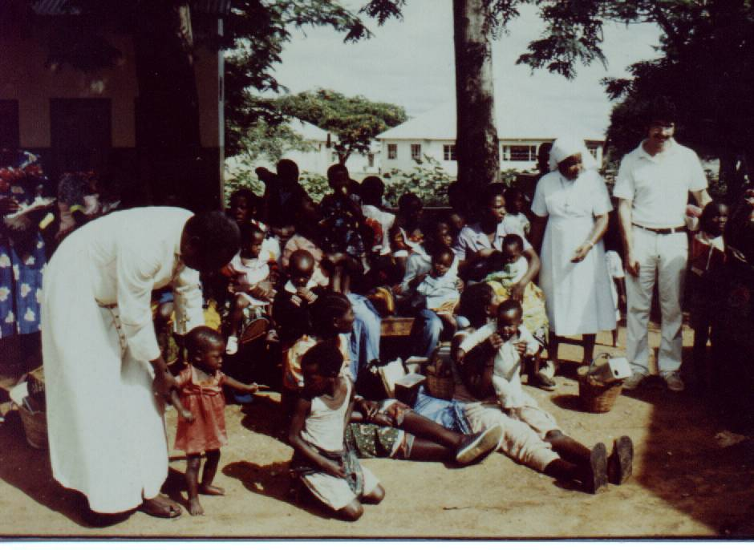

Slide 21
W Model: Entry-Re-entry

Slide 22
Coming to the Honeymoon
2012-15
2012 intern class first with 2011 restricted hours
2012-2015, n =30 (2 late)

Slide 23
The Arrival and National Geographic Stages
83 % residents started OK to great
  Noted, “I got a job, bought a house”
10 % residents started stressed/distressed
  Noted, “nervous”, “apprehensive”, “leaving a significant relationship”
By 2 months only 1/29 was distressed
  The nervousness subsides

Slide 24
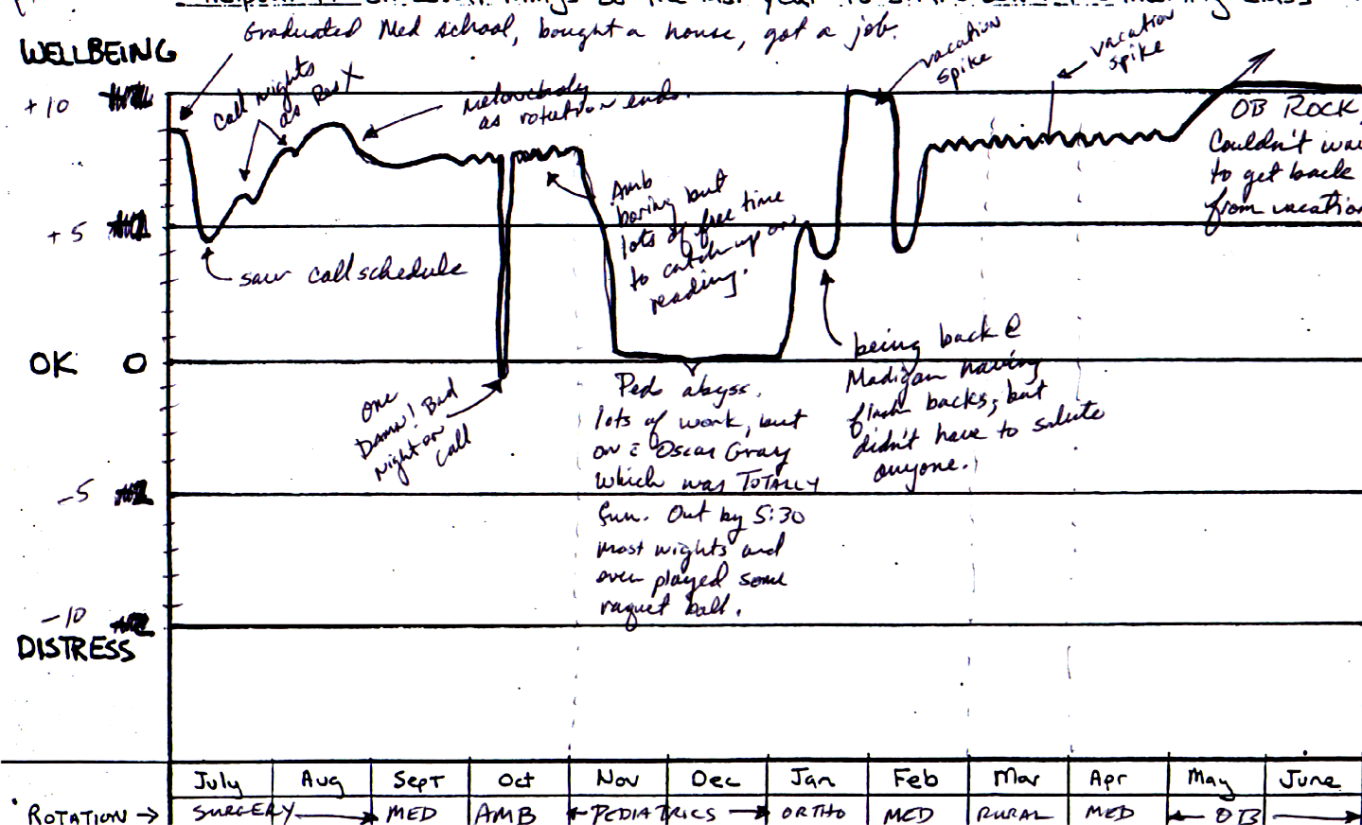
Always OK or better, the glass always half full, resilient
1-2 residents per class

Slide 25
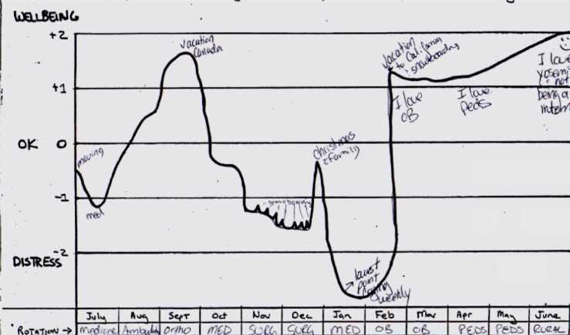
Typical Resident, Ups and Downs
5-6 residents per year
Up Vacation, June
Down Inpt & Jan

Slide 26
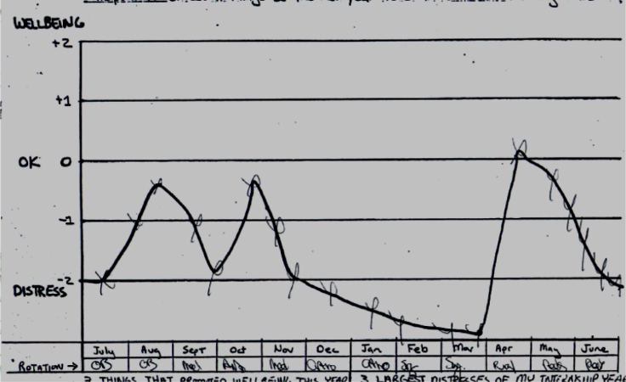
Always Less than OK, Use Advisor and seek Professional Help
1-2 residents per class

Slide 27
Transition
“If its not bolted on, it’s going to fly off”
Pre and post duty hours:
  30/47 (36%) reached a –2 distress level, (98-2003)
  20/29 (31%) reached a -2 distress level, (2012-2015)
Distress and stress tends to be
  short duration 2 weeks to one month at a time,
  average of 1-2 mo per resident in 1st year

Slide 28
Distress and Stress are Short
The Intern Glass is 10/12ths full
Post 2011 Duty hours Interns: 2012-2015 n=24

Slide 29
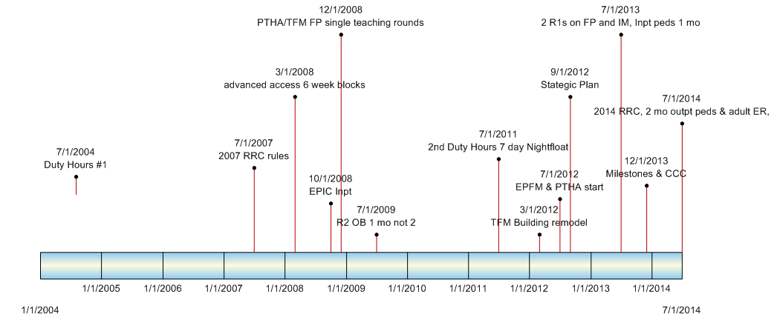
TFM Journey changes in last 10 years
“Change to improve is the norm”

Slide 30
Wellbeing and Distress
Since 2011 Duty Hours: 29 returns 2012-15 on end of year survey with wellbeing curve
Asked
  “3 things that promoted well-being this year”
  “3 largest distresses of my internship year”
Often wrote 5-6 items in three spaces
Notes:
(4 not done: one no response, one left program @ 2 mo for family emergency, two late responses for 2015)

Slide 31
3 Promoters of Wellbeing
People
17 fellow interns
15 spouse/SO
10 family
8 friends
4 supportive faculty
3 supportive senior residents
1 appreciative patient
1 direct patient care
1 new best friend
1 church
Activities
10 Exercise
7 vacation
4 cooking
4 hobbies
3 hiking/backpacking
3 sleep/rest
2 gardening
2 weekends off (golden)
1 each: sports, “no doctor anything time”, massage, yoga, dating, phone calls

Slide 32
Promoters of Wellbeing
Other
5 pet (mostly dogs)
2 positive attitude
1 self reflection
1 getting more efficient
1 loving myself despite external forces

Slide 33
Sources of Distress
People
5 family member is sick or dies
5 missing important life/family events
4 long distance relationships
3 unclear communications
1 each: relationship breakup, unsupportive senior, family at my house, negative interaction with staff or faculty
Pathos
2 difficult complex patients
2 dying patients/codes
Other
3 long dark winter
2 dog dies
2 moving
1 “chores” at home
1 debt load

Slide 34
Sources of Distress
Residency
6 not enough time
5 EMR/charting
2 unfavorable scheduling = “unorganized”
2 newby voices in program change seem less valued
2 working hard but no benefit of the doubt
1 long days
Internal/Personal Health
5 poor choices in work/life balance
5 lack of confidence
4 inefficiency/slow in mastering the basics
3 so much to learn
2 lack of sleep
1 each: I get sick, missing home, future unsure, feeling unsupported, feeling trapped by debt, questioning career choice, anxiety-imposter syndrome, not fitting in

Slide 35
Interns Protected
Burnout Moving to Senior Classes

Slide 36
Question #2
What does your residency do to promote resident wellbeing?
  A) Exercise opportunities
  B) Proactive vacation and break scheduling
  C) Support of resident personal efficacy & local control
  D) Support Groups
  E) Resilience training
  F) Other

Slide 37
Structural Residency Issues
Program and Faculty Chance to Set Up
Programatic
  Clerical Work
  Balanced Curriculum
Supportive
  Teaching styles
  Advising system
  Debriefing Pathos

Slide 38
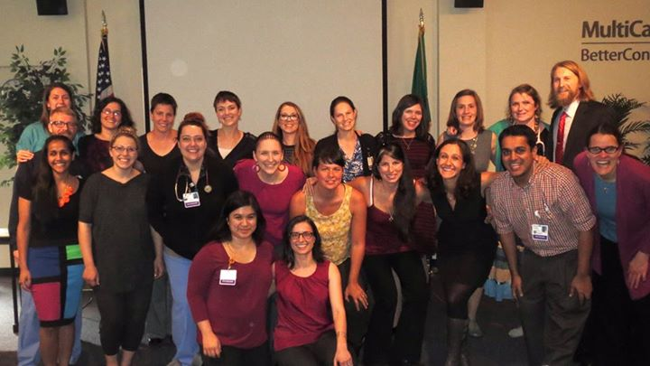
Each is an individual
On the residency journey

Slide 39
The Approach
Self Discovery
  The teachable moment
  Safe relationship with the advisor
  Signature Strengths
    https://www.authentichappiness.sas.upenn.edu/testcenter
Avoid Sharing on Demand (SOD session)
  Can seem like “shame and blame”

Slide 40
Reframing Stress in the Moment when flooding
Take a “short time out” (3 minutes, a redo):
  Gottman’s finding, “you can not hear your spouse when your emotions race your pulse > 100 bpm”
“Phone a friend”
  Teammate: Bounce it off the team, don’t be afraid to not know the answer
  Faculty give the answer once they say I don’t know
  Look it up together

Slide 41
Johari Window
In Resident Advising and Coaching
Johari Window |  | Faculty
 |  | Known | Unknown
Resident | Known | Public Self | Private Self
 | Unknown | Blind Side | Transference/ Counter-Transference

Slide 42
Cognitive Behavioral Therapy Advising
Making choices going forward
  Unlock “learned helplessness”
ABCD model
  Adversity: event
  Belief:
    Our belief about and reaction to the event
    What we believe in why it happened and what it means for our future
  Consequence:
  Disputation: challenging our assumptions and beliefs, what evidence for this belief,
    A chance to de-catastrophize

Slide 43




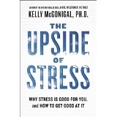
Wellness Books:
Positive Psychology Self Help
Peace is Every Step: 1992 Thich Nhat Hanh
Flow: 2008 Mihaly Csikszentmihalyi
The Happiness Advantage: 2010 Shawn Achor
Flourish: 2011 Martin Seligman
The Upside of Stress: Kelly McGonigal
Photo credit: book images from Amazon.com

Slide 44
Promoting Resilience
Practice positive emotions
  Play to your style stength
  Write down 3 gratitudes/day
  Give 3-5 praises for every constructive comment
  Learn something new everyday
  Remember your “calling” and meaning
  Celebrate little wins
  Reframe: De-catastrophize
Practice time efficient healthy activities
  Exercise: take the steps
  Meditate: 3 minutes breathing, the beeper medication
  Mindfulness: “I wonder who could be calling”
  Get outside for a break
  Protect your rest, sleep, nap
  Buy experiences not stuff
Promote Optimistic style:
  adversity is temporary and local
Master the zones and fundamentals:
  Tighten zone of control: “the Zorro Circle”,
  have your say but not way on zone of influence,
  Become efficient in the fundamentals, EMR, clinic visit, H&P, Discharge
Be Proactive and flexible:
  think ahead, don’t sweat the small stuff
  Pace yourself: marathon not sprint
Tap into Life-giving Relationships:
  Team, significant other, family, friends
Balance
  (emotional, physical, intellectual, spiritual)

Slide 45
Professional Help
Professional counseling/medication:
  Accessed by about 2 residents per class of 8
  In-house,
    Behavioral Scientist
    Sponsor Employee Assistance Program
  Community,
    Personal Health Insurance with referral from personal Family Physician
    List of resources and referrals residents have found helpful in the past

Slide 46
Conclusions
Published rates of resident
  Burnout: 24% to 51%
  PHQ-9 of ≥10: 41%
  Depression: moderate to severe 10%
Residents are individuals
  Recognize and respond to individual need
  Genetics + learning style + Imprinting + belief system + current situation + current choices
Avoid shame and blame
  Good vs bad residents, good vs bad faculty
Both/And
  Need for supportive residency structure
  Need for resilence promotion

