Slide 1
Chronic Disease in Global Health: Opportunities and Challenges
Tina Neogi, MD, MS, MPHc
Department of Family Medicine Grand Rounds
February 5, 2014
©2014 Neogi

Slide 2
Disclosure: Conflicts of Interest
Dr. Neogi states:
Neither I, nor any immediate family member has any financial relationship with, or interest in, any commercial interest connected with this presentation.

Slide 3
Case
64 yo Iraqi woman immigrated as a refugee to the US 3 months prior to visit. She had been diagnosed with type 2 diabetes, high blood pressure, and high cholesterol in Iraq, and started on medications. She moved four times in the past three years, to Saudi Arabia, Turkey, and Germany prior to coming to the US. She reports that she was “well controlled”, but cannot recall her medications. She does recall that she had not tolerated one of her medications previously but was then changed. She has been off all medications for the past 3 months since arriving to the US.

Slide 4
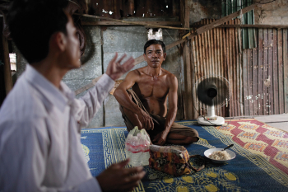

Case
“I wish I had HIV”
Picture Source: www.capacity.org

Slide 5
Agenda
Background on Chronic Disease and Global Health
Projects in the Department
Questions?

Slide 6
Learning Objectives
At the end of this activity, the participant will be able to:
1. Identify what are noncommunicable diseases and how they are similar and/or different to chronic diseases.
2. Describe the term “double burden of disease”.
2. Discuss how noncommunicable diseases are being embedded into the global health agenda.
3. Apply your knowledge on chronic disease in global health to the care of your immigrant and refugee populations.

Slide 7
Chronic vs NCD
Chronic Disease
Noncommunicable disease (NCD)
Infectious or noninfectious in etiology
  HIV
  TB
  Cardiovascular Disease
  Diabetes
Typically noninfectious (with exception)
Defined by the WHO as:
  Cancer
  Diabetes
  Cardiovascular disease
  Chronic Respiratory Disease
Significant debate regarding Mental Health issues (Depression, PTSD, etc.)
OFTEN USED INTERCHANGABLY, but there are differences

Slide 8
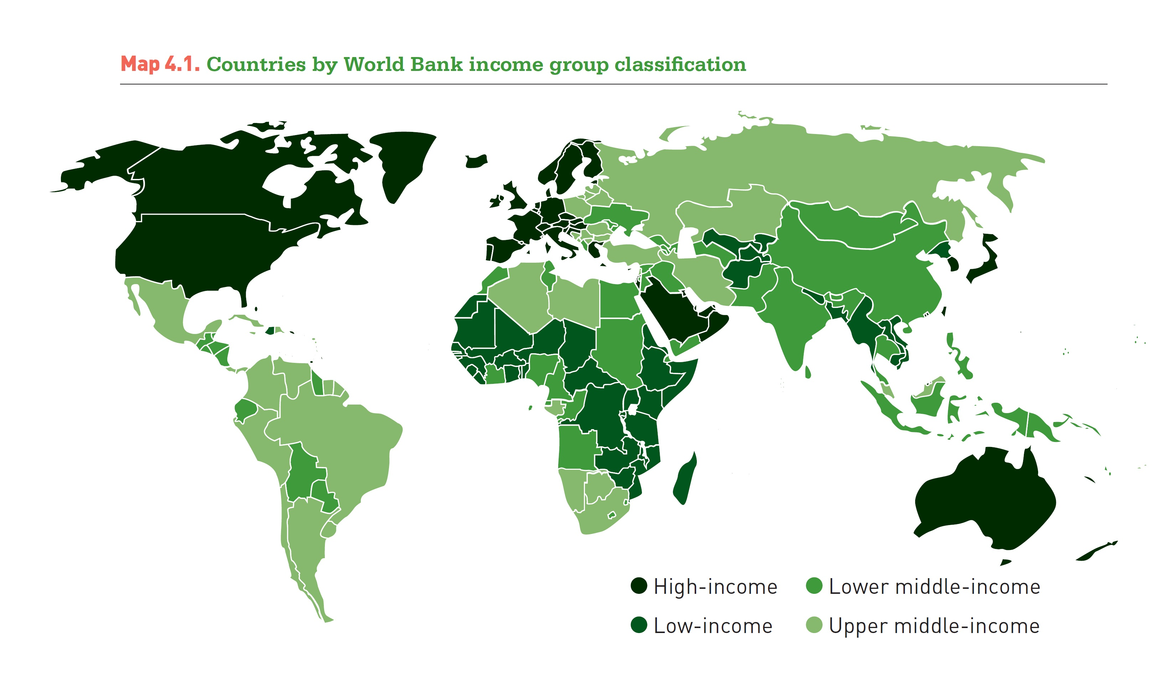
nternational Diabetes Federation. IDF Diabetes Atlas, 6th edn. Brussels, Belgium: International Diabetes Federation, 2013. http://www.idf.org/diabetesatlas

Slide 9
Burden of Disease
63% of 57 million total deaths due to NCDs (WHO, 2008)
80% of deaths related to NCDs occur in low and middle incoe countries
These countries account for 90% of the 9 million noncommunciable disease-related deaths occuring before the age of 60.
Cardiovacuslar disease accounts for the largest fraction of deaths due to NCDs
Hunter, D. Reddy, K. Noncommunciable Diseases.
New England Journal of Medicine 2013; 369: 1336-43.

Slide 10
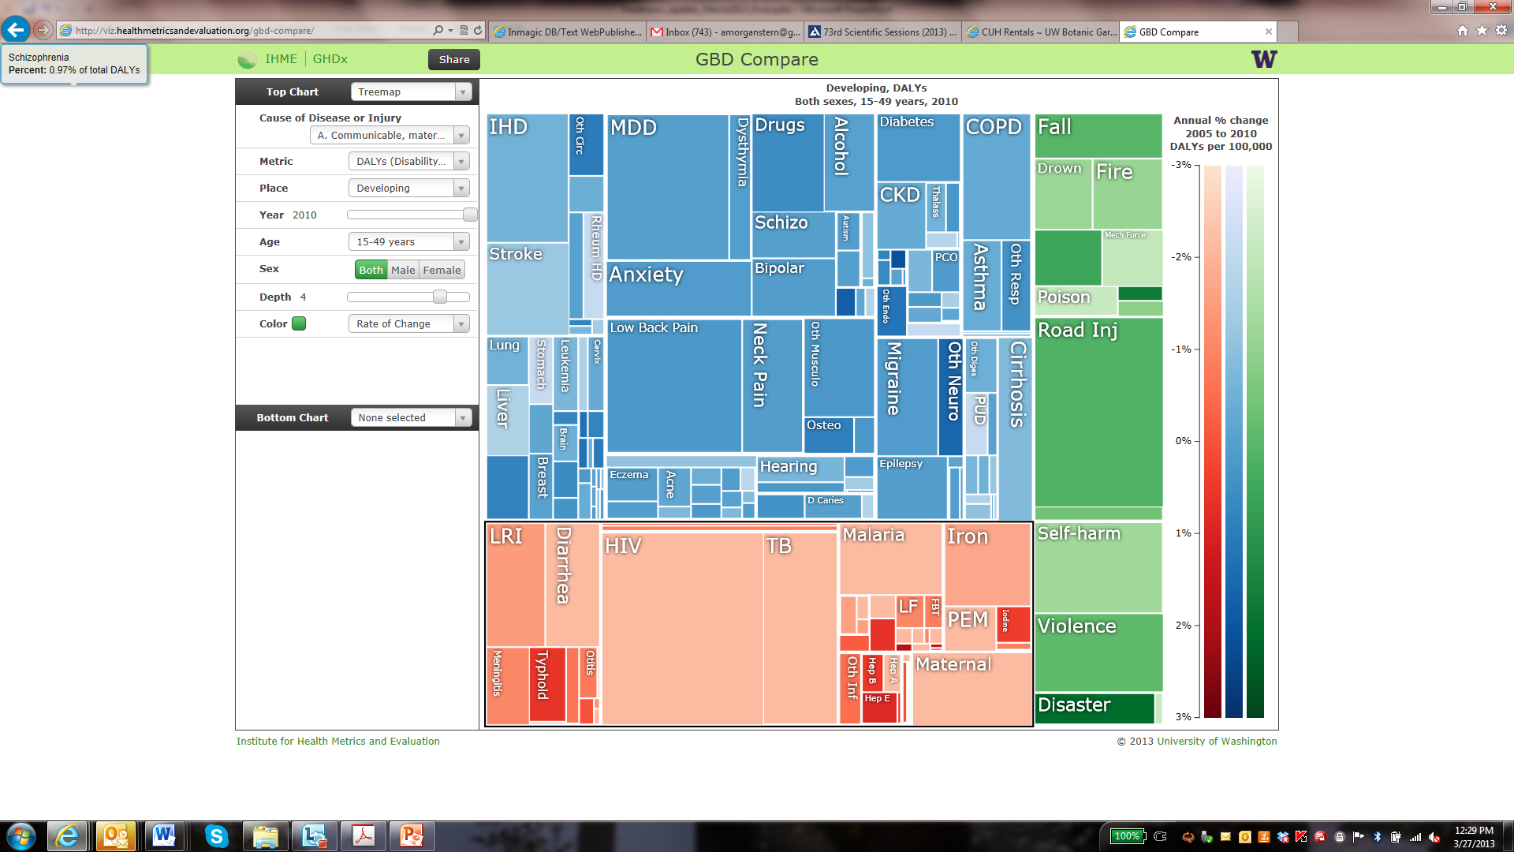
NCDs overtake communicable disease

Slide 11
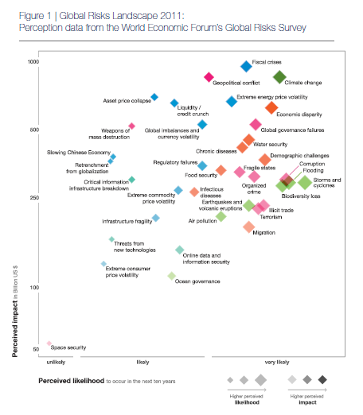
Noncommunicable Disease Situation Worldwide
Economic impacts
  Between 2005 and 2015, China, Russia, and India will lose the following in foregone national income due to preventable deaths
    558 billion USD due to diabetes
    303 billion USD due to heart disease
    237 billion USD due to stroke
Notes:
This graph from the World Economic Forum’s 2011 Global Risks report highlights chronic diseases as likely to have a significant economic impact.

Slide 12
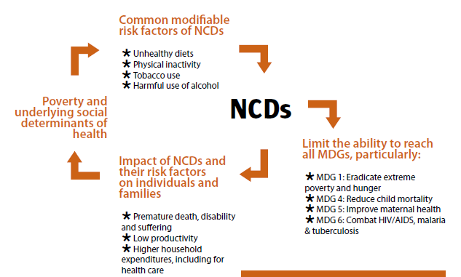
Barriers to Care
Source: NCD Alliance
Notes:
\
Although not formally part of the MDG framework, increasing rates of morbidity and mortality due to chronic disease may compromise progress on the MDGs, especially those highlighted here.

Slide 13
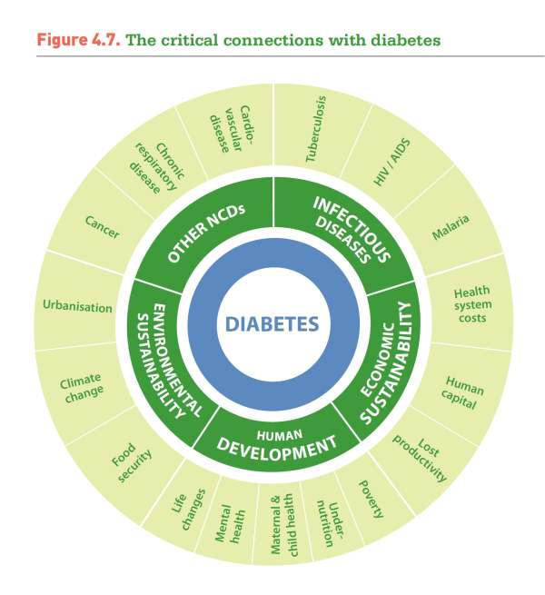
nternational Diabetes Federation. IDF Diabetes Atlas, 6th edn. Brussels, Belgium: International Diabetes Federation, 2013. http://www.idf.org/diabetesatlas

Slide 14
Embedding Noncommunicable Disease into the Post-2015 agenda
Alleyne,G. et al. Embeddiing non-communicable diseases in the post-2015 development agenda. Lancet 2013; 381:566-74.

Slide 15
Positioning of NCDs in global health
Integration of NCD care
  Shared risk factors
  Early treatment
  Similar platform for care delivery
Global Monitoring Framework
  25 indicators
  Set of 9 voluntarily global targets
Global Action Plan
  A call for integration with communicable diseases
  Multisectoral action
  Universal health coverage
  Life course approach
  Evidence based strategies

Slide 16
Targets and
Indicators:
WHO Global
Action Plan
25% relative reduction in premature mortality from NCDs by 2025

Slide 17
Women in NCDs
NCDs are the cause of 65% of deaths in women worldwide
Half of all people with DM are women
1 in 25 pregnant women is likely to have gestational diabetes
Barriers for women
Economic, sociocultural, and geographic barriers
Primary care givers for family members
Suffer greater stigma and discrimination in society, with potential loss of employment and family due to morbidity
More likely to withdraw girls from schools to help at home

Slide 18
Dual Burden of Disease

Slide 19
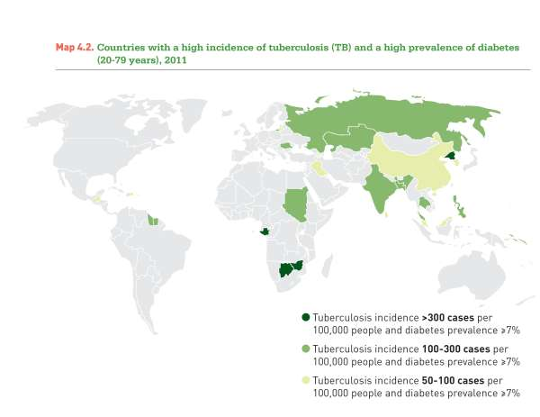
nternational Diabetes Federation. IDF Diabetes Atlas, 6th edn. Brussels, Belgium: International Diabetes Federation, 2013. http://www.idf.org/diabetesatlas

Slide 20
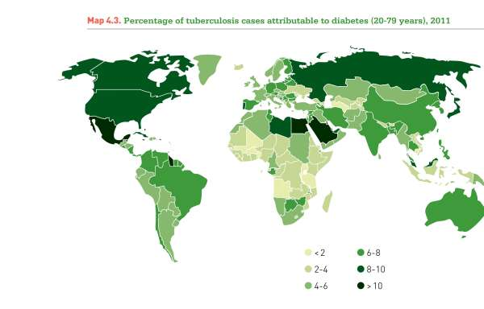
nternational Diabetes Federation. IDF Diabetes Atlas, 6th edn. Brussels, Belgium: International Diabetes Federation, 2013. http://www.idf.org/diabetesatlas

Slide 21
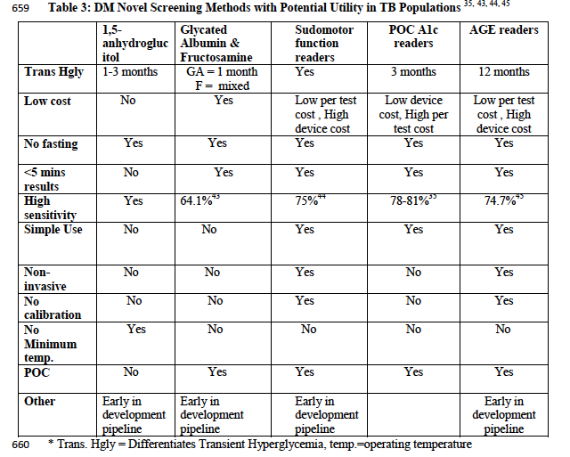
Adepoyibi T. McGuire H, Neogi T, Weigl B. New screening technologies
for type 2 diabetes mellitus appropriate for use in tuberculosis patients. Public Health Action.
Acceptance for publication July 2013.

Slide 22
Importance, Opportunities, and Challenges For Primary Care and Chronic Disease And/Or NCDS

Slide 23
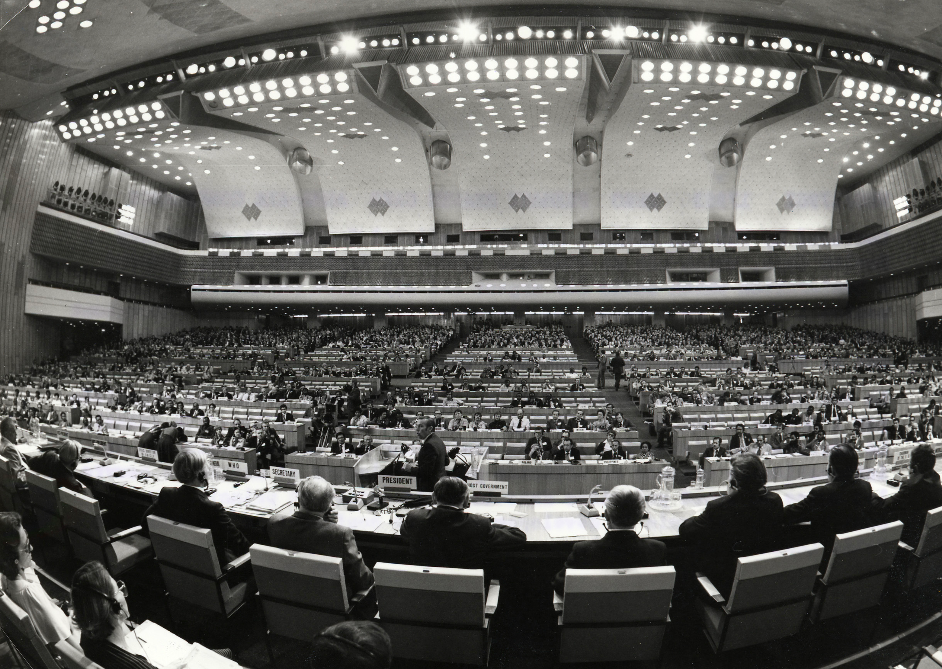

Slide 24
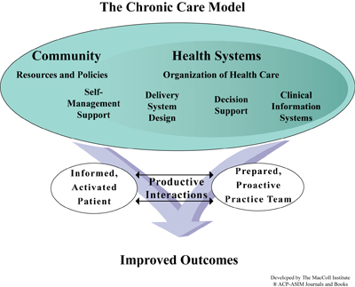
Chronic care model

Slide 25
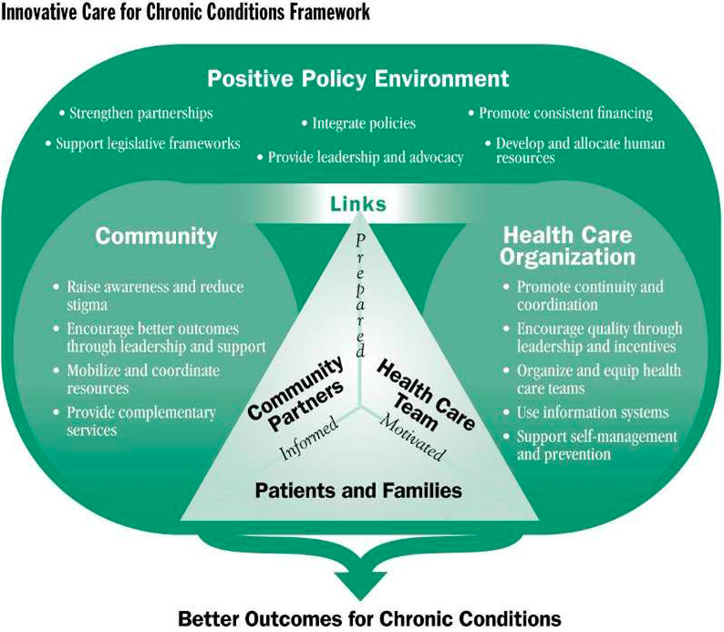
Chronic Care and Innovative Care Models

Slide 26
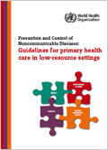
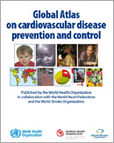
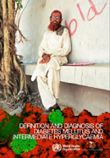




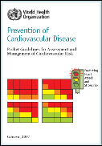
Guidelines
WHO/ISH guidelines

Slide 27
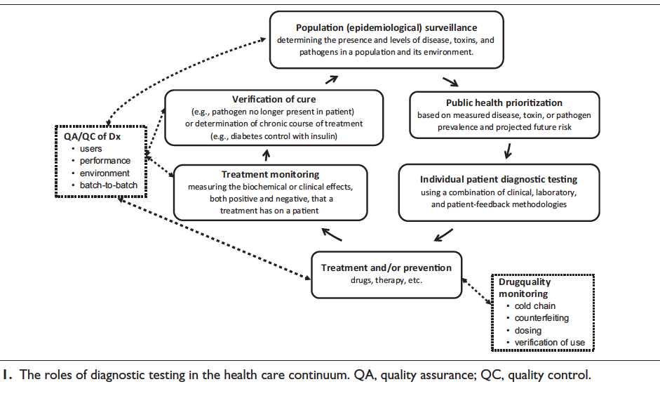
Weigl B, Neogi T, McGuire H. The Future of Point-of-Care Diagnostics
for Low-Resource Settings in the Age of the Chronic Disease Epidemic.
Journal of Laboratory Automation. Accepted for publication August 2013.

Slide 28
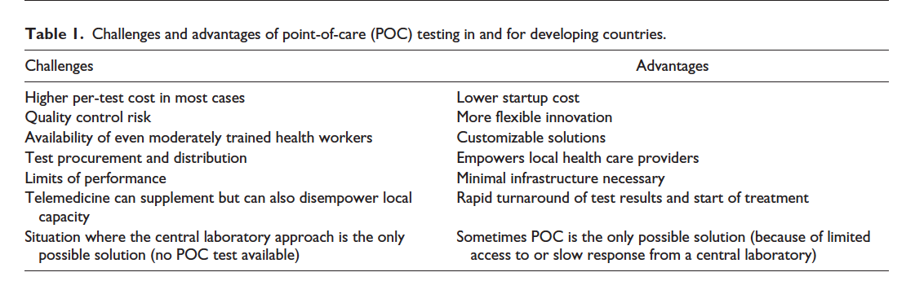
Weigl B, Neogi T, McGuire H. The Future of Point-of-Care Diagnostics
for Low-Resource Settings in the Age of the Chronic Disease Epidemic.
Journal of Laboratory Automation. Accepted for publication August 2013.

Slide 29
Shall We Travel?:
Projects in Department

Slide 30
Research Area of Interest
Point of care technologies to optimize chronic disease care in low resource settings [primary care]

Slide 31
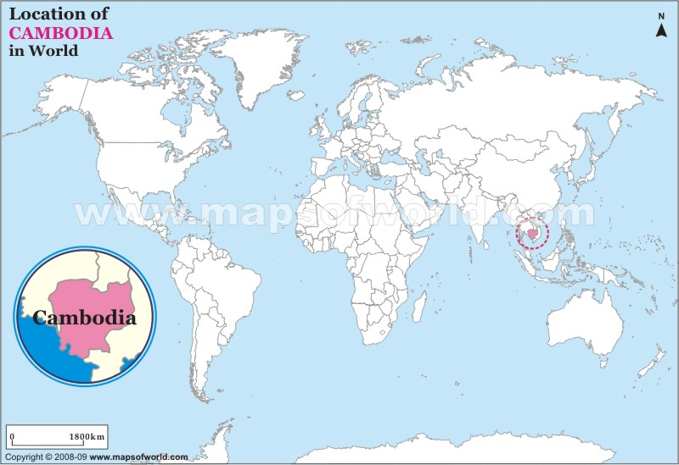

Slide 32
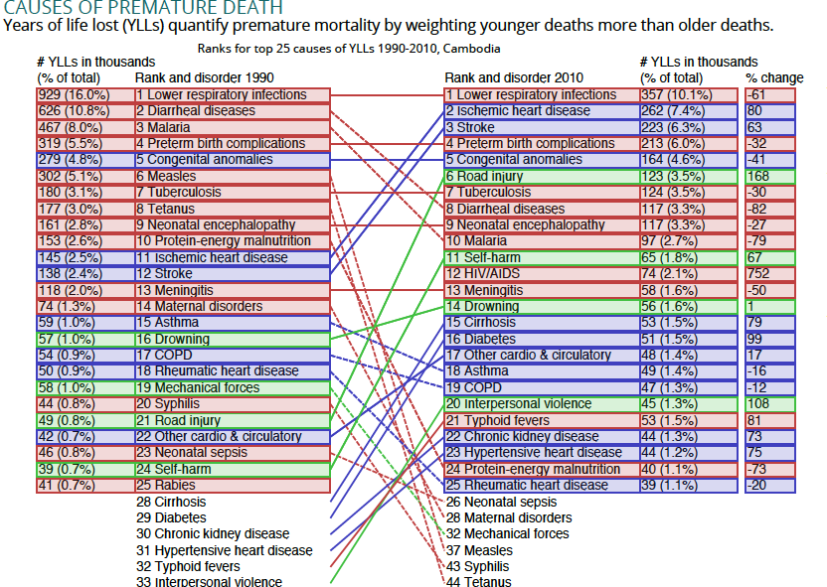
Cambodia
IHME GBD 2010

Slide 33

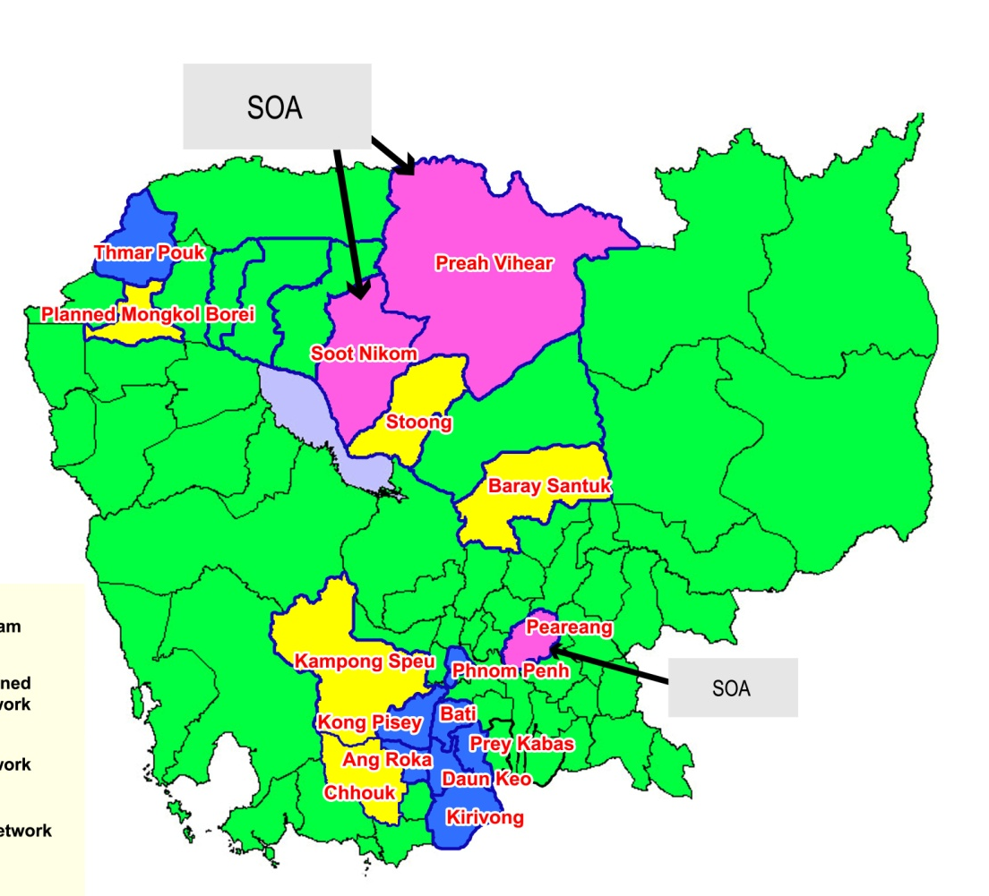
MoPoTsyo: Technology and delivery
Since 2007, MoPoTsyo has screened over 460,000 adults.
100 peer educators help facilitate services for 12,000 people living with diabetes and hypertension.
Primarily based in Phnom Penh and surrounding urban slums; expanding into other parts of Cambodia.
Notes:
Maurits van Pelt founded MPT in 2004.
MoPoTsyo’s mission is to: empower people living with diabetes and hypertension to control and manage their disease
NGO that engages patients through self-management with support from peer educators.
Since 2007, MoPoTsyo has screened over 460,000 adults. Today, 100 peer educators help facilitate services for 12,000 people living with diabetes and hypertension.

Slide 34
The MoPoTsyo study
MoPoTsyo: one of very few promising model for sustainable diabetes care in low-resource setting.
Our goals:
  Identify key success factors and explore future opportunities to more thoroughly assess the model and verify potential sustainability.
  Determine sensitivity/specificity of their process as well as possible LRS-compatible alternatives.
  Determine impact of alternatives – more patients, less severity, technology trade-off.
=> Synthesize findings, improve technology and delivery model, widen applicability, and scale.

Slide 35
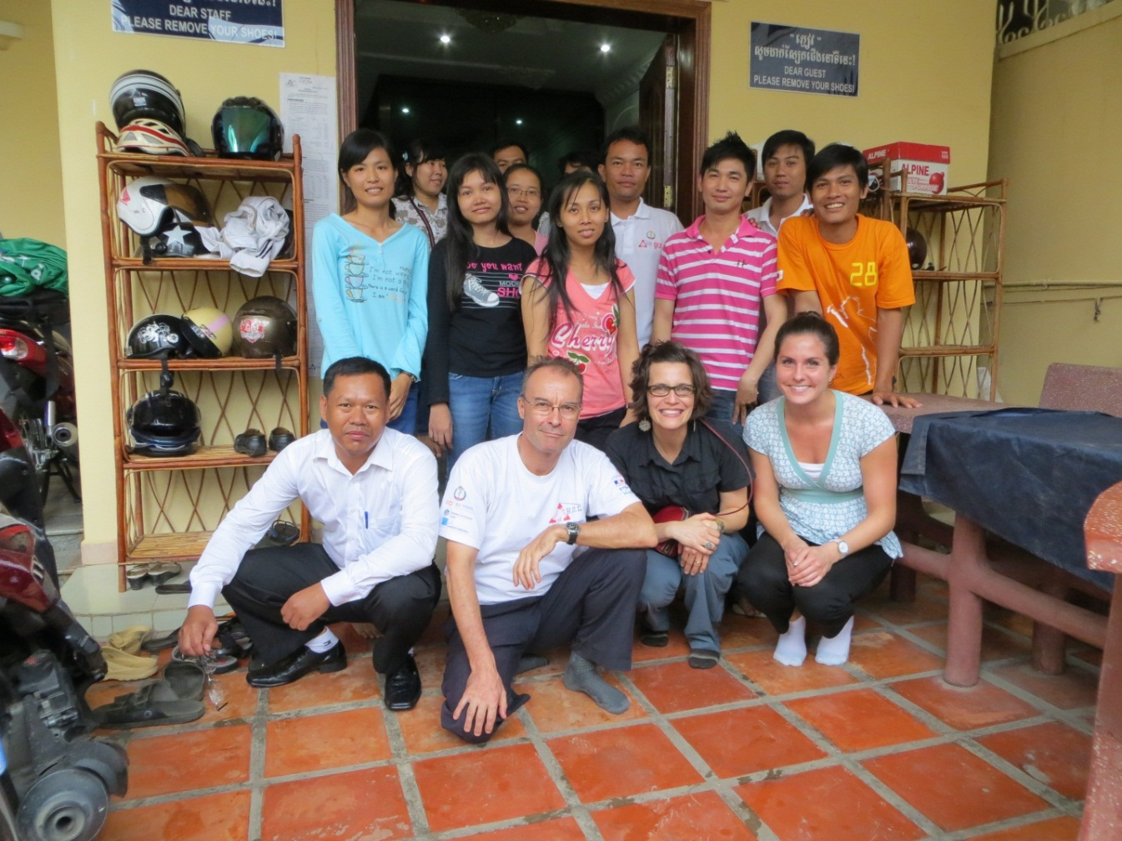
Examining MoPoTsyo as a Model for Delivering chronic disease care
Literature review
Discussion guides tailored for 5 groups
25 structured conversations in Phnom Penh, Kampong Speu, and Siem Reap, Cambodia.
Observed
  Peer Education session
  Physician patient interaction
  Distribution of medication by pharmacist
Notes:
A literature review of care models and background research on diabetes in Cambodia and MoPoTsyo informed creation of five discussion guides that were consistently used through all of the conversations.
A literature review of care models and background research on diabetes in Cambodia and MoPoTsyo informed creation of five discussion guides that were consistently used through all of the conversations.
15 MoPoTsyo headquarters staff, 4 Peer Educators, a board member, a MoPoTsyo contracted physician, a MoPoTsyo partner pharmacist, a government operational district manager, a ministry of health official, and a deputy director at the Cambodia Diabetes Association.
In Cambodia, the structured conversations were conducted by two PATH staff members, who also served as the note takers through all of the interviews.

Slide 36

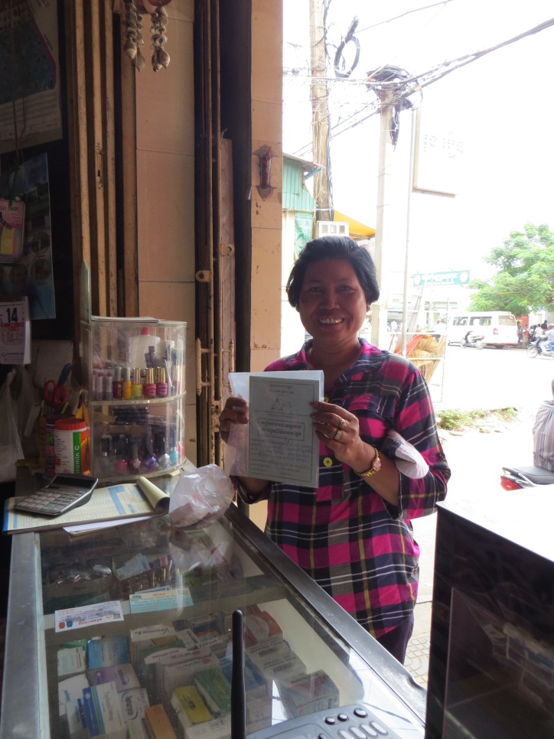
Findings:
Four key success factors
Employing an interdisciplinary, proactive team-based model of care.
Facilitating increased access through provision of community-level services.
Establishing trust though peer educators.
Harnessing the capabilities of a dynamic and well-connected leader who supports and inspires others.

Slide 37
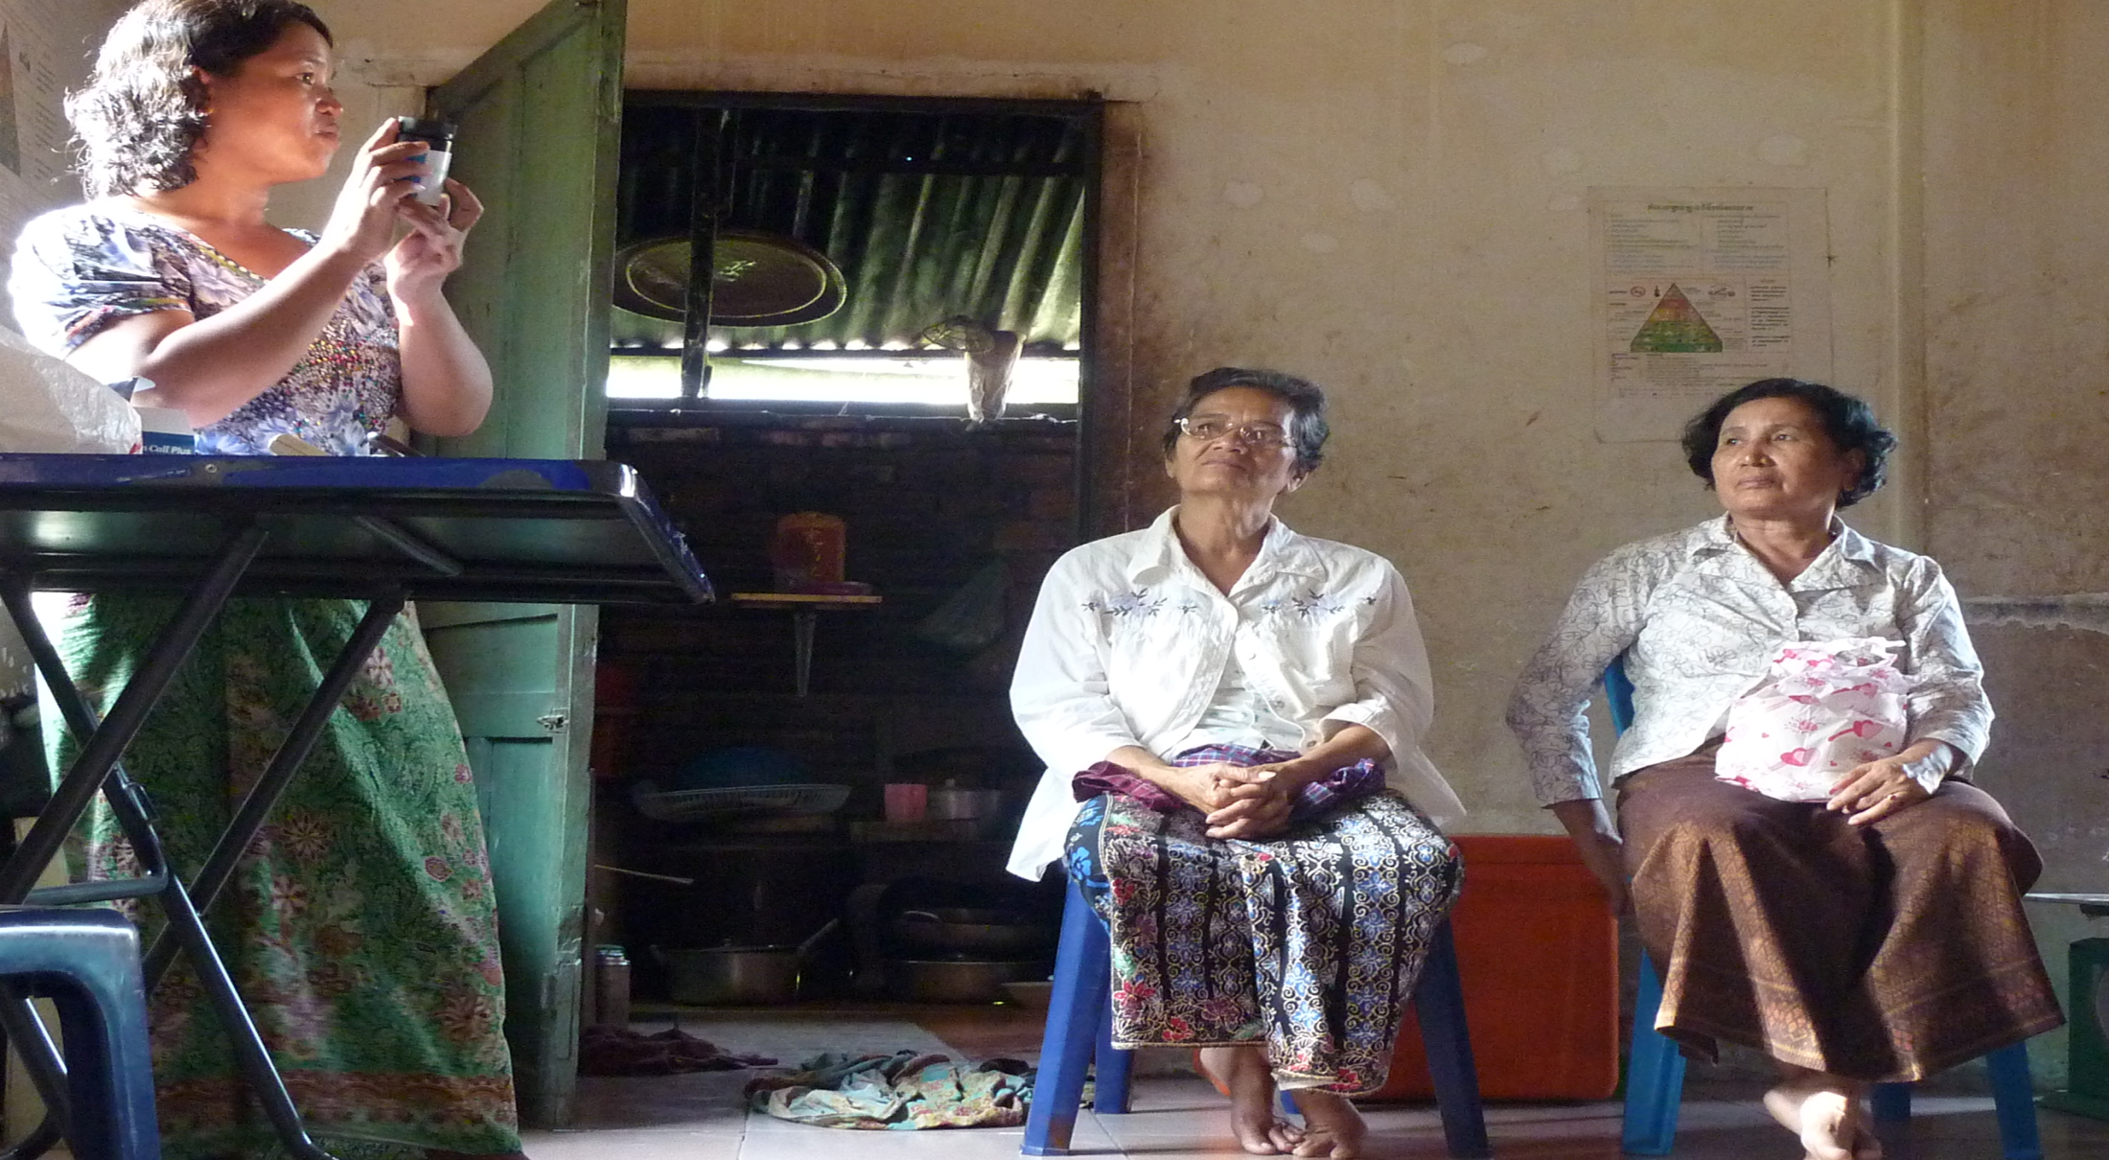
Value and Implications of Alternative Diabetes Screening Tools: PATH-Mopotsyo study

Slide 38
Aims of the Study
Determine the sensitivity/specificity of a urine glucose dipstick compared to the gold standard oral glucose tolerance test in the MPT population
Determine the sensitivity/specificity of alternative screening methods compared to the gold standard oral glucose tolerance test in the MPT population.
Compare two separate positive screening test for diagnosis of diabetes based on the ADA/ WHO diagnostic criteria of two positive screening tests
Compare the health status of patients diagnosed as diabetics by urine glucose dipstick to those diagnosed as non-diabetic, based on health history and indicators of co-morbidities (other laboratory tests), with particular attention to OGTT as a foundation for a diagnostic accuracy criteria
Baseline analysis for future tools

Slide 39
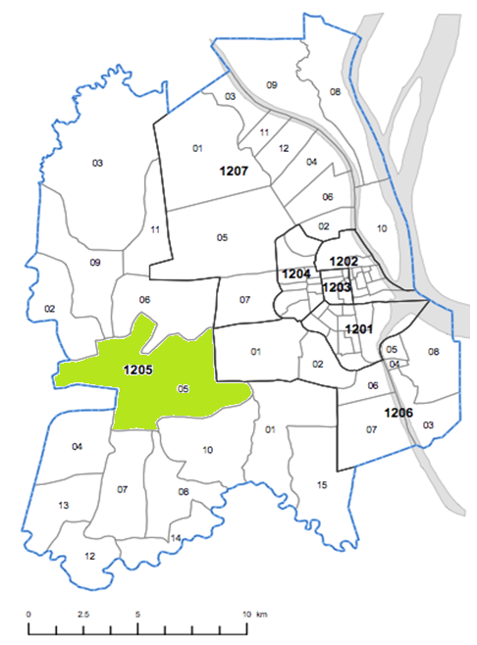
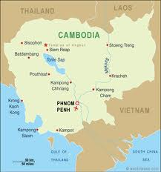
Study Location: Boray Santhepheap
Approximately 12 kilometers from central Phnom Phen
8 kilometers to the district hospital
Peer educator in place
Population: approximately 2,500

Slide 40
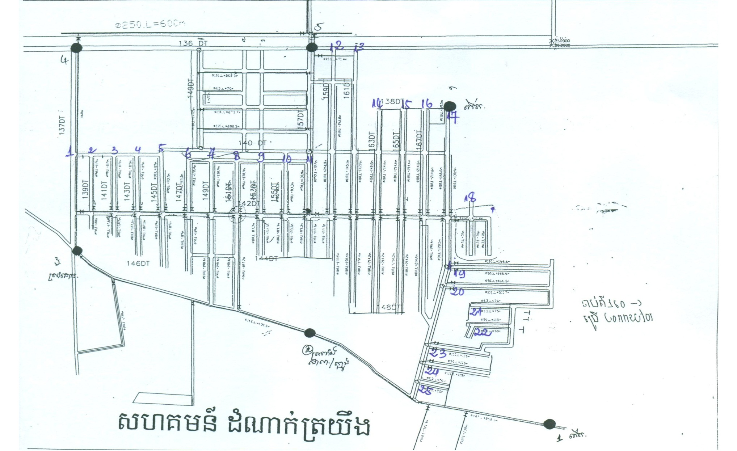
Research Area Map

Slide 41
Value and Implications of Alternative Diabetes Screening Tools – Proposed PATH-Mo Po Tsyo Study
Objective 1: Determine sensitivity/specificity of urine dipstick in MPT population and the relative health status of patients it identifies (in comparison with gold standard/OGTT).
Objective 2: Assess operational and logistical requirements of introducing alterative, more sensitive screening approaches
Recruitment of participants: Follow routinely screened and (self-)referred) new MPT patients. N=1315 (assuming 5% prevalence). Site= Phnom Phen Municipality,District Dangkao, Commune Chom Chao, in Boray Santhepheap
Self Screening with Urine Glucose Dipstick
Determine sensitivity/specificity of Urine Dipstick in MPT population compared to OGCT
Estimate # of additional patients based on determined or estimated sensitivity/specificity of alternative screening methods
Participants arrive at MPT HQ fasting, consent, begin
Determine sensitivity/specificity of FBG compared to OGCT
FBG
HbA1c
Estimate # of diabetics, prediabetics, stratify by likely care needs according to collected health histories and labs
A1c
Serum & Urine Creatinine
Determine sensitivity /specificity of A1c compared to OGCT
Health History, Biometrics
Fasting Lipid Profile
OGTT
Urine Analytes
Determine the comorbid health conditions
Determine operational impact of alternative screening methods on screening process compared to urine dipstick
Deliver screening results to participant
Diagnosis
No Diagnosis
Follow up referral of care
Exit

Slide 42
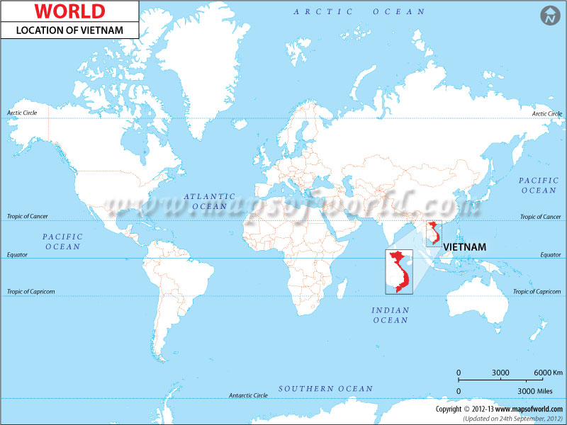

Slide 43
Obesity and Chronic Disease
Greater than 2.8 million people die each year as a result of being overweight or obese
Estimated 35.8 million of global DALYs are caused by overweight or obesity
Obesity is associated with adverse metabolic effects, including on blood pressure, cholesterol, triglycerides, and insulin resistance,
Risk of cerebro- and cardiovascular disease and DM increase steadily with increased weight, as well as risk for a number of cancers

Slide 44
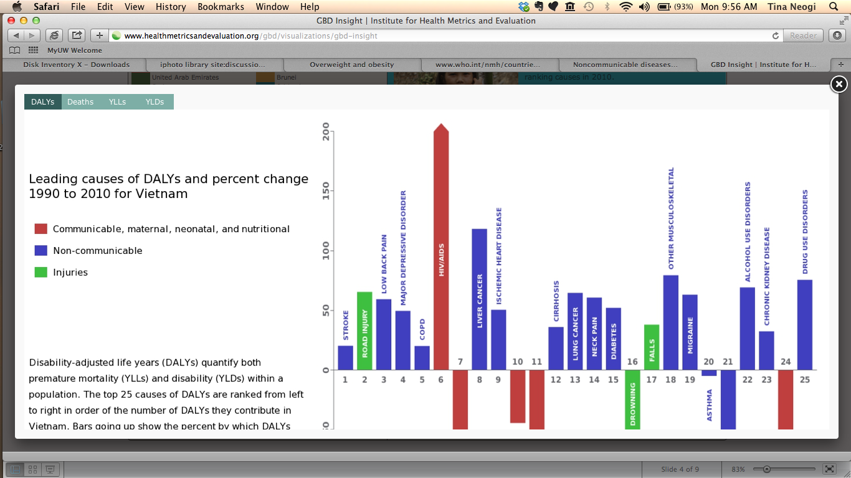
Chronic Disease Impact in Vietnam
Source: Institute of Health Metrics. Global Burden of Disease 2010.
http://www.healthmetricsandevaluation.org/gbd/visualizations/gbd-insight

Slide 45
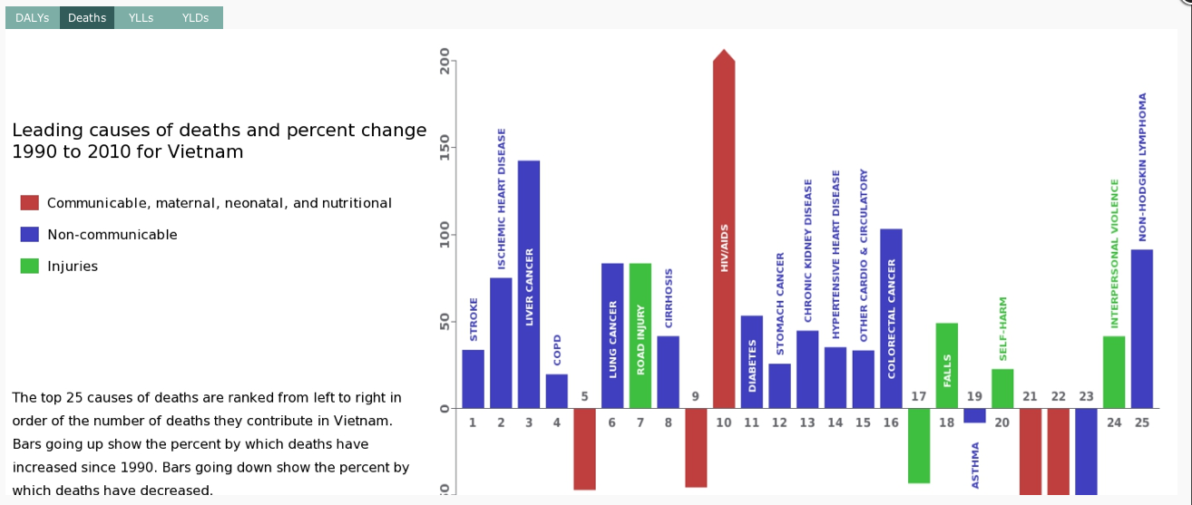
Chronic Disease Impact in Vietnam
Source: Institute of Health Metrics. Global Burden of Disease 2010.
http://www.healthmetricsandevaluation.org/gbd/visualizations/gbd-insight

Slide 46
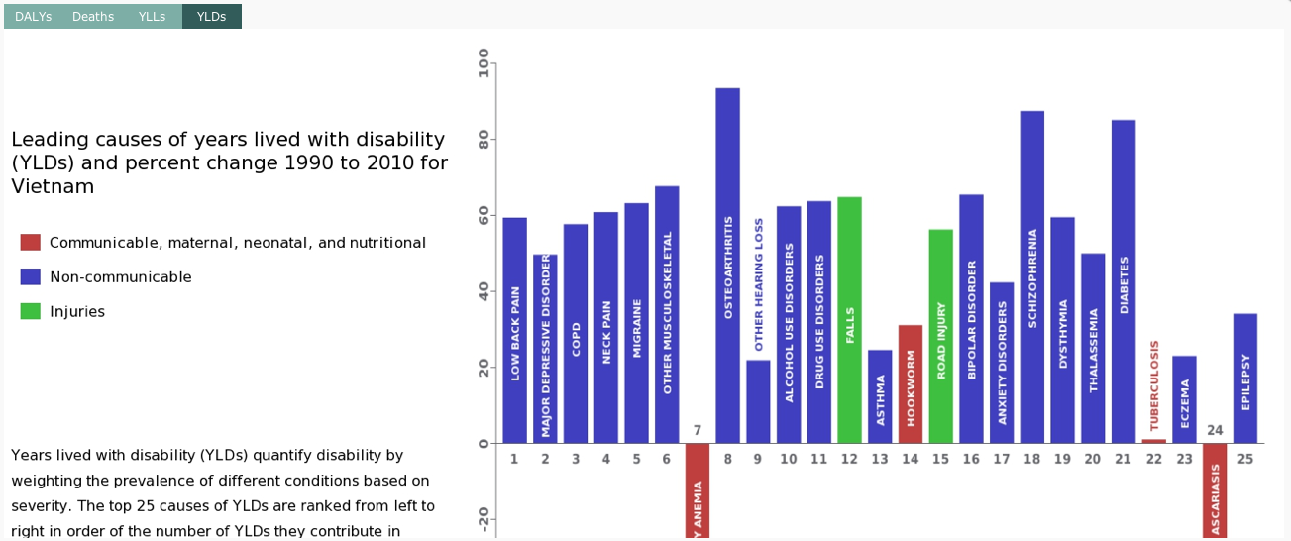
Chronic Disease Impact in Vietnam
Source: Institute of Health Metrics. Global Burden of Disease 2010.
http://www.healthmetricsandevaluation.org/gbd/visualizations/gbd-insight

Slide 47
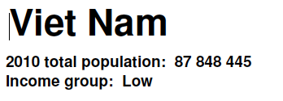
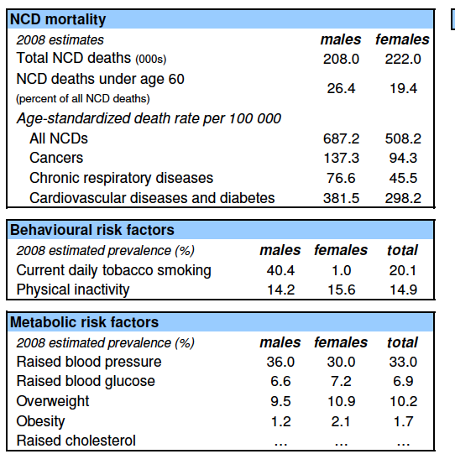
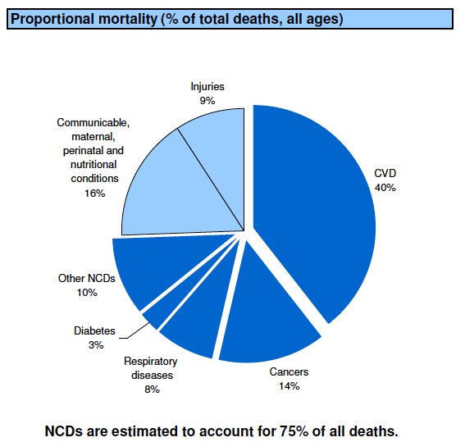
Chronic Disease Impact in Vietnam

Slide 48
Obesity in Asian Populations
Debate on appropriate measurement for obesity in Asian populations
Current methods for obesity measurement include:
  Body Mass Index (BMI) (WHO)
  Waist/hip circumference (WC/HC) (WHO)
  Percent Body Fat (%BF)
Increasing evidence that Asian populations have normal or low BMI but higher percentage of body fat- [WHO technical committee review in 2004]

Slide 49
Bioelectrical Impedance
Bioelectrical impedance
  Validated method for measurement of percent body fat
  Easy to use
  Inexpensive
  Readily available

Slide 50
Critical Information Needed
There is a need for more information and evidence to determine whether BMI thresholds for obesity need to be changed for the Vietnamese populations and if percentage body fat may provide additional clinically useful information to assess obesity related risks

Slide 51
Research Question
The overall purpose of this study is to answer the question: “Would percentage fat provided by bioelectrical impedance provide additional clinically useful information for clinicians in Vietnam and potentially other similar settings?”

Slide 52
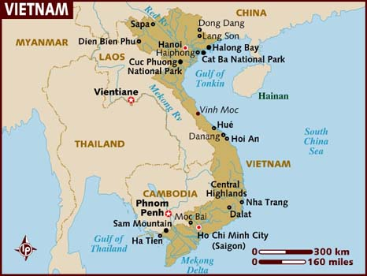
DaNang Stroke Study Location, Design, Population
Secondary data analysis
Cross sectional survey completed from July to December 2010
Stratified multistage cluster sampling technique
  Three-stage cluster sampling methodology stratified by urbanization
  Disproportionate sampling was used to allow for sufficient between-strata estimation while minimizing cost and maximizing operational efficiency for data collection.
  The primary sampling units were the 56 wards. The secondary sampling units were hamlets in the selected wards. The last sampling units were households in the selected hamlets.

Slide 53
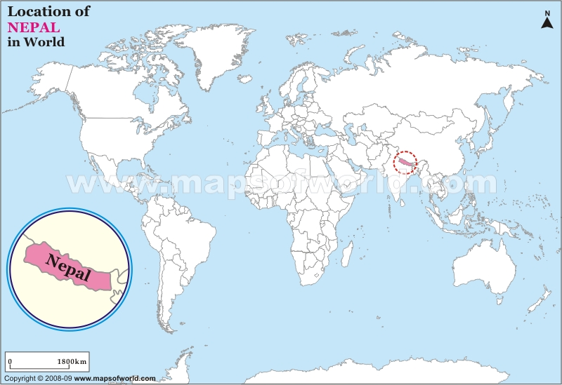

Slide 54


Slide 55





Slide 56



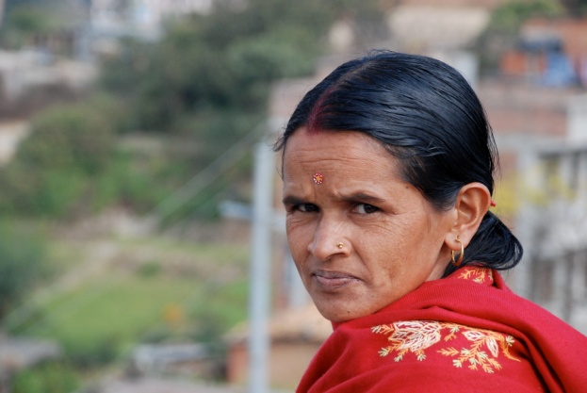

Slide 57
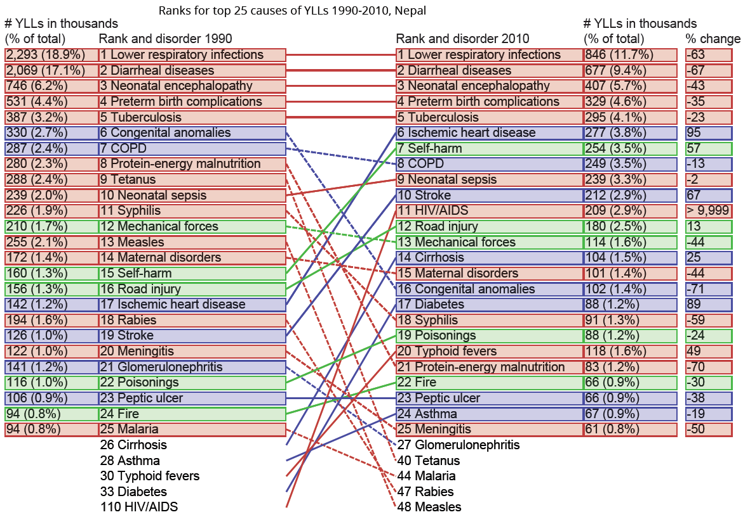
CVD in Nepal: Why is it important?
95% increase in years of life lost due to Ischemic heart disease
67% increase in years of life lost due to Stroke
89% increase in years of life lost due to Diabetes
Source: http://www.healthmetricsandevaluation.org/gbd/country-profiles

Slide 58
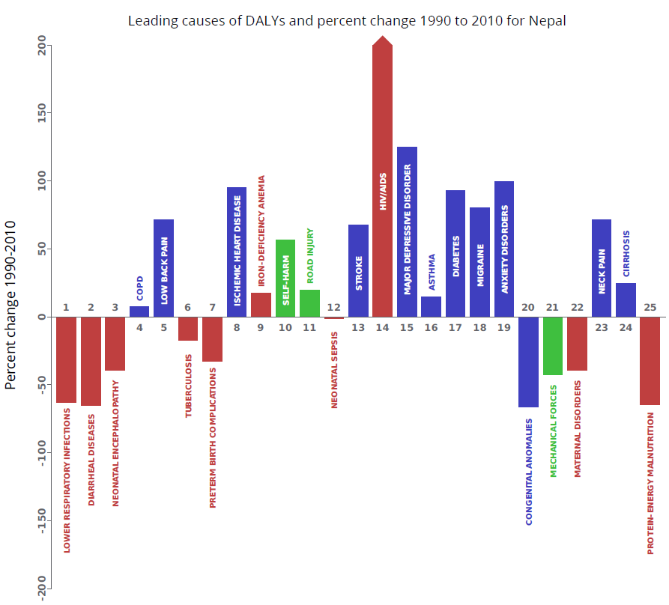
CVD in Nepal: Why is it important?
Ischemic heat disease
Stroke
Diabetes
Among top 20 causes for Disability adjusted Life Years (causing death and disability)
Increased nearly 100% in 2 decades
Source: http://www.healthmetricsandevaluation.org/gbd/country-profiles

Slide 59
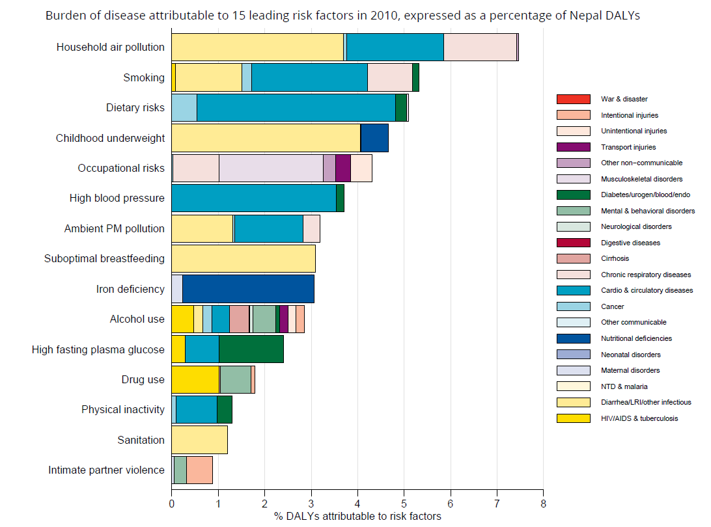
What risk CVD factors are important?
Major risk factors behind CVD (light blue box)
Diet
High blood pressure
Smoking
Household air pollution
Ambient air pollution
Physical inactivity
High fasting plasma glucose
Alcohol use
Source: http://www.healthmetricsandevaluation.org/gbd/country-profiles

Slide 60
National Health Program and CVDs
Lack of clear national level policy and capacity in addressing CVDs.
Proportion of cardiovascular specialists in general population: 1:45,000.
  90% concentrated in the capital
Growing involvement of non-governmental sectors.

Slide 61
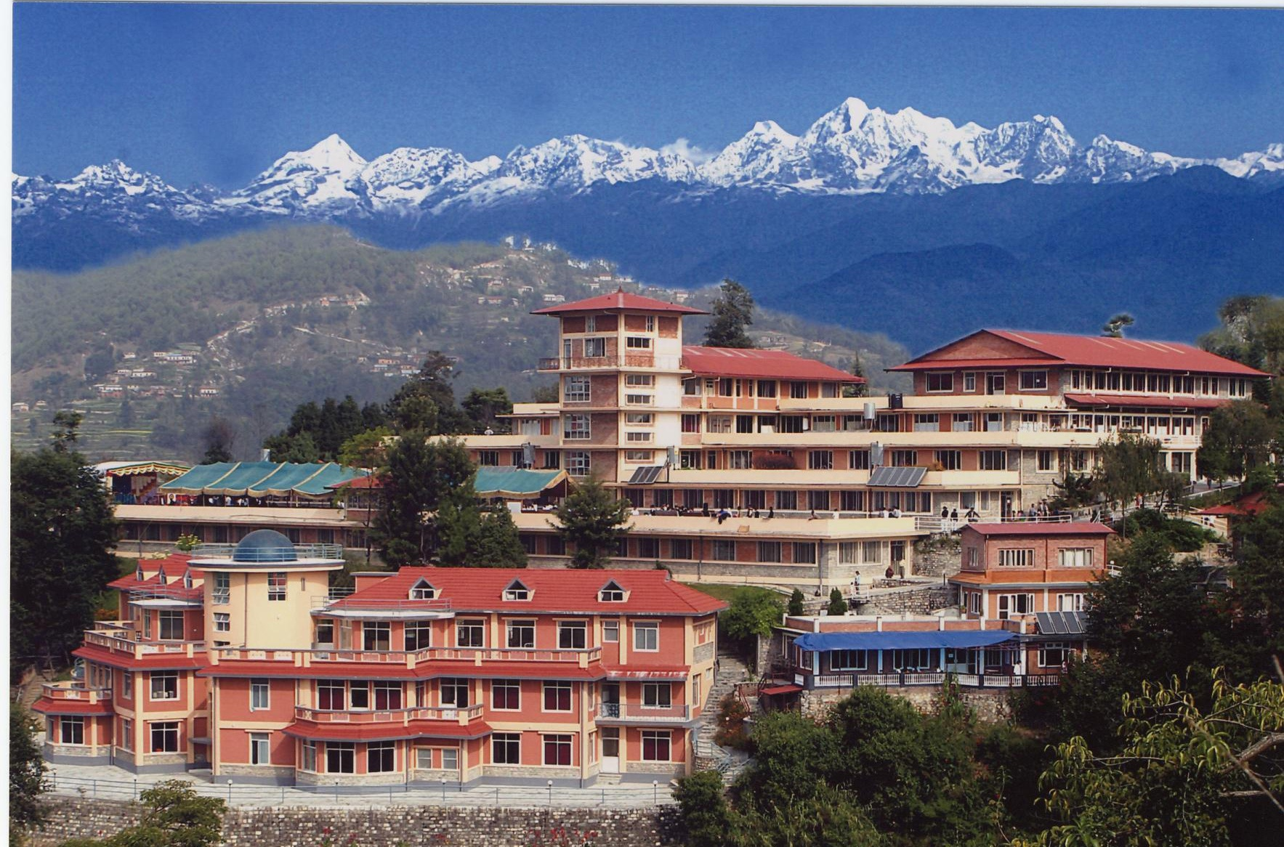

Slide 62
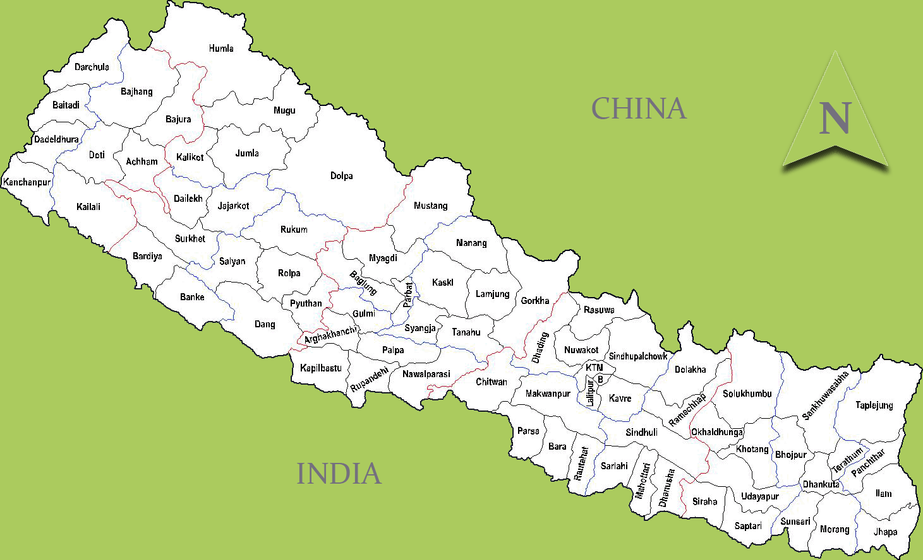
Rural Health Care
8
8. Dolpa
9. Okhaldhunga
10. Nawalparsasi
11. Parbat
6
11
1. Kavre
5
2
2. Sindupalchowk
10
3. Lalitpur
3
1
7
4
4. Solukhambu
9
5. Dhading
6. Gorkha
7. Ramechhap

Slide 63
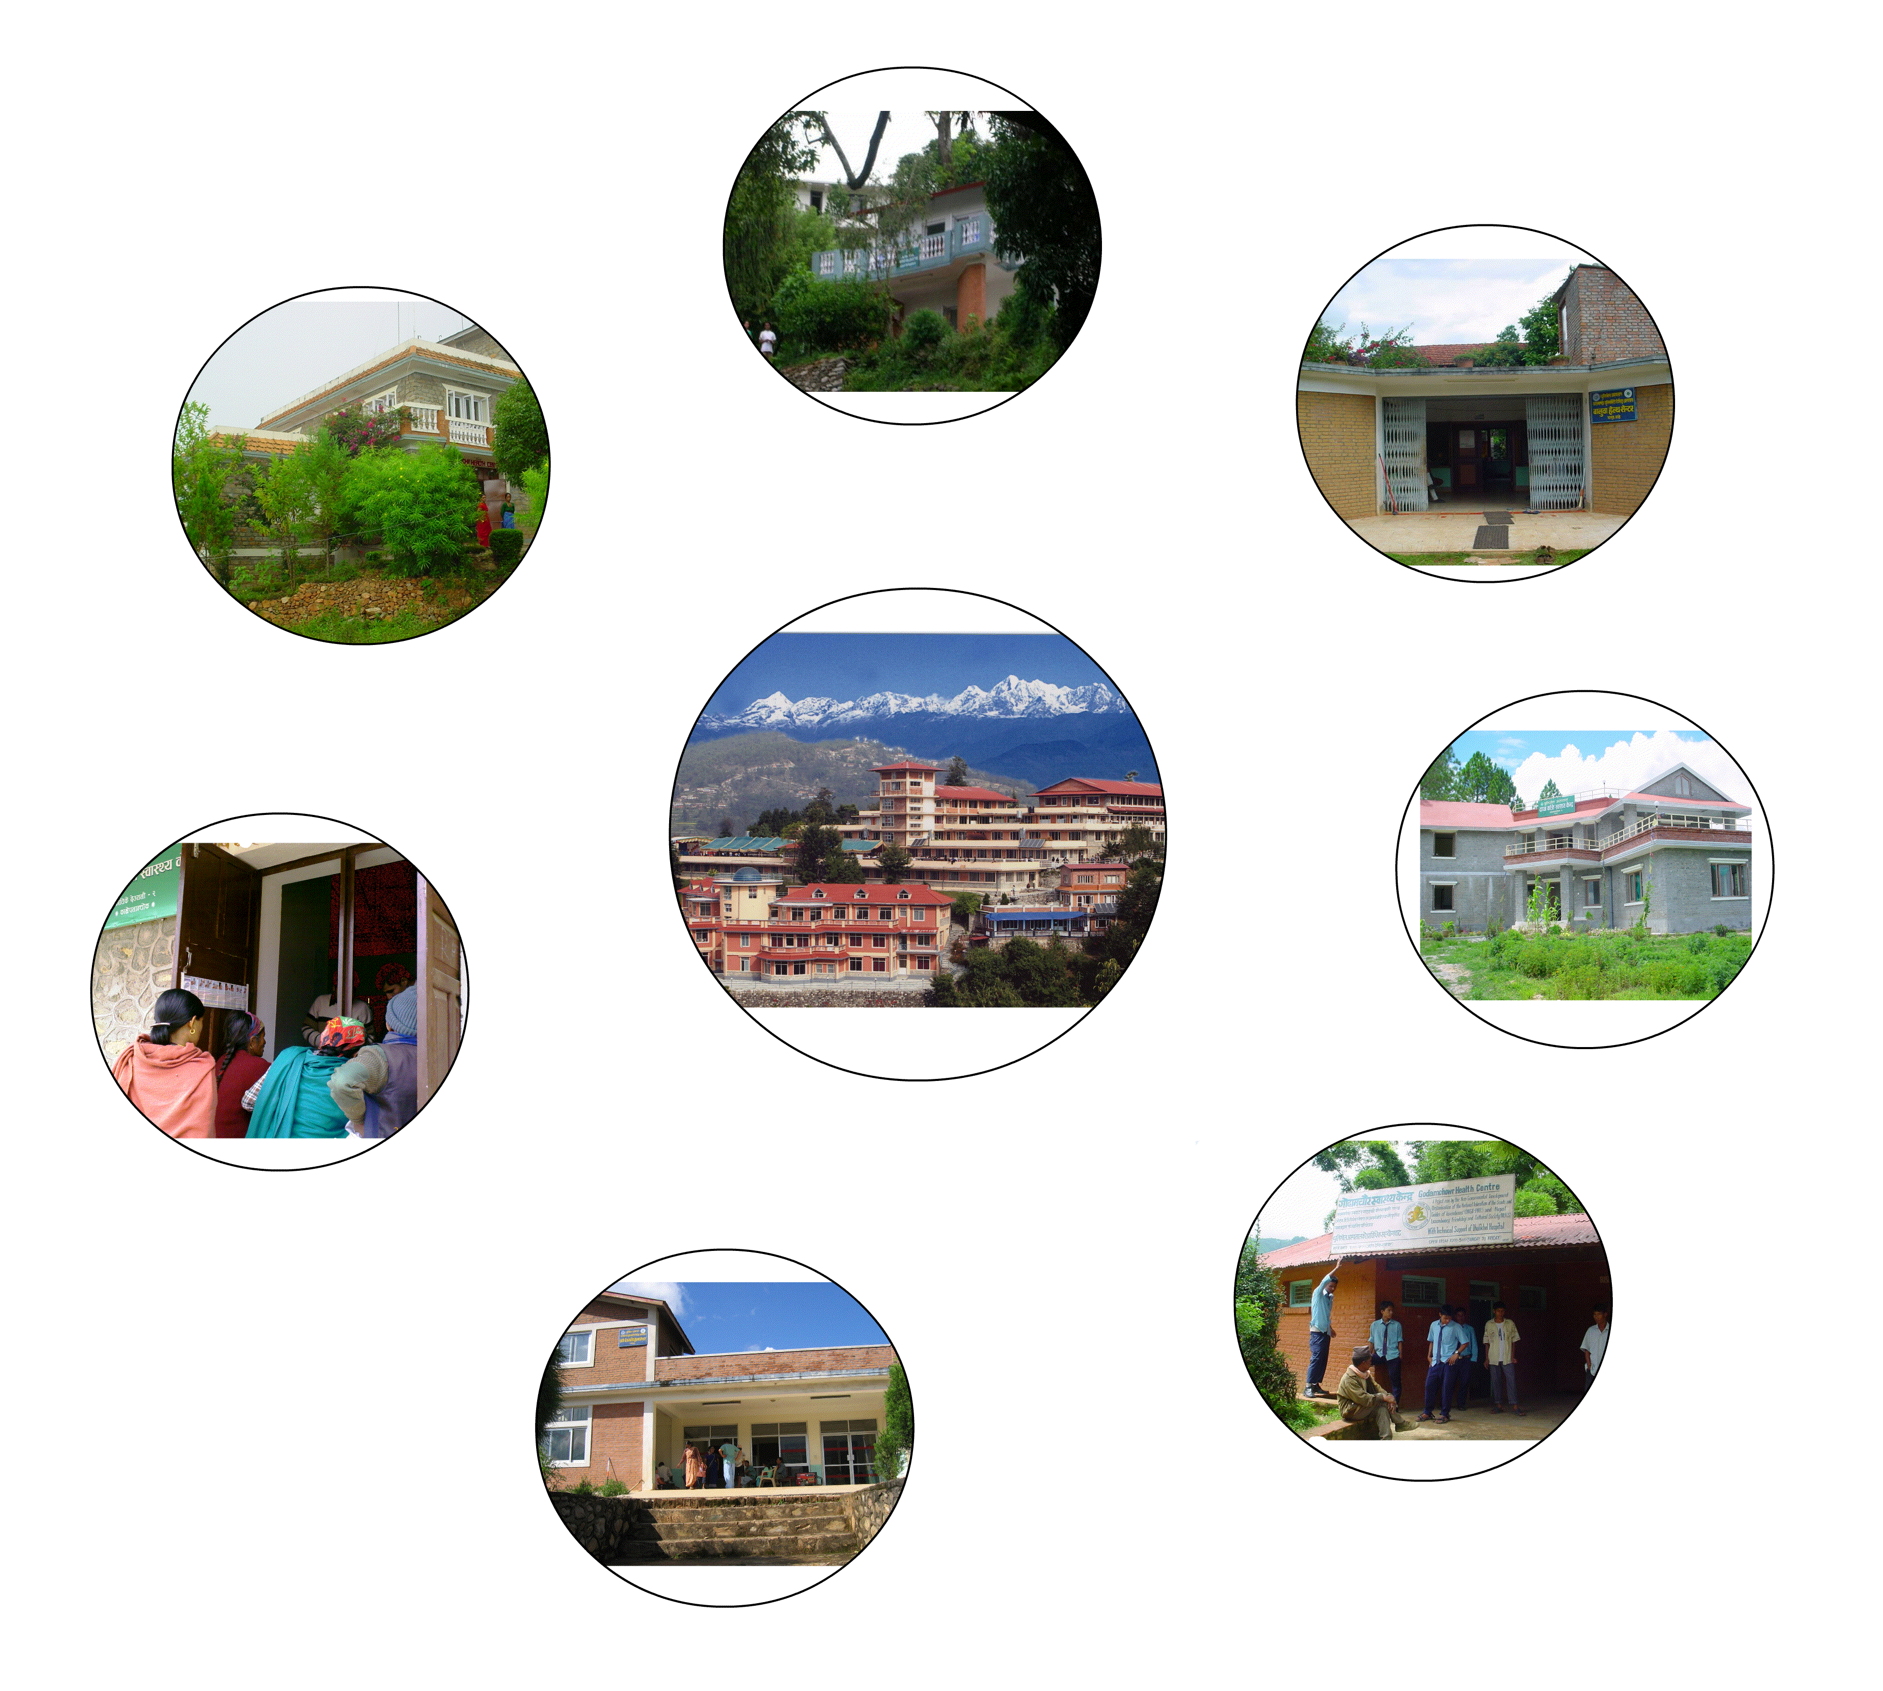

Slide 64
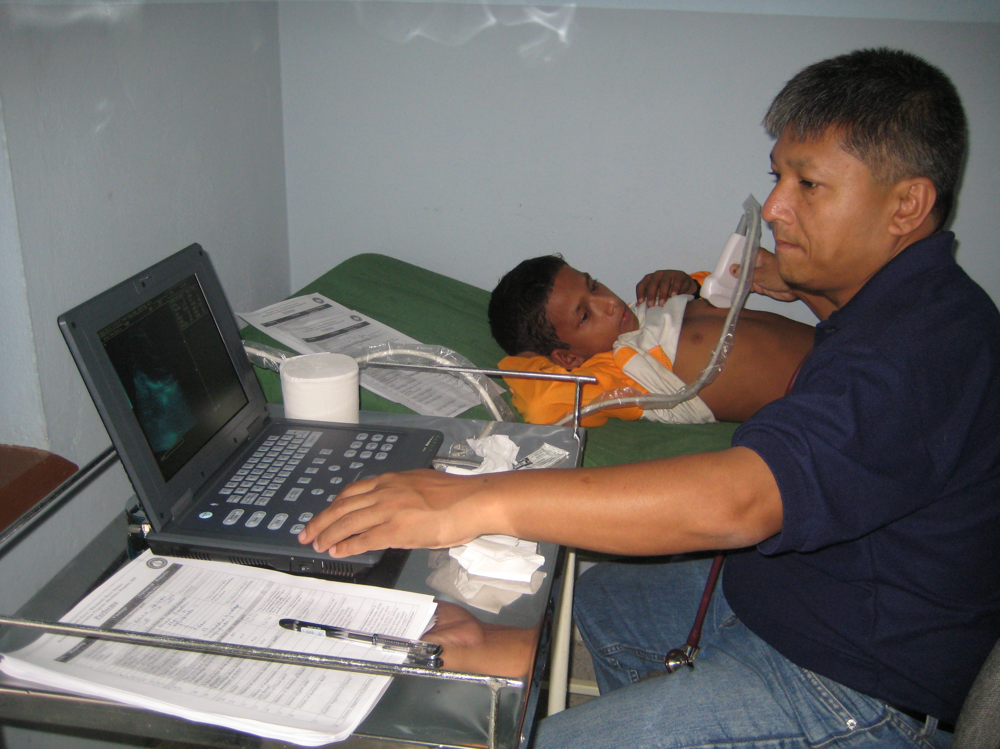

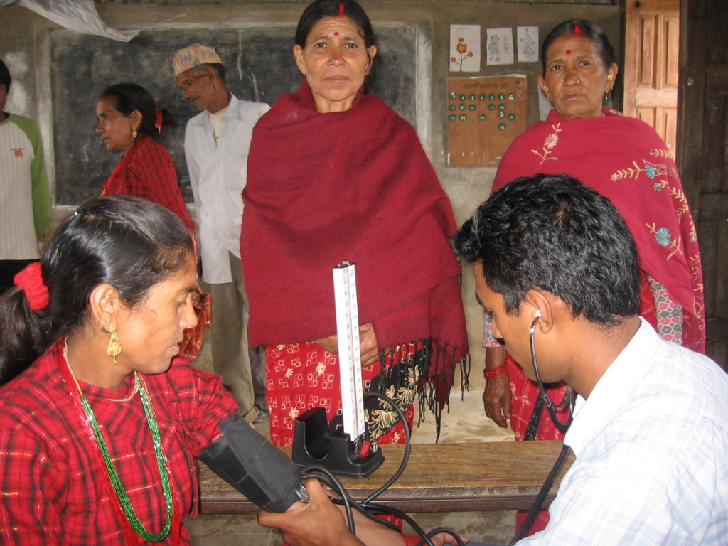
CVD Services and Research in DH
Community based epidemiological surveys on CVDs started : 2006
Rheumatic Heart Disease study among school children started: 2007

Slide 65
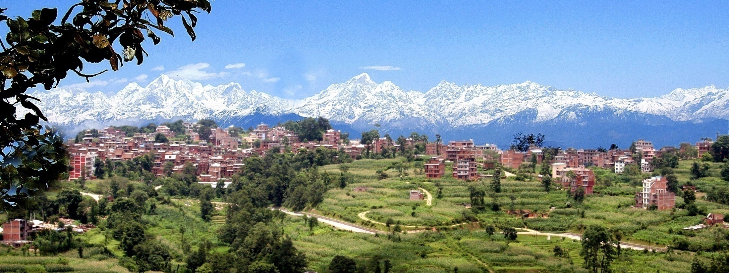
DHULIKHEL HEART STUDY

Slide 66
Building on the Dhulikhel Heart Study
Population based prospective cohort study.
Special focus on
  Conventional CVD Risk Factors
  CVD Burden
  Health Care Practices
    Adherence to medications
    Health Service Seeking Behavior/Barriers
Opportunities for point care diabetes management support and mhealth opportunities.

Slide 67


Slide 68
Interested in learning more?
Excellent review articles in NEJM and Lancet on NCDs and Primary Care
Email or visit:
  tneogi@uw.edu
  R1

Slide 69
Learning Objectives
At the end of this activity, the participant will be able to:
1. Identify what are noncommunicable diseases and how they are similar and/or different to chronic diseases.
2. Describe the term “double burden of disease”.
2. Discuss how noncommunicable diseases are being embedded into the global health agenda.
3. Apply your knowledge on chronic disease in global health to the care of your immigrant and refugee populations.

Slide 70

THANK YOU!

Slide 71
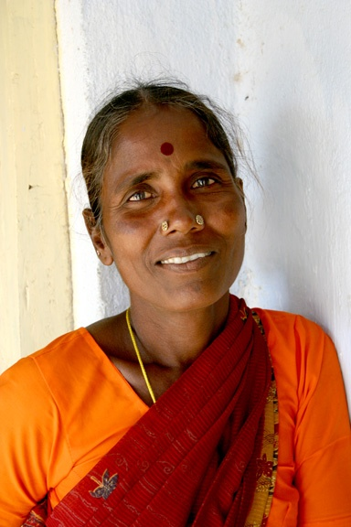

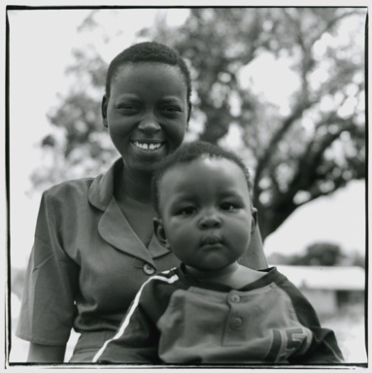
Questions?

