Slide 1
iPads in Residency Teaching
Bill Kriegsman
East Pierce Family Medicine Residency

Slide 2
Disclosures
We own Apple stock
I use both Windows and iOS products

Slide 4
Goals?
Reading Lists and Shared Files
Sharing Presentations
Software
Hardware
Software
Educational Software

Slide 5
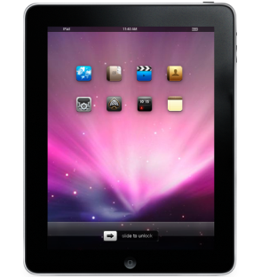
Legend
Simple
Medium
Challenging
Icon

Slide 6
Reading Lists?
Into the cloud…

Slide 7
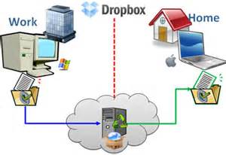
Dropbox
Free, iTunes Store
https://itunes.apple.com/us/app/dropbox/id327630330?mt=8

Slide 8
Dropbox
 | Dropbox | Dropbox Pro | Dropbox for Business
Price | Free | $99 / user / year | $795 / year for 5 users $125 / additional user / yr
Storage | 2 GB | 100 GB | As much as needed
Free, iTunes Store
https://itunes.apple.com/us/app/dropbox/id327630330?mt=8

Slide 9
Google Drive
Free, iTunes Store
https://itunes.apple.com/us/app/google-drive/id507874739?mt=8

Slide 10
Avoiding the Cloud…

Slide 11
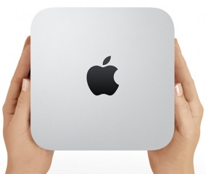
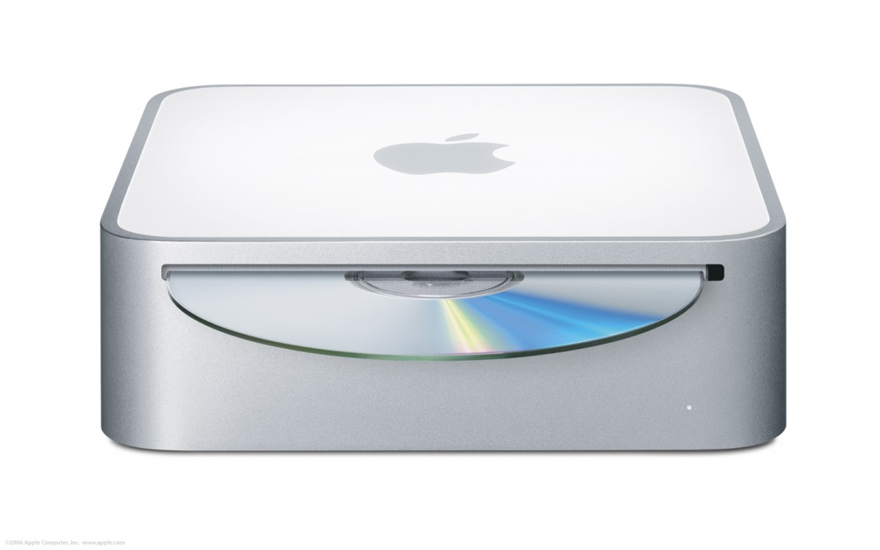
$999, Apple Store
http://www.apple.com/mac-mini/server/

Slide 12
How do we access the data?

Slide 13
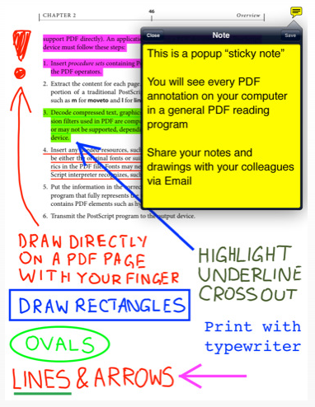
GoodReader
$4.99, iTunes Store
https://itunes.apple.com/us/app/goodreader-for-ipad/id363448914?mt=8

Slide 14
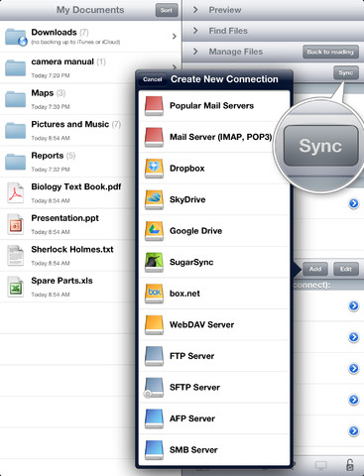
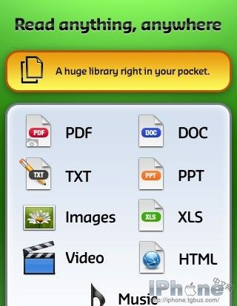
GoodReader

Slide 15
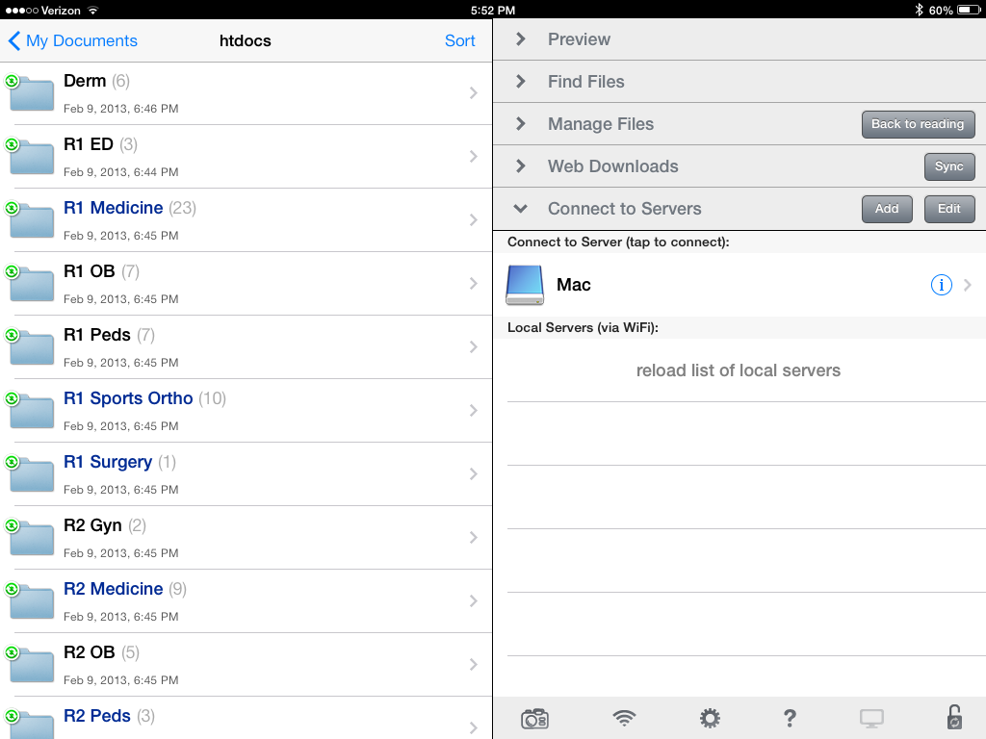
GoodReader

Slide 16
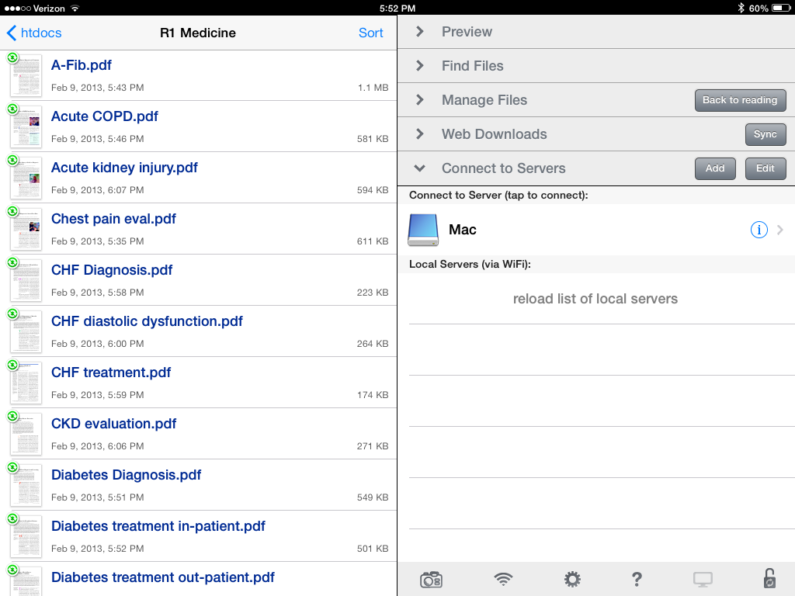
GoodReader

Slide 17
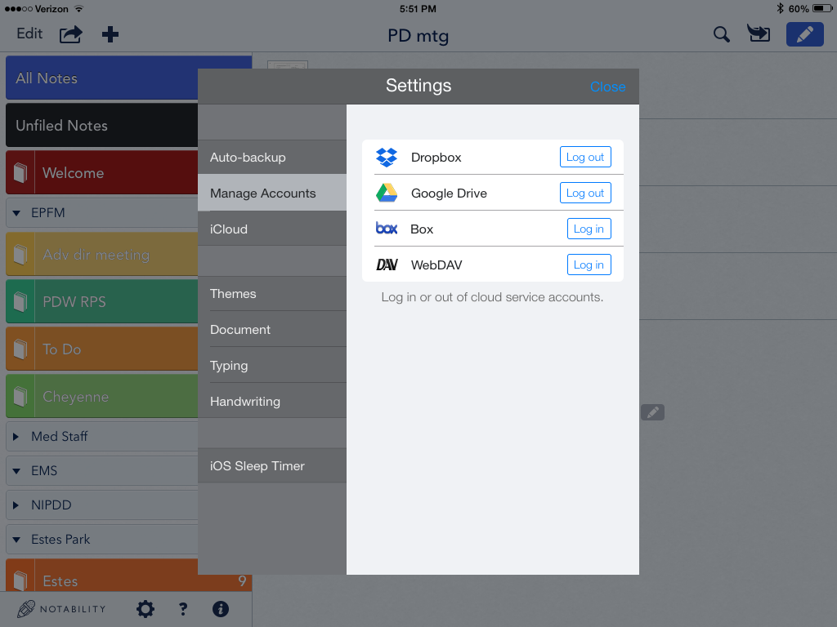
Notability
$2.99, iTunes Store
https://itunes.apple.com/us/app/notability/id360593530?mt=8

Slide 18
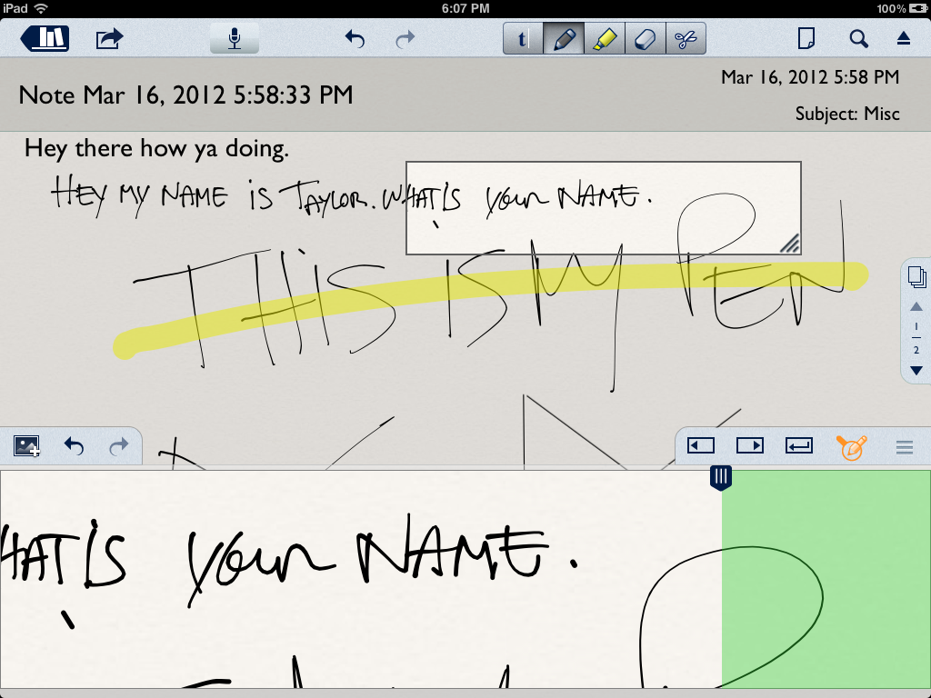
Notability

Slide 19
How I used to share presentations on my iPad

Slide 21
What my son wants to share on his iPad

Slide 22
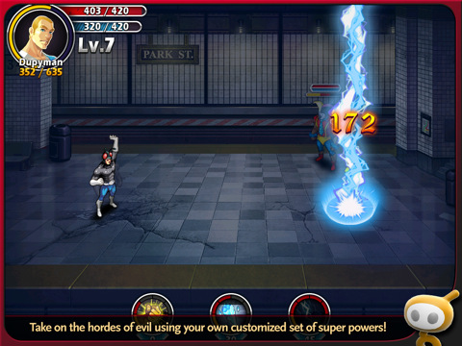

Slide 23
How faculty want to share their iPad

Slide 25
But how?

Slide 26
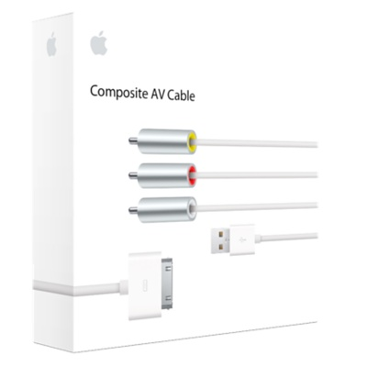
$39.00, Apple Store
http://store.apple.com/us/product/MC748ZM/A/apple-composite-av-cable?fnode=3a

Slide 27
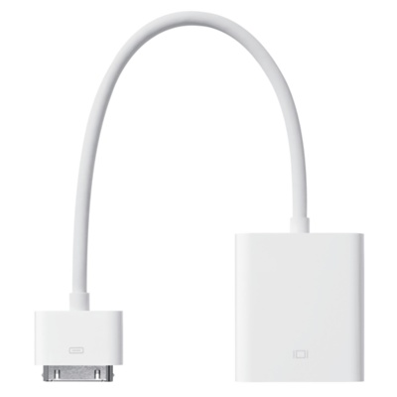
$29.00, Apple Store
http://store.apple.com/us/product/MC552ZM/B/apple-vga-adapter

Slide 28
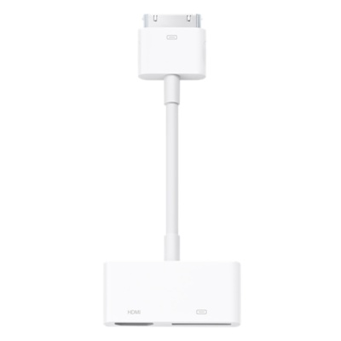
$39.00, Apple Store
http://store.apple.com/us/product/MD098ZM/A/apple-digital-av-adapter?fnode=3a

Slide 29
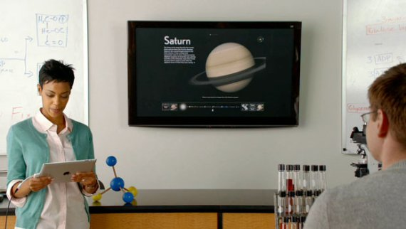
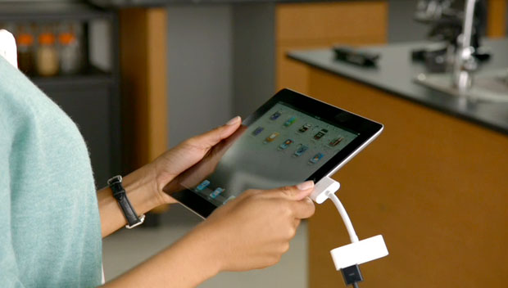

Slide 30
What software do I need?

Slide 31
Keynote
$9.99, iTunes Store
https://itunes.apple.com/us/app/keynote/id361285480?mt=8&ls=1
Notes:
Keynote

Slide 32
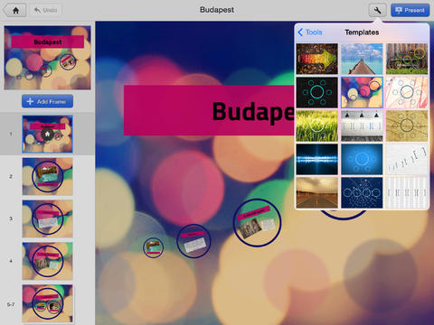
Prezi
Free, iTunes Store
https://itunes.apple.com/us/app/prezi-for-ipad/id407759942?mt=8
Notes:
Keynote

Slide 33
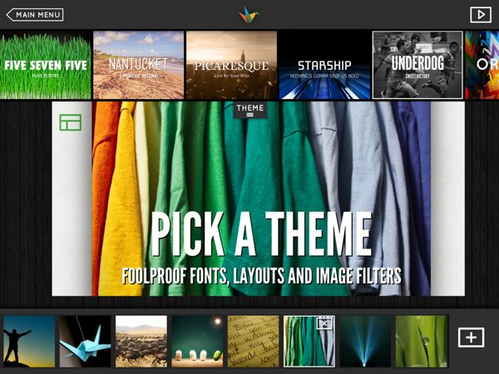
Haiku Deck
Free, iTunes Store
https://itunes.apple.com/us/app/haiku-deck-presentation-slideshow/id536328724?mt=8

Slide 34
Can I do better?

Slide 35
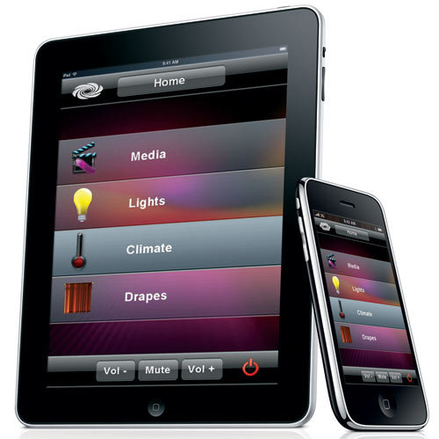

Slide 36
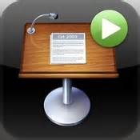
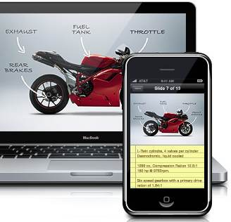

Slide 37
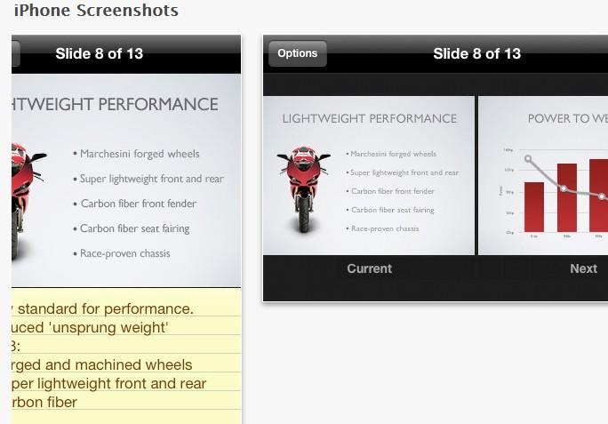

Slide 38
Keynote Remote

Slide 39
Keynote Remote

Slide 40
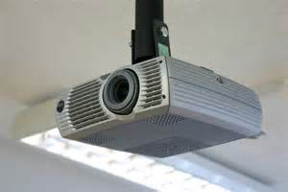

Slide 41
What about New Innovations?

Slide 42
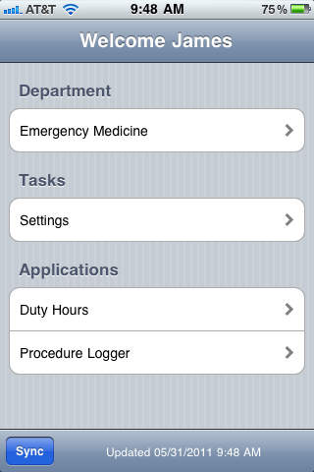
What about New Innovations?
Free, iTunes Store
https://itunes.apple.com/us/app/ni-gme/id317122881?mt=8

Slide 43
What about simulations?

Slide 44
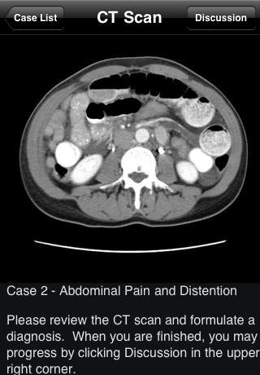
Imaging Teaching
Free, iTunes Store
https://itunes.apple.com/us/app/radiology-2.0-one-night-in/id397926581?mt=8

Slide 45
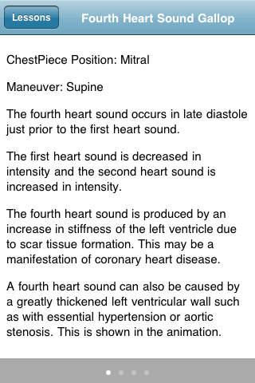
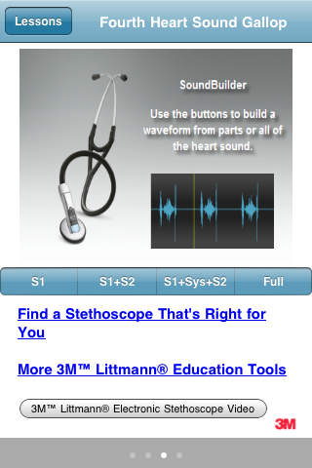
Heart Sounds
Free, iTunes Store
https://itunes.apple.com/us/app/3m-littmann-soundbuilder/id414942730?mt=8

Slide 46
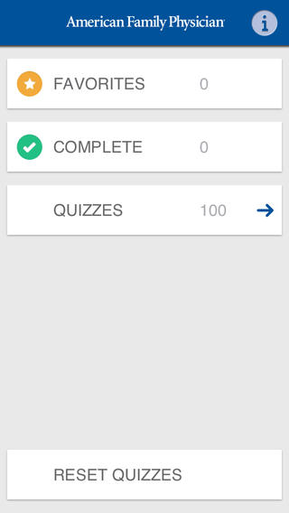
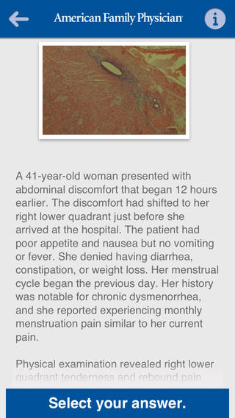
AFP Photo Quiz
$9.99, iTunes Store
https://itunes.apple.com/ca/app/afp-photo-quiz/id679069573?mt=8

Slide 47
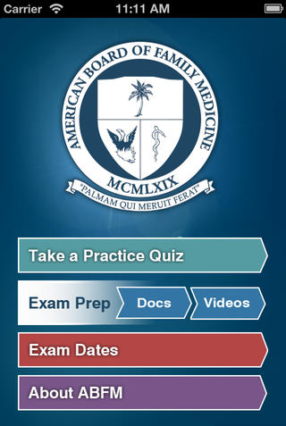
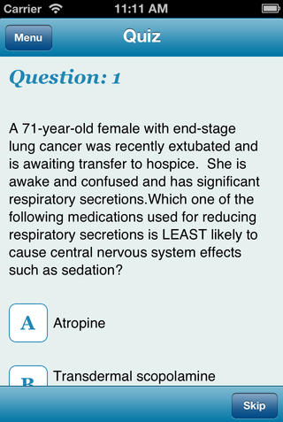
ABFM Exam Prep
Free, iTunes Store
https://itunes.apple.com/us/app/abfm-exam-prep/id401650093?mt=8

Slide 48
Thoughts?

