Slide 1
Family Medicine Grand Rounds University of Washington Organizational Social Context of Community Health Centers and variation in maternal depression outcomes 12/2/2015
Ian M. Bennett MD PhD
Professor
Departments of Family Medicine & Psychiatry and Behavioral Sciences

Slide 2
CME
This live series activity, UW Family Medicine Grand Rounds, is under review for 1 Prescribed Credit by the American Academy of Family Physicians. Attendees should claim only the credit commensurate with the extent of their participation in the activity.

Slide 3
Learning Objectives
At the end of this activity, the participant will be able to:
1. Identify obstacles to perinatal depression care,
2. Describe the influences of contextual factors associated with better outcomes at health centers, and
2. Discuss the possible role of organizational factors of health centers on health outcomes.

Slide 4
Disclosure: Conflicts of Interest
Dr. Bennett states:
Neither I, nor any immediate family member has any financial relationship with, or interest in, any commercial interest connected with this presentation.

Slide 5
Disclosure of Off-Label Drug Use
The of material in this CME activity will not include discussion of unapproved or investigational uses of products or devices.

Slide 6
Thanks to:
AIMS Center, Department of Psychiatry and Behavioral Health
Jurgen Unutzer, Ya Fen Chan
Mindy Vredevoogd, Johnny Mao
Enola Proctor – Washington University
Nathaniel Williams and Phillip Green - University of Tennessee
Funding:
Eitel Foundation
University of Pennsylvania
Washington University - Implementation Research Institute (NIH)

Slide 7
Outline
Perinatal depression
The Problem Defined
Evidence based practices
Implementation Science Approaches
A framework for improving services
Organizational Processes in Care Delivery
Organizational Social Context
Data from MOMS
Next steps

Slide 8
Perinatal Depression
A Common Disorder Affecting
10% of women in pregnancy/postpartum with major depressive disorder or dysthymia
5% with minor depression
High Burden
The greatest source of disabled years lived
Associated with PTB/LBW
Association with child mental health
Great Benefit of Treatment
Increase in function
Reduced risk to children
Whiteford et al (2013) GlobBurdDis Lancet

Slide 9
Effect on pediatric health
US
Impact on behavioral development*
Global – Low and Middle Income Countries (LMIC)
Growth (risk of stunting and underweight)
Behavioral and developmental effects
Effect of depression on these outcomes is reduced†
Rahman (2013), Patel (2013), Harpham (2005), Weissman (2005)*†

Slide 10
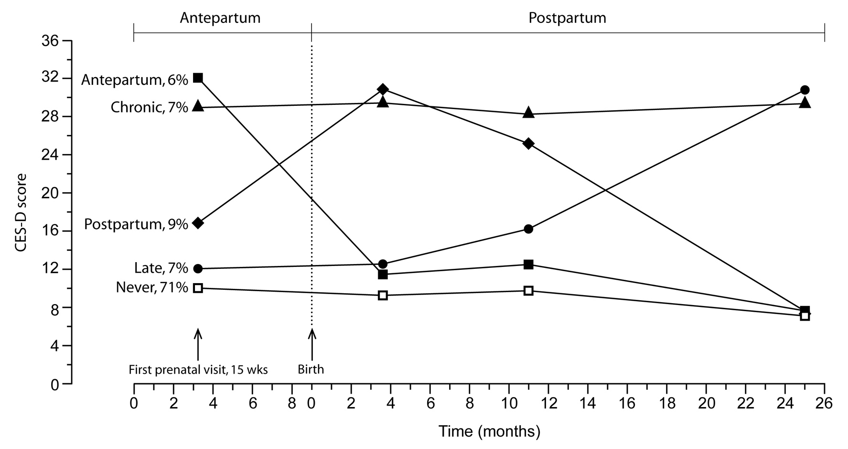
Depression Symptom Trajectories Mora, Bennett, et al (2007) A J Epi

Slide 11
Some Opportunities and Obstacles to Perinatal Depression Care *Bennett et al (2009)
Women are willing to get care for depression in the prenatal setting*
Patient
Stigma, cultural beliefs, fear of effect on fetus
Provider
Inadequate training and support
Care System
Focus on specialty care
Lack of supports for clinical care

Slide 12
Collaborative Care for Depression
Team based intervention for depression in primary care
Strong evidence base
Cochrane review & other meta-analyses
>80 RCTs showing benefit
DAWN study in OB / GYN & women’s health care settings at UW (Melville et al 2014; Grote et al 2015)
Achieves triple aim
1. More satisfied patients and providers, 2. Better health outcomes, 3) Lower health care costs

Slide 13
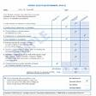
Collaborative Care
Effective
Collaboration
PCP supported by
Care Coordinator
Informed,
Active Patient
Practice Support
Outcome
Measurement
Caseload-focused
Consultation
Training

Slide 14
Collaborative Care: Mental health providers augment primary care team
Primary Care
Provider
New Roles
High Risk
Mom
MCH Care
Coordinator
Psychiatric Consultant

Slide 15
Applying the CC to Perinatal Depression *Melville et al (2014), Grote et al (2015)
Evidence Based Guideline Care
Case finding and treatment
Practice Reorganization to Address Needs
Allowing for short follow up visits
Telephone follow ups
Multidisciplinary Approach (Care Teams)
Care managers and other support staff
Collaborative care with depression care providers
Effectiveness trial shows that this works like for the general adult population*
But – the rates of implementation success are low

Slide 16
Implementation Science
Generalizable knowledge of how to get EBP into use
Synonyms = Knowledge Transfer
Overlapping domains with Improvement Science
Quality improvement
Focuses on processes of tailoring to a site
Not necessarily targeting EBP

Slide 17
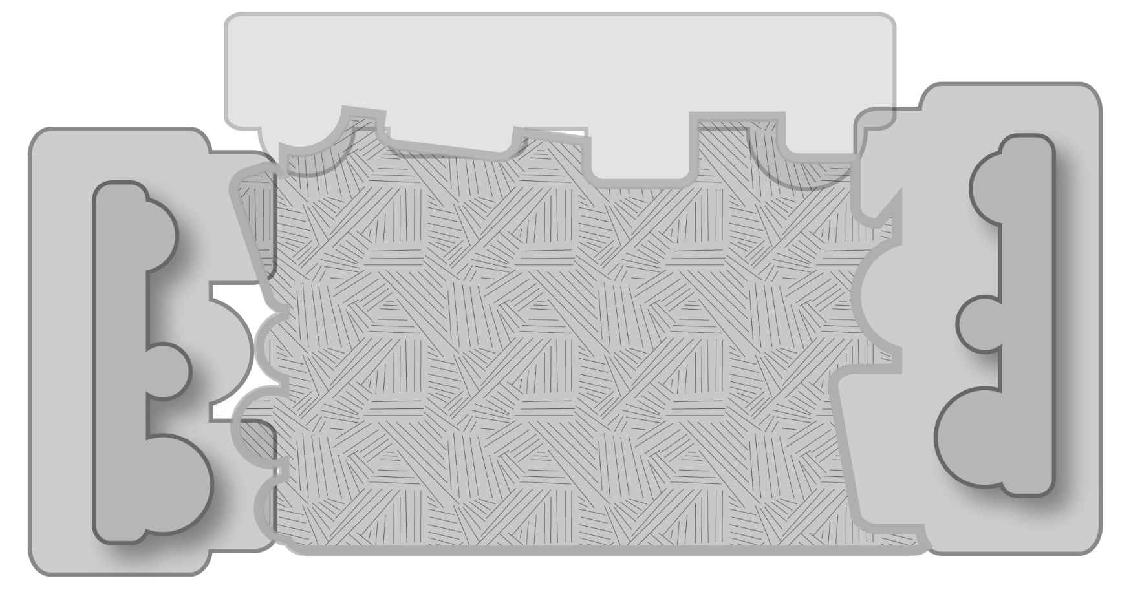
Consolidated Framework for Implementation Research (CFIR)
Intervention
(unadapted)
Intervention
(adapted)
Outer Setting
Inner Setting
Core Components
Adaptable Periphery
Adaptable Periphery
Core Components
Individuals
Involved
Process

Slide 18
Inner Setting
Structural Characteristics
Networks and Communication
Readiness for implementation
Culture
Shared norms, values, and expectations
Passed on by members of the organization
Implementation Climate
The shared receptivity of involved individuals to an intervention and the extent to which use of that intervention will be “rewarded, supported, and expected within their organization”

Slide 19
Socio-Technical Model of Organizational Effectiveness
Some organizations more effective than others
“Core technology” (care delivery)*
Embedded in a social context
Social context supports or inhibits effectiveness
Implications
The social context can be measured
The relationship between context and effectiveness can be assessed across organizations
The context can be modified to improve effectiveness
*Organizational Development Theory (Porras & Robertson 1991)

Slide 20
Organizational Interventions
ARC (Availability, Responsiveness, Continuity)
Glisson and Schoenwald
Addresses service barriers in the organizational social context
Organizational tools, principles of effective service systems (mission driven, results oriented), and attitudes of service providers (flexibility, openness)
Trials supporting benefit
Within child welfare and community mental health systems
Improvement of established systems
Improved uptake of EBP innovations

Slide 21
Mental Health Integration Program
(MHIP) for High Risk Mothers
2,500 low-income moms with depression and other mental disorders treated in 6 community health centers (14 community health clinics) from 2009 – 2014
Age range 14 – 72
34 % with thoughts of suicide
35 % with high levels of PTSD symptoms
Collaborative Care model adapted for pregnant and parenting women
Funded by King County Tax Levy

Slide 22
Study Goals
Characterize clinical site variation:
Patient outcomes
Implementation outcomes
Assess whether implementation outcomes are related to clinical outcomes
Implementation outcomes of interest:
Contextual factors of individual clinical sites

Slide 24
Depression Improvement by Clinic
(PHQ-9 <10 or >=50% reduction)
1 2 4 5 6 7 8 9 10 11 12 13 14 15
Prenatal Sites

Slide 25
Organizational Social Context (OSC)
Assessment tool for ARC
Survey to measure aspects of work
Organizational culture
Organizational climate
Worker attitudes
Norms, values, expectations, perceptions, and attitudes of members
105 items, pencil and paper,
7 scales
Culture: Proficiency, Rigidity, Resistance
Climate: Engaged, Functional, Stressful
Worker attitudes: Morale

Slide 26
Culture
Proficient culture - expectations that:
the wellbeing of each client comes first
individual service providers will be competent and have up-to-date knowledge
Rigidity - service providers have:
less discretion and flexibility in their work
limited input into key management decisions
controlled by bureaucratic rules/regulations
Resistance - service providers will:
Show little interest in change or in new ways of providing service
Will suppress any opportunity for change

Slide 27
Climate
Engaged - employee perception that:
they are able to personally accomplish many worthwhile things in their work
remain personally involved in their work
can be concerned about their clients
Functional:
they receive the cooperation and help from coworkers and administration required to do their job
have a clear understanding of how they fit in
can work successfully within their organizational unit
Stressful:
Are emotionally exhausted from their work
pulled in different directions
unable to get the necessary things done

Slide 28
Interview Methodology
MOMS team members identified
Directly clinically involved (no supervisors)
Group interviews
At lunch times with food provided by the study
Supervised by study staff
Responses sealed before leaving the interview
Incentive included analysis and feedback of results to the clinics

Slide 29
Analytic approach
Group constructs rather than individual
Hierarchical Linear Models (HLM) with 3 levels
Level 1 = Individual patient depression growth trajectories
Level 2 = Patients as a group
control for race/ethnicity
Level 3 = Clinics as a group
Control for clinic level average fidelity to collaborative Care
Control for clinic size

Slide 30
Study Question
To what extent does characterization of culture and climate at the level of the clinic explain velocity of change in patient symptom levels
Above and beyond the effect of clinic and patient level covariates

Slide 31
Results
12 individual centers and 6 organizations
Depression outcomes for 516 patients seen in the year prior and following the interviews (2013-2014)
62 individual interviews
Very good psychometrics
Cronbach α ≥0.68 for all scales
r_{wg} >0.9 for all scales at all sites
National norms for centers providing youth mental health services

Slide 32
Sample Selection
Total Sample
Sites = 15
Ineligible
Sites = 1
Sites = 14
No Interviews
Sites = 2
Sites = 12
Interviews = 65
Interviews missing >10% OSC data = 3
Final Sample
Sites = 12
Interviews = 62

Slide 33
Participating Health Centers & Providers
 | Mean | SD | Min. | Max.
Number of participating clinicians per site | 5.17 | 1.70 | 3 | 9
Number of patients in sample | 42.92 | 29.86 | 10 | 113
Fidelity to CC model (%) | 63 | 12 | 38 | 79
Participating Clinicians | Mean | SD | Min. | Max.
Age | 46.95 | 12.51 | 25 | 67
Years of experience | 19.24 | 11.60 | 2 | 40
Years in clinic | 9.08 | 7.61 | 1 | 33

Slide 34
Participating Clinicians | Percent
Educational level
High school | 5
Some college | 10
Bachelor’s degree | 18
Master’s degree | 31
Doctoral degree | 37
Major of highest degree
Education | 2
Social Work | 19
Nursing | 16
Medicine | 33
Psychology | 14
Other | 17

Slide 35
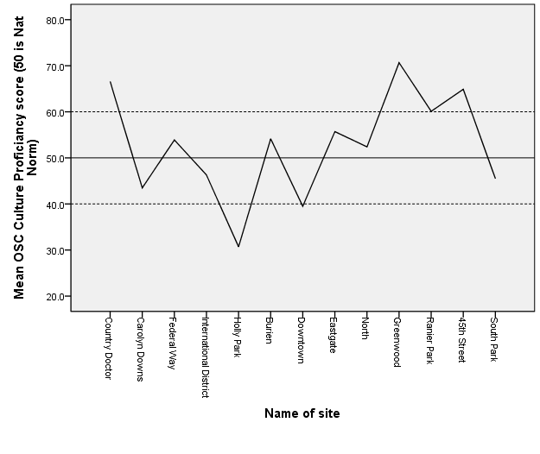
Proficiency

Slide 36
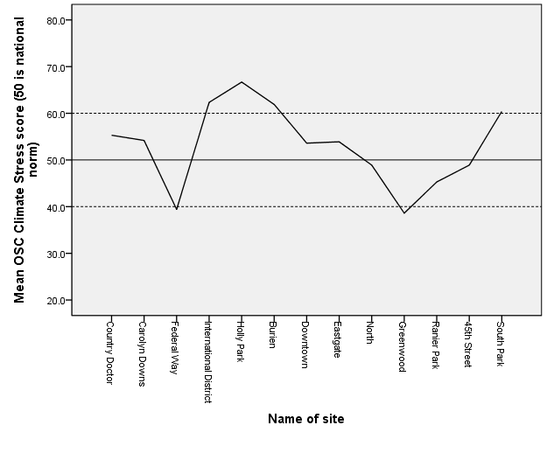
Stress

Slide 37
Ave. rates of change in PHQ-9 scores for agencies low vs. high OSC scores
 | Average linear rate of change in PHQ-9 per month
OSC dimension | Low OSC (-1 SD) | High OSC (+1 SD) | Ratio of high/ low
Culture
Proficiency* | -.47 | -.76 | 1.62*
Rigidity | -.62 | -.57 | .92
Resistance | -.66 | -.53 | .80
Climate
Engagement* | -.44 | -.79 | 1.80*
Functionality | -.59 | -.61 | 1.03
Stress* | -.80 | -.41 | .51*

Slide 38
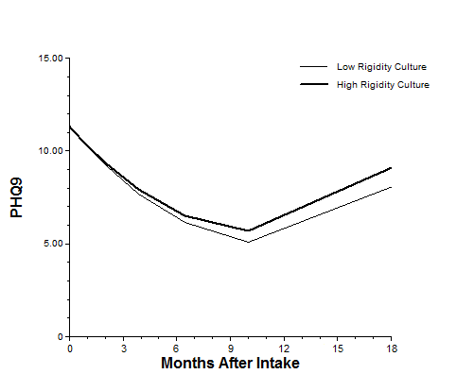
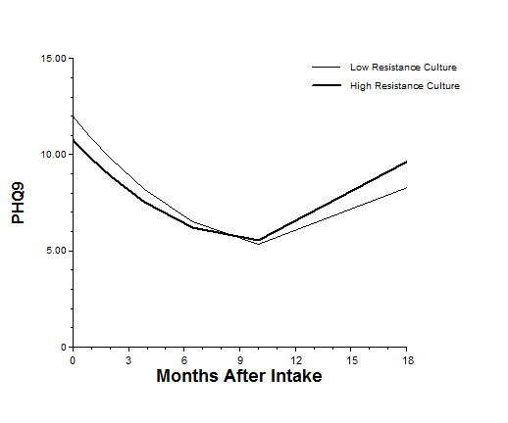
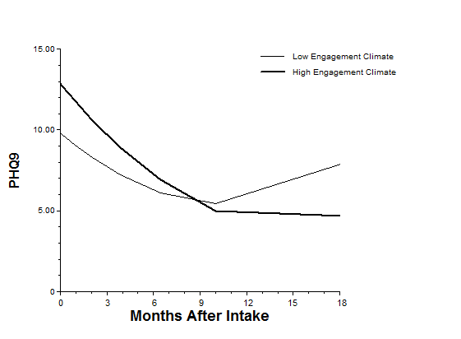
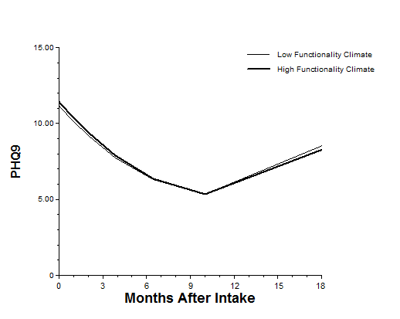
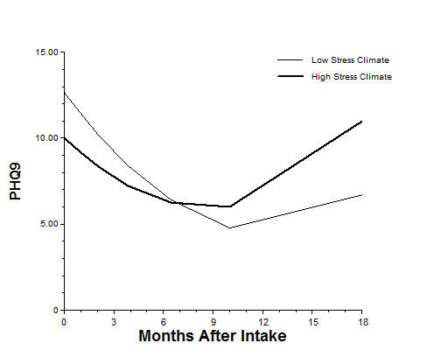
Culture Subscales
Proficiency
Rigidity
Resistance
Climate Subscales
Engagement
Functionality
Stress

Slide 39
Culture Subscales
Proficiency
Rigidity
Resistance
Climate Subscales
Engagement
Functionality
Stress

Slide 40
Summary
Three distinct domains of a well validated assessment of organizational culture and climate were associated with improved depression outcomes
Study limitations include: limited sample and cross sectional design
Next steps:
Assessment in other depression settings
Using interventions targeting these measures as implementation strategies

Slide 41
Family Medicine Grand Rounds
Faculty Coordinator: William R. Phillips, MD, MPH (206) 543-9425 wphllps@u.washington.edu
Staff Coordinator: Katie Clements
(206) 543-3101
katlyn08@uw.edu
http://depts.washington.edu/fammed/grand-rounds

