Slide 1
Creating a Safe and Positive Learning Environment in Residency Around Treatment of Chronic Pain
Paul Gianutsos, MD, MPH
Program Director
Swedish Family Medicine Residency Cherry Hill
Seattle, WA
Abi Plawman, MD
Associate PD/Fellowship Director
East Pierce Family Medicine Residency
Puyallup, WA

Slide 2
Creating a safe and positive learning environment in residency around treatment of chronic pain
Paul Gianutsos, MD, MPH
Swedish Family Medicine Residency Cherry Hill
Seattle, WA

Slide 3
Disclosure
No financial conflict of interest
Will discuss off label use of sublingual buprenorphine for pain

Slide 4
A case
54 yo male low back pain presents for refill
Chronic low back pain
Receiving oxycodone 15mg #120/mo
Resident thinks a long acting preparation might be better

Slide 5
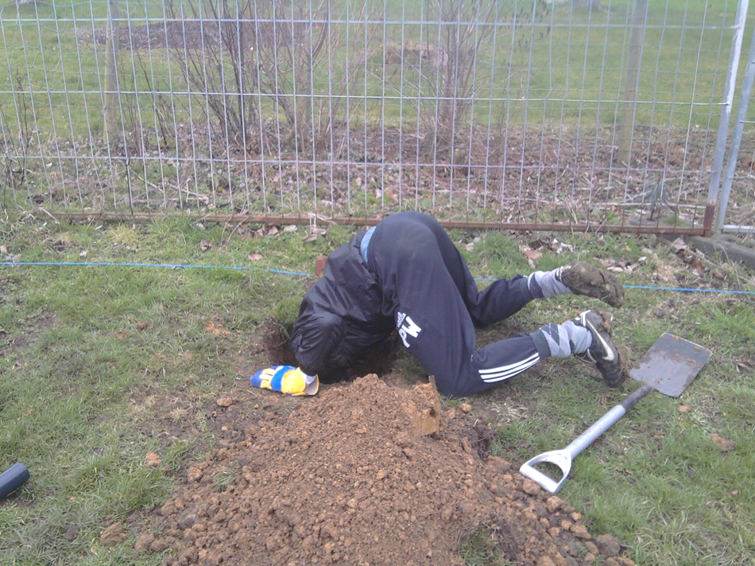
Guiding Principles
“If you can do no good, at least do no harm.”
If you find yourself in a hole, stop digging.

Slide 6
Summary Points
The patients at highest risk of adverse outcomes receive the highest doses of opioids and the riskiest combinations.
Patients with mental health or substance use disorders are:
-More likely to be on chronic opioids -Have higher doses of opioids -More likely to misuse and abuse opioids
Opioid doses > 50-100 MED do not improve chronic pain or function better than lower doses AND
Opioid doses > 50-100 MED increase the risk of mortality
Buprenorphine is a useful medication for managing patients with opiate use disorder

Slide 7
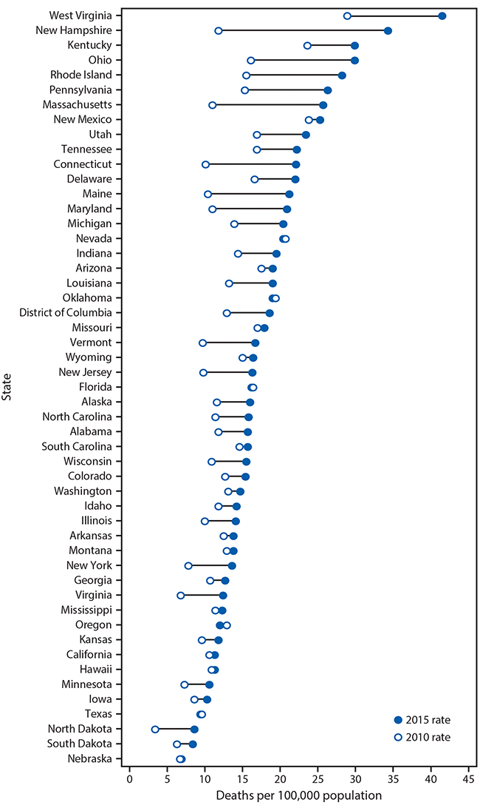
Opioid mortality continues to increase
2010 - 2015
MMWR/December 30, 2016/
Vol. 65/ Nos. 50 & 51

Slide 8
Intersection of Pain, Addiction and Mental Health Disorders
Mental Health
Anxiety Depression Bipolar PTSD Personality disorders
Addiction
Chronic Pain

Slide 9
50% of chronic pain patients have clinically significant depression
Depression is associated with greater pain complaints and increased disability
Depression reduces compliance with pain treatment recommendations
Depression and pain comorbidity: a literature review. Arch Int Med. 2003; 163: 2433-2445

Slide 10
Mood disorders precede pain
200 patients with chronic low back pain
59% met criteria for at least one psychiatric diagnosis: depression and anxiety were the most common
Anxiety disorders preceded pain (95%); depression (54%)
51% Axis 2 disorder
Polatin PB et al, Psychiatric illness and chronic back pain. Spine, 1993, 18(1):66-71

Slide 11
Chronic Opioid Therapy Guidelines
Guidelines generally call for
Use of COT reserved for intractable pain
Caution with substance abuse history
Caution with mental health disorders
CDC Guideline for Prescribing Opioids for Chronic Pain, MMWR / March 15, 2016 / Vol. 65
FDA announces safety labeling changes and postmarket study requirements for ER/LA opioids, Sept. 10, 2013 http://www.fda.gov/NewsEvents/Newsroom/PressAnnouncements/ucm367726.htm
Chou et al The Journal of Pain, 10:2, 2009, 113-130

Slide 12
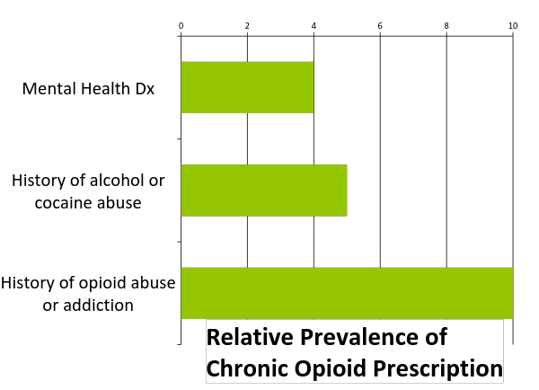
Opioid Prescribing Reality
Braden 2009, Weisner 2009, Edlund 2010
Notes:
3-4x more likely to be on COT with dx of depression or other MH disorders (Braden 2009, Edlund 2010)
4-5x more likely: alcohol or non-opioid abuse history (Weisner 2009, Edlund 2010)
5-10x more likely: opioid abuse or dependence (Weisner 2009, Edlund 2010)

Slide 13
Characteristics of patients with chronic opioid prescriptions
• 30-40% recipients use sedative-hypnotics most days. 13% drink alcohol within 2 hours of opioid use (Saunders 2012)
• Opioid use concentrated (Edlund 2010):
In publicly insured, 5% patients use 48% opioids
In commercially insured, 5% patients use 70% opioids
• MH and SUD concentrated in high dose users (Morasco 2010, Seal 2012, Kobus 2012, Merrill 2012)
• Patients with MH and SUD are more likely to receive: • Higher daily doses, high potency Schedule II opioids • Concurrent sedative-hypnotics (Saunders 2012)

Slide 14
Adverse Selection
Adverse selection is the practice of prescribing opioids more commonly and at higher doses to the highest risk population

Slide 15
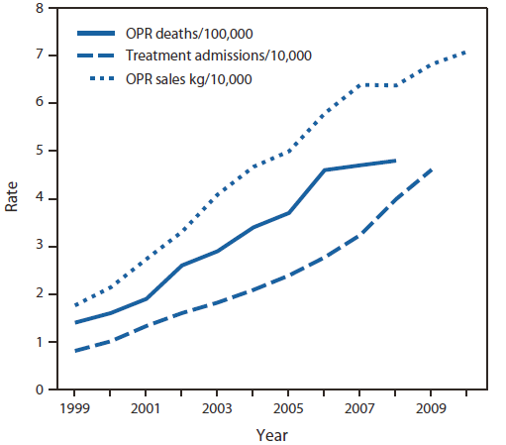
Opioid mortality is related to prevalence and dose
MMWR November 4, 2011 / 60(43);1487-1492
.
Notes:
Age-adjusted rates per 100,000 population for OPR deaths, crude rates per 10,000 population for OPR abuse treatment admissions, and crude rates per 10,000 population for kilograms of OPR sold
Rates of prescription opioid overdose death, OPR treatment admissions, and kilograms of OPR sold --- United States, 1999--2010

Slide 16
Risk of Fatal Opiate Overdose Dunn et al
Opiate dose in MED
Dunn, et al, Annals of Internal Medicine. 2010 Jan;152(2):85-92.

Slide 17
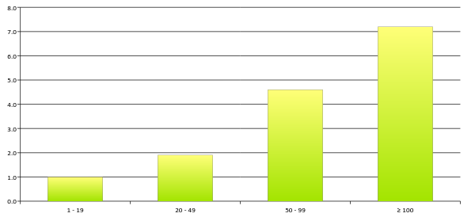
Risk of Fatal Opiate Overdose Bohnert, et al
Opiate dose in MED
Bohnert et al, JAMA. 2011;305(13):1315-1321

Slide 18
Risk Stratification
 | Risk
 | Low | Moderate | High
Psychiatric | No history of psychiatric disorder | Stable, well compensated mood disorder | Unstable mood, psychotic or personality disorder Poor adherence to therapy Chronic benzodiazepine use
Addiction | No personal or family history of addiction | Past history of addiction or family history of addiction | Active addiction including non substance use disorders Positive UDT High risk score (SOAP, DIRE)
Medical | No medical comorbidities | Stable comorbidities | Unstable comorbidities, severe OSA, severe COPD or asthma Poor adherence to therapy.
Social | Good social support | Social discord | Isolated Destructive social network Litigation
Activity | Active engagement in work, recreation or hobbies | Unemployment due to compensable injury | No satisfying work or recreation
Pain Etiology | Clear etiology | Uncertain etiology | Unclear etiology with non anatomic distribution of pain Indications FM, IBS, HA, CPP, LBP
Adapted with permission from Steven Passik

Slide 19
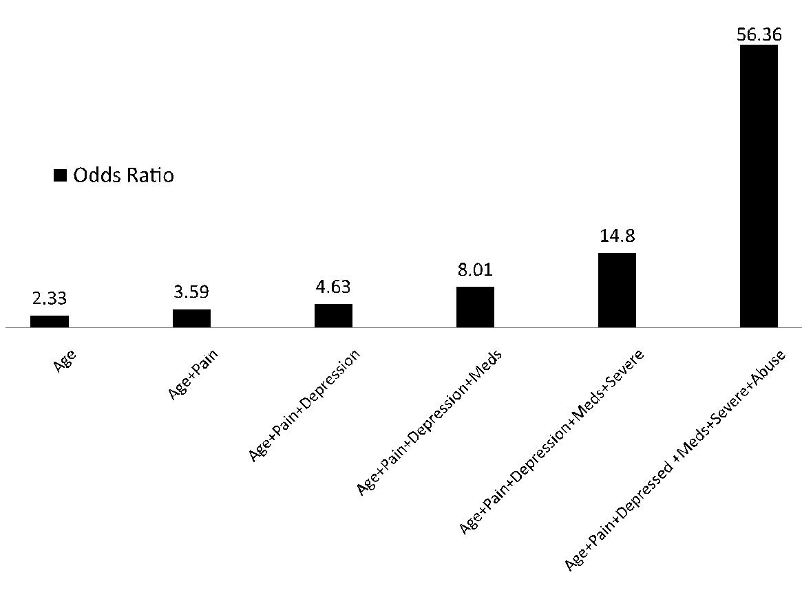
Odds of Opiate Dependence in Chronic Pain Patients on Chronic Opioid Therapy
Notes:
Random sample of outpatients
705 of 2000 eligible patients interviewed
Age ≥18, 4+ prescriptions/12 mo, non cancer pain
26% had diagnosis of opiate addiction
Boscarino, et al, Addiction, 2010, 105, 1776-82
Age<65
Pain disability BPI
Depression dx, current
Psychotropic meds, current
Severity of opioid dependence: Our study also included the Severity of Dependence Scale (SDS), adopted for opiates, to assess life-time opioid dependence severity [25]. The SDS has been used in addiction research and validated previously [48]. We used a score of 7+ to define high life-time opioid addiction severity.
Lifetime Hx of opioid abuse
Substance dependence/abuse measures
Substance misuse was defined based on DSM-IV criteria which were collected using the CIDI instrument [18,20,21], modified to capture data relevant to prescription opioid use. Because we assessed prescription opioid dependence at the beginning of the interview, we used a substance dependence scale adapted for telephone administration that had been validated previously [31–33]. The criteria for dependence on this scale were concordant with DSM-IV nomenclature for dependence [18]. Alcohol dependence was assessed using the CIDI instrument. Because history of prescription opioid abuse is thought to be a predictor of current opioid dependence [34], this was defined as the presence of one or more prescription opioid abuse problems (e.g. health, family, functional or legal problems) in the patient's history, consistent with DSM-IV.
Odds ratios represent the combined odds of having current prescription opioid dependence (based on DSM-IV criteria) for each respective combination of risk factors, compared to those without these risk factors, respectively [49]. Age = less than 65 years old; pain = high current pain impairment; depression = history of depression; meds = current psychotropic medication use; severe = history of high prescription opioid dependence severity; abuse = history of prescription opioid abuse

Slide 20
Our case
57 yo male low back pain presents for refill
Receiving oxycodone 15mg #120/mo
Worsening pain “11/10”
Unemployed
Remote hx IDU reported in Hx – denies recent drug use
Depressed, not taking citalopram – “you’d be depressed too if…”
COPD, 1ppd smoker
Resident thinks a long acting preparation might be better

Slide 21
Audience selection
Change to Oxycodone SR 20 MG TID
Opioid rotation: trial different opioid
No change
Taper opioids

Slide 22
Our case
Current dose 90 MED without pain relief or functional improvement
High risk age, MDD, high PDI, Hx of opiate dependence
Non adherent with medical treatment recs
Taper

Slide 23
and then...
"Oh great, so now you're going to make me go broke. I already can't afford the extra pills I need to buy from the street"
Evaluate for opiate use disorder
Offer buprenorphine

Slide 24
Create clinic and residency policies around opioid prescribing
Clinic Policies
Screen for substance use and mental health disorders
Avoid starting higher risk patients on chronic opioid therapy
No patient leaves the clinic with > 2wk supply of opioids without real time precepting
Keep doses less than 100 or even 50 MED
No benzos + opioids, no carisoprodol (Soma)
Safety committee/clinic champion
No prescriptions for chronic opioids at first visit/do not accept patients into practice who only want a new prescriber for controlled substance
Use Tools: Registry, UDA, PMP, Informed consent and patient agreements, naloxone – universal precautions (and understand WA legal requirements)
Obtain buprenorphine waiver

Slide 25
Residency Policies
Require residents and faculty to obtain buprenorphine waivers
Prescribe buprenorphine
Require annual opioid prescribing training

Slide 26
Resources
CDC Guideline for Prescribing Opioids for Chronic Pain — United States, 2016
2015 Interagency Guideline on Prescribing Opioids for Pain http://www.agencymeddirectors.wa.gov/CMEActivities.asp
COPE REMS http://www.coperems.org/

Slide 27
Summary Points
The patients at highest risk of adverse outcomes receive the highest doses of opioids and the riskiest combinations.
Patients with mental health or substance use disorders are:
-More likely to be on chronic opioids -Have higher doses of opioids -More likely to misuse and abuse opioids
Opioid doses > 50-100 MED do not improve chronic pain or function better than lower doses AND
Opioid doses > 50-100 MED increase the risk of mortality
Buprenorphine is a useful medication for managing patients with opiate use disorder

Slide 28
Chronic Pain Management: Setting the Educational Stage
Abi Plawman, MD
Associate PD/Fellowship Director
East Pierce Family Medicine Residency

Slide 29
Reviewing your schedule…
55 yo male alcoholic, known arthritis/knee pain. EMR shows 2 PT visits followed by a no-show.
cc: “pain meds”
How effective do you feel as a clinician preparing to see this patient?

Slide 30
Reviewing your schedule…
55 yo man in sustained recovery from alcohol use disorder with scheduled followup for knee arthritis/pain. EMR shows 2 PT visits followed by one marked “no-show” with comment on transportation issues
Cc: “f/u knee pain”
How effective do you feel as a clinician preparing to see this patient?

Slide 31
Preparing Learners

Slide 32
Setting the Stage
Teach the ground-rules [Paul]
State/federal guidelines
Clinic policy/procedure
Safety parameters
Templates? Forms? EMR issues?
PMP review
Reflect on patient/provider factors interact SEPARATELY from specific visit
Notes:
Take a moment BEFORE visit for awareness so you don’t get sandbagged by contextual issues that trigger your own bias
**bias discussion tool for didactics/group process beforehand?

Slide 33
Interacting factors
Patient:
Provider:
Biopsychosocial
Care plan/boundaries
Training background
Bias
External pressures
Notes:
Take a moment BEFORE visit for awareness so you don’t get sandbagged by contextual issues that trigger your own bias
**bias discussion tool for didactics/group process beforehand?
Know your patient
Biopsychosocial factors
Plan of care previously established/boundaries
Know yourself
Explore bias – “real pain”, addiction background, training, recall bias, family of origin
Mindfulness skills/personal preparation
External pressures – Late? OB patient? Insurance? Preceptor bias?

Slide 34
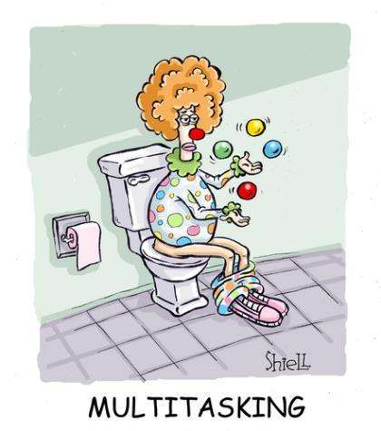
Barriers…
Notes:
Barriers – rehashing past, future-tripping, relationships/expectations, distractions

Slide 35
Why mindfulness?
When working with patients managing chronic pain, do you ever feel:
Exhausted
Irritated
Late
Frustrated
Overwhelmed
Sad
Manipulated
?
Notes:
Which of these things come from the patient and which come from things you bring to the table?

Slide 36
Mindfulness
“Mindfulness means paying attention in a particular way; on purpose, in the present moment, and non-judgementally.”
- Jon Kabat-Zinn

Slide 37
Stop
Take a breath
Observe sensations, emotions, thoughts
Proceed in a less reactive way

Slide 38
How do you STOP?
Stop
Pause before entering room or conversation
Step out of exam room
Take a breath
Stand still and balanced or sit squarely and breathe from abdomen
Observe sensations, emotions, thoughts
Tachycardic? Tachypneic? Tight shoulders? Clenching jaw?
Proceed in a less reactive way

Slide 39
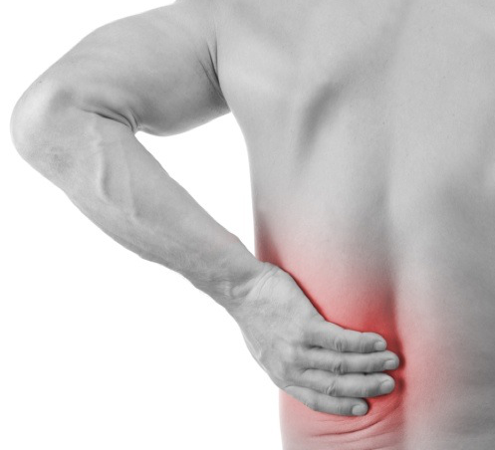
What’s the agenda?
Get a refill
Fix a problem
Evaluate safety and efficacy
Comply with rules
Improve relationship
Teach a skill
Model a behavior

Slide 40
What is success?
Doc will find the right medicine and my pain will finally GO AWAY!
I’m trying to find a safe regimen that allows her to do all the important things and not get sicker!
She’ll learn to provide safe care and develop resiliency and job satisfaction!

Slide 41
Boundaries/Consequences
Encourage the learner to clarify boundaries of safety and behavior BEFORE visit
Requirements
Restrictions
Behavioral expectations
Clarify consequences in advance AND DOCUMENT
EMR – for partners
Visit summary – for patients
Notes:
Refer to agreements, local laws, prior agreement with patient on POC.
Reference signed agreement, AVS written for patient
CONSISTENCY IS KEY

Slide 42
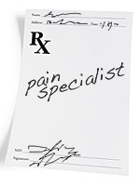
Requirements
“You have to see the pain specialist.”
“You must have a pain specialist consult visit scheduled by your next visit. If this consult can not be confirmed at that visit, we will begin tapering off your medication.”

Slide 43
Restrictions
“Benzodiazepines are not allowed.”
“If your urine is confirmed positive for benzodiazepines or you fill any further prescriptions for benzodiazepines, you will not receive any further prescriptions for opioid pain medication.”

Slide 44
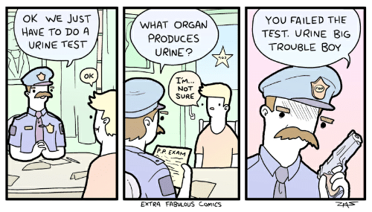

Slide 45
Behavioral Expectations
“Stop swearing at the receptionists.”
“Your signed contract states you will be polite to staff. If you continue to speak to staff in this way, you will be asked to leave clinic and be terminated as a patient, and your pain medication regimen will be stopped.”

Slide 46
Precepting

Slide 47
Who are you excited to precept?
46 yo chronic pain patient,10/10 back pain on Percocet. He refuses NSAIDs. Took some of roomate’s sleeping medications, requests sedative.
46 yo father of 3, low back pain after a workplace injury 4 years ago. Ongoing severe pain, minimal improvement with trial of Percocet. Sleep better with roomate’s sleeping medication; requests evaluation of insomnia. GI side effects from ibuprofen and is afraid to try similar medications.

Slide 49
Precepting STOP
STOP: Are you multitasking? Eye contact with learner.
Take a breath: How behind is your learner? What are today’s goals?
Observe: Learner body language? Tone of voice? Choice of words? Rapid vs slow presentation? Tools they are holding?
Proceed: Ask first, then teach. Inquire about bias, experience, fears. Balance safety and autonomy.

Slide 50
Language and Context
Who are you seeing?
“Chronic pain patient”
“Addict”
“Crazy”
“Med seeker”
“Noncompliant”
“Hypochondriac”
“Hysterical”

Slide 51
Language and Context
Who are you seeing?
“Chronic pain patient” “managing chronic leg pain”
“Addict” “in recovery or SUD”
“Crazy” “mental health comorbidity”
“Med seeker” describe behaviors in context
“Noncompliant” “did not do X because of Y”
“Hypochondriac” “multiple health concerns”
“Hysterical” “anxious, fearful, agitated”
Patient-centered language changes the context from dismissive to curious and engaged

Slide 52
Language and Context
What are you doing?
“Med refill”
“Monthly check-in”
“Pain review”
“Pee test”
“Checking boxes”

Slide 53
Language and Context
What are you doing?
“Med refill”
“Monthly check-in”
“Pain review”
“Pee test”
“Checking boxes”
Reviewing function
Optimizing regimen
Ensuring safety
Medicolegal compliance
Building rapport
Considering differential diagnosis!

Slide 54
Differential diagnosis
Reasons behind behaviors
“pseudoaddiction” / insufficient pain control
Substance Use Disorder
Poverty (to sell?)
Victimization (stolen?)
Maladaptive “training” by system
Behavioral health issue
Poor health literacy
Poor vision
IT’S NOT PERSONAL

Slide 55
In Summary…
Prepare in advance
Safety
Rules/requirements
Provider background/bias
Mindfulness → STOP!
Define agenda/success
Boundaries/consequences
Language/context

