Slide 1
15 Steps to a Stellar Faculty Orientation
Leslie A. Waldman, MD, FAAFP
Northwest Washington Family Medicine Residency
May 3, 2017

Slide 2
Objectives
Identify what new faculty want in an orientation
Recognize what you need to commit
Detail the benefits to your program

Slide 3
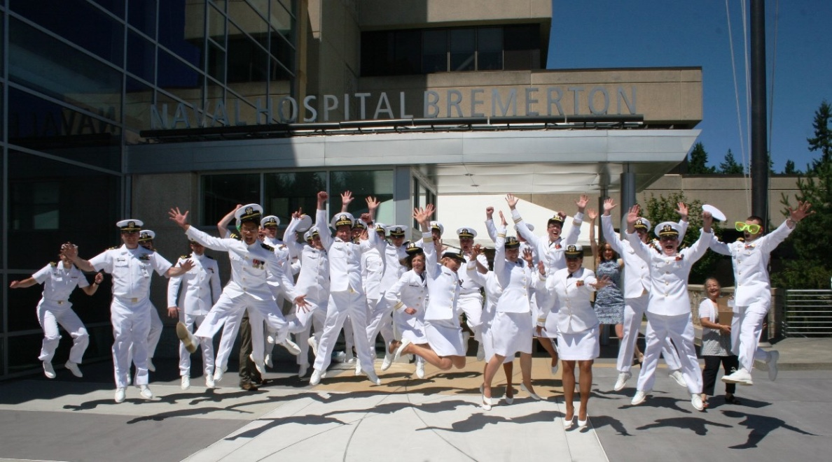
How did I get here, from there

Slide 4
How did I get here, from there

Slide 5
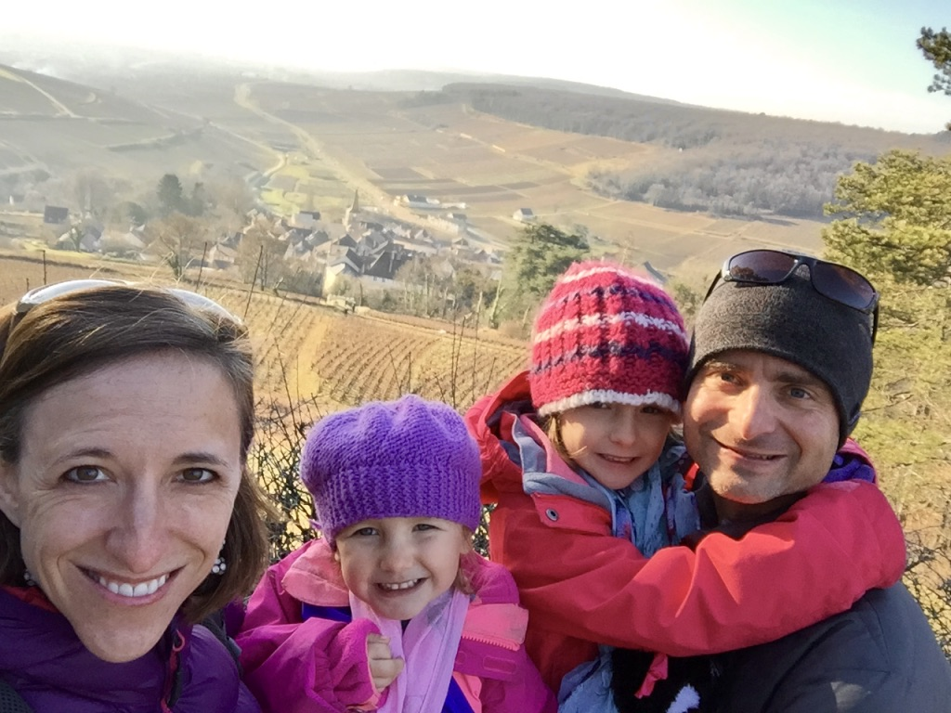
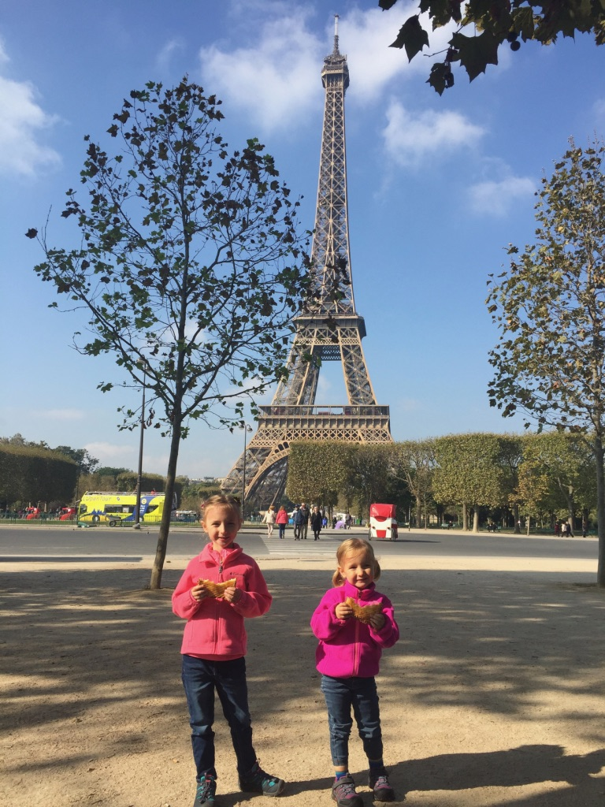
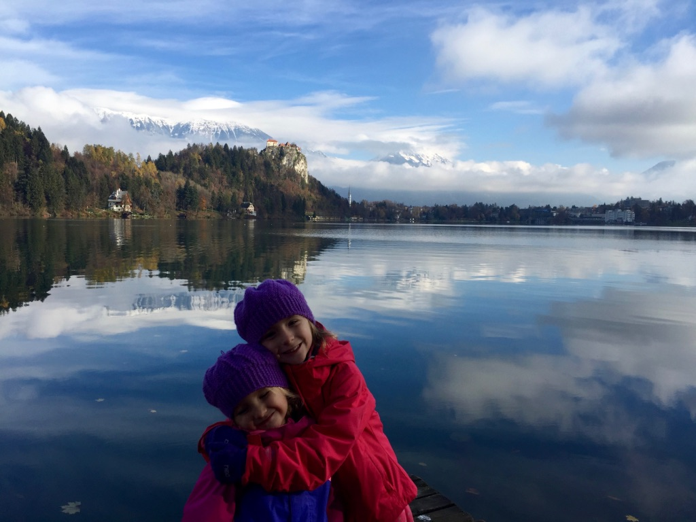
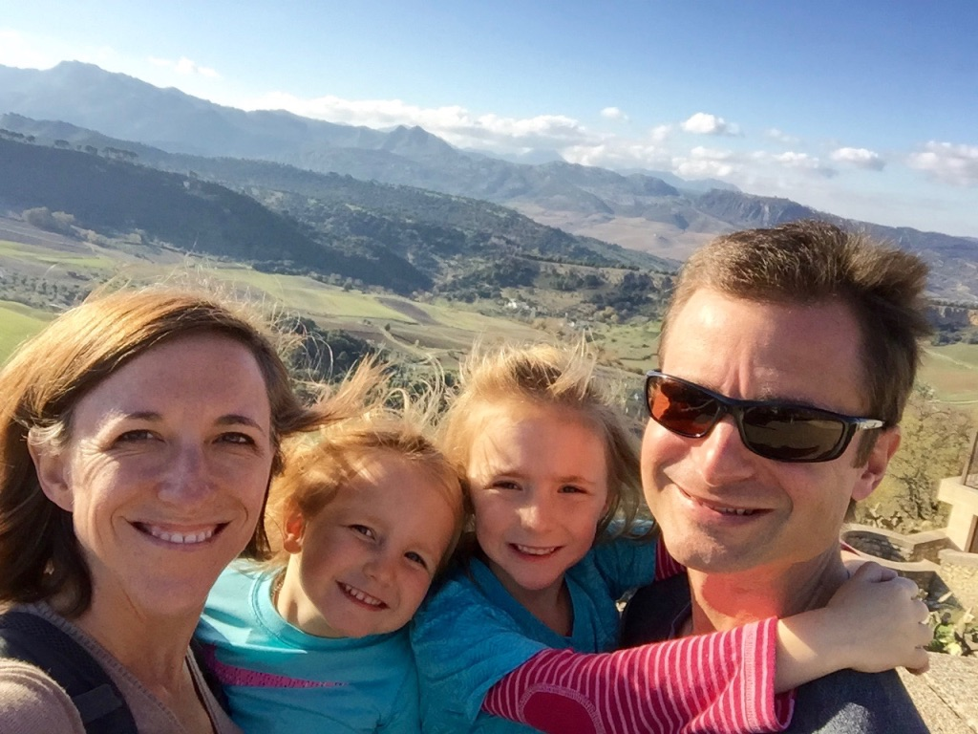
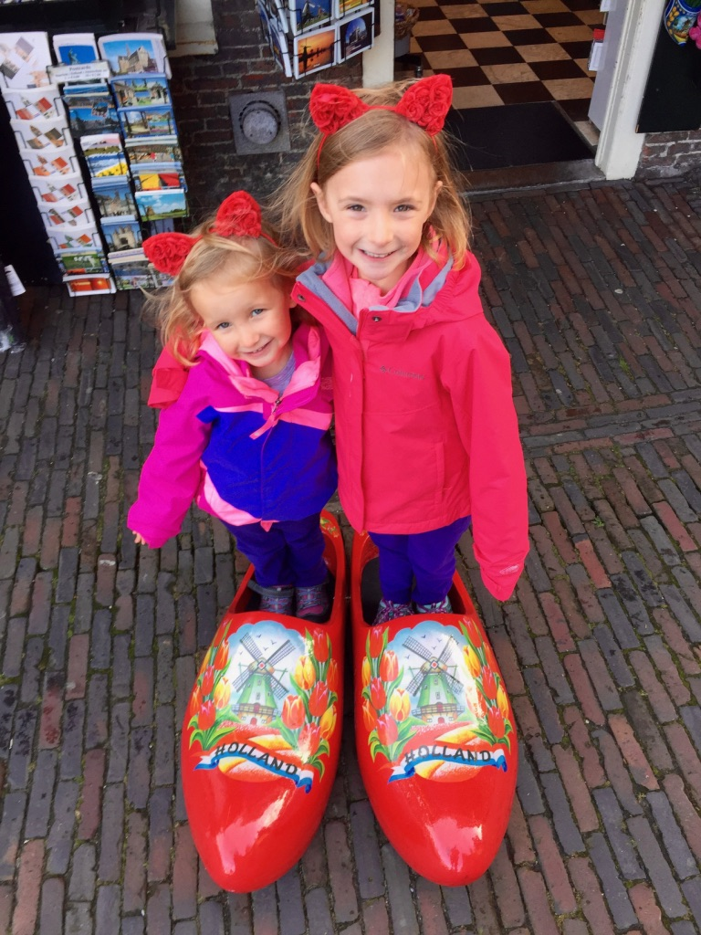
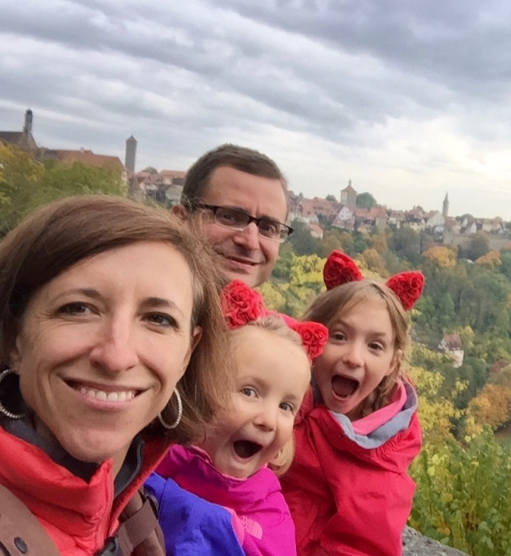
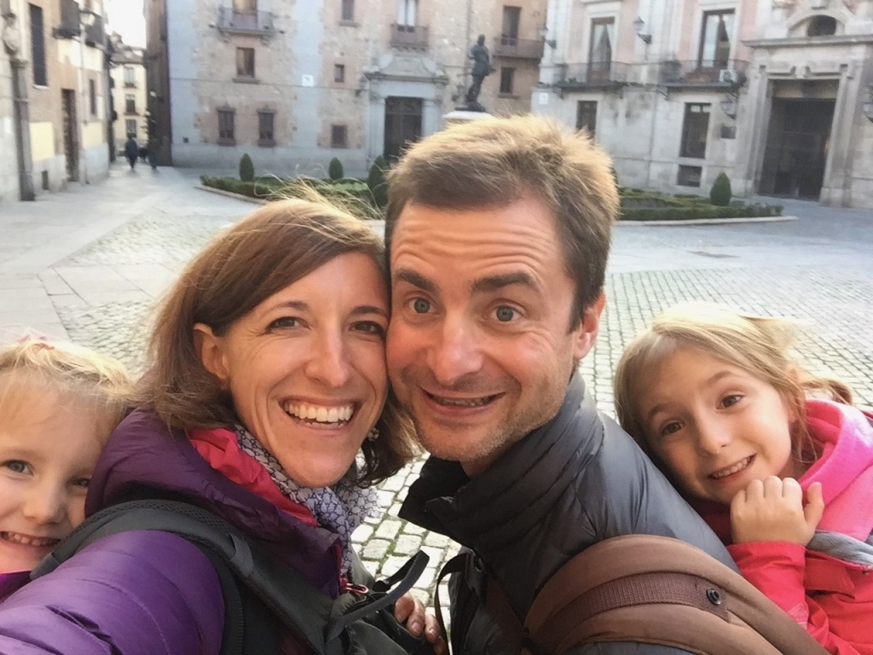
How did I get here, from there

Slide 6
#1 Have a faculty orientation
Time Commitment New Hire Program | Monetary Commitment | Benefits
Time Commitment New Hire Program |  | Monetary Commitment | Benefits
 | 3 half days (preparation) |  | Increases recruitment Dials up the caliber of educators much earlier in their career Avoids the black hold of “On-the-job training” Faculty feel as important as new interns

Slide 7
#2 Communicate expectations and requirements

Slide 8
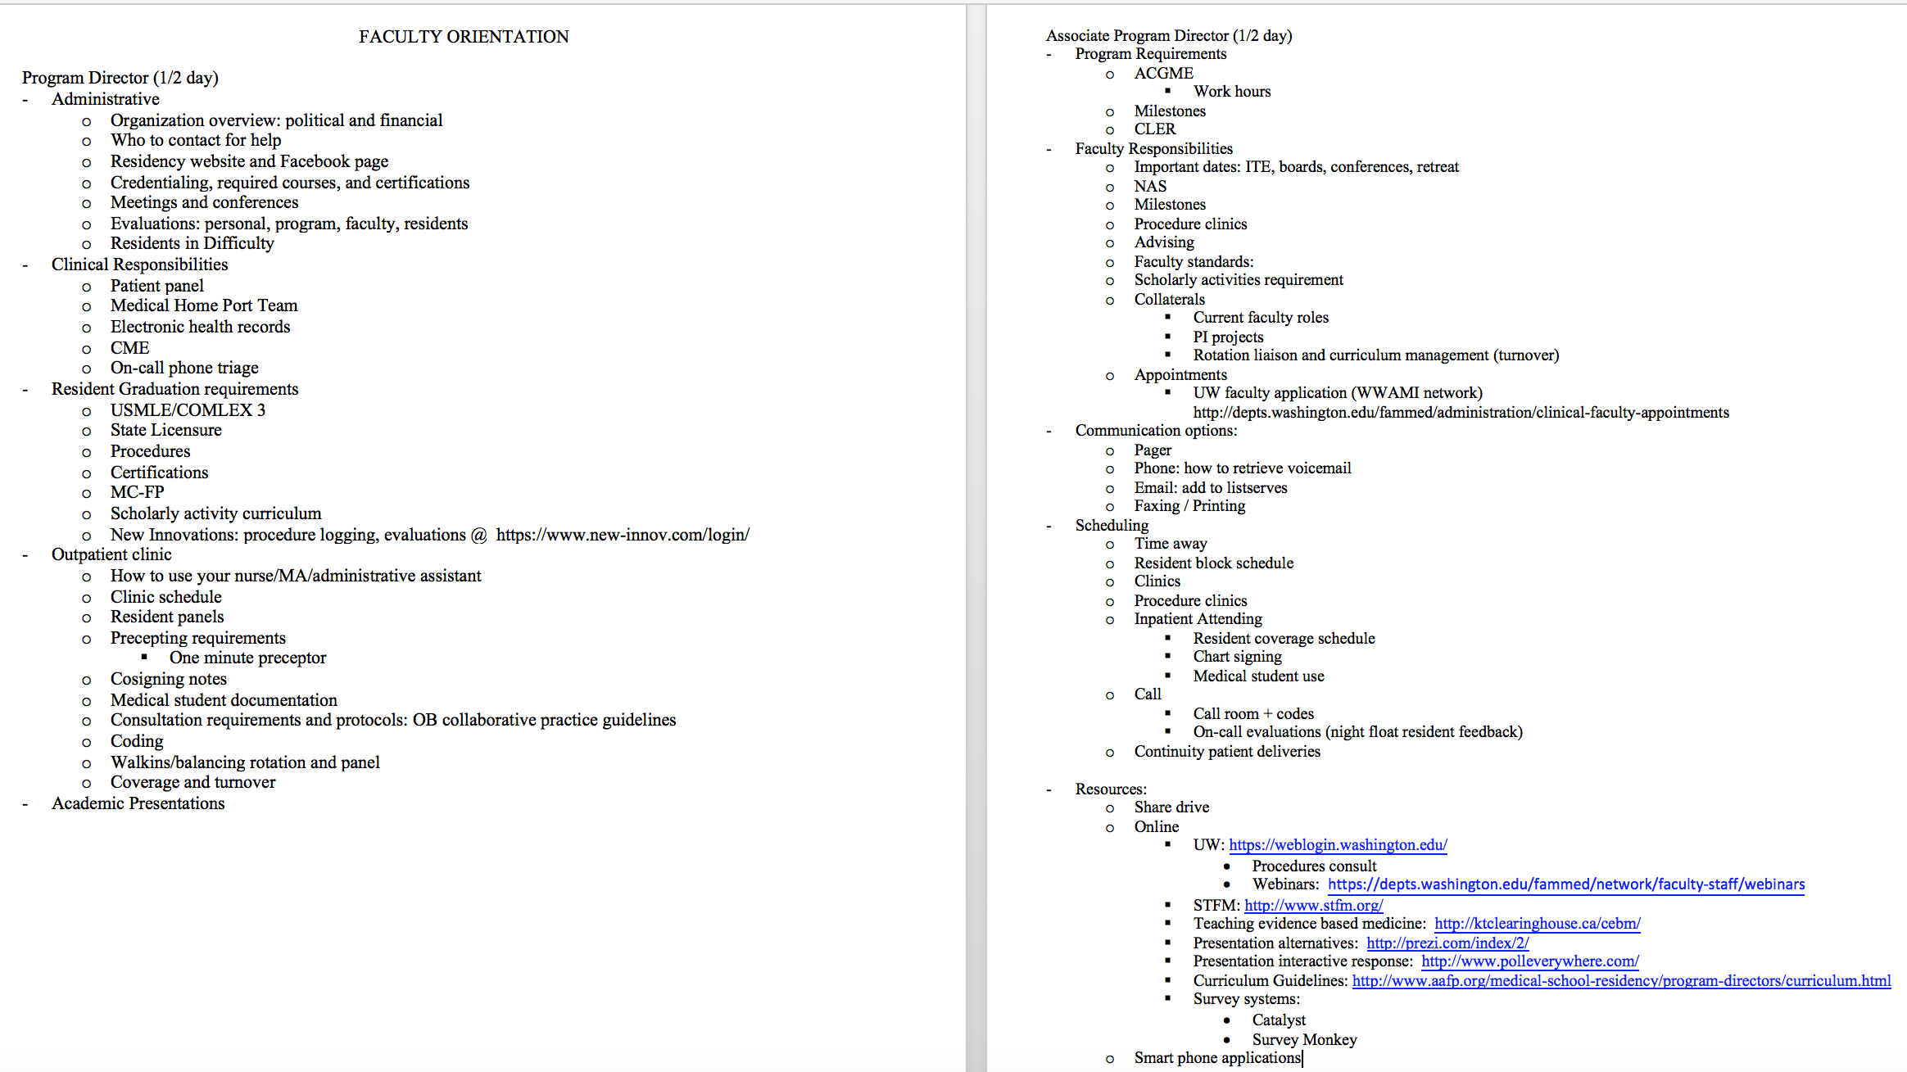
#2 Communicate expectations and requirements
Time Commitment New Hire Program |  | Monetary Commitment | Benefits
 | 3 half days (preparation) |  | Increases recruitment, Dials up the caliber of educators much earlier in their career, Avoids the black hold of “On-the-job training”, Faculty feel as important as new interns
6h | PD: 2h + 1h x2 APD: 2h |  | Boosts confidence and diffuses the sense of being overwhelmed → Resiliency and Retention

Slide 9
#3 Elucidate the administrative layers
Time Commitment New Hire Program |  | Monetary Commitment | Benefits
 | 3 half days (preparation) |  | Increases recruitment, Dials up the caliber of educators much earlier in their career, Avoids the black hold of “On-the-job training”, Faculty feel as important as new interns
6h | PD: 2h + 1h x2 APD: 2h |  | Boosts confidence and diffuses the sense of being overwhelmed → Resiliency and Retention
3h |  | $5 | Promotes active participation in meetings and discussions Thought-process aligns with that of the program
ACGME
Local Healthcare System
Family Medicine Residency

Slide 10
Time Commitment New Hire Program |  | Monetary Commitment | Benefits
 | 3 half days (preparation) |  | Increases recruitment, Dials up the caliber of educators much earlier in their career, Avoids the black hold of “On-the-job training”, Faculty feel as important as new interns
6h | PD: 2h + 1h x2 APD: 2h |  | Boosts confidence and diffuses the sense of being overwhelmed → Resiliency and Retention
3h |  | $5 | Promotes active participation in meetings and discussions Thought-process aligns with that of the program

Slide 11
#4 Introduce all team members
Time Commitment New Hire Program |  | Monetary Commitment | Benefits
 | 3 half days (preparation) |  | Increases recruitment, Dials up the caliber of educators much earlier in their career, Avoids the black hold of “On-the-job training”, Faculty feel as important as new interns
6h | PD: 2h + 1h x2 APD: 2h |  | Boosts confidence and diffuses the sense of being overwhelmed → Resiliency and Retention
3h |  | $5 | Promotes active participation in meetings and discussions, Thought-process aligns with that of the program
10h | 2h orientation 2h x3 faculty | Lunch x6 people | Demonstrates the importance of the new Faculty Member to the non-FM community and highlights their already-completed accomplishments to create "credibility" with specialty colleagues The new faculty member looks like a superstar!
Requests:
Explain the roles of non-faculty members
Explain the roles of faculty members
Share local practice styles
Share some pointers
Answer questions

Slide 12
#5 Evaluate, evaluations, evaluators
Time Commitment New Hire Program |  | Monetary Commitment | Benefits
 | 3 half days (preparation) |  | Increases recruitment, Dials up the caliber of educators much earlier in their career, Avoids the black hold of “On-the-job training”, Faculty feel as important as new interns
6h | PD: 2h + 1h x2 APD: 2h |  | Boosts confidence and diffuses the sense of being overwhelmed → Resiliency and Retention
3h |  | $5 | Promotes active participation in meetings and discussions, Thought-process aligns with that of the program
10h | 2h orientation 2h x3 faculty | Lunch x6 people | Demonstrates the importance of the new Faculty Member to the non-FM community and highlights their already-completed accomplishments to create "credibility" with specialty colleagues The new faculty member looks like a superstar!
 | 1h FacDev lecture |  | More objective and effective evaluations A happier CCC team

Slide 13
#6 Shadow a preceptor
Time Commitment New Hire Program |  | Monetary Commitment | Benefits
 | 3 half days (preparation) |  | Increases recruitment, Dials up the caliber of educators much earlier in their career, Avoids the black hold of “On-the-job training”, Faculty feel as important as new interns
6h | PD: 2h + 1h x2 APD: 2h |  | Boosts confidence and diffuses the sense of being overwhelmed → Resiliency and Retention
3h |  | $5 | Promotes active participation in meetings and discussions, Thought-process aligns with that of the program
10h | 2h orientation 2h x3 faculty | Lunch x6 people | Demonstrates the importance of the new Faculty Member to the non-FM community and highlights their already-completed accomplishments to create "credibility" with specialty colleagues The new faculty member looks like a superstar!
 | 1h FacDev lecture |  | More objective and effective evaluations, A happier CCC team
2 half days |  |  | Effectively uses the One-Minute Preceptor Model Directly observes the intricacies of precepting in the EHR Secures knowledge of precepting requirements Builds a solid foundation for their precepting style

Slide 14
#7 Shadow Call and inpatient medicine teams
Time Commitment New Hire Program |  | Monetary Commitment | Benefits
 | 3 half days (preparation) |  | Increases recruitment, Dials up the caliber of educators much earlier in their career, Avoids the black hold of “On-the-job training”, Faculty feel as important as new interns
6h | PD: 2h + 1h x2 APD: 2h |  | Boosts confidence and diffuses the sense of being overwhelmed → Resiliency and Retention
3h |  | $5 | Promotes active participation in meetings and discussions, Thought-process aligns with that of the program
10h | 2h orientation 2h x3 faculty | Lunch x6 people | Demonstrates the importance of the new Faculty Member to the non-FM community and highlights their already-completed accomplishments to create "credibility" with specialty colleagues The new faculty member looks like a superstar!
 | 1h FacDev lecture |  | More objective and effective evaluations, A happier CCC team
2 half days |  |  | Effectively uses the One-Minute Preceptor Model, Directly observes the intricacies of precepting in the EHR, Secures knowledge of precepting requirements, Builds a solid foundation for their precepting style
3 days |  |  | Maintains the inpatient team’s pace Assimilates them into the local practice style Systematic transfer of knowledge demonstrating commitment to patient safety

Slide 15
#8 Co-signing: who, what, where, when, and why
Time Commitment New Hire Program |  | Monetary Commitment | Benefits
 | 3 half days (preparation) |  | Increases recruitment, Dials up the caliber of educators much earlier in their career, Avoids the black hold of “On-the-job training”, Faculty feel as important as new interns
6h | PD: 2h + 1h x2 APD: 2h |  | Boosts confidence and diffuses the sense of being overwhelmed → Resiliency and Retention
3h |  | $5 | Promotes active participation in meetings and discussions, Thought-process aligns with that of the program
10h | 2h orientation 2h x3 faculty | Lunch x6 people | Demonstrates the importance of the new Faculty Member to the non-FM community and highlights their already-completed accomplishments to create "credibility" with specialty colleagues The new faculty member looks like a superstar!
 | 1h FacDev lecture |  | More objective and effective evaluations, A happier CCC team
2 half days |  |  | Effectively uses the One-Minute Preceptor Model, Directly observes the intricacies of precepting in the EHR, Secures knowledge of precepting requirements, Builds a solid foundation for their precepting style
3 days |  |  | Maintains the inpatient team’s pace, Assimilates them into the local practice style, Systematic transfer of knowledge demonstrating commitment to patient safety,
 |  |  | Increases revenue and production

Slide 16
#9 Define the alphabet soup
Time Commitment New Hire Program |  | Monetary Commitment | Benefits
 | 3 half days (preparation) |  | Increases recruitment, Dials up the caliber of educators much earlier in their career, Avoids the black hold of “On-the-job training”, Faculty feel as important as new interns
6h | PD: 2h + 1h x2 APD: 2h |  | Boosts confidence and diffuses the sense of being overwhelmed → Resiliency and Retention
3h |  | $5 | Promotes active participation in meetings and discussions, Thought-process aligns with that of the program
10h | 2h orientation 2h x3 faculty | Lunch x6 people | Demonstrates the importance of the new Faculty Member to the non-FM community and highlights their already-completed accomplishments to create "credibility" with specialty colleagues The new faculty member looks like a superstar!
 | 1h FacDev lecture |  | More objective and effective evaluations, A happier CCC team
2 half days |  |  | Effectively uses the One-Minute Preceptor Model, Directly observes the intricacies of precepting in the EHR, Secures knowledge of precepting requirements, Builds a solid foundation for their precepting style
3 days |  |  | Maintains the inpatient team’s pace, Assimilates them into the local practice style, Systematic transfer of knowledge demonstrating commitment to patient safety
 |  |  | Increases revenue and production

Slide 17
#10 Advise the advisor
Time Commitment New Hire Program |  | Monetary Commitment | Benefits
 | 3 half days (preparation) |  | Increases recruitment, Dials up the caliber of educators much earlier in their career, Avoids the black hold of “On-the-job training”, Faculty feel as important as new interns
6h | PD: 2h + 1h x2 APD: 2h |  | Boosts confidence and diffuses the sense of being overwhelmed → Resiliency and Retention
3h |  | $5 | Promotes active participation in meetings and discussions, Thought-process aligns with that of the program
10h | 2h orientation 2h x3 faculty | Lunch x6 people | Demonstrates the importance of the new Faculty Member to the non-FM community and highlights their already-completed accomplishments to create "credibility" with specialty colleagues, The new faculty member looks like a superstar!
 | 1h FacDev lecture |  | More objective and effective evaluations, A happier CCC team
2 half days |  |  | Effectively uses the One-Minute Preceptor Model, Directly observes the intricacies of precepting in the EHR, Secures knowledge of precepting requirements, Builds a solid foundation for their precepting style
3 days |  |  | Maintains the inpatient team’s pace, Assimilates them into the local practice style, Systematic transfer of knowledge demonstrating commitment to patient safety
 |  |  | Increases revenue and production
2h | 2h |  | Continues effective resident guidance Imparts comfort in their new role Early identification of strengths/growth areas for the new advisor

Slide 18
#11 Demonstrate feedback skills
Time Commitment New Hire Program |  | Monetary Commitment | Benefits
 | 3 half days (preparation) |  | Increases recruitment, Dials up the caliber of educators much earlier in their career, Avoids the black hold of “On-the-job training”, Faculty feel as important as new interns
6h | PD: 2h + 1h x2 APD: 2h |  | Boosts confidence and diffuses the sense of being overwhelmed → Resiliency and Retention
3h |  | $5 | Promotes active participation in meetings and discussions, Thought-process aligns with that of the program
10h | 2h orientation 2h x3 faculty | Lunch x6 people | Demonstrates the importance of the new Faculty Member to the non-FM community and highlights their already-completed accomplishments to create "credibility" with specialty colleagues, The new faculty member looks like a superstar!
 | 1h FacDev lecture x2 |  | More objective and effective evaluations, A happier CCC team Integrates them into our environment of effective listening and performance development Less pimping and “guess what I’m thinking” and more objective feedback
2 half days |  |  | Effectively uses the One-Minute Preceptor Model, Directly observes the intricacies of precepting in the EHR, Secures knowledge of precepting requirements, Builds a solid foundation for their precepting style
3 days |  |  | Maintains the inpatient team’s pace, Assimilates them into the local practice style, Systematic transfer of knowledge demonstrating commitment to patient safety
 |  |  | Increases revenue and production
2h | 2h |  | Continues effective resident guidance, Imparts comfort in their new role, Early identification of strengths/growth areas for the new advisor

Slide 19
#12 Introduce building a CV and Educators Portfolio
Time Commitment New Hire Program |  | Monetary Commitment | Benefits
 | 3 half days (preparation) |  | Increases recruitment, Dials up the caliber of educators much earlier in their career, Avoids the black hold of “On-the-job training”, Faculty feel as important as new interns
6h | PD: 2h + 1h x2 APD: 2h |  | Boosts confidence and diffuses the sense of being overwhelmed → Resiliency and Retention
3h |  | $5 | Promotes active participation in meetings and discussions, Thought-process aligns with that of the program
10h | 2h orientation 2h x3 faculty | Lunch x6 people | Demonstrates the importance of the new Faculty Member to the non-FM community and highlights their already-completed accomplishments to create "credibility" with specialty colleagues, The new faculty member looks like a superstar!
 | 1h FacDev lecture x2 |  | More objective and effective evaluations, A happier CCC team, Integrates them into our environment of effective listening and performance development, Less pimping and “guess what I’m thinking” and more objective feedback
2 half days |  |  | Effectively uses the One-Minute Preceptor Model, Directly observes the intricacies of precepting in the EHR, Secures knowledge of precepting requirements, Builds a solid foundation for their precepting style
3 days |  |  | Maintains the inpatient team’s pace, Assimilates them into the local practice style, Systematic transfer of knowledge demonstrating commitment to patient safety
 |  |  | Increases revenue and production
2h | 2h |  | Continues effective resident guidance, Imparts comfort in their new role, Early identification of strengths/growth areas for the new advisor
 |  |  | Eases the burden of reporting scholarly activities Promotes award submissions Helps w/ performance reviews & goal-setting

Slide 20
#13 WWAMI benefits and UW appointment
Time Commitment New Hire Program |  | Monetary Commitment | Benefits
 | 3 half days (preparation) |  | Increases recruitment, Dials up the caliber of educators much earlier in their career, Avoids the black hold of “On-the-job training”, Faculty feel as important as new interns
6h | PD: 2h + 1h x2 APD: 2h |  | Boosts confidence and diffuses the sense of being overwhelmed → Resiliency and Retention
3h |  | $5 | Promotes active participation in meetings and discussions, Thought-process aligns with that of the program
10h | 2h orientation 2h x3 faculty | Lunch x6 people | Demonstrates the importance of the new Faculty Member to the non-FM community and highlights their already-completed accomplishments to create "credibility" with specialty colleagues, The new faculty member looks like a superstar!
 | 1h FacDev lecture x2 |  | More objective and effective evaluations, A happier CCC team, Integrates them into our environment of effective listening and performance development, Less pimping and “guess what I’m thinking” and more objective feedback
2 half days |  |  | Effectively uses the One-Minute Preceptor Model, Directly observes the intricacies of precepting in the EHR, Secures knowledge of precepting requirements, Builds a solid foundation for their precepting style
3 days |  |  | Maintains the inpatient team’s pace, Assimilates them into the local practice style, Systematic transfer of knowledge demonstrating commitment to patient safety
 |  |  | Increases revenue and production
2h | 2h |  | Continues effective resident guidance, Imparts comfort in their new role, Early identification of strengths/growth areas for the new advisor
 |  |  | Eases the burden of reporting scholarly activities, Promotes award submissions, Helps w/ performance reviews & goal-setting
 |  |  | Instills a sense of value and importance Integrates them into the regional GME community Provides networking opportunities

Slide 21
#14 “Avoid the dump”
Time Commitment New Hire Program |  | Monetary Commitment | Benefits
 | 3 half days (preparation) |  | Increases recruitment, Dials up the caliber of educators much earlier in their career, Avoids the black hold of “On-the-job training”, Faculty feel as important as new interns
6h | PD: 2h + 1h x2 APD: 2h |  | Boosts confidence and diffuses the sense of being overwhelmed → Resiliency and Retention
3h |  | $5 | Promotes active participation in meetings and discussions, Thought-process aligns with that of the program
10h | 2h orientation 2h x3 faculty | Lunch x6 people | Demonstrates the importance of the new Faculty Member to the non-FM community and highlights their already-completed accomplishments to create "credibility" with specialty colleagues, The new faculty member looks like a superstar!
 | 1h FacDev lecture x2 |  | More objective and effective evaluations, A happier CCC team, Integrates them into our environment of effective listening and performance development, Less pimping and “guess what I’m thinking” and more objective feedback
2 half days |  |  | Effectively uses the One-Minute Preceptor Model, Directly observes the intricacies of precepting in the EHR, Secures knowledge of precepting requirements, Builds a solid foundation for their precepting style
3 days |  |  | Maintains the inpatient team’s pace, Assimilates them into the local practice style, Systematic transfer of knowledge demonstrating commitment to patient safety
 |  |  | Increases revenue and production
2h | 2h |  | Continues effective resident guidance, Imparts comfort in their new role, Early identification of strengths/growth areas for the new advisor
 |  |  | Eases the burden of reporting scholarly activities, Promotes award submissions, Helps w/ performance reviews & goal-setting
 |  |  | Instills a sense of value and importance, Integrates them into the regional GME community, Provides networking opportunities
 |  |  | Demonstrates the collaborative nature of the program Models appropriate faculty behaviors Avoids creating a culture where "being the new team member" means offloading work

Slide 22
#15 Consider on-going faculty development options
Time Commitment New Hire Program |  | Monetary Commitment | Benefits
 | 3 half days (preparation) |  | Increases recruitment, Dials up the caliber of educators much earlier in their career, Avoids the black hold of “On-the-job training”, Faculty feel as important as new interns
6h | PD: 2h + 1h x2 APD: 2h |  | Boosts confidence and diffuses the sense of being overwhelmed → Resiliency and Retention
3h |  | $5 | Promotes active participation in meetings and discussions, Thought-process aligns with that of the program
10h | 2h orientation 2h x3 faculty | Lunch x6 people | Demonstrates the importance of the new Faculty Member to the non-FM community and highlights their already-completed accomplishments to create "credibility" with specialty colleagues, The new faculty member looks like a superstar!
 | 1h FacDev lecture x2 |  | More objective and effective evaluations, A happier CCC team, Integrates them into our environment of effective listening and performance development, Less pimping and “guess what I’m thinking” and more objective feedback
2 half days |  |  | Effectively uses the One-Minute Preceptor Model, Directly observes the intricacies of precepting in the EHR, Secures knowledge of precepting requirements, Builds a solid foundation for their precepting style
3 days |  |  | Maintains the inpatient team’s pace, Assimilates them into the local practice style, Systematic transfer of knowledge demonstrating commitment to patient safety
 |  |  | Increases revenue and production
2h | 2h |  | Continues effective resident guidance, Imparts comfort in their new role, Early identification of strengths/growth areas for the new advisor
 |  |  | Eases the burden of reporting scholarly activities, Promotes award submissions, Helps w/ performance reviews & goal-setting
 |  |  | Instills a sense of value and importance, Integrates them into the regional GME community, Provides networking opportunities
 |  |  | Demonstrates the collaborative nature of the program, Models appropriate faculty behaviors, Avoids creating a culture where "being the new team member" means offloading work
Up to 5w |  | $1000 | Creates a cycle of faculty development and retention to perpetuate the effective transition to future leadership roles as others graduate or retire

Slide 23
Conclusions
You know what it takes.
You have a means and a framework.
The benefits outweigh the costs.
Time Commitment New Hire Program |  | Monetary Commitment | Benefits
53 hours + Up to 5w | PD: 4h APD: 3h Faculty: 24h | $1005 + lunch x6 people | Increases recruitment, Dials up the caliber of educators much earlier in their career, Avoids the black hold of “On-the-job training”, Faculty feel as important as new interns, Boosts confidence and diffuses the sense of being overwhelmed → Resiliency and Retention, Promotes active participation in meetings and discussions, Thought-process aligns with that of the program, Demonstrates the importance of the new Faculty Member to the non-FM community and highlights their already-completed accomplishments to create "credibility" with specialty colleagues, The new faculty member looks like a superstar!, More objective and effective evaluations, A happier CCC team, Integrates them into our environment of effective listening and performance development, Less pimping and “guess what I’m thinking” and more objective feedback, Effectively uses the One-Minute Preceptor Model, Directly observes the intricacies of precepting in the EHR, Secures knowledge of precepting requirements, Builds a solid foundation for their precepting style, Maintains the inpatient team’s pace, Assimilates them into the local practice style, Systematic transfer of knowledge demonstrating commitment to patient safety, Increases revenue and production, Continues effective resident guidance, Imparts comfort in their new role, Early identification of strengths/growth areas for the new advisor, Eases the burden of reporting scholarly activities, Promotes award submissions, Helps w/ performance reviews & goal-setting, Instills a sense of value and importance, Integrates them into the regional GME community, Provides networking opportunities, Demonstrates the collaborative nature of the program, Models appropriate faculty behaviors, Avoids creating a culture where "being the new team member" means offloading work, Creates a cycle of faculty development and retention to perpetuate the effective transition to future leadership roles as others graduate or retire

Slide 24
Questions

