Slide 1
Training Resilience in Residency
By: Brad Baumgardner

Slide 2
What is Resilience?
Can it be trained?
Key Components of Resilience
What makes an individual resilient?
My Training Model
INTRODUCTION
My Resilience Curriculum
Lessons Learned
Mistakes were made
Example of Session

Slide 3
Poll
What are you most interested in?
Resilience defined
The trainable aspects of resilience
The training model of practice
Resilience curriculum
Practical lessons for effective training

Slide 4
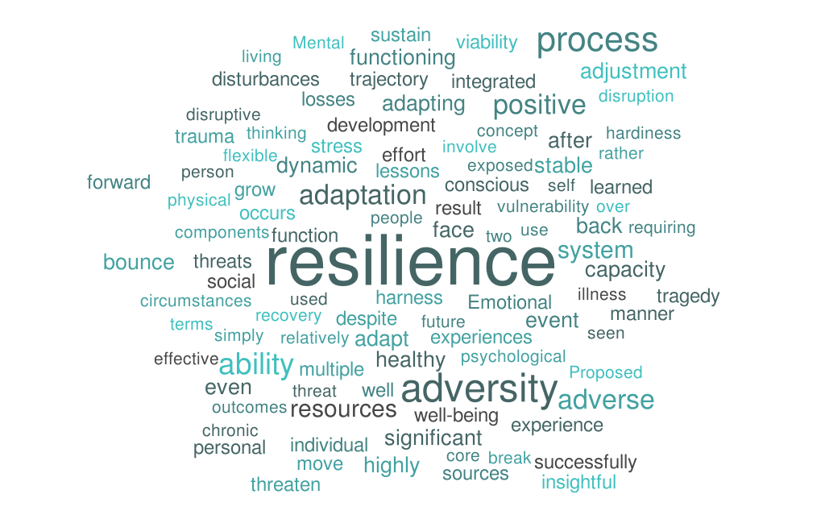
What is Resilience?
Can it be taught?

Slide 5
Factors of Resilience
Mental
Toughness
Self-Regulation
Challenge/Adversity
Social Support
Sense of Self
Positive
Emotions
Self-Awareness

Slide 6
Poll
Which factor of resilience do you see your residents struggling with the most?
Self-Awareness
Self-Regulation
Overcoming Challenges and Adversity
Social Support
Positive Emotions (Hope, Optimism and Gratitude )
Mental Toughness Skills
Sense of Self

Slide 7
Training Setup
Resident Sessions 10 one hour sessions and a 15 minute follow up monthly
The residents are introduced to different performance and resilience tools and given a chance to practice them. The fifteen minute follow up is a chance to remind the residents of the concepts and to fine tune them.
Staff Sessions
4 one and a half hour sessions quarterly
Take the staff through an abbreviated version of what the residents are learning and let them know how they can supplement it.
Individual Sessions
30-90 minutes in length
Allows the individuals more time to customize the skills learned to pertain to their individual needs as well as going more in depth with the concepts.

Slide 8
Session Flow
1) Review
3) Simulation
Remind the residents about what was covered in the previous session as well as catch up anyone who missed the most recent session
The residents enjoy doing something active and often times remember the concepts better when there is an activity
2) Instruct
4) Discuss
During this time we go more in depth with the topic for the current session. I use workbooks rather than PowerPoint and share the research behind each skill
This gives the residents the opportunity to begin to think about how they can apply this concept, tool or skill in their residency and personal life

Slide 9
Poll
Where are you currently in developing a resilience curriculum for your residents?
Haven’t spent much time thinking about it
In the process of researching what to do
Started this year
Have been doing it for 1-3 years
Have been doing resilience training for 3 years or more

Slide 10
Current Curriculum
1
2
3
4
Introduction & A.I.R. (CBT)
Fixed vs. Growth
Mindset
Self-Awareness &
Red, Yellow, & Green Lights
Beliefs, Values &
Confirmation Bias
7
6
5
Solution Focused
Thinking
Positive
Emotions
Flash
Judgements
8
9
10
Stress &
Deliberate Breathing
Burnout & Active
Constructive Responding
Character Strengths

Slide 11
Biggest Lessons Learned
No PowerPoint
Activities are Key
Get Staff on Board
When the projector turns on the mind turns off, so get rid of the PowerPoint.
We learn more from doing. Individuals at all ages love to do things much more than just sitting and receiving information.
Staff make or break the training. The best results I have seen comes from the departments that have heavy staff involvement as long as it’s the right staff members.

Slide 12
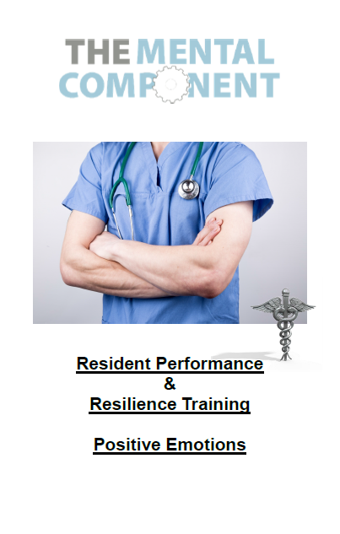
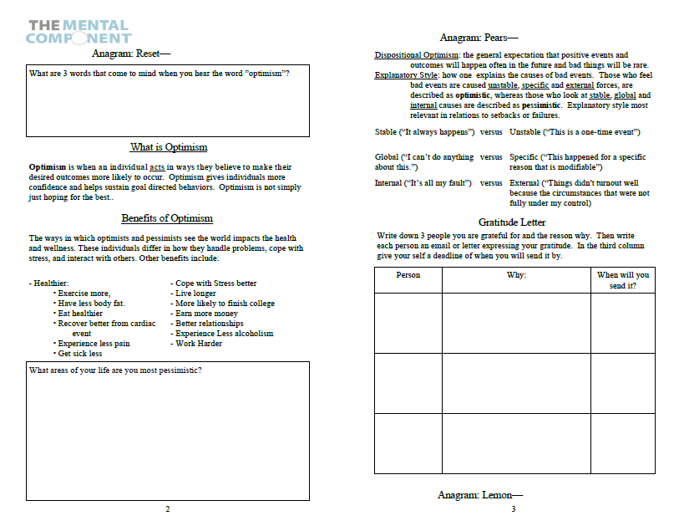
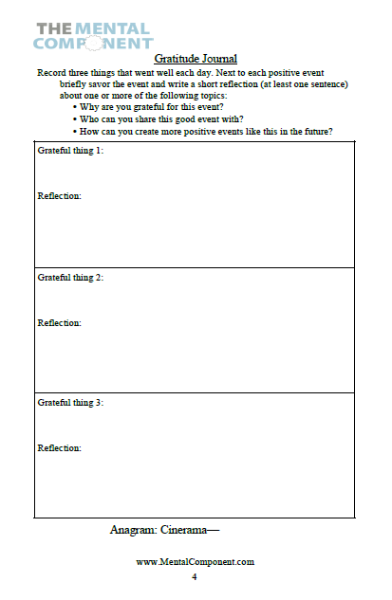
Session Example

Slide 13
Questions?

Slide 14
Thank you for your time
Any additional questions:
Brad@mentalcomponent.com

