Slide 1
Faculty Orientation to Clerkship Goals and Objectives
Misbah Keen, MD, MPH, MBI
Co-Director
Jeanne Cawse-Lucas, MD
Co-Director
Stephanie Drake
Program Administrator
Updated 12/22/2017

Slide 2
Foundational Knowledge
Clinical Phase now goes from end of March to March
Students have all completed the Foundations phase, which includes:
Basic sciences
Foundations of Clinical Medicine curriculum
Primary Care Practicum (outpatient)
College Mornings (inpatient)
Ecology of Health and Medicine
Epidemiology and biostatistics

Slide 3
Goals
Learn and apply key components of the Family Medicine approach to health care:
Biopsychosocial Aspects of Care
Comprehensive Care
Continuity of Care
Context of Care
Coordination and Integration of Care
Buffalo, WY

Slide 4
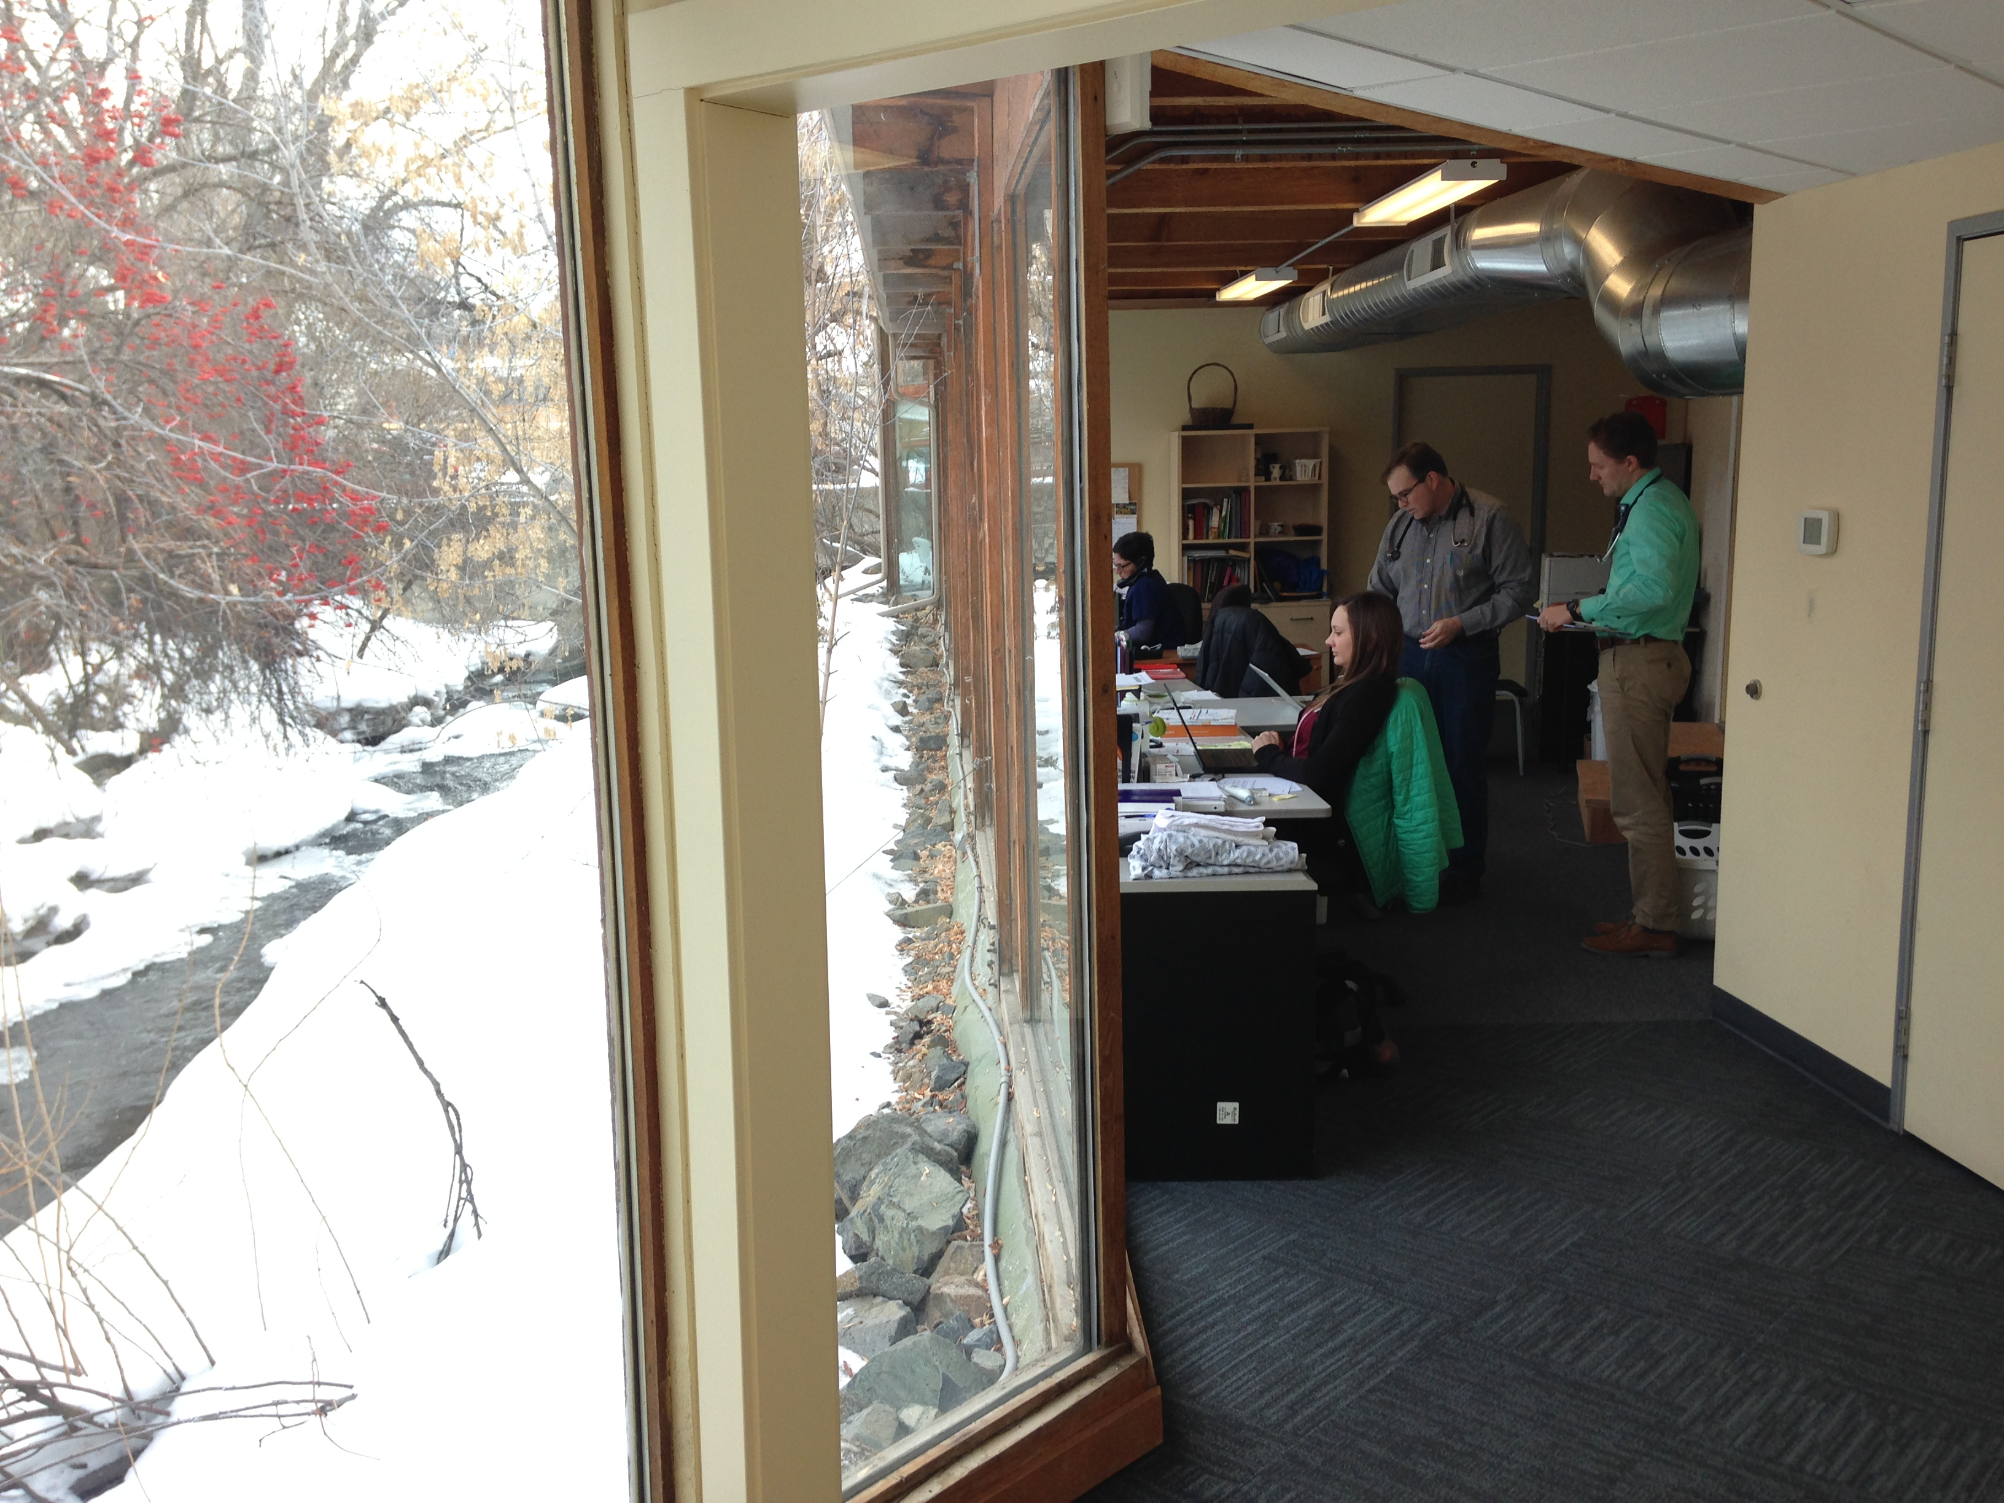
Objectives
1. Discuss:
The principles of care within the framework of family medicine & the critical role of family physicians within any health care system.
Bozeman, MT

Slide 5
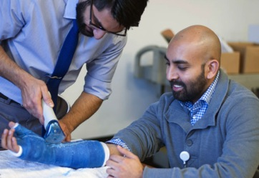
Objectives 2-4: Clinical Knowledge
Gather information, formulate differential diagnoses, propose initial diagnostic evaluation, and offer management plans for patients with common presentations within the within the framework of the family medicine.
Manage initial evaluation and follow-up visits with patients needing longitudinal care such as such as chronic disease and pregnancy, in a family medicine setting.
Collaboratively, with patient input, develop evidence-based health promotion/disease prevention plans for patients of any age or gender in a family medicine setting.
Central WA FMRP in Yakima

Slide 6
Objectives 5-6: Patient Centered Communication & Professionalism
Demonstrate use of patient centered communication skills during history taking, physical exam, use of electronic health records, and collaborative decisions making in an outpatient setting.
Demonstrate professionalism in the care of patients and families, and in interactions with the health care team and communities.
Bozeman, MT

Slide 7
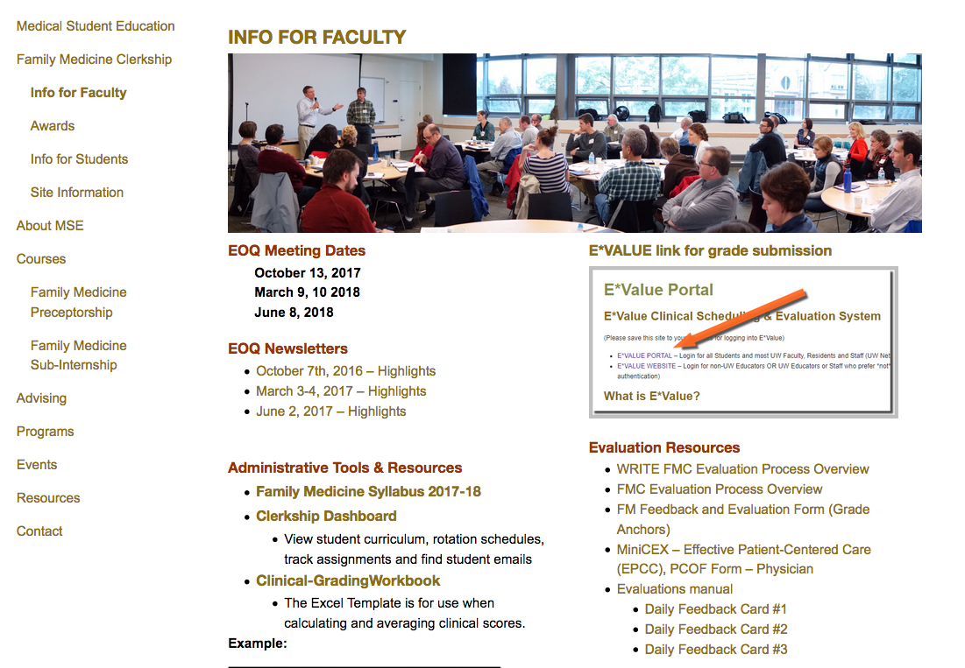
Family Medicine Clerkship www.uwfmc.org

Slide 8
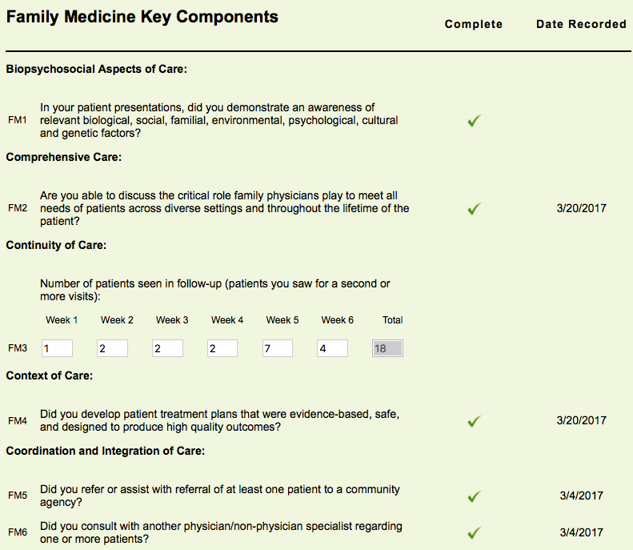
Assignment Tracker
Track all curricular activities and timelines online
Update Assignment Tracker WEEKLY
Bring print out of tracker to Mid & End of Clerkship Reviews
SCROLL ALL THE WAY DOWN, weekly assignments at bottom

Slide 9
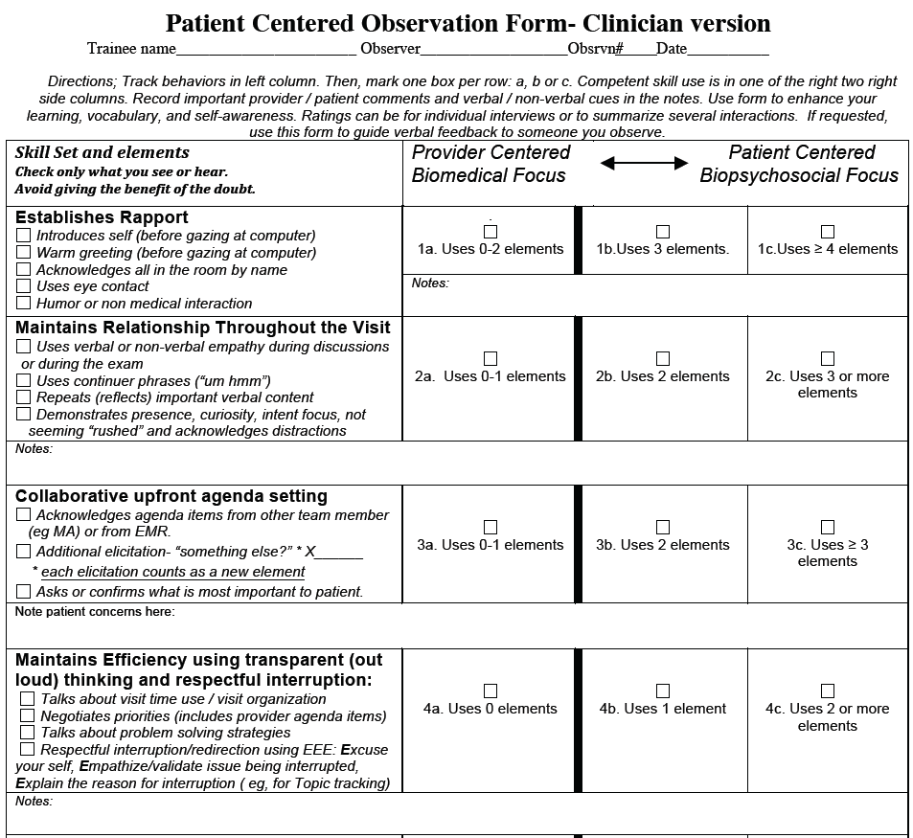
Objective 2
Effective Patient
Centered Care (EPPC)
MINI-CEX for
Family Medicine

Slide 10
Professional Learning Environment
Teacher-learner relationships: Both have rights and responsibilities
Responsibilities of Teachers:
Treat learners fairly, respectfully, and without bias related to their age, race, gender, sexual orientation, disability, religion, or national origin.
Give learners timely, constructive, and accurate feedback.

Slide 11
Professional Learning Environment
Responsibilities of Learners:
Be courteous and respectful of others.
Put patients' welfare ahead of educational needs.
Know limitations and ask for help when needed.
Maintain patient confidentiality.
View feedback as an opportunity to improve knowledge and performance skills.

Slide 12
Professional Learning Environment
The UWSOM takes faculty and student professionalism very seriously
The school reviews all reports of mistreatment, and investigates as appropriate.
Faculty with an ongoing and substantiated record of mistreating students may be removed from teaching duties

Slide 13
Concerns About Students
If you are concerned about a student’s performance, even early in the clerkship, feel free to reach out to the clerkship team
We can offer you resources and/or connect you with the student’s college mentor
Omak, WA

Slide 14
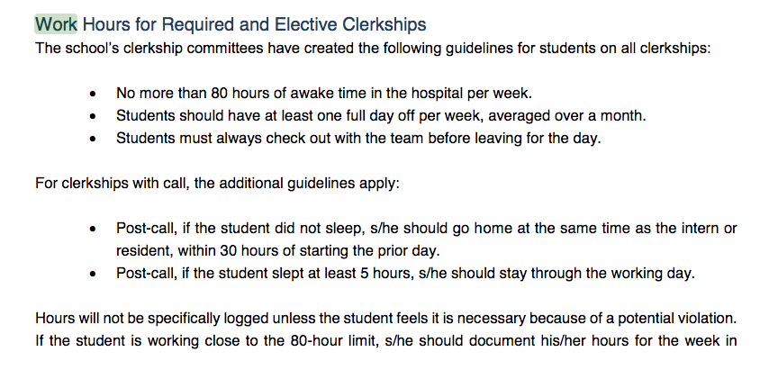
Duty Hours
The FM clerkship adheres to the UWSOM duty hour restrictions

Slide 15
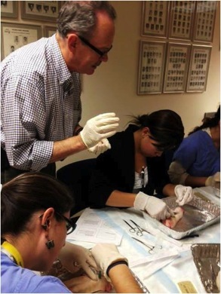
Formal Curriculum: fmCASES
40 interactive virtual cases:
33 fmCASES (1-33)
5 CLIPP (1,2,3,4,13)
2 SIMPLE Cases (2,6)
Use the fmCASES content area list to engage the students
Tacoma FMR

Slide 16
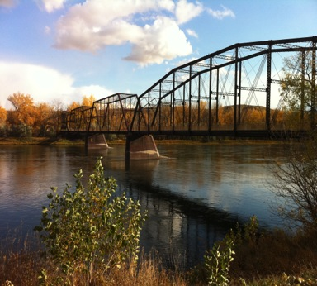
Required Activities
Week One:
Site Orientation
Clerkship Orientation Webinar
Week Two:
Required Clinical Reasoning Practice Test (Catalyst)
Outside of Havre, Montana

Slide 17
Required Activities
Week Three
Mid-Clerkship Review
Week Six
Final Exam - Thu 9:30am-12:30pm PT
End of Clerkship Review
End of Week Six
Site and Faculty Evaluations
4-6 times DURING the rotation
Use of the PCOF form as the mini-CEX
Pocatello, ID

Slide 18
Evaluation Process
Site Director collects feedback from preceptors about student’s performance.
Final grades are assigned by Clerkship Directors at the Seattle office based on the site’s scores and final exam performance.
Site Director incorporates feedback into preliminary grade form considering depth, length of time, and when each faculty worked with the student.

Slide 19
Grading
Student Evaluations are based on 11 scoring categories and the final exam
Knowledge of Subject Area
Data-Gathering Skills
Clinical Skills
Patient-Centered Care Skills
Management Skills
Integration Skills
Communication Skills
Relationships with Patients
Professional Relationships
Dependability and Responsibility
Educational Attitudes

Slide 20
Final Exam Scores
Honors (82 percent and above) – grade adjustment: +0.1
High Pass (75 to 81.9 percent) – grade adjustment: No adjustment
Pass (55 to 74.9 percent) – grade adjustment: -0.2
Fail (less than 55 percent) – Fail clerkship
NOTE: If you Pass on the Exam it is not possible to get Honors as a Final Grade

Slide 21
Teaching Pearls
OPTIONAL !

Slide 22
Clinic Orientation
What is the patient population?
With whom will the student be working?
Who are the main contact people?
ON FAMILY MEDICINE Website :
Orientation best practices
Sample orientations
Notes:
You, clinic manager, whom to call if the student can’t make it, etc.

Slide 23
“I'd like (my faculty) to … sit down with me and go over goals and expectations.”
GLEAM
Goals
Learning style
Experiences
Activities
More

Slide 24
Pre-Clinic Huddle
What is the student working on? Are there any particular expectations (from student or faculty) for that day? (This will help focus your feedback at the end of the day!)
Which patients may be good to see? Students should have “first touch” with 3-4 patients per half day.
Students should write at least one note per half day.
Notes:
If heavy residency audience, this could also be useful to talk about which pts to see, pregame if residents have any questions about patients
Finding out what the student is working on makes it easier to provide feedback at the end, too.

Slide 25
“Let’s go in together. You take the history and I’ll be
your scribe.”
“I want you to take 10 minutes to interview the patient. I’ll knock on the door and you present what you’ve found.”
“I don’t know what the best next step is. Can you look it up and we can talk after I see the next patient by myself?”

Slide 26
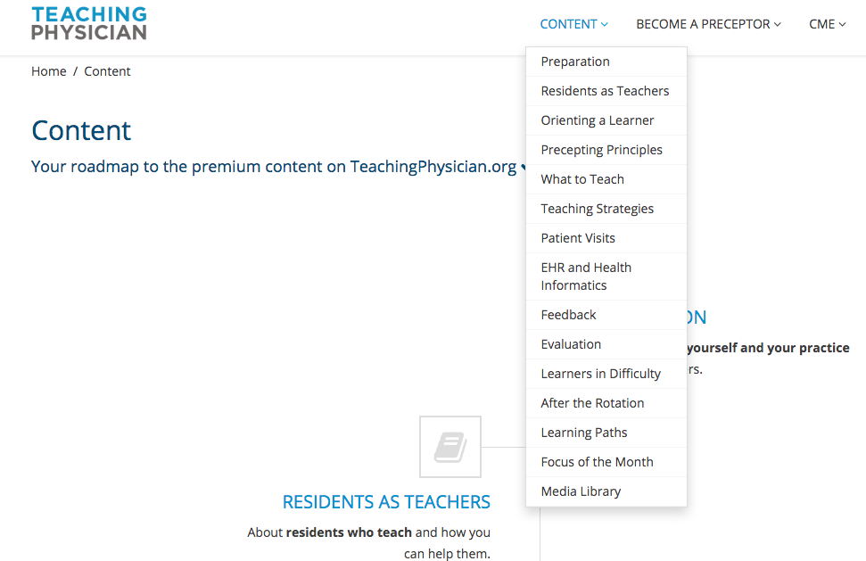
Stfm Teaching Physician
www.teachingphysician.org
username: uwfamedmse password: uwfamedpassword

Slide 27
Other Teaching Resources
One Minute Preceptor
If the link doesn’t work, this is the “5 Microskills for Teaching” link on the Info for Faculty Page
“Ask Tell Ask” feedback method instructional video
If the link doesn’t work, google “Ask Tell Ask Columbia”

Slide 28
QUESTIONS?
YOU CAN ALWAYS CONTACT US AT FMCLERK@UW.EDU

