Slide 1
Program Support for In-Training Exams: Individual Education Plans and OSCEs
Kelli Christensen, MD – Idaho State University Family Medicine Residency, Pocatello, ID
A.J. Weinhold, MD – Idaho State University Family Medicine Residency, Pocatello, ID
Laila Siddiqui, MD – Community Health Care Family Medicine Residency, Tacoma, WA
Shannon Waterman, MD – Swedish Family Medicine Cherry Hill, Seattle, WA
January 3, 2018
Family Medicine Residency Network - Webinar

Slide 2
ABFM ITE – What is it?
Shannon U Waterman, MD
Swedish Family Medicine Cherry Hill
Seattle, WA
January 3, 2018

Slide 3
In Training Exam (ITE)
240 questions
Internet-based, last week of October
Annual “practice” exam
Identify knowledge gaps
Milestones: Medical Knowledge
https://www.theabfm.org/cert/ite.aspx
Notes:
10,000 residents in 450 ACGME accredited residencies take the ITE (as of 2015, though with dual accreditation I’m unsure what the numbers are in 2017…)
Also worth noting that All ABFM diplomates have access to the last 3 years of ITEs for free, and it is not uncommon for diplomates to download and take an ITE to assess how well prepared they are for their next certification examination.

Slide 4
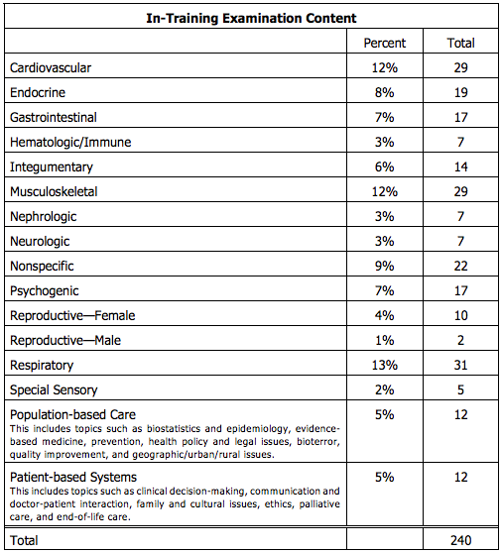
Notes:
16 content areas, but more than 1/3 of the test questions are centered in CV+Resp+MSK = 37%

Slide 5
In Training Exam (ITE)
No “Passing Score”
Bayesian Score Predictor – how likely to pass certification exam
https://cbas.theabfm.org/BayesianPrediction.aspx
Residents show gains each year of residency
Biggest gain between years 1 and 2
Notes:
We’ll talk in a little bit about the predictive value of ITE scores.
STFM: The Predictive Validity of the ABFM’s In-Training Examination
ITE scores generally correlate at about .7 with the following year’s ITE or with the following year’s certification examination.
The mean growth from PGY1 to PGY2 was 52 points, from PGY2 to PGY3 was 34 points, and from PGY3 to initial certification was 27 points.
Very good sensitivity and positive predictive value.
Sensitivity .91
Specificity .47
Positive predictive value .96
Negative predictive value were .27
(Fam Med 2015;47(5):349-56.)

Slide 6
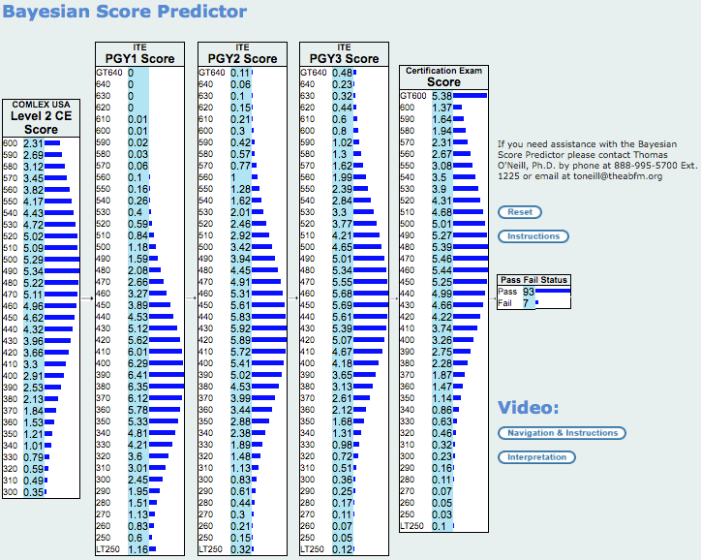
Notes:
In its initial state, each box is populated with the expected distribution of scores for the COMLEX-USA Level 2 CE, the ITE, and the certification examination. However, if the user clicks on a score in any one of these boxes, it changes the distribution from the expected distribution of scores to an observed score. Note observed scores have 100% probability of happening because they actually happened.
Clicking on any score will, in turn, cascade forward to revise the distribution of expected ITE scores in later years of residency and/or the expected distribution of the certification examination scores. These revisions represent the probabilities that are expected based upon only those people who actually received the score that was selected.

Slide 7
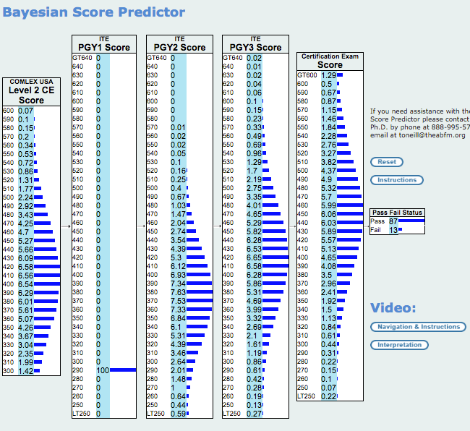

Slide 8
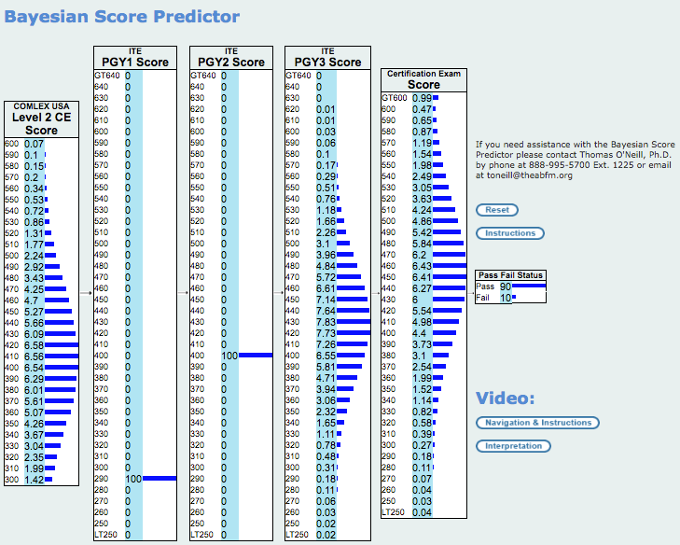
Notes:
This resident made dramatic improvement (over twice what we generally expect from R1 to R2 based solely on residency learning.) And has come up to a 90% pass liklihood in R3 year. In our program, for instance we use that 90% predicted pass rate as a cutoff for participation in an AOC. Lower than that and we figure the residents would be better served by focusing on general medical knowledge and test prep, rather than taking on extra curricular demands.

Slide 9
In Training Exam (ITE)
Intended to show progress
Mean growth
PGY1 to PGY2 was 52 points
PGY2 to PGY3 was 34 points
PGY3 to initial certification was 27 points.
Very good sensitivity and positive predictive value.
Sensitivity .91
Specificity .47
Positive predictive value .96
Negative predictive value were .27
(Fam Med 2015;47(5):349-56.)
Notes:
STFM: The Predictive Validity of the ABFM’s In-Training Examination
ITE scores generally correlate at about .7 with the following year’s ITE or with the following year’s certification examination.
The mean growth from PGY1 to PGY2 was 52 points, from PGY2 to PGY3 was 34 points, and from PGY3 to initial certification was 27 points.
Very good sensitivity and positive predictive value.
Sensitivity .91
Specificity .47
Positive predictive value .96
Negative predictive value were .27
(Fam Med 2015;47(5):349-56.)
For people who pass, the ITE was usually (91%) correct when assuming that an ITE of 390 predicts passing. For people who fail, the ITE was far less predictive (47%).
So why such poor NPV? Turns out advisors and programs are doing a good job identifying those residents who may have been sick, failed to take the test seriously, been called away to perform a clinical task, had a serious family issue, etc. The ITE should be used to help residents identify issues related to their timely progress toward becoming certified by the ABFM. It seems that this is indeed happening. The low NPV (.27) shows that a substantial number of people who were predicted to fail were able to successfully remediate before taking the MC-FP Examination. That is really what we want to spend the rest of our time addressing.

Slide 10
In Training Exam (ITE)
After ITE, resident (or program) can download a document from resident Physician Portfolio containing answers and critiques for all questions.

Slide 11
Academic Individual Educational Plans
Kelli Christensen, M.D. & A.J. Weinhold M.D.
Idaho State University Family Medicine Residency
January 3, 2018

Slide 12
Academic Assessment at ISUFMR
Mock ITE during orientation
Orientation OSCE
Annual ITE
Ongoing rotation & clinic evaluations
Notes:
Kelli

Slide 13
History of Academic Remediation at ISUFMR
Individual and personal
Punishment for the advisor
Struggling for appropriate resources
Perceived as punitive to the resident
Notes:
Kelli

Slide 14
Audience Question…
What sort of intervention do you currently have for a struggling learner? (may choose more than one)
Standardized IEP (Medical Knowledge Enhancement Plan)
Individualized/Ad hoc Study Plan
None
Other (free text)
Notes:
Kelli

Slide 15
Goals For Developing An Academic IEP
Create a standardized process
Reduce advisor workload – why reinvent the wheel?
Create standardization of intervention intensity
Allow standardized tracking of individual and residency progress
Allow us to track impact on ITE scores
Notes:
Kelli

Slide 16
Methods of Development
Reached out to other FMRs (why reinvent the wheel?)
AFMRD listserv for resources
Reviewed plans from 8 programs, identified 4 that seemed to be within reach from our existing academic assessment structure
Shared amongst faculty at faculty meeting then held 2 faculty development hours to develop ISU FMR’s IEP using those 4 plans as templates
Notes:
Kelli

Slide 17
Tool For Intervention
Purpose
Procedure
Intensity of Plan Specs
Outline of Plans
Definition of Compliance
Resources
Agreement

Slide 18
Moderate MKEP: R1 score > 280 < 330 (85-90% chance of passing boards)
R2 score > 330 < 380 (83-89% chance of passing boards)
R3 score > 380 < 410 (85-89% chance of passing boards)
Review your ITE results. Log on to the ABFM website. You will need your username & password. Review your board score, z-score, and ITE questions (highlighted questions are the ones that are incorrect).
Focus your study in the content areas where you had difficulty.
After in-training exam, meet with faculty advisor to develop MKEP (required portions of MKEP listed below).
Meet monthly with faculty advisor and review MKEP progress.
Read TWICE MONTHLY AFP journal and complete each quiz (2 per month).
Log on to the AAFP website: www.aafp.org. or the AAFP app
You must use your own username and password to obtain access to the site and appropriate CME credit. If you do not remember your username and password, contact AAFP at 800-274-2237.
Sign in to AFP quizzes: AFP CME Quizzes
Report CME from quiz completion on your AAFP CME site.
Complete 10 board review questions weekly; choose topic areas for board questions based on performance on ITE and focus on areas where performance was suboptimal.
Log on to the AAFP website: www.aafp.org or the AAFP app
You must use your own username and password to obtain access to the site and appropriate CME credit. If you do not remember your username and password, contact AAFP at 800-274-2237.
Sign into the Sample Board Questions.
AAFP Sample Board Review Questions
After you complete the board review section you have selected, it will automatically score, have answer explanations, and will list your completion on your CME tracker.
See resources below for URL.
Take screen shots from AAFP website or app upon completion of each section to review with faculty advisor and file in resident file.

Slide 19
Intensive MKEP: R1 score < 280 (<85% chance of passing boards)
R2 score < 330 (<83% chance of passing boards)
R3 score < 380 (<85% chance of passing boards)
Review your ITE results. Log on to the ABFM website. You will need your username & password. Review your board score, z-score, and ITE questions (highlighted questions are the ones that are incorrect).
Focus your study in the content areas where you had difficulty.
After in-training exam, meet with faculty advisor to develop MKEP (required portions of MKEP listed below).
Meet monthly with faculty advisor and review MKEP progress.
Read TWICE MONTHLY AFP journal and complete each quiz (2 per month – one current and one from 2 years prior).
Log on to the AAFP website: www.aafp.org.
You must use your own username and password to obtain access to the site and appropriate CME credit. If you do not remember your username and password, contact AAFP at 800-274-2237.
Sign in to AFP quizzes: AFP CME Quizzes
Report CME from quiz completion on your AAFP CME site.
Complete 20 board review questions WEEKLY (10 from AAFP, 10 from ABFM); choose topic areas for board questions based on performance on ITE and focus on areas where performance was suboptimal.
Log on to the AAFP website: www.aafp.org
You must use your own username and password to obtain access to the site and appropriate CME credit. If you do not remember your username and password, contact AAFP at 800-274-2237.
Sign into the Sample Board Questions.
AAFP Sample Board Review Questions
Login using your AAFP # and select: “go to review questions”
After you complete the board review section you have selected, it will automatically score, have answer explanations, and will list your completion on your CME tracker.
See resources below for URL.
Take screen shots from AAFP website or app upon completion of each section to review with faculty advisor and file in resident file.
Must complete The FP Comprehensive ™: a board preparation tool and family medicine reference. The complete CD review must be completed before the next ITE (October, 2018).
A program copy can be checked out from Renee Thompson, ISU FMR Assistant Coordinator.
An individual copy may be purchased through this link: AAFP FP Comprehensive ™
Provide proof of completion of the FP Comprehesive ™ by submitting completed practice tests (17 total) to faculty advisor quarterly (4 due each quarter with 5 due last quarter prior to next ITE). Compliance is reviewed at quarterly resident review.

Slide 20
Process For Intervention
Present the IEP to all residents as a potential study guide for those who wish
Intern meets with advisor to review mock ITE performance and is notified of scoring criteria for possible intervention, again notified of study guide
Based on ITE scores, administration will automatically notify resident and advisor of moderate or intensive ITE status and schedule monthly advising meetings
Initial 2 hour long advising meeting to discuss ITE, learning styles, implementation process/plan
Monthly advising meeting to check on progress through IEP
Notes:
A.J.

Slide 21
Trial of IEP Intervention
Older adult learner
2016 ITE score 270
Identified in evaluations with poor fund of medical knowledge
Intensive IEP implemented
Notes:
A.J.

Slide 22
Lessons Learned
Having a resident with insight into his learning style
Lack of tracking of resident progress on AAFB and ABFM question bank apps (screen shots to document compliance)
A need to protect study time to some degree
Notes:
A.J.

Slide 23
Did it help?
Index Resident Scores
Moderate Intervention
Intensive Intervention
Notes:
A.J.

Slide 24
Further Tweaking…
Prior to the 2017 ITE we sent out an email with the IEP to all residents and faculty: this provoked anxiety, residents took offense, and residents criticized our motives. There was also misunderstanding about the relationship between scores and national averages.
We assessed this again at faculty meeting
We formally presented national and ISUFMR trends in ITE scores to identify our need to intervene
Adjusting benchmarks and intervention lines based on ABFM Bayesian Score Predictor – defensible and standardized. Explained the nature of a scaled test.
Benchmark goal 93-95% predicted pass, moderate 90%, intensive 85%
Renaming, as some found IEP pejorative – Medical Knowledge Enhancement Plan
Notes:
Kelli

Slide 25
Audience Question…
Do you perceive that your program needs to implement a standardized IEP?
Notes:
Kelli

Slide 26
Need For Intervention?
While we have a 100% boards pass rate for over 5 years, we could have been helping our residents earlier
It is about more than just passing boards
Notes:
Kelli

Slide 27
Notes:
A.J.

Slide 28
Audience Question…
What do you perceive to be barriers to implementing a standardized intervention in your program? (type a response)
Notes:
A.J.

Slide 29
Ease of Administrative
Implementation
Notes:
A.J.

Slide 30
Next Steps
Add a Learning Styles questionnaire to implementation notification email for review at initial advisor meeting.
Codify administrative implementation.
Determine a method for tracking our own compliance with intervention.
Should we implement a mid-year mock ITE for residents participating in interventions to track progress?
Notes:
A.J.

Slide 31
Questions?
Kelli Christensen, M.D. chrikell@isu.edu
A.J. Weinhold, M.D. weinana@isu.edu

Slide 32
OSCEs for Interns: An assessment of Baseline Knowledge
Laila F. Siddiqui, MD
Community Health Care Family Medicine Residency
Tacoma, WA
January 3, 2018

Slide 33
About CHC Tacoma
6/6/6 program
Teaching Health Center/FQHC
Urban underserved population
Graduated 1st class in 2017

Slide 34
Why do OSCEs, anyway?
Newer programs, like ours, have a history of getting “pioneers” as interns, who have a variety of backgrounds with their medical education. It is important for their future advisors to have an idea of where the intern’s baseline skill set and knowledge is. OSCEs can also show potential areas for improvement that the advisor may want to pay closer attention to throughout residency training.

Slide 35
Evidence-Based
There is good evidence that using OSCEs and resident self evaluation is beneficial in assessing baseline skills
Dong T¹, Zahn C², Saguil A³, Swygert KA⁴, Yoon M⁵, Servey J⁶, Durning S⁷. The Associations Between Clerkship Objective Structured Clinical Examination (OSCE) Grades and Subsequent Performance. Teach Learn Med. 2017 Mar 2:1-6.
Schleicher I¹, Leitner K², Juenger J³, Moeltner A⁴, Ruesseler M⁵, Bender B⁶, Sterz J⁷, Stibane T⁸, Koenig S⁹, Frankenhauser S¹⁰, Kreuder JG¹¹. Does quantity ensure quality? Standardized OSCE-stations for outcome-oriented evaluation of practical skills at different medical faculties. Ann Anat. 2017 Jul;212:55-60

Slide 36
ACGME required
V.A.2.b) The program must:
V.A.2.b).(1) provide objective assessments of competence in patient care and procedural skills, medical knowledge, practice-based learning and improvement, interpersonal and communication skills, professionalism, and systems-based practice based on the specialty-specific Milestones; (Core)
V.A.2.b).(1).(a) This assessment must involve direct observation of resident-patient encounters. (Detail)
V.A.2.b).(1).(b) Each resident should be assessed in each of the six competency areas on entrance into the program.

Slide 37
Topic Choices
Relevant to our program
OB and pediatrics heavy curriculum
Urban underserved population
Trouble with these areas with previous classes
Low ITE scores in topic areas globally
Wide variety of topics to attempt to reflect full spectrum training

Slide 38
Sample Scenario
A 58 y/o male reports to the ER with chest pain. 30 pack year smoker with elevated blood pressure, but no official diagnosis of HTN.
FHx: Diabetes, father with CAD s/p CABG
Vitals: BP 185/98, HR: 108, RR: 18, T: 99F SaO2: 98%
How should this patient be evaluated?

Slide 39
Sample Template

Slide 40
Results (Chest Pain)
Intern #1: Ok overall. Needed prompting for cardiac risk factors.
Intern #2: Met expectations, no corrections
Intern #3: met expectations. Needed some prompting with office tx of angina, but done correctly.
Intern #4: No issues, can clearly identify emergent problems in adult medicine easily
Intern #5: adequate performance, met expectations
Intern #6: met expectations. Can adequately identify adult emergent problems and triage to ED

Slide 41
Scenario #2
32 YO G3P3 Female at 6 week postpartum visit reports feeling overwhelmed and fatigued. She is sleeping poorly and has little appetite. The FOB is in jail again and she has little family around to help her. She asks for help. She sometimes has thoughts of getting in her car and driving away.
How should this patient be evaluated?
What are the next steps in management?

Slide 42
Depression Template

Slide 43
Results (Depression)
Intern #1: Marginal pass overall. Did not expand on differential, did well with MDD as diagnosis
Intern #2: Met expectations. Needed guidance for other signs of MDD (reading topic)
Intern #3: non-pass overall. Meets expectations with MDD, but needed coaching and showed lack of experience with PPD. Did not do exam or discuss what needed to be done.
Intern #4: Non-pass overall, due to inability to diagnose post-partum depression or ask relevant questions pertaining to this topic. Tended to use judgmental language, and did not do an appropriate (or any) physical exam.
Intern #5: Non pass overall. Appears that the issues were with the post-partum section of this case, but was closer to the mark for MDD.
Intern #6: Non-pass overall. Global improvement needed.

Slide 44
Scenario #3
A 58 y/o female reports to the clinic for a well woman exam. She has no chronic medical conditions. She has not seen a doctor for 10 years.
What are the recommendations for her?
She reports that she cannot afford the appropriate screenings-what now?
She is also a current every day smoker who would like to quit.

Slide 45
Well Woman Template

Slide 46
Results (Preventative Health)
Intern #1: Met expectations overall, with prompting
Intern #2: Did well overall
Intern #3: Met expectations, needed prompting with some guidelines
Intern #4: Needs improvement in knowing standard of care guidelines and current recommendations. Will need overall guidance in how to look up resources.
Intern #5: Adequate, but needed a lot of prompting Needs more guidance in how to use preventative care guidelines (USPSTF, etc).
Intern #6: Adequate. As previously, needs guidance for community resources. Needed significant prompting for all preventative measures

Slide 47
2017 ITE Results
Our program separates residents into “zones” to best assess the degree of medical knowledge intervention needed
Intern #2 green, Intern #5 red, Intern #6 yellow
Green zone: >440
Yellow zone: 350-420
Red zone: <340

Slide 48
Selected Conclusions
Intern #2: Only intern who successfully passed all 6 OSCE stations. Also did well in hospital, OMM, and clinic baselines. Did not start the academic year with an IEP. Currently doing well with commendations on rotations.
The OSCE evaluations gave the advisor and the CCC a strong idea that this would not be a resident in difficulty for the coming academic year.

Slide 49
Selected Conclusions
Intern #5: Passed 2 of the 6 OSCE stations, needing significant prompting on 1 station, and was given a non-pass on 3 stations.
Passed OMM baseline, but non-pass on hospital and clinic baselines
Advisor and CCC cautioned that this would be a resident with possible struggles, so advisor started the year with additional meetings and a reading plan for the year
So far, has had adequate performance on almost all hospital rotations
Recent ITE score in red zone will prompt an official IEP for the remainder of the academic year.

Slide 50
Selected Conclusions
Intern #6: Non-pass on 2 stations, adequate performance on the other 4.
Passed clinical and OMM baselines, was given a marginal pass on hospital baseline
No initial learning plan in place.
Yellow zone on ITE with marginal pass on some hospital rotations, now has IEP for the rest of the year based on CCC recommendations.

Slide 51
Acknowledgements
Brian Veauthier, MD (University of Wyoming Family Medicine Residency-Casper)
Nancy Stevens, MD
Ardis Davis and Marcia McGuire

Slide 52
Questions and Discussion
Kelli Christensen, MD – Idaho State University Family Medicine Residency, Pocatello, ID
A.J. Weinhold, MD – Idaho State University Family Medicine Residency, Pocatello, ID
Laila Siddiqui, MD – Community Health Care Family Medicine Residency, Tacoma, WA
Shannon Waterman, MD – Swedish Family Medicine Cherry Hill, Seattle, WA

