Slide 1
Foundational Faculty Training:
Using the STFM
Residency Faculty Fundamentals
Certificate Program
Emily Walters
Russell Maier, MD

Slide 2
Objectives
Define the importance of faculty development to provide the proper tools to ensure success as an educator
Describe an approach to faculty development that identifies and emphasizes the fundamental skills that all faculty educators should possess
Discuss a resource for faculty development that includes distance-learning to ensure that all faculty can have access to educational opportunities

Slide 3
The Scope of the Problem
There is a national shortage of Family Medicine faculty
Expected to worsen with increased demand for Family Medicine physicians and the need for the training of more physicians to fill this care gap
STFM Residency Accreditation Toolkit, STFM Launches Initiative in Response to Faculty Shortage. Ann Fam Med. 2015 May; 13(3): 290–291

Slide 4
Why is There a Shortage?
Salary gap between primary care and specialty care
Salary gap between private/clinical practice and academic medicine
Physicians feel unprepared to assume academic role
STFM Residency Accreditation Toolkit, STFM Launches Initiative in Response to Faculty Shortage. Ann Fam Med. 2015 May; 13(3): 290–291

Slide 5
Why is There a Shortage?
Faculty role can be less attractive
Lack of protected time
Increased demands for scholarship - a change for new faculty
Demands to be the triple threat
Excellent ambulatory care
Excellent teacher
Excellent in the hospital
STFM Residency Accreditation Toolkit, STFM Launches Initiative in Response to Faculty Shortage. Ann Fam Med. 2015 May; 13(3): 290–291

Slide 6
Polling Question – Are you currently recruiting faculty at your program?
Yes
No

Slide 7
Need for Intervention!
Programs need to prepare faculty for success!
Provide them with the necessary tools to perform the roles that are being requested of them
Provide role modeling, mentoring and support

Slide 8
Polling question
How long have you been recruiting faculty?
<6 months
6-12 months
1-2 years
>2 years

Slide 9
Polling question
What is your average turnover of new faculty?
A. <6 months
B. 6 months to 2 years
C. 2-5 years

Slide 10
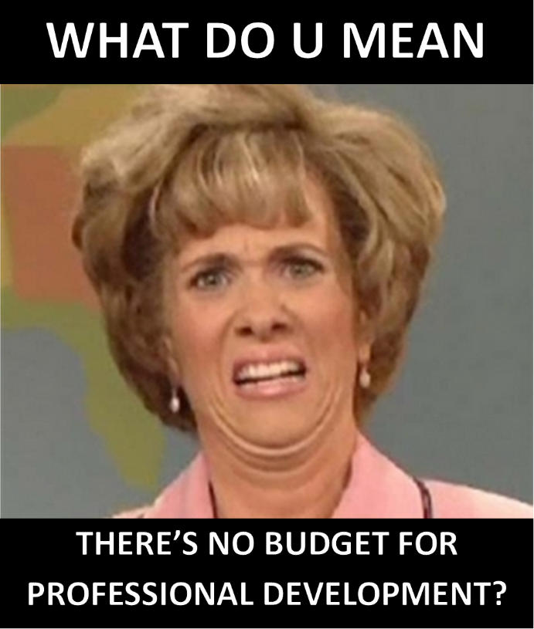
EXPENSIVE and limited options
It costs time and money
Where do you get training?
WWAMI Fellowship
WWAMI Certificate Program
WWAMI Webinars
WWAMI Conferences
STFM Annual and MSE, PDW, RPS

Slide 11
Need for Intervention!
2012 study by Danilkewich
Faculty with 5 years of experience or less
Identified as needs:
Teaching
Developing Scholarly Activities
Career Development
Danilkewich A, et al. Implementing an evidence-informed faculty development program. Can Fam Physician. 2012 Jun; 58(6):e337-43

Slide 12
Polling Question - How do you currently educate new faculty?
Formal faculty development fellowship
Institution-based education
Peer mentoring
Conference attendance (STFM, PDW, etc.)
Online education

Slide 13
Advantages of On-line / Asynchronous Learning
Allows for on-demand learning
Self-paced
Can fit into a variety of busy schedules
Allows opportunities for reviewing/revisiting material
Does not require time away from the residency program
Typically less expensive

Slide 14
What is available to address these needs?

Slide 15
Residency Faculty Fundamentals Certificate Program
Developed by STFM under the guidance of the GMEC
Launched June 2017
25 CME credits available
Online training in fundamental topics pertinent to ALL faculty
~25 hours to complete
$995 for STFM members; $1,495 for non-members

Slide 16
Certificate Program Content
14 courses on key topics
Individual courses include:
Interactive learning activities
Reading assignments
Videos
Assignments
Reflective & knowledge assessment quizzes

Slide 17
Topics
ACGME Program Requirements
Definition of Competencies, Milestones, and EPAs
Structure and Funding of Residency Programs
Billing and Documentation Requirements
Recruiting and Interviewing Residents
ABFM Rules and Requirements
Scholarly Activity for Residency Faculty
Writing for Academic Publication
Curriculum Development
Didactic Teaching Skills
Clinical Teaching Skills
Assessment and Evaluation
Giving Feedback
Residents in Difficulty: Academic and Behavioral Problems

Slide 18
Developing the Certificate Program
Subject Matter Experts
Outlines and Scripts
Peer Review
Instructional Design
Assignments

Slide 19
Demonstration of the Format and Content

Slide 20
Residency Faculty Fundamentals: Learner Dashboard

Slide 21
Residency Faculty Fundamentals: Course List

Slide 22
Residency Faculty Fundamentals: Feedback Course

Slide 23
Residency Faculty Fundamentals: Feedback Course

Slide 24
Residency Faculty Fundamentals: Feedback Course

Slide 25
Residency Faculty Fundamentals: Feedback Course

Slide 26
Residency Faculty Fundamentals: Feedback Course Quiz

Slide 27
Residency Faculty Fundamentals: Feedback Course Video

Slide 28
Residency Faculty Fundamentals: Feedback Course Video

Slide 29
Residency Faculty Fundamentals: Feedback Course Assignment

Slide 30
Self-Directed Learning
Clear, concise content
Frequent quizzing
Stories from experienced faculty
Assignments that require interactions with program director and other faculty

Slide 31
Data From the First Seven Months
149 learners (94 have started, 5 have completed)
65 institutions (22 with more than one learner)
30 states represented
1 international learner

Slide 32
Data From the First Seven Months
Average pre-test score: 57%
Average post-test score: 100%
Most users start at the beginning and then proceed in order; some pick a specific topic to start with and then go in order

Slide 33
Early Feedback from Learners
“The pacing was just right. The material wasn’t too hard or too easy. Could definitely be done rapidly (i.e. 2 weeks like an elective) or slowly over time.”
“Very pleased with the end result and look forward to applying the information.”
“The material in the courses required me to focus intensely so the video mentors provided a nice break.”
One learner surprised at how often she needed to “bother” her PD

Slide 34
Polling Question – Do you plan to use online faculty development in the future?
Yes
No

Slide 35
Take Home Points
There is an increasing need for Family Medicine faculty educators
Programs need to equip faculty with the necessary tools to fulfill the role they are being asked to
Online education such as the STFM Residency Faculty Fundamentals Certificate Program can prepare new faculty members or provide additional training to established ones
Together we can work to develop the Family Medicine physicians of the future!

Slide 36
Questions and Answers
Notes:
Link to the Unique Session URL

Slide 37
Thank you for your attention!

Slide 38
STFM Graduate Medical Education Committee
Russell Maier, MD (Chair)
Wendy Biggs, MD
Isabel Chen, MD
Timothy Graham, MD
Simon Griesbach, MD
Marcy Lake, DO
Harald Lausen, DO
David Lick, MD, MBA
Mary Theobald, MBA
Emily Walters
Brian Hischier
Former members:
Alisahah Cole, MD
Rob Freelove, MD
Cynthia Passmore, MA

