Slide 1
Shoshana Aleinikoff, MD – HealthPoint/The Wright Center FMR, Auburn, WA Abby Davids, MD, MPH – FMR Idaho, Boise, ID Pebbles Shanley, MD – Alaska FMR, Anchorage, AK Ying Zhang, MD – University of Washington FMR, Seattle, WA
Developing Experiences
for Residents
Around Refugee Health
FMRN Webinar | September 5, 2018

Slide 2
Poll
Are there Refugee/Asylees in your community that seek healthcare at your site?
We have some Refugees/Asylees at our site.
We have few Refugees/Asylees seeking healthcare at our site.
We have no known Refugees/Asylees seeking healthcare at our site.

Slide 3
Poll
How do you provide healthcare for Refugee/Asylees in your community?
Our site completes the initial domestic health screen and ongoing primary healthcare.
Our site has a large Refugee/Asylee population, but don’t complete the initial domestic health screen.
Other (describe in chat box)
NA – No known Refugees/Asylees.

Slide 4
Poll
Do you have a transcultural medicine training curriculum (i.e. cultural competency, working with translators, travel medicine, international medicine projects/lectures, group visits for community specific needs)?
Extensive curriculum supporting different local or international communities.
Some curriculum, using translational services regularly.
Minimal curriculum, using translational services rarely
No curriculum, interested in developing dedicated training
No curriculum, no need identified.

Slide 5
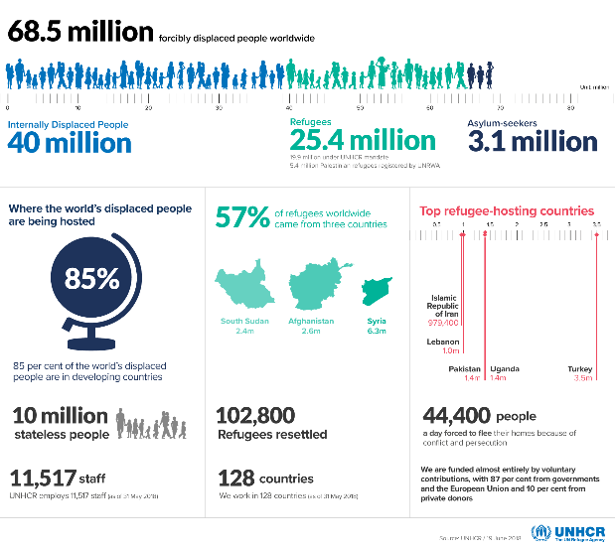
Introduction

Slide 6
Introduction
Why develop a Refugee/Asylee health curriculum?
Public health duty and opportunity to work with community organizations.
Guide our residents to success when caring for the most vulnerable and complicated patients.
Curriculum home for Trauma Informed Care, Social Medicine, Behavioral health/Psychiatry, Infectious disease, Immunizations, certainly others.
Community Medicine/Global Health curriculums are very attractive to students interested in family medicine.
Khan OA, Guerrant R, Sanders J, et al. Global health education in U.S. Medical schools. BMC Medical Education. 2013;13:3. doi:10.1186/1472-6920-13-3.

Slide 7
Alaska Family Medicine Residency
Pebbles Shanley, MD

Slide 8
Alaska FMR
Train residents to practice full-spectrum medicine in rural Alaska.
Anchorage’s Population ~298, 000
Mountain View, Most Diverse Neighborhood in the U.S. per US Census data.
Anchorage School District has students speaking 95-100 languages (Aug 26, 2018, https://www.asdk12.org/domain/1254).

Slide 9
Alaska FMR

Slide 10
Alaska FMR
Notes:
Paired Family Medicine Residency Program and Psychology Intern Training Program, and could begin supporting the community with a priority for counseling for this population.

Slide 11
Alaska FMR
Resident Orientation to Refugee Clinic in the R2 Psychiatry Rotation (backup R3s).
Spend approximately 2 hours orienting 1:1 with faculty
Initial Domestic Health Screen requirements
Immunization Catch Up
Labs required
Infectious Disease screening, follow-up, reporting
Best Practices with translators, negotiating transculturally about care plans
Behavioral Health screening practices, trauma informed care, Triple trauma paradigm, Acculturation

Slide 12
Alaska FMR

Slide 13
Alaska FMR
Clinic day:
We are notified a family requires their initial domestic health screen, and are scheduled for a Monday afternoon.
R2 Resident on Psychiatry has an open afternoon for Same-Day Access or for Refugee Clinic.
The entire afternoon is blocked, typically.
BH Doctoral Intern, Resident, and MA work as a team to complete Medical Hx/Exam, Immunizations, Labs, and BH Screen.

Slide 14
Executive Order January 27th, 2017

Slide 15
Lessons Learned
Finding flexibility in scheduling
Serving Refugees/Asylees better, during the lull.
Adapting to community specific challenges.
Live vaccines protocols for female cisgender patients- misses and near misses.
Communication with community organizations- CDC and Health and Human Services, finding efficient work flows

Slide 16
U.S. Department of State, Documents for Congress, PROPOSED REFUGEE ADMISSIONS FOR FISCAL YEAR 2018, REPORT TO THE CONGRESS. https://www.state.gov/j/prm/releases/docsforcongress/index.htm

Slide 17
Family Medicine Residency of Idaho
Abby Davids, MD, MPH

Slide 18
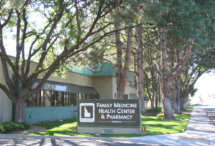
Family Medicine Residency of Idaho
Who we are
What we do
Emerald clinic
Notes:
Federally qualified teaching health center with 7 clinics
Emerald Clinic – many specialty clinics under one location
Screening and primary care for people arriving with refugee status
HIV Clinic – Ryan White grant recipient with ~650 patients from large catchment area
Viral Hepatitis Clinic – hep B and C care
TB clinic – collaboration with health department
Four residents have their continuity clinic empaneled at Emerald and participate in the Global Medicine Training Track.
Includes longitudinal curriculum with monthly lectures and meetings over the 26 blocks comprising R2 and R3 years, structured elective time, and online learning
HIV & Viral Hepatitis Fellows also participate

Slide 19
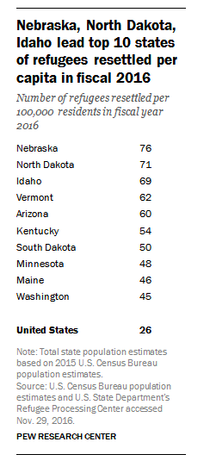
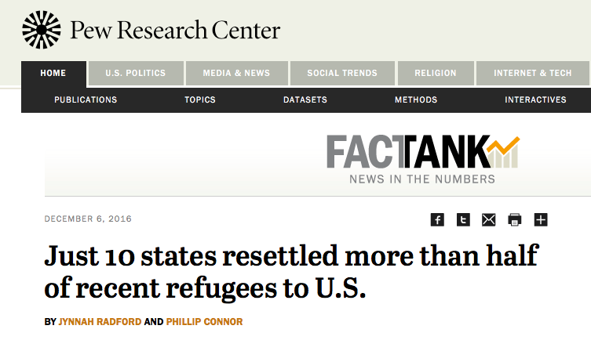

Slide 20
Idaho Numbers
2016 (818 total)
2017 (429 total)
Other includes: Burundi, CAR, Eritrea, Ethiopia, Kenya, Somalia, Sudan, Burma, Russia, Ukraine, Colombia, Iran, Pakistan, Nigeria, Rwanda, Mexico

Slide 21
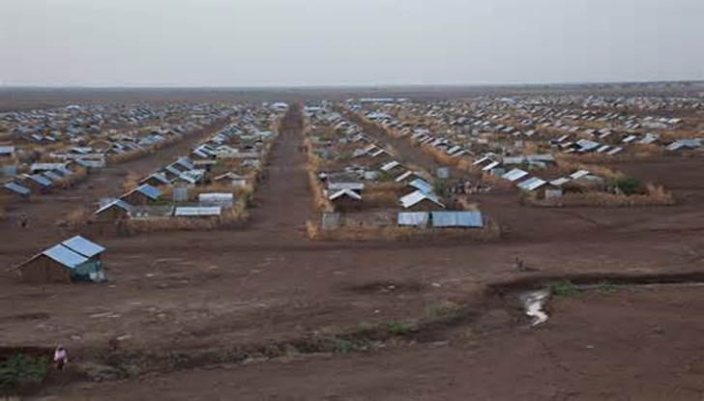
Refugee Care at FMRI
Dual services
Screening exams for new arrivals
Primary Care
Refugee Team
Providers
Social work
Behavioral health
Case manager
Interpreters
Coordinators
Referral
OB
Transportation
Pharmacy
Clinical pharmacist
Kakuma, Kenya

Slide 22
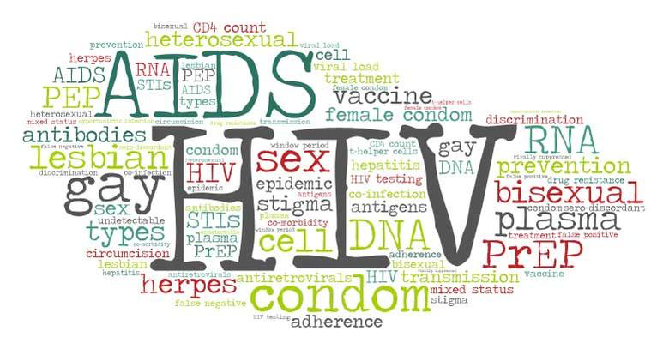
The Wellness Center at FMRI
Notes:
Ryan White grant recipient clinic
Comprehensive, interdisciplinary medical care to ~650 individuals living with HIV/AIDS in Southern Idaho and Eastern Oregon.
Largest clinic in Idaho treating persons living with HIV/AIDS
Nationally recognized graduate medical education opportunities in HIV care
Staffed by family medicine trained HIV specialists and one ID trained doc

Slide 23
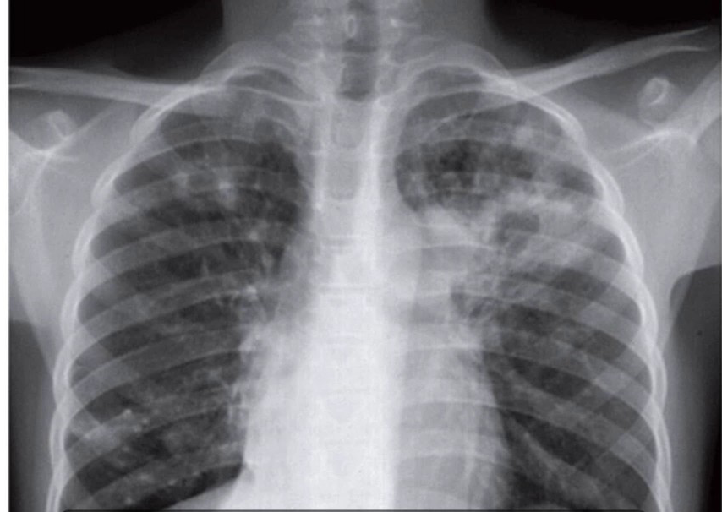
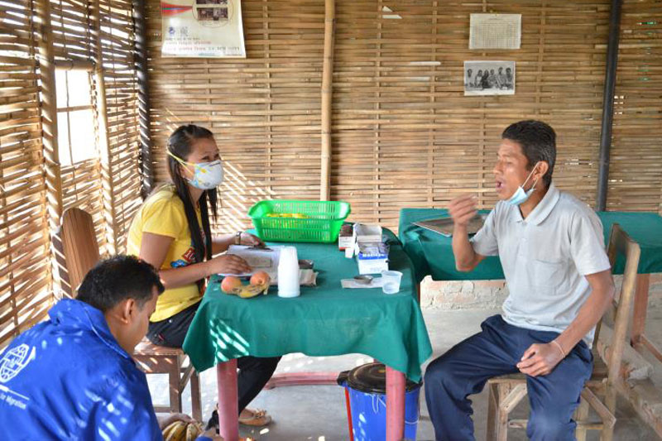
FMRI’s TB Clinic
Notes:
All TB care for health district 4
ATBD and LTBI
Consulting on active cases around the state as needed
Collaboration among FMRI, local health dept, state health dept

Slide 24
Levels of resident involvement
All residents
Refugee 101
Cultural competency training
Didactics through the year
Inpatient teaching
Empanelment of patients who arrived with refugee status in the last several years
All rotate once through screening
Interested residents
Elective time available with reading list and set schedule
Very interested residents
Empaneled at Emerald clinic (4 total)
Global Medicine Training Track

Slide 25
Global Medicine Training Track
History and background
Curriculum
Q4 week meetings/lectures
Online resources
Elective time
Pre/post testing
2 core faculty – guest as needed
Notes:
Started out as HIV Primary Care Training Track
Grant funded
Issues with logistics, resident waning interest
In 2017 changed to Global Medicine Training Track
2 R2s, 2 R3’s – Emerald residents on opt-out basis
Additional opportunities for interested residents as requested
Beyond our regular infectious disease/global health/cultural competency curriculum that all residents receive
Curriculum
Once per 4 week block meeting
Evening, with dinner
Lecture then discussion
26 topics on rotating basis
2 core faculty; guest faculty as needed

Slide 26
What We Have Learned…
Positives
More resident integration into specialty services offered at clinic
Sharing passion
Chance to help prep residents for specific future careers
Challenges
“Who’s my doctor?”
Conflicting priorities of patient continuity vs integration of learners
Attending-driven clinics/programs in a resident-centric organization
Admin approval, formalizing process
Resident schedules
Evaluation
Fewer patients arriving
Time for learning

Slide 27
Take Away Points
Many residents interested in “global health”
Utilizing resources here in the US can be helpful – rather than relying solely on away electives
Engage decision makers in value of expertise curricula within family practice
Every clinic/residency likely has niche populations and faculty expertise
Our model is one way to add curricular elements for interested residents

Slide 28
WA Collaborative Elective
Shoshana Aleinikoff, MD – Wright Center National FMR at HealthPoint
Ying Zhang, MD- University of Washington FMR
Mary Puttmann-Kostecka, MD – Swedish Cherry Hill FMR
Notes:
- Healthpoint: all residents train in CHC setting, healhtpoint as a system provides primary care to >60% newly arrived refugees, most grads stay in CHC, 75% this past year stay at a HP site
UW: residents are in UW neighborhood clinics and at harborview, at harborview see more refugees, fewer at other sites
Cherry hill: residents at 4 FQHC and 1 GQHC look alike clinic, about 50% practice in areas after graduation that care for newly arrived refugees
We offer a one month elective, with two days a week of continuity clinic, ½ day didactics, and the rest of the time refugee and asylee health curriculum
We have a faculty mentor at each site, with organized assigned reading and meetings with faculty mentor
Note: at WCN FMR we have 9 months of COPC- first three in year 1, and our interns all complete parts of this elective as part of their COPC curriculum in year 1, also have didactics in orientation around refugee resettlement, how to work with an interpreter, didactics throughout the year to cover refugee/immigrant related curriculum, and AM clinc pearls throughout the year with a refugee focus- ie lead, TB, DM in Ramadan etc

Slide 29
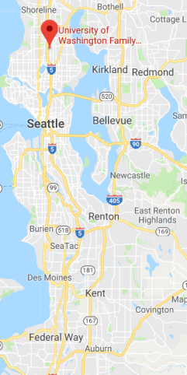
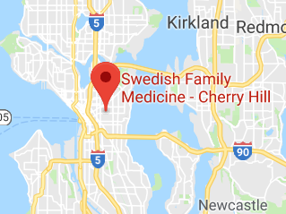
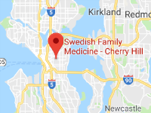
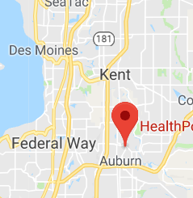
Refugee Resettlement in WA
In 2017, WA was the 4th highest state in refugee resettlement
> 2000 refugees resettled in King County in 2017
Seattle and King County Public Health performs the initial new arrival refugee health screenings (this is NOT at a residency site)
Geographic distance from residency clinics
Notes:
Screening does not happen at any of sites
Did have high volume, no longer have high volume
Residencies are > 20 miles from largest resettlement areas- not going to have pts travel to get to residents, had to create experience for residents to get to where they are for learning

Slide 30
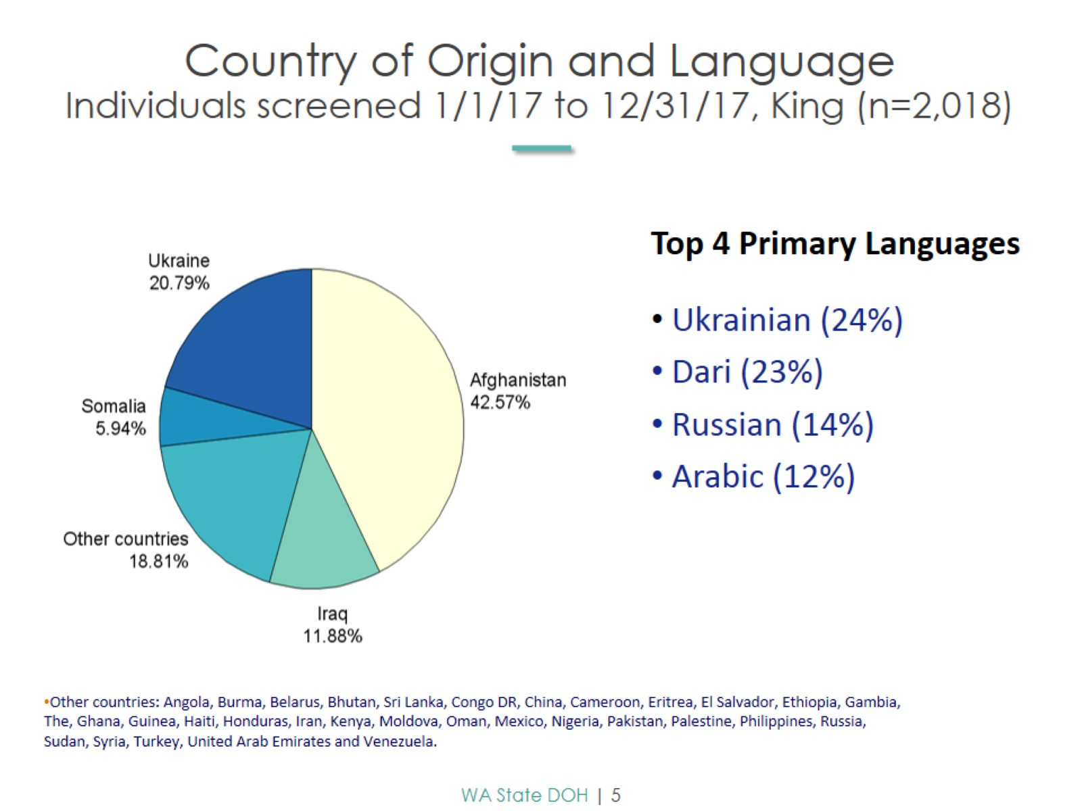
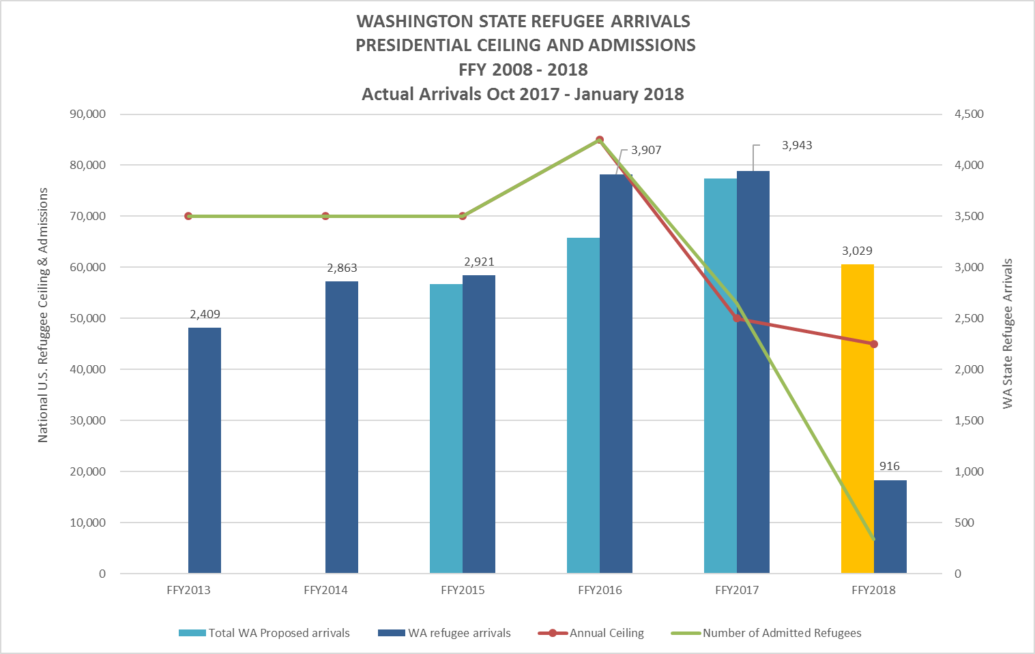
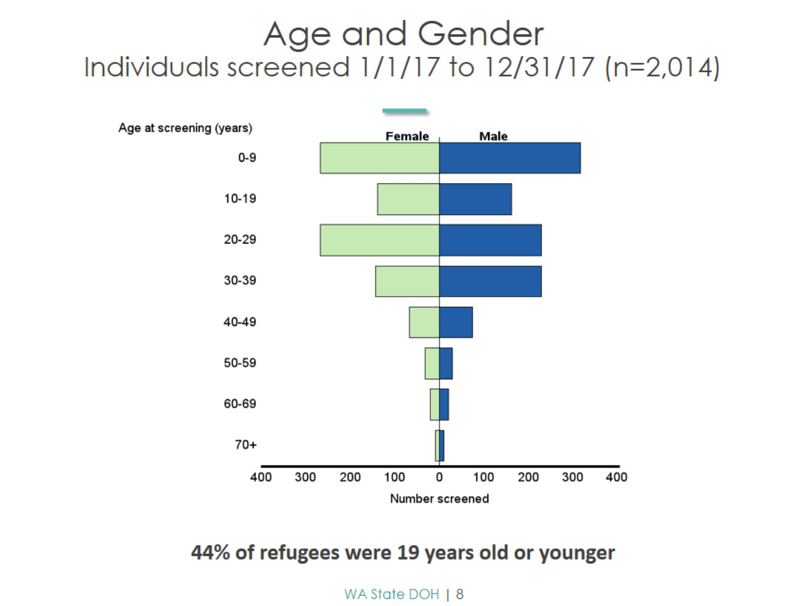
Refugee Resettlement in King County, WA
Refugee Health Program, Washington State Department of Health. Preliminary 2017 Refugee Health Screening Report, Washington State.
Notes:
Red line is the presidential determination, which is set annually for the federal fiscal year
Green line is the number of refugees actually admitted nationally
Dark blue bar is actual WA refugee arrivals
Teal bar (and yellow) is the number that had been proposed for WA refugee arrivals for that year.

Slide 31
Elective Curriculum
Complex CM
TB
Community Based Organizations
Specialty Care
Ethnomed
Faculty Meeting
Pain Group
Interpreters
Hepatitis B
Country of Departure
Overseas Medical Exam
Primary Care Clinic
Refugee PCP
VOLAG Orientation
Resettlement with VOLAG
Mental Health Counseling
Public Health Refugee Screening Clinic
Mental Health Care
VOLAG
DOH
Refugee Screening Clinic
Cultural Understanding/Background Refugee Process Clinical Experiences Mental Health Experiences
Notes:
The way that we built this elective was to look at the resettlement process and all of the communities partners at play, try to have residents engaged in many parts of the process, with reading/meetings to reinforce clinical and community based experiences
Meet with faculty lead- to get an overiview of resettlement process, discuss background reading, understand goals of elective, CDC guidelines, local numbers
Ethnomed- local (national resoruces) with CDC guidelines, background reading- refugee specefic
VOLAG orientation – all volags do a cultural orientation with a medical component- great perspecive for learners on what introduction to this new health care system refugees get, also feedback from VOLAGS that refugees like having a doctor there for questions
VOLAG - meet with local volags to better understand their role, how they find PCPs, CMs involvement
DOH- overview of health process, recent trends in epideimiology
Clinical
Having a clinic or two that sees most newly arrived- partner with them to get residents exposure – I now have a newly arrived refugee clinic residents rotate through, and HMC peds
Or in our case, PH does all screening, residents spend time there in clinic
In KC high rates of hep B and TB with our refugee patients, often managed in primary care, but at times need consultation with specialists
Somali pain
Mental health
Can’t talk about refugee care without talking about mental health care
We have a few local organiations with linguistically parallel and cultulrally matched counselors, trauma focused care, our residents observe and intake apt (with permission of patient)
Also do home visits with CM for medically or mental health complex families
** now having our residents come to community groups russian elders group etc
Not pictured here-- Legal
Have our residents meet with one of the asylum attorneys at our immigration legal aid non profit NWIRP, and see a hearing if time permits
Asylum eval – work with a faculty member to prepare, observe and write up evaluation

Slide 32
Elective curriculum
Cultural Understanding/Background
Meet with Faculty Lead
Ethnomed
Meeting with interpreters/cultural mediators
VOLAG Orientation of newly arrived refugees
(Ethnic specific community based organizations)
Refugee Process
VOLAG Case Managers
Department of Health Refugee Coordinator
Clinical Experiences
TB
Hep B
Refugee screening clinic
Refugee primary care clinic
Somali Women’s Chronic Pain Group
Mental Health Experiences
Community-based refugee focused mental health clinic
Case management for complex families
Asylum/Legal process
Asylum Evaluation
Meet with immigration legal aid lawyer
Notes:
Same information expressed in a different way

Slide 33
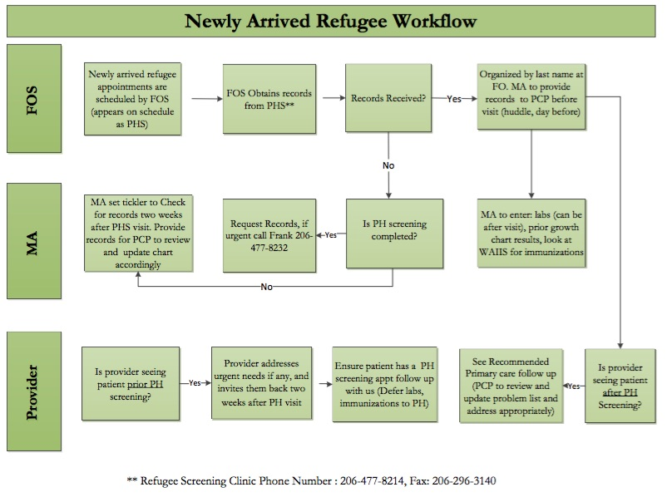
Refugee Clinic at HealthPoint
>300 patients in 2017
½ day per month, 12 newly arrived patients seen in families (3-6 families per session)
Pre clinic: collaboration with resettlement organizations, obtaining records from PH, scheduling interpreters, huddle, pre-visit planning
Multidisciplinary clinic day: medical services, nutritional counseling, behavioral health counseling, welcome to WIC/MSS, dental care, SW resources, pharmacy
Residents involved/learning from all providers
Post clinic: problem list updating, referrals to ICM programs, debrief
Notes:
In 2017 – 3500 refugees in WA, majority in KC, majority establish primary care at HP, many in our refugee clinic, over 300 in 2017

Slide 34
Challenges and Lessons
Decreasing arrivals numbers
PLAs
Evaluation of residents and experiences
Scheduling / coordination
Relationships with community partners
Notes:
Figure from MPI report 2017
ADD WA specific graph if able to obtain from DOH- I emailed Jasmine
Many logistical challenges including:
Arrival Numbers decreasing- when started elective in 2015 arrivals were increasing significantly, now at the lowest in decades, and new proposals threaten this even further – means organizations are loosing funding, and/or have less opportunities for learners, lesson is to stay informed about national policies and local numbers (go to multidisciplinary meetings, stay in touch with DOH contacts)
Institutional requirements for residencies to be able to send residents palces – PLAs are scary for community based organizations – lesson: Clear contact person, initial conversation through them, not just blast to the main office - make sure the point person in your organization is cc’d on everything.
Evaluation of residents and of the experiences – going to so many places, how to we evaluate them appropriately, and how do we know what kind of educational experience they are having – created some resident eval which we will talk about later
Relationship building - (between the faculty leads and with the organizations) – turnover high, lots of asks – try to meet in person, frequent check ins , capitalize on relationships
Strain on smaller organizations – especially with expansion to three residencies – once established, can meet asks of organizations
Most Important:
Scheduling!!!! = tons of emails/ timing for each place/ sharing experiences

Slide 35
Goals and Objectives
Understand the medical, social, and legal context of refugee and asylee health in King County, WA.
Learn how to conduct new arrival refugee examination following CDC-recommended guidelines.
Learn how to conduct a new asylee interview to assess for trauma history and sequelae.
Demonstrate knowledge of where to find evidence-based resources and guidelines for refugee health care, including immunizations and screening guidelines.
Become familiar with the community-based organizations, legal services, and public health personnel involved in refugee health and resettlement services in King County.
Build awareness of the cultural context and non-clinical aspects of the refugee experience that may affect refugee healthcare.

Slide 36
Evaluation Design
Pre- and Post- elective evaluation surveys
Domains of Interest
Knowledge
Prior experience
Opinions/feedback on rotation experience
Future practice intentions
Demographics of participants

Slide 37
Resident reflections
It was an opportunity to talk to refugee families outside of the 15 minute clinic visit, and to hear a small piece of their stories.” - PGY 3
“Having a better understanding of the resettlement process ….. has taken me from a provider caring for refugees to a physician advocate.” - PGY 3
“One can read endlessly on the subject but until you look a person in the eye and invite them to share their story can you truly know where to start when it comes to rebuilding or attending to their health.” - PGY 2

Slide 38
National Curriculum Development
Immigrant and Refugee Health Curricular Development Working Group
Sural Shah, Med/Peds, UCLA
Janine Young, Pediatrics, Denver Health
Andrea Green, Pediatrics, University of Vermont
Elizabeth Dawson-Hahn, Suzinne Pak-Gorsein, Pediatrics, UW
James Sutton, Society of Refugee Healthcare Providers Executive Director, Rochester
Anna Banjeri, Society of Refugee Healthcare Providers President, University of Toronto
Shoshana Aleinikoff, Family Medicine
Notes:
NARHC – north American refugee health conference – annually- multi specialty, last two years have had two year workshop to come together to try to think about core competencies for refugee and immigrant curriclum

Slide 39
Curriculum Objectives
1. To provide a standardized educational framework about immigrant and refugee health that can be adapted for any health profession, including medical, nursing, physician assistant, and continuing education programs.
2. To prepare healthcare providers, regardless of specialty, with the clinical knowledge and skills to provide quality, evidence-based and trauma-informed care for immigrant and refugee patients’ unique needs, while recognizing their patients’ challenges and strengths.
3. To familiarize healthcare providers with relevant public health concepts as they relate to global health, vulnerable populations and refugee health, to equip providers to contextualize and integrate their patients’ needs and clinical care within the larger biopsychosocial context.
4. To equip healthcare providers with the knowledge and skills to effectively advocate for their immigrant and refugee patients, particularly for quality, accessible, culturally and linguistically appropriate healthcare, and in areas that impact health and wellbeing, such as social services and legal issues.
5. To prepare healthcare providers with the tools to provide for their own self-care and to prevent and/or mitigate common concerns experienced by providers working with vulnerable, underserved populations.

Slide 40
Core Competencies
Evidence-based clinical practice
Trauma-informed care
The Refugee Health Journey
Cultural humility and communication
Professional development and ethics
Prevention and health promotion
Advocacy

Slide 41
Example: Evidence Based Clinical Practice
Develop clinical skills in:
The treatment and prevention of chronic disease in underserved populations.
Immigrant and refugee patients’ health across the lifespan, from prenatal and infant care to children, adolescents, women, families, the aging, and dying.
Identifying, assessing, advocating for and providing care for special populations, including refugees, asylees, asylum-seekers, LGBTQ, victims of trafficking, survivors of torture, and survivors of gender-based violence.
The diagnosis, treatment and prevention of infectious diseases, including HIV/AIDS, TB, Hepatitis A/B/C, parasites and other chronic infections commonly experienced by immigrant and refugee populations.
The diagnosis, treatment and prevention of malnutrition and the role of provider social prescribing, such as referrals to community-based organizations.
Violence prevention and intervention, particularly for gender-based violence, including techniques for partnering with other professions (e.g. social work) to develop a plan of action.

Slide 42
More to come...
If you want to be part of the workgroup
If you want to be informed of the outcomes of the work group/curriculum
Email: Sural at suralshah@mednet.ucla.edu

Slide 43
Questions?
Alaska FMR, Anchorage, AK
Pebbles Shanley, MD
FMR Idaho, Boise, ID
Abby Davids, MD, MPH
WA Collaborative Elective
Shoshana Aleinikoff, MD – HealthPoint/The Wright Center FMR, Auburn, WA Ying Zhang, MD – University of Washington FMR, Seattle, WA
National Curriculum Development
Shoshana Aleinikoff, MD

