Slide 1
Foot Care, Common Foot Problems and Examination of the Diabetic Foot

Slide 2
Look for any of the following foot problems:
Callous
Corns
Plantar warts
Deformity
Tinea pedis
Splits in the skin
Blisters
Nail problems
And other wounds or problems with the legs

Slide 3
look closely for infection, slow healing, or breakdown of surrounding tissue:
Redness
Heat
Swelling
The presence of pus or exudate
Bleeding into the surrounding skin
And pain may also be present

Slide 4
Attending to Foot Problems
Foot problems are notoriously slow to heal.
If a serious foot problem is identified or if there are signs of infection present, a review by a primary care provider or podiatrist will be needed.

Slide 5
Common Foot Problems
Corns/ Callous
Foot Deformities
Infections
Ingrown toenails

Slide 6
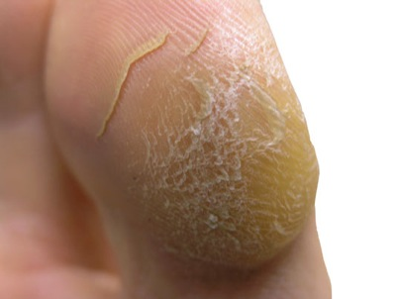
CALLOUS

Slide 7
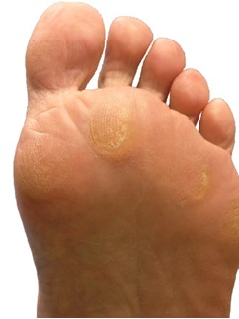
CALLOUS

Slide 8
Cracked heels pre & post scalpel debridement

Slide 9
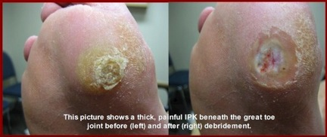
Debrided callous

Slide 10
Pre-ulcerous callous

Slide 11
Corns

Slide 12
CORNS

Slide 13
A “soft” corn

Slide 14
CORNS

Slide 15
Common Nail Problems
Nail overgrowth
Onychomycosis/Fungal toenails
Ingrown nails

Slide 16
Overgrown nails and Callouses

Slide 17
Ingrown toenail

Slide 18
Pincer toenail causing ingrowth

Slide 19
INFECTIONS

Slide 20
ONYCHOMYCOSIS

Slide 21
Plantar warts

Slide 22
PLANTAR WART

Slide 23
PLANTAR WART

Slide 24
Tinea pedis or athlete’s feet

Slide 25
TINEA PEDIS

Slide 26
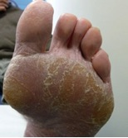
TINEA PEDIS

Slide 27
TINEA PEDIS

Slide 28
TINEA PEDIS

Slide 29
BONY DEFORMITIES

Slide 30
Bunions

Slide 31
BUNION

Slide 32
BUNION

Slide 33
Bunion

Slide 34
Hammer Toes

Slide 35
HAMMER TOES

Slide 36
LEG PROBLEMS

Slide 37
Venous stasis

Slide 38
VENOUS STASIS

Slide 39
Diabetes and the Feet

Slide 40
Social Systems Important to Diabetic Foot Health

Slide 41
Body Systems important to Diabetic foot health
Skin
Immune System
Neurologic
Musculoskeletal
Vascular

Slide 42
Steps to DM Plantar ulcer
Plantar pressure
Callous formation
Tissue damage
Infection
Osteomyelitis

Slide 43
Pathogenesis of DM Foot Ulcer

Slide 44
Diabetic Foot Exam

Slide 45
Model good shoes

Slide 46
Initial ulcer

Slide 47
Same toe after six weeks

Slide 48
Same toe after two months

Slide 49
Autoamputation complete

Slide 50
Basic Foot Care

Slide 51
Definitions & guidelines
Basic Foot Care is defined as:
The cutting of normal nails and the maintenance of foot hygiene such as can be expected in self care of a person in a low risk category

Slide 52
Normal Healthy Nails are Defined as:
Nails that have no underlying pathology of a systemic or structural nature.

Slide 53
“Basic foot care” does not include:
Debridement of callous and corns with a surgical scalpel.

Slide 54
Foot Hygiene is Defined as:
the cleansing of the foot,
the debridement of rough skin with a smoothing agent such as a pedicure file or pumice stone,
the removal of inter-digital debris with a swab
applying moisturizing agents to the skin, and
the cutting and filing of normal healthy nails

Slide 55
Cleaning Feet
An essential part of basic foot care.
Very important to clean carefully between all of the toes.
During a foot soak be careful about the temperature and don’t let the feet soak for too long. Five to ten minutes is plenty.
Notes:
Keeping feet clean is obviously an essential part of basic foot care. Good foot hygiene will help keep skin and nail infections at bay and help prevent foot odor.
It is very important to clean carefully between all of the toes.
Things you could try include:
Baby wipes Wet gauze or cotton wool swabs Cotton buds.
During a foot soak you will need to be particular about the temperature of the water - not too hot, not too cold - and don’t let the feet soak for too long. Long foot soaks can damage and dry out the skin. Five to ten minutes is plenty.

Slide 56
Drying Feet
Getting feet dry and keeping them dry can be a challenge.
It can be hard to dry in between toes that are fixed closely together. A thin piece of gauze can do the trick.
If there is a space in between two toes that is particularly macerated – or moist – a rubbing alcohol, such as isopropyl alcohol on a cotton bud can help dry the area more efficiently. Isopropyl alcohol is used undiluted on the skin. Do not use a drying agent on the skin if the skin is broken.
Encourage the use of natural fiber socks - such as cotton socks.
If shoes or socks get wet through the day - change them as quickly as possible.

Slide 57
Moisturizing the Feet
One of the most beneficial things you can do for feet
Never put cream on someone's feet just before they stand up and walk around barefoot.
Pay attention to what you feel with your hands
Generally, it isn’t a good idea to rub cream in between the toes and then put socks and shoes
Notes:
Never put cream on someone's feet just before they stand up and walk around barefoot. Their feet will be very slippery.
Try putting the cream on just before socks and shoes go on
Rub the cream all over the feet. Pay attention to what you feel with your hands – sometimes your hands will pick up painful lumps and bumps that they eye didn’t see.
Generally, it isn’t a good idea to rub cream in between the toes and then put socks and shoes on – it can get quite macerated in there.
If skin is particularly dry there are various urea creams, which draw extra moisture into the skin. You can buy these from your drug store.

Slide 58
Trimming Toenails
A basic hygiene necessity.
Trim only “normal” toenails.
Where you have someone with diabetes or peripheral vascular disease it is a good idea to get specific instruction from a primary care provider or podiatrist.
Trim toe nails straight across, do not cut down the side of the nail. Use a nail file to round off any sharp edges.
Leave a small amount of “white” at the top of the nail.
Notes:
Trimming normal toenails is a basic hygiene necessity.
There are a few factors to keep in mind when trimming toenails.
You can trim “normal” toenails.
Once you start seeing ingrown toenails, very thick toenails or fungal toenails you should get advice from a podiatrist or primary care provider.
Where you have someone with diabetes or peripheral vascular disease, again it is a good idea to get specific instruction from a primary care provider or podiatrist.
Always do what you can. If there are a few toenails that are too thick, too curved or ingrown, leave them and do the rest.
Trim toe nails straight across, do not cut down the side of the nail. Use a nail file to round off any sharp edges.
Leave a small amount of “white” at the top of the nail.
Do not cut the nail down as low as you can. It is better to leave a bit of length on the nails and have to trim them more often, than cut the nail too low and risk an infection.

Slide 59
A properly cut toe nail

Slide 60
A poorly cut toe nail

Slide 61
Checking for Foot Problems
While you are cleaning and drying the feet – take the time to check for any foot problems. You will find some parts of the foot are more difficult to observe than others.
The back of the heel can be difficult to see clearly. Sometimes it can be hard to observe in between the toes when they are fixed tightly together. Hold the toes gently in your hands and separate carefully. Sometimes you can move the toes apart, sometimes you might need to carefully pull one toe up, and one down slightly.

Slide 62
Questions?

