Slide 1
Polling question #1
What FPIN products do you regularly use? (check all that apply)
Evidence-Based Practice journal (read or distribute to others)
PURLs Journal Club
FPIN Institute
Write or edit HelpDesk Answers (HDA)
Write or edit Clinical Inquiries (CI)
Write or edit Priority Updates from the Research Literature (PURL)

Slide 2
Polling question #2
How long have you been using FPIN products? (check one)
Less than 1 year
1 to 5 years
5 to 10 years
More than 10 years
Have not been using FPIN products

Slide 3
Polling question #3
What FPIN products do you want to know more about? (check all that apply)
Evidence-Based Practice journal
PURLs Journal Club
FPIN Institute
HelpDesk Answers (HDA)
Clinical Inquiries (CI)
Priority Updates from the Research Literature (PURL)
Good Evidence Matters (GEM – new feature)

Slide 4
FPIN Overview 2019-20
Family Physicians Inquiries Network
E. Chris Vincent, MD

Slide 5
What is FPIN?
FPIN is a 501(c)(3) nonprofit, membership organization offering medical scholarship education to students, residents, faculty, and fellows in family medicine.

Slide 6
What is FPIN?
FPIN Vision: “FPIN envisions a primary care workforce that thinks critically, communicates expertly, and utilizes the best current evidence to improve the health of patients.”
FPIN Mission: “FPIN provides quality education and professional development for primary care clinicians to practice evidence-based medicine and produce scholarship.”

Slide 7
What is FPIN?
FPIN Values:
Answering the most important questions in primary care with the best and most current evidence.
Caring for our community members with respect and contributing to their professional growth.
Service that is so remarkable and rare that people can’t help but talk about us.”

Slide 8
Member Benefits
Opportunities:
Writing, Publishing, and Editing
Peer Review
Workshops
Tangible:
EBP (FPIN’s journal)
FPIN Institute (not discussed)
PURLs Journal Club
Assistance with maintaining residency ACGME accreditation through scholarly opportunities

Slide 9
ACGME Requirements for Faculty Scholarship
Core Faculty ACGME Requirements
Must establish and maintain an environment of inquiry and scholarship with an active research component
Must regularly participate in clinical discussions, rounds, journal clubs, and conferences
Some should also demonstrate scholarship
Peer-reviewed funding, publications, presentations, participation in national committees or organizations
Should encourage and support residents in scholarly activities

Slide 10
ACGME Requirements for Resident Scholarship
The curriculum must advance residents’ knowledge of the basic principles of research, including how research is conducted, evaluated, explained to patients, and applied to patient care.
Residents should participate in scholarly activity [and] should complete two scholarly projects, at least one of which should be a quality improvement project
The sponsoring institution and program should allocate adequate educational resources to facilitate resident involvement in scholarly activities.

Slide 11
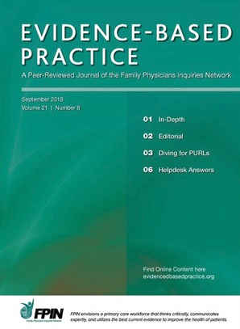
FPIN Publications

Slide 12
Evidence-Based Practice
FPINs journal focused on topics relevant to the daily practice of family medicine.
Partnership with Wolters Kluwer
Where to access Evidence-Based Practice? (How to find the EBP website)

Slide 13
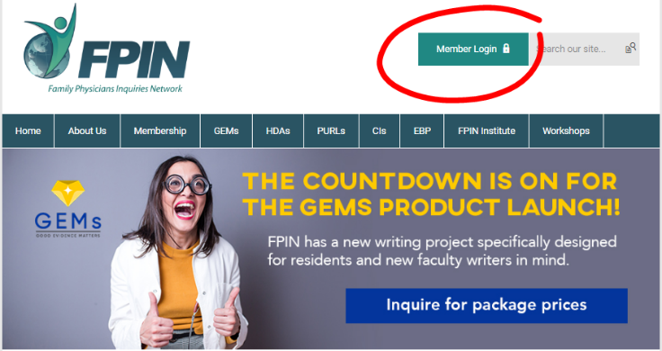
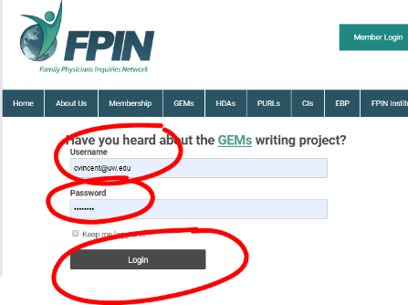
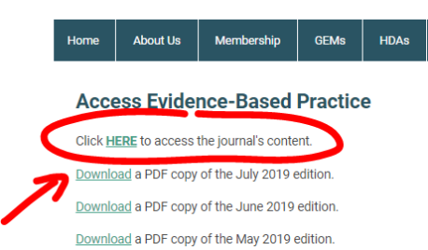
Evidence-Based Practice
To find the EBP journal:
Go to the FPIN web site (www.fpin.org)
Login with your member name and password (register if new user)
Go to the EBP Archives under the EBP menu

Slide 14
450-900 word manuscript
Brief, structured evidence-based answers to clinical questions
Residents can be co-authors (with faculty members)
Work with Local (deputy) Editor and Editor-in-Chief
Peer reviewed at another FPIN program
Published in Evidence-Based Practice, JFP and AFP (selected HDAs are in JFP and AFP)
Can be finalized within an academic year

Slide 15
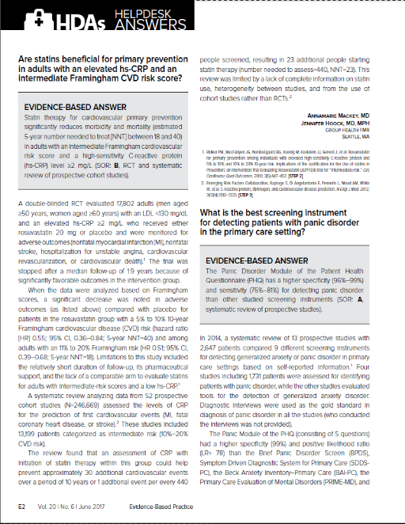
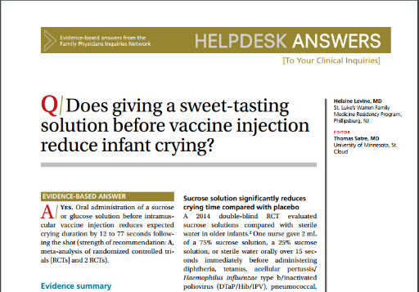
Where are HDAs published?

Slide 16
FPIN’s flagship publication
~600 word manuscript
Based on the best evidence resulting from a formal systematic literature search done by a medical librarian editor
Peer-reviewed indexed publication in The Journal of Family Practice or American Family Physician

Slide 17
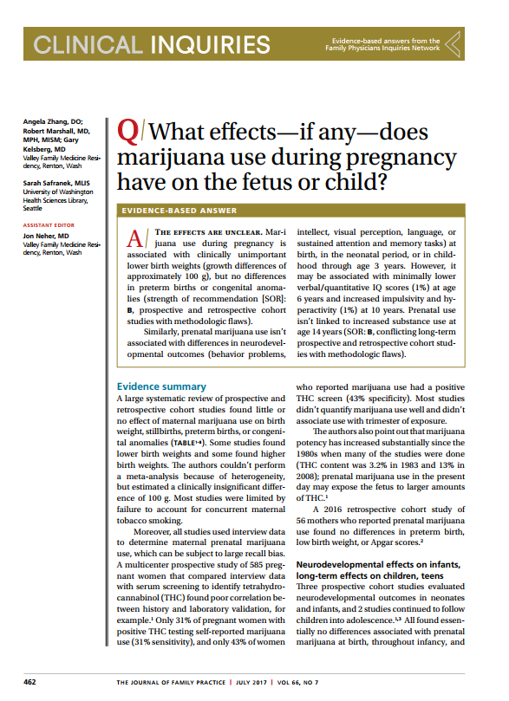
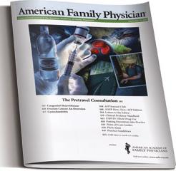
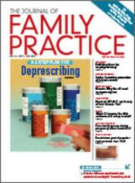
Where are CIs published?

Slide 18
Priority Updates from the Research Literature Surveillance system
Relevant, valid, practice-changing, and immediately-applicable recommendations
Drawn from literature surveillance system
Work with team to review literature or author manuscript
Ideal for programs looking for a high-level team activity
Published in The Journal of Family Practice

Slide 19
Each PURL must meet 6 criteria:
Relevant: Relevance to family medicine and primary care.
Valid: Scientific validity, including integration of prior research.
Change in Practice: Leads to a change from the current prevailing practice.
Applicable to Medical Care: The new practice approach is applicable in a medical care setting.
Implementable: The new practice is immediately applicable.
Clinically Meaningful: Expected benefits outweigh expected harms

Slide 20
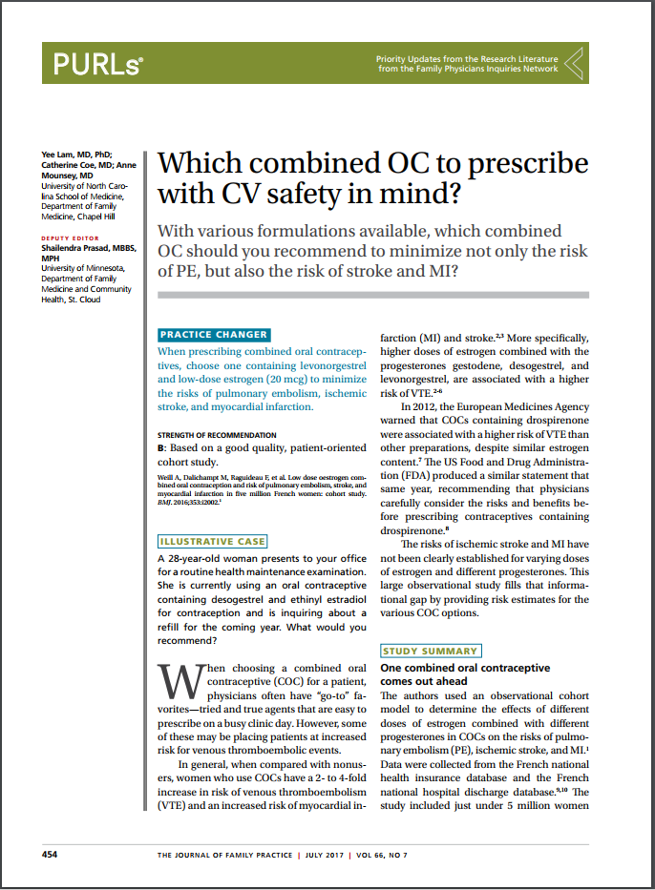
Where are PURLs published?

Slide 21
FPIN’s newest product (launching this year)
Concise summary of a single, recent study
Residents or faculty can be solo authors who are new to writing for publication and looking to bolster critical appraisal skills, working with local editor
Local Editor reviews all manuscripts before submission
Peer reviewed and disseminated nationally (to meet ACGME requirements for scholarly activity)
Published in Evidence-Based Practice
Can be finalized within an academic year (ideally ~ 5 months)

Slide 22
Where will GEMs be published?
??

Slide 23
PURLs Journal Club
A quick start guide to using FPIN’s ready made journal clubs for family medicine residency programs

Slide 24
PURLs Journal Clubs are…
“Plug and play” comprehensive monthly toolkit available through FPIN Institute that include:
Journal Club Instructions
Speaker Notes including teaching points
Journal Club participant worksheet
Completed review form for reference
Published PURL (in The Journal of Family Practice)
Ideal for programs looking for a structured approach to journal clubs with little faculty skill or time.
Web site also has a list of all JC topics with associated teaching points (Excel file)

Slide 25
Steps (see screenshots)
Go to the FPIN.org web site (http://www.fpin.org/)
Click on PURLs Journal Club link in the PURLs dropdown menu
Sign in with your user name and password (password can be saved). This will take you to the PURLs Journal Club Toolkit home page
PURLs Journal Club Toolkits are sorted by month. Select a Toolkit and download the documents. Follow the instructions on the “instructions” sheet

Slide 26
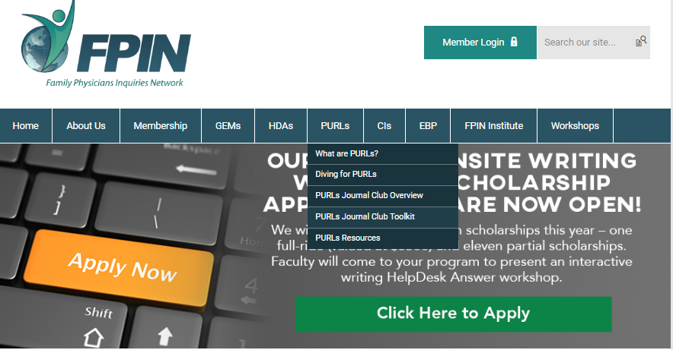
Screenshots of Steps

Slide 27
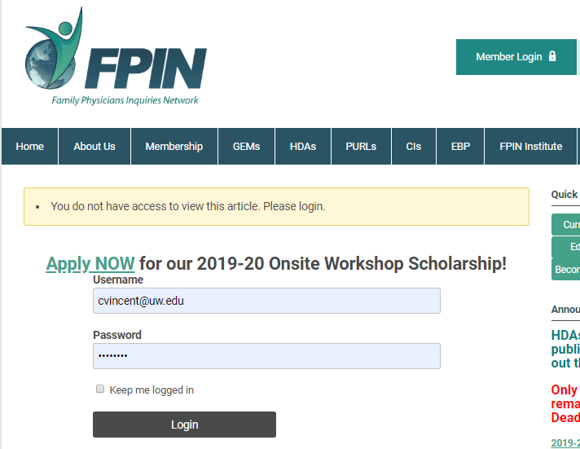

Slide 28
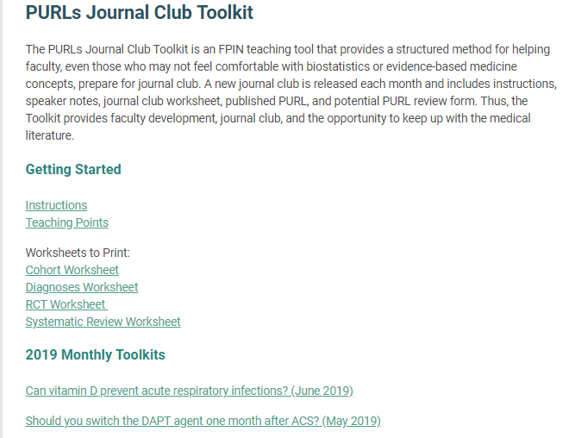
click the top 2 links to download Instructions and Teaching Points (list of topics)
click link to download the appropriate worksheet (depending on the PURLs article type)
click the appropriate link to download the PURLs article (in the JFP), potential PURL review form, speaker notes

Slide 29
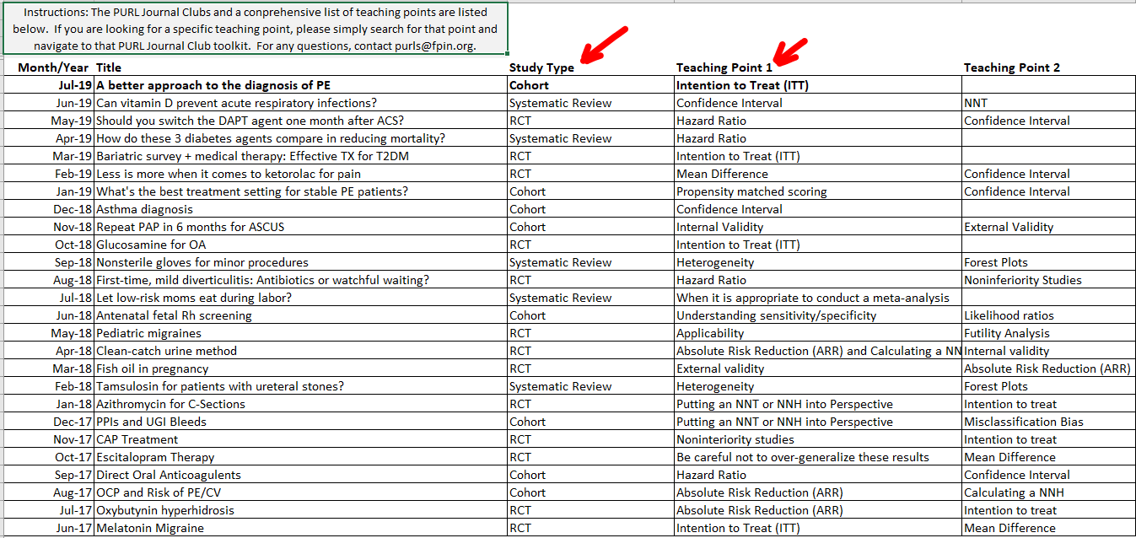
Partial list of PURLs Journal Club Topics*
*Full list in “PJC-Teaching-Points-List.xlsx” List is updated monthly

Slide 30
Learn More
Email membership@fpin.org
Call 573-256-2066
Visit FPIN at www.fpin.org

Slide 31
Examples of FPIN Use in Network Programs
Ryan gilles, mD
Associate Program Director of Academic Operations Kootenai Clinic FM Coeur d'Alene Residency

Slide 32
Example #1 – Tacoma Family Medicine
Help Desk Answer writing project in R3 year
R3 & Faculty Co-author
1 hour monthly in didactics for residents and faculty co-authors
August
3 question ideas created
Focus on specificity
Recommend treatment questions (Pro tip: they’re easier to answer)
Search Pubmed systematic reviews or Cochrane while creating questions for idea of existing literature
PICO format

Slide 33
Example #1 – Tacoma Family Medicine (cont.)
September
Literature Search
Start with most recent systematic review – e.g. Cochrane
Find last search date on the SR, then pubmed search from that date forward for other SRs or RCTs
Look for guidelines as well
October
Abstraction
Into abstraction tables provided by FPIN
November/December
Draft manuscript
Write evidence summary first → then write evidence-based answer
Follow the formula provided by FPIN!

Slide 34
Example #1 – Tacoma Family Medicine (cont.)
January
Edit and submit draft
March/April
Peer reviews
May
Present summary of HDA findings at Grand Rounds
Template provided for presentation
Thank you Janelle Guirguis-Blake for sharing!

Slide 35
Example #2 – Kootenai FMR
PURLS Journal Club
Scheduled monthly in didactics
Run by faculty
Time given for residents to review article and fill out worksheet at start of session
Focus on EBM teaching points provided in the speaker’s notes

Slide 36
Example #2 – Kootenai FMR
Help Desk Answer
Every 2 years
6 groups – each with one faculty, one R2, one R1
February – 4 hour HDA workshop
List of questions provided ahead of time, with teams choosing question prior to workshop
Questions chosen based on recent systematic reviews
Literature search – first systematic review provided
Abstraction
Start rough draft
Periodic time scheduled in didactics for teams to finish draft, submit, work through edits
Drawbacks
Much of the burden for edits falls to faculty
Most teams still need time outside of didactics to work on this project

Slide 37
Example #3 – Montana FMR
Scholarly activity point system
Independent of QI project, ABFM MOC requirements, and didactic presentations
Help Desk Answer is encouraged - satisfies requirement if written solo, but only a little over half credit if co-authored
Other options include
Publication of original research, clinical process improvement, or educational or administrative improvement project
Poster presentation – variable points based on forum
FPIN Clinical Inquiry
Podium presentation (outside didactics) – variable points based on forum
Advocacy work
Letter to editor
Thank you Mike Geurin for sharing!

Slide 38
Example #4 – Valley Family Medicine
EBM curriculum consisting of a series of exercises, each allowing practice of microskills, that allow residents to practice the key steps in information retrieval, appraisal, synthesis and communication
Formulating a clinical question according to PICO
Doing literature searches with PubMed and/or Information Mastery precepts
Identifying within the search results applicable research and guidelines
Assessing the quality of a specific research paper, meta-analysis or guideline
Describing the key strengths and weaknesses of a particular trial (or guideline)
Ranking a body of similar papers according to quality and applicability
Integrating information from various sources
Communicating evidence summaries to patients and peers

Slide 39
Example #4 – Valley Family Medicine
Clinical Inquiries
Partnered with faculty and sometimes pharmacy resident
Formulate clinical question
Short evidence search to assure sufficient evidence to answer
Submit proposed question with references to FPIN
If not accepted → start over
Pro-tip: “Goldilocks principle” Focus on questions – not too little evidence, not too much evidence – aim for 4-8 references, individual RCTs or higher level of evidence preferred
Thank you to Jon Neher and Gary Kelsberg for sharing!

Slide 40
Examples of FPIN Use in Network Programs:
Program Example, FMR of Idaho-Boise
Winslow Gerrish, PHD
Behavioral scientist at fmr of Idaho-boise

Slide 41
Set-Up
Single Faculty HDA Wrangler
R2 class
HDA groups = 2-3 residents with Faculty author
2 half-days (block 7 and block 8)
1st half-day
EBM curriculum
Select clinical question (from pre-approved FPIN list)
Complete Lit review
2nd half-day
Write first draft of HDA
Submit to local editor

Slide 42
Follow-up
Faculty Wrangler
Work Directly with faculty authors.
Keep tracking sheet.
Send group emails to check status/give updates.
Faculty authors
Prompt resident team members.
Make sure deadlines are met, edits submitted, etc.
Post and email congratulations when published!

Slide 43
Common Sticky Issues
Getting residents engaged and interested.
Establishing approved clinical question.
Frustration with rigid structure for writing HDA.
Coping with meeting deadlines.
Time
Tracking and engagement through prolonged peer-review process.

Slide 44
Wrap up
Questions
Or
Comments?

