Slide 1
Teaching Medical Students While Maintaining Joy (and efficiency)
Jeanne Cawse-Lucas, MD
Ruth Michaelis, MD
November 6, 2019
Notes:
Co-director FM Clerkship
Director PCP
This talk is based on feedback from clerkship and PCP students, as well as best practices developed by PCP faculty as well as clerkship faculty

Slide 2
Thanks to…
Jeff Haney, MD - WSU
Brandon Isaacs, DO – CWFMR
Serena Brewer, DO – UW Clinical faculty
For their contributions to this presentation

Slide 3
Learning Objectives
Utilize a tool for setting goals and expectations
Describe best practices for the pre-clinic huddle for clinical student teaching
Describe strategies for student scheduling
Describe workflows for using medical student documentation within the CMS guidelines
Demonstrate at least one method of in-the-moment feedback Ask-Tell-Ask or 1-Minute Preceptor
Notes:
What are your Goals and expectations for this mentorship? What are your goals and expectations for your career? What do you feel are your content deficiencies and skill challenges?
How do you Learn most effectively? What has helped you succeed? What did you find challenging? How do you like to receive feedback? What is your learning style? How do you best assimilate material and experience?
What previous patient Experiences have been meaningful to you? What worked for you and helped you learn? What seemed to derail you? Have there been other mentors who seemed to be particularly helpful?
What Activities are you involved in outside of medicine? Consider exploring the student’s support system. What other roles/responsibilities do you have in your family and community?
What More do I need to know about you to make this an optimal mentorship experience for you? What have I forgotten to ask you? Do you have any questions for me?

Slide 4
Agenda
Preparation – students, staff, and patients
The clinical interaction with students
EMR Documentation
Teaching and Feedback
Bonus Items

Slide 5
1. Preparing Students, Staff, and Patients
Notes:
Remember that this is ALL NEW to the student. Don’t assume that they know anything. We are purposefully spending time on preparation/setting the stage. Success/Efficiency follows preparation.

Slide 6
Introducing Students to Staff
Let staff know what roles your learner will take on and how that affects their job responsibilities.
Nurses and medical assistants can teach students to administer injections, perform lab tests, obtain ECGs, complete blood draws, etc.

Slide 7
Learner Orientation to the Environment
Population
Preceptors
Contacts
IT
Hydrate
Caffeinate
Micturate
Notes:
Pay attention to the unsaid rules in the environment. Did the student get an orientation at all? Did they get re-oriented when things came up?
You, clinic manager, whom to call if the student can’t make it, etc.
Remember that this is ALL NEW to the student. Don’t assume that they know anything.
Invite participants to share their experiences as we go through

Slide 8
Introducing Students to Patients
Ask patients for permission to include a learner in their visits. Have work lined up for your learner to perform if a patient declines.
Consider having learners present findings in the patient room.
Allow your learners to educate patients about health conditions and treatments.
Notes:
Precepting can benefit you, your patients, and your learners. Most preceptors are able to maintain and sometimes actually improve clinical productivity while teaching medical students and residents.

Slide 9
Ways to Schedule Students
Create a parallel schedule for your student. Visit template is 1 hour, slightly staggered from yours
(make sure to decrease your own schedule a little bit since you have to see and examine every patient!)
Block a catch-up slot in the middle of a half-day session or feedback time at the end of each half-day
Wave scheduling: double book at the top of the hour and see 2-3 patients while your student sees one or book urgent and chronic visits concurrently
Notes:
Schedule concurrent urgent care visits and complex visits. You can complete one or more brief visits while your learner conducts the basic components of a visit with a patient with complex problems. (let the learner obtain information from the patients to manage the intricacies of complex cases. This allows you to become more efficient and allows the student opportunities to do complete evaluations.)
Block out a few minutes in both the morning and afternoon to provide feedback.

Slide 10
Two Students at Once?!
Students of different levels or disciplines teach each other
Stagger the students’ patients
Have students observe each other
Ideally have at least 3 rooms
Notes:
Ruth and Jeff
Ruth data on timing and flow , peer education
Jeff – each student would teach a pearl from their patients to the other student

Slide 11
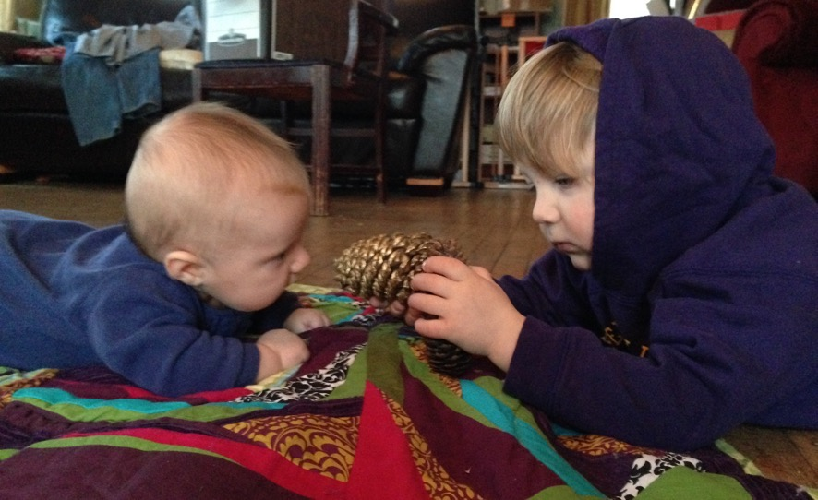
“I'd like [my faculty] to … sit down with me and go over goals and expectations.”

Slide 12
GLEAM Setting the stage for a Long-Term relationship
Goals
Learning style
Experiences
Activities
More
Notes:
Jeanne
The GLEAM is a tool that is particularly useful when you will be with a student for more than 1 session
You can also use a couple of pieces of this for your preclinic huddle (Goals, Experiences in particular)
What are your Goals and expectations for this mentorship? What are your goals and expectations for your career? What do you feel are your content deficiencies and skill challenges?
How do you Learn most effectively? What has helped you succeed? What did you find challenging? How do you like to receive feedback? What is your learning style? How do you best assimilate material and experience?
What previous patient Experiences have been meaningful to you? What worked for you and helped you learn? What seemed to derail you? Have there been other mentors who seemed to be particularly helpful?
What Activities are you involved in outside of medicine? Consider exploring the student’s support system. What other roles/responsibilities do you have in your family and community?
What More do I need to know about you to make this an optimal mentorship experience for you? What have I forgotten to ask you? Do you have any questions for me?

Slide 13
Pre-Clinic Huddle Setting the stage for day-to-day goals
What is the student working on?
Are there any particular expectations (from student or faculty) for that day?
Which patients may help meet those goals?
One Minute Learner
Notes:
Consider One minute learner role play
If heavy residency audience, this could also be useful to talk about which pts to see, pregame if residents have any questions about patients
Finding out what the student is working on makes it easier to provide feedback at the end, too.
How might the day go? Will they shadow you some? Make first contact always? Do you want to present in the room or outside of the room?
This is also a moment in which you can spend a minute teaching about good questions to ask for a particular concern, like red flags for low back pain or indications for antibiotics for respiratory infection

Slide 14
One Minute Learner Overview
Goals
Getting Going
How Much and How Long
Presenting
Charting
Questions
Feedback
Used with permission of Miriam Hoffman, MD https://www.stfm.org/publicationsresearch/publications/educationcolumns/2013/march/

Slide 15
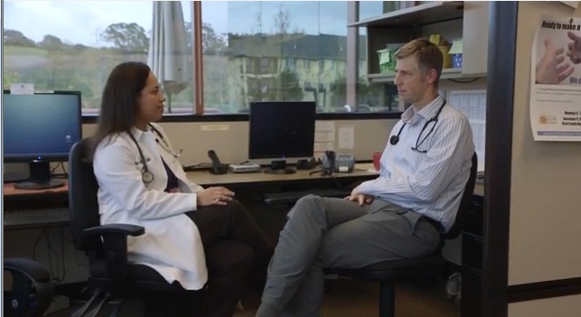
2. Learning In Action
“I would like [my faculty] to teach me and test me. Give me a small doable specific task and then evaluate me on the spot.”
Notes:
Transition Slide to teaching

Slide 16
“Let’s go in together. You take the history and I’ll be your scribe.”
“I want you to take 10 minutes to interview the patient. I’ll knock on the door and you present what you’ve found.”
“I don’t know what the best next step is. Can you look it up and we can talk after I see the next patient by myself?”
Notes:
Think Pair Share
What have you tried/heard about that was useful

Slide 17
What can we do to help students appreciate the value of Family Medicine?
Demonstrate continuity and the joy of relationships with patients
Demonstrate broad scope of practice and expertise
Flexibility to pursue passions in a wide range of patient care without having to do more residency or fellowship
Community health orientation
Health and health equity
Broad sense of wellness and health
Notes:
Think Pair Share and/or vignette:
Student: I don’t think I want to be a family doc because of X reason.
Preceptor: You’re just hearing that from Y because they only can take care of one organ
How would you reframe this conversation?

Slide 18
Opportunities for Student Continuity (AKA ”Why Family Medicine is Awesome” )
Assign students to an OB patient and help the student follow that patient through delivery
Schedule follow up visits for days that students will be with you
If students sees a patient in hospital, have the student see them for hospital follow up as well
Give the students an opportunity to follow patients to specialists, imaging, lab, and therapies
Notes:
Students should follow patient and not preceptor for continuity

Slide 19
3. Documentation

Slide 20
Benefits of Student Charting
Saves time: 15-90 minutes of preceptor charting time
Students feel part of the team, like their interactions matter
It helps students understand what is happening and keeps them actively engaged
It’s a critical skill to learn, prepares for PE part of boards

Slide 21
Teaching Physician Attestation (MyPhrase)
“I attest that I was physically present with the student, verified all student documentation, and performed (or re-performed) the physical exam and medical decision making. [Attending name].”
Notes:
keep?
Ruth
Thanks to UNC Beat Steiner’s post on STFM

Slide 22
Student MyPhrase
“(Student Doctor’s Name, title, date, and time of entry) documented the following service on behalf of Dr. XXX…”
Notes:
keep?
Ruth

Slide 23
Why Let Students Document?
Students like being part of the team
Preceptors feel that it saves them time
Allows real-time evaluation of students’ clinical thinking
Trains student for future practice
CMS allows it
Notes:
Ruth present data and high points
Use the time that you would take to write your own note to review the student’s documentation (ideally together)
Offer feedback about what should be different
Either give the opportunity for student to update OR
Write your attestation with the appropriate changes

Slide 24
CMS Documentation Update
CMS continues to pay only for those services provided by the Teaching Physician, but after verifying the history of present illness and re-performing the exam and medical decision making, the teaching physician may now verify and attest to the medical student’s documentation without having to re-document the findings

Slide 25
4. Teaching and Feedback

Slide 26
What are barriers to teaching?
Notes:
Time
Patient Complexity
Resident Presentation Style

Slide 27
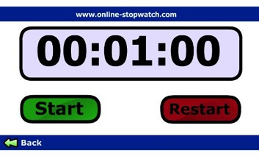
The One Minute Preceptor (OMP)?
Get a commitment
Probe for supporting evidence
Teach general rules
Reinforce what is right
Correct mistakes
Neher, et al. A Five-Step "Microskills" Model of Clinical Teaching. Journal of the American Board of Family Medicine. 5:419-424, 1992.
Notes:
This is part of the “teach general rules” The What If precepting model helps learners develop critical thinking skills. The model involves simply asking “What if…” questions after a learner has presented a patient case and outlined an appropriate plan.
Quick Tips:
Use the What If model following presentations of common conditions to change the situation and assess clinical reasoning and knowledge.
With more experienced learners, ask a series of what if questions, such as:
What if the patient was pregnant?
What if the patient had a history of heart disease?
What if the patient is on medication for hypertension?

Slide 28
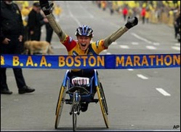
Why OMP?
Condensed way to streamline assessments, instructions, and feedback
Saves time when a full case presentation is not necessary
Using OMP improves the quality of feedback in ambulatory settings
Salerno et al. Faculty Development Seminars Based on the One-Minute Preceptor Improve Feedback in the Ambulatory Setting. JGIM. 17 (10) :779-787. 2002.
Aagaard, et al. Effectiveness of the One-Minute Preceptor Model for Diagnosing the Patient and the Learner: Proof of Concept. Academic Medicine. 79 (1): 42-49. 2004.
Notes:
Serena to introduce

Slide 29
The What If Model
helps learners develop critical thinking skills
simply ask “What if…” questions after a learner has presented a patient case and outlined an appropriate plan
Use following presentations of common conditions to change the situation and assess clinical reasoning and knowledge.
With more experienced learners, ask a series of questions:
What if the patient was pregnant?
What if the patient had a history of heart disease?
What if the patient is on medication for hypertension?

Slide 30
Choose the method that works best for you!

Slide 31
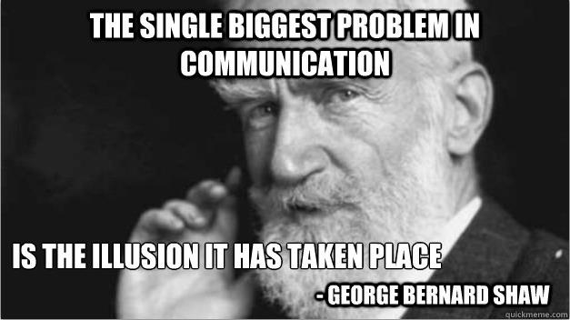
Notes:
For the context of this talk, we are going to focus on in-the-moment or end of the day and not summative feedback
Content is clear
Presentation is succinct but complete
Format is organized
Message is effectively articulated
“Now I am giving you FEEDBACK”

Slide 32
Ask-Tell-Ask
Ask the trainee to assess his/her own performance
What went well? What areas need improvement?
Tell
Share your impression of positive behaviors and areas of concern
Provide suggestions for problem solving
Ask
Ask what areas could be improved
Allow the trainee to develop a specific plan for improvement
Add
Add any other things you think could be improved
Summarize the positives and areas for future growth
Notes:
Conducted at a time and place with safety in mind.
Specific, focused, and based on observations.
Focused on specific behaviors the learner controls.
Provided as proximal to the behavior as possible.
Includes positive comments as well.
Includes the “right” amount of information.
Understood by the receiver.
Inclusive of the learner perspective.
Linked to the learner’s goals.
Summarized and includes a follow-up plan.

Slide 33
Ask-Tell-Ask
https://www.youtube.com/watch?v=SYXgMobMU8U
(or google “Ask-Tell-Ask Columbia”
and click the youtube link)

Slide 34
Teaching Physician
Library Access
Academic Title
And this just in ABFM part IV credit

Slide 35
https://itconnect.uw.edu/

Slide 36
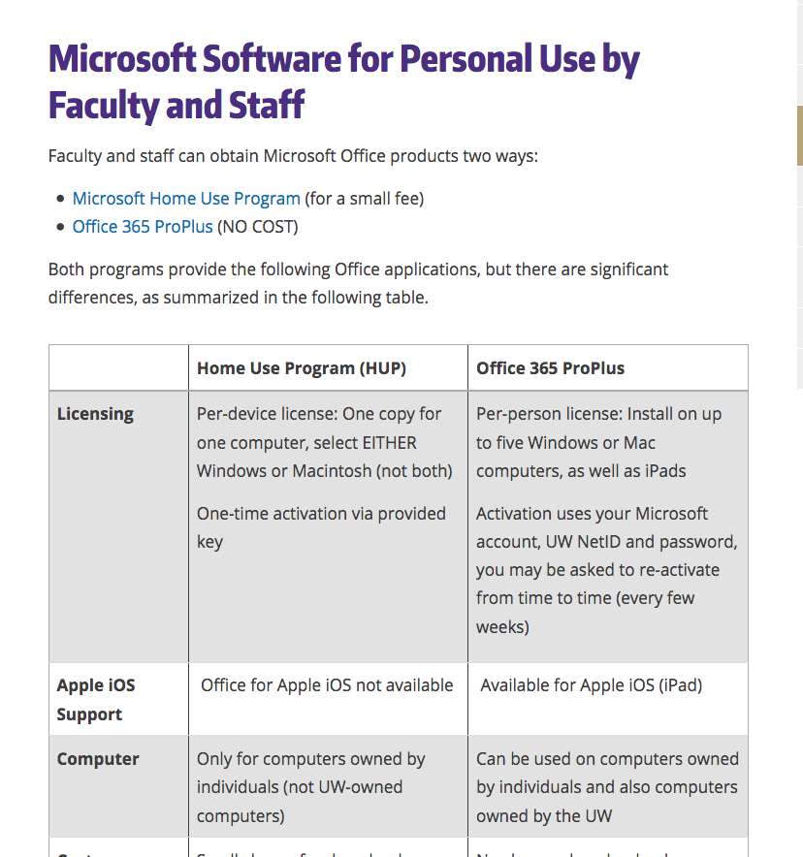
https://itconnect.uw.edu/

Slide 37
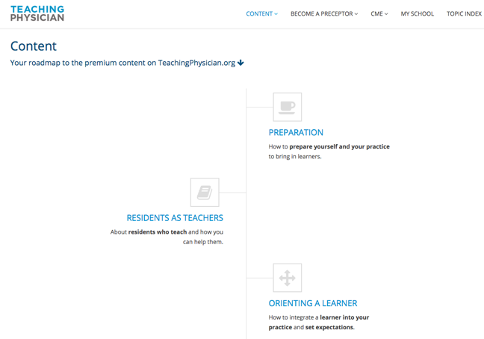
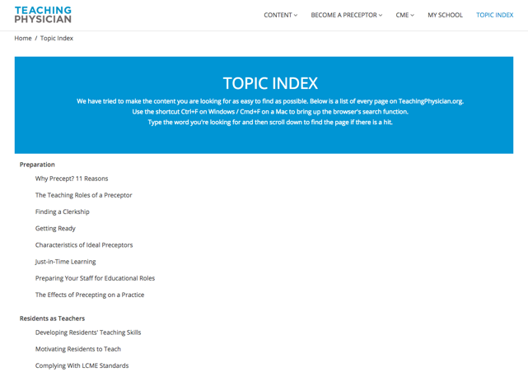
Teaching Physician
www.teachingphysician.org
username: uwfamedmse
password: uwfamedpassword
Notes:
https://www.teachingphysician.org/content/teaching-strategies/tipps-teaching-in-the-presence-of-patients

Slide 38
www.hsl.uw.edu

Slide 39
https://hsl.uw.edu/toolkits/care-provider/

Slide 40
Clinical Faculty Appointments
http://depts.washington.edu/fammed/administration/clinical-faculty-appointments
This will give you a UW Net ID

Slide 41
Thoughts, Questions, Ideas?

Slide 42
Contact
Jeanne Cawse-Lucas
cawse@uw.edu
Ruth Michaelis
rmichaelis@atsu.edu

