Slide 1
Integrating Multidisciplinary Teams into Daily Practice
Steven Elrod, PharmD, BCACP; J. Miguel Lee, MD; Erica Dennehy MSW, LICSW, SUDP
Notes:
Expanding and establishing inter-professional relationships is needed when improving team based care. This requires support from all team members to enhance components of, not only patient care, but a medical residency. Areas that need to be reviewed before collaboration would be education (didactic), clinic workflows, and patient care initiatives. This may be daunting and challenging to initially overcome for learners, educators, and clinicians alike and we aim to help ease those potential tensions.

Slide 2
Objectives
Describe interprofessional cultural initiatives
Review how a hybrid curriculum impacts didactic schedule
Develop implementation strategies for a behaviorist and pharmacist into a medical residency

Slide 3
Interprofessional Learning Framework
Enhance Population Health
Improve Patient Outcomes
Reduce Cost
Triple Aim for Population Health
Notes:
To do this work effectively, it’s important to harness a range of community determinants of health, empower individuals and families, and for the scope of today’s conversation - substantially broaden the role and impact of primary care and other community based services. Before we put the cart before the horse, let’s take a deeper look at the potential advent of where interprofessional collaboration happens…

Slide 4
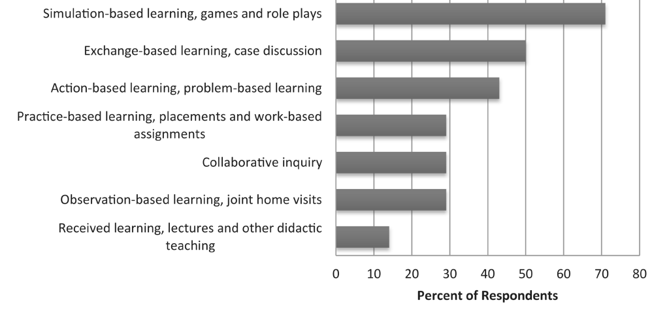
Medical School Interprofessional Education
West, C et al. J Interprof Educ Pract 2016 Sept; 4:41-49
Notes:
A study done by West and colleagues looked at how medical students from 16 different, well established schools, interacted with other professions through interprofessional learning while in school…over 70% focused on simulation based learning which included games and role plays and anywhere from 30-50 % had some type of team based learning with assignments, cases, and discussion. However, once we break down the categories into educational components the results weren’t as robust…

Slide 5
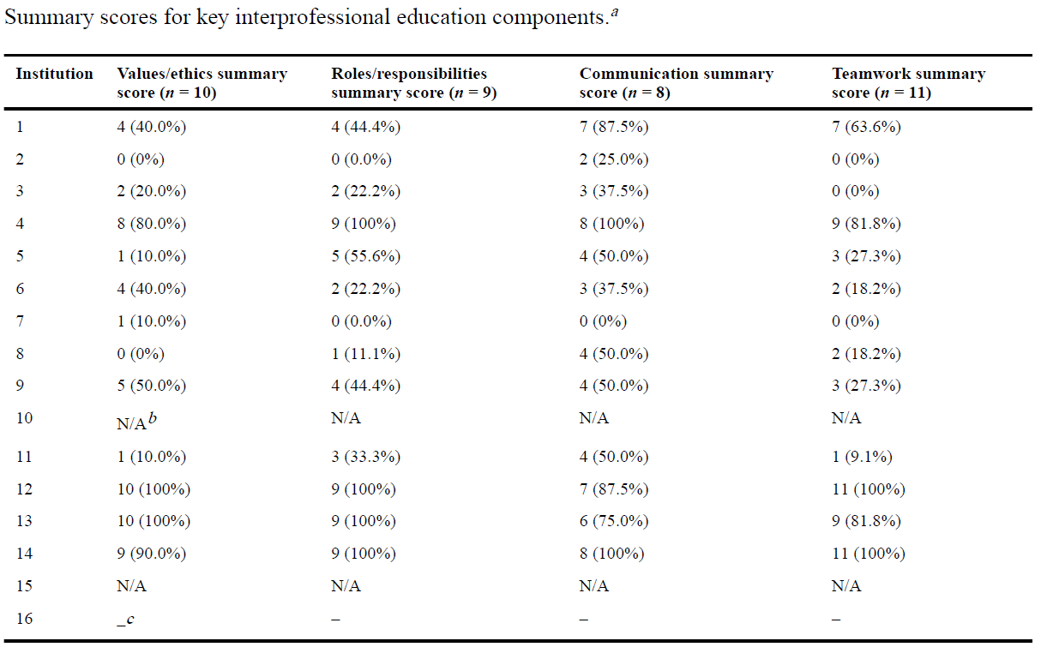
Medical School Interprofessional Education
West, C et al. J Interprof Educ Pract 2016 Sept; 4:41-49
Notes:
Just because there are 16 schools in this trial saying they have “IPE” how much time they really spend on certain components? We can see here that only 3 of the 16 schools are consistently working with other professions from a curriculum standpoint.
Greater communication increases the diversity and choice of care options,
subsequently providing a higher patient care quality [4]. IPE
brings together learners, students, and faculty in an interactive,
team oriented, collaborative forum. The collaborative aspect
places all participants on a similar contributory level.

Slide 6
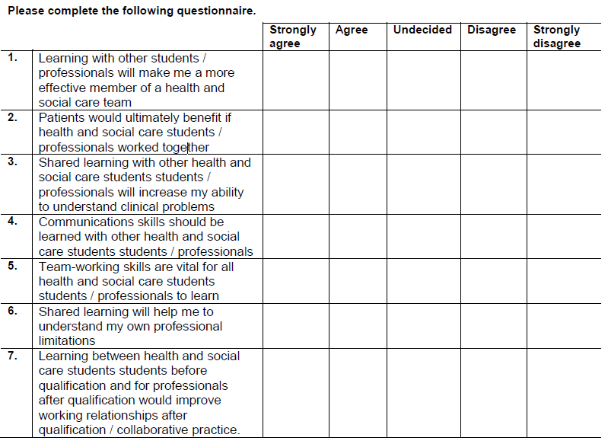
Parsell, G and Bligh J. Medical Education, 1999. 33(2), 95-100J

Slide 7
Perception of Interprofessional Education
Visser C, et al BMC Medical Education (2017) 17:77

Slide 8
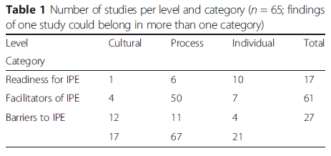
Perception of Interprofessional Education
Readiness
Interaction based
Facilitators
Acquainted and work experience
Barriers
Miscommunication and
gaps in role perception
Visser C, et al BMC Medical Education (2017) 17:77

Slide 9
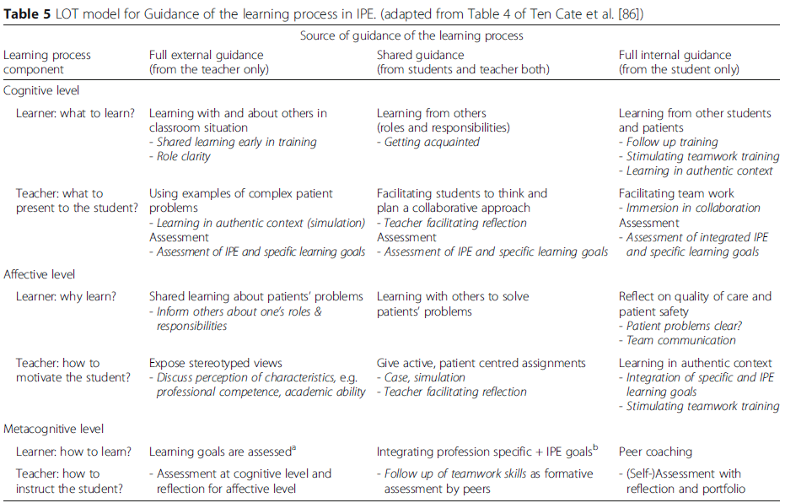
Visser C, et al BMC Medical Education (2017) 17:77
Notes:
It combines two aspects of learning: the components of
learning and the amount of guidance required [86]. The
components of learning are cognition (content of learning),
affect (motivation and emotions) and metacognition
(Metacognition allows people to take charge of
their own learning: awareness of how they learn, evaluation
of their learning needs, generating strategies to
meet these needs and then implementing the strategies
[87]).
Learning oriented teaching
cognition (content of learning),
affect (motivation and emotions) and metacognition
(Metacognition allows people to take charge of
their own learning: awareness of how they learn, evaluation
of their learning needs, generating strategies to
meet these needs and then implementing the strategies

Slide 10
Culture. Process. Individual.
Buy in
Mutual respect
Residents’ self identified needs
Curriculum design
and delivery
Involvement at all levels
Team based care
Interview process
Professionalism
Recognizes gaps

Slide 11
Where We Started
Notes:
- clinic was traditional and old fashioned
Resources were scarce, outcomes not measured
Access was scarce and worsening
Conventional was not working for clinic or residency
Team based care was the answer
So began the task of implementing

Slide 12
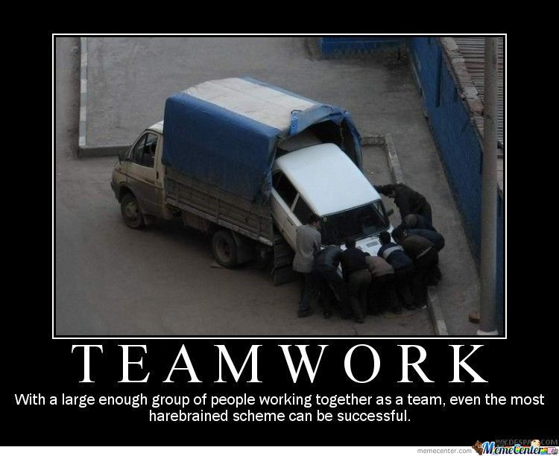
Where We Are Now
Notes:
Unconventional has worked well
Everyone seems happy
Collaborative environment
Team members working at the max of their license

Slide 13
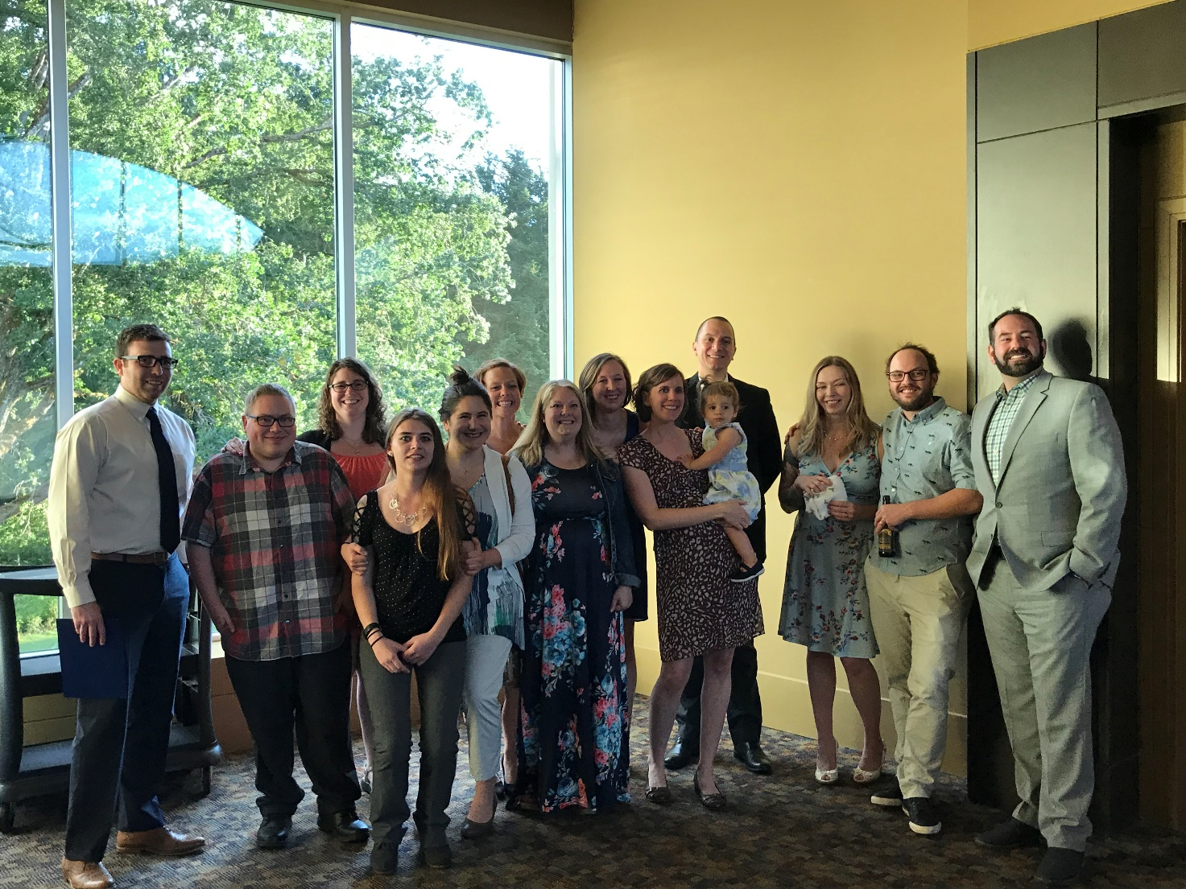
What We Learned
Conventional doesn’t work everywhere
Buy in is essential
Everybody has their place
Residency graduation →
MAs, PSRs, admin all invited!
Notes:
Teams will be different everywhere, make maximum use of who you have
We recruit clinicians, residents, everyone with the understanding this is the norm
Buy in requires equal partnership, story of ancillary
We had Pharm D and behaviorist as core faculty before ACGME

Slide 14
Timeline of Interprofessional Education
Behaviorist and Pharmacist as Advisors
Interprofessional lecture on “Your Legacy and Professionalism”
Residents shadow Behaviorist and Pharmacist in clinic
Layered learning lectures throughout residency
CCC/PEC- ACGME Milestones
Self Assessment
Shadow Residents in Clinic
Notes:
We work in a Patient Centered Medical Home and live this model to the full extent. We are fortunate to work in a culture where from the get go, we have been viewed as integral members of the team and as core faculty.
Had the autonomy to develop curriculum and have been supported in implementing.
About 3-4 yrs ago, Dr. Rein Lambrecht, who has quite a passion for the ACGME milestone came to Steven and I and asked us to review the milestones and see what areas we felt our curriculum aligned with. Being a new program, we have constantly been reviewing areas to improve on.
This elicited a robust discussion between Steven and I about how we fit into the residency. How we contribute and due to time and limited resources, what areas we could assist in to fill the gaps within our small residency as well as future possibilities to make the most out of what we had.

Slide 15
Ways to Involve Pharm and BH Faculty
Topic | Pharmacist | Behaviorist
Interview season | ✔ | ✔
Suboxone clinic | ✔ | ✔
Hepatitis C clinic | ✔
Advising | ✔ | ✔
Wellness |  | ✔
Didactics | ✔ | ✔
Shadow sessions | ✔ | ✔
Scholarly activity | ✔
Nursing home preceptor/Home visit | ✔ | ✔
Program Evaluation Committee | ✔ | ✔
Clinical Competency Committee | ✔ | ✔

Slide 16
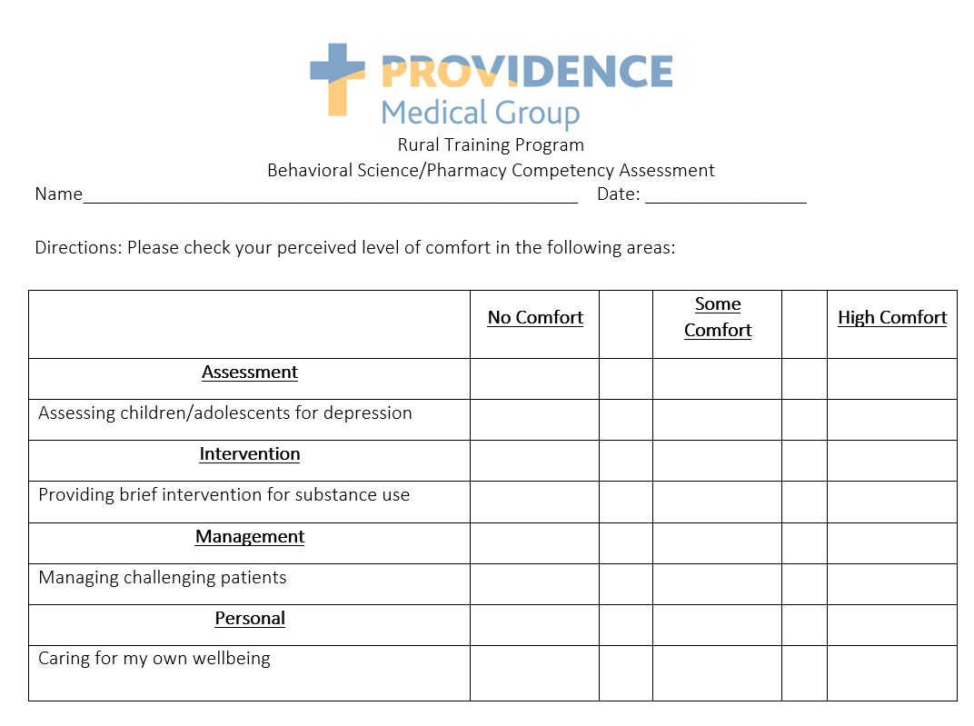
Resident Self Identified Needs
Notes:
We provide each of the residents with an Assessment that they rate their comfort level of certain areas pertaining to both BH and Pharm
We broke it down into areas of Assessment/Intervention/Mgmt/Personal
Rating scale 1-5 of comfort level
This allows up to target some topics specific to our residents during lunch n learns, 1:1, etc.
We have the residents complete this assessment once every 6 mos.
It also allows us to track to see if something has changed. Has a residents areas of comfort decreased in a certain topic, and if so, why

Slide 17
Anxiety
Mood Disorders
Psychosis
Abuse/Mandated Reporting
Substance Use Disorders
Developmental Stages
Weight Loss
Sleep/ Insomnia
Diabetes Management
Primary Prevention (Hypertension/Hyperlipidemia)
Conducting a family meeting
Chronic Pain
Personality Disorder
Wellness (self awareness, well being)
Biostatistics
Assessment
Intervention
Management
Personal
Notes:
Ex: Providing brief interventions to address substance use
Discuss weight loss options with my patients
Assess bipolar disorder
Prescribing mood stabilizers
Ability to care for my own well being

Slide 18
Individual Curriculum Topics
Diabetes/Insulin Mgmt
Asthma/COPD
Osteoporosis
Primary Prevention
High Risk Medications (opioids, benzodiazepines)
Biostatistics
Substance Use Disorders
Suicide
Trauma informed Care
Personality Disorders
Wellness
End of Life Care
Communication
Abuse/Mandated Reported
?
Notes:
Looking at individual residency topics that overlapped
And how we could blend the topics to make the most of the time we have and be more efficient and effective in our didactics.
It didn’t make sense or wasn’t an efficient use of time to silo

Slide 19
Brain Storm on Topics of Collaboration
Professionalism
Wellness
Psychiatric topics (Children and Adults)
Mood Disorders
Anxiety
ADHD
Insomnia
Chronic pain
Diabetes
Suicide
Smoking Cessation
Considerations in End of Life Care
Dementia
Notes:
What were the types of referrals we were getting, what areas during the self assessment did we find residents had low comfort level in and patients that we were jointly working with. Common themes that continued to come up in both our clinical work with patients and our discussions with the residents.
What we found was a number of overlapping topics
Taking a disease state or behavior and breaking it down
Evidence based practice for both; Behavioral Interventions- Pharmaceutical Approaches

Slide 20
Our Didactic Schedule
1230 – 1330 on Tuesdays and/or Fridays
During interview season (Oct-Dec) didactics are on Friday
In addition to 3 hour workshops residents go to every other Wednesday with our core program
Notes:
Expectation that faculty attend didactics as able.
Bridging that gap on interprofessional communication and role modeling respectful behavior

Slide 21
Our Didactic Schedule
Topic | Number of Lectures
Behavioral Health | 8
Pharmacology | 8
Population Health | 4
Wellness | 6
Support Group | Monthly
Practice Management | ??
Case Conference | 4
Journal Club | 4

Slide 22
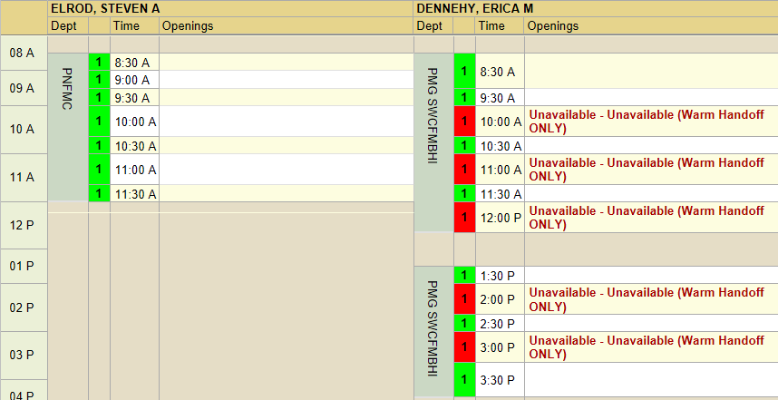
Team Based Care
Suboxone case
Who is included?
Depression/Anxiety case
Who is included
Sharing care
Increasing access for patients

Slide 23
Our Schedules
Faculty Pharmacist Schedule
Faculty Behaviorist Schedule
Monday | Tuesday | Wednesday | Thursday | Friday
Clinic | Clinic | Admin | Admin | Clinic
Clinic | Clinic | Clinic | Admin | Admin
Monday | Tuesday | Wednesday | Thursday | Friday
Clinic | Clinic | Clinic | Admin | Clinic
Clinic | Clinic | Admin | Admin | Clinic

Slide 24
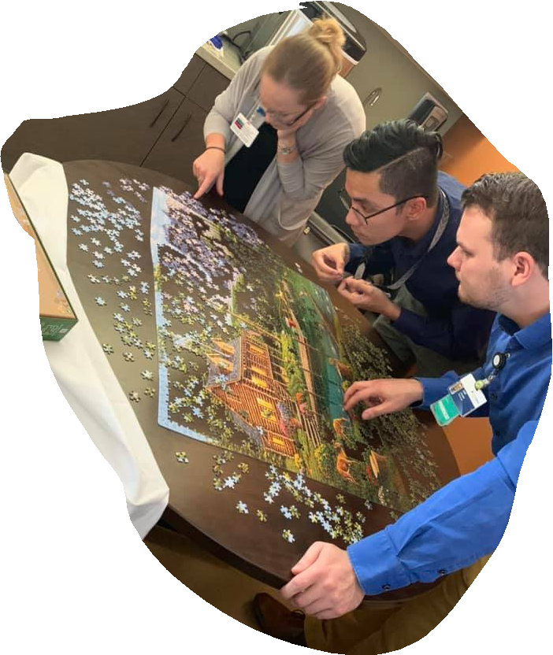
Medical and Pharmacy Residency Interview Process
This is where we start setting the expectation
Applicants meet MD, PharmD, and BH
This is for medical and pharmacy residency interviews
Setting the expectation of team
based care/collaborative work environment
Standardized questions vs free response
interview portion

Slide 25
Advising and Advisors
Started with all faculty members, including PharmD and BH, as advisors
Each of us had a resident from each class
Changed to Miguel (PD) advising all 3rd years; Steven (PharmD) advising all 2nd years; Rein (APD) advising all first years
Erica (BH) advised as needed during times of stress or needed some brief counseling
Residents are completely aware that if they need advising from a particular faculty, we will meet that need

Slide 26
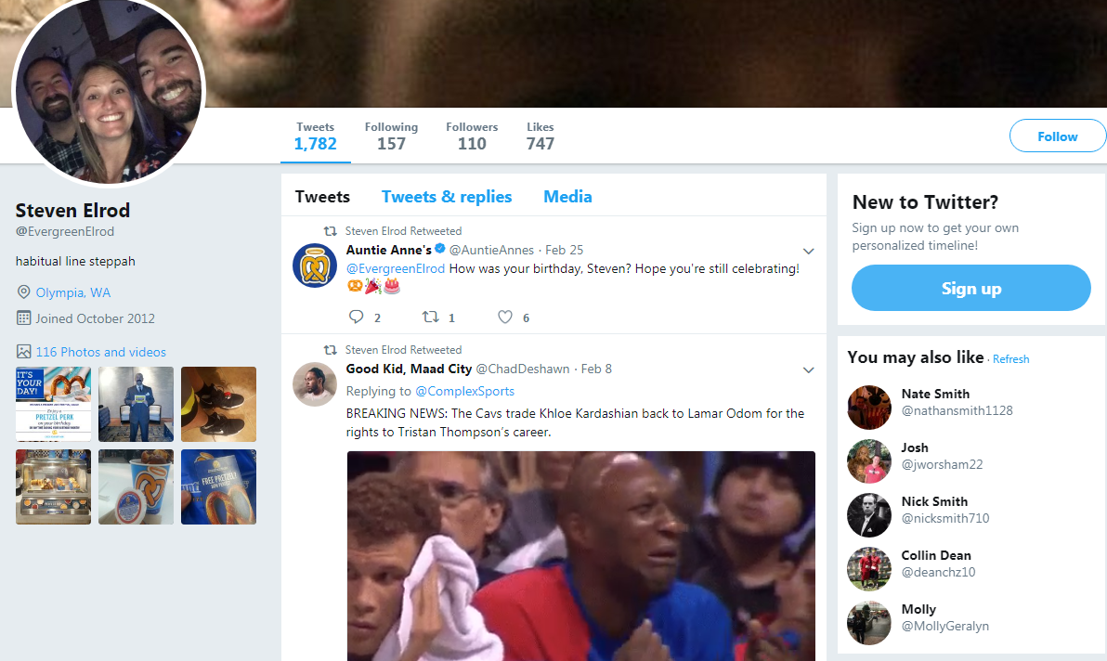
Professionalism
Created lecture together
How is everyone involved
in professionalism?
Holding each other
accountable

Slide 27
Wellness
Quarterly
Idea generation
Taking turns leading
Burnout questionnaire
Notes:
Continue highlighting team mentality throughout presentation

Slide 28
Creation of Faculty
ACGME has started to catch up
Advocating within our own system
Being recognized as faculty not just on paper but receiving full benefits that come with that role as well

Slide 29
Professionalism Component
Group led discussion with core faculty and all residents
How we “grade professionalism” via new innovations
Focus on communication and time management
Make it timely and relatable to ACGME
Notes:
Difficulties in residency: and examination of clinical rotations and competencies where family medicine residents most often struggle
Orysya svuystun, MD BSc; shelley ross phd
Stfm vol 50 #8 sept 2018

Slide 30
ACGME Professionalism Milestones
PROF-1
Completes a process of professionalization
PROF-2 Demonstrates professional conduct and accountability
PROF-3 Demonstrates humanism and cultural proficiency
PROF-4
Maintains emotional, physical, and mental health; and pursues continual personal and professional growth

Slide 31
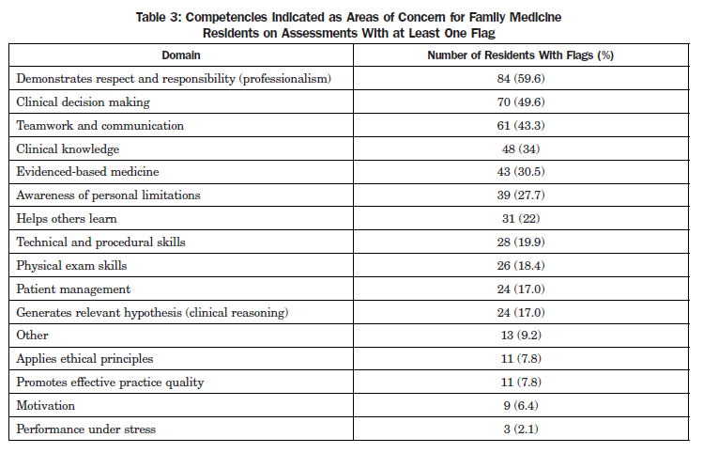
Flags and Professionalism
Svystun O, Ross S. Family Medicine. 2018 Sept. 50:8.

Slide 32
Integrating Multidisciplinary Teams into Daily Practice
Steven Elrod, PharmD, BCACP; J. Miguel Lee, MD; Erica Dennehy MSW, LICSW, SUDP

