Slide 1
Writing a Grant: Focus on Mentored Awards
HMC
J. Randall Curtis, MD, MPH
Professor of Medicine
University of Washington, Seattle, WA USA
jrc@uw.edu
VAMC
UWMC
FHCRC

Slide 2
Personal Disclosures
Funded by two institutes at NIH and six foundations
Less knowledgeable about other institutes and funders
Most of this talk is my opinion based on my experience

Slide 3
Outline
Types of grants
Mentored awards
Independent funding (“R” awards)
Timelines and deadlines
Key parts of mentored awards
Mentor and environment
Career development plan
Specific aims and science

Slide 4
Mentored Awards
Fellowship grants
Individual NRSA (F32)
Specialty society fellowship awards
Foundation awards
Most common K-level awards
K08 (“basic” science)
K23 (patient-oriented)
K12 or KL2 awards (institutional)
Other career development awards

Slide 5
Independent Awards: “R” Awards
Don’t worry about these yet – years away
“Independence” is an archaic term
Still important for promotion
Independent awards
R01, VA Merit Award
Multiple project grants
Program Project Grants, “U” grants
Increasing recognition of “team science”
Multiple PI mechanisms

Slide 6
Which awards should you apply for and when?
Individualized: work with your mentor and your mentoring committee
Apply for multiple awards
Overlap in science is fine if you can’t accept more than one
Overlap is NOT fine if you can accept more than one

Slide 7
Which Institute and which study section?
Picking the “right” institute is key
NIH has 27 institutes and centers
AHRQ is a separate institution
Picking the “best” study section is also important
Expertise in your science and clinical area
Use your mentors and advisors to make these decisions

Slide 8
Outline
Types of grants
Mentored awards
Independent funding (“R” awards)
Timelines and deadlines
Key parts of mentored awards
Mentor and environment
Career development plan
Specific aims and science

Slide 9
Getting Started: Three Most Important Steps
Read the instructions
Read the instructions
Read the instructions

Slide 10
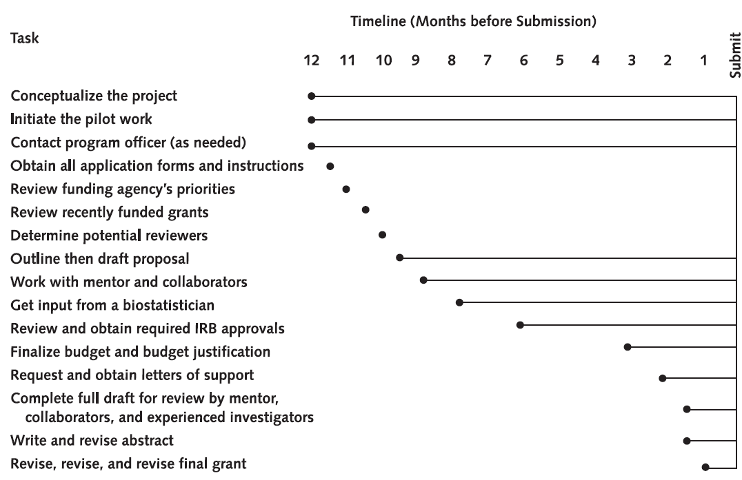
Timeline for Writing a Grant
Inouye, Annals Intern Med 2005; 142:274-282

Slide 11
Grant Deadlines
Grant deadline to NIH is always at least a week later than the REAL deadline for you!
UW internal review process
To get thorough internal reviews, you need to give reviewers 2 weeks
Deadline for GOOD draft is a least 1 month before the NIH deadline

Slide 12
Outline
Types of grants
Mentored awards
Independent funding (“R” awards)
Timelines and deadlines
Key parts of mentored awards
Mentor and environment
Career development plan
Specific aims and science

Slide 13
Mentors
Picking a mentor may be the most important decision you make
Mentor/co-mentor can work well
Mentors for NIH mentored grants
Should be currently funded by NIH
Should have a track record for mentoring to K- and R-level awards
Accessible and fun to work with

Slide 14
Environment
Mentor’s lab/program important, but only one part
Use other resources at UW
Transcend Department/School boundaries
Get creative (but not too creative!)
Tap into the ITHS
“Distant” mentors ok, but be careful
Clear role and mechanism of involvement
Clear connection with distant mentor

Slide 15
Career Development Plan
Identify your learning objectives
Make them specific and make them fit your specific aims
Provide concrete tasks you will do to achieve these objectives
Courses, workshops, practicums
Use tables and figures

Slide 16
Specific Aims: The Most Important Part
The one thing everyone will read
The essence of your grant proposal
Write them first and revise them often
Like a good poem
There is no “one right way”
Depends on your project
Depends on the investigator

Slide 17
Which Would You Rather Read?

Slide 18
Writing a Good Specific Aims
Interesting
Cohesive: aims must fit together
Novel
Feasible
Specific: All terms operationally defined
Identify a testable hypothesis
Publishable regardless of result
Builds on investigator’s experience

Slide 19
Interesting, Novel, and Feasible
Ultimate challenge is finding aims that satisfy these three criteria
Easy to write aims that are either
Interesting and novel but not feasible or
Feasible but not interesting or novel
Create new knowledge
Improve health or health care

Slide 20
Identify a Testable Hypothesis
Aims should include hypotheses
Qualitative research is the exception
Hypothesis should be important whether it is supported or refuted
Even qualitative research needs to articulate the importance of the aim
Ask yourself “Who cares?”
Where is this going?

Slide 21
Operational Definitions
Every term clear and defined
“Critical illness”
Defined by what?
“Improve outcomes”
What outcomes
How will you measure the outcomes

Slide 22
Specific and Concise
Your aims should “tell it all”
What are you going to do
How your are going to do it
Methods and analysis
Concise
Not too long and no run-on sentences
Beautifully written - poetry
Most important thing you will write

Slide 23
Fatal Flaws
Too long or too hard to follow
Assume reviewers are tired, cranky, and not experts in your science
Too much overlap between aims
Not really separate aims
No connection between aims
Not really one project
“Interdependence of aims”

Slide 24
“Interdependence of Aims”
Important fatal flaw in the eyes of some reviewers
No aim should depend on the success of a prior aim
If aim 2 depends on the success of aim 1 in order to be done, these aims need to be two separate grants
If unavoidable, have an explicit “plan B”

Slide 25
One Approach to Putting Together the Aims Page
Start with “Statement of the Problem”
Why is this problem REALLY important?
List the specific aims
Finish with long-term objectives
For mentored award include your training goals
When finished first page, reader knows
What the problem is that you are addressing
What you are going to do to address it
What the long-term goals of this research are
Why she or he should care

Slide 26
Good Preliminary Data Strengthens Any Grant
Important for getting funding
Aims should build on prior research and preliminary data
Can build on your mentor’s experience and preliminary data
Choose your early fellowship projects in part based on how they can generate preliminary data

Slide 27
Summary
Choose mentors/advisors carefully
Read the instructions
Start early
Write the Specific Aims page first
Get it “right” before writing the grant
Include preliminary data
Be creative about preliminary data

