Slide 1
Scientific Writing - Getting your work published
Thomas Hawn
July 19, 2013
Fellows Survival Course

Slide 2
Outline
1. Preparing to Write
Writing a Paper
The Editorial Office
Summary

Slide 3
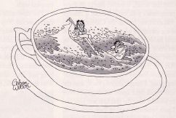
1. Preparing to Write
Will I ever get “publishable” data?
Anticipate research
“dark days”
Navigate them
Focus vs diversity
Priorities—life & work
Career & project alternatives

Slide 4
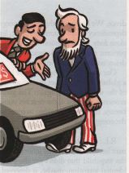
Preparing to Write
-Gather data
-Decide whether & when to start writing
Getting the Facts

Slide 5

Preparing to Write
Identify: Idea Space
Writing Space

Slide 6
2. Writing a Paper
The Order
Tables & Figures
Results
Methods
Discussion
Introduction
Abstract
Choose a journal

Slide 7
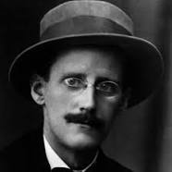


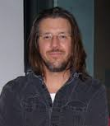
BAD NEWS …
GOOD NEWS …
James Joyce
Toni Morrison
JK Rowling
David Foster Wallace

Slide 8
Writing
You do not need to be a great literary writer
Science writing is teachable
Strive for clarity, brevity, substance

Slide 9
Tables & Figures & Results
What are your primary observations?
Identify what experiments & analyses remain
Writing: Rough copy helps many
Data that doesn’t fit
Embrace it “Interestingly”

Slide 10
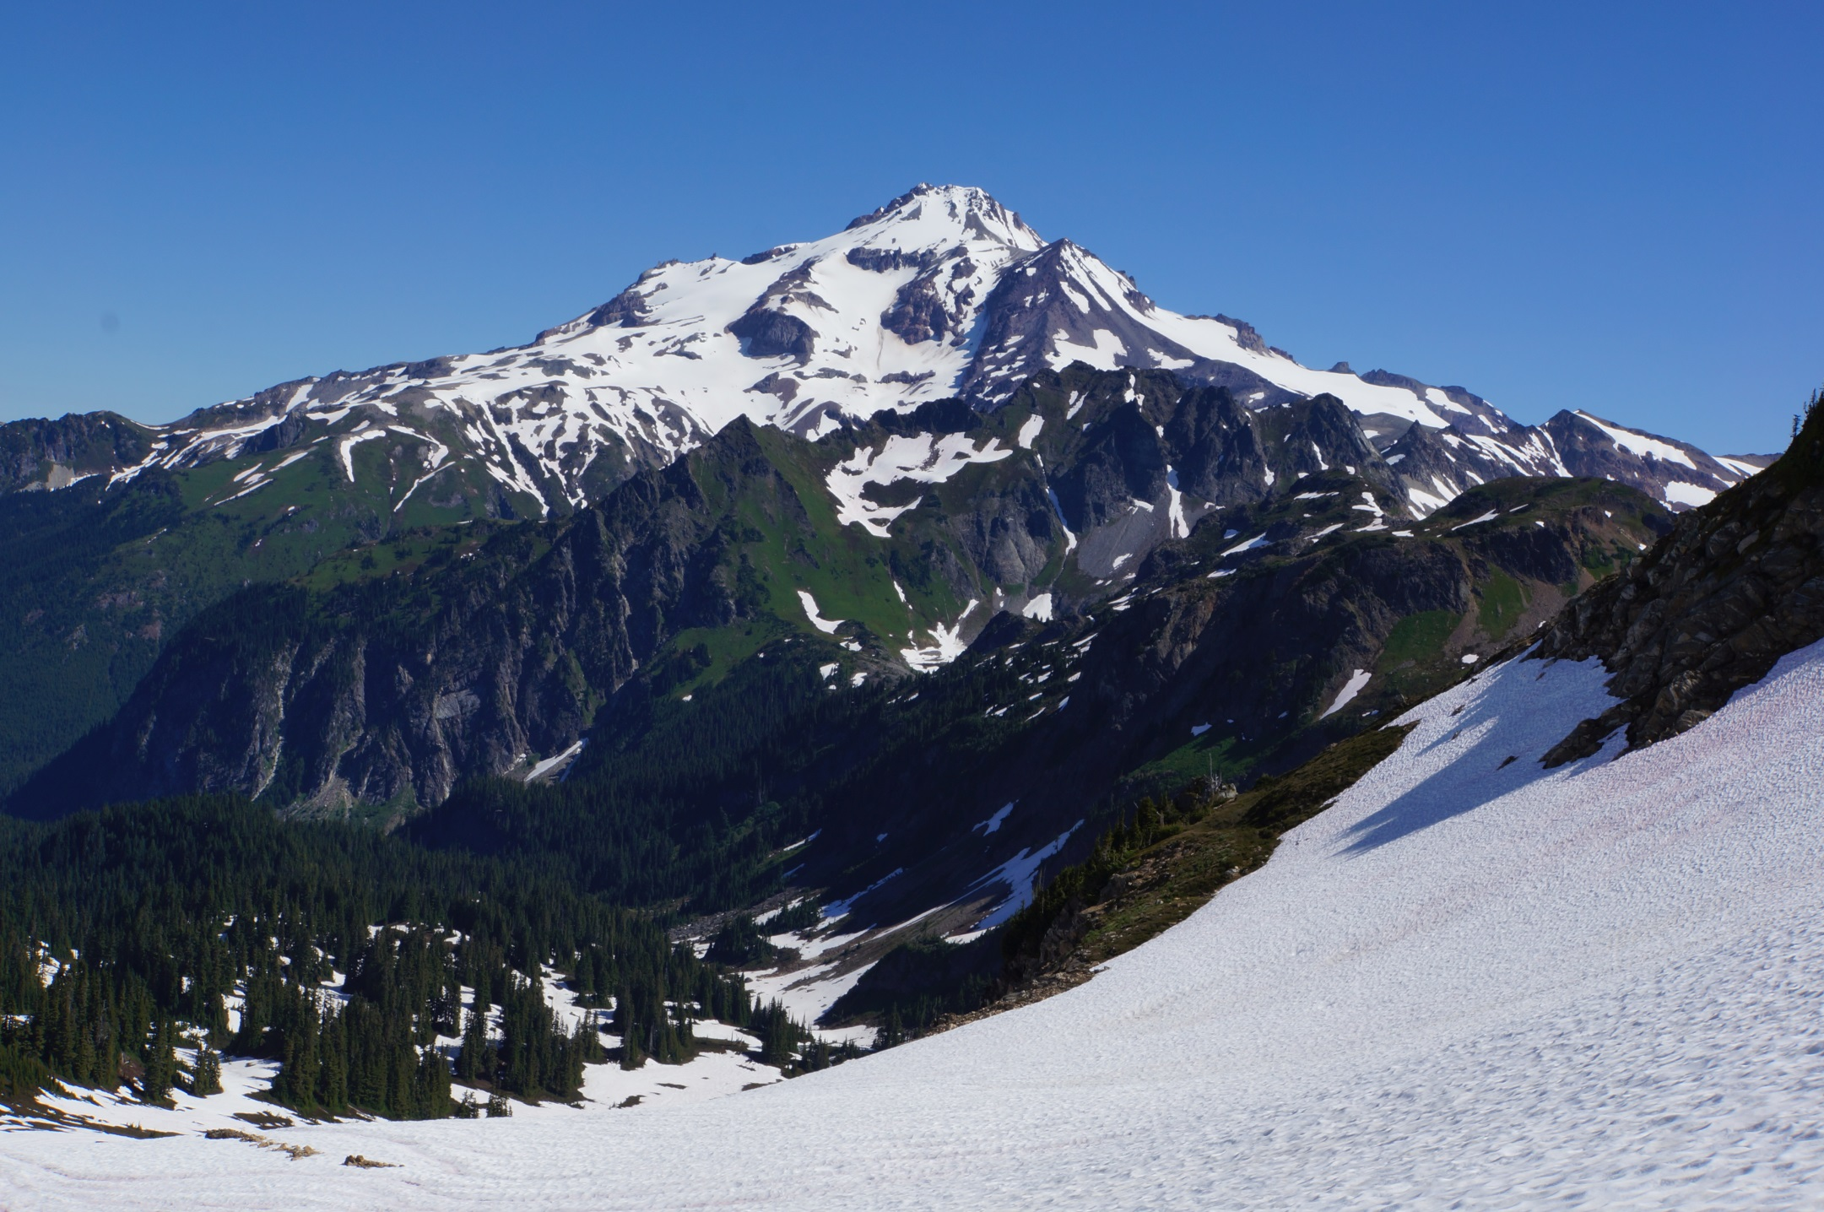
INTRODUCTION

Slide 11
2. Writing a Paper
A. Introduction
Intro
A. Para 1: Broad background
B. Para 2-4: More specific
C. Last Para: Some describe main findings (optional style)
2. Each paragraph has a purpose and ends with an unknown
3. Avoid being encyclopedic—get to your points quickly

Slide 12
INTRODUCTION: SHOW THE PATH
DON’T BE A MYSTERY WRITER

Slide 13
Methods
1. Provide enough information to replicate expts
2. OK to refer to previous papers for methods—but don’t make them dig too deep for essentials

Slide 14

DISCUSSION
Discuss the path
Add interpretation
3. Do not get lost in the forest

Slide 15
Discussion
Begin by stating your primary observations
Answer the unknowns from your Intro
Each paragraph has a purpose
Often address a mechanism/causality
Include a limitation paragraph
End with forward looking implication

Slide 16
Abstract
Clearly state unknown or hypothesis
Provide pithy summary of data
Provide conclusion
Avoid overstatements

Slide 17
Polishing
The time to begin writing an article is when you have finished it to your satisfaction. By that time you begin to clearly and logically perceive what it is that you really want to say.
- Mark Twain's Notebook, 1902-1903

Slide 18
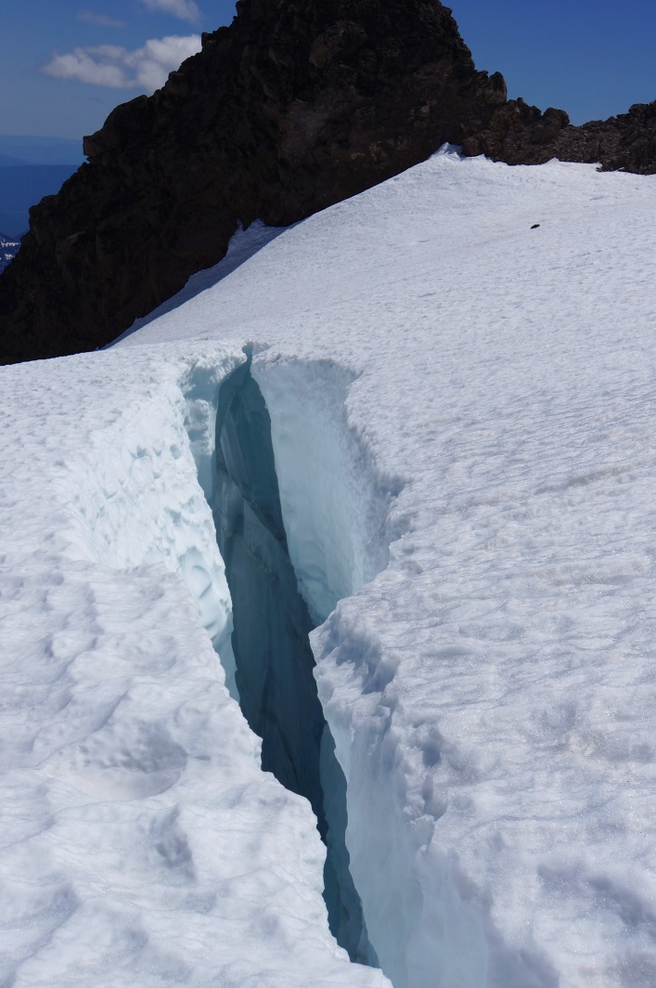
Crevasse Avoidance
-clarify the framing & idea flow
-improve grammar
-find typos
-find run-on sentences

Slide 19
Be pithy …
Anybody can have ideas--the difficulty is to express them without squandering a quire of paper on an idea that ought to be reduced to one glittering paragraph.
Mark Twain Letter to Emeline Beach, 10 Feb 1868
But avoid paralysis…
I was working on the proof of one of my poems all morning , and took out a comma. In the afternoon, I put it back again.
--Oscar Wilde

Slide 20
Style
A number of things are indicated by these results including whether gene X modulates function Y.
Versus
These results indicate that gene X modulates function Y.

Slide 21
Beware of the passive voice
passive voice=
form of “to be” + past participle
e.g. “are indicated …”
Can confuse the subject & object
Avoid making the object of an action into the subject of a sentence
Reduce word number
Look for the phrase “by the …”

Slide 22
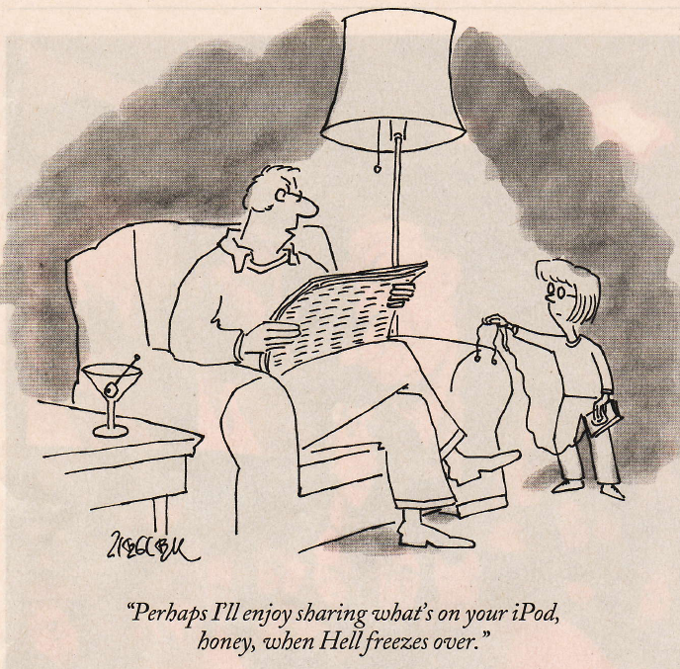
Mentor-Mentees & Writing
How polished is the draft?
Giving time to review
When to solicit mentor input
When to solicit beyond mentor

Slide 23
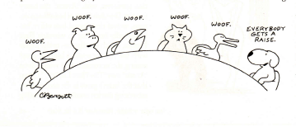
At the Journal
Finding a journal fit
Craft cover letter with care

Slide 24
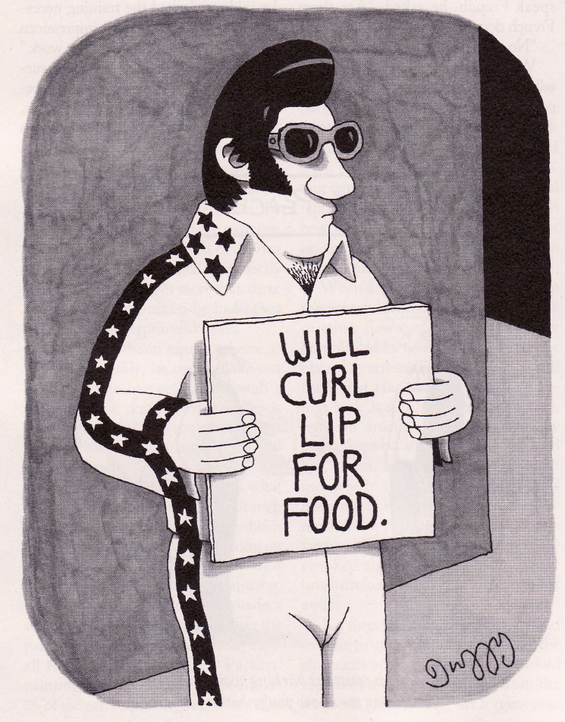
Revisions: the point by point reply
Be thorough
Be polite
Provide all easy answers
Sometimes
Know when & how to argue

Slide 25
Summary Points
1. Create space for your ideas & writing
2. Tell a simple story with a clear & connected path
3. Use active voice
4. Avoid writer paralysis—break it down
5. Do not strive to be a mystery writer

