Slide 1
Growth Mindset & Mindfulness Techniques
Lunch Session Wednesday
2012 Punahou Brain Symposium
Notes:
“What do you know about intelligence?

Slide 2
University of Washington Presenters
Dr. Karen Morell
Dr. Ben McCune

Slide 3
Introductions/Who’s Here
Grade Levels
Familiarity /
  Mindset, Dweck?
  Mindfulness

Slide 4
Resources Handout
Materials available at
http://globalquest.info

Slide 5
The Why
Learn from Mindset and Mindfulness and improve:
  academic performance, retention, and graduation
  --Based on new Neuroscience and Psychology
  Enjoy your lunch.

Slide 6
Rewire our brains
By shifting your attention
Half Empty
Half Full
Notes:
You will literally rewire your brain. This is how you can create the changes you want. Rewire.

Slide 7
But How? Observe Our Thoughts
Higher level brain functions Intervene
Creates new neural pathways for what one Chooses

Slide 8
Raisin Practice
A simple introduction
No “wrong” experiences

Slide 9
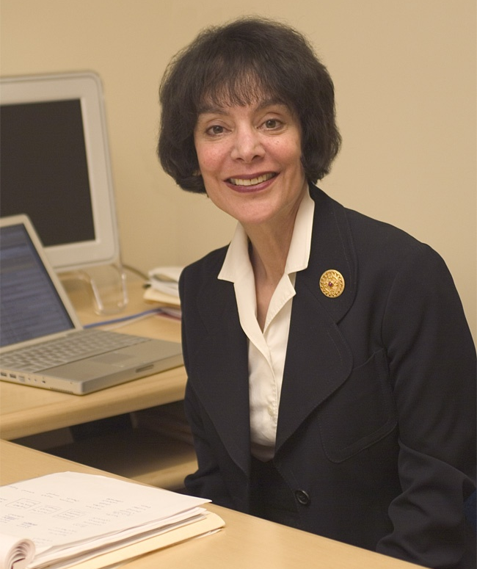
Carol Dweck: Psychology Research
Stanford University
Mindset
http://mindsetonline.com
Brainology
http://brainology.us
Notes:
Awarded the 2011 Am Psy Assoc’s Distinguished Scientific Contribution Award
“Her widely cited work has produced, in addition, clever and effective strategies for promoting more functional incremental theories, learning goals, and PERSISTENCE IN STUDENTS FACING APPARENT FAILURE.”

Slide 10
Square Breathing
From Mindset and Brainology
On the count of 4
Helps reduce anxiety, stress, upset

Slide 11
Brainology
From the MindsetWorks website and newsletter
  Popcorn and Hot Potato Game

Slide 12

Mindfulness
Attention on the Now (Oprah Reading)

Slide 13
Mindfulness Research
Kabat-Zinn, Jon – beginning 1982
  “An outpatient program in behavioral medicine for chronic pain patients based on the practices of mindfulness meditation: Theoretical considerations and preliminary results,” General Hospital Psychiatry 4(1):33-47
Davidson, Richard—Waisman Laboratory for Brain Imaging and Behavior and Center for Investigating Healthy Minds, University of Wisconsin–Madison, Madison, Wisconsin, USA.
Siegel, Daniel UCLA Center for Culture, Brain, and Development and Mindful Awareness Research Center

Slide 14
Mindfulness for Students
Edutopia.org see 2/22/12 with links
  And Six Tips for Brain-Based Learning
  Meditation Education Infographic (handout)
Mindful Schools, Oakland, CA.
Mindfulschools/org
  With research by Biegel, Gina and Brown, Kirk
    And YouTube link with Jon Kabat-Zinn for 2012 fundraiser
    http://www.youtube.com/watch?v=fEINtdXIqns

Slide 15
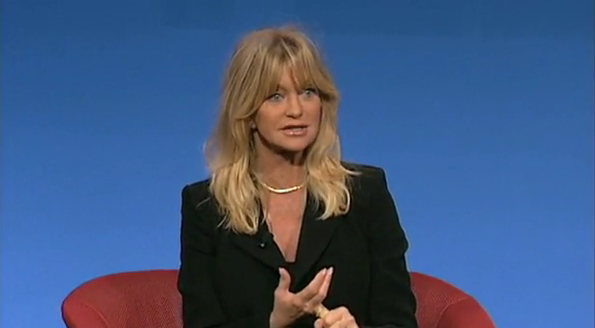
MindUP – Hawn Foundation
Goldie Hawn

Slide 16
MindUP
15 lessons
Self-regulating tools to promote
  Mindful attention when learning
  Create spacious openmind

Slide 17
Core Practice
Deep belly breathing
Focused attention
Breathing and listening
Suggested for the start and end of a day or workshop

Slide 18
The Practice
Sit comfortably
Listen to sound
When it fades, focus on every breath
At the second sound, listen as long as possible, still breathing calmly
When the sound is gone, open eyes

Slide 19
Ten
Another technique
Teaching students to count to ten
Allows for PFC to become more of the controller

Slide 20
MindUP – Video
Goldie Hawn with Dr. Daniel Siegel

Slide 21
Meditation proven to reduce stress and its affects

Slide 22
A Practice
No script needed
3-5 minutes

Slide 23
Questions and Discussion
A
Q

