Slide 1
Basic Analysis in SPSS

Slide 2
Procedure
Import data
Configure data set
Use Explore command
Get descriptive statistics
Look at distributions of variables
Check normality of variables
Run statistical test

Slide 3
Data Import
SPSS likes Excel spreadsheets
Save as SPSS *.sav files

Slide 4
SPSS Data Types
Nominal
Discrete, unordered values, like colors or people
Ordinal
Discrete, ordered values, like scale-response questions
Scale
Continuous values

Slide 5
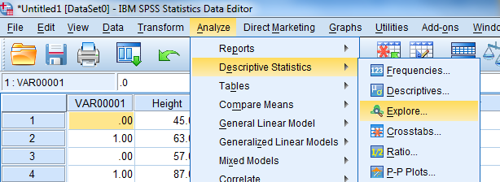
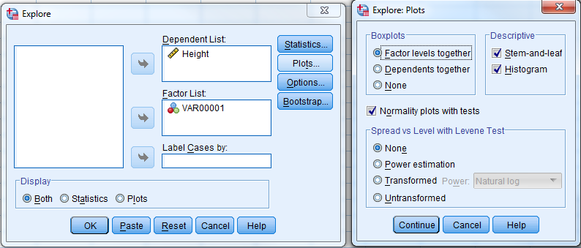
SPSS Explore Command

Slide 6
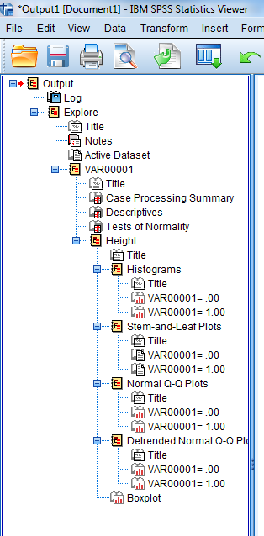
SPSS Explore Command
Output I like to check
Descriptives
Test of Normality
Histograms
Boxplot

Slide 7
Explore Example
ps4hci/posts.sav
Experiment:
40 college students
Half use Android and half use iOS
Count # of facebook posts
Questions:
Experiment design?
Factors/levels?
Measures?
Hypotheses?

Slide 8
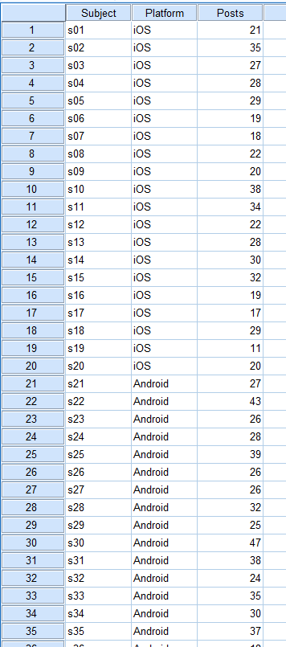
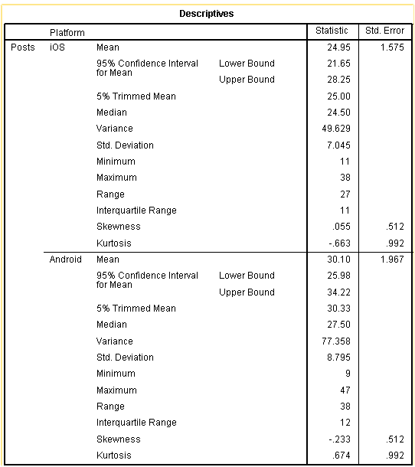
Explore Example
ps4hci/posts.sav

Slide 9
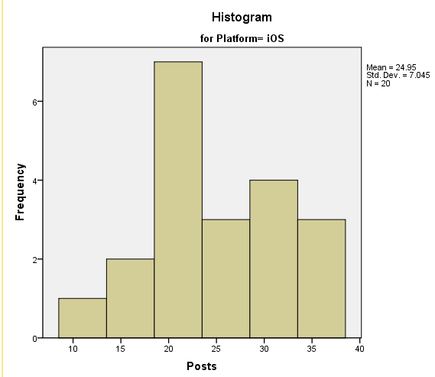
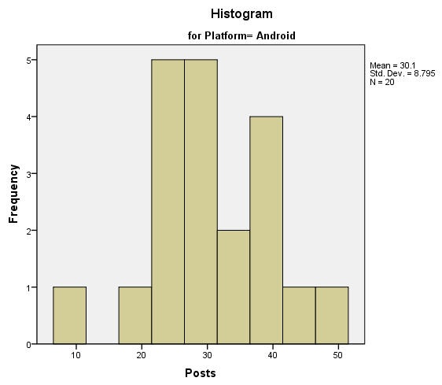
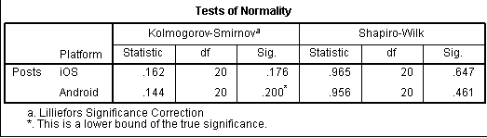
Explore Example
ps4hci/posts.sav
Non-significant p-value indicates data may be normally distributed

Slide 10
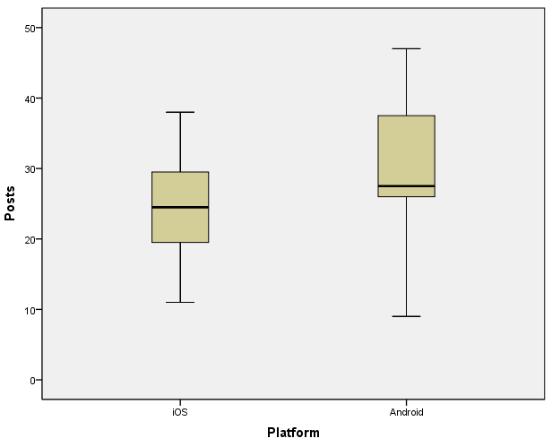
Explore Example
ps4hci/posts.sav
Histograms, box-plots, and descriptive stats suggest that Android users posted more than iOS users.

Slide 11
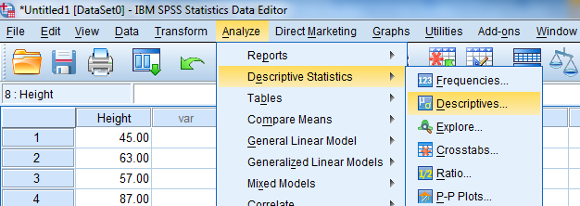
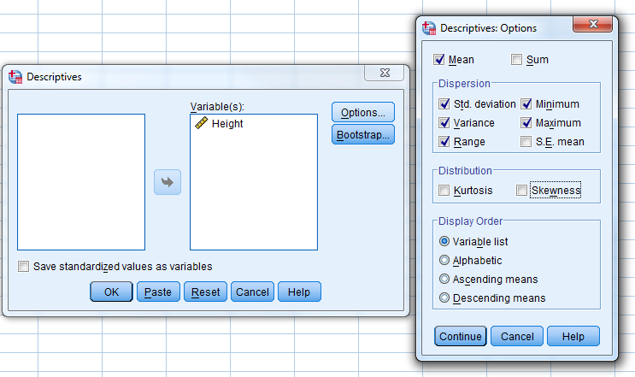
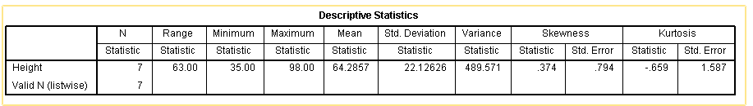
SPSS Descriptives Command

Slide 12
Statistical Test
Design: between subjects
Factors: Platform (Android, iOS)
Measures: Posts
Posts is normal (in both groups)
Which test to use?

Slide 13
Statistical Test
Design: between subjects
Factors: Platform (Android, iOS)
Measures: Posts
Posts is normal (in both groups)
Which test to use?
One-way ANOVA
Since only 2 levels, this is the same as a t-test

Slide 14

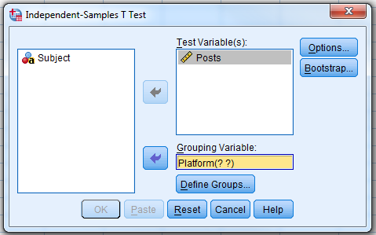
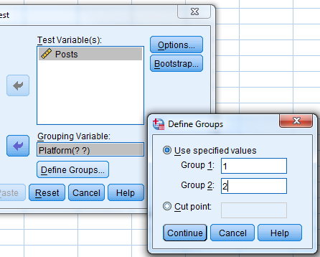
t-test in SPSS

Slide 15
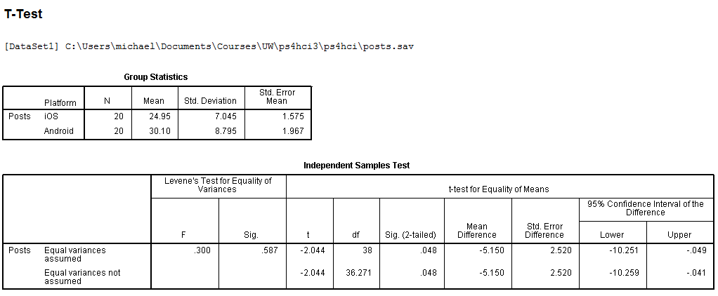
t-test Output
College students who used Android posted significantly more than those who used iOS (30.10 vs. 24.95, t(38) = -2.04, p < .05).

