Slide 1
Hepatitis C Incidence and Prevalence in the U.S.
David Spach, MD
Professor of Medicine
Division of Infectious Diseases
University of Washington School of Medicine
Last Updated: November 5, 2012

Slide 2
Disclosure Information
No disclosures to report

Slide 3
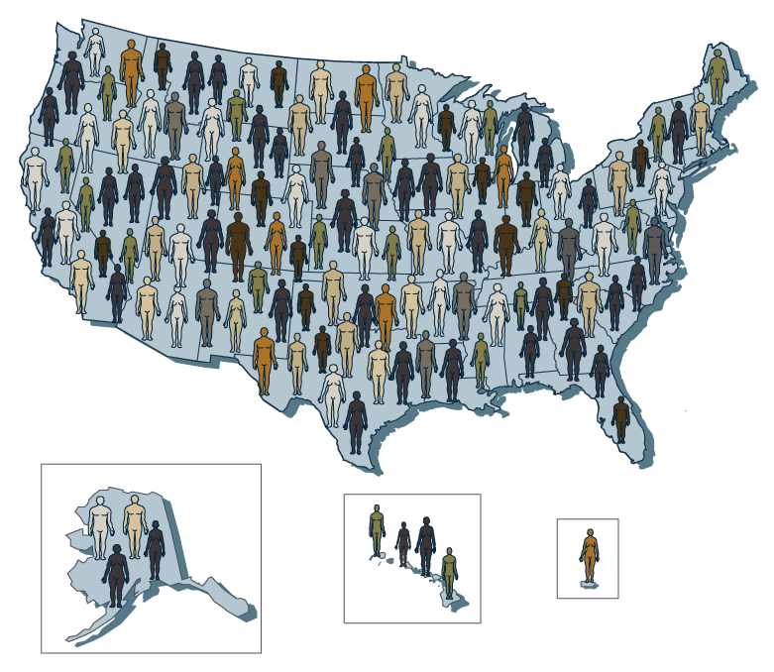
Hepatitis C Incidence and Prevalence in the US: Outline
HCV Incidence
HCV Prevalence
Awareness of Hepatitis C Infection

Slide 4
Hepatitis C Incidence and Prevalence
HCV Incidence. The number of people who become newly infected with HCV in a defined time period.
HCV Prevalence. The number of people living with HCV in a population at a point in time.
Source: CDC Division of Viral Hepatitis. Statistics and Surveillance.

Slide 5
HCV Incidence in the United States

Slide 6
Hepatitis C Incidence in United States, 1982-2010
Source: CDC Division of Viral Hepatitis. Statistics and Surveillance.

Slide 7
Hepatitis C Incidence in United States, 1982-2010
Surrogate testing of blood donors
Anti-HCV test
(1st gen) licensed
Anti-HCV test
(2nd gen) licensed
Decline among
transfusion recipients
Decline among
injection drug users

Slide 8
New Hepatitis C Infections in the United States
Incidence of New Hepatitis C Infections
Type of Cases | Year
 | 2002 | 2003 | 2004 | 2005 | 2006 | 2007 | 2008 | 2009 | 2010
Acute Clinical Cases Reported | 1,223 | 891 | 758 | 694 | 802 | 849 | 878 | 781 | 853
Estimated Number of Acute Clinical Cases | 4,800 | 4,500 | 4,200 | 3,400 | 3,200 | 2,800 | 2,900 | 2,600 | 2,800
Estimated Number of New Infections | 29,000 | 28,000 | 26,000 | 21,000 | 19,000 | 17,000 | 18,000 | 16,000 | 17,000
Source: CDC. Division of Viral Hepatitis-Statistic and Surveillance.

Slide 9
Acute Hepatitis C Incidence by Age Group, United States, 1992-2009
7
years
0-19
20-29
30-39
40-49
50-59
6
5
4
Reported cases/
100,000 population
3
2
1
0
1992
1994
1996
1998
2000
2002
2004
2006
2008
Year
Source: CDC and Prevention and National Notifiable Disease Surveillance System.

Slide 10
Sentinel Counties Surveillance Project, 1982-2006
Acute Hepatitis C Incidence (per 100,000 Population) by Race
Source: Williams IT, et al. Arch Intern Med. 2011;171:242-8.

Slide 11
HCV Prevalence in the United States

Slide 12

NHANES Survey
Estimated Prevalence of Hepatitis C in U.S.
4.1 million Persons Antibody Positive for HCV
3.2 million Persons Living with Chronic HCV
Source: Armstrong GL, et al. Ann Intern Med. 2006;144:705-14.

Slide 13
Expanded Estimate of HCV Prevalence
Estimated Number of anti-HCV Positive Persons in U.S
HCV Prevalence Estimate: Expansion of NHANES Survey
Addition of Groups
- Incarcerated
- Homeless
- Nursing Home Residents
- Hospitalized Persons
- Active Military Duty
Recalculation of Groups
- Healthcare Workers
- Chronic Hemodialysis
- Veterans
5.2 million Antibody Positive for HCV
Source: Chak E, et al. Liver Int. 2011;31:1090-101.

Slide 14
NHANES Survey and Expanded Prevalence
Estimated Number of anti-HCV Positive Persons in U.S
Source: Chak E, et al. Liver Int. 2011;31:1090-101.
Notes:
1

Slide 15
NHANES Survey: United States, 1988-1994 and 1999-2002
Prevalence of HCV Antibody, by Year of Birth
7.0
1988–1994
6.0
1999–2002
5.0
4.0
HCV Prevalence(%)
3.0
2.0
1.0
0
1910
1920
1930
1940
1950
1960
1970
1980
1990
Year of birth
Source: Armstrong GL, et al. Ann Intern Med. 2006;144:705-14.

Slide 16
NHANES Survey: United States, 1988-1994 and 1999-2002
Prevalence of HCV Antibody, by Year of Birth
7.0
1945-1965
1988–1994
6.0
1999–2002
5.0
4.0
HCV Prevalence(%)
3.0
2.0
1.0
0
1910
1920
1930
1940
1950
1960
1970
1980
1990
Year of Birth
Source: Armstrong GL, et al. Ann Intern Med. 2006;144:705-14.

Slide 17
Private Health Care Organizations , U.S, 2006-2008
HCV Infection (Antibody Test or HCV RNA)
Tested
12.7%
HCV-Positive
5.5%
HCO Population
Not Tested
HCV-Negative
Aware
Population: 865,659
Population: 865,659
Tested: 109,575
Tested: 109,575
HCV Positive: 6,008
Source: Spradling PR, et al. Clin Infect Dis. 2012;55:1047-55.
Notes:
1

Slide 18
Private Health Care Organizations, United States, 2006-2008
HCV Infection by Age Group
HCV infection defined as either positive anti-HCV or HCV RNA
Source: Spradling PR, et al. Clin Infect Dis. 2012;55:1047-55.
Notes:
1

Slide 19
Private Health Care Organizations, United States, 2006-2008
HCV Infection by Race
HCV infection defined as either positive anti-HCV or HCV RNA
Source: Spradling PR, et al. Clin Infect Dis. 2012;55:1047-55.
Notes:
1

Slide 20
Awareness of HCV Infection States

Slide 21
NHANES Survey, United States, 2001-2008
Awareness of HCV Infection Status
Knowledge of HCV Infection
Unaware of
HIV infection
21%
Aware of
HIV infection
79%
Source: Denniston M, et al. Hepatology. 2012:55:1652-61.
Notes:
1

Slide 22
NHANES Survey, United States, 2001-2008
Lack of Knowledge of HCV Infection Status, by Age
Source: Denniston M, et al. Hepatology. 2012:55:1652-61.
Notes:
1

Slide 23
NHANES Survey, United States, 2001-2008
Lack of Knowledge of HCV Infection Status, by Race
Source: Denniston M, et al. Hepatology. 2012:55:1652-61.
Notes:
1

Slide 24
Private Health Care Organizations, United States, 2006-2008
Awareness of HCV Infection Status
Knowledge of HCV Infection
Unaware of
HIV infection
21%
Aware of
HIV infection
79%
Source: Spradling PR, et al. Clin Infect Dis. 2012;55:1047-55.
Notes:
1

Slide 25
Hepatitis C Incidence and Prevalence in the U.S.: Summary
The HCV annual incidence has declined dramatically since the mid-1980’s
In 2010, an estimated 17,000 new cases of hepatitis have occurred
An estimated 4.2 to 5.1 million persons are HCV antibody positive
An estimated 3.2 to 4.1 million persons are living with chronic hepatitis C
The HCV prevalence is highest among persons born during 1945 to 1965
Approximately 50% of persons are unaware of their hepatitis C status

Slide 26
End
This presentation is brought to you by
Hepatitis Web Study & the Hepatitis C Online Course
Funded by a grant from the Centers for Disease Control and Prevention

