Slide 1

Antiretroviral Therapy Guidelines
Christian B. Ramers, MD, MPH
Medical Director, NW AETC ECHO
Assistant Professor of Medicine & Global Health, University of Washington
Presentation Prepared by:
Christian B. Ramers, MD, MPH and David Spach, MD
Last Updated: February 22, 2012

Slide 2
- October 2011 DHHS Guidelines
- July 2010 IAS-USA Guidelines
- Supporting Evidence Base
When To Start

Slide 3
Source: 2011 DHHS Antiretroviral Therapy Guidelines. (aidsinfo.nih.gov)
Notes:
The Panel is composed of more than 30 voting members who have expertise in HIV care and research. The U.S. government representatives include at least 1 representative from each of the following DHHS agencies: Centers for Disease Control and Prevention (CDC), FDA, Health Resource Services Administration (HRSA), and National Institutes of Health (NIH). These members are appointed by their respective agencies. Approximately 2/3 of the Panel members are nongovernmental scientific members. There are 4–5 community members with knowledge in HIV treatment and care. Members who do not represent U.S. government agencies are selected after an open announcement to call for nominations. Each member serves on the Panel for a 4-year term, with an option to be reappointed for an additional term

Slide 4
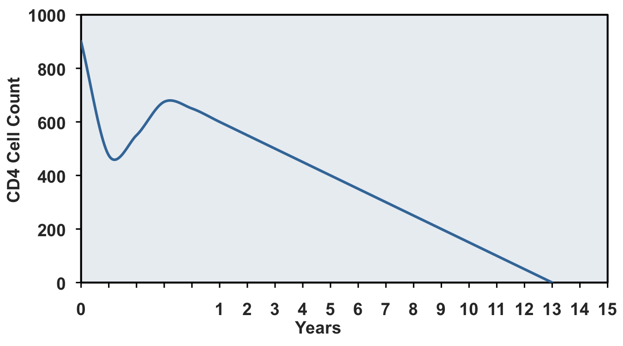
Natural History of Untreated HIV Infection
CD4 < 200: High risk for Opportunistic Infection
Year 1

Slide 5
Initiating Antiretroviral Therapy in Treatment-Naïve Patients
Change in CD4 Threshold in DHHS Guidelines
ANTIRETROVIRAL THERAPY: DHHS GUIDELINES
500
2009
350
2007
200
2003
Source: DHHS Antiretroviral Therapy Guidelines. (aidsinfo.nih.gov)

Slide 6
DHHS Antiretroviral Therapy Guidelines: October 2011
Initiating Therapy in Treatment-Naïve Patients
ANTIRETROVIRAL THERAPY: DHHS GUIDELINES
Consider
Favor: 50% of panel
Optional: 50% of panel
500
Recommend
Strong: 55% of panel
Moderate: 45% of panel
350
Strongly Recommend
Source: DHHS Antiretroviral Therapy Guidelines. (aidsinfo.nih.gov)

Slide 7
DHHS Antiretroviral Therapy Guidelines: October 2011 Initiating Therapy in Treatment-Naïve Patients
ANTIRETROVIRAL THERAPY: DHHS GUIDELINES
Clinical AIDS
Pregnancy
Chronic HBV
HIVAN
Antiretroviral therapy indicated regardless of CD4 cell count
Source: 2011 DHHS Antiretroviral Therapy Guidelines. (aidsinfo.nih.gov)

Slide 8
DHHS Antiretroviral Therapy Guidelines: October 2011
Initiating Therapy in Treatment-Naïve Patients
ANTIRETROVIRAL THERAPY: DHHS GUIDELINES
CD4 Cell Count | Recommendation for Antiretroviral Therapy
<350 cells/mm³ | Strongly Recommend Initiating Therapy (AI)
350-500 cells/mm³ | Recommend Initiating Therapy (A/B-II): -55% of panel voted for strong recommendation (A) -45% of panel voted for moderate recommendation (B)
>500 cells/mm³ | Consider Initiating Therapy (B/C-III): -50% of panel favor starting antiretroviral therapy (B) -50% of panel view treatment is optional (C)
Initiating Antiretroviral Therapy Regardless of CD4 Cell Count
History of AIDS-defining illness (AI) Pregnancy (AI) Hepatitis B virus (HBV) co-infection when treatment of HBV is indicated (AIII) HIV associated nephropathy (AII)
Source: DHHS Antiretroviral Therapy Guidelines. (aidsinfo.nih.gov)

Slide 9
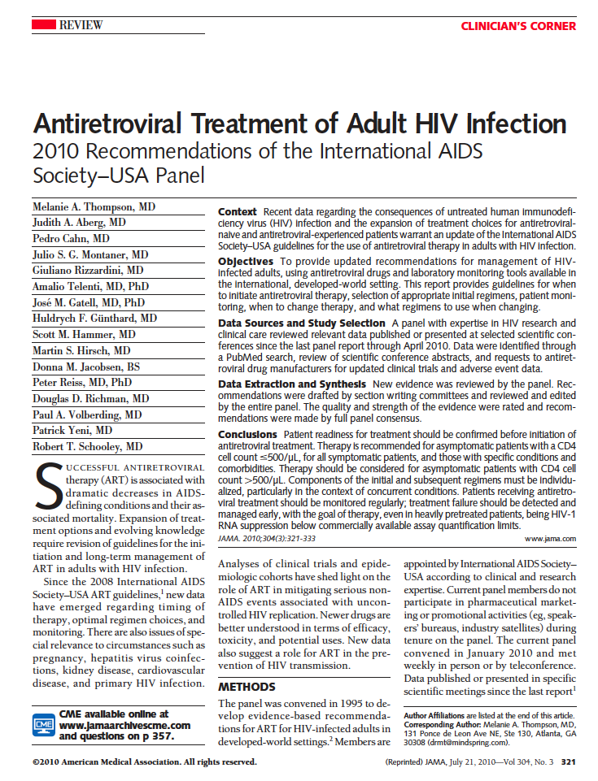
Source: Thompson MA, et al. JAMA. 2010;304:321-33.

Slide 10
IAS-USA Antiretroviral Therapy Guidelines: July 2010
Recommendations for Initiating Therapy in Treatment-Naive
ANTIRETROVIRAL THERAPY: IAS-USA GUIDELINES
Consider*
*Consider unless patient is an elite controller (HIV RNA < 50 copies/ml) or
has stable CD4 cell count and low-level viremia in absence of HAART
500
Recommend
Recommend
Source: Thompson MA, et al. JAMA. 2010;304:321-33.

Slide 11
IAS-USA Antiretroviral Therapy Guidelines: July 2010
Recommendations for Initiating Therapy in Treatment-Naive
ANTIRETROVIRAL THERAPY: IAS-USA GUIDELINES
Antiretroviral Therapy Recommend regardless of CD4 cell count with following conditions:
Symptomatic HIV
Active or High-Risk for CVD
Pregnancy
HIVAN
HIV RNA >
100,000 copies/ml
Symptomatic Primary HIV
Rapid CD4 Decline (> 100/yr)
Age > 60
Chronic HBV
Chronic HCV
High Risk for 2° Transmission
Source: Thompson MA, et al. JAMA. 2010;304:321-33.

Slide 12
IAS-USA Antiretroviral Therapy Guidelines: July 2010
Recommendations for Initiating Therapy in Treatment-Naive
ANTIRETROVIRAL THERAPY: IAS-USA GUIDELINES
2010 IAS-USA Recommendations: Initiating ARV Therapy in Treatment-Naive HIV-1 Infected Adults*
Measure | Antiretroviral Therapy Recommendation | Rating
Specific Conditions
Symptomatic HIV Disease | Antiretroviral Therapy Recommended Regardless of CD4 cell Count | AIa
Pregnant women |  | AIa
HIV-1 RNA > 100,000 copies/ml |  | AIIa
Rapid decline in CD4 count, > 100/µl per year |  | AIIa
Active HBV or HCV coinfection |  | BIIa, AIIa
Active or high risk for cardiovascular disease |  | BIIa
HIV-associated nephropathy |  | BIIa
Symptomatic primary HIV infection |  | BIIa
High risk for secondary HIV transmission |  | BIIa
Asymptomatic
CD4 cell count < 350/µl | Recommended | AIa
CD4 count 350-500/µl | Recommended | AIIa
CD4 count >500/µl | Consider | CIII
Source: Thompson MA, et al. JAMA. 2010;304:321-33.

Slide 13
Mounting Evidence supporting Earlier HAART
Study | Type | Setting | Main Findings
CIPRA HT 001 | RCT | Haiti | Deferring ART until CD4<200 associated with higher mortality than starting when CD4 between 200 and 350
SMART substudy | RCT | Europe, Australia | Deferring ART until CD4<250 associated with higher mortality than starting when CD4 between 350 and 250
ART-CC | Obs | Europe, North America | Significant increase in risk of AIDS and death when therapy was delayed until patients CD4+ counts fell below 350 cells/mm³ compared to earlier treatment.
NA-ACCORD | Obs | North America | 69% lower mortality in those who initiated in 350-500 range than those who deferred; 94% lower mortality in those who initiated at CD4 > 500 than in those who deferred
HPTN 052 | RCT | Africa, US, Asia, S. America | 96% decrease in transmission of HIV in serodiscordant couples when one partner on ART; 41% decrease in AIDS-related events (extra-pulmonary TB) for those on ART
CID. 2009 Apr 15;48(8):1138-51; 16th CROI, 2009 Abs 72LB; JID 2008;197:1133–1144; NEJM 2009;360:1815

Slide 14
- Regimens for ART Naïve Patients
- New, Alternative, and Acceptable Agents
What to Start

Slide 15
Anti-retroviral drug targets
Entry Inhibitors
Nucleoside RTI
Integrase Inhibitors
HIV
Nucleus
CCR5
CD4
HIV RNA
HIV DNA
mRNA
HIV
Myr
Non-Nucleoside RTI
Gag
Protease Inhibitors
Host Cell
Gag-Pol
Notes:
1

Slide 16
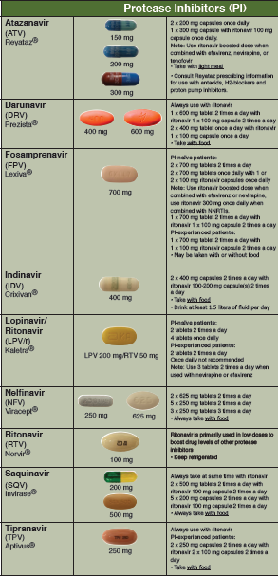
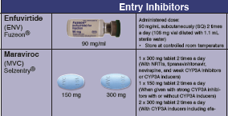
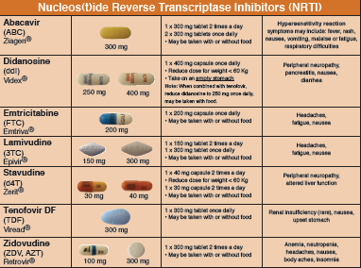
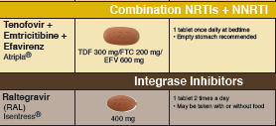
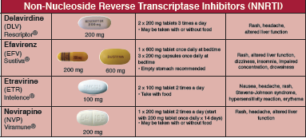
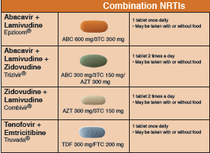

Anti-retroviral Therapy in 2012
New NNRTI: Rilpivirine
Co-formulated with Emtricitabine-Tenofovir as Complera
Source: www.nwaetc.org

Slide 17

DHHS Antiretroviral Therapy Guidelines: October 2011
Preferred Regimens for ARV-Naïve Patients
ANTIRETROVIRAL THERAPY: DHHS GUIDELINES
Third Agent
Non-Nucleoside Reverse Transcriptase Inhibitor (NNRTI)
Backbone
or
(2) Nucleoside Reverse Transcriptase Inhibitors (NRTIs)
+
Protease Inhibitor (PI)
(ritonavir-boosted)
or
Integrase Strand
Transfer Inhibitor (INSTI)
Source: DHHS Antiretroviral Therapy Guidelines. (aidsinfo.nih.gov)

Slide 18
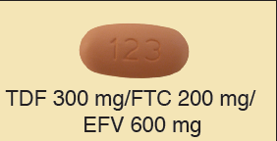


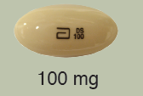
DHHS Antiretroviral Therapy Guidelines: October 2011
Preferred Regimens for ARV-Naïve Patients
ANTIRETROVIRAL THERAPY: DHHS GUIDELINES
(2) Nucleoside RTI (NRTI)
(2) Nucleoside RTI (NRTI)
(2) Nucleoside RTI (NRTI)
+
+
+
Non-Nucleoside RTI (NNRTI)
Protease Inhibitor
Integrase Inhibitors
BID
OR
Source: DHHS Antiretroviral Therapy Guidelines. (aidsinfo.nih.gov)
Notes:
1

Slide 19
DHHS Antiretroviral Therapy Guidelines: October 2011
Preferred Regimens for ARV-Naïve Patients
ANTIRETROVIRAL THERAPY: DHHS GUIDELINES
Class | Therapy
NNRTI-Based Regimen | Efavirenz-Tenofovir-Emtricitabine (AI)
PI-Based Regimen | Atazanavir + Ritonavir + Tenofovir-Emtricitabine (AI) Darunavir (qd) + Ritonavir + Tenofovir-Emtricitabine (AI)
INSTI-Based Regimen | Raltegravir + Tenofovir-Emtricitabine (AI)
Source: DHHS Antiretroviral Therapy Guidelines. (aidsinfo.nih.gov)

Slide 20
DHHS Antiretroviral Therapy Guidelines: October 2011
Alternative Regimens for ARV-Naïve Patients
ANTIRETROVIRAL THERAPY: DHHS GUIDELINES
Class | Therapy
NNRTI-Based | Efavirenz + Abacavir-Lamivudine (BI)
 | Rilpivirine + Tenofovir-Emtricitabine (BI)
 | Rilpivirine + Abacavir-Lamivudine (BIII)
PI-Based | Atazanavir + Ritonavir + Abacavir-Lamivudine (BI)
 | Darunavir + Ritonavir + Abacavir-Lamivudine (BIII)
 | Fosamprenavir (1-2x daily) + Ritonavir + Abacavir-Lamivudine (BI) Fosamprenavir (1-2x daily) + Ritonavir + Tenofovir-Emtricitabine (BI)
 | Lopinavir-Ritonavir (1-2x daily) + Abacavir-Lamivudine (BI) Lopinavir-Ritonavir (1-2x daily) + Tenofovir-Emtricitabine (BI)
INSTI-Based | Raltegravir + Abacavir-Lamivudine (BIII)
Source: DHHS Antiretroviral Therapy Guidelines. (aidsinfo.nih.gov)

Slide 21
DHHS Antiretroviral Therapy Guidelines: October 2011
Acceptable Regimens for ARV-Naïve Patients
ANTIRETROVIRAL THERAPY: DHHS GUIDELINES
Class | Therapy
NNRTI-Based | Efavirenz + Zidovudine-Lamivudine (CI)
 | Nevirapine + Tenofovir-Emtricitabine (CI) Nevirapine + Zidovudine-Lamivudine (CI) Nevirapine + Abacavir-Lamivudine (CIII)
 | Rilpivirine + Zidovudine-Lamivudine (CIII)
PI-Based | Atazanavir + Abacavir-Lamivudine (CI) Atazanavir + Zidovudine-Lamivudine (CI)
 | Darunavir + Ritonavir + Zidovudine-Lamivudine (CIII)
 | Fosamprenavir + Ritonavir + Zidovudine-Lamivudine (CI)
 | Lopinavir-Ritonavir + Zidovudine-Lamivudine (CI)
INSTI-Based | Raltegravir + Zidovudine-Lamivudine (CIII)
CCR5 Antagonist-Based | Maraviroc + Zidovudine-Lamivudine (CI)
 | Maraviroc + Tenofovir-Emtricitabine (CIII)
 | Maraviroc + Abacavir-Lamivudine (CIII)
Source: DHHS Antiretroviral Therapy Guidelines. (aidsinfo.nih.gov)

Slide 22
- Acute HIV Infection
- Pregnancy
- Opportunistic Infections
- Tuberculosis
Special Populations

Slide 23
ART in Special Populations: Acute HIV & Pregnancy
ANTIRETROVIRAL THERAPY: DHHS GUIDELINES
Acute HIV Infection
Benefit unknown for treatment of acute HIV infection; treatment should be considered optional (CIII) except in pregnant women (AI).
A ritonavir (RTV)-boosted PI-based regimen should be used if therapy is initiated before drug-resistance test results are available (AIII).
Pregnancy
Antiretroviral therapy (ART) is recommended for all pregnant women, regardless of CD4 count with the goal to prevent perinatal transmission (AI)
The preferred regimen for pregnant women is Lopinavir/ritonavir (Kaletra) + Zidovudine/Lamivudine (Combivir) twice daily
Source: DHHS Antiretroviral Therapy Guidelines. (aidsinfo.nih.gov)

Slide 24
ART in Special Populations: OI’s & Tuberculosis
ANTIRETROVIRAL THERAPY: DHHS GUIDELINES
Opportunistic Infections
In OI’s with no effective therapy (Cryptosporidiosis, Microsporidiosis, PML). Initiate ART as soon as possible (AIII)
In OI’s with a high potential for IRIS (Cryptococcus, MAC). A short delay may be warranted before initiating ARV treatment (CIII)
In OI’s known to have better survival with early ART (Pneumocystis pneumonia). ART should not be delayed (AI)
Tuberculosis
CD4 Cell Count | Recommendations for TB Therapy and ART
All | Start TB therapy immediately (AI)
< 200 cells/mm³ | Initiate ART within 2-4 weeks of starting TB treatment (AI)
200-500 cells/mm³ | Initiate ART within 2-4 weeks, or at least by 8 weeks, after starting TB treatment (AIII)
> 500 cells/mm³ | Initiate ART within 8 weeks of starting TB treatment (BIII)
Source: DHHS Antiretroviral Therapy Guidelines. (aidsinfo.nih.gov)
Notes:
OI evidence: Zolopa et al ACTG 5164
TB evidence: STRIDE, CAMELIA, and SAP-IT trials

Slide 25
Antiretroviral Therapy Guidelines - Summary
When to Start
DHHS and IAS-USA Guidelines recommend starting ART at or below a CD4 count threshold of 500 cells/mm³. Treatment above this level is considered optional.
What to Start
Starting regimens should use a dual NRTI backbone of Emtricitabine and Tenofovir (FTC/TDF – Truvada) and a third agent such as Efavirenz, Atazanavir/ritonavir, Darunavir/ritonavir, or Raltegravir
The role of newly approved agents is constantly evolving
Special Populations
All pregnant women should start ART to prevent vertical transmission
ART in the setting of Primary HIV and/or acute OI or TB is complex and evolving based on current evidence

