Slide 1
Acute HCV Infection
Arthur Y. Kim, MD
Assistant Professor of Medicine
Harvard Medical School
Director, Viral Hepatitis Clinic
Massachusetts General Hospital
Boston, Massachusetts
FORMATTED: 03-13-2015:

Slide 2

Disclosure Information
Disclosure Information
In past 12 months:
  Funding to institution: AbbVie Pharmaceuticals, Gilead Sciences
  Scientific Advisory Board: Bristol-Myers Squibb

Slide 3
Outline
Rationale to identify acute HCV
Definition of acute HCV
Diagnosis of acute HCV
Treatment of acute HCV

Slide 4
Case
A 22-year-old white female is seen in your clinic with a complaint of a 2 cm abscess on the antecubital fossa of her left arm.
On further questioning you learn she has a five-year history of injection drug use, but is adamant that she has never shared needles or syringes. She was tested for HCV approximately three years ago and was seronegative.
Her only symptom is fatigue and mild discomfort at the site of the small abscess. The rest of her exam is normal.
The patient has recently shared cotton/cookers with her new boyfriend.
HBsAg is non-reactive and her anti-HBc is non-reactive while her anti-HBs is reactive (>100 IU/mL); hepatitis A IgM and IgG is non-reactive, HIV nonreactive.
Her HCV antibody is reactive; her HCV RNA is 3,300 IU/mL; genotype 1a, ALT 120; AST 90.

Slide 5
Rationale to identify acute HCV
For personal and public health benefit
  Provision of education, HAV/HBV vaccines
  Harm reduction, including HIV prevention
  Knowledge of status critical
  Interruption of transmission

Slide 6
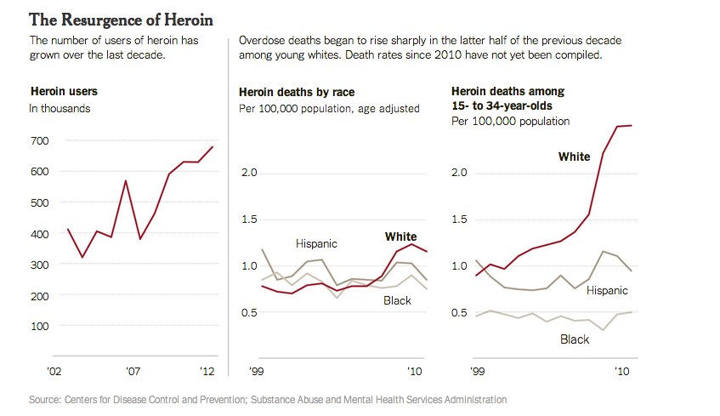
HCV incidence is likely rising
Driven by opioid epidemic
Graphic from “Heroin’s Small-Town Toll, and a Mother’s Grief” New York Times, 2/10/2014

Slide 7
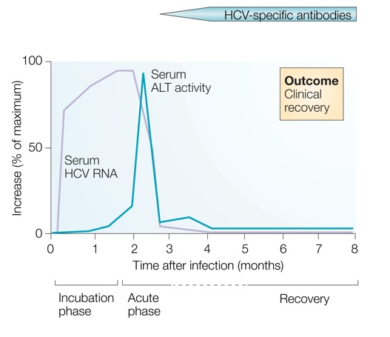
What is acute HCV?
Earliest phase of infection, defined as first 6 months
  Spontaneous clearance possible
  Responsiveness to exogenous IFN highest
Often asymptomatic
~66% of spontaneous clearance occurs in first 6 months
SC associated with:
female gender
young age
immunocompetence
non-African American race
IL28B CC and HLA genes symptoms
HCV RNA required to diagnosis reinfection
ALT normal
HCV RNA neg
HCV Ab pos
Rehermann and Nascimbeni. Nat Rev Immunol 2005 Grebely et al. Hepatology 2010; Detering et al. Lancet Infect Dis 2013;Grebely et al. Hepatology 2014

Slide 8
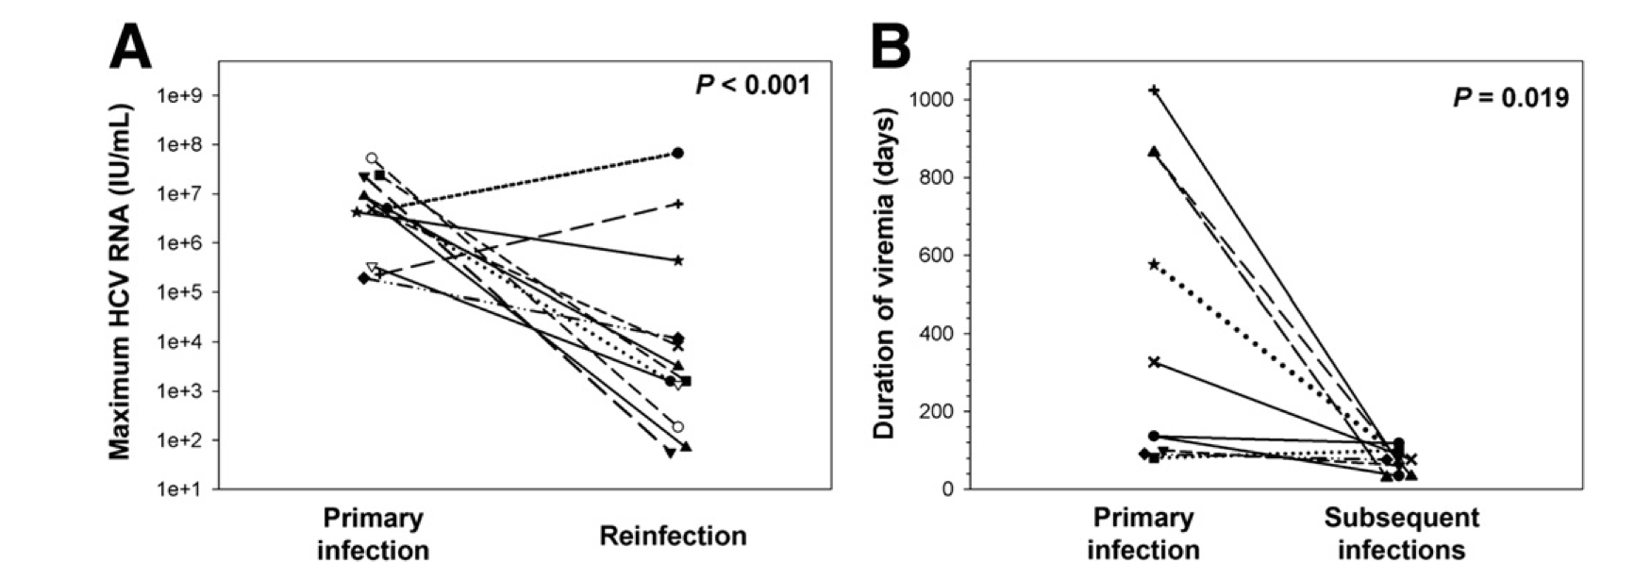
Clearance is associated with protection from reinfection
HCV peak viral load (A) and duration of viremia (B) during reinfection in injection drug users
Osburn et al. Gastroenterology 2010

Slide 9
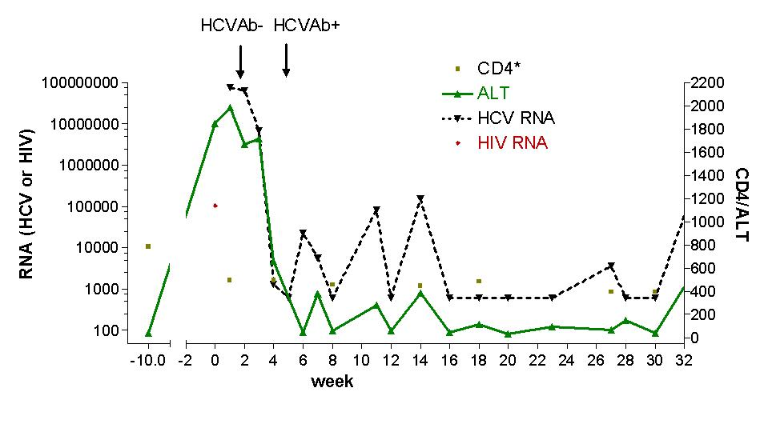
Acute HCV may exhibit a dynamic course
Seroconversion
HCV RNA
ALT
Dynamic changes
HCV RNA and ALT
McGovern et al. Clinical Infectious Disease 2009

Slide 10
Case
A 22-year-old white female with 5-year history of injection drug use, never shared needles/syringes, tested 3 years prior as negative now with new antibody.
The patient has recently shared cotton/cookers with her new boyfriend.
Her HCV antibody is reactive; her HCV RNA is 3,300 IU/mL; genotype 1a, ALT 120; AST 90
Serial monitoring of HCV RNA and LFTs:
baseline: HCV RNA 3,300 IU/mL; ALT 120; AST 90
week 4: HCV RNA 50,000 IU/mL; ALT 390; AST 270
week 10: HCV RNA 1,115 IU/mL; ALT 690; AST 425
bilirubin remains normal

Slide 11
Utility of IL28B testing
Single nucleotide polymorphisms on chromosome 19 are associated with interferon-induced and spontaneous clearance of HCV
rs12979860 SNP testing commercially available (not FDA-approved)
CC type favorable, CT or TT unfavorable
  CC about twice as likely to clear, correlates with jaundice
  Not a perfect predictor
Clinical utility likely less important in the novel direct-acting antiviral era due to high cure rates in chronic phase
Thomas et al. Nature 2009; Grebely et al. Hepatology 2010

Slide 12
Diagnosis of acute HCV
High clinical suspicion + supporting laboratory data
  Seroconversion, fluctuating HCV RNA > 1 log, or value < 10⁵ IU/mL
  HCV RNA for seronegative window, reinfections
React to changes in LFTs
Screen for high-risk behaviors
  PWID: sharing of paraphernalia
  HIV+MSM: Bloody practices, exposure to semen
Screen those engaging in high-risk behaviors
  Yearly antibodies recommended and cost-effective
Schmidt et al. PLoS One 2011; EASL (2010), NY State (2010); Linas et al. Clin Infect Dis 2012

Slide 13
Should we treat acute HCV?
Rarely fulminant, so unlikely to prevent acute liver failure/death
Fibrosis accelerated for HIV+ individuals, more rationale to treat
In past, rationale to treat early included cure rates of interferon-based therapies during acute phase >> chronic phase
At this time, no data to indicate that less intensive courses of interferon-free based regimens are as effective for acute HCV
Major rationale is to reduce transmission

Slide 14
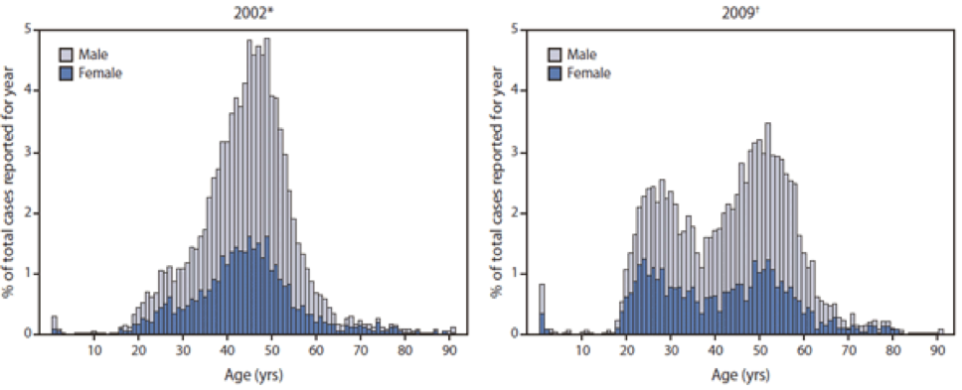
Should we treat acute HCV?
Burden of new infections is high and rising in the United States
Massachusetts surveillance data for HCV cases
~2000 cases
<30 years annually
Source: Onofrey et al MMWR: May 6, 2011 / 60(17);537-541, Kim et al. Journal of Infectious Diseases 207 Suppl 1:S1-6, 2013 Mar

Slide 15
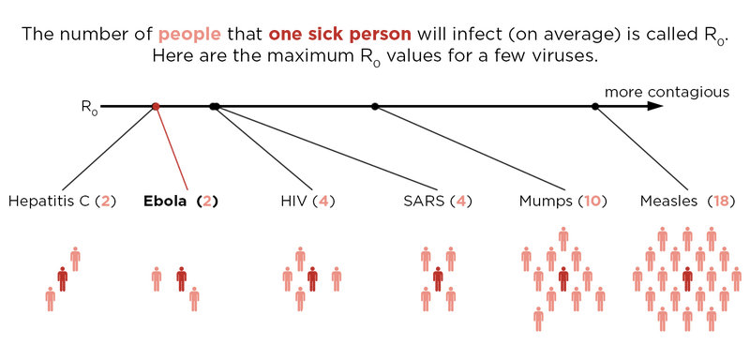
R0 (basic reproductive number)
C = # of contacts per unit of time
P = probability of transmission per contact with infectious person
D = duration that patient is infectious to others

Slide 16
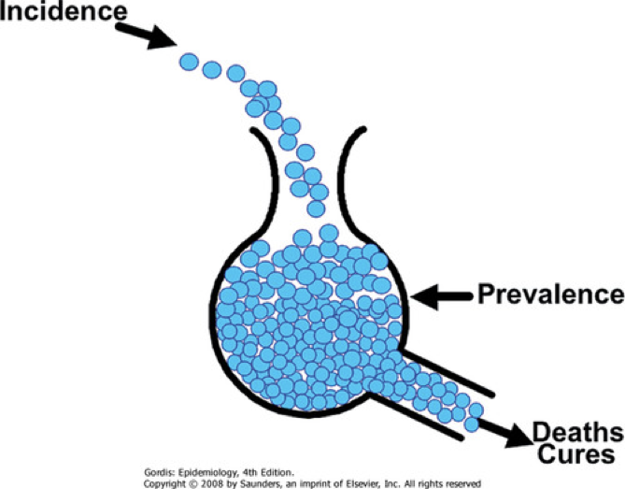
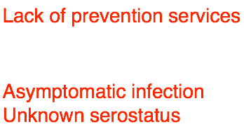
Incidence, prevalence, and sustaining an epidemic
Rising opiate use
Access restrictions and cost of treatment

Slide 17
Can treatment as prevention be applied for HCV among people who inject drugs (PWID)? Modeling DAAs
Source: Martin et al. Hepatology 2013

Slide 18

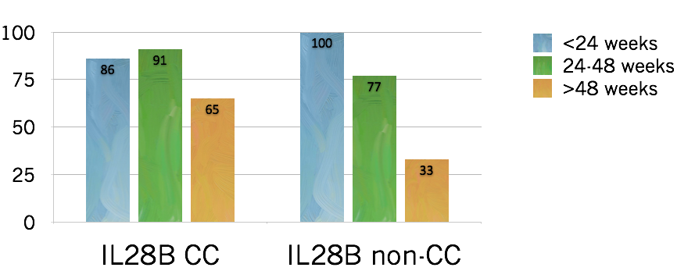
How to treat acute HCV
Timing mattered in the interferon era
80 acute HCV patients treated in Italy
  Timing determined by patient/provider preference
  Shortened course < 24 weeks, standard course for chronic HCV if > 24 weeks
Source: Mangia et al. J Hepatology 2013

Slide 19
Timing of treatment, IFN-era
Largest randomized-control trial of HCV therapy
  Immediate PEG monotherapy vs. delayed PEG/RBV combination therapy
Source: Detering et al. Lancet Infect Dis 2013

Slide 20
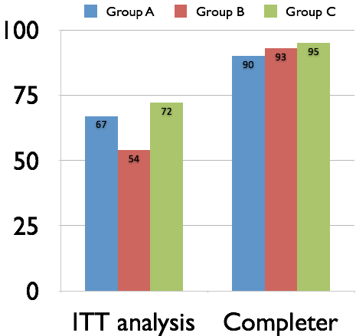
Hep-Net Trial shows delays not as effective, but completers of therapy did quite well
Group A: immediate
Group B: delayed
  11 or 52 on delayed arm spontaneously cleared
Group C: immediate (if no symptoms)
PEG/RBV not as effective, but highly dependent on adherence
Source: Detering et al. Lancet Infect Dis 2013

Slide 21
PEG/RBV + telaprevir for total 12 weeks
41 patients with HIV + aHCV enrolled from 2011-2012
  7 non-GT1
  7 did not have access
  5 spontaneously cleared
  2 refused treatment
19 patients treated: median age 44
  12 IL28B genotype CC (63%)
  SVR12: 16/19 84%
  Historical SVR 63% with PEG/RBV
Source: Fierer et al. Clinical Infectious Diseases 2013

Slide 22
What to do while awaiting data from interferon-free regimens?
All published data are in interferon-era
  Could use shortened course PEG-IFN +/- RBV
  Many patients and providers may shun side effects
Reasonable to wait for spontaneous clearance unless risk of transmission is high
  Surgeon suffering aHCV after needlestick injury
  Active PWID
Can treat with same regimens used for chronic infection after waiting period
Vital to provide knowledge, services and treatment to reduce further transmission
Source: http://hcvguidelines.org

Slide 23


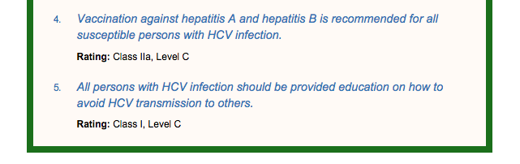
Vaccinate or ensure immunity against other hepatitis viruses
Educate regarding avoidance of HCV transmission
  Harm reduction for PWID: clean needles & equipment
  Harm reduction for HIV+MSM: barriers, practices

Slide 24
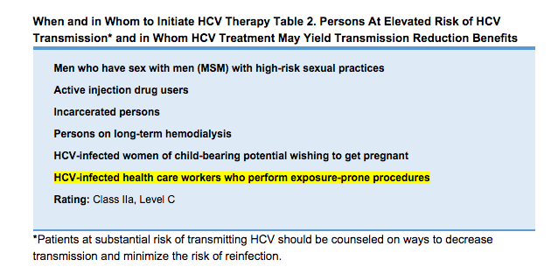
Decision to initiate earlier - preventing transmission (ie, needlestick to surgeon, PWID) - ? utility of IL28B genotype

Slide 25
Recommendations for medical management and monitoring in acute HCV infection.
Regular laboratory monitoring is recommended in the setting of acute HCV infection until the alanine aminotransferase (ALT) level normalizes and HCV RNA becomes repeatedly undetectable, suggesting sponteneous resolution.
Monitoring HCV RNA (eg, every 4 weeks to 8 weeks) for 6 months to 12 months is recommended to determine spontaneous clearance of HCV infection versus persistence of infection.
Counseling is recommended for patients with acute HCV infection to avoid hepatotoxic insults, including hepatotoxic drugs (eg, acetaminophen) and alcohol consumption, and to reduce the risk of HCV transmission to others.
Referral to an addiction medicine specialist is recommended for patients with acute HCV infection related to injection drug use.

Slide 26

If the practitioner and patient have decided that a delay in treatment initiation is acceptable, monitoring for spontaneous clearance is recommended for a minimum of 6 months. When the decision is made to initiate treatment after 6 months, treating as described for chronic hepatitis C is recommended
If a decision has been made to initiate treatment during the acute infection period, monitoring HCV RNA for at least 12-16 weeks is recommended to allow for spontaneous clearance before starting treatment.

Slide 27
Recommended regimens for patients with acute HCV infection
Owing to high efficacy and safety, the same regimens recommended for chronic HCV infection (see Initial Treatment of HCV Infection and When and in Whom to Treat sections) are also recommended for acute infection.
High rates of cure for novel regimens for chronic HCV
Vast majority of data is with PEG-IFN, less costly, but far more side effects. Experts in U.S. generally would not recommend this option.

Slide 28
Summary
Acute HCV incidence is rising in the United States
  Achievement of viral clearance will be important to prevent new cases
Diagnosis requires a high clinical suspicion
  Yearly antibody recommended
    People who inject drugs
    HIV+MSM
Acute HCV is a dynamic phase of infection
  Longitudinal values may show elevated ALT and fluctuating HCV RNA
  Spontaneous clearance
  Determining outcome informs the patient’s infectiousness to others
IL28B genotyping available for prognosis, but currently less useful in clinical-decision making

Slide 29
Summary
Diagnosis of acute HCV requires a high clinical suspicion
  No single diagnostic test
Counseling points for newly-identified acute HCV
  Not likely to have fulminant disease
  Possibility of spontaneous clearance
  Able to transmit to others
Treatment decisions
  Most often we will be allowing for spontaneous clearance
  No reason to believe that SVRs will be lower for the same regimens used for chronic HCV
  Awaiting data of clinical trials of interferon-free regimens

