Slide 1
Hepatitis B Case Studies
Nina Kim, MD MSc
Associate Professor of Medicine
University of Washington
Harborview Madison Clinic and Hepatitis & Liver Clinic
No conflicts of interest
Notes:
Thank you – I’m very happy to be here and talk about my favorite topic, hepatitis B. I hope in the next 20 minutes to go over a few cases from my own patient panel to illustrate what I think are some of the more challenging aspects of HBV management in coinfected patients, and in the end, show you some of the limitations with our current armamentarium of therapy. Full disclosure – for obvious reasons: I will be assuming some general knowledge about HBV – so this is not an introductory talk so I welcome questions at end if you want me to review concepts.

Slide 2
Case 1 – Extensive Treatment Experience
44 yo man with longstanding HIV infection, stage 2 with nadir CD4 220 and chronic hepatitis B infection. Diagnosed with both in 1996, risk factor: sex with men & women. Hx major depression.
HIV Hx
Hx multiple ART regimens including d4T/3TC dual therapy in 1990s
HIV resistance: Protease mutations - D30N and N88D and RT mutations - M184V, R211K, K70R, L74V, L100I, K103N, and K219E
Chronic HBV Hx
eAg positive with baseline HBV level of 110 million IU/mL
Ultrasound: Echogenic liver. In 2004, US showed early hepatofugal flow and mildly enlarged spleen

Slide 3
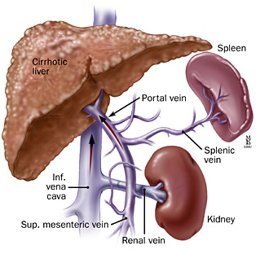
Source: gi.jhsps.org

Slide 4
Case 1 – Extensive Treatment Experience
44 yo man with longstanding HIV infection, stage 2 with nadir CD4 220 and chronic hepatitis B infection, e-Ag positive with high baseline HBV viral level and probable cirrhosis.
Persistent HBV viremia in 5 log₁₀ IU/mL range on lamivudine/adefovir (along with various antiretroviral agents) for many years
Notes:
Two questions: (1) So why am I making a big deal about this persistent HBV viremia? (2) Does this scenario seem unusual or unexpected?

Slide 5
Case 1 – Extensive Treatment Experience
44 yo man with longstanding HIV infection, stage 2 with nadir CD4 220 and chronic hepatitis B infection, e-Ag positive with high baseline HBV viral level and probable cirrhosis.
Persistent HBV viremia in 5 log₁₀ IU/mL range on lamivudine/adefovir (along with various antiretroviral agents) for many years
Notes:
Two questions: (1) So why am I making a big deal about this persistent HBV viremia? (2) Does this scenario seem unusual or unexpected?

Slide 6
HBV DNA Level Associated With
Increased Risk of HCC & Cirrhosis
REVEAL: Long-term follow-up of untreated HBV carriers in Taiwan
50
Cumulative Incidence of HCC at
Year 13 Follow-up ¹ (N = 3653)
Cumulative Incidence of Cirrhosis at
Year 13 Follow-up ² (N = 3582)
40
36.2
30
Patients (%)
23.5
20
12.2
14.9
10
9.8
4.5
5.9
1.3
1.4
3.6
0
< 300
300-
999
1000-
9999
10,000-
99,999
≥ 100,000
< 300
300-
9999
10,000-
99,999
100,000-
999,999
≥ 1 million
Baseline HBV DNA (copies/mL)
1. Chen CJ, et al. JAMA. 2006;295:65-73.
2. Iloeje UH, et al. Gastroenterology. 2006;130:678-686.
Notes:
HBV viremia can have significant consequences…
Two major studies with longterm follow-up of HBV monoinfected patients highlighted the role of HBV viral replication in disease progression.
You can see here that the baseline HBV viral burden had a dose-dependent relationship with likelihood of developing HCC and cirrhosis, independent of HBeAg status or ALT level.
These findings have been the main impetus for more “proactive” HBV treatment & HBV suppression in our effort to reverse this natural history.

Slide 7
Case 1 – Extensive Treatment Experience
44 yo man with longstanding HIV infection, stage 2 with nadir CD4 220 and chronic hepatitis B infection, e-Ag positive with high baseline HBV viral level and probable cirrhosis.
Persistent HBV viremia in 5 log₁₀ IU/mL range on lamivudine/adefovir (along with various antiretroviral agents) for many years
Notes:
Two questions: (1) So why am I making a big deal about this persistent HBV viremia? (2) Does this scenario seem unusual or unexpected?

Slide 8
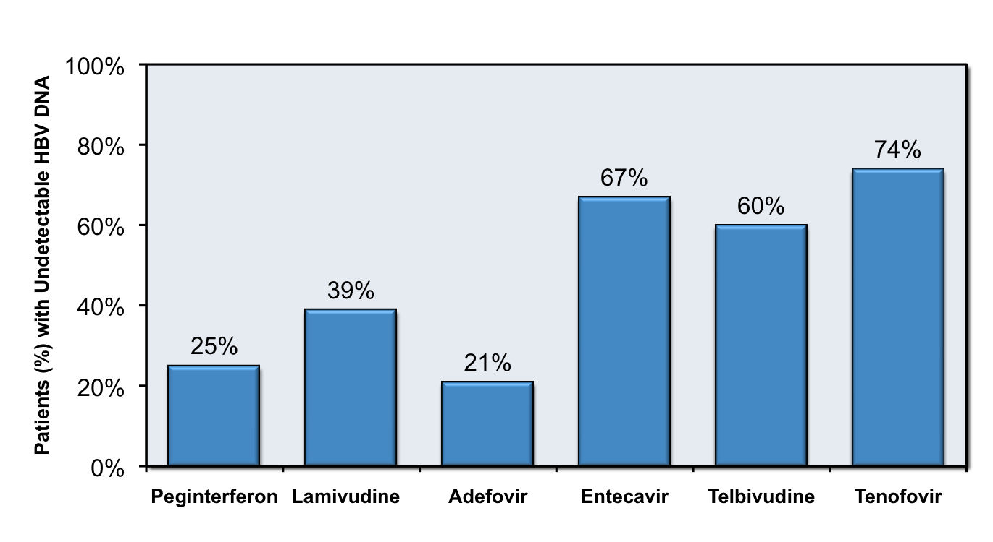
HBV Suppression after 1 Year
HBeAg-positive Patients
EASL Hep B Clinical Practice Guidelines 2012
Notes:
Is persistent viremia for years on ADF + 3TC at all unexpected? Answer is no.
As you can see in this chart, the probability of HBV suppression after a year is noticeably less likely in eAg positive patients with adefovir. But what about the lamivudine? Why would one continue to be viremic on this?

Slide 9
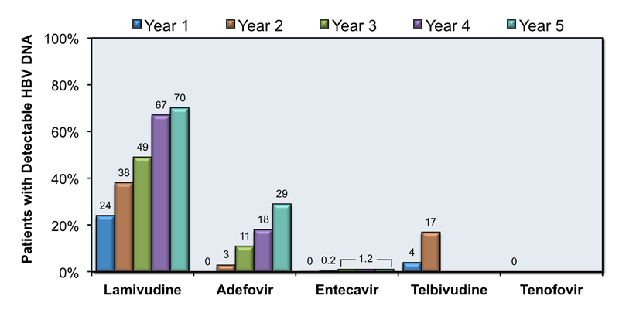
Probability of Virologic Failure
EASL Hep B Clinical Practice Guidelines 2012
Notes:
You can see here that the probability of virologic failure is markedly high with each year that you are on lamivudine. This is data from monoinfected patients but the rates are comparable if not slightly greater in HBV-HIV coinfected patients. LAM resistance is almost a given when you have a patient with ongoing viremia after years on 3TC. And coinfected patients like my patient who are extensively treatment experienced and has seen what is effectively LAM monotherapy for HBV for years are particularly vulnerable to this.

Slide 10
Case 1 – Extensive Treatment Experience
44 yo man with longstanding HIV infection, stage 2 with nadir CD4 220 and chronic hepatitis B infection, e-Ag positive with high baseline HBV viral level and probable cirrhosis.
Persistent HBV viremia in 5 log₁₀ range on lamivudine/adefovir (& various ART) for many years until finally
Switched to ART: Truvada, Kaletra and fosamprenavir in 2007.
CD4 480 cells/mm³, HIV suppressed and HBV DNA at nadir 20 IU/mL
Chemistry panel shows new Cr elevation 1.6. Serum phophate 2.5. ALT remain normal. UA: 1+ protein, 1+ glucose (normal serum glucose), no cells or casts.
What would you do next?
Notes:
So patient is showing signs of TDF nephrotoxicity and renal tubular injury.

Slide 11
Peginterferon in HIV-HBV Coinfected Patients
Advantages | Disadvantages
Finite treatment course No drug resistance Highly sustainable response* (eAg/Ab conversion) HBsAg clearance* | Subcutaneous injection Frequent adverse effects Risk of hepatitis flare Contraindicated in advanced cirrhotics
*Treatment efficacy may be limited/suboptimal in HIV-infected patients, esp. with low CD4 cell counts.
DiMartino, Gastroenterol 2002;123:1812-22.

Slide 12
Oral HBV-active Antiviral Agents
Medication | Potency against HBV | Barrier to HBV Resistance | HIV Activity | Selection of HIV Resistance Reported
Lamivudine | Moderate | Low | Yes | Yes
Adefovir | Low | Moderate | Noª | No
Entecavir | High | High | Partial | Yes
Emtricitabine | Moderate | Low | Yes | Yes
Telbivudine | High | Low | Partial^{b} | No
Tenofovir | High | High | Yes | Yes
ª = anti-HIV activity at higher doses; more potent against HBV ^{b} = No in vitro activity observed against HIV, but HIV RNA decline reported
http://depts.washington.edu/hepstudy/
Notes:
So here are the 6 antiviral agents with HBV activity, in contrast to IFN, the advantage of low toxicity. I have bolded the ones that also have activity vs HIV. Among these choices – the one with the highest potency & greatest barrier to resistance, with dual activity vs both HIV and HBV is tenofovir and it remains the first choice agent.

Slide 13
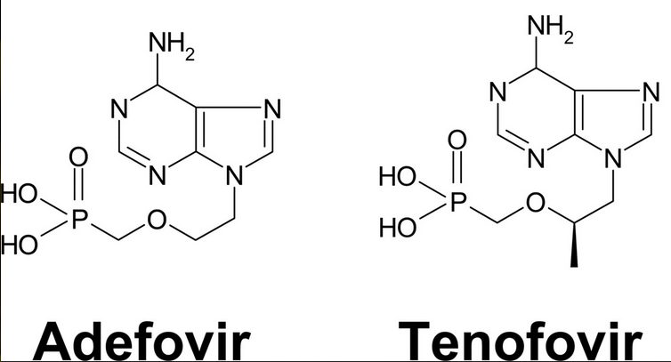
Nucleotide Analogues: Adefovir and Tenofovir
Notes:
Just a reminder that the chemical difference between these two drugs is just a few molecules. This is the reason why we do not use these in combination. And a patient who has renal toxicity with TDF will most likely experience the same with ADF.

Slide 14
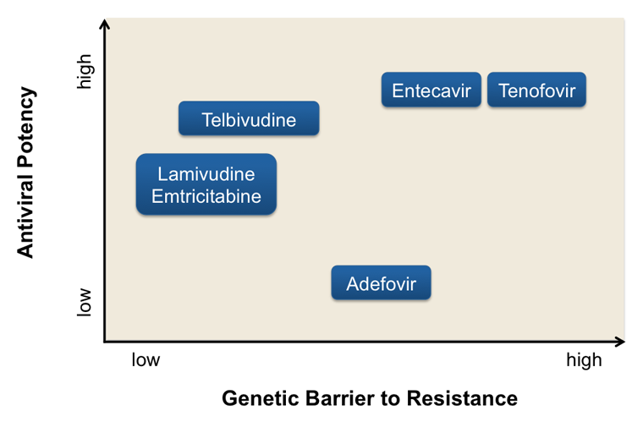
EASL Hep B Clinical Practice Guidelines 2012
Notes:
This is a graphical illustration of where these different drugs fall in the spectrum of antiviral potency and barrier to resistance. Telbivudine incidentally is not a great choice for the same reasons that LAM is not a great choice – threshold for resistance is quite low. So ultimately you want to choose something in this corner.

Slide 15
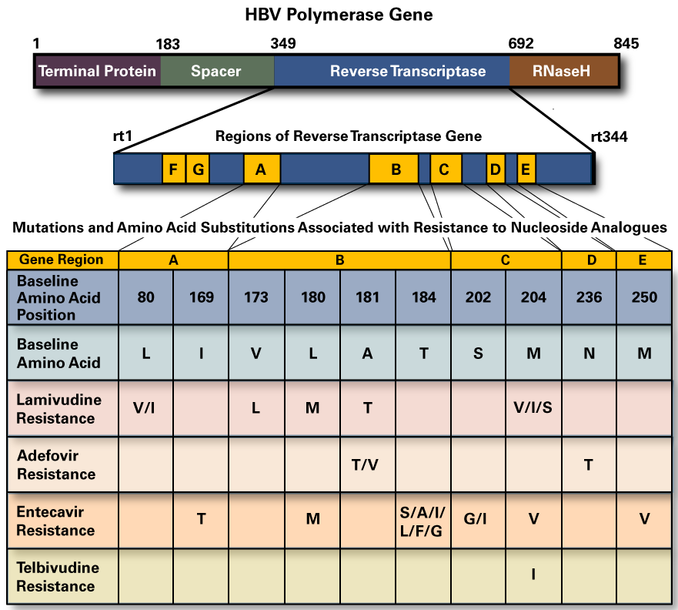
Notes:
LAM, ETV and TBV all share the same resistance pathway…
LAM resistant patients, we use a higher dose of ETV

Slide 16
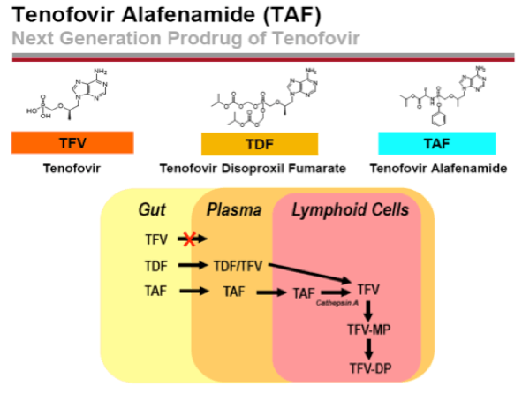
Tenofovir Alafenamide for HBV?
Hepatocytes

Slide 17
Case 1 – Extensive Treatment Experience
44 yo man with longstanding HIV infection, stage 2 with nadir CD4 220 and chronic hepatitis B infection.
Persistent HBV viremia in 5 log₁₀ range on lamivudine/adefovir (& various ART) for many years until finally
CD4 480 cells/mm³, HIV suppressed and HBV DNA at nadir 20 IU/mL on ART: Truvada, Kaletra and fosamprenavir in 2007.
Chemistry panel shows new Cr elevation 1.6. Serum phophate 2.5. ALT remain normal. UA: 1+ protein, 1+ glucose.
Tenofovir stopped. Entecavir 1.0 mg daily dose started with continued HBV suppression.
Ultrasound in 2015: normal-sized spleen, hepatopetal flow & mildly echogenic liver

Slide 18
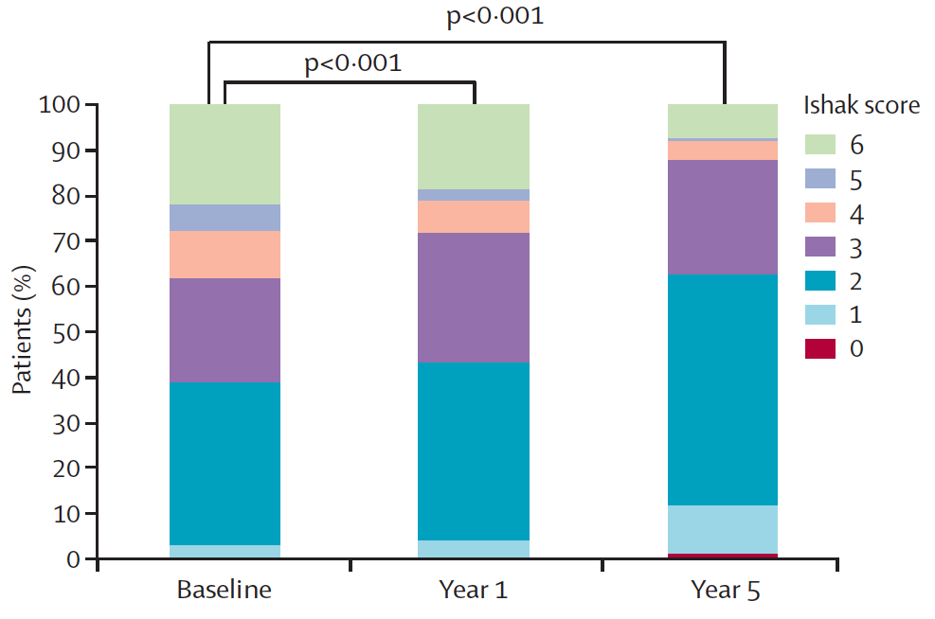
Regression of Cirrhosis in Patients on Tenofovir
Marcellin, et. al. Lancet 2013; 381: 468-75.
Notes:
We are however starting to see more of the longterm benefits of sustained HBV suppression on antiviral therapy. In this study published in the Lancet a few yrs ago, 87% nearly 350 HBV infected pts who were treated with tenofovir showed histologic improvement on liver biopsy and 51% had regression of their fibrosis by year 5 of treatment.
Ishak fibrosis score of 4-6 represent varying stages of cirrhosis, early to late.

Slide 19
Case 2 – Ongoing HBV Viremia on TDF/FTC
47 yo man with stage 3 HIV infection nadir CD4 0 with a history of cryptococcal meningitis in 2007, VZV meningitis in 2008. Seizure disorder and spastic paraparesis 2* HIV myelopathy. Chronic hepatitis B without clinical evidence of cirrhosis.
2009 – started on Truvada (TDF/FTC), abacavir, darunavir, raltegravir
2009-2010 – Still HBV viremic to 5-7 log₁₀ IU/mL range in background of HIV suppression
Notes:
Quintuple regimen – CNS penetrating combination and INSTI for rapid viral control. But was on 2-active agents for HBV through this time.

Slide 20
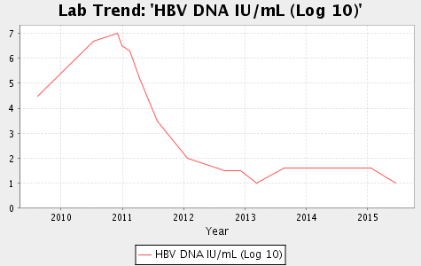
Case 2 – Ongoing HBV Viremia on TDF/FTC
350
Entecavir
300
ALT (IU/L)
L180M, M204V
250
200
150
100
50
Tenofovir/FTC
Notes:
HBV resistance assay sent late 2010 → LAM mutations
Entecavir added Dec 2010
And one might infer causality and say in all likelihood that was responsible for viral decline which certainly looks that way BUT another thing that was occurring in the background

Slide 21
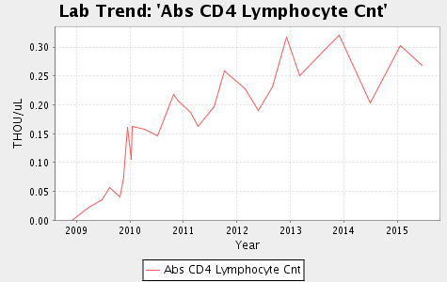
Case 2 – Ongoing HBV Viremia on TDF/FTC
Notes:
I bring up this patient to illustrate a few points:
It can take a very long time before we see HBV suppression. We’re quite impatient and used to HIV viral kinetics
You need an immune response to help clear the HBV – the antivirals play a role but it may not do all the heavy lifting.

Slide 22
Chronic HBV in the CNICS Cohort
939 patients
Treated with Tenofovir (TDF)
≥3 months
1067 patients
(+)HBsAg or HBV DNA
397 patients
HBV DNA measured on TDF & detectable baseline HBV DNA
Kim, JAIDS 2014; 66:96-101.
Notes:
We confirmed this in a study that I did within the CNICS cohort – network of Center for AIDS research centers – 8 academic sites of HIV care. Our goal was to examine HBV suppression on tenofovir, and examine risk factors for delayed viral suppression.

Slide 23
Risk Factors for Delayed HBV Suppression
Variable | Adjusted Hazard Ratio (95% CI) | P
3TC exposure | 0.60 (0.42-0.85) | <0.01
Age >40 yrs | 1.08 (0.81-1.43) | 0.62
Nadir CD4, cells/mm³ (ref: ≥500) 350-499 200-249 <200 | 0.58 (0.33-1.01) 0.55 (0.32-0.93) 0.53 (0.31-0.88) | 0.06 0.03 0.02
HBV DNA level >10,000 IU/mL | 0.34 (0.22-0.53) | <0.01
Race (ref: white) Black Other | 0.78 (0.56-1.08) 1.21 (0.60-2.45) | 0.14 0.61
Serum ALT >80 U/L | 1.56 (1.14-2.15) | 0.01
Kim, JAIDS 2014; 66:96-101.
Notes:
A lower nadir CD4 count was also associated with delayed HBV suppression. Both findings underscore the influence of treatment experience and immune status on HBV clearance.

Slide 24
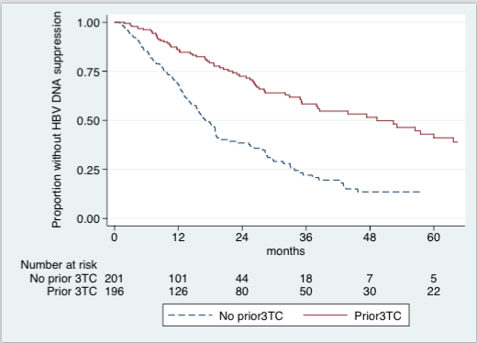
Delayed HBV DNA Suppression on Tenofovir
Kim, JAIDS 2014; 66:96-101.
Notes:
Most of whom were eAg positive, we found that 3TC-exposed patients were less likely to suppress their HBV promptly on tenofovir – their median time to HBV suppression was 50 months compared to 17 months in 3TC-naïve patients.
Why would this be? I am not sure: 3TC does not share the same resistance pathway as TDF, but it can promote compensatory mutations which can result in more “fit” viral phenotype. Does this reflect the fact that 3TC experienced patients were effectively on TDF monotherapy, and that patients esp those with higher VL may benefit from dual therapy.

Slide 25
Dual Therapy for HBV: TDF + ETV or FTC
Probably not worth the cost & additional drug exposure in HBV mono-infected patients who are treatment-naive.
Dual* therapy may be considered in patients who are:
  Treatment-experienced esp if HBV viremic on prior therapy
  Cirrhotic
  HIV-co-infected (esp. if lamivudine-experienced)
  Transplant patients
*NOTE: It remains unclear if dual therapy should be TDF/FTC vs TDF/ETV
Lok, Gastroenterol 2012;143:619.
Petersen, J Hepatol 2012;56:520.
Notes:
Dual therapy is controversial. General consensus is that it’s probably not worth it.

Slide 26
Take Home Points
Avoid lamivudine or emtricitabine monotherapy for your HIV-HBV co-infected patients
Adefovir is not potent. Know the limitations of these antivirals.
Peginterferon is not 1st-line standard of care in HIV-HBV
HBV viral suppression can be delayed out to 2 or more years in some HIV-HBV patients.
  Some of this may not be due to drug but to lack of immune clearance
  Not everyone needs entecavir

