Slide 1
Initial Treatment of HCV G1
2016
Hugo E. Vargas, MD
Professor of Medicine
Medical, Director Office of Clinical Research
Mayo Clinic Arizona

Slide 2

Disclosure Information
Disclosure Information
Dr. Vargas receives research grant support paid directly to his institution from:
  Gilead
  Bristol Myers
  Merck
  AbbVie
He also serves in the ABIM test writing committee. No discussion of ABIM test materials will take place

Slide 3
Outline
Whom and when to treat
Viral Genotype 1a initial treatment
  Non-Cirrhotic
    Recommended
    Alternatives
  Compensated Cirrhotic
    Recommended
    Alternatives
Viral Genotype 1b initial treatment
  Non-Cirrhotic
    Recommended
    Alternatives
  Compensated Cirrhotic
    Recommended
    Alternatives
Cautions/Controversies

Slide 4
Treatment Candidates

Slide 5
Worldwide Burden of Disease due to HCV is Increasing
WHO estimates 130-170 million people, (3% of world's population) HCV infected and at risk of cirrhosis/HCC
There are 3 to 4 million new infections/yr
HCV is responsible for 50–76% of all HCC and 50-60% of all liver transplants in the developed world
HCV-associated cirrhosis leads to liver failure and death in about 20%-25% of cirrhotic patients
World Health Organization

Slide 6
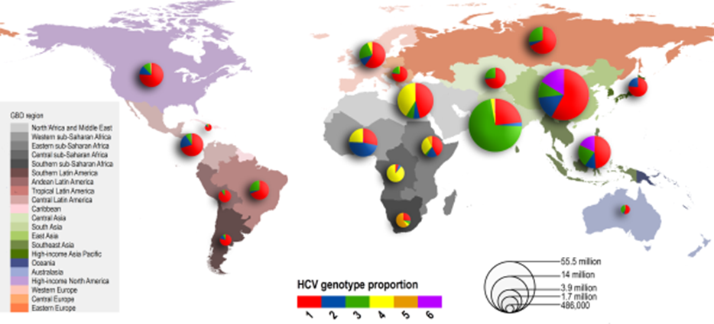
HCV Global Genotype Distribution
Messina, Hepatology 2014

Slide 7
Current Status of HCV in the US: Screening and Linkage to Care Rates Remain Low
US population with chronic HCV infection
3.2 million
HCV detected
1.6 million (50%)
Referred to care
1.0 – 1.2 million (32%-38%)
HCV RNA test
630,000 – 750,000 (20-23%)
Liver biopsy
380,000 – 560,000 (12%-18%)
Treated
220,000 – 360,000 (7-11%)
Successfully treated
170,000 – 200,000 (5-6%)
Holmberg, NEJM 2013

Slide 8
Who should be treated?
Overriding principles in recommendations are that:
1-HCV infection is a curable disease
2-All HCV infected patients should receive treatment
3-There are several groups of patients who should receive treatment immediately as they derive highest benefit:
a) Patients with cirrhosis
b) Recipients of Liver Transplantation who remain HCV+
c) HIV/HCV co-infected patients
d) Patients with extra-hepatic manifestations of HCV
-Cryoglobulinemia
-B-cell lymphoma
-Porphyria cutanea tarda
AASLD/IDSA Treatment Guidelines (www.hcvguidelines.org)

Slide 9
Who should be treated?
Consideration should also be given to the possibility HCV treatment potentially decreasing transmission of HCV in the community, thus the following populations should be treated:
1-Prision inmates
2-HIV/HCV+ men who have sex with men
3-Clinicians at high risk of transmission to patients
4-IVD users
There are patients who should not receive treatment, specifically those with life threatening illness whose treatment would not change their immediate survival (12mo)
AASLD/IDSA Treatment Guidelines (www.hcvguidelines.org)

Slide 10
Regimen Basics:
Initial Treatment

Slide 11
Ledipasvir and Sofosbuvir

Slide 12
Ledipasvir/Sofosbuvir (LDV/SOF)
Ledipasvir (LDV) is an NS5A complex inhibitor
Sofosbuvir (SOF) is an NS5B nucleoside inhibitor
Approved in US 2014 for treatment of HCV G1 disease
Fixed dose combination (FDC) as a single pill,
90mg LDV/400mg SOF
Pivotal registration trials for this discussion were ION 1,2,3
Banerjee AP&T 2016 43:674

Slide 13
Ledipasvir/Sofosbuvir
Special considerations:
  To be avoided in patients with GFR<30mg/dL
  Co-administration with amiodarone can cause life-threatening bradycardias
  Has excellent profile in patients with compensated cirrhosis
  Avoid the use of PPI as LDV absorption is decreased
Banerjee AP&T 2016 43:674

Slide 14
ION Studies: Pivotal LDV/SOF studies
ION-1: FDC for 12 or 24 weeks ± RBV in treatment naïve patients Afdhal et al., NEJM 2014, 370:1889
ION-3 FDC for 8 weeks± RBV vs 12 weeks in treatment naïve patients Kowdley et al., NEJM 2014, 370: 1879
ION-2 FDC for 12 or 24 weeks ± RBV in treatment experienced patients (cirrhotics included) Afdhal et al., NEJM 2014, 370:1483

Slide 15
Study Design
GT 1 Treatment-Naïve (ION-1)
Wk 0
Wk 12
Wk 24
Wk 36
LDV/SOF
SVR12
LDV/SOF + RBV
SVR12
LDV/SOF
SVR12
LDV/SOF + RBV
SVR12
GT 1 HCV treatment-naïve patients in Europe and USA
865 patients randomized 1:1:1:1 across four arms
Stratified by HCV subtype (1a or 1b) and cirrhosis
Afdhal et al., NEJM 2014, 370:1889

Slide 16
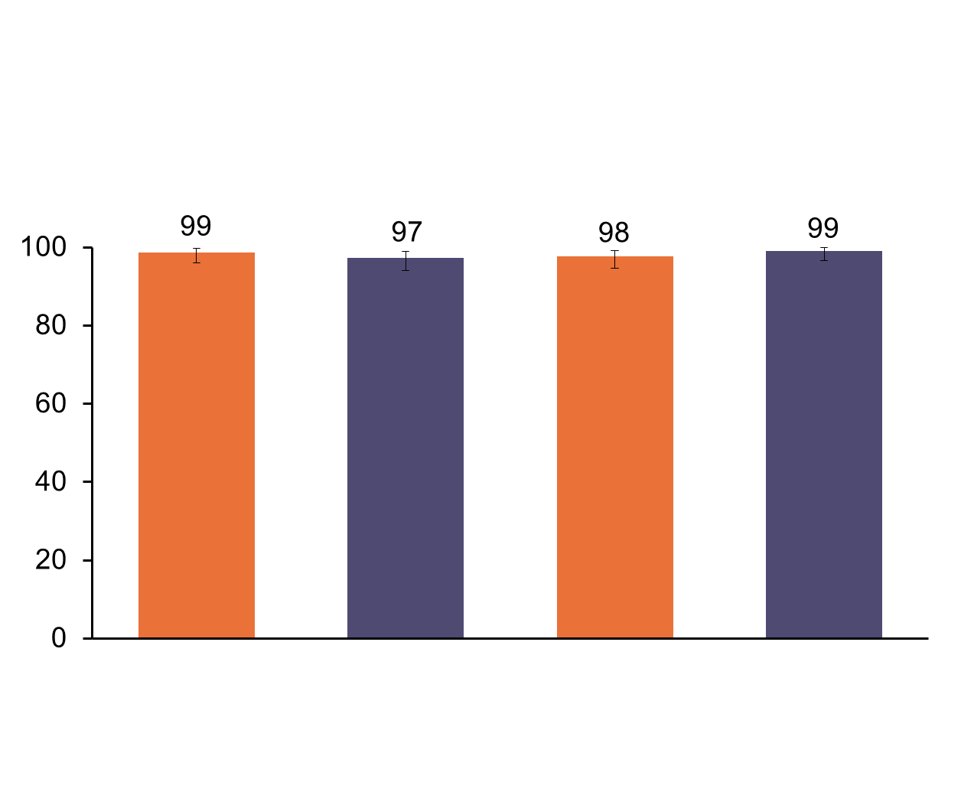
Results: SVR12
GT 1 Treatment-Naïve (ION-1)
SVR12 (%)
211/214
211/217
212/217
215/217
LDV/SOF
LDV/SOF + RBV
LDV/SOF
LDV/SOF + RBV
12 Weeks
24 Weeks
Error bars represent 95% confidence intervals.
Afdhal et al., NEJM 2014, 370:1889

Slide 17
Study Design
GT 1 Treatment-Naïve (ION-3)
Wk 0
Wk 8
Wk 12
Wk 20
Wk 24
LDV/SOF
SVR12
LDV/SOF + RBV
SVR12
LDV/SOF
SVR12
GT 1 treatment-naïve patients without cirrhosis
647 patients randomized 1:1:1 across three arms
Stratified by HCV subtype (1a or 1b)
Kowdley et al., NEJM 2014, 370: 1879

Slide 18
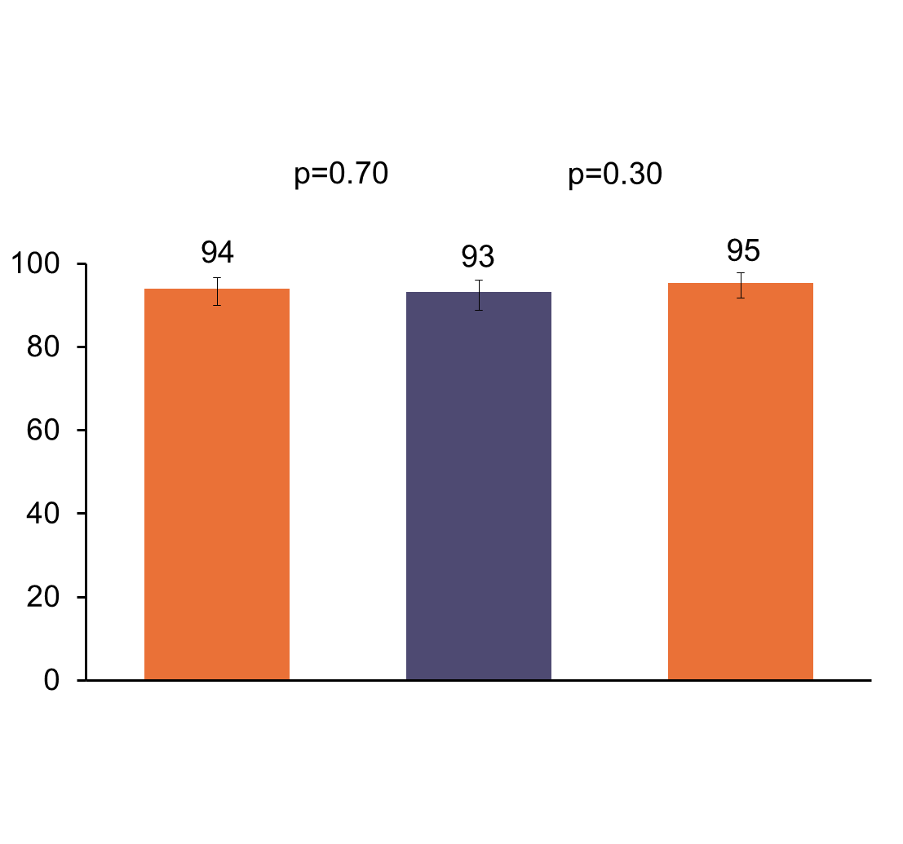
Results: Non-Inferiority Comparison
GT 1 Treatment-Naïve (ION-3)
p=0.52
SVR12 (%)
202/215
201/216
206/216
LDV/SOF
LDV/SOF + RBV
LDV/SOF
8 Weeks
12 Weeks
Error bars represent 95% confidence intervals.
Kowdley et al., NEJM 2014, 370: 1879

Slide 19
Conclusions Across Phase 3 SOF/LDV Studies
SOF/LDV effective across G1 patients
  Treatment naive
    No additional benefit to 24 weeks – 12 weeks adequate
    8 weeks adequate for non-cirrhotic patients (with titers ≤ 6M IU/mL)
    RBV of no benefit
    No significant breakthrough and relapse rare

Slide 20
Simeprevir and Sofosbuvir

Slide 21
Simeprevir and Sofosbuvir (SMV/SOF)
Approved separately for overlapping indications
Simeprevir is a second wave, first generation NS3/4a Protease Inhibitor
Sofosbuvir is a nucleotide polymerase inhibitor
The combination was tested as proof of concept IFN free regimen for G1 in the Phase II COSMOS study
Treatment outside clinical trials very successful

Slide 22
SMV/SOF +/- RBV: SVR12 in TN and NR (COSMOS)
Pooled 12 and 24 week treatment arms
Pooled +/- RBV arms
SVR12 (%)
82/87
F0-F2
F3-F4
Lawitz et al., Lancet 2014, 384:1756

Slide 23
SMV/SOF COSMOS: Summary
FDA approved the combination in November 2014 based on this study
RBV did not improve SVR12
  RBV may not be necessary (small numbers: 2/3 patients received RBV)
Non-cirrhotics: 12 week treatment
Cirrhotics: 24 week treatment (naïve or experienced)
Phase 3 results recently published
Lawitz et al., Lancet 2014, 384:1756

Slide 24
SMV/SOF in GT 1 Non-cirrhotics (OPTIMIST-1)
112/115
88/103
38/40
40/52
112/116
92/116
44/46
36/49
68/70
56/67
38/39
36/39
Q80k+
Q80k-
Kwo et al., Hepatology 2016 epublish

Slide 25
OPTIMIST-2: SVR12
SMV+SOF for 12 Weeks in Cirrhotics
SVR12: SMV + SOF 12 weeks
Proportion of patients (%)
44/50
42/53
Implication: SMV+SOF for 12 weeksinsufficient for GT1 cirrhotics
Lawitz E, et al. Hepatology 2016 epublish

Slide 26
Adjusted SVR4 for SOF/SMV±RBV (HCV TARGET)
SVR12 (%)
Sulkowski, et al. Gastroenterology 2016, 150:419

Slide 27
Simeprevir/Sofosbuvir
Special Considerations
Screening GT 1a patients for the presence of Q80K polymorphism important if cirrhotic or considering re-treatment
No dosage adjustment of SMV required in patients with mild, moderate or severe renal impairment
Drug:drug interactions
  Co-administration of SMV with drugs that are moderate/strong inducers or inhibitors of CYP3A may significantly affect the plasma concentrations of SMV.
  Co-administration of amiodarone with sofosbuvir in combination with SMV may result in serious symptomatic bradycardia and is not recommended
Banerjee AP&T 2016 43:674

Slide 28
Elbasvir and Grazoprevir

Slide 29
Elbasvir/Grazoprevir (EBV/GZR)
Grazoprevir Second generation NS3/4a protease inhibitor
Elbasvir Second generation NS5A complex inhibitor
As will all PI inhibitors, drug-drug interactions should be closely scrutinized and package insert should be closely followed
The use of this regimen should be considered in G1a patients after reviewing for the presence of NS5A specific RAV’s

Slide 30
Elbasvir/Grazoprevir
RAV testing at population level (detecting mutations in >10-25% of the quasispecies) is felt to be adequate at this time
RAV testing to genotypes other than 1 not widely available
NS5A mutations that are impactful to EBV are:
  M28A/G/T
  Q30D/E/H/G/K/L/R
  L31F/M/V
  Y93C/H/N/S

Slide 31
SVR12: Grazoprevir/Elbasvir (GZR/EBR) for 12 Weeks in GT 1 Treatment-Naïve Patients (C-EDGE)
67% of failures due to relapse
Most common adverse events were headache, fatigue, nausea and arthralgia (no difference from placebo arm)
Zeuzem et al., Ann Intern Med 2014, 163: 1

Slide 32
Elbasvir/Grazoprevir in Compensated Cirrhosis: SVR12
Treatment Naive Pts; 12 Wks
98
90
100
80
Treatment-naive pts: SVR12 rates similar regardless of RBV use and platelets level.
  SVR12 rate range across subgroups treated without RBV: 96% to 100%
Previous relapsers: SVR12 rates not affected by duration or RBV use
Previous nonresponders: SVR12 rates lower with 12-wk
  GT1: 92% vs 100%
  GT4: 67% vs 100%
60
SVR12 (%)
40
20
135/
138
28/
31
n/N =
0
No RBV
RBV
Treatment Experienced Pts
89
91
94
100
100
80
60
SVR12 (%)
40
20
48/
54
74/
81
46/
49
49/
49
n/N =
0
No RBV
RBV
No RBV
RBV
12 wks
16 or 18 wks
Jacobson IM, et al. AASLD 2015. Abstract

Slide 33
Paritaprevir/r, Ombitasvir, Dasbuvir ± Ribavirin (3D)

Slide 34
3D regimen
Paritaprevir is a ritonavir boosted NS3/4a protease inhibitor
Ombitasvir is an NS5A complex blocker
  FDC preparation
Dasabuvir is a non-nucleoside inhibitor (administered twice daily)
Ribavirin administration is required in G1a, not in most cases with G1b

Slide 35
Pivotal 3D regimen studies
SAPPHIRE I: Placebo-Controlled, 12-Week Regimen Of Paritaprevir/r/Ombitasvir, Dasabuvir, and Ribavirin in Treatment-Naïve Adults With HCV Genotype 1 Feld et al.; NEJM 2014 370:1594
SAPPHIRE II: Placebo-Controlled, 12-Week Regimen Of Paritaprevir/r/Ombitasvir, Dasabuvir, and Ribavirin in Treatment-Experienced Adults With HCV Genotype 1 Zeuzem et al., NEJM 2014 370:1604
TURQUOISE-II: Open label, 12 vs 24-week Regimen Of Paritaprevir/r/Ombitasvir, Dasabuvir, and Ribavirin in HCV G1-infected patients with Compensated Cirrhosis Poordad et al., NEJM 2014 370: 1973

Slide 36
SAPPHIRE-I: Placebo-Controlled Design (N=631)
Double-Blind
Treatment Period
Open-Label
Treatment Period
3D + RBV
(n=473)
48-Week
Follow-Up
Placebo
(n=158)
3D + RBV
48-Week
Follow-Up
Week 0
Week 12
Week 24
Week 60
Week 72
Primary Analysis:
SVR12
3D: ABT-450/r/ombitasvir, 150 mg/100 mg/25 mg QD; dasabuvir, 250 mg BID
RBV: 1000-1200 mg daily according to body weight (<75 kg and >75kg, respectively)
Feld et al.; NEJM 2014 370:1594

Slide 37
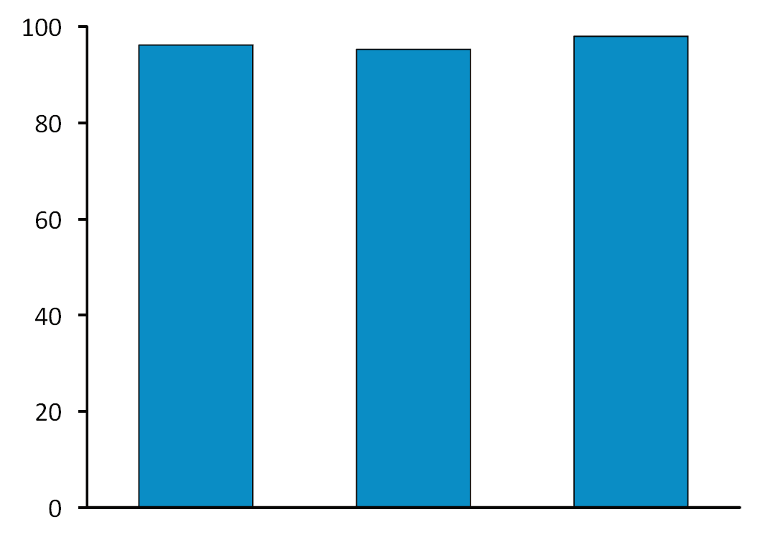
SAPPHIRE-I Results: SVR12 Rates
(Superiority to Historical Rate)
96.2%
95.3%
98.0%
SVR12, % Patients
455/473
307/322
148/151
All Patients
GT1a
GT1b
Feld et al.; NEJM 2014 370:1594

Slide 38
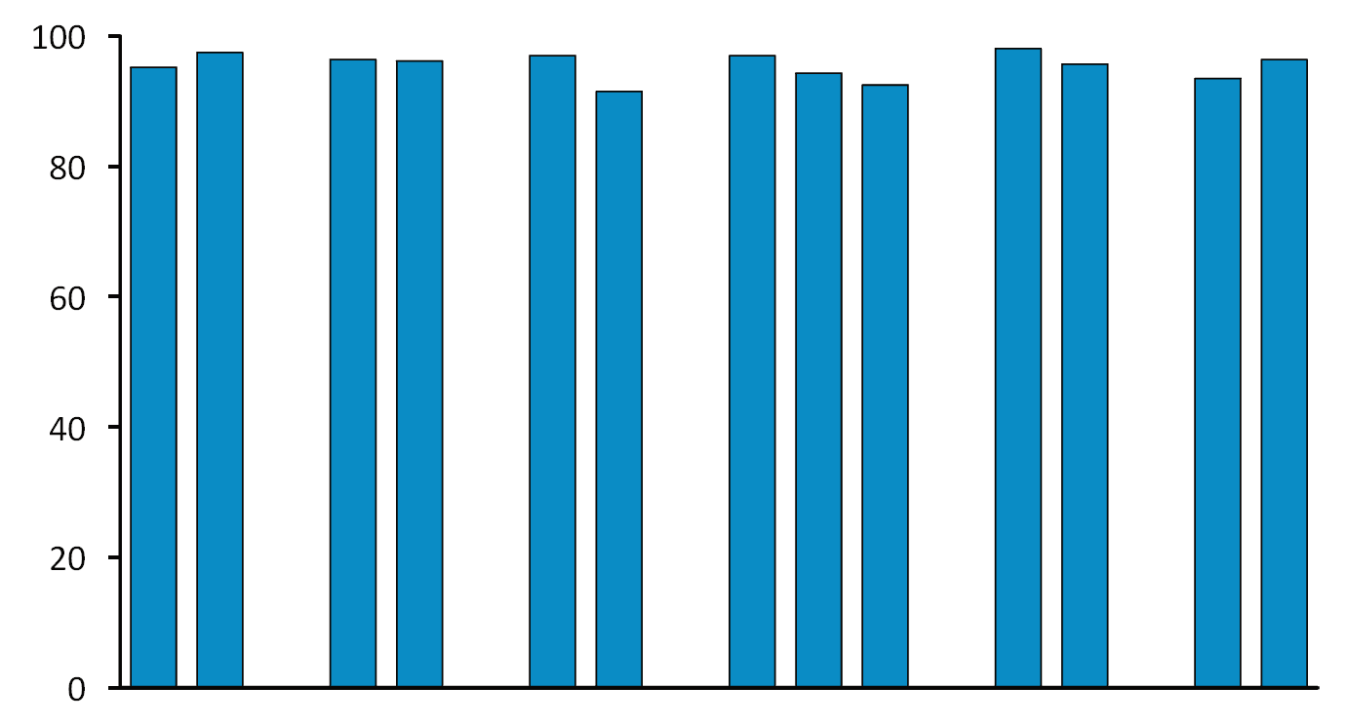
SAPPHIRE-I: ITT SVR12 Rates in Subpopulations
95.2
97.5
96.4
96.2
97.0
91.5
97.0
94.3
92.5
98.1
95.7
93.5
96.4
SVR12, % Patients
271
202
28
445
402
71
363
70
40
104
369
31
442
Male
Female
Black
Non-
Black
<30
>30
F0-F1
F2
F3
<800K
>800K
Yes
No
Gender
Race
BMI
(kg/m²)
Fibrosis
Stage
Baseline
HCV RNA
(IU/mL)
RBV
Modification
Feld et al.; NEJM 2014 370:1594

Slide 39
TURQUOISE-II Study Design: Phase 3 in 380 GT1-Infected Cirrhotics
SVR12
3D + RBV
(N=208)
3D + RBV
(N=172)
SVR12
Day 0
Week 12
Week 24
3D: co-formulated ABT-450/r/ombitasvir, 150 mg/100 mg/25 mg QD; dasabuvir, 250 mg BID
RBV: 1000-1200 mg daily according to body weight (<75 kg and >75kg, respectively)
Poordad et al., NEJM 2014 370: 1973

Slide 40
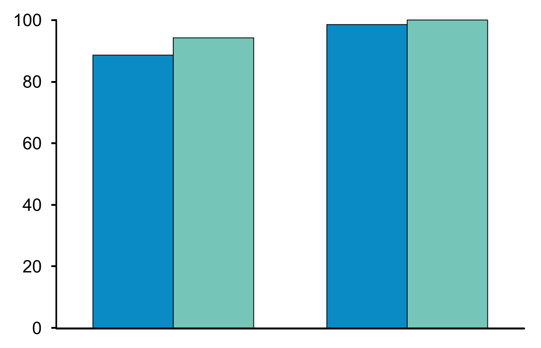
TURQUOISE-II Results:
ITT SVR12 Rates by HCV Subtype
94.2
98.5
100
88.6
3D + RBV
12-week arm
24-week arm
SVR12, % Patients
124/140
114/121
67/68
51/51
GT 1a
GT 1b
Poordad et al., NEJM 2014 370: 1973

Slide 41
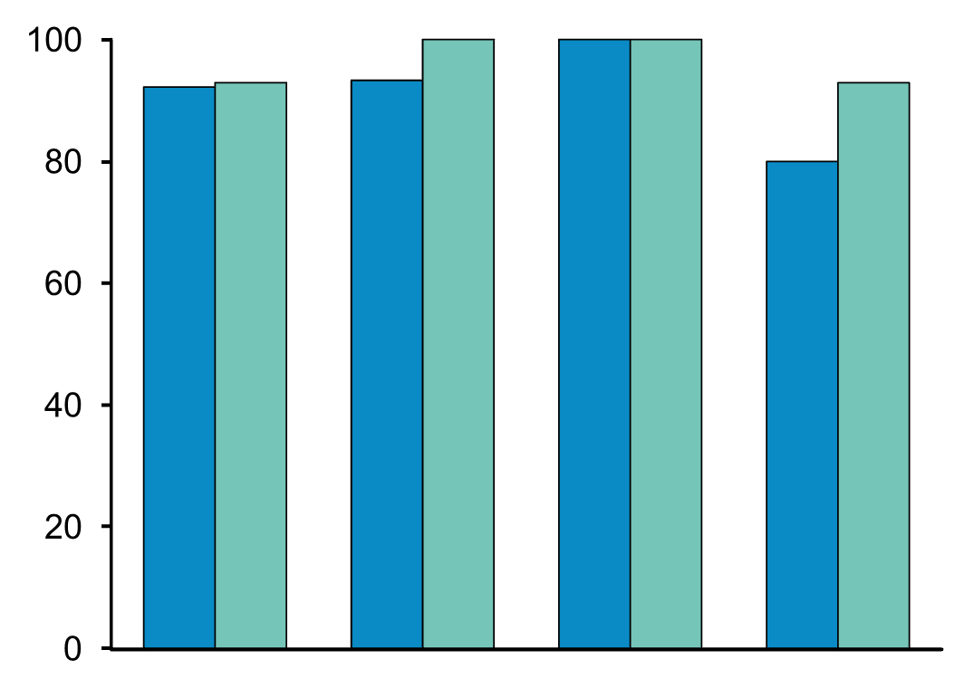
TURQUOISE-II: SVR12 Rates by TE in G1a
92.2
92.9
93.3
100
100
100
92.9
80.0
3D + RBV
12-week arm
24-week arm
SVR12, % Patients
59/64
52/56
14/15
13/13
11/11
10/10
40/50
39/42
Naïve
Prior Relapse
Prior Partial
Prior Null
Poordad et al., NEJM 2014 370: 1973

Slide 42
Conclusions G1 Phase 3 Program 3D regimen
Treatment with PI + NS5A + NNI + RBV
Treatment-naïve and treatment experienced non-cirrhotic
  Very effective 12 week regimen – 96% SVR
  Very well tolerated – compared to placebo
  Similar G1a and G1b
  1 breakthrough, infrequent relapse
Cirrhosis
  Largest cirrhotic trial
  Highly effective
  24 weeks necessary for G1a null responders, 12 adequate for everyone else
  Safety has been raised as an issue post-marketing

Slide 43
Daclatasvir/Sofosbuvir

Slide 44
Daclatasvir/Sofosbuvir (DCV/SOF)
Daclatasvir is a potent, pangenotypic NS5A complex blocker
Sofosbuvir is a nucleotide polymerase inhibitor
Daclatasvir has been approved by FDA to treat G1 and G3 infections (RBV can be added for subgroups)
Daclatasvir dose needs to be adjusted when used with CYP3A4 inhibitors or activators
  Efavirenz or etravirine containing regimens require a dose boost
  Ritonavir boosted atazanavir requires dose decrease
Banerjee AP&T 2016 43:674

Slide 45
ALLY-1: SOF + DCV + RBV in Cirrhotic or Post-transplant HCV-Infected Pts
Multicenter, open-label phase III trial
Enrolled advanced cirrhosis (n = 60) or post–liver transplant (n = 53) pts
  95% and 96% of pts were white, 40% and 42% were treatment naive, 75% and 77% were infected with GT1 HCV
Treatment
  All pts: 12 wks of daclatasvir 60 mg QD + sofosbuvir 400 mg QD + RBV
    Initial RBV dose 600 mg/day, adjusted to 1000 mg/day based on hemoglobin levels and creatinine clearance
  Pts with advanced cirrhosis who interrupted treatment due to liver transplantation could receive 12 additional wks of therapy immediately after transplantation
  Individuals relapsing following 12 wks of daclatasvir + sofosbuvir + RBV offered
  re-treatment with the same regimen for 24 wks
Poordad F, et al. Hepatology 2016 epublish
Notes:
DCV, daclatasvir; GT, genotype; HCV, hepatitis C virus; QD, once daily; RBV, ribavirin; SOF, sofosbuvir.

Slide 46
ALLY-1: Key Results
All Pts
Advanced Cirrhosis Cohort
Posttransplant Cohort
Advanced
Cirrhosis Cohort
100
83
94
100
100
97
91
100
94
83
90
92
76
80
80
60
56
SVR12 (%)
40
20
50/60
50/53
26/34
11/
11
4/
5
5/
6
4/
4
0/
0
30/31
9/
10
0/
0
10/
11
0/
0
1/
1
11/12
30/
32
9/
16
n/N =
0
1a
1b
2
3
4
6
1a
1b
2
3
4
6
A
B
C
Advanced
Cirrhosis
Post-transplant
Genotype
Child-Pugh Class
In subgroup analysis of pts in the advanced cirrhosis group, those who were
Child-Pugh class C (n = 16) or had albumin < 2.8 g/dL (n = 18) had SVR12 rates of 56%
10/10 pts who relapsed in the advanced cirrhosis group had NS5A RAVs at virologic failure; 4 of 10 pts had NS5A RAVs at baseline
3/3 pts who relapsed in the posttransplantation group had NS5A RAVs at virologic failure; none had NS5A RAVs at baseline
Poordad F, et al. Hepatology 2016 epublish
Notes:
RAV, resistance associated variant; SVR, sustained virologic response.

Slide 47
ALLY-2: Daclatasvir + Sofosbuvir for HIV/HCV Coinfection
Multicenter, randomized phase 3 study
Treatment arms well matched at baseline and GT1 HCV infection most prevalent
(> 80% per arm)
Cirrhosis more common on TE arm (29% vs 9% to 10% in TN)
Most HIV patients on ART
Wk 8
Wk 12
HCV +
HCV/HIV TN
(151)
Daclatasvir + Sofosbuvir
(n = 101)
Daclatasvir + Sofosbuvir
(n = 50)
HCV treatment-experienced,
HCV/HIV-coinfected
pts
(n = 52)
Daclatasvir + Sofosbuvir
(n = 52)
Daclatasvir 60 mg QD, (adjusted for ART). Sofosbuvir 400 mg QD.
Wyles et al., NEJM 2015 373:714
Notes:
ART, antiretroviral therapy; GT, genotype; HCV, hepatitis C virus; HIV, human immunodeficiency virus; NNRTI, nonnucleoside reverse transcriptase inhibitor; PI, protease inhibitor; QD, once daily.

Slide 48
ALLY-2
96.4
97.7
97.0
98.1
100
75.6
TN, DCV + SOF 12 wks
TN, DCV + SOF 8 wks
TE, DCV + SOF 12 wks
76.0
80
60
SVR12 (%)
40
20
n/N =
80/83
31/41
43/44
98/101
38/50
51/52
0
Genotype 1
All Treated
No significant differences in SVR12 rates by HCV genotype, HCV disease characteristics, CD4+ cell count, or ART use in either 8-wk or 12-wk arms
Ongoing control of HIV disease maintained without need for ART modification
28 of 32 pts with NS5A RAVs achieved SVR12
  Among 4 pts with NS5A RAVS who did not achieve SVR12, 3 were in 8-wk arm
  Emergent NS5A Q30 RAVs detected in 3 of 13 pts with virologic failure
Wyles et al., NEJM 2015 373:714
Notes:
ART, antiretroviral therapy; DCV, daclatasvir; HCV, hepatitis C virus; HIV, human immunodeficiency virus; RAV, resistance associated variant; SOF, sofosbuvir; SVR, sustained virologic response.

Slide 49
Regimens for Genotype 1a

Slide 50
G1a Treatment Inexperienced (non cirrhotic)
Regimen | Considerations
EBV/GZP daily for 12 wks | Obtain NS5A RAV testing 16 wks if high risk*
LDV/SOF daily for 12 wks
PTVr/OBV/DBV+RBV 12 wks
SMV/SOF daily for 12 wks
DCV/SOF daily for 12 wks | Less data driving this regimen
*High-risk= 1 or more polymorphism at amino acid positions 28, 30, 31, or 93
AASLD/IDSA Treatment Guidelines (www.hcvguidelines.org)

Slide 51
G1a Treatment Inexperienced (cirrhotic)
Regimen | Considerations
EBV/GZP daily for 12 wks | Obtain NS5A RAV testing May want to avoid if high risk
LDV/SOF daily for 12 wks
AASLD/IDSA Treatment Guidelines (www.hcvguidelines.org)

Slide 52
G1a Treatment Inexperienced (cirrhotic)
Alternative
Regimen | Considerations
EBV/GZP+ RBV daily for 16 wks | Obtain NS5A RAV testing
PTVr/OBV/DBV+RBV 24 wks
SMV/SOF daily for 24 wks | Obtain NS3/4A RAV testing Avoid if Q80K+
DCV/SOF daily for 24 wks | Less data driving this regimen
AASLD/IDSA Treatment Guidelines (www.hcvguidelines.org)

Slide 53
Regimens for Genotype 1b

Slide 54
G1b Treatment Inexperienced (non cirrhotic)
Regimen | Considerations
EBV/GZP daily for 12wks
LDV/SOF daily for 12wks
PTV/R/OBV/DBV 12 wks | No RBV needed
SMV/SOF daily for 12wks
DCV/SOF daily for 12wks | Less data driving this regimen
AASLD/IDSA Treatment Guidelines (www.hcvguidelines.org)

Slide 55
G1b Treatment Inexperienced (cirrhotic)
Regimen | Considerations
EBV/GZP daily for 12wks
LDV/SOF daily for 12wks
PTVr/OBV/DBV 12 wks | No RBV needed
AASLD/IDSA Treatment Guidelines (www.hcvguidelines.org)

Slide 56
G1b Treatment Inexperienced (cirrhotic)
Alternative
Regimen | Considerations
SMV/SOF daily for 24 wks | Longer duration (RBV optional)
DCV/SOF daily for 24 wks | Longer duration (RBV optional)
AASLD/IDSA Treatment Guidelines (www.hcvguidelines.org)

Slide 57


http://www.hcvguidelines.org/
Recommendations for Testing, Managing, and Treating Hepatitis C

Slide 58
Summary
HCV G1 is the most common viral type in USA
HCV is a curable disease
There are at least 5 regimens to treat those who have not been treated before
Access to treatment remains a significant challenge
Knowledge of the regimens and expected results facilitates high rates of response to treatment
In future RAV may drive many treatment decisions

