Slide 1
Telaprevir (Incivek)
Prepared by: David Spach, MD & H. Nina Kim, MD
Last Updated: February 3, 2014

Slide 2
Background and Dosing
Telaprevir (Incivek)

Slide 3
Telaprevir (Incivek)
Approval: FDA Approved May 23, 2011
Indications
- In combination with peginterferon-alfa and ribavirin (PR)
- Chronic HCV genotype 1 infection
- Adults (> 18 years of age) with compensated liver disease, including cirrhosis
- Treatment-naïve or prior interferon-based treatment
Dosing
- 1125 mg (three 375-mg tablets) twice daily (10-14 hours apart)
- Take with food (not low fat)
- Telaprevir + PR for 12 weeks, followed by 12 or 36 weeks PR alone
- Patients with cirrhosis may benefit from total of 48 weeks of treatment
Adverse Effects
- Rash, anemia, nausea, fatigue, headache, diarrhea, pruritus,
and anal or rectal irritation and pain
Source: Telaprevir (Incivek) Prescribing Information. Vertex Pharmaceuticals.

Slide 4

HCV Protein Processing
Role of Role of NS3/4A Serine Protease
Polyprotein Precursor
Signal Peptidase
NS2/3 Protease
NS3/4A Serine Protease
C
E1
E2
p7
NS2
NS3
A
B
A
NS4
NS5
B
Protein Processing
Proteins
C
E1
E2
p7
NS2
NS3
NS4A
NS4B
NS5A
NS5B

Slide 5

Telaprevir: Mechanism of Action
NS3/4A Serine Protease Inhibition
Telaprevir
NS3/4A Serine Protease
Polyprotein Precursor
C
E1
E2
p7
NS2
NS3
A
B
A
NS4
B
NS5
Proteins
A
B
A
C
E1
E2
p7
NS2
NS3
NS4
B
NS5

Slide 6
Telaprevir
Response Guided Therapy
Treatment-Naïve and Prior Relapse Patients^
HCV RNA* | Regimen |  |  | Total
Weeks 4 & 12: Undetectable | Telaprevir 12 weeks |  |  | 24 Weeks
 | Peginterferon + Ribavirin 24 weeks
Weeks 4 and/or 12: Detectable at Low-level (< 1000 IU/ml) | Telaprevir 12 weeks |  |  | 48 Weeks
 | Peginterferon + Ribavirin 48 weeks
Prior Partial and Null Responders
All Patients | Telaprevir 12 weeks |  |  | 48 Weeks
 | Peginterferon + Ribavirin 48 weeks
*In clinical trials, HCV-RNA in plasma was measured using a COBAS® TaqMan® assay with a lower limit of quantification of 25 IU/mL and a limit of detection of 10 IU/mL
^Treatment-naïve patients with cirrhosis who have undetectable HCV RNA levels at weeks 4 and 12 may benefit from total treatment duration of 48 weeks
Source: Telaprevir (Incivek) Prescribing Information. Vertex Pharmaceuticals.

Slide 7
Telaprevir Response-Guided Therapy
Treatment Naïve and Prior Relapse Patients
Telaprevir: Response Guided Therapy (RGT) for Treatment Naïve and Prior Relapse Patients
RGT
Telaprevir-12 wks
Peginterferon + Ribavirin-24 wks
Telaprevir-12 wks
Peginterferon + Ribavirin-48 wks
Undetectable

Slide 8
Telaprevir
Treatment Futility Rules for All Patients
Futility Rules for Treatment with Telaprevir and Peginterferon plus Ribavirin
Stopping Criteria* | Regimen and Treatment Duration (weeks)
Week 4 HCV RNA > 1000 IU | Telaprevir
 | PR
Week 12 HCV RNA > 1000 IU | Telaprevir
 | PR
Week 24 Detectable HCV RNA | Telaprevir
 | PR
0
4
12
24
STOP
STOP
STOP
PR = Peginterferon + Ribavirin
*In clinical trials, HCV-RNA in plasma was measured using a COBAS® TaqMan® assay with a lower limit of quantification of 25 IU/mL and a limit of detection of 10 IU/mL.
Source: Telaprevir (Incivek) Prescribing Information. Vertex Pharmaceuticals.

Slide 9
Adverse Effects
Telaprevir (Incivek)

Slide 10
Telaprevir
Adverse Effects
Adverse Clinical Symptom with ≥ 5% Higher Frequency with Telaprevir
Symptom | Telaprevir + PEG + RBV N = 1797 | PEG + RBV N = 493
Rash (any) | 56% | 34%
Fatigue | 56% | 50%
Pruritus | 47% | 28%
Nausea | 39% | 28%
Anemia | 36% | 17%
Diarrhea | 26% | 17%
Vomiting | 13% | 8%
Hemorrhoids | 12% | 3%
Anorectal Discomfort | 11% | 3%
Dysgeusia | 10% | 3%
Anal Pruritus | 6% | 1%
Source: Telaprevir (Incivek) Prescribing Information and Vertex Pharmaceuticals.

Slide 11
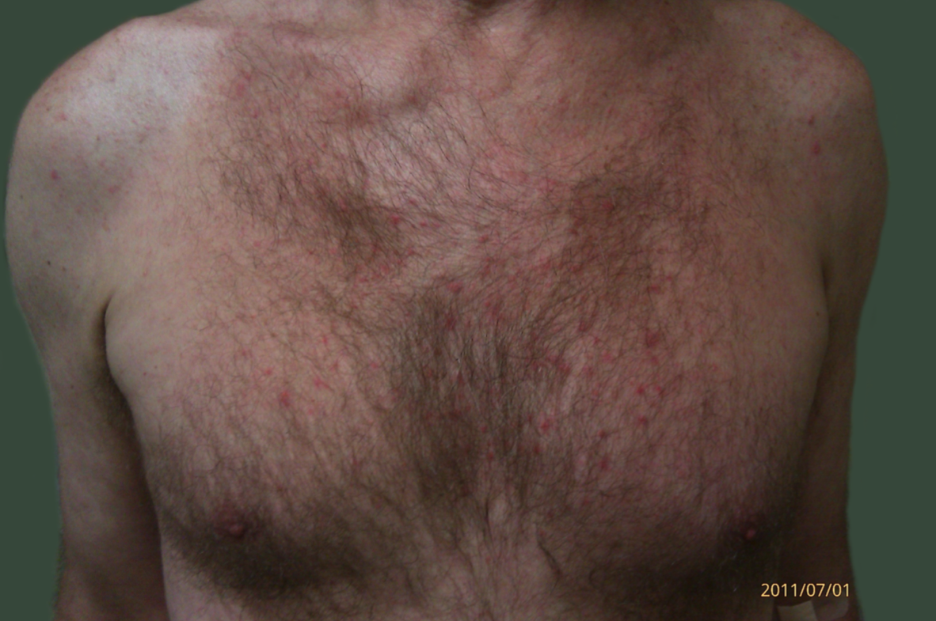
Telaprevir
Mild Skin Rash
Source: Photograph Courtesy of John Scott, MD, University of Washington

Slide 12
Telaprevir
Mild Skin Rash
Assessment
- Localized rash and/or rash with limited distribution
- With or without associated pruritus
Management
- Continue all medications for HCV therapy
- Use good skin care practices
- Consider oral antihistamine plus topical corticosteroid
- Monitor and reassess if progression occurs*
*Stop telaprevir if becomes severe or systemic symptoms develop; OK to continue Peginterferon and Ribavirin, but if rash persists within 7 days of stopping Telaprevir, consider sequential or simultaneous discontinuation of Peginterferon and Ribavirin
Source: Telaprevir (Incivek) Prescribing Information and Vertex Pharmaceuticals.

Slide 13
Telaprevir
Good Skin Care for Telaprevir-Associated Rash
Apply skin moisturizers at least twice a day
Avoid perfumes and other scented skin care products
Use hypoallergenic products
Keep hydrated
Wear loose-fitted clothing
Avoid scratching
Use unscented and mild laundry detergent
Avoid using dryer sheets with clothes in dryer
Limit sun exposure and use sun screen when out in sun
Avoid hot showers and hot baths
Consider using a nonsoap cleanser
Apply skin moisturizers after bathing (before drying off)
Source: Vertex Pharmaceuticals.

Slide 14
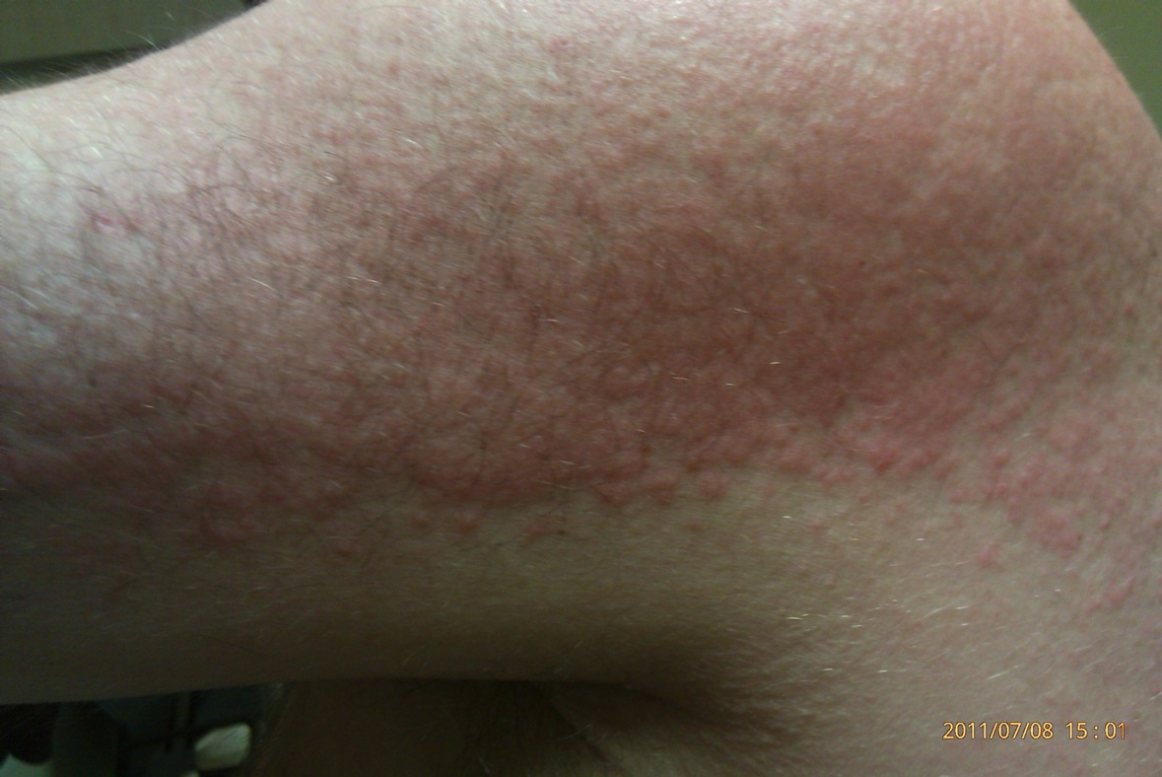
Telaprevir
Moderate Skin Rash
Source: Photograph Courtesy of John Scott, MD, University of Washington

Slide 15
Telaprevir
Moderate Skin Rash
Assessment
- Diffuse rash and/or rash with limited distribution
- With or without superficial skin peeling, pruritus, or mucous membrane
involvement with no ulceration
Management
- Continue all medications for HCV therapy
- Use good skin care practices
- Consider oral antihistamine plus topical corticosteroid
- Monitor and reassess if progression occurs*
*Stop telaprevir if becomes severe or systemic symptoms develop; OK to continue Peginterferon and Ribavirin, but if does not improve within 7 days after stopping Telaprevir, consider sequential or simultaneous discontinuation of Peginterferon and Ribavirin
Source: Telaprevir (Incivek) Prescribing Information and Vertex Pharmaceuticals.

Slide 16
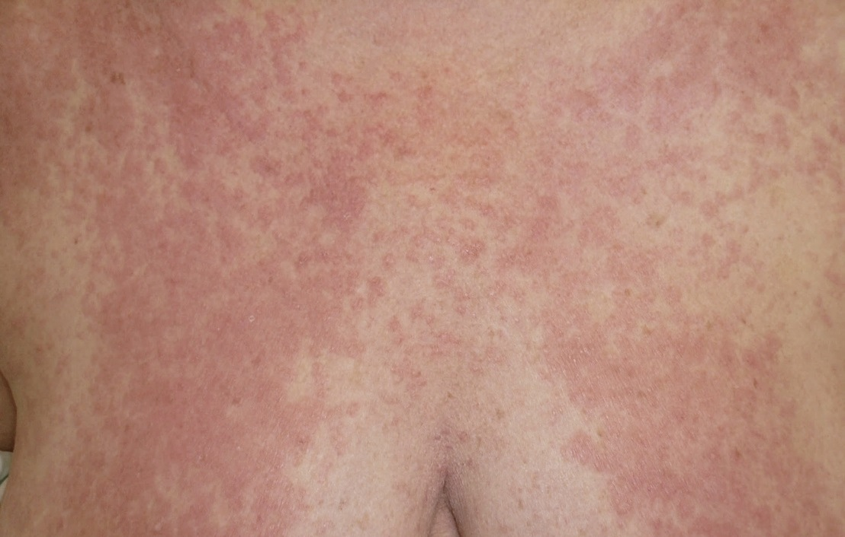
Telaprevir
Severe Skin Rash
Source: Photograph Courtesy of John Scott, MD, University of Washington

Slide 17
Telaprevir
Severe Skin Rash
Assessment
- Generalized rash with or without pruritus
OR
- Rash with vesicles, bullae, or ulcerations (other than SJS)
Management
- Stop Telaprevir (do not restart)
- May continue peginterferon plus ribavirin
- Use good skin care practices
- Consider oral antihistamine plus topical corticosteroid
- Monitor and reassess*
*If rash does not improve within 7 days of stopping Telaprevir, consider sequential or simultaneous discontinuation of Peginterferon and Ribavirin
Source: Telaprevir (Incivek) Prescribing Information. Vertex Pharmaceuticals.

Slide 18
Telaprevir
Serious Skin Rash (DRESS or SJS)
Assessment
- Stevens-Johnson Syndrome (SJS): Generalized rash with symptoms that may include fever, target lesions, and mucosal erosions or ulcerations
OR
- Drug Rash with Eosinophilia and Systemic Symptoms (DRESS): Presenting signs and systemic symptoms may include rash, fever, facial edema, and evidence of internal organ involvement (eg. hepatitis, nephritis). May occur with or without eosinophilia.
Management
- Stop all drugs immediately
- Promptly refer for urgent medical care
- Do NOT restart telaprevir at any time in future
Source: Telaprevir (Incivek) Prescribing Information and Vertex Pharmaceuticals.

Slide 19
Drug Interactions
Telaprevir (Incivek)

Slide 20
Telaprevir
Drug-Drug Interactions: Contraindicated Medications
Medications Contraindicated for use with Telaprevir
Drug Class | Medication and Interaction
Alpha-1 Adrenoreceptor Antagonist | Alfuzosin
Anticonvulsants | Carbamazepine, phenobarbital, phenytoin
Antimycobacterials | Rifampin
Ergot Derivatives | Dihydroergotamine, ergonovine, ergotamine, methylergonovine
Gastrointestinal Motility Agent | Cisapride
Herbal Products | St John’s wort (Hypericum perforatum)
HMG CoA-Reductase Inhibitors | Lovastatin, simvastatin
Neuroleptic | Pimozide
PDE5 Inhibitor | Sildenafil or Tadalafil (dose levels for treatment of pulmonary hypertension)
Sedatives/hypnotics | Orally administered midazolam, triazolam
Source: Vertex Pharmaceuticals.

Slide 21
Resistance
Telaprevir (Incivek)

Slide 22
Viral Breakthrough & Telaprevir Resistance
14 (8.7%) viral breakthroughs were observed
Half of these occurred before or at week 4
Viral breakthroughs were more frequent in patients with HCV genotype 1a (11/14) than 1b (3/14).
11 (79%) of 14 patients with viral breakthrough had variants harboring mutations (V36M, V36M/R155K, or A156S) associated with decreased susceptibility to telaprevir
No differences in number and type of mutations were observed across telaprevir arms
Source: Marcellin P, et. al. Gastroenterology. 2011;140:459-68.

Slide 23
Telaprevir for Chronic HCV Infection
Resistance Among those who did not Achieve SVR
Treatment-emergent resistance mutations occurred in 62% of subjects from ADVANCE, ILLUMINATE, and REALIZE trials who did not achieve SVR.
Resistance mutations occurred in nearly 100% of subjects who failed during initial 12 weeks of triple therapy, and in most who failed after week 12 or who relapsed.
On-treatment virologic failure was more frequent in subjects with genotype 1A compared with 1B.
Most common mutations: R155K/T, V36M, and V36M + R155K/T
Source: Vertex Pharmaceuticals.
Notes:
You might have to format the graph a bit.

Slide 24
Telaprevir for Chronic HCV Infection
Resistance Among those who did not achieve SVR24
323/525
247/356
76/169
Treatment-emergent resistance mutations in 525 subjects from ADVANCE, ILLUMINATE, and REALIZE trials who did not achieve SVR.
Source: Vertex Pharmaceuticals.
Notes:
You might have to format the graph a bit.

Slide 25
Telaprevir and Boceprevir
Genotypic Resistance
Mutation | Telaprevir | Boceprevir
V36A/M | + | +
T54S/A | + | +
V55A | In vitro | +
Q80R/K | - | -
R155K/T/Q | + | +
A156S | + | +
A156T/V | + | In vitro
D168A/V/T/H | - | -
V170A/T | In vitro | +
Source: Sarrazin C, Zeuzem S. Gastroenterology. 2010;138:447-62.

Slide 26
Treatment Data
Telaprevir (Incivek)

Slide 27
HEPATITIS C: TREATMENT
Telaprevir: Summary of Key Studies
Telaprevir Studies in Treatment-Naïve
- PROVE-1: Phase 2b
- PROVE-2: Phase 2b
- ADVANCE (Study 108): Phase 3
- ILLUMINATE (Study 111): Phase 3
- OPTIMIZE (Study C211): Phase 3
Telaprevir Studies in Previously Treated
- PROVE-3: Phase 2b
- REALIZE (Study C216): Phase 3

Slide 28
Telaprevir + Peginterferon + Ribavirin for GT1
PROVE1 Study
Phase 2b
Treatment Naïve
McHutchison JG, et. al. N Engl J Med. 2009;360:1827-38.

Slide 29
Telaprevir for Treatment-Naïve HCV Genotype 1
PROVE1: Study Feature
PROVE1: Study Features
N = 236 randomized Randomized, double-blind, placebo-controlled Phase 2b trial Chronic HCV and treatment naïve All with Genotype 1 Age = 18-65; HIV negative; HBsAg negative Setting: 37 centers in United States Randomized to one of four treatment groups
Drug Dosing
Telaprevir = 1250 mg on day 1, then 750 mg every 8 hours
Peginterferon alfa-2a = 180 µg weekly
Ribavirin = 1000 mg/day for wt < 75 kg; 1200 mg/day for wt > 75 kg
Source: McHutchison JG, et. al. N Engl J Med. 2009;360:1827-38.

Slide 30
Telaprevir for Treatment-Naïve HCV Genotype 1
PROVE1 Study: Treatment Regimens
Week
0
12
24
48
N=17
T12
PR12
Telaprevir
PEG + RBV
N=79
T12
PR24
Telaprevir
PEG + RBV
N=79
T12
PR48
Telaprevir
PEG + RBV
N=75
PR48
Placebo
PEG + RBV
Source: McHutchison JG, et. al. N Engl J Med. 2009;360:1827-38.

Slide 31
Telaprevir for Treatment-Naïve HCV Genotype 1
PROVE1 Study: Results
PROVE1: SVR24 by Regimen
SVR = Sustained Virologic Response; T = Telaprevir; PR = Peginterferon + Ribavirin
Source: McHutchison JG, et. al. N Engl J Med. 2009;360:1827-38.

Slide 32
Telaprevir for Treatment-Naïve HCV Genotype 1
PROVE1 Study: Results
PROVE1: Percentage of Patients with Relapse by Regimen
T = Telaprevir; PR = Peginterferon + Ribavirin
Source: McHutchison JG, et. al. N Engl J Med. 2009;360:1827-38.

Slide 33
Telaprevir for Treatment-Naïve HCV Genotype 1
PROVE1 Study: Results
PROVE1: Patients with SVR24 and Relapse by Regimen
SVR = Sustained Virologic Response; T = Telaprevir; PR = Peginterferon + Ribavirin
Source: McHutchison JG, et. al. N Engl J Med. 2009;360:1827-38.

Slide 34
Telaprevir for Treatment-Naïve HCV Genotype 1
PROVE1 Study: Conclusions
Conclusions: “Treatment with a telaprevir-based regimen significantly improved sustained virologic response rates in patients with genotype 1 HCV, albeit with higher rates of discontinuation because of adverse events.”
Source:McHutchison JG, et. al. N Engl J Med. 2009;360:1827-38.

Slide 35
Telaprevir in Treatment Naïve GT-1
PROVE2 Study
Phase 2b
Treatment Naïve
Hézode C, et al. N Engl J Med. 2009;360:1839-50.

Slide 36
Telaprevir for Treatment-Naïve HCV Genotype 1
PROVE2: Study Design
PROVE2: Study Features
N = 334 enrolled and 323 received at least 1 dose Randomized, partially double-blind trial, placebo-controlled Phase 2b trial Chronic HCV and treatment naïve All with Genotype 1; 84% with HCV RNA > 800,000 IU/ml Age = 18-65 and HIV-negative Setting: 28 sites in Europe Randomized to one of 4 arms
Drug Dosing
Telaprevir = 1250 mg on day 1, then 750 mg every 8 hours
Peginterferon alfa-2a = 180 µg weekly
Ribavirin = 1000 mg/day for wt < 75 kg; 1200 mg/day for wt > 75 kg
Source: Hézode C, et al. N Engl J Med. 2009;360:1839-50.

Slide 37
Telaprevir for Treatment-Naïve HCV Genotype 1
PROVE2 Study: Treatment Regimens
Week
0
12
24
48
N=82
T12
PR12
Telaprevir
PEG + RBV
N=81
T12
PR24
Telaprevir
PEG + RBV
N=78
T12
P12
Telaprevir
PEG
N=82
PR48
Placebo
PEG + RBV
Source: Hézode C, et al. N Engl J Med. 2009;360:1839-50.

Slide 38
Telaprevir for Treatment-Naïve HCV Genotype 1
PROVE2 Study: Results
PROVE2: SVR24 by Regimen
SVR = Sustained Virologic Response; T = Telaprevir; P = Peginterferon; PR = Peginterferon + Ribavirin
Source: Hézode C, et al. N Engl J Med. 2009;360:1839-50.

Slide 39
Telaprevir for Treatment-Naïve HCV Genotype 1
PROVE2 Study: Results
PROVE2: Patients with Relapse by Regimen
T = Telaprevir; P = Peginterferon; PR = Peginterferon + Ribavirin
Source: Hézode C, et al. N Engl J Med. 2009;360:1839-50.

Slide 40
Telaprevir for Treatment-Naïve HCV Genotype 1
PROVE2 Study: Results
PROVE2: Patients with SVR and Relapse by Regimen
SVR = Sustained Virologic Response; T = Telaprevir; P = Peginterferon; PR = Peginterferon + Ribavirin
Source: Hézode C, et al. N Engl J Med. 2009;360:1839-50.

Slide 41
Telaprevir for Treatment-Naïve HCV Genotype 1
PROVE2 Study: Results
PROVE2: Severe (Grade 3) Adverse Events by Regimen
T = Telaprevir; P = Peginterferon; PR = Peginterferon + Ribavirin
Source: Hézode C, et al. N Engl J Med. 2009;360:1839-50.

Slide 42
Telaprevir for Treatment-Naïve HCV Genotype 1
PROVE2 Study: Conclusions
Conclusions: “In this phase 2 study of patients infected with HCV genotype 1 who had not been treated previously, one of the three telaprevir groups had a significantly higher rate of sustained virologic response than that with standard therapy. Response rates were lowest with the regimen that did not include ribavirin.”
Source: Hézode C, et al. N Engl J Med. 2009;360:1839-50.

Slide 43
Telaprevir in Treatment Naïve GT-1
ADVANCE (Study 108)
Phase 3
Treatment Naïve
Jacobson IM, et. al. N Engl J Med. 2011;364:2405-16.

Slide 44
Telaprevir for Treatment-Naïve HCV Genotype 1
ADVANCE: Study Design
ADVANCE: Study Features
N = 1,088 enrolled Randomized, double-blind, placebo-controlled, Phase 3 trial Genotype 1 HCV and treatment naïve 77% with HCV RNA ≥ 800,000 IU/ml Randomized to one of 3 arms RVR = HCV RNA undetectable at week 4 eRVR = HCV RNA undetectable at weeks 4 & 12 Erythroid stimulating agents not allowed Telaprevir-treated patients without eRVR received PR up to week 48
Drug Dosing
Telaprevir = 750 mg every 8 hours
Peginterferon alfa-2a = 180 µg weekly
Ribavirin = 1000 mg/day for wt < 75 kg; 1200 mg/day for wt > 75 kg
Source: Jacobson IM, et. al. N Engl J Med. 2011;364:2405-16.

Slide 45
Telaprevir for Treatment-Naïve HCV Genotype 1
ADVANCE Study: Treatment Regimens
Week
0
8
12
24
48
N =364
T8
PR 24 or 48
Telaprevir
+
PEG + RBV
PEG
+
RBV
eRVR: PEG + RBV
No eRVR: PEG + RBV
T12
PR 24 or 48
Telaprevir
+
PEG + RBV
eRVR: PEG + RBV
N =363
No eRVR: PEG + RBV
PR48
Placebo
+
PEG + RBV
PEG + RBV
N =361
Source: Jacobson IM, et. al. N Engl J Med. 2011;364:2405-16.

Slide 46
Telaprevir for Treatment-Naïve HCV Genotype 1
ADVANCE Study: Results
ADVANCE: SVR24 by Regimen
250/364
271/363
158/361
SVR = Sustained Virologic Response; T = Telaprevir; PR = Peginterferon + Ribavirin
Source: Jacobson IM, et. al. N Engl J Med. 2011;364:2405-16.

Slide 47
Telaprevir for Treatment-Naïve HCV Genotype 1
ADVANCE Study: RVR and eRVR Rates
ADVANCE: Patients with RVR and eRVR
242/364
246/363
34/361
207/364
212/363
29/361
T = Telaprevir; PR = Peginterferon + Ribavirin; RVR = rapid virologic response; eRVR = extended rapid virologic response
Source: Jacobson IM, et. al. N Engl J Med. 2011;364:2405-16.

Slide 48
Telaprevir for Treatment-Naïve HCV Genotype 1
ADVANCE Study: Results According to eRVR
ADVANCE: SVR24 by eRVR Status
171/207
189/212
28/29
79/157
82/151
130/342
T = Telaprevir; PR= Peginterferon + Ribavirin; SVR = Sustained Virologic Response
eRVR = extended rapid virologic response (undetectable HCV RNA at weeks 4 and 12)
Source: Jacobson IM, et. al. N Engl J Med. 2011;364:2405-16.

Slide 49
Telaprevir for Treatment-Naïve HCV Genotype 1
ADVANCE Study: Results According to eRVR
ADVANCE: SVR24 by eRVR Status
171/207
79/157
189/212
82/151
28/29
130/342
SVR = Sustained Virologic Response; T = Telaprevir; PR = Peginterferon + Ribavirin;
eRVR = extended rapid virologic response (undetectable HCV RNA at weeks 4 and 12)
Source: Jacobson IM, et. al. N Engl J Med. 2011;364:2405-16.

Slide 50
Telaprevir for Treatment-Naïve HCV Genotype 1
ADVANCE Study: Results According to Race
ADVANCE: SVR24 by Race
221/315
244/325
147/318
23/40
16/26
7/28
29/44
26/35
15/38
SVR = Sustained Virologic Response; T = Telaprevir; PR = Peginterferon + Ribavirin
Source: Jacobson IM, et. al. N Engl J Med. 2011;364:2405-16.

Slide 51
Telaprevir for Treatment-Naïve HCV Genotype 1
ADVANCE Study: Results by Baseline HCV RNA
ADVANCE: SVR24 by Baseline HCV RNA Level
67/85
64/82
57/82
184/279
207/281
101/279
SVR = Sustained Virologic Response; T = Telaprevir; PR = Peginterferon + Ribavirin
Source: Jacobson IM, et. al. N Engl J Med. 2011;364:2405-16.

Slide 52
Telaprevir for Treatment-Naïve HCV Genotype 1
ADVANCE Study: Results by Fibrosis Stage
ADVANCE: SVR24 by Fibrosis Stage
101/128
109/134
67/147
104/151
117/156
67/141
34/59
32/52
17/52
11/26
13/21
7/21
SVR = Sustained Virologic Response; T = Telaprevir; PR = Peginterferon + Ribavirin
Source: Jacobson IM, et. al. Hepatology. 2010;52 (Supplement 1):427A. Abstract 211.

Slide 53
Telaprevir for Treatment-Naïve HCV Genotype 1
ADVANCE Study: Adverse Effects
ADVANCE: Percentage of Patients with Anemia
146/364
131/363
51/361
33/364
33/363
7/361
T = Telaprevir; PR = Peginterferon + Ribavirin
Source: Jacobson IM, et. al. N Engl J Med. 2011;364:2405-16.

Slide 54
Telaprevir for Treatment-Naïve HCV Genotype 1
ADVANCE Study: Adverse Effects
ADVANCE: Percentage of Patients with Rash
15/364
22/363
129/364
133/363
88/361
4/361
T = Telaprevir; PR = Peginterferon + Ribavirin
Source: Jacobson IM, et. al. N Engl J Med. 2011;364:2405-16.

Slide 55
Telaprevir for Treatment-Naïve HCV Genotype 1
SVR Rates by IL28B rs12979860 Genotype
ADVANCE: SVR24 by rs12979860 Genotype
6/26
20/80
35/55
16/22
48/68
45/50
PR48 = Peginteron/Ribavirin x 48 weeks
PR/T12 = Peginteron/Ribavirin + Telaprevir x 12 weeks
Source: Telaprevir (Incivek) Prescribing Information. Vertex Pharmaceuticals.

Slide 56
Telaprevir for Treatment-Naïve HCV Genotype 1
ADVANCE Study: Conclusions
Conclusions: “Telaprevir with peginterferon–ribavirin, as compared with peginterferon–ribavirin alone, was associated with significantly improved rates of sustained virologic response in patients with HCV genotype 1 infection who had not received previous treatment, with only 24 weeks of therapy administered in the majority of patients.”
Source: Jacobson IM, et. al. N Engl J Med. 2011;364:2405-16.

Slide 57
Telaprevir in Treatment Naïve GT-1
ILLUMINATE (Study 111)
Phase 3
Treatment Naïve
Sherman KE, et. al. N Engl J Med. 2011;365:1014-24.

Slide 58
Telaprevir for Treatment-Naïve HCV Genotype 1
ILLUMINATE: Study Design
ILLUMINATE: Study Features
Randomized, open label, Phase 3 trial Genotype 1 HCV and treatment naïve, with or without cirrhosis N = 540 enrolled RVR = HCV RNA undetectable at week 4 eRVR = HCV RNA undetectable at weeks 4 & 12 Erythroid stimulating agents not allowed All received telaprevir x 12 weeks Patients with eRVR randomized to PR for 24 or 48 weeks Patients without eRVR received PR x 48 weeks
Drug Dosing
Telaprevir = 750 mg every 8 hours
Peginterferon alfa-2a = 180 µg per week
Ribavirin = 1000 mg/day for wt < 75 kg; 1200 mg/day for wt > 75 kg
Source: Sherman KE, et. al. N Engl J Med. 2011;365:1014-24.

Slide 59
Telaprevir for Treatment-Naïve HCV Genotype 1
ILLUMINATE Study: Design
Week
0
12
20
24
48
PR
eRVR (+)
T12/PR24
With eRVR
PR
eRVR (+)
T12/PR48
T12
PR 24 or 48
Telaprevir
PEG + Ribavirin (PR)
Without eRVR
PR
eRVR (-)
T12/PR48
T = Telaprevir
PR = Peginterferon + Ribavirin
eRVR = extended rapid virologic response (undetectable HCV RNA at weeks 4 and 12)
Source: Sherman KE, et. al. N Engl J Med. 2011;365:1014-24.

Slide 60
Telaprevir for Treatment-Naïve HCV Genotype 1
ILLUMINATE Study: Results
ILLUMINATE: SVR 24 by Regimen
388/540
149/162
140/160
76/118
SVR = Sustained virologic response; T = Telaprevir; PR = Peginterferon + Ribavirin
eRVR = extended rapid virologic response (undetectable HCV RNA at weeks 4 and 12)
Source: Sherman KE, et. al. N Engl J Med. 2011;365:1014-24.

Slide 61
Telaprevir for Treatment-Naïve HCV Genotype 1
ILLUMINATE Study: Key Findings
24 weeks of Peg-IFN non-inferior to 48 weeks in patients with eRVR
Overall SVR 72%
SVR in 60% of blacks
SVR of 63% in patients with cirrhosis
65% of patients had eRVR
88-92% of those who achieved eRVR achieved SVR
7% stopped treatment early due to virologic failure
17% stopped early due to fatigue or anemia
Source: Sherman KE, et. al. N Engl J Med. 2011;365:1014-24.

Slide 62
Telaprevir for Treatment-Naïve HCV Genotype 1
ILLUMINATE Study: Conclusions
Conclusions: “In this study, among patients with chronic HCV infection who had not received treatment previously, a regimen of peginterferon–ribavirin for 24 weeks, with telaprevir for the first 12 weeks, was noninferior to the same regimen for 48 weeks in patients with undetectable HCV RNA at weeks 4 and 12, with an extended rapid virologic response achieved in nearly two thirds of patients.”
Source: Sherman KE, et. al. N Engl J Med. 2011;365:1014-24.

Slide 63
Telaprevir BID versus q8 in Treatment Naïve GT-1
OPTIMIZE (Study C211)
Phase 3
Treatment Naïve
Buti M, et al. Gastroenterology. 2013 Dec 4. [Epub ahead of print]

Slide 64
Twice Daily Telaprevir for Treatment-Naïve HCV Genotype 1
OPTIMIZE Study: Design
OPTIMIZE: Study Features
N = 740 enrolled Randomized, double-blind, placebo-controlled, Phase 3 trial Genotype 1 HCV and treatment naïve 85% with HCV RNA ≥ 800,000 IU/ml Randomized to one of 2 arms to compare bid and q8h telaprevir RVR = HCV RNA undetectable (<25 IU/ml) at week 4 All patients received telaprevir for 12 weeks (bid or q8h) Patients with RVR received PR for 24 weeks Patients without RVR received PR for 48 weeks
Drug Dosing
Telaprevir = 1125 mg bid or 750 mg q8h
Peginterferon alfa-2a = 180 µg weekly
Ribavirin = 1000 mg/day for wt < 75 kg; 1200 mg/day for wt > 75 kg
Source: Buti M, et al. Gastroenterology. 2013 Dec 4. [Epub ahead of print]

Slide 65
Twice Daily Telaprevir for Treatment-Naïve HCV Genotype 1
OPTIMIZE Study: Treatment Regimens
Week
0
12
24
48
T12 bid
PR 24 or 48
(n = 369)
Telaprevir (bid)
PEG + RBV
If (-) RVR continue PEG + RBV
T12 q8h
PR 24 or 48
(n = 371)
Telaprevir (q8h)
PEG + RBV
If (-) RVR continue PEG + RBV
RVR = week 4 HCV RNA undetectable
PEG = peginterferon; RBV = ribavirin
Therapy stopped if HCV RNA > 1000 IU/mL at week 4 or HCV RNA > 25 IU/mL at weeks 12, 24, 32, or 40
Source: Buti M, et al. Gastroenterology. 2013 Dec 4. [Epub ahead of print]

Slide 66
Twice Daily Telaprevir for Treatment-Naïve HCV Genotype 1
OPTIMIZE Study: Results
OPTIMIZE: SVR12 by Regimen
274/369
270/371
SVR = Sustained Virologic Response; T = Telaprevir; PR = Peginterferon + Ribavirin
Source: Buti M, et al. Gastroenterology. 2013 Dec 4. [Epub ahead of print]

Slide 67
Twice Daily Telaprevir for Treatment-Naïve HCV Genotype 1
OPTIMIZE Study: Results
OPTIMIZE: SVR12 by Week 4 Virologic Response
274/369
270/371
221/256
213/250
53/113
57/121
RVR = rapid virologic response (undetectable HCV RNA at week 4)
Abbreviations: SVR = sustained virologic response; PR = peginterferon + ribavirin
Source: Buti M, et al. Gastroenterology. 2013 Dec 4. [Epub ahead of print]

Slide 68
Twice Daily Telaprevir for Treatment-Naïve HCV Genotype 1
OPTIMIZE Study: Results
OPTIMIZE: SVR12 by Genotype 1 Subtype
146/210
145/209
126/157
123/160
Abbreviations: Abbreviations: SVR = sustained virologic response; PR = peginterferon + ribavirin
Source: Buti M, et al. Gastroenterology. 2013 Dec 4. [Epub ahead of print]

Slide 69
Twice Daily Telaprevir for Treatment-Naïve HCV Genotype 1
OPTIMIZE Study: Results
OPTIMIZE: SVR12 by Host IL28B Genotype
97/105
92/106
139/206
141/208
38/58
37/57
Abbreviations: SVR = sustained virologic response; PR = peginterferon + ribavirin
Source: Buti M, et al. Gastroenterology. 2013 Dec 4. [Epub ahead of print]

Slide 70
Twice Daily Telaprevir for Treatment-Naïve HCV Genotype 1
OPTIMIZE Study: Results
OPTIMIZE: SVR12 by Fibrosis Stage
138/172
140/177
75/95
68/85
32/48
38/59
29/54
24/49
Abbreviations: SVR = sustained virologic response; PR = peginterferon + ribavirin
Source: Buti M, et al. Gastroenterology. 2013 Dec 4. [Epub ahead of print]

Slide 71
Twice Daily Telaprevir for Treatment-Naïve HCV Genotype 1
OPTIMIZE Study: Conclusions
Conclusions: “Based on a phase 3 trial, telaprevir twice-daily is noninferior to every 8 hrs in producing SVR12, with similar levels of safety and tolerability. These results support use of telaprevir twice-daily in patients with chronic HCV genotype 1 infection, including those with cirrhosis.”
Source: Buti M, et al. Gastroenterology. 2013 Dec 4. [Epub ahead of print]

Slide 72
Telaprevir in Treatment Experienced GT-1
PROVE3
Phase 2b
Treatment Experienced
McHutchison JG, et al. N Engl J Med. 2010;362:1292-303.

Slide 73
Telaprevir for Treatment-Experienced HCV Genotype 1
PROVE3 Study: Study Design
PROVE3: Study Features
Randomized, partially double-blind trial, placebo-controlled Phase 2b trial All with HCV and lack of SVR with Peginterferon + Ribavirin Eligible if 18 to 70 years of age All with Genotype 1; 92% with HCV RNA > 800,000 IU/ml N = 465 enrolled and 453 received at least 1 dose Setting: 53 international sites (41 in US) Randomized to one of 4 arms
Drug Dosing
Telaprevir = 1125 mg loading dose, then 750 mg every 8 hours
Peginterferon alfa-2a = 180 µg weekly
Ribavirin = 1000 mg/d for wt < 75 kg; 1200 mg/d for wt > 75 kg
Source: McHutchison JG, et al. N Engl J Med. 2010;362:1292-303.

Slide 74
Telaprevir for Treatment-Experienced HCV Genotype 1
PROVE3 Study: Treatment Regimens
Week
0
12
24
48
N=115
T12
PR24
Telaprevir
Peginterferon + Ribavirin
N=113
T24
PR48
Telaprevir
Peginterferon + Ribavirin
N=111
T24
P24
Telaprevir
Peginterferon
N=114
PR48
Placebo
Peginterferon + Ribavirin
Source: McHutchison JG, et al. N Engl J Med. 2010;362:1292-303.

Slide 75
Telaprevir for Treatment-Experienced HCV Genotype 1
PROVE3 Study: Results
PROVE3: SVR24 by Regimen
SVR = sustained virologic response; T = Telaprevir; P = Peginterferon; PR = Peginterferon + Ribavirin
Source: McHutchison JG, et al. N Engl J Med. 2010;362:1292-303.

Slide 76
Telaprevir for Treatment-Experienced HCV Genotype 1
PROVE3 Study: Results Based on Prior History
PROVE3: SVR24 by Prior Response Status
SVR = sustained virologic response; T = Telaprevir; P = Peginterferon; PR = Peginterferon + Ribavirin
Source: McHutchison JG, et al. N Engl J Med. 2010;362:1292-303.

Slide 77
Telaprevir for Treatment-Experienced HCV Genotype 1
PROVE3 Study: Results
PROVE3: Adverse Events
T = Telaprevir; P = Peginterferon; PR = Peginterferon + Ribavirin
Source: McHutchison JG, et al. N Engl J Med. 2010;362:1292-303.

Slide 78
Telaprevir for Treatment-Experienced HCV Genotype 1
PROVE3 Study: Conclusions
Conclusions: “In HCV-infected patients in whom initial peginterferon alfa and ribavirin treatment failed, retreatment with telaprevir in combination with peginterferon alfa-2a and ribavirin was more effective than retreatment with peginterferon alfa-2a and ribavirin alone.”
Source: McHutchison JG, et al. N Engl J Med. 2010;362:1292-303.

Slide 79
Telaprevir in Treatment Experienced GT-1
REALIZE (Study 216)
Phase 3
Treatment Experienced
Zeuzem S, et al. N Engl J Med. 2011;364:2417-28.

Slide 80
Telaprevir for Treatment-Experienced HCV Genotype 1
REALIZE Study: Study Design
REALIZE: Study Features
Phase 3 trial Randomized, double-blind, placebo-controlled Eligible if 18 to 70 years of age All with genotype 1 chronic HCV infection Lack of SVR with prior peginterferon + ribavirin treatment N = 663 enrolled Setting: 100 international sites (most in Europe and US) Randomized to one of 3 arms (2:2:1 ratio)
Drug Dosing
Telaprevir = 750 mg q8h
Peginterferon alfa-2a = 180 µg weekly
Ribavirin = 1000 mg/day for wt < 75 kg; 1200 mg/day for wt > 75 kg
Source: Zeuzem S, et al. N Engl J Med. 2011;364:2417-28.

Slide 81
Telaprevir for Treatment-Experienced HCV Genotype 1
REALIZE Study: Definitions for Prior Response
No Response: Reduction of less than 2 log₁₀ in HCV RNA after 12 weeks of therapy
Partial Response: Reduction of 2 log₁₀ or more in HCV RNA after 12 weeks of therapy, but with detectable HCV RNA
Relapse: undetectable HCV RNA at the end of a previous course of therapy but HCV RNA positivity thereafter
Source: Zeuzem S, et al. N Engl J Med. 2011;364:2417-28.

Slide 82
Telaprevir for Treatment-Experienced HCV Genotype 1
REALIZE: Treatment Regimens
Week
0
4
12
16
24
36
48
N=266
T12
PR48
Telaprevir
Placebo
Peginterferon + Ribavirin
N=264
Lead-In
T12
PR48
Placebo
Telaprevir
Peginterferon + Ribavirin
N=132
PR48
Placebo
Peginterferon + Ribavirin
Source: Zeuzem S, et al. N Engl J Med. 2011;364:2417-28.

Slide 83
Telaprevir for Treatment-Experienced HCV Genotype 1
REALIZE Study: Results
REALIZE: SVR24 by Regimen
171/266
175/264
22/132
SVR = Sustained Virologic Response; T = Telaprevir; PR = Peginterferon + Ribavirin
Source: Zeuzem S, et al. N Engl J Med. 2011;364:2417-28.

Slide 84
Telaprevir for Treatment-Experienced HCV Genotype 1
REALIZE: Results Based on Prior History
REALIZE: SVR24 by Prior Response
21/72
25/75
2/37
29/49
26/48
4/27
121/145
124/141
16/68
SVR = Sustained Virologic Response; T = Telaprevir; PR = Peginterferon + Ribavirin
Source: Zeuzem S, et al. N Engl J Med. 2011;364:2417-28.

Slide 85
Telaprevir for Treatment-Experienced HCV Genotype 1
REALIZE: Adverse Effects
REALIZE: Anemia
71/266
73/264
20/132
28/266
36/264
7/132
T = Telaprevir; P = Peginterferon + Ribavirin
Source: Zeuzem S, et al. N Engl J Med. 2011;364:2417-28.

Slide 86
Telaprevir for Treatment-Experienced HCV Genotype 1
REALIZE Study: Conclusions
Conclusions: “Telaprevir combined with peginterferon plus ribavirin significantly improved rates of sustained virologic response in patients with previously treated HCV infection, regardless of whether there was a lead-in phase.”
Source: Zeuzem S, et al. N Engl J Med. 2011;364:2417-28.

Slide 87
This slide deck is from the University of Washington’s Hepatitis C Online and Hepatitis Web Study projects.
Hepatitis C Online
www.hepatitisc.uw.edu
Hepatitis Web Study
http://depts.washington.edu/hepstudy/
Funded by a grant from the Centers for Disease Control and Prevention.

