Slide 1
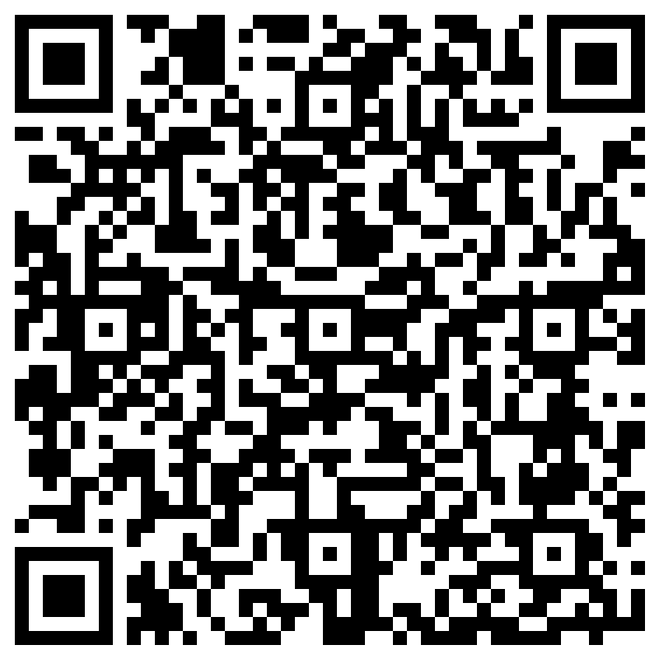
RESIDENTIAL LIFE STUDENT LEADER INFO SESSION
APPLICANTS FOR 2023-2024
Please scan & sign in!
https://bit.ly/SL_Info
Notes:
IMPORTANT: As individuals are coming in, give reminders to fill out and scan the QR code. Give 1-2min at start of the session for attendees to complete the form. This is essential for their attendance to be counted and to complete the info session requirement.
Welcome group
Introductions of staff
Name/Pronouns
Position

Slide 2
TODAY’S AGENDA
Student Leader Positions
Key Skills of a Student Leader
Application Process
Selection Timeline
Considerations
Compensation
Resources
Q&A
Notes:
Review topics briefly, no need to elaborate.

Slide 3
Learning Outcomes
Participants will will be able to
Describe the student leader roles
Differentiate between the student leader roles
Formulate a decision on which student leader roles they are suited for
Understand the steps of the Student Leader Application process

Slide 4
WHAT IS AN RA?
Community Builder
Educator
Role Model
Mediator
Programmer
Administrator
Team Member
Safety, Security, and Initial Response
Notes:
Review some of the hats that Resident Advisers will typically where. Be sure to expand upon each bullet using the guidelines below.
Community Builder
Ensure people feel welcome in the community, help residents meet one another and create connections, and make the halls feel like a home!
Educator
Help residents understand policies/processes at UW and within HFS.
Role Model
Be a positive and mature presence on the floor. Role model how to have fun in the halls while respecting community standards.
Mediator
Help residents talk out disagreements and guide them toward constructive solutions.
Programmer
Plan small-scale social programs to help students build connections. (This is a relatively small part of the RA role. If programming is of strong interest to you, one of our other positions may be of interest to you!)
Administrator
Complete administrative tasks as assigned. These will include written reports and documentation, weekly info logs, and inspection paperwork. This is a great opportunity to develop skills around administrative work, time management, and professional writing.
Team Member
Work within a team of other students and professional staff to create the best living environment we can provide to UW students!
Safety, Security, and Initial Response
Regularly act as the RA on-call to ensure resident safety and resolve issues (with professional staff support) after hours.

Slide 5
What does the RA role look like in action?
Interactions:
Resident Advisers regularly interact with the residents on their floor. RAs have consistent scheduled or impromptu conversations in 1-on-1 or group settings to check in on residents, get to know them, and build a trusting relationship.
Programming:
Resident Advisers plan programs periodically each quarter. Programs planned by RAs are typically smaller in scale and can be social or educational in nature.
Passive Engagement:
Resident Advisers build community passively by creating decorations for their assigned floors, hanging and distributing informative flyers, and creating bulletin boards and/or displays for digital screens located in their communities.

Slide 6
What does the RA role look like in action?
Serving On-Call
Resident Advisers serve on call overnight. RAs complete rounds and hold an on-call phone for residents to reach out if they have concerns after business hours.
Responding to Violations of the Housing Agreement
Resident Advisers learn about the housing agreement and the policies therein to educate residents on the policies. RAs also confront policy violations and provide educational conversations to residents and document behaviors that they notice within their community.
Supporting Students by Connecting Them to Resources
Resident Advisers are trained with helping skills to support students experiencing crisis. RAs are one of multiple layers of support for students, and they report when students are experiencing crisis to their supervisors.
RAs can help residents who are experiencing conflict with their roommates with mediations and in learning about other housing options.
RAs are trained to identify facilities concerns within their community, and trained to support the triage of those concerns.
Notes:
Regarding supporting students, focus on RA role being about connecting to resources and avoid getting in the weeds about actual crisis response.

Slide 7
WHAT IS AN REP OR RPB MEMBER?
Residential Life has two Programming Teams made up of Student Leaders: Residence Education Programmers (REP) and the Residential Programming Board (RPB).
Both teams focus on large scale programming for our residents. The goals of these programs vary by team.

Slide 8
WHAT DO REP AND RPB DO?
Build Community Through Programming
Role Model leadership
Event Planning
Collaborate with campus & community partners
Example Programs
REP
Destress Crafts
Spice up your Studying
DIY Planners
Late Night Carnival
RPB
Movie Screenings
Rolling Through the Decades
Trip to the Pumpkin Patch
Late Night Carnival

Slide 9
REP
Educational Programming
The Residence Education Programmer team will collaboratively plan numerous programs each quarter, including both active and passive programs, social media campaigns, and other educational initiatives.
REP programs focus on academic success, wellness, and social justice/diversity.
Collateral Assignments
There are opportunities for REPs to participate in elective areas to gain more skills and insights, such as: social media management, staff team development activities, creating a newsletter and more!
Collaboration and Teamwork
REPs are responsible for many different tasks that require working with a variety of campus and community partners. REPs will support efforts as needed for the Residential Programming Board (RPB), RCSA, and hall councils.

Slide 10
RPB
Residential Programming Board seeks to promote community building within residential spaces
Programming
Host large scale social events for the entire residential population to increase communication and engagement across communities
Host ~26 programs each year
Collaboration & Teamwork
Work with other Student Leader groups (REP, RCSA, hall councils, etc) to host events.
Other areas to contribute:
There are opportunities for RPBs to participate in elective areas to gain more skills and insights, such as: social media management, staff team development activities, creating a newsletter and more!

Slide 11
KEY SKILLS OF THE STUDENT LEADER ROLES
Accountability
Active Listening
Communication
Community Building
Problem solving
Adaptability
Empathy
Time-management
Taking Initiative
Resourcefulness
Notes:
Review the skills. No need to elaborate in depth
Emphasis that these are skills to keep in mind and to consider highlighting in application materials.

Slide 12
Application Process
Attend a required information session ✅
Complete written application materials
Record virtual interview
Submit materials using application form
Notes:
Provide a brief overview of the application components and emphasise that detailed information and links for each component are on the Student Leader Application Page

Slide 13
Written Application Materials
3 components:
Diversity Statement, a Personal Statement, and supplemental questions
If applying for an RA and an REP or RPB role, you will need to write 2 personal statements; one for the RA position and one for the REP/RPB positions.
Diversity Statement
In 250 words or less, please tell us: What diversity, equity, and inclusion mean to you, and how you plan to foster DEI in the roles you are applying for.
Notes:
Inform audience that there is a template word document on the Student Leader Application page for candidates to download and use to write their written materials for ease of use when applying.

Slide 14
Written Application Materials cont.
Resident Adviser Specific Questions
Personal Statement: In 500 words or less, please submit a personal statement that:
Describes why you are interested in the Resident Adviser position;
describes a skill you have learned through a job, project, or position that you feel would positively contribute to the role, and
describes a skill you would like to develop if selected for the position.
Supplemental Question: In 75 words or less, tell us what is your understanding of what a Resident Adviser does?
For LLC RA Applicants: For EACH LLC you are interested in, describe why you are interested in that LLC in no more than 75 words per LLC.
Notes:
Briefly explain what LLCs are
Explain that LLC RAs complete same responsibilities as RAs but the subject matter of their work is more grounded in the LLC theme.

Slide 15
Written Application Materials cont.
REP/RPB Specific Questions
Personal Statement: In 500 words or less, please submit a personal statement that:
Describes why you are interested in a Programming Team position;
describes a skill you have learned through a job, project, or position that you feel would positively contribute to the role, and
describes a skill you would like to develop if selected for the position.
Supplemental Question 1: In 75 words or less, tell us what is your understanding of what the Programming Team(s) you are applying for do.
Supplemental Question 2: In 75 words or less, tell us how you believe programming contributes to a sense of community and belonging for residents

Slide 16
Virtual Recorded Interview
Record video responses to 7 interview questions
You will need a device with camera and microphone capabilities.
Just like a real interview, once the question is asked, the system will automatically begin recording your response
maximum of 2.5 minutes to respond to each question
You will be allowed to re-attempt the interview up to 2 times if you wish
You will have the option to either re-record the entire interview or specific questions. Redoing a specific question will count as 1 of your 2 attempts.

Slide 17
Virtual Recorded Interview pt. 2
After you have completed your interview you will need to follow the steps on the Application page to create a link to share your responses with the Selection Committee
If you are not familiar with the StandOut software it is HIGHLY ENCOURAGED that you try one of the practice interviews
Guide on how to navigate the software and how to access the link to share your responses can be found on the recruitment website

Slide 18
Selection Process Overview/Timeline
Application
Due January 3, 2023 by 9AM
Live Interview
Occur week of February 20 - 24
Activity-based rather than question-based
If selected to proceed to this stage, candidates will learn more about what to expect closer to the interview.
Only required for RA candidates
REP/RPB candidates will complete a program presentation which will occur the week of February 27.
Offers sent out by end of Winter quarter following interviews/presentations.
Notes:
After applying, materials will be reviewed and candidates will be notified in early February if they have been selected to move on to the next round of the selection process which is the Live Interviews.

Slide 19
Student Leader Class
(after selection process)
This class is a requirement of the role and offers will be rescinded if students are unable to attend. The class is 2 credits and is credit/non-credit. Student LEaders can enroll for credit or not enroll but attend.
Spring 2023 Class Time options
Section B: Mon/Wed | 8:30 AM – 9:50 AM
Section C: Mon/Wed | 10:00 AM – 11:20 AM
Section D: Mon/Wed | 1:00 PM – 2:20 PM
Section E: Mon/Wed | 3:30 PM – 4:50 PM
Section F: Tue/Thu | 1:30 PM – 2:50 PM
Section G: Tue/Thu | 2:30 PM – 3:50 PM
Section H: Tue/Thu | 2:30 PM – 3:50 PM
Section I: Tue/Thu | 3:30 PM – 4:50 PM
Notes:
Candidates who receive and accept a Student Leader position or Alternate offer will be required to complete the Student Leader Class in Spring Quarter. This class is a requirement of the role and offers will be rescinded if student’s are unable to attend. Please see the Spring 2023 Class Time options below and keep them in mind when planning your Spring schedule:

Slide 20
CONSIDERATIONS
Conduct History
Student conduct history is assessed on an individual basis. If this is something you are concerned or unsure about, please still consider applying.
Financial Aid
Compensation for the student leader positions are required to be reported to the Financial Aid Office and may affect a student’s Financial Aid package. It is the applicant’s responsibility to understand their individual impacts. The Financial Aid Office is happy to talk with you proactively about what may be the anticipated impact to your Financial Aid package.
GPA
Maintain a cumulative GPA of at least 2.45 throughout the selection process
Notes:
If they have concerns about Conduct history, candidates can contact Nick
Emphasize the Financial Piece and encourage candidates to discuss with financial aid if they are concerned about the impacts.

Slide 21
CONSIDERATIONS cont.
Commitment
All positions require a commitment for one full academic year, including mandatory fall training in early September.
Training Dates: Tuesday, September 5, 2023 – Friday September 22, 2023
Agreement Dates: Tuesday, September 5, 2023 – Saturday, June 8, 2024
Average of 19.5 hours per week
Peak operational times
Autumn training
Move-in
Spring closing
You do not have to have lived on campus to apply!
Notes:
Emphasize that fall training is mandatory and a contracted expectation
Emphasize that we encourage students without live-on experience to apply

Slide 22
COMPENSATION
RA
A private room in a Residence Hall, or a room within an apartment and are not assigned a roommate
Apartment RAs will have other residents living in the apartment space
Level 4 Dining Plan
Additional dining funds for Autumn Training
$60.00 per academic quarter for laundry use only
REP/RPB
Housing credit up to the value of the cost of a double room with a private bath
Level 1 Dining Plan
Additional dining funds for Autumn Training
Do not receive laundry compensation
Notes:
For 2022-2023 a Level 4 Plan equates to ~$19.64 per day
for 2022-2023 a Level 1 Plan equates to ~$14 per day

Slide 23
RESOURCES
Career Center
134 Mary Gates Hall
https://careers.uw.edu/
Monday-Friday
Lobby hours 9:00am-5:00pm
closed Nov. 24-25th
206-543-0535
askcic@uw.edu
UW CLUE Writing Center
Mary Gates Hall Commons
https://academicsupport.uw.edu/clue/subjects/writing-center/
Sunday-Thursday 7pm-11pm
Notes:
Interview Prep

Slide 24
RESOURCES pt. 2
Career Center
Workshops
Cover letter*
Preparing for an interview
Build Skills
https://careers.uw.edu/channels/build-skills/
CLUE Writing Center
CLUE tutoring Sun-Thurs
Specific writing tutors available
Notes:
* application asks for personal statement not cover letter but wanted to provide this resource

Slide 25
Student Leader Q&A
Each community has varying needs and those nuances impact an individual experience and perspective
Notes:
Introduce the Q&A and explain that it will include some pre-set questions from student leaders and time to ask audience questions for the panel.

Slide 26
Introduction of Student Leaders
Name
Pronouns
Position
Major
How long have you been a student leader?
Prior communities?
Prior SL roles?
Notes:
If student leader is an ARD, have either you or the student leader explain that these are promotional/elevated student leader positions and you must be a student leader for one academic year to be eligible for this position and this position will not be included in this selection process.

Slide 27
Q&A
1. What are some skills you have learned/developed within the student leader role?
2. What do you like about your student leader position/role?
3. Why did you become a student leader?
Notes:
After allowing Student LEaders to answer the 3 questions, turn it over to the audience to ask questions to the Student LEaders or about the process
It is up to the facilitator to determine if Student Leaders are best suited to answer or if the facilitator should
If Facilitator does not know the answer, please write down the question and send it to Nick ASAP. Nick will answer in the next day in the email he sends to attendees to confirm their attendance.

Slide 28
QUESTIONS?
If you have additional questions, please contact
Nick Vitalone
Specialist for Training & Selection
njvitalo@uw.edu
206-897-2107

Slide 29
REMINDER: Sign-In on Attendance Form if You Have Not Yet Done So
https://bit.ly/SL_Info
Notes:
If students ask about where they can access this info direct them to the recruitment site. All information from the powerpoint is also on the website.
https://depts.washington.edu/hfsresed/2017/

