Slide 1
Conditions of Use & Acknowledgement
This information may be used for research, teaching, and private study purposes. Any reselling or sub-licensing is expressly forbidden.
The publisher shall not be liable for any loss, actions, claims, proceedings, demand, or costs or damages whatsoever or howsoever caused arising directly or indirectly in connection with or arising out of the use of this material.
Please acknowledge the USDA Forest Service and University of Washington for use of any or all slides.
Dr. Kathleen Wolf kwolf@u.washington.edu December 2012
Notes:
This presentation can be used for public distribution, but not for commercial purposes, that is, not for any fees or charges for use.

Slide 2
Crime & Public Safety
Green Cities:
Good Health
science summaries
How Trees and Vegetation Relate to Aggression & Violence
USDA Forest & University of Washington

Slide 3
City Life & Nearby Nature
living in urbanized areas > 80% of U.S. population > 50% of all people in the world
urban nature & greening = parks, gardens, trees, small landscapes, the urban forest, natural areas
Notes:
The U.S. is now an urbanized country. And many other countries have high density population concentrations in cities.
Jefferson and other early U.S. leaders envisioned an agrarian society where citizens combined civic activity with work on the land for economic gain. The industrial revolution altered that vision as efficient production systems boosted economic activity and provided non-farm jobs in the cities. Yet rapid economic development and urban growth created places that had harsh living conditions.
Frederick Law Olmsted, co-designer of Central Park in New York City, generated a plan that had exceptional aesthetic qualities (appreciated by park visitors to this day) but Olmsted also wrote eloquently about the importance of nature respite for people who lived in crowded conditions and worked long hours. Civic leaders in many U.S. cities recognized the benefits of trees and parks in the early 20th century.
Today, many concerned citizens, organizations, and public leaders are working to conserve or introduce more greening in cities. Once justified as ‘beautification’ recent science has helped us to understand that urban nature generates many layers of services and benefits in addition to beauty and aesthetics. Urban nature and greening is profoundly important for creating livable, economically competitive communities.

Slide 4
Science about Nature Benefits
environmental services air quality stormwater management energy savings
economic value & savings
social benefits public health (eg. physical activity) mental health & function children in nature
Notes:
Generally, there are 3 broad categories of benefits provided by nature in cities – environmental, economic, and social. Claims of these benefits and services are supported by scientific evidence. Research has been done over recent decades by scientists working in government agencies, in universities, and supported by foundations or not-for-profit organizations.
Environmental benefits are perhaps what first comes to mind when we think about nature’s or ecosystem services. Local governments (cities and counties) are using trees and landscape in ‘green infrastructure.’ Carefully planned and managed nature can be used to to address some of the greatest challenges of cities, as quality urban greening can improve air quality, reduce stormwater runoff, and lower the elevated temperatures of urban heat island effect.
Economic value is another benefit. Urban trees and vegetation are not harvested to generate market goods. So economic benefits are of several possible sources. It may cost less to use vegetation than gray infrastructure, say for stormwater management, so there are cost savings. Or landscape may enhance the value of a home. Or a quality urban forest canopy may attract shoppers, providing greater revenues for local businesses.
The last category of benefits – social - is the focus of the Green Cities: Good Health project. From the earliest days of human culture, people have written about their intuitions concerning the benefits of the experience of nature. Such writings date back to the times of Greek and Roman civilizations.
In recent times we have empirical evidence to support those observations. Scientific evidence from nearly 40 years of research both confirms our intuitions and expands the detailed knowledge of why we need nature in cities. This presentation focuses on one small slice of the scientific knowledge base – the local economics of communities.

Slide 5
Social Benefit Crime & Public Safety
landscape & vegetation often implicated as screen for criminal activity
contrast to other public attitudes that nature is restorative
limited studies – but experience of nature may contribute to reduced anger & aggression
Notes:
There are conflicting public attitudes about city trees and vegetation. On one hand, experiences in natural settings are believed to promote healing and renewal. Yet in urban settings the presence of vegetation is often implicated as a screen for criminal activity.
This briefing summarizes the research findings on the relationship between urban vegetation and crimes, aggressive behavior, and safety.
The science findings are not conclusive and may even seem inconsistent or conflicting, yet certain patterns and relationships appear across many studies.

Slide 6
The Source?
Notes:
The studies about the human benefits of urban greening are found within the peer-reviewed journals of many disciplines, including economics, geography, psychology, sociology, and human physiology. The findings about human health and welfare are also found in the scholarly journals of the applied fields of urban forestry, urban planning, public health and epidemiology, and landscape architecture - and others.
Accessing the research articles can be difficult as many of the journals are only found in academic libraries, or fees are charged if one is able to find an on-line article.

Slide 7
Research Portal
database of research articles
> 2,200 peer reviewed articles
sorted into benefits themes
providing web-based products
www.greenhealth.washington.edu
Notes:
During the time period of 2009-2012 a team at the University of Washington (Seattle) collected research publications about urban greening and human benefits.
After collecting several hundred articles the publications were sorted by topic (using content analysis) into human benefits and welfare themes.
Additional articles were collected during an extensive literature search, and the database of publications eventually exceeded 2,200 in number. As the article collections grew, summaries were prepared for each theme to capture the highlights of the research results.

Slide 8
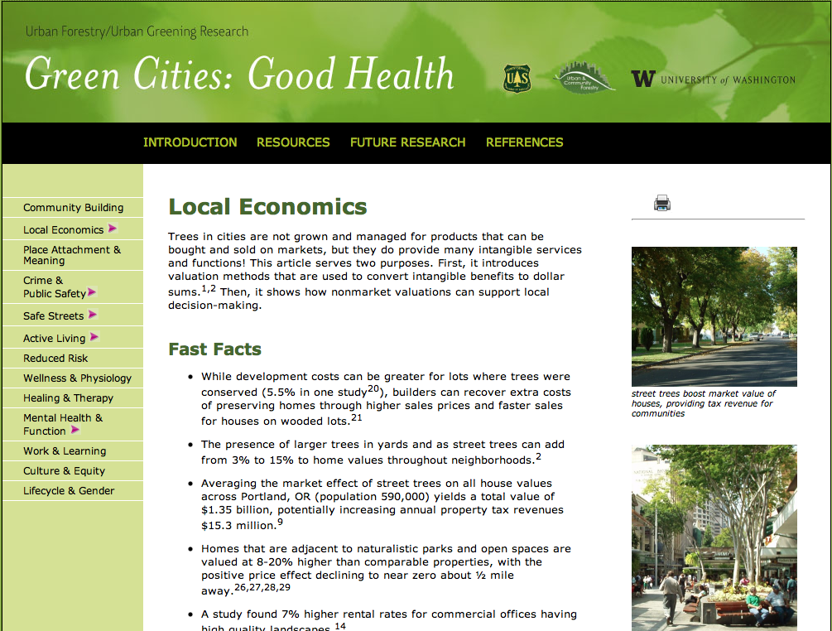
Notes:
The web site is organized by 13 themes of benefits (left column in slide).
Each online summary starts with a brief introduction. ‘Fast Facts’ follow, providing evidence-based bullet points that can be ‘borrowed’ for use in fact sheets, newsletters, and other community outreach. Then the summary contains an extended essay that further explains the scientific results, and some theoretical background for the topic.
The Fast Facts and the essay are all fully cited, with article references provided at the end of page. Links in the top right corner of each page provide a downloadable datasheet and Powerpoint presentation for each benefits theme.

Slide 9
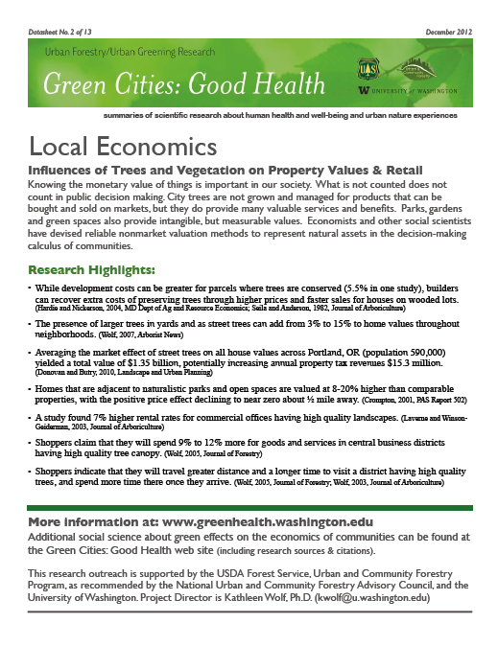
Datasheet
research highlights
one page briefing
print & share
Notes:
For each of the 13 benefits summaries, one can download a printable datasheet. The one page briefing repeats the research highlights of the web page, and provides information about the entire Green Cities: Good Health project.

Slide 10
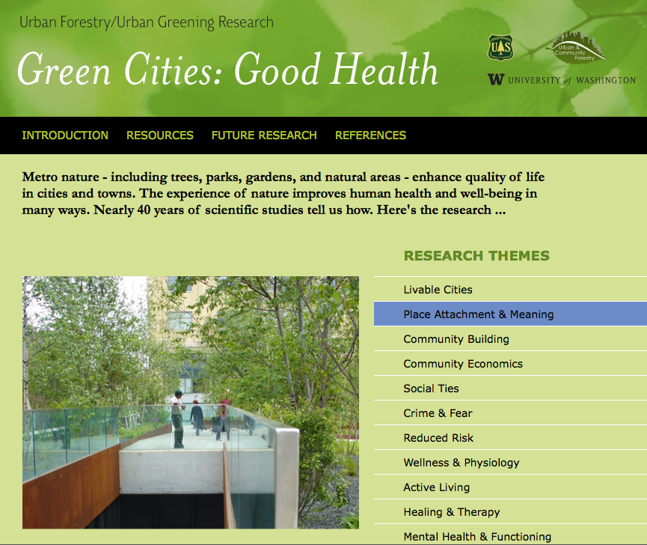
Acknowledgements
Project Director:
Kathleen Wolf, Ph.D.
Thanks to University of Washington students:
Katrina Flora, B.A.
Mary Ann Rozance, M.S.
Sponsors:
University of Washington
USDA Forest Service Natl Urban & Community Forestry Advisory Council
NGO partners
Notes:
This research outreach project is supported by the:
USDA Forest Service, Urban and Community Forestry Program,
as recommended by the National Urban and Community Forestry Advisory Council,
and the University of Washington.
Two students helped build the article database and write draft summaries: Katrina Flora & Mary Anne Rozance. Katrina is now in a Masters degree program in urban planning at University of Pennsylvania, and Mary Anne is doing doctoral studies at Portland State University (Oregon).
Project Director is Kathleen Wolf, Ph.D., Research Social Scientist at the University of Washington; kwolf@u.washington.edu

Slide 11
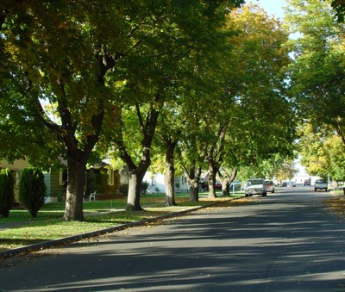
back to …. Crime & Public Safety
the character & quality of landscape
can reduce negative behaviors in a community . . . .

Slide 12
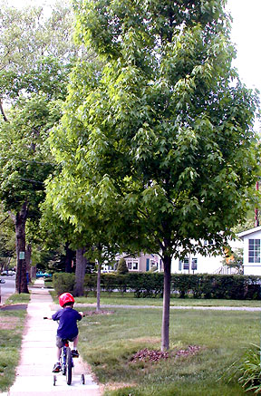
research highlights Single Family Residential Areas
Trees in the public right-of-way & patterns of crime
smaller, view obstructing trees are associated with increased property crime
larger trees are associated with reduced crime
Donovan & Prestemon. 2012. Environment and Behavior
Notes:
More complete information about these studies and results can be found at the Green Cities: Good Health web site.

Slide 13
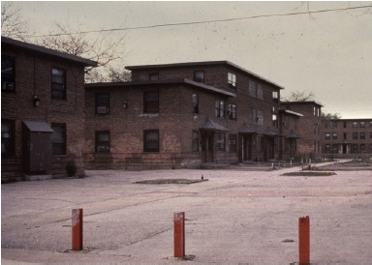
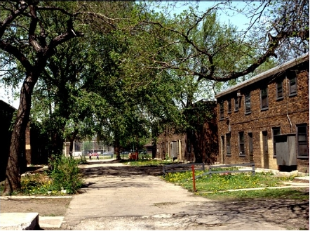
research highlights Apartment Complexes
several studies - Chicago public housing
natural experiment-residents randomly assigned to apartments Crompton, 2001, PAS Report 502
Notes:
Vegetation and landscape character differed across different buildings. these differences in management of the outdoor environments set up natural experiments. Eligible residents were randomly assigned to apartments. Measures were conducted with residents.
More complete information about these studies and results can be found at the Green Cities: Good Health web site.

Slide 14
research highlights Apartment Complexes
buildings having greater amounts of vegetation
52% fewer total crimes
48% fewer property crimes
56% fewer violent crimes
residents having nearby trees and natural landscapes reported 25% fewer acts of domestic aggression and violence Kuo and Sullivan, 2001, Environment and Behavior
Notes:
Crime reports showed that the buildings having greater amounts of vegetation experienced less crime against both property and people.
Self-reports in interviews also indicated less domestic aggression and violence in households within buildings having greater amounts of vegetation.
More complete information about these studies and results can be found at the Green Cities: Good Health web site.

Slide 15
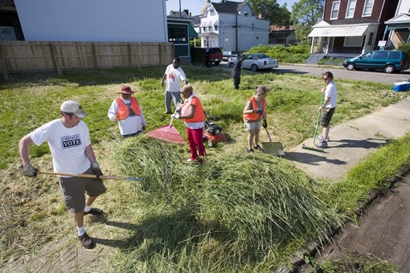
research highlights Vacant Lot Clean Up
study of 4 sections in Philadelphia
reductions in gun assaults across 4 sections
reductions in vandalism in 1 section Branas et al. 2011. American Journal of Epidemiology
Notes:
Similar to findings from a study of community policing innovations, done by Braga and Bond, 2008, Criminology.
More complete information about these studies and results can be found at the Green Cities: Good Health web site.

Slide 16
Conclusion
City trees & urban greening provide many intangible services & benefits
Studies suggest positive affects of landscape on crime
Vegetation is part of Crime Prevention Through Environmental Design (CPTED)
People gather in quality places providing informal social control of places
Notes:
A small number of studies have explored the relationship of urban greening and the incidence of crime. Several quality studies suggest the positive affects of quality landscapes.
CPTED addresses the elements of a place than can enable or discourage crime. Vegetation can be a physical element in crime. For instance, dense vegetation may inhibit sight lines making a place less secure, as not all activity within a space is immediately visible.
More important, perhaps, are the social aspects of crime. Quality landscapes send cues about the level of care and attention of residents, perhaps deterring property crime. Quality landscapes in public spaces provide places for people to gather and interact; social cohesion is the result of informal relationships and is also a product of community projects such as vacant lot clean ups. Socially connected communities are ‘occupied’ by people who care and are the ‘eyes on the streets’ that informally deter undesirable activity.

Slide 17
For more information:
Project Support:
University of Washington
USDA Forest Service
Green Cities: Good Health
www.greenhealth.washington.edu
Project Director:
Kathleen Wolf, Ph.D., Research Social Scientist, University of Washington
Notes:
Closing information- repeat web site address. Acknowledge project support and the project source.

Slide 18
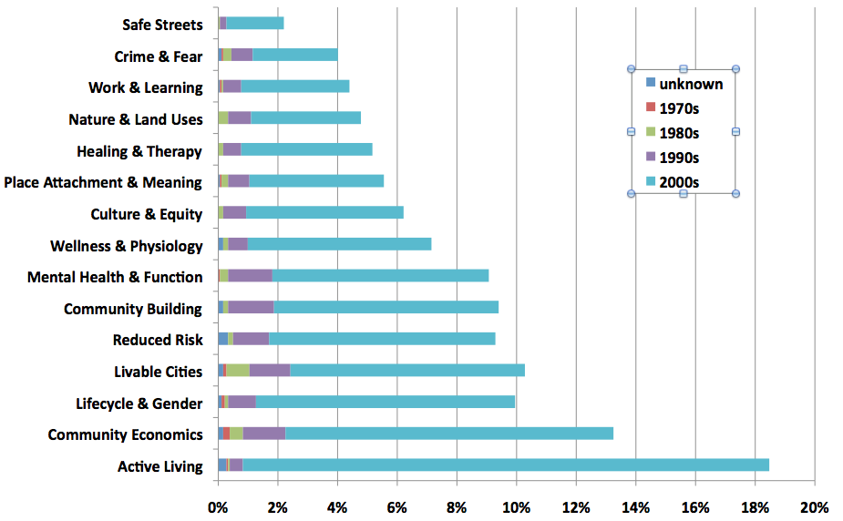
Article Database . . . .
Notes:
This is an optional slide if you wish to communicated the breadth and depth of the evidence about urban forest and urban greening benefits.
This chart is a quick overview of the entire article database. On the left axis one can see all of the 13 themes (plus a couple of extras). The publication history spans about 40 years, starting in the 1970s. In December 2012 the database included slightly more than 2,000 peer reviewed articles and scholarly book chapters.
For each benefits theme the horizontal bar represents the % of the article count of the total database. Some articles double load, for instance an article might be about garden therapy for dementia so would be listed for both ‘Mental Heath & Function’ and ‘Lifecycle & Gender.’ So one can see that the Active Living theme includes almost 20% of the articles; Safe Streets represents only about 2% of the studies. The database can serve as a research ‘gap analysis’ to discuss and focus future research efforts.
Looking more closely at each horizontal bar, one can see the distribution by decade of publication. Up until the 1990s there wasn’t much research to report. Since the year 2000 there has been a surge of science activity and publication. What might the reason for this? Perhaps with greater urbanization (of the U.S. and the world) there is more interest in urban livability. Perhaps there is greater recognition of the role of environment in achieving public health and well-being. Or . . . . ?

