Slide 1
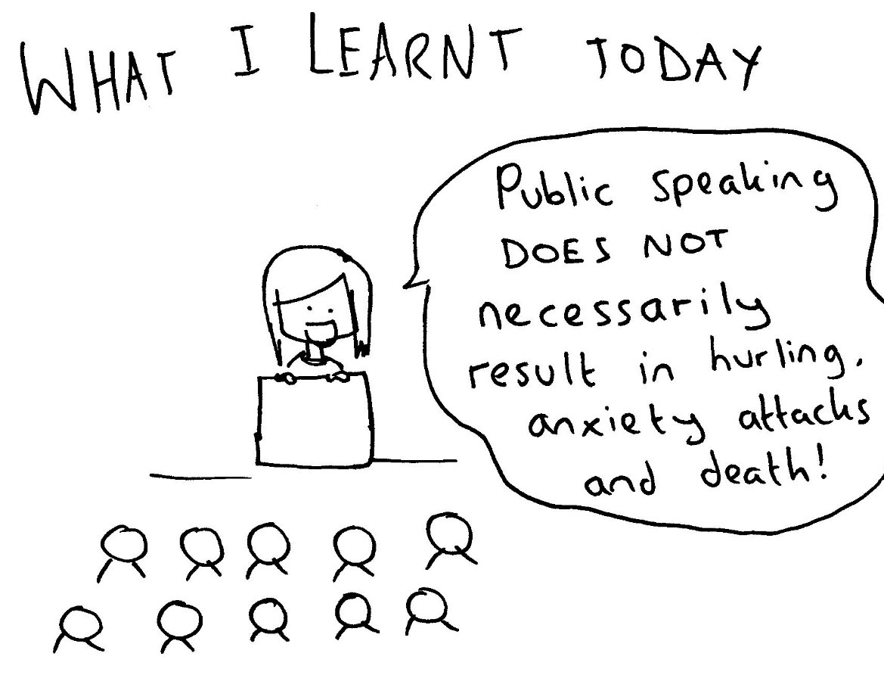
Chip’s Tips: Speaking Can Be Fun & Rewarding
1. PLANNING
how many slides?
what to show? what to skip?
slide design
2. PRACTICE
to yourself
to others (lab, friends, family)
3. PERFORMANCE
setup
delivery
Q&A
Notes:
These are tips for talks that I have learned over the years,
sometimes from my mentors and sometimes “the hard way” (by making mistakes).
I hope you might find them useful.
Learning to give good talks (and also to write well) is a lifelong pursuit – something at which we can never be “good enough”.
If you take up the challenge and stick with it,
you can continuously improve and also get great enjoyment from the process.
Chip Asbury
Professor
Neurobiology & Biophysics
University of Washington
October 1, 2024
---------------------------------------------------------------------------------------------------------------------
Giving seminars, and public speaking more generally, does not come naturally to everyone.
I used to be mortified by the idea of speaking in public.
But I assure you that by working hard on it,
each of us can learn to be good at it, and to even enjoy it.
I want to share a few tips I’ve learned.
NOTE: We will focus in this course specifically on scientific talks.
But know that speaking persuasively to an audience is a very important skill,
not only for scientists, but for any career that involves leadership.

Slide 2
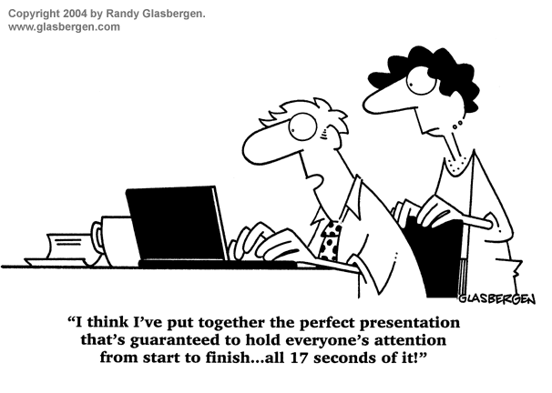
Planning: Pay Strict Attention to Allotted Time
≤ 1 slide per minute (don’t cheat!)
omit anything not “on message”
avoid data dumping
“In public speaking,
you say one thing,
or you say nothing.”
- Edward Teller
(taught to me by Bill Zagotta)
Notes:
For this class, you each get 20 min for your talk, plus 5 min for questions and changeover.
That means, 20 slides, max.
At first, you’ll probably think,
“I can’t possibly tell my story in so few slides!”
THINK AGAIN.
It is always possible to whittle down to a briefer treatment.
Plan carefully: What is your main takeaway message for this talk?
Omit anything that does not support that main message.
Avoid the temptation to show lots of data.
1 or 2 incisive pieces of data, with clear explanation of how you got them,
and what they mean
– this is way more impressive than a whirlwind of data that your audience cannot follow.
For brevity, you can often omit controls
– go straight to the killer experiment that supports your takeaway message.
The audience can ask later about controls,
or go look at your preprint in bioRxiv, or your publication when it’s out.

Slide 3
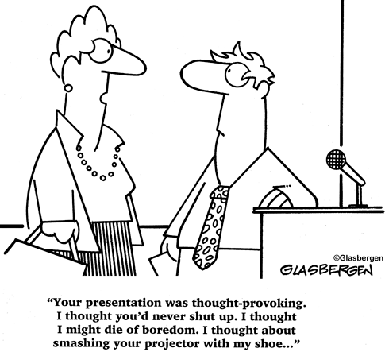
Planning: Reach For Everyone in Your Audience
avoid jargon, avoid acronyms
give sufficient background info
(carefully chosen)
favor concepts and overall ideas,
avoid weedy details
avoid the “mystery story” or “striptease” maneuver
Notes:
When we talk with colleagues in our own lab, or in our own small scientific discipline,
jargon and acronyms can be so useful that,
after a while, we use them without even thinking about them.
To reach an audience, you have to jettison all of them.
You also need to give sufficient background,
starting with brief basics that everyone should already know.
But choose carefully what background info to include, and what to omit.
Don’t dump a long list of previously discovered facts onto your audience.
Cover only the background info needed to understand the main points that your talk addresses.
(This is a restatement of the same principle as before:
Omit anything that does not support your main message.)
Favor clarity of ideas, and simplicity as much as possible.
Avoid getting into weedy details that are nuanced and unimportant to the main story.
A common mistake is attempting to give what I call a “mystery story” or “striptease” talk.
That is, to leave the main conclusion as a surprise revelation for the end of the talk.
-- this almost never works!
People have short attention spans, and most will drift off by the end if they do not understand where you are going.
Better to give a succinct summary of the main message at the beginning,
and use the rest of the talk to provide the key supporting information.

Slide 4
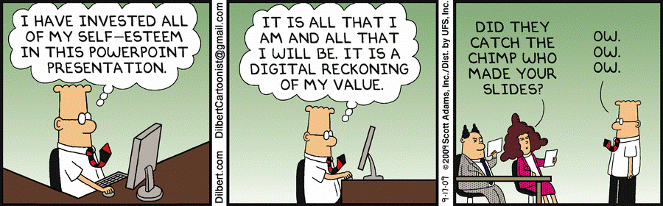
Planning: Good Slide Design Helps
use BIG fonts, thick lines, clear graphics
fill the entire slide
every title should give the main message of the slide
maintain consistency and continuity
Notes:
If people in the back cannot see, they will get lost and tune out.
Common mistake is to leave margins,
with little “postage stamp” graphics or images surrounded by…empty space
This is counterproductive – make everything big, easily visible, blown up to fill the slide as completely as possible.
Compose titles for every slide that give the main message that slide conveys.
You will give this message with your words too,
but your words will not always be sufficient.
Some audience members might be jotting notes during that sentence or spacing out for a moment.
Having the message given also as the title of the slide helps everyone stay with you.
Commercial movies have continuity editors who make sure the cars stay the same color from scene to scene,
and people wear the same clothing coming out of the door as they did going into it.
You can do the same in your slides:
If you show several graphs across a few slides, keep the same color, symbol, thickness for control data versus test data
(or across data categories, like wildtype is always black and mutant always red)
In diagrams, represent the same object the same way every time you show it
(e.g., the ubiquitin ligase enzyme is always a red clamshell,
the ubiquitin tag always a yellow circle,
the target substrate protein is always a green blob)

Slide 5
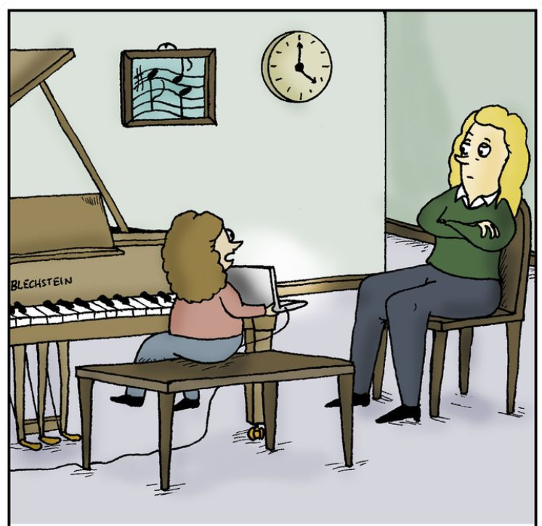
Practice Out Loud, Multiple Times
transitions between slides are important, sometimes tricky
practice out loud
practicing to a test audience
is crucial for editing
practice to yourself
for polishing
“I’ve prepared this PowerPoint presentation to explain why I didn’t have time to practice this week.”
Notes:
For a truly polished talk, you need to practice.
Transitions between slides can be tricky, and important.
Before advancing to the next slide, you should ideally begin introducing it, anticipating it.
I sometimes plan these “segues” in advance, or I work them out while I’m practicing my delivery.
Practicing in my own head is useless.
I need to exercise those connections between my brain and my vocal chords,
in order for the practice to actually be useful.
Practicing to a test audience, with people who are willing to give you their honest, unvarnished opinions, is crucial for editing.
There is no substitute for getting others’ perspectives.
They help you see where you’ve omitted something important or included too much confusing detail.
You want a test audience that will be generous with their advice, and you want to take it all seriously.
Jot down all their comments and suggestions, use their ideas to improve your slides, your delivery.
Do this well in advance, so you have time to make those improvements.
After you’ve edited, practicing to yourself is crucial for polishing.
Giving a talk to yourself out loud can feel awkward.
Find a private space where you won’t disturb anyone.
My approach is to go for a walk or a hike, ideally on a woodsy trail without much traffic.
I print my slides and notes, and carry them with me.
At first, I might need to refer to them a lot.
But I keep practicing until I can give the whole talk without looking at the notes anymore.
Use a timer to test whether you’re coming in on time. If not, cut something!

Slide 6
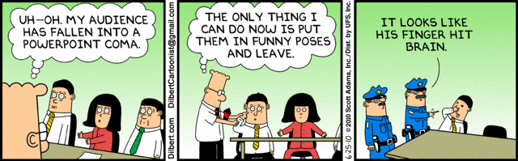
Setup Early, Speak Clearly, Enjoy the Q&A
anticipate A/V issues, arrive early & have a backup
fill the room with your voice (amplified)
avoid pointer antics
fun Q&A is one of your rewards
Notes:
How many times have we all waited, while a speaker wastes 5 min or more of their alotted talk time,
fighting with their laptops and the A/V system?
Please, don’t be that person!
Arrive early enough to plug in your laptop and test
1. that your presentation plays properly on the system
2. that the microphone works
3. while you’re at it, check that the lighting seems right
If there’s any question, you should insist that the host gives you time for all this.
In case of total laptop breakdown, have a backup copy of your talk, on a thumb drive or accessible on the cloud,
so you can put it onto someone else’s laptop if needed.
I always use a mic. If you have a booming voice, then maybe you can get away without it.
But usually not. Use it, and enjoy the “rockstar” feeling of your voice filling the room.
If the mic clips to your collar, put it on the side toward the screen,
so if you turn your head toward the screen, the mic picks you up better, rather than losing your voice.
Speak toward the audience, not toward the screen.
Pointer antics: common mistake is to jiggle the pointer round and round an object as you’re talking about it.
This makes the audience dizzy and distracts them.
Just point briefly, then retract the pointer, and face the audience again.
Don’t squeeze out the Q&A by going past 20 min.
It is the most fun part for you as the speaker.
It’s exhilarating to get people who are interested in your work asking questions about it.
Relax, bask in the excitement, do your best to understand and address what they’re asking.
Let the questioner finish without interrupting them.
Consider repeating their question in your own words, to make sure you understand it.
After you answer, if you’re unsure that you’ve addressed what they were interested in, it’s okay to ask.
“Does that answer your question?”

