Slide 1


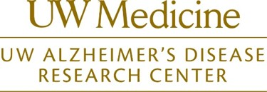
Natives CARE
Understanding Alzheimer's Disease and Dementia in American Indian and Alaska Native People
Outreach Clinic Presentation
Meghan Jernigan, MPH (Choctaw), Project Lead
Collaborators

Slide 2

Partnerships for Native Health
Community-based action research, education and training
Urban and reservation-based AI/AN populations across the lifespan
Physical and mental health, chronic disease, elder health, healthcare needs
~ 160 partners: tribal colleges, AI/AN organizations, tribes (30 active partners)
75 projects funded since 2007

Slide 3
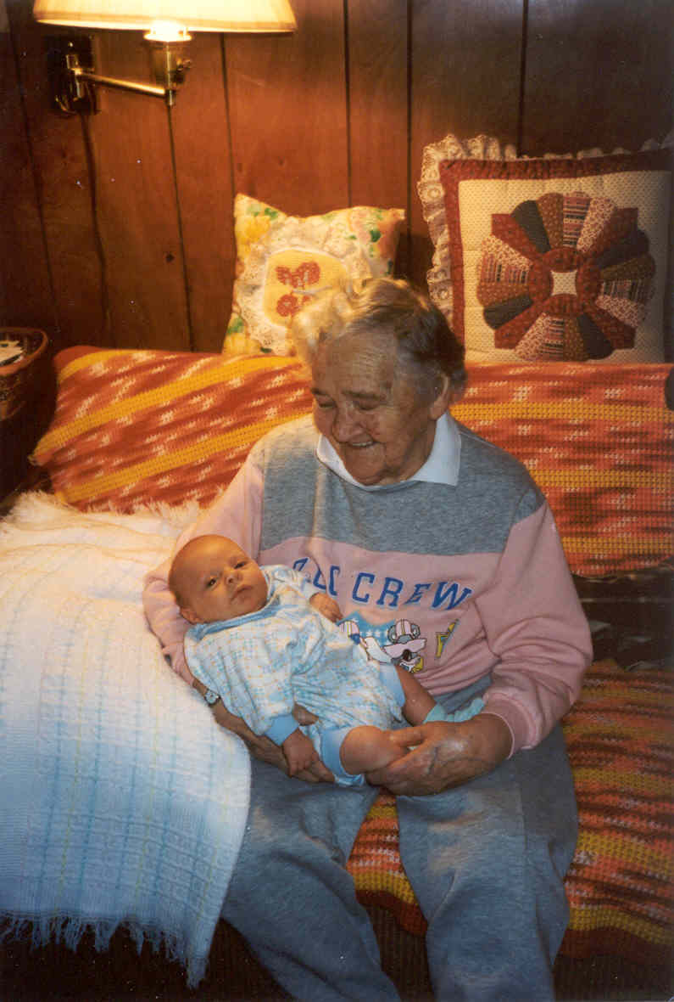
Presentation Overview
Context
  Dementia 101
  American Indians/Alaska Natives (AI/ANs), cognitive impairment, and dementia
  Washington State data
Clinical Integration
  Native outreach and education
  Detection
  Resources
Collaborations and Partnership Opportunities
Notes:
Add slides on the overall Alzheimer’s disease
Use the question content area labels to guide the areas to include, table 2

Slide 4
Mild Cognitive Impairment (MCI)
Mild cognitive impairment is an early stage of cognitive change.
  Patients or family members notice changes in thinking.
  Impairment is documented by formal testing.
  Patient is able to independently carry out daily activities.
People with MCI are more likely to develop Alzheimer’s disease or other dementias than people without MCI.
Notes:
Citation: https://www.alz.org/dementia/mild-cognitive-impairment-mci.asp#about

Slide 5

What is Dementia?
Dementia is a decline in mental ability, including memory, that is severe enough to result in loss of independence in typical daily activities.
Dementia is most common in older adults and has many known causes.
Alzheimer’s disease is the most common type of dementia in older adults.

Slide 6
What is Alzheimer’s Disease?
When cognitive impairment is due to Alzheimer’s disease, symptoms usually start gradually and progress slowly, over many years.
In its early stages, memory loss is mild, but with late-stage Alzheimer's, individuals lose the ability to carry on a conversation and respond to their environment.
There is no cure for Alzheimer’s disease, but there are opportunities for early diagnosis and interventions which temporarily slow the worsening of dementia symptoms and improve quality of life.

Slide 7
What is Alzheimer’s Disease?
Mild Cognitive Impairment
Dementia
Cognitive Function
Gradual accumulation of neuropathology
Years

Slide 8
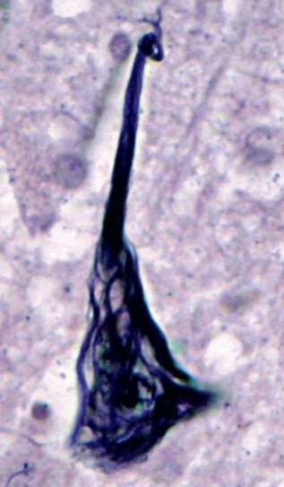
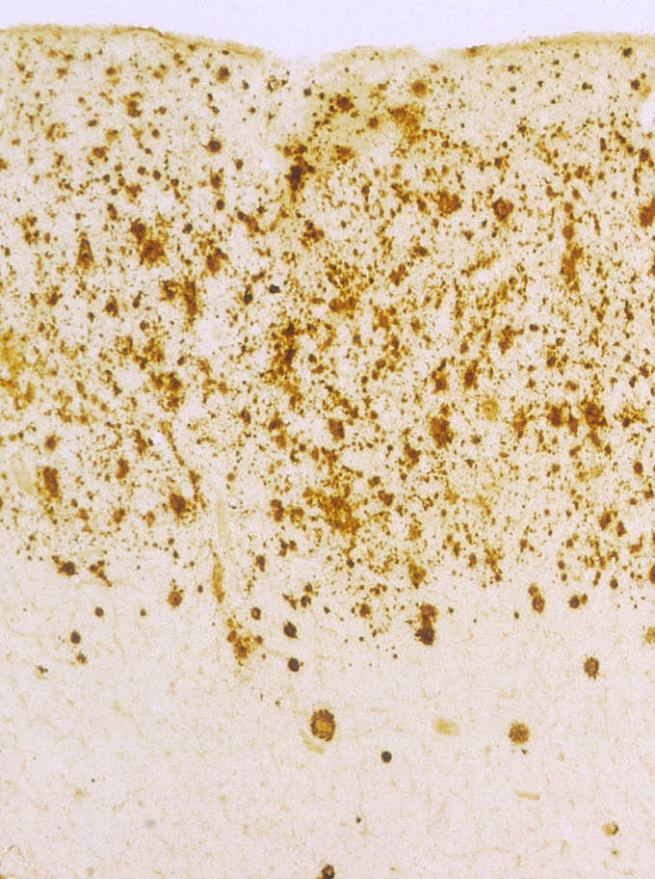
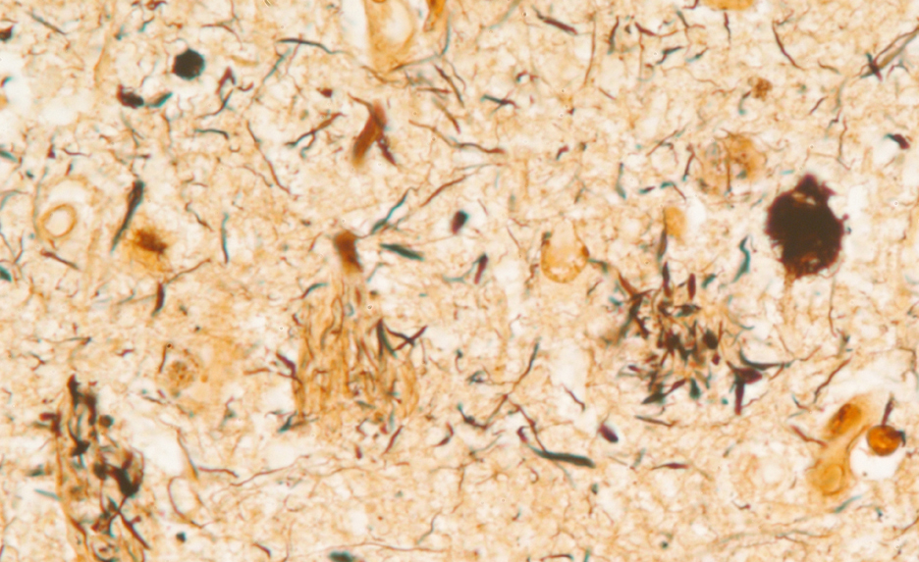
What is Alzheimer’s Disease?
+
→
tau
amyloid
neurodegeneration

Slide 9
Alzheimer’s Disease and AI/ANs
The number of AI/ANs age 65 and older is growing fast.
The US Census Bureau estimated that in 2012, 266,000 AI/ANs were aged 65 and older
According to projections, the population of Native elders in this age range will almost quadruple by 2050, to 996,000.
Many experts believe that Alzheimer's disease is underdiagnosed in our communities.
Notes:
AI/AN community context

Slide 10
AI/AN Dementia Risk: What do we know?
Two recent studies of Alzheimer’s disease:
Mayeda et al. Alzheimer’s & Dementia (2016)
  AI/ANs and African Americans have the highest incidence of dementia among all racial and ethnic groups.
Chen and Panegyres. Journal of Alzheimer’s Disease (2016)
  AI/ANs and Native Hawaiians have twice the risk of early-onset dementia (before age 65) relative to Whites (lowest risk group).

Slide 11
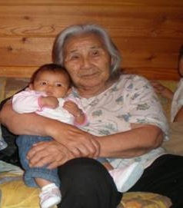
Challenges in Addressing Alzheimer’s among AI/ANs
  Fragmented healthcare and surveillance systems
    26 hospitals operated by the Indian Health Service
    19 tribally operated hospitals
  Inconsistencies in diagnostic criteria
  Known barriers to screening
    Lack of transportation
    Little continuity of care
  Alzheimer’s stigma and myths
    “Normal part of aging”
    “Can’t be treated”
    Patients might be labeled “crazy” and could be removed from their homes

Slide 12
Why diagnose Alzheimer’s disease?
  Memory loss may be caused by other issues, such as sleep apnea, alcohol use, stroke, traumatic brain injury, or the side effects of medication.
  A diagnosis of Alzheimer’s disease means that the patient’s memory and thinking problems are expected to gradually worsen. It is important to begin planning for future care needs, ideally while the patient can participate in the discussion.
  An accurate diagnosis can help the patient and family obtain access to appropriate resources for education and support.

Slide 13
2017 Facts and Figures
Alzheimer’s Association 2017 Disease Facts and Figures http://www.alz.org/

Slide 14
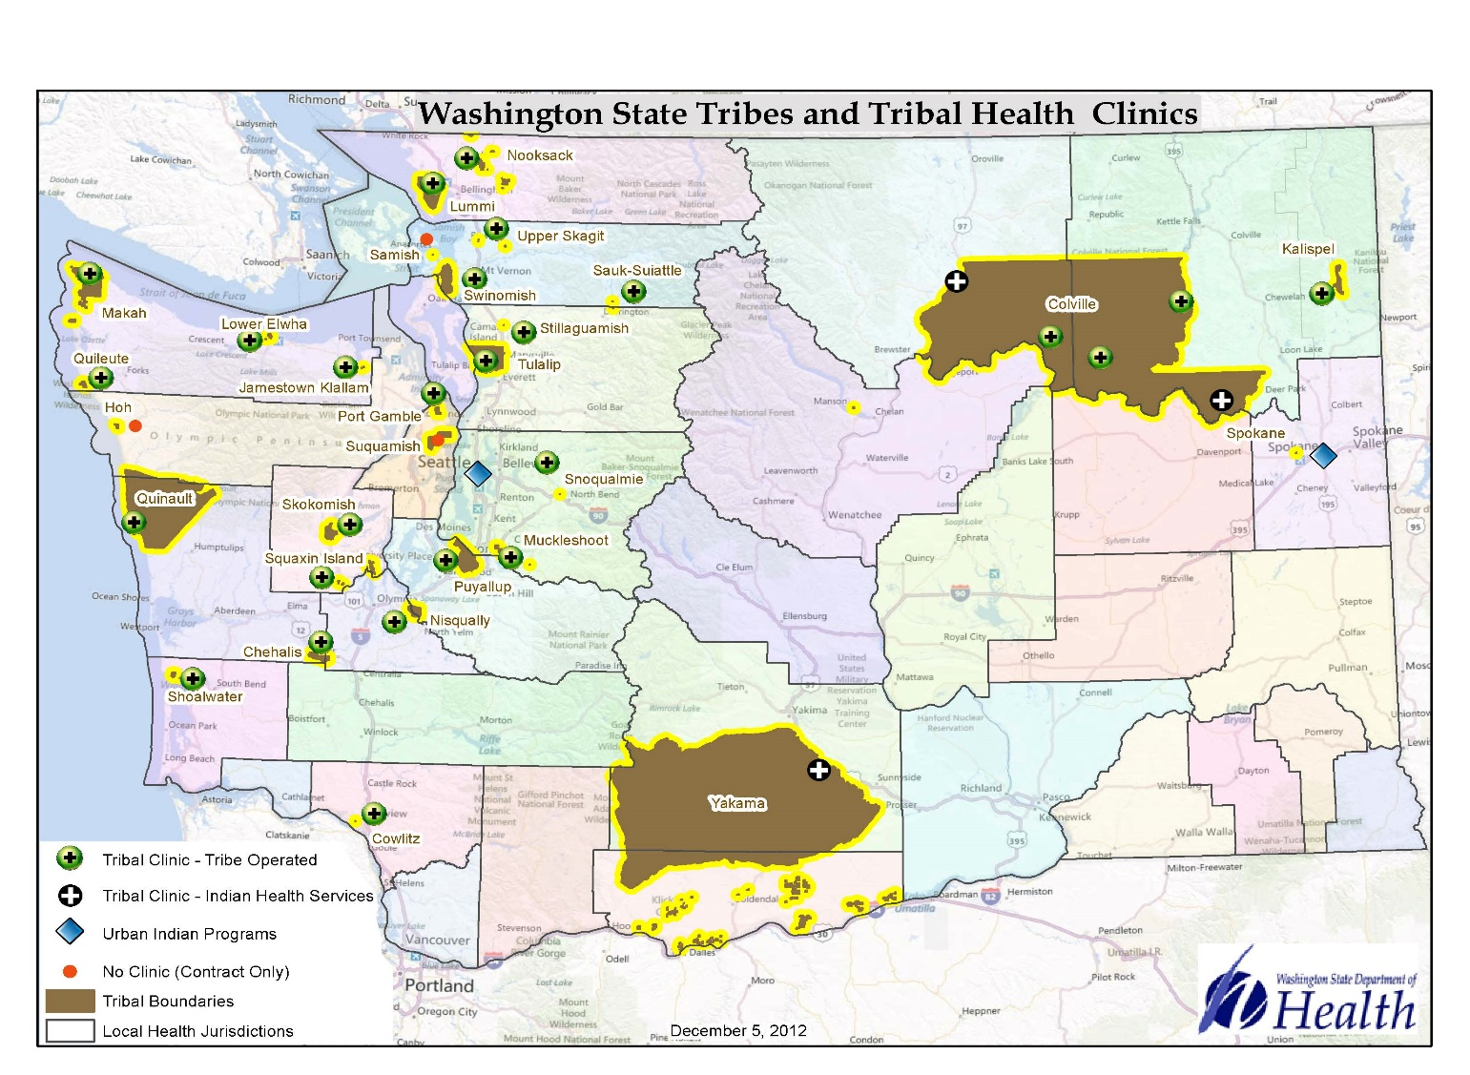
Alzheimer’s in Washington State
  100,000 cases in Washington
    - 40% increase expected by 2025
  Third highest incidence rate in the US
  Third leading cause of death
  9th cause of death among AI/AN in Washington State 2006-2010.
Alzheimer’s Association. 2017 Alzheimer’s Disease Facts and Figures. Alzheimer’s & Dementia 2015;11(3)332+
Washington State Death Certificates, 2006-2010 corrected for misclassified AI/AN race, NWPAIHB.

Slide 15
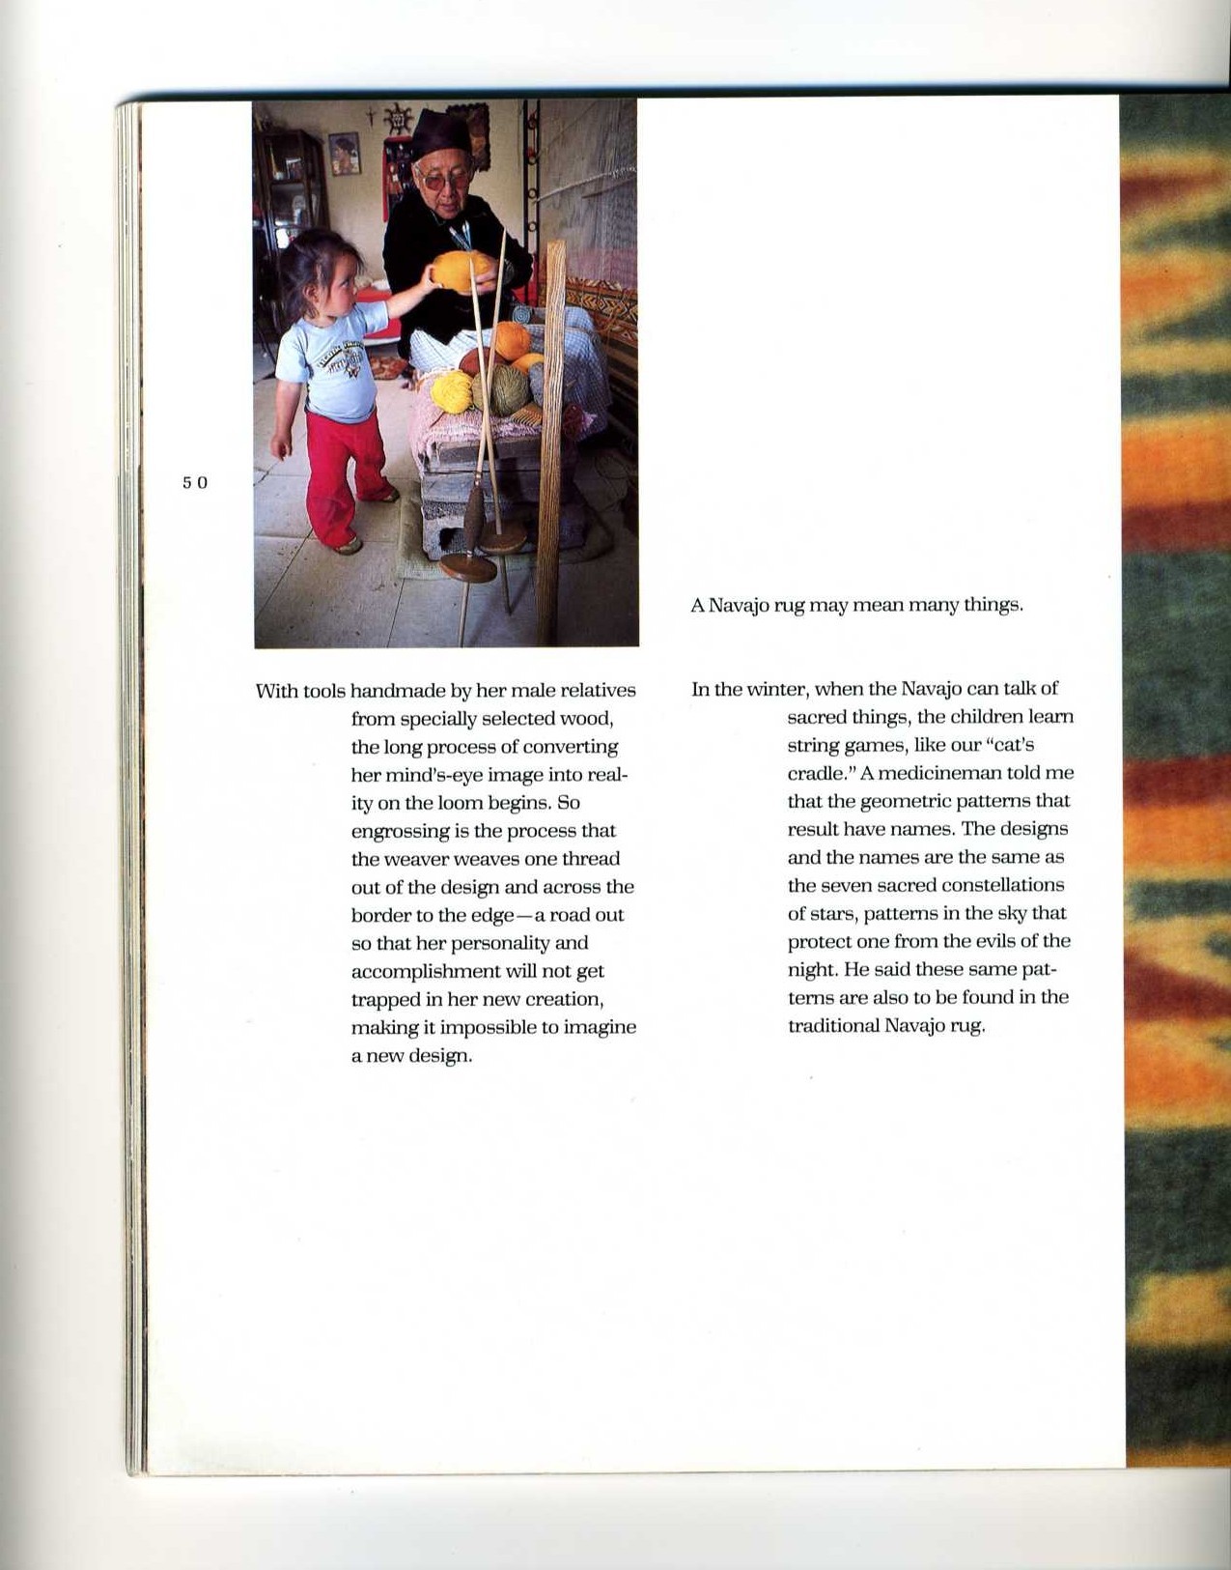
Early Detection
Fewer than 50% of cases of dementia are diagnosed in a
clinical setting.
Family members and healthcare providers play a critical role in detecting mild cognitive impairment and dementia.
Better diagnostic aids are needed
  Culturally relevant
  Brief
  Cost-effective
Connoly et al, Aging and Mental Health, 2011; Mattson, et al. JAMA; 302(4):385-393.

Slide 16
Clinic-based Evaluation
Interview and history
Physical and neurologic exam
Cognitive assessment
Depression screening
Functional status
Medical history review
Medication review
Laboratory tests
Brain imaging
Repeat evaluation in 6-12 months if cause unclear
Source: Dementia Update for Primary Care: Detection, Diagnosis and Management.
Dr. Kristoffer Rhoads, PhD. Seattle, WA 2/7/17

Slide 17
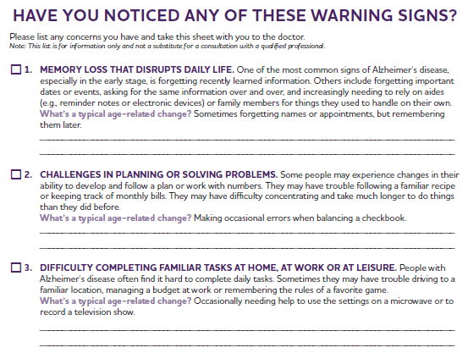
Clinic-based Screening
http://www.alz.org/national/documents/10_signs_checklist.pdf

Slide 18
Cognitive Screening Tools
Mini-Mental State Examination (Folstein et al., 1975)
  Sensitivity = 66-73%
  Specificity = 87-92%
Mini-Cog (Borsen et al., 2000)
  Sensitivity = 65-85%
  Specificity = 87-91%
Montreal Cognitive Assessment (Nazreddine et al., 2005)
  Sensitivity = 90-100%
  Specificity = 87-90%
Source: Dementia Update for Primary Care: Detection, Diagnosis and Management. Kristoffer Rhoads, PhD. Seattle, WA 2/7/17
Notes:
Content Area: Assessment and Diagnosis
MMSE – Mini-mental State Examination
Mini-Cog
MoCA – Montreal Cognitive Assessment

Slide 19
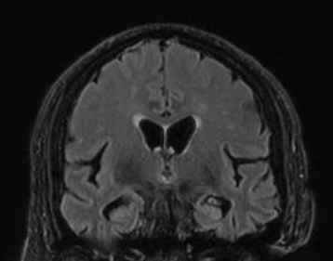
Clinical Imaging
Brain MRI
  No tumor
  No stroke
  Hippocampal shrinkage

Slide 20
Prevention and Intervention
Healthy Diet
Education & Mental Stimulation
Social Engagement
Physical Activity & Sleep
Stress Management
Reduced risk of dementia
Baumgart, Matthew, et al. Alzheimer’s & Dementia (2015) Summary of the evidence on modifiable risk factors for cognitive decline and dementia: A population-based perspective.
Notes:
Content Area: Prevention

Slide 21
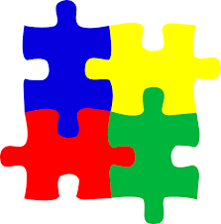
Modifiable Risk Factors in Mid-Life
  Diabetes
  Hypertension
  Obesity
  Social Engagement
  Physical Activity
  Tip: Wellness programs are ideal for staging mini-memory screening events.

Slide 22
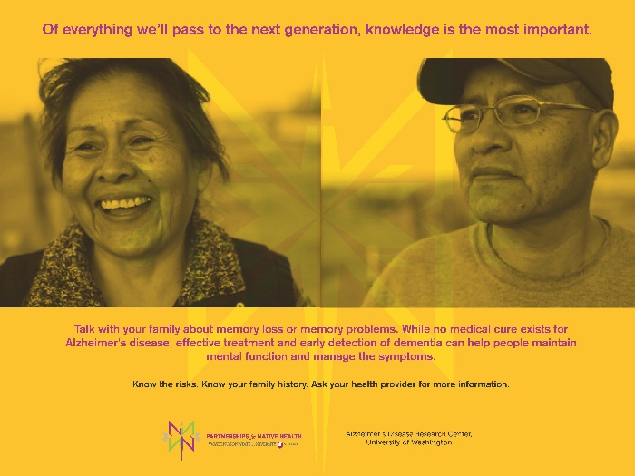
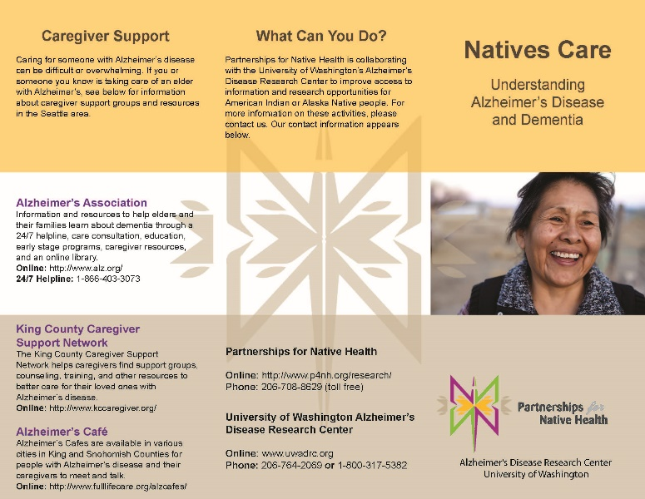
Partnership Activities
  Distribute educational materials in clinic waiting rooms
  Distribute materials at health fairs and powwows
  Mail fact sheet to priority audiences
  Resource sharing
  Capacity building

Slide 23
Partnership Activities
  Provider training
    Integrate practice recommendations described by the Alzheimer's Association
    Promote principles of patient-centered care
  Dementia follow-up with specialists
    Focus on active clinic patients who are AI/AN
    Facilitate follow-up clinic visits to review test results
    Refer patients interested in research participation to the University of Washington Alzheimer’s Disease Research Center

Slide 24
Partnership Activities
  Improve patient and family knowledge of dementia by hosting “Natives Care: Understanding Alzheimer’s Disease,” an in-service session for community
      Share a digital story on Alzheimer's disease
      Review the signs and symptoms of dementia
      Discuss implications for AI/ANs
      Distribute educational materials
      Engage in dialogue with community members

Slide 25
Allied Partners
  University of Washington Memory and Brain Wellness Clinic
    Based at Harborview Medical Center in Seattle
    Multidisciplinary: psychiatry, neurology, geriatrics, social work
    Neuropsychologic testing and cognitive rehabilitation
    Examples of free community offerings
      Living with Memory Loss: A Basic Guide (download)
      Memory Loss: Let’s Face It (monthly lecture)
      Powerful Tools for Caregivers (quarterly education series)
      Professional education (lectures available online)

Slide 26
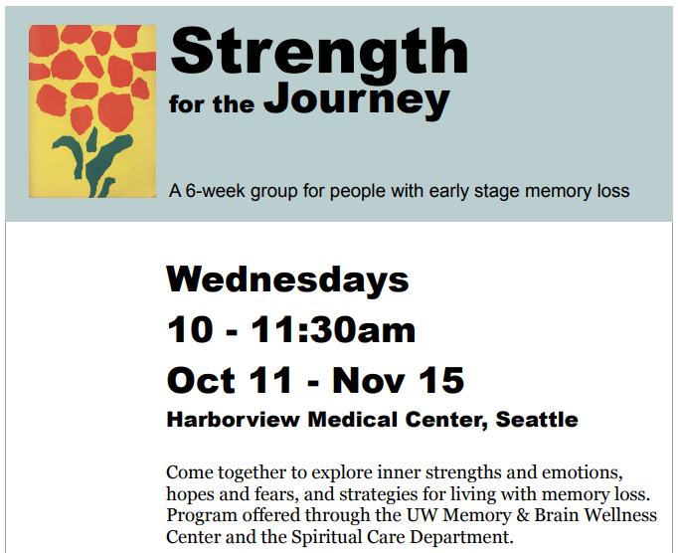
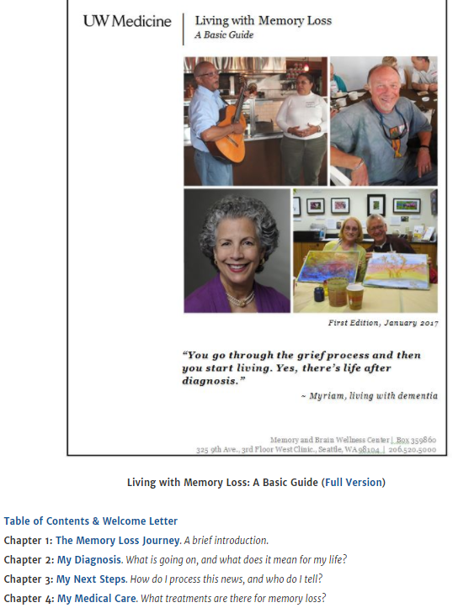

Partnership Activities

Slide 27
Other Research Activities
“Alzheimer's Disease Research Study for American Indians and Alaska Natives” is a pilot study that was funded to:
  Develop and deliver a presentation on Alzheimer’s disease research
  Administer pre- and post-presentation surveys
  Conduct focus groups with AI/ANs on the impact of the presentation

Slide 28
Research Activities at University of Washington
AI/ANs are under-enrolled in clinical research and population-based studies.
The University of Washington Alzheimer’s Disease Research Center is a site for clinical trials and studies of potential treatments, prevention strategies, and new diagnostic approaches for Alzheimer’s disease and related neurodegenerative conditions.
http://depts.washington.edu/mbwc/research/clinical-trials

Slide 29
Research Opportunities at University of Washington
Examples of intervention/treatment studies
  EMERGE; CONNECT: placebo-controlled drug trials for people with early-stage Alzheimer’s disease
  A4: placebo-controlled drug trial for symptom-free older adults
  Estia: computer games for older people with depression

Slide 30
Research Opportunities at University of Washington
Examples of observational studies
  Alzheimer’s Disease Research Center Clinical Core: natural history study to learn about cognitive aging over time in people with and without memory loss
  IDEAS: Medicare-funded study to learn whether brain scans for detection of amyloids are useful
  Neuroimaging and function studies to learn how changes in walking are associated with cognitive function in older people

Slide 31

Contacts
Meghan Jernigan, MPH
Staff Scientist
meghan.jernigan@wsu.edu

