Slide 1
Visual Impairment and Memory Loss | Case Presentation
10/14/22
Bonnie M. Keung, MD
Swedish Neuro-ophthalmology Clinic

Slide 2
Neuro-ophthalmologist
Neurology or ophthalmology trained followed by fellowship
Common diagnoses:
Optic neuritis, papilledema, ischemic optic neuropathy, nystagmus, diplopia, myasthenia gravis, compressive optic neuropathy, occipital lesions
Notes:
& vision loss related to occipital lesions

Slide 3
Occipital lesions
66 year old man HTN, HLD, CAD who suddenly noticed left sided visual field defect.
Notes:
Classic case of CVA

Slide 4
Notes:
Went to eye clinic where there was a R inferior homonymous quadrantanopia

Slide 5
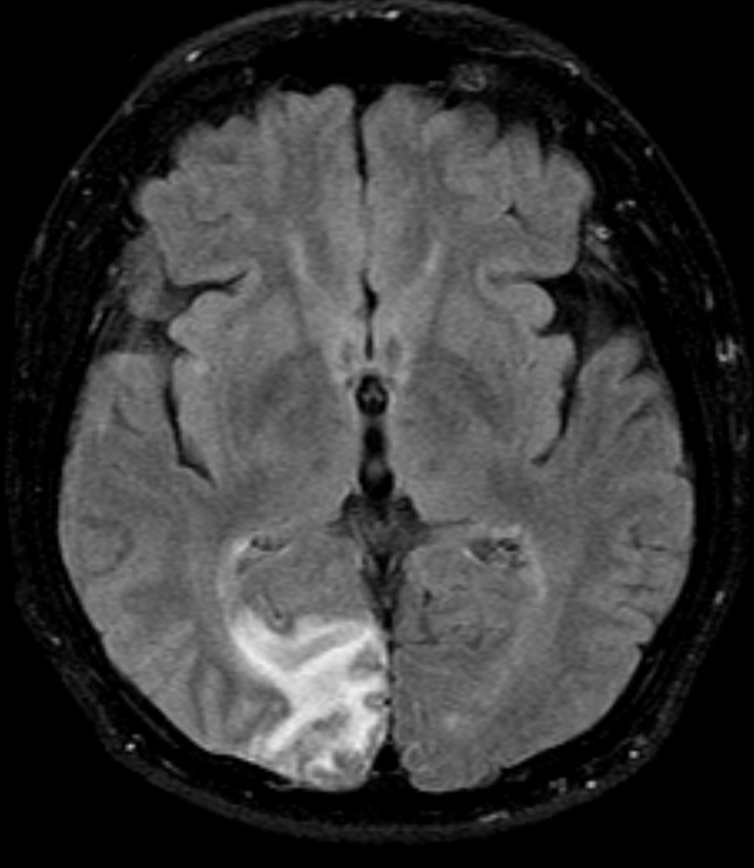
Notes:
MRI a few days later and there is evidence of a subacute stroke in the R posterior cerebral artery territory

Slide 6
Occipital lesions | Case 1
66 year old man HTN, HLD, CAD who suddenly noticed left sided visual field defect.
R PCA territory infarct
Outpatient holter monitor → atrial fibrillation

Slide 7
Neuro-ophthalmologist
Neurology or ophthalmology trained followed by fellowship
Common diagnoses:
Optic neuritis, papilledema, ischemic optic neuropathy, hereditary optic neuropathy, brainstem syndrome, nystagmus, diplopia, myasthenia gravis, compressive optic neuropathy, occipital lesions
Rare diagnoses:
Higher cortical vision loss in the setting of neurodegenerative disease

Slide 8
Occipital Lesions| Case 2 CC: visual field defect and normal MRI
Referred by PCP and ophthalmologist
64 year old woman
1 month: driving home and vision was off
Seen by ophthalmologist (1):
“Things aren’t focusing right, things look weird, some objects look bigger and some look smaller”
Possibly due to epiretinal membrane in the right eye → plan for retinal surgery
Second opinion ophthalmologist (2):
Left homonymous hemianopia → go to ED for stroke work up
Notes:
Thin layer of scar tissue that can form over the top of the eye’s macula

Slide 9
VF from ophthalmologist

Slide 10
MRI in ED
Notes:
DWI on the left, no stroke.
I am going to point out that there is general atrophy and ex vacuo dilation of ventricle which could be related to general atrophy.
ED’s rule out stroke and understandably sent her home.

Slide 11
Neuro-ophthalmology clinic
HPI
Progressive left sided vision loss
Cognitive decline, unclear timeline, but could also be from anxiety (from vision loss)
Gets lost in conversations
Able to recognize faces
No hallucinations
No jerking movements
No episodes of change in consciousness
Notes:
Just patient

Slide 12
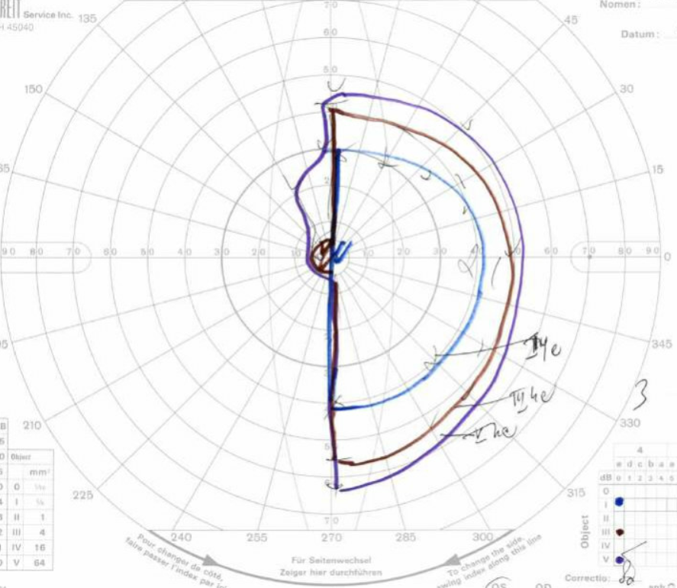
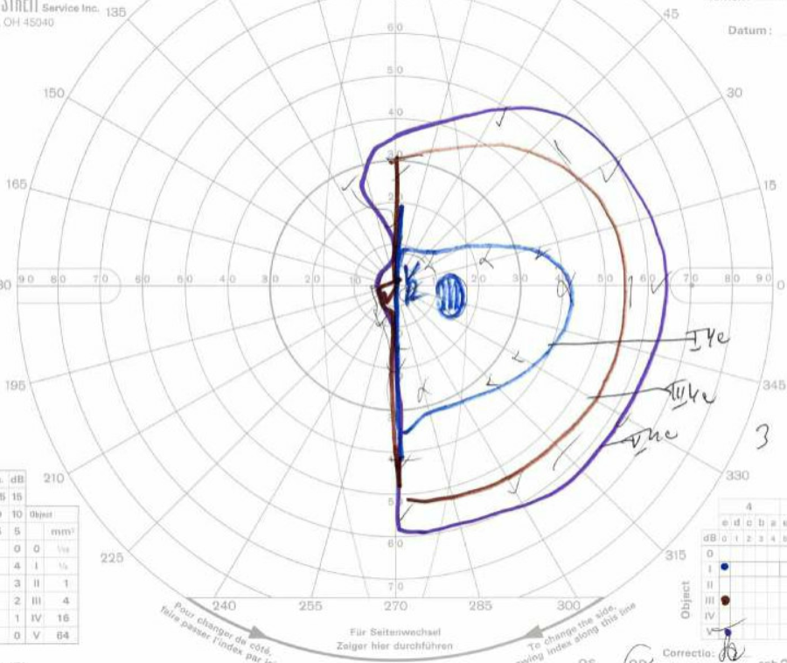
Notes:
We performed a manual visual field test which again showed the left homonymous hemianopia

Slide 13
Repeat MRI, 2-week interval
Notes:
Ddx includes encephalitis, epilepsy, but also very concerning for prion disease

Slide 14
Lumbar Puncture
Cell count
WBC: 0
RBC: 0
Protein: 28 (normal)
Glucose: 60 (normal)
Gram stain/culture: no growth

Slide 15
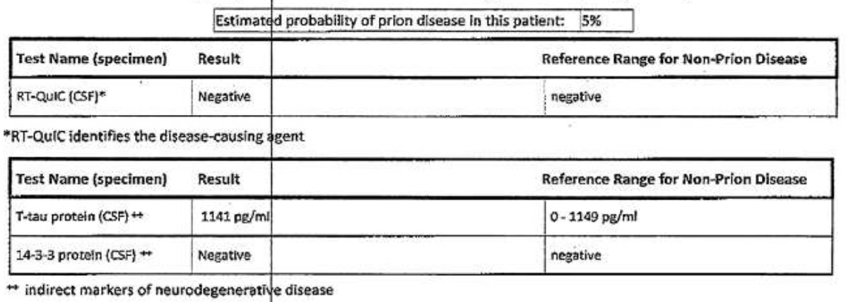
Notes:
Real time quaking induced conversion: samples are shaking and breaks apart the aggregates of prion protein, then amplify the amount of misfolded prion proteins to detectable levels. Highly sensitive and specific.

Slide 16
Clinical course
1 month later, further cognitive decline.
Unable to hold a conversation
Lost all ability to care for herself
Cortical blindness
SNF
Notes:
This was very disconcerting. She continued to progress.

Slide 17
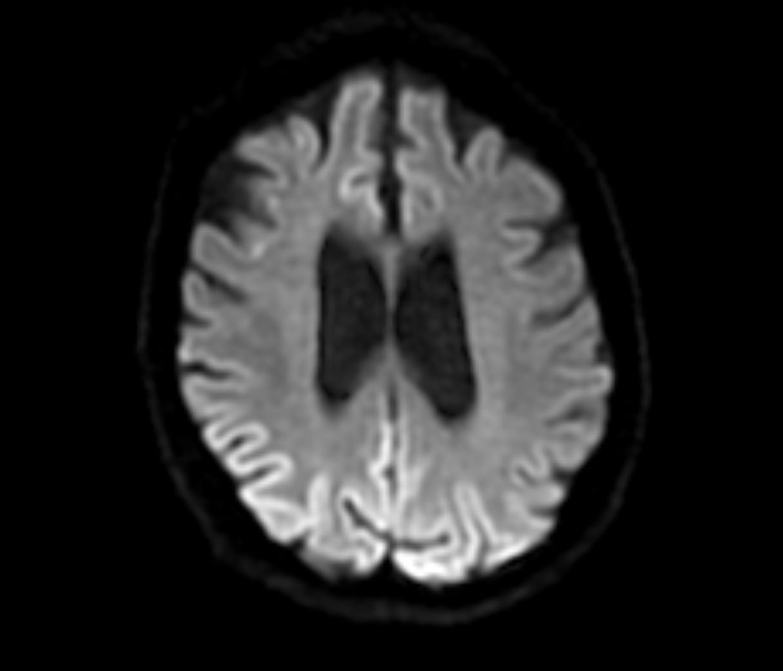
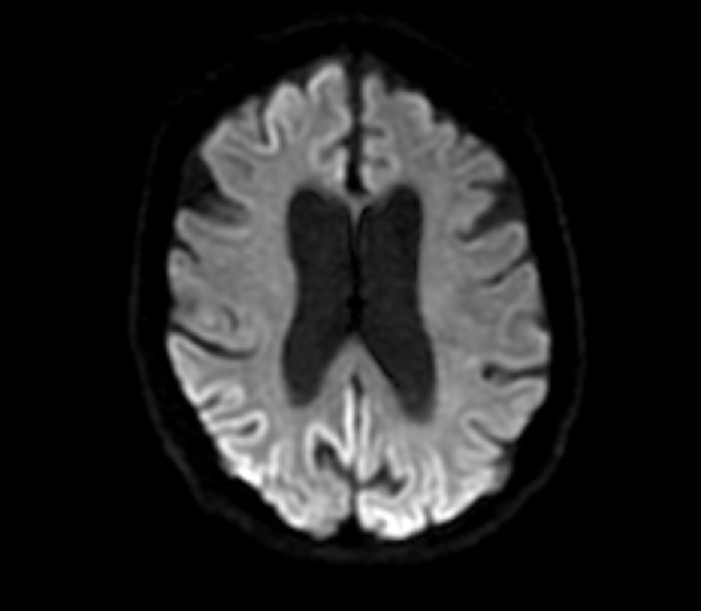
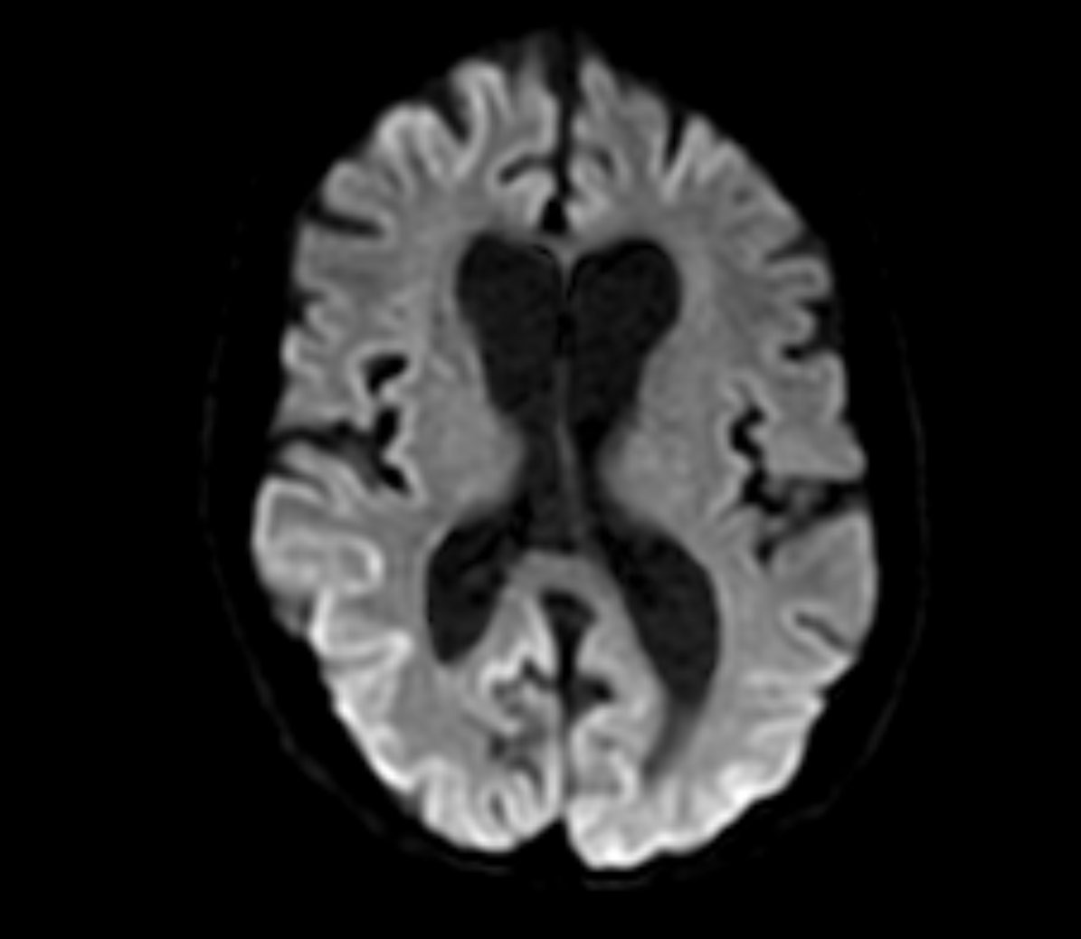
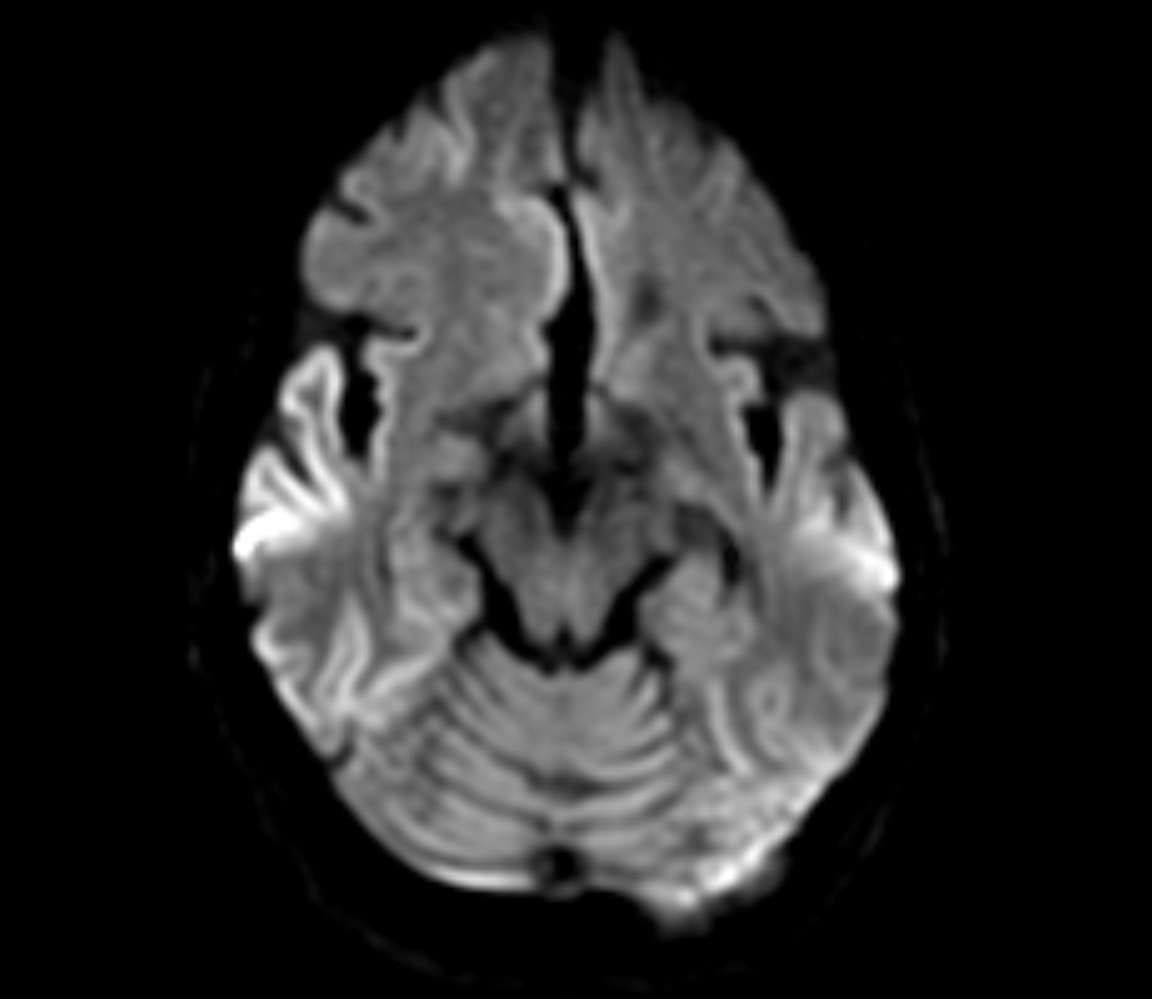
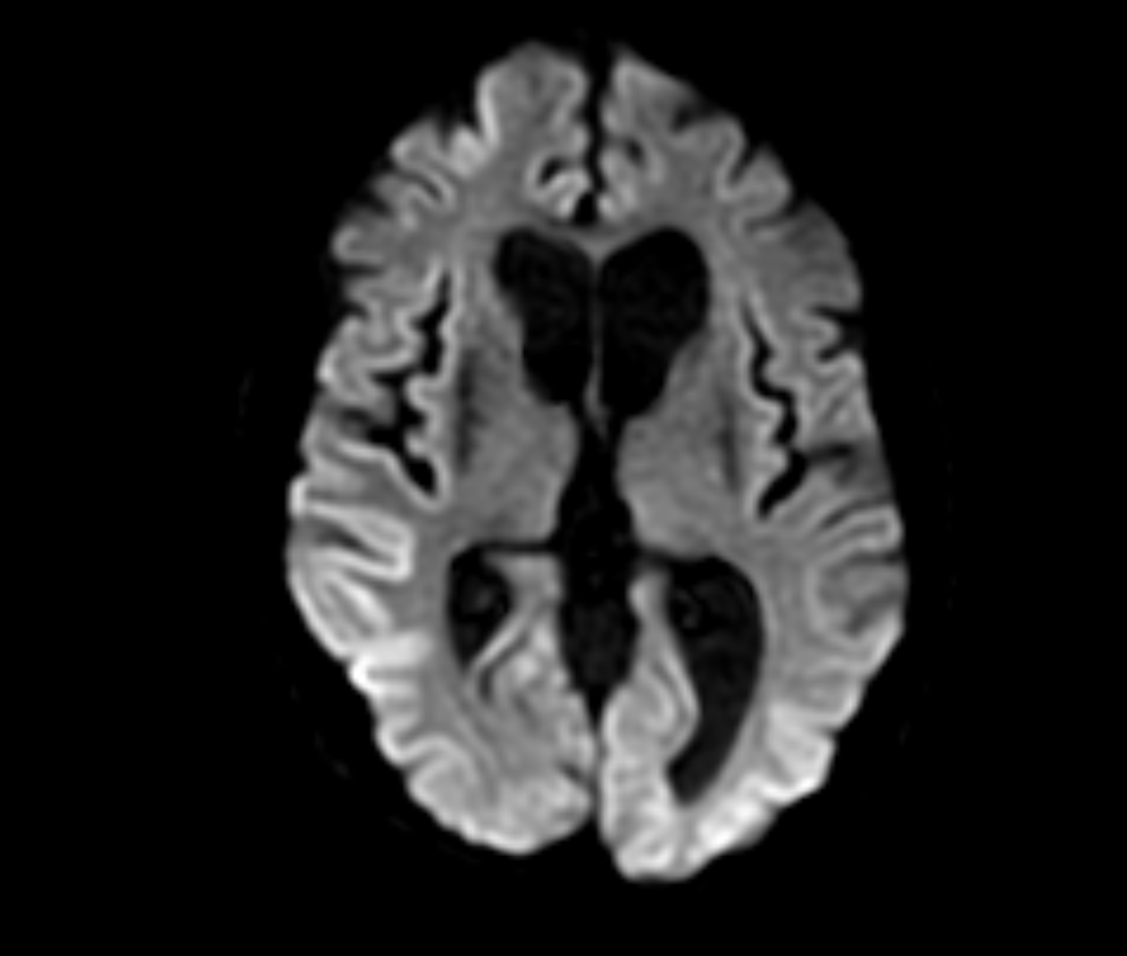
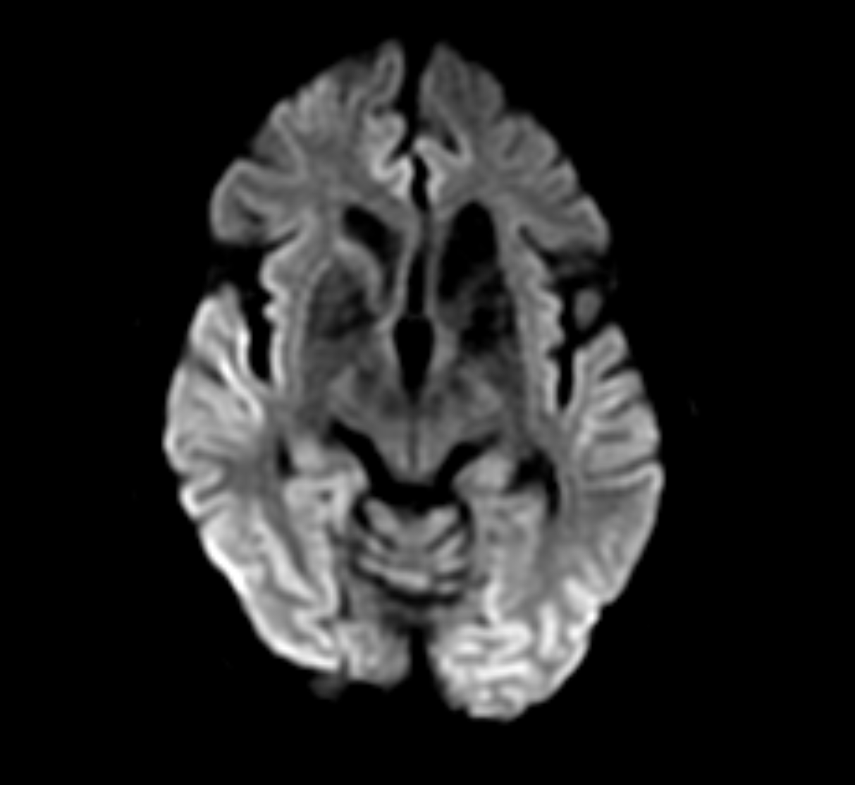
Notes:
1.5 months after last one
Significant interval progression of cortical diffusion restriction,
with asymmetric involvement of both cerebral hemispheres now present.
Findings suggestive of variant Creutzfeldt Jakob disease,
Heidenhain variant.
This MRI makes it clear why she would be cortically blind

Slide 18
Autopsy
“Immunohistochemical analysis: immunostaining with 3F4, the monoclonal antibody to the prior protein, reveals granular deposits as seen in prior disease. This finding establishes the diagnosis of prion disease, Creutzfeldt-Jakob disease”.

Slide 19
CJD presenting with cortical vision loss
CJD – Creutzfeldt-Jakob Disease: rapidly progressive, fatal neurogenerative disorder
1 per 1,000,000
Caused by the transformation to abnormal glycoprotein: prion protein
Commonly occurs sporadically
Can present with cortical visual loss → Heidenhain variant
Diagnosis: rapid progressive dementia + positive RT-QuIC in CSF
MRI features
EEG features
No treatment
www.cdc.gov
Notes:
The diagnosis is made by the clinical presentation of rapidly progressive cognitive decline and frequently with the combination of the + RT-QiIC.

Slide 20
Cortical Vision Loss
CVA, IPH
Occipital mass/vascular lesion
PRES
Hypoxic Ischemic Injury
Higher Cortical Visual Disorders
Neurodegeneration
CJD: Heidenhain variant
Alzheimer’s variant: posterior cortical atrophy
Notes:
That is a very super zebra case. Mostly cortical vision loss comes in the form of the first case in CVA…
May not be as simple as VF defect and may have presentations that stem from lesions in the visual association cortex. The goal today is to talk bout higher cortical visual disorders. In order to get there though, we need to review the visual pathway.

Slide 21
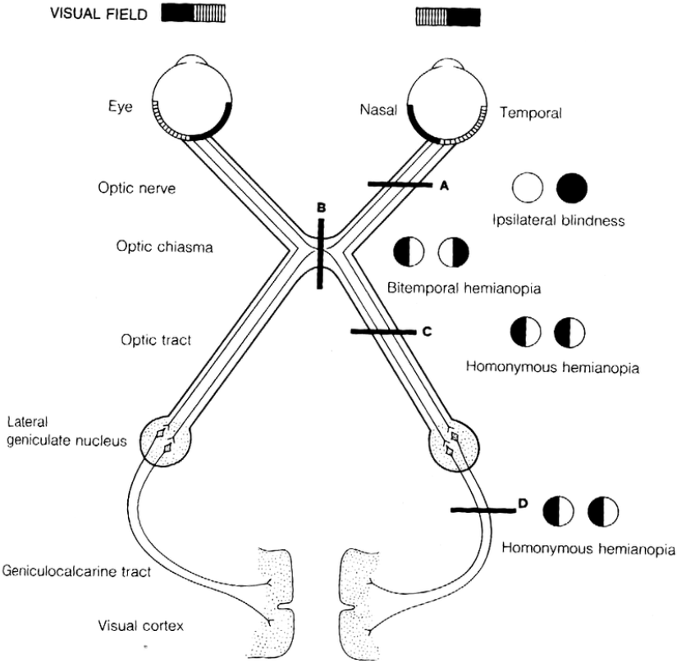
The Visual Pathway
Al-Tameeni, Kareen. Neurologic Examination Made Practical. BM-Publisher; 2015
Notes:
The visual pathway is the route by which retinal stimuli are transferred to the occipital cortex of the brain. It encompasses the retina, the optic nerve, optic chiasm, optic radiation, and the visual center of the occipital lobe.
The photoreceptors in the retina are stimulated by photons of light entering the eye. The photoreceptors synapse with retinal bipolar cells which in turn transmit these signals to the retina ganglion cells. The retinal ganglion cells converge at the optic disc forming the optic nerve.
The optic nerve is responsible for transmitting the information for vision. Once inside the skull the optic nerve travels along the floor of the middle cranial fossa. The left and right optic nerve converge at the optic chiasm. The chiasm is above the pituitary gland and you may remember that a pituitary tumor compressing the chiasm would cause bitemporal hemianopia.
At the chiasm, fibers from the nasal aspect of the retina cross over/decussate to the contralateral optic tract, while fibers from the temporal retina remain on their respective sides. In this way, left sided post chiasmal fibers pertain to the right side of the visual field and vice versa.
The optic tracts extend from the chiasm to the thalamus. Here, there is synapse with the second order sensory neurons, at the lateral geniculate nucleus in the thalamus. From here the nerves radiate dorsally to the calcarine sulcus of the occipital lobe. This is the primary visual cortex where basic/raw vision is housed/processed.
So, if there is a problem here, how should it be mapped out?
======
But we are here to learn more than the basics. From the occipital visual center, signals are sent to the frontal, parietal, and temporal lobes to further make sense of the input information (reading and facial recognition).

Slide 22
Confrontation visual field testing
Video
https://webeye.ophth.uiowa.edu/eyeforum/atlas-video/confrontation-visual-field-testing.htm
Notes:
Bedside evaluation

Slide 23
Standard Automated Perimetry
Notes:
It can be mapped out by: Automated visual field test/perimetry which is ubiquitous in almost all eye clinics. Usually, extra time is set aside to do this. The pattern of visual field defect matters and clues eye providers in on whether the problem is from glaucoma. The pattern also matters for localizing the lesion when the problem arises from the brain. Advantages include very reproducible results since many offices use similar software.

Slide 24
Manual Perimetry
Notes:
A problem in the primary visual cortex can also be mapped out with manual perimetry: useful for individual who cannot adapt well to the automated interface. If cannot stay focused and fixated, may benefit from manual perimetry. I use it in settings where vision is quite poor, like worse than 20/100 or 20/150 vision. Works with children. Patients with impaired cognition.
Photo: https://healthjade.net/visual-field-test/

Slide 25
The Visual Pathway
Al-Tameeni, Kareen. Neurologic Examination Made Practical. BM-Publisher; 2015
Notes:
Optic pathway picture
The visual pathway is the route by which retinal stimuli are transferred to the occipital cortex of the brain. It encompasses the retina, the optic nerve, optic chiasm, optic radiation, and the visual center of the occipital lobe.
The photoreceptors in the retina are stimulated by photons of light entering the eye. The photoreceptors synapse with retinal bipolar cells which in turn transmit these signals to the retina ganglion cells. The retinal ganglion cells converge at the optic disc forming the optic nerve.
The optic nerve is responsible for transmitting the information for vision. Once inside the skull the optic nerve travels along the floor of the middle cranial fossa. The left and right optic nerve converge at the optic chiasm. The chiasm is above the pituitary gland and you may remember that a pituitary tumor compressing the chiasm would cause bitemporal hemianopia.
At the chiasm, fibers from the nasal aspect of the retina cross over/decussate to the contralateral optic tract, while fibers from the temporal retina remain on their respective sides. In this way, left sided post chiasmal fibers pertain to the right side of the visual field and vice versa.
The optic tracts extend from the chiasm to the thalamus. Here, there is synapse with the second order sensory neurons, at the lateral geniculate nucleus in the thalamus. From here the nerves radiate dorsally to the calcarine sulcus of the occipital lobe. This is the primary visual cortex where basic/raw vision is housed/processed.
======
Ware here to learn more than the basics. From the occipital visual center, signals are sent to the frontal, parietal, and temporal lobes to further make sense of the input information (reading and facial recognition).

Slide 26
Higher Order Visual Cortex
Where/How Pathway
Visual spatial processing
Grasping objects
Attention
What Pathway
Identification of objects
Color
Patterns/shapes
Notes:
After initial processing in the primary visual cortex, which receives raw visual information, numerous adjacent cortical areas continue the work of analyzing specific aspect of visual information.
There are two major pathways:
What pathway is the ventral stream from the occipital lobes to the temporal lobes: it is involved in recognition of an object. These areas help with discerning olor, face patterns, shape recognition.
Where pathway. Dorsal stream.
Where pathway is the stream from occipital lobe to parietal lobes: This region helps with locating objects in space and also how body acts on objects. We need to analyze objects with body in space. This area discerns action of vision. Helps with analyzing moving objects, helps with discerning body in comparison to object. This area is also involved in attention—which objects are important to act on/prioritzes on visual information.
When there is a problem here, patients would not have problem with recognizing the object, but would have problem acting on the object in 3D space.

Slide 27
Higher Cortical Visual Disorders- Case 1
70 year old woman
Difficulty reaching for things: forks, cups
Able to read individual words, but has difficulty moving from word to the next
Gets confused in big supermarket
Exam:
Normal visual acuity
Inaccurate with reaching for objects = optic ataxia
Inaccurate eye movements when searching for objects = optic apraxia
Simultanagnosia
Balint’s Syndrome
Prasad S, Dinkin M. Higher Cortical Visual Disorders. Continuum (Minneap Minn). 2019 Oct;25(5):1329-1361.
Notes:
Balint’s syndrome (more where)
Prosopagnosia (what)

Slide 28
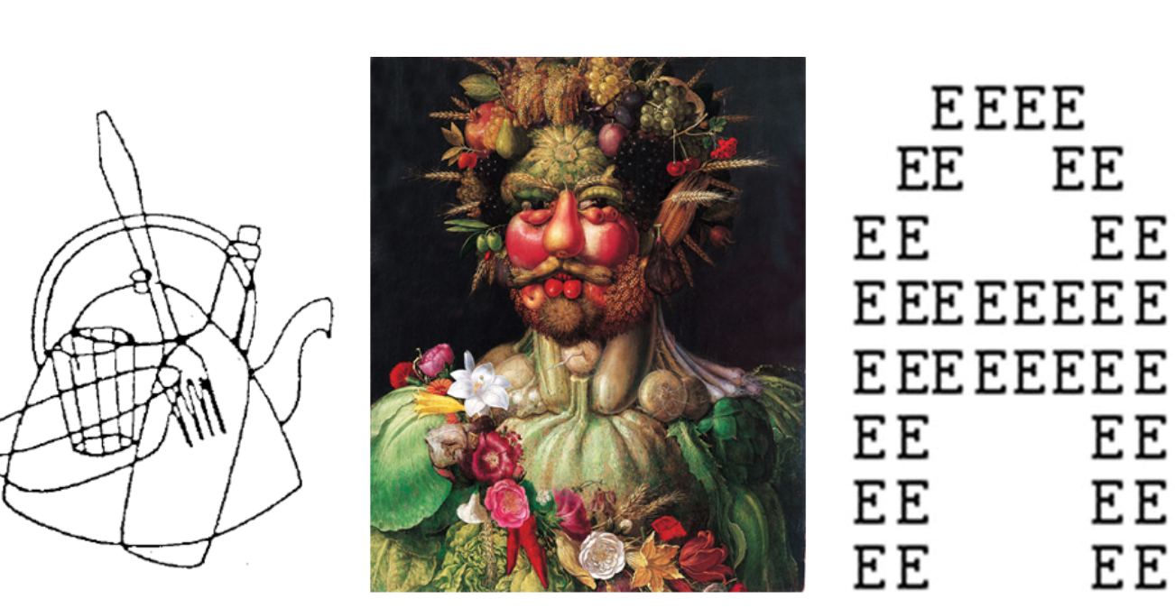
Simultanagnosia
Able to see local elements of a scene but not he global elements in their totality. “Missing the forest for the tree”
Notes:
Simultanagnosia is the inability to perceive more than once object at a time. Patients with simultanagnosia are able to see local elements of a scene but not the global elements in their totality. In other words, thy are missing the forest for the tree.

Slide 29
Balint’s Syndrome in Posterior Cortical Atrophy
Where/How Pathway
Visual spatial processing
Grasping objects
Attention
Notes:
MRI showed severe atrophy of the posterior parietal and occipital regions leading to the diagnosis of posterior cortical atrophy. Posterior cortical atrophy is a variant presentation of Alzheimer's dementia where degeneration initially has predilection for posterior regions rather than more classically the mesial temporal lobes. Due to the bilateral parietal occipital lobes being affected, patients can present with symptoms arising from problems in the dorsal pathway which manifests as having trouble figuring out where objects are in space, where the body is compared to object, and also problems acting and keeping attention on what is important/maintaining attention. When attention is messed up you see things like simultanagnosia.

Slide 30
Higher Cortical Visual Disorders- Case 2
37 year old woman
Difficulty distinguishing faces
Faces were smoother/Instagram filter
Exam:
Normal visual acuity and visual field testing
Difficulty recognizing famous faces = prosopagnosia
Prasad S, Dinkin M. Higher Cortical Visual Disorders. Continuum (Minneap Minn). 2019 Oct;25(5):1329-1361.

Slide 31
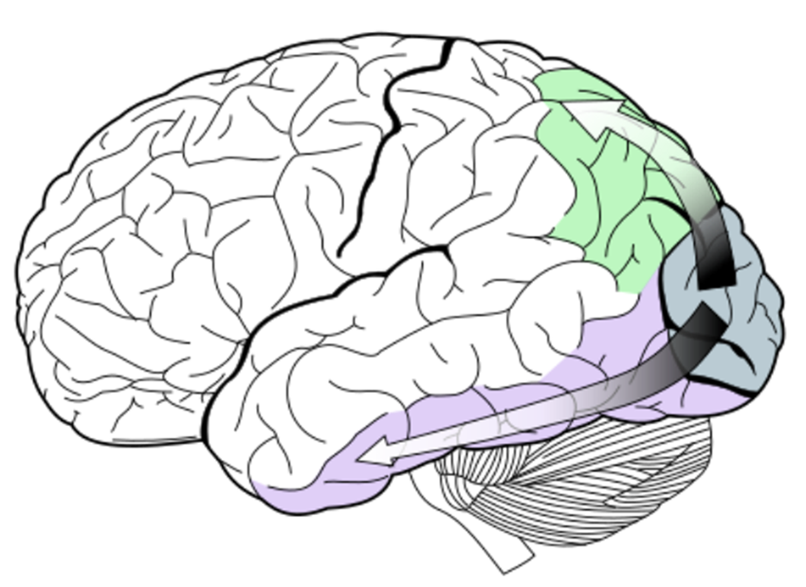
Prosopagnosia with temporal lesion
What Pathway
Identification of objects
Color
Patterns/shapes
Faces
Notes:
Metastatic lesion n the R temporal lobe and post operative image showing resection cavity (arrow). This lesion disrupts an area that processes faces in the what pathway

Slide 32
Other Higher Cortical Visual Disorders
Anton’s syndrome
Central hemichromatopsia
Alexia without agraphia
Hemispatial neglect

Slide 33
Conclusions
Occipital lobe lesions can be detected with visual field testing
A R homonymous quadrantanopia would localize to the L occipital lobe
CVA, IPH, PRES, mets
Neurodegeneration
CJD, posterior cortical atrophy
Sometimes, lesions are not easily seen on MRI
Need expert review: if “negative” do you need a second look?
Thinking outside of primary visual cortex: higher cortical visual disorders
Balint’s syndrome
Prosopagnosia
Notes:
I also challenged you to think

