Slide 1
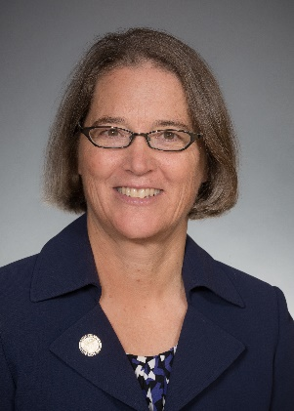
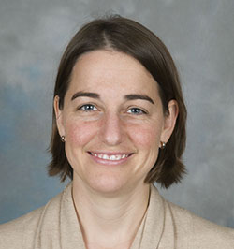
Cognition in Primary Care
Concise. Practical. Better care.
Notes:
Interdisciplinary team representing Schools of Medicine, Public Health and Nursing, including researchers and practitioners and graduate students

Slide 2
Annual wellness visit
82-year-old woman
Very healthy
Mentions (and marks on her AWV Questionnaire)
“I‘ve been worried
about my memory.”

Slide 3
Primary Care Dilemma
Reassure? saying “Me too. Don’t worry, it’s normal to get more forgetful with age.”
Automatically refer to a Memory Clinic ?
Try to do cognitive assessment then and there (and then run 40 minutes late?)
Or: offer follow-up cognitive-evaluation visit, with family member coming also.

Slide 4
Dementia: primary care disease
We’re on the front lines.
Patients trust us.
Specialists hard to access.
Goal: a structure to evaluate cognition: improve care: helping us all.

Slide 5
Better Care from Diagnosis
Better communication, support, family involvement.
Makes care easier, less chaotic.
Take steps to improve brain health now: treat sleep apnea, treat hearing loss.

Slide 6
Creating a smooth process

Slide 7
Rollout to UW Primary Care: 2021
October: Three-part CME reached 68 PCPs across UW Primary Care.
Nov-April: Pilots at two clinics, testing an in-clinic workflow. Putting the training into practice.

Slide 8
Evaluations - Highly Positive
Relevant to Practice = 100% (“very much” 93%)
Quality Education = 100% (“excellent” 93%)
Expect to Use = 99% (“strongly agree” 94%)
Six-months later:
91% still report Increased confidence assessing cognitive concerns.

Slide 9
Evaluation Comments
“This was an excellent course.”
“Appreciate the simple, straightforward approach.”
“Good content and tools, particularly helpful tools.”
“This was one of the most practical and helpful CME's I've attended.”

Slide 10
Education Series
A 3-part free Zoom series. Practical, efficient. March 2023 dates now open: free registration.
Make a diagnosis of cognitive impairment
Set a plan for a newly diagnosed patient
Manage dementia

Slide 11
1. Be Aware: When memory concerns come up (e.g. “yes” at AWV)
Steps to evaluate cognition
2. Decide: Concerning? or easy to reassure
3. Evaluate: Sched a long-appt, with family
4. Counsel: Return visit: discuss + set plan

Slide 12
Decide:
Is a dedicated visit for evaluation warranted?
If yes: encourage family member to come.
Ideally: schedule as a longer visit, if possible.
Longer Level 5 visits: now 2x RVUs as a Level 3
For Level 5 only need 40 minutes total spent on care (both prep and charting) … not just face-time.

Slide 13
Three Parts of a Dedicated Visit to Evaluate Cognitive Concerns
Cognitive Checklist: reversible causes and other factors you can fix.
Assess cognitive function with MoCA.
Get input from a family member. (AD8)

Slide 14
AD8
A brief informant interview to detect dementia.
Neurology
2005;65(4)
559-64

Slide 15
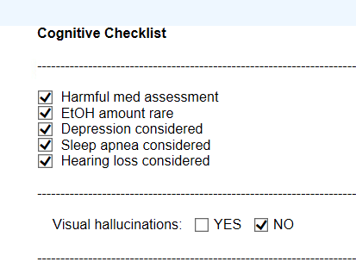
Epic Checklist
.cognitive
Epic .dotphrase with vanishing tips

Slide 17
Session #2 Set a plan for the newly diagnosed
Difficult-conversation (“serious-news”) communication model.
Guidance on when to refer to specialist, and what are key education and support resources to provide.
Interventions to maintain Brain Health.

Slide 18
Brain Health – Epic Checklist
Alcohol: Limiting 0-1 drinks will help your thinking.
Medications: avoid sedating and anticholinergic
Contributing Conditions: Sleep apnea, hearing loss.
Exercise and socialization: Daily walks with a friend.
Connect to Resources
Cognition-PrimaryCare.org

Slide 19
Website Cognition-PrimaryCare.org
Access CME handouts, office workflow materials.
Links to high quality regional support resources.

Slide 20
Sign Up Open Now!
Cognition-PrimaryCare.org
Session Dates (via Zoom) – choose one that works for you: (45-min sessions)
Tues March 14 at 5:00 PM
Wed March 22 at 12:00 Noon
Tues March 28 at 5:00 PM
Tues April 4 at 5:00 PM

Slide 21
Continued Funding:
Follow-Up Contract to Expand Use of the Model
Future Plan:
Share among many other health systems

Slide 22
Questions
Sign Up now for CME!
Cognition-PrimaryCare.org

