Slide 1
HuskyMOSSAIC: Email Templates
By: Hiu Tung Gloria Lam

Slide 2
Getting familiar with email layouts

Slide 3
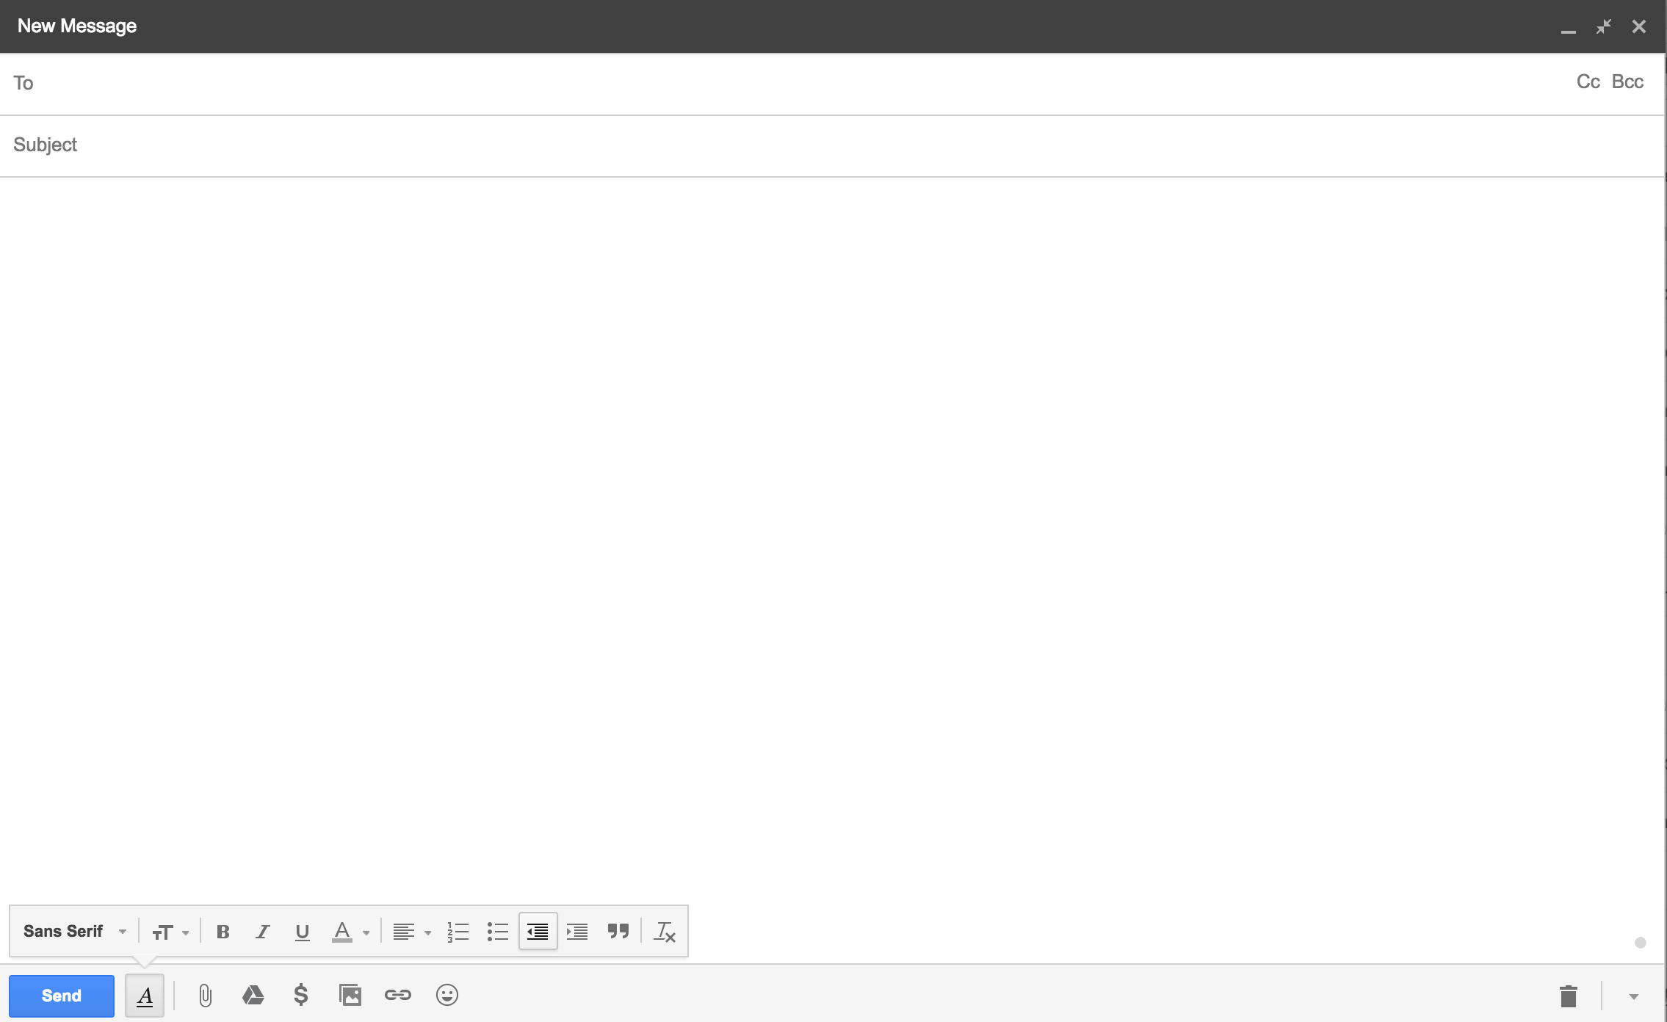
Google Mail

Slide 4
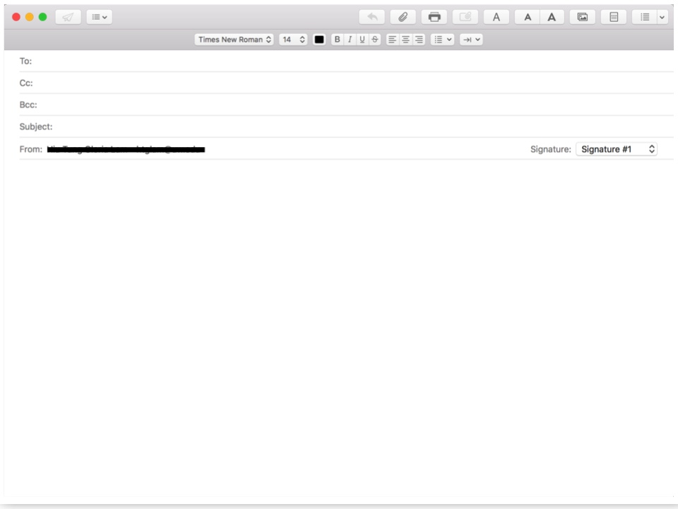
Apple Mail

Slide 5
Google Mail
Cc: Carbon copy - allows you to send the message to another person who is not the main addressee. OPTIONAL
To:
Email address of the main recipient
Bcc: Blind carbon copy - allows you to “copy” someone on the email like you would with Cc, but the main recipient will not see that you “copied” anyone. OPTIONAL
Content: Type in your email message here.
Subject: Key words of the main point of the email (ex. Letter of Recommendation)

Slide 6
Apple Mail
To:
Email address of the main recipient
Cc: Carbon copy - allows you to send the message to another person who is not the main addressee. OPTIONAL
Bcc: Blind carbon copy - allows you to “copy” someone on the email like you would with Cc, but the main recipient will not see that you “copied” anyone. OPTIONAL
Content: Type in your email message here.
Subject: Key words of the main point of the email (ex. Letter of Recommendation)

Slide 7
General format, notes on tone,
and common
purposes for writing an email

Slide 8
General Format of Emails
Step 1: Greetings
Step 2: Introduce yourself
Step 3: Address the main purpose of your email
Step 4: Additional Explanation/Information
Step 5: Show appreciation
Step 6: Sign off

Slide 9
Some Things to Keep in Mind
How close are you with the recipient?
If you are emailing the recipient for the first time and you have not met them or really talked to them before, it is best to be as professional and polite as possible. This might look like introducing yourself and using your full name and school as your signature.
How formal should you be?
Even if you are emailing a professor that you have talked to many times and he/she is very friendly with you, it is still polite to write a formal email as a form of respect.
Sometimes, professors will tell you how formal or casual they prefer you to be when interacting with them. This information is usually found in the syllabus or shared in class on the first day. It would be helpful to keep that in mind when writing an email.
When unsure, go formal!
If you are unsure of how good the relationship you have with someone, just write a formal email.

Slide 10
Common Types/Purposes for Writing an Email
Classmates: Talk about a group project, schedule a time to meet up, form a study group
Professors/TAs: Make a general appointment, ask a brief question via email, ask about office hours/make an appointment for office hours, request a letter of recommendation
Advisors/Counselors: Set up an appointment
Doctors/Nurses: Set up an appointment
Job/Career/Internship Purposes: Request additional information about a job, apply for a job

Slide 11
Email Templates

Slide 12
1. Classmates – Talking about a group project (assuming the groups have already been assigned)
Recipient@uw.edu, Recipient2@uw.eduxt
EDUC 150 – Group Project
Hello Jane and Jack,
My name is John Smith. We were assigned to work together for the group project the professor explained in class today. Would you want to meet up at some time this coming week to make a plan for it? I am available Tuesday from 1:30 – 4:30.
Thank you.
Talk soon,
John Smith
The parts of the sample email on the right that are italicized are the parts you would change to fit your name, assignment, availabilities, etc.
Notes:
To: recipient@uw.edu
Subject: Class Name (e.g. EDUC 150) – Group Project
From: sender@uw.edu
Hello (specific person’s name/Everyone),
I am John. I am assigned to this group for the project. During class today, the professor explained the details of the group project (or write in a specific name of the project). Would you want to meet up some time this coming week to make a plan for it? I am available on (day & time).
Thank you.
(Sincerely/Regards),
John Smith

Slide 13
2. Classmates – Forming a study group (assuming you've already met or introduced yourselves in class)
Recipient3@uw.edu, Recipient4@uw.eduxt
EDUC 150 – Form a study group
Hello Jill and Jordan,
My name is John Smith -- we met during class today. I’m wondering if you would want to study together for the exam we have coming up next Thursday? I am typically available on Tuesdays from 1:30 – 4:30.
Thank you.
Talk soon,
John Smith
Notes:
To: recipient@uw.edu
Subject: Class Name (e.g. EDUC 150) – Form a Study Group
From: sender@uw.edu
Hello (specific person’s name/Everyone),
I am John, we met during class today. We have an upcoming test/assignment and I am wondering if you would want to study together for the test? I am typically available on (day & time).
Thank you.
(Sincerely/Regards),
John Smith

Slide 14
3a. Professors – Making an appointment (use this template if the professor's syllabus says that their office hours are "by appointment")
Recipient5@uw.eduxt
EDUC 150 – Make an appointment
Who you are:
Include specific information about yourself
Name
Class
Dear Professor Johnson,
I am John Smith, a student who is currently taking your EDUC 150 class. I would like to arrange a meeting with you, as I have some questions that I would like to ask in person regarding the upcoming exam. I am available next Tuesday, 12:30pm – 1:30pm, Wednesday after 3pm and Thursday between 11am – 2pm. Please let me know which times and day would work best for you when you get a chance.
Thank you for your attention.
Sincerely,
John Smith
Notes:
To: recipient@uw.edu
Subject: Class Name (e.g. EDUC 150) – Make an Appointment
From: sender@uw.edu
Dear Professor Last name/ Dr. _________/ Professor Full name,
I am John Smith, a student who is currently taking your EDUC 150 class. I would like to arrange a meeting with you as I have some questions that I would like to ask in person regarding the upcoming exam. I am available next Tuesday, 12.30pm-1.30pm, Wednesday after 3pm and Thursday between 11am-2pm. Please let me know which times and day would work best for you.
Thank you for your kind attention.
Yours sincerely,
John Smith

Slide 15
3b. Professors – Making an appointment (use this template if the professor's syllabus says that their office hours are "by appointment")
Recipient5@uw.eduxt
EDUC 150 – Make an appointment
Purpose of email :
(E.g. arrange a meeting)
Additional information as to why do you want to meet him/her (E.g. questions regarding exam)
Dear Professor Johnson,
I am John Smith, a student who is currently taking your EDUC 150 class. I would like to arrange a meeting with you, as I have some questions that I would like to ask in person regarding the upcoming exam. I am available next Tuesday, 12:30pm – 1:30pm, Wednesday after 3pm and Thursday between 11am – 2pm. Please let me know which times and day would work best for you when you get a chance.
Thank you for your attention.
Sincerely,
John Smith
Notes:
To: recipient@uw.edu
Subject: Class Name (e.g. EDUC 150) – Make an Appointment
From: sender@uw.edu
Dear Professor Last name/ Dr. _________/ Professor Full name,
I am John Smith, a student who is currently taking your EDUC 150 class. I would like to arrange a meeting with you as I have some questions that I would like to ask in person regarding the upcoming exam. I am available next Tuesday, 12.30pm-1.30pm, Wednesday after 3pm and Thursday between 11am-2pm. Please let me know which times and day would work best for you.
Thank you for your kind attention.
Yours sincerely,
John Smith

Slide 16
3c. Professors – Making an appointment (use this template if the professor's syllabus says that their office hours are "by appointment")
Recipient5@uw.eduxt
EDUC 150 – Make an appointment
Dear Professor Johnson,
I am John Smith, a student who is currently taking your EDUC 150 class. I would like to arrange a meeting with you, as I have some questions that I would like to ask in person regarding the upcoming exam. I am available next Tuesday, 12:30pm – 1:30pm, Wednesday after 3pm and Thursday between 11am – 2pm. Please let me know which times and day would work best for you when you get a chance.
Thank you for your attention.
Sincerely,
John Smith
List out times and dates that you are available so that the professor can look at his/her schedule and tell you what times will work for both of you.
Notes:
To: recipient@uw.edu
Subject: Class Name (e.g. EDUC 150) – Make an Appointment
From: sender@uw.edu
Dear Professor Last name/ Dr. _________/ Professor Full name,
I am John Smith, a student who is currently taking your EDUC 150 class. I would like to arrange a meeting with you as I have some questions that I would like to ask in person regarding the upcoming exam. I am available next Tuesday, 12.30pm-1.30pm, Wednesday after 3pm and Thursday between 11am-2pm. Please let me know which times and day would work best for you.
Thank you for your kind attention.
Yours sincerely,
John Smith

Slide 17
4. Professors – Making an appointment (use this template if you'd like to stop by the professor's office hours)
Recipient5@uw.eduxt
EDUC 150 – Office Hours
Dear Professor Johnson,
I am John Smith, a student who is currently taking your EDUC 150 class. I would like to know if you would be available this Monday during your office hours to answer some clarifying questions I have regarding last week's lecture.
Thank you for your attention.
Sincerely,
John Smith
It is common courtesy to notify your professor beforehand that you will be coming in during his/her office hours so that he/she will be expecting to see you.
This also allows you to double-check that the professor will be there and not attending to other important matters.
Notes:
To: recipient@uw.edu
Subject: Class Name (e.g. SPHSC 320) – Office Hours
From: sender@uw.edu
Dear Professor Last name/ Dr. _________/ Professor Full name,
I am John Smith, a student who is currently taking your EDUC 150 class. I would like to know if you would be available this Monday during your office hours as I would like to ask some clarifying questions I have regarding last week’s lecture.
Thank you for your kind attention.
Yours sincerely,
John Smith

Slide 18
5. Professors – Ask about office hours
Recipient5@uw.eduxt
EDUC 150 – Office Hours
Dear Professor Johnson,
I am John Smith, a student who is currently taking your EDUC 150 class. I am emailing to ask about office hours, as the syllabus did not mention any.
Thank you for your attention.
Sincerely,
John Smith
Mention that you have checked the syllabus and have not found information regarding office hours so that the professor is aware that you have read the course materials.
Notes:
To: recipient@uw.edu
Subject: Class Name (e.g. SPHSC 320) – Office Hours
From: sender@uw.edu
Dear Professor Last name/ Dr. _________/ Professor Full name,
I am John Smith, a student who is currently taking your EDUC 150 class. As the syllabus have not mentioned about office hours, I am emailing to ask about office hours for this class.
Thank you for your kind attention.
Yours sincerely,
John Smith

Slide 19
6a. Professors – Ask brief questions over email
Recipient5@uw.eduxt
EDUC 150 – Questions regarding EDUC 150
Dear Professor Johnson,
I am John Smith, a student who is currently taking your EDUC 150 class. I have a couple of brief questions that I would like to ask regarding a concept you taught in class last week. My questions are:
1. For children with disabilities, are they required to have an IEP plan?
2. ….?
3. ….?
Thank you for your attention. I really appreciate your clarification.
Sincerely,
John Smith
This format will be easier for the professor to answer your questions via email.
Notes:
To: recipient@uw.edu
Subject: Class Name (e.g. EDUC 150) – Questions regarding EDUC 150
From: sender@uw.edu
Dear Professor Last name/ Dr. _________/ Professor Full name,
I am John Smith, a student who is currently taking your EDUC 150 class. I have a couple of brief questions that I would like to ask via email regarding a concept you have taught in class last week. These are my questions:
For children with disabilities, are they required to have an IEP plan?
……?
……?
Thank you for your kind attention. I really appreciate your clarification.
Yours sincerely,
John Smith

Slide 20
6b. Professors – Ask brief questions over email
Recipient5@uw.eduxt
If you really are considering majoring in the department that the class falls within, saying this can help explain your interest in the course.
EDUC 150 Fall 2017
Dear Professor Johnson,
My name is John Smith and I am an incoming first year student hoping to major in Education. I read over EDUC 150’s course description on the Registrar and your class sounds very interesting – my only hesitation concerns the intensity of the course.
If you have the time, I would really appreciate hearing your thoughts about how manageable your course is for first year students planning to take a full course load. If you have a syllabus on hand, that would be much appreciated as well.
Thank you very much for your time and help.
Sincerely,
John Smith
Since you are asking them to put in some time and effort, show that you’ve done the same!
Notes:
To: recipient@uw.edu
Subject: Class Name (e.g. EDUC 150) – Questions regarding EDUC 150
From: sender@uw.edu
Dear Professor Last name/ Dr. _________/ Professor Full name,
I am John Smith, a student who is currently taking your EDUC 150 class. I have a couple of brief questions that I would like to ask via email regarding a concept you have taught in class last week. These are my questions:
For children with disabilities, are they required to have an IEP plan?
……?
……?
Thank you for your kind attention. I really appreciate your clarification.
Yours sincerely,
John Smith

Slide 21
7a. Professors – Request a letter of recommendation
Recipient5@uw.eduxt
Request for Letter of Recommendation
Dear Professor Johnson,
I am John Smith, a student who took your EDUC 150 class Spring 2016. I am currently applying to the University Scholarship Award and would like to ask you to support my application with a letter of recommendation. The letter would need to be submitted through an online application portal by May 25. I have attached my personal statement and resume for your reference. Please let me know if you'd like any additional documents.
If possible, I'd like to meet in person to go over the details of the scholarship and application. I'd also appreciate any advice you can offer to make my application as strong as possible. Are you free next Monday after 1:30, Tuesday between 10:30-12:30, or Friday before 12?
Thank you for your time. I look forward to hearing back from you.
Sincerely,
John Smith
Who you are and how you know the professor
Notes:
Important things to include in your email:
Introduce yourself. Include which of the professor's classes you were in
Professors teach many different students. Reminding them which class of theirs you took makes it easy for them to remember who you are.
Request an in-person meeting to talk about the letter. Emphasize that you intend to ask the professor to write you a letter supporting your application
This shows sincerity and respect for the professor.
Application deadline -- when would the professor need to submit their letter by?
Additional documents that will help them get to know your strengths and interests (ex.: resume, personal statement, cover letter, some schoolwork you've done in the past that you're proud of)
Information about how they would submit the letter of recommendation (ex.: online or mail it in)

Slide 22
7b. Professors – Request a letter of recommendation
Recipient5@uw.eduxt
Request for Letter of Recommendation
Dear Professor Johnson,
I am John Smith, a student who took your EDUC 150 class Spring 2016. I am currently applying to the University Scholarship Award and would like to ask you to support my application with a letter of recommendation. The letter would need to be submitted through an online application portal by May 25. I have attached my personal statement and resume for your reference. Please let me know if you'd like any additional documents.
If possible, I'd like to meet in person to go over the details of the scholarship and application. I'd also appreciate any advice you can offer to make my application as strong as possible. Are you free next Monday after 1:30, Tuesday between 10:30-12:30, or Friday before 12?
Thank you for your time. I look forward to hearing back from you.
Sincerely,
John Smith
What are you applying for? If possible, include a link to the award, scholarship, internship, etc. page

Slide 23
7c. Professors – Request a letter of recommendation
Recipient5@uw.eduxt
Request for Letter of Recommendation
Dear Professor Johnson,
I am John Smith, a student who took your EDUC 150 class Spring 2016. I am currently applying to the University Scholarship Award and would like to ask you to support my application with a letter of recommendation. The letter would need to be submitted through an online application portal by May 25. I have attached my personal statement and resume for your reference. Please let me know if you'd like any additional documents.
If possible, I'd like to meet in person to go over the details of the scholarship and application. I'd also appreciate any advice you can offer to make my application as strong as possible. Are you free next Monday after 1:30, Tuesday between 10:30-12:30, or Friday before 12?
Thank you for your time. I look forward to hearing back from you.
Sincerely,
John Smith
Politely tell them what you are asking them for.
Example of what we do NOT want: "I'd like you to write me a letter of recommendation."
While writing letters of recommendation is a part of their job description, they are still doing you a favor!

Slide 24
7d. Professors – Request a letter of recommendation
Recipient5@uw.eduxt
Request for Letter of Recommendation
Dear Professor Johnson,
I am John Smith, a student who took your EDUC 150 class Spring 2016. I am currently applying to the University Scholarship Award and would like to ask you to support my application with a letter of recommendation. The letter would need to be submitted through an online application portal by May 25. I have attached my personal statement and resume for your reference. Please let me know if you'd like any additional documents.
If possible, I'd like to meet in person to go over the details of the scholarship and application. I'd also appreciate any advice you can offer to make my application as strong as possible. Are you free next Monday after 1:30, Tuesday between 10:30-12:30, or Friday before 12?
Thank you for your time. I look forward to hearing back from you.
Sincerely,
John Smith
How would they be submitting the letter of recommendation? When would they need to have it written by?

Slide 25
7e. Professors – Request a letter of recommendation
Recipient5@uw.eduxt
Request for Letter of Recommendation
Dear Professor Johnson,
I am John Smith, a student who took your EDUC 150 class Spring 2016. I am currently applying to the University Scholarship Award and would like to ask you to support my application with a letter of recommendation. The letter would need to be submitted through an online application portal by May 25. I have attached my personal statement and resume for your reference. Please let me know if you'd like any additional documents.
If possible, I'd like to meet in person to go over the details of the scholarship and application. I'd also appreciate any advice you can offer to make my application as strong as possible. Are you free next Monday after 1:30, Tuesday between 10:30-12:30, or Friday before 12?
Thank you for your time. I look forward to hearing back from you.
Sincerely,
John Smith
Mention what you've attached to the email

Slide 26
7f. Professors – Request a letter of recommendation
Recipient5@uw.eduxt
Request for Letter of Recommendation
Dear Professor Johnson,
I am John Smith, a student who took your EDUC 150 class Spring 2016. I am currently applying to the University Scholarship Award and would like to ask you to support my application with a letter of recommendation. The letter would need to be submitted through an online application portal by May 25. I have attached my personal statement and resume for your reference. Please let me know if you'd like any additional documents.
If possible, I'd like to meet in person to go over the details of the scholarship and application. I'd also appreciate any advice you can offer to make my application as strong as possible. Are you free next Monday after 1:30, Tuesday between 10:30-12:30, or Friday before 12?
Thank you for your time. I look forward to hearing back from you.
Sincerely,
John Smith
Mention that you'd like to meet in person. Offer a few different times you're free to meet

Slide 27
7g. Professors – Request a letter of recommendation while still in their class
Recipient5@uw.eduxt
Request for Letter of Recommendation
Dear Professor Johnson,
I am John Smith, a student taking your EDUC 150 class this quarter. I am currently applying to the University Scholarship Award and would like to ask you to support my application with a letter of recommendation. The letter would need to be submitted through an online application portal by May 25. I have attached my personal statement and resume for your reference. Please let me know if you'd like any additional documents.
If possible, I'd like to meet in person to go over the details of the scholarship and application. I'd also appreciate any advice you can offer to make my application as strong as possible. Would it be alright to discuss this during your office hours next Tuesday?
Thank you for your time. I look forward to hearing back from you.
Sincerely,
John Smith

Slide 28
8. Advisors/Counselors – Schedule an appointment
Recipient6@uw.eduxt
Schedule an Appointment
Hello Ms. Jones,
I am John Smith, student ID: 1234567. I would like to arrange a meeting with you to discuss my academic plans for next year. When are you available to meet?
Thank you for your time.
Sincerely,
John Smith
Include your student ID number so that your advisor can remind themselves of your class year, major, etc. and run your degree audit before you meet.
Notes:
To: recipient@uw.edu
Subject: Schedule an Appointment
From: sender@uw.edu
Hello ____________,
I am John Smith, student ID: 3849177. I would like to arrange a meeting with you to discuss about my academic plans for the next academic year.
Thank you for your kind attention.
Yours sincerely,
John Smith

Slide 29
9. Doctors/Nurses – Schedule an appointment
linda@harborview.com
Schedule an Appointment
Hello,
I would like to schedule an appointment next Tuesday at 2:30pm to have my annual check-up.
Thank you,
John Smith
Notes:
To: Haborview Clinic
Subject: Schedule an Appointment
From: sender@uw.edu
Hello,
I would like to schedule an appointment next Tuesday at 2.30pm to have my annual check-up.
Thank you,
John Smith

Slide 30
10a. Job/Career Purposes – Request for additional information about a job
recipient@shoreline.com
Inquiry regarding Shoreline Company Office Assistant position
Introduce yourself and provide some basic, relevant information about yourself (education, major, current job, etc.)
Dear Mr. Johnson,
I am John Smith, a recent graduate from University of Washington who majored in electrical engineering. I have came across your contact information through the company website and I would like to request more details and information about the Office Assistant Position in the Sales Department at Shoreline Company.
What are the specific responsibilities this job encompasses? Are there degree requirements? What are the standard procedures to apply for this position?
Thank you for your attention.
Sincerely,
John Smith
Notes:
To: recipient@shoreline.com
Subject: Inquiry regarding Shoreline Company Office Assistant Position
From: sender@uw.edu
Dear ________ OR To Whom It May Concern OR Dear Sir/Madam,
I am John Smith, a recent graduate from University of Washington who majored in electrical engineering. I would like to inquire more details and information about the Office Assistant Position at Shoreline Company. What are the specific responsibilities this job encompasses? Are there degree requirements? What are the standard procedures to apply for this position?
Thank you for your kind attention.
Yours sincerely,
John Smith

Slide 31
10b. Job/Career Purposes – Request for additional information about a job
recipient@shoreline.com
Inquiry regarding Shoreline Company Office Assistant position
Dear Mr. Johnson,
I am John Smith, a recent graduate from University of Washington who majored in electrical engineering. I have came across your contact information through the company website and I would like to request more details and information about the Office Assistant Position in the Sales Department at Shoreline Company.
What are the specific responsibilities this job encompasses? Are there degree requirements? What are the standard procedures to apply for this position?
Thank you for your attention.
Sincerely,
John Smith
Mention where you found the contact information; state the purpose of your email; specify the company and job position
Notes:
To: recipient@shoreline.com
Subject: Inquiry regarding Shoreline Company Office Assistant Position
From: sender@uw.edu
Dear ________ OR To Whom It May Concern OR Dear Sir/Madam,
I am John Smith, a recent graduate from University of Washington who majored in electrical engineering. I would like to inquire more details and information about the Office Assistant Position at Shoreline Company. What are the specific responsibilities this job encompasses? Are there degree requirements? What are the standard procedures to apply for this position?
Thank you for your kind attention.
Yours sincerely,
John Smith

Slide 32
10c. Job/Career Purposes – Request for additional information about a job
recipient@shoreline.com
Inquiry regarding Shoreline Company Office Assistant position
Dear Mr. Johnson,
I am John Smith, a recent graduate from University of Washington who majored in electrical engineering. I have came across your contact information through the company website and I would like to request more details and information about the Office Assistant Position in the Sales Department at Shoreline Company.
What are the specific responsibilities this job encompasses? Are there degree requirements? What are the standard procedures to apply for this position?
Thank you for your attention.
Sincerely,
John Smith
Include specific questions to show employer your great interest in the job position
Notes:
To: recipient@shoreline.com
Subject: Inquiry regarding Shoreline Company Office Assistant Position
From: sender@uw.edu
Dear ________ OR To Whom It May Concern OR Dear Sir/Madam,
I am John Smith, a recent graduate from University of Washington who majored in electrical engineering. I would like to inquire more details and information about the Office Assistant Position at Shoreline Company. What are the specific responsibilities this job encompasses? Are there degree requirements? What are the standard procedures to apply for this position?
Thank you for your kind attention.
Yours sincerely,
John Smith

Slide 33
11. Job/Career Purposes – Apply for a job
recipient@shoreline.comt
Shoreline Company – Office Assistant Job Application
Dear Mr. Johnson,
I am John Smith, a recent graduate from University of Washington who majored in electrical engineering. I came across your contact information through your company website. I am interested in applying for the office assistant position in the Sales Department at Shoreline Company.
Please find attached to this e-mail the job application and a copy of my CV that details my past experiences.
Thank you for your attention.
Sincerely,
John Smith
Notes:
To: recipient@shoreline.ccom
Subject: Shoreline Company - Office Assistant Job Application
From: sender@uw.edu
Dear ________ OR To Whom It May Concern OR Dear Sir/Madam,
I am John Smith, a recent graduate from University of Washington who majored in electrical engineering. I have come across your contact information through your company web site and I am interested in applying for the office assistant position in the Sales Department at Shoreline Company.
Please find attached to this e-mail the job application and a copy of my CV that details my past experience.
Thank you for your kind attention.
Yours sincerely,
John Smith

Slide 34
Purposes of Follow-Up Emails/Reply
Express appreciation or gratitude for someone’s help
E.g. Professor submitted a letter of recommendation in support of your application
Confirm times and day of a meeting, event, or appointment
E.g. Unsure of the schedule
Accept or decline an invitation to an event or meeting

Slide 35
12. Express gratitude for someone’s help
recipient5@uw.edu
RE: Request for Letter of Recommendation
Dear Professor Johnson,
I would like to express my gratitude and appreciation to you for taking the time to write a letter of recommendation on behalf of my scholarship application.
Thank you again for your support. I really appreciate it.
Sincerely,
John Smith
Notes:
To: recipient@uw.edu
Subject: RE: Request for Letter of Recommendation
From: sender@uw.edu
Dear Professor Last name/ Dr. _________/ Professor Full name,
I would like to express my gratitude and appreciation to you for taking the time to write a letter of recommendation on behalf of my scholarship application.
Thank you again for your support. I really appreciate it.
Yours sincerely,
John Smith

Slide 36
13. Confirm time and date of a meeting, event, or appointment
recipient@uw.edu; recipient2@uw.edu
Meeting Tomorrow
Hello Jane and Jack,
I would like to confirm with you that we will be meeting tomorrow at 12:30pm in room MIL 283.
Thank you.
Talk soon,
John Smith
Notes:
To: recipient@uw.edu
Subject: RE: Request for Letter of Recommendation
From: sender@uw.edu
Dear Professor Last name/ Dr. _________/ Professor Full name,
I would like to express my gratitude and appreciation to you for taking the time to write a letter of recommendation on behalf of my scholarship application.
Thank you again for your support. I really appreciate it.
Yours sincerely,
John Smith

Slide 37
14. Accept an invitation to an event or meeting
recipient6@uw.edu
RE: Invitation to Annual School of Business Formal Event
To Whom It May Concern,
I would like to accept your invitation to the Annual School of Business Formal Event.
Thank you for your attention.
Sincerely,
John Smith
Notes:
To: recipient@uw.edu
Subject: RE: Request for Letter of Recommendation
From: sender@uw.edu
Dear Professor Last name/ Dr. _________/ Professor Full name,
I would like to express my gratitude and appreciation to you for taking the time to write a letter of recommendation on behalf of my scholarship application.
Thank you again for your support. I really appreciate it.
Yours sincerely,
John Smith

Slide 38
15. Decline an invitation to an event or meeting
recipient6@uw.edu
RE: Invitation to Annual School of Business Formal Event
To Whom It May Concern,
I unfortunately have to decline your invitation to the Annual School of Business Formal Event.
Thank you for your attention.
Sincerely,
John Smith
Notes:
To: recipient@uw.edu
Subject: RE: Request for Letter of Recommendation
From: sender@uw.edu
Dear Professor Last name/ Dr. _________/ Professor Full name,
I would like to express my gratitude and appreciation to you for taking the time to write a letter of recommendation on behalf of my scholarship application.
Thank you again for your support. I really appreciate it.
Yours sincerely,
John Smith

Slide 39
Closing remarks

Slide 40
Final Thoughts
The same email template can rarely be used for multiple situations. These templates are meant to help you to understand the email format… be ready to tweak the templates provided in this document according to your needs!
Always try to be sincere and polite in your emails
If you’d rather not schedule an appointment over email and would rather try and do it in person, you can always try to catch the professors before or after class to talk to them. Some doctor’s offices prefer patients to make non-emergency appointments through a website or over the phone, so that’s always an option as well
If you are unsure if your email is appropriate, you can always ask a family member/friend/classmate to read over the email
If you are really unsure about how to write a specific email, consult the Career Center - https://careers.uw.edu/ or the Odegaard Writing and Research Center (OWRC) - https://depts.washington.edu/owrc/

Slide 41
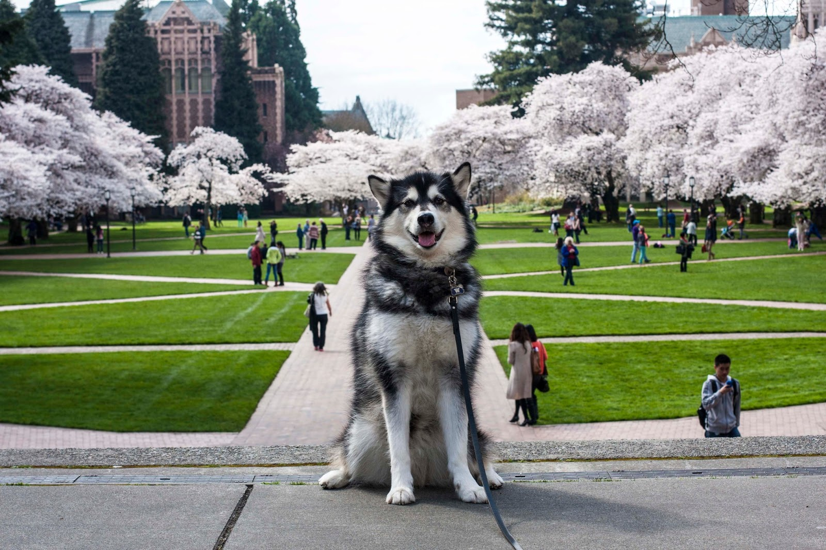
Go Huskies!

