Slide 1
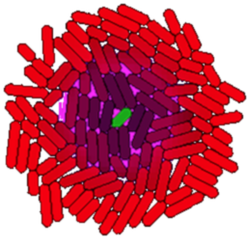
gro Tutorial 4

Slide 2
Movies
Saving snapshots
Movies with ImageJ
Other methods

Slide 3
Saving Snapshots
include gro
alpha_g := 100; // gfp production rate
beta_g := 1; // gfp degradation rate
program expression() := {
gfp := 0;
rate(alpha_g) : { gfp := gfp +1 }
rate(beta_g*gfp) : { gfp := gfp - 1 }
};
program main() := {
t := 0; // framerate time tracker
s := 0; // total time tracker
n := 0;
true : {
t := t + dt,
s := s + dt
}
t > 2 : {
snapshot ( "expression" <> if n <10 then "0" else "" end <> tostring(n) <> ".tif" ),
n := n + 1,
t := 0
}
s > 150 : {
stop()
}
};
ecoli ( [], program expression() );
The top half of this program sets up cells with stochastically varying expression of GFP
snapshot() saves a tiff of the current frame and takes one argument: the file path. If no absolute path is given, it saves to the gro executable directory.
This line is long because it adds a 0 to the filename to ensure proper sorting when there are less than 100 snapshots. A more complex if-then statement is required when there are more than 100 snapshots.
Images in this case are saved as “expressionNN.tif”, where NN is the frame number e.g. 01, 04, 12, etc.
The main loop takes snapshots every 2 program minutes and stops at 150 minutes, generating 73 images at the default dt setting.

Slide 4
Movies with ImageJ
ImageJ is freely available for all major OSes and can be downloaded here: http://rsb.info.nih.gov/ij/download.html
Let’s make this movie (only animates in the .pptx version of this tutorial):

Slide 5
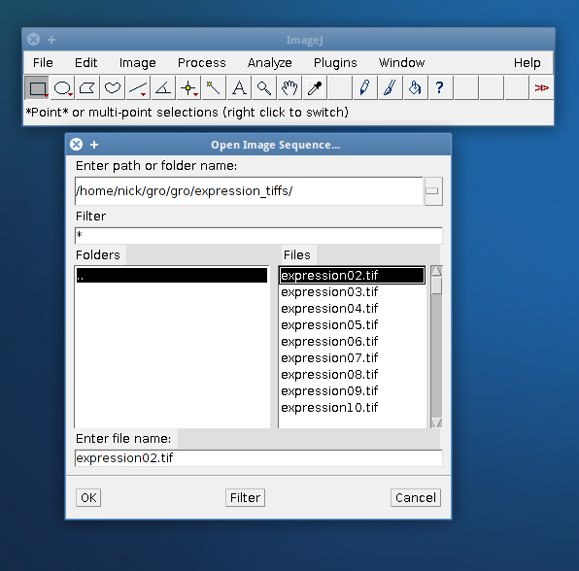
Movies with ImageJ
Step 1: Move the .tiff files to a new folder. I called mine “expression_tiffs”.
Step 2: Open ImageJ and select File > Import > Image Sequence. Navigate to your folder (e.g. “expression_tiffs”) and select the first image, then select OK.

Slide 6
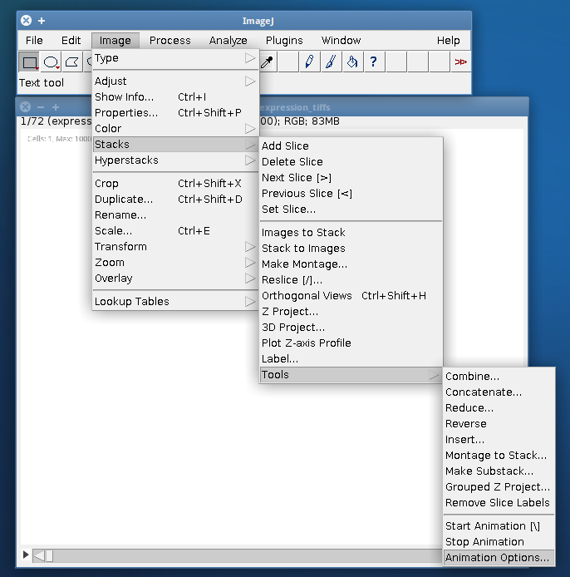
Movies with ImageJ
Step 3: ImageJ will launch an import options dialog. The defaults are usually fine. This is a good point to opt to resize the images, if you are planning to do so. I typically resize to 75%.
Step 4: Open ImageJ and select Image > Stacks > Tools > Animation Options.
Step 5: Select a higher FPS than the default 7. 24 fps is a good starting point for a smooth animation.

Slide 7
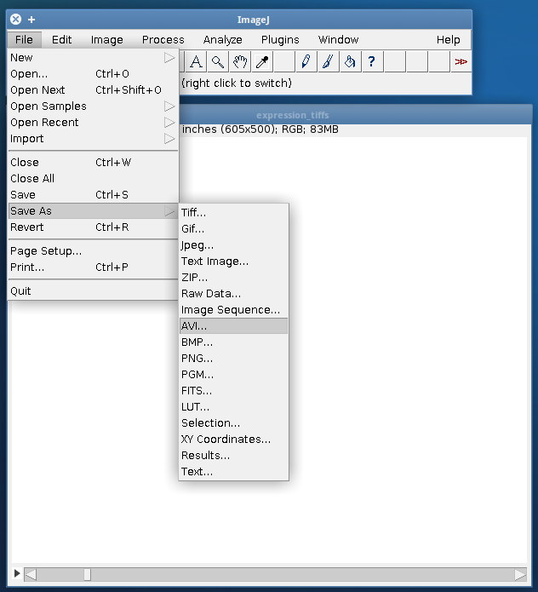
Movies with ImageJ
Step 6: To save your movie, select File > Save > AVI (or any other movie format). Using JPEG compression makes a smaller, but uglier movie. PNG compression makes a larger but high quality (lossless) movie. A JPEG-format avi can be uploaded directly to YouTube. If you want a higher-quality option, save as a PNG avi and convert using a separate program (like HandBrake).
Note: To save an animated GIF (which can be used directly in powerpoint), you must first convert the image to 8-bit color. This can be done by selecting Image > Type > 8-bit color.

Slide 8
Alternative Methods
There are many other ways to make a movie once you have saved the gro snapshots into a folder of tiffs.
Matlab: http://www.mathworks.com/help/matlab/ref/tiffclass.html to read tiffs, many ways to output an image series to videos.
Mathematica: http://reference.wolfram.com/mathematica/ref/format/VideoFrames.html
Python: OpenCV bindings - http://opencv.willowgarage.com/wiki/PythonInterface
ffmpeg: (various frontends available for windows, mac, and linux)

