Slide 1
STARTALK: Preparing
Teachers for the 21st Century
Day 8 July 17, 2015

Slide 2
Can-do statements for today
Identify the purpose and usage of assessment.
Develop various types of assessments that require students to demonstrate evidence of learning.
define proficiency and identify assessment tools

Slide 3
Assessment – Big Ideas
Enduring Understanding: Assessment is an essential element of planning and instruction
Essential Question: What kinds of assessment will help me and my students reach our language learning goal? How can we use assessment to help students and programs grow?

Slide 4
Student Assessment
Formative
Summative
Good tests lead to good teaching, especially when we plan with the Backward Design approach

Slide 5
Performance Assessment
Link directly to objectives
What should students be able to DO?
How to design good tasks?
Contextualize
Meaningful
Performance, not drill
Start at the end – the target and the standard

Slide 6
Sample Performance Assessments
Should look just like normal tasks students do regularly – they won’t even know they are being assessed!

Slide 7
Sample Performance Assessments
BAME
Beginning
Approaching
Meeting
Exceeding

Slide 8
Evaluating Performance
Checklists. Including can-do statements
Rubrics
Analytic
RubiStar: http://rubistar.4teachers.org/
holistic

Slide 9
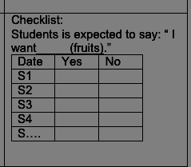
Assessment

Slide 10
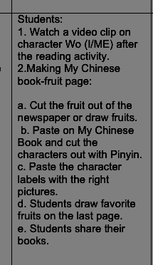
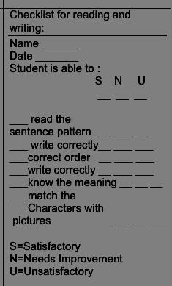

Slide 11
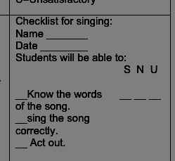
Assessment for singing

Slide 12
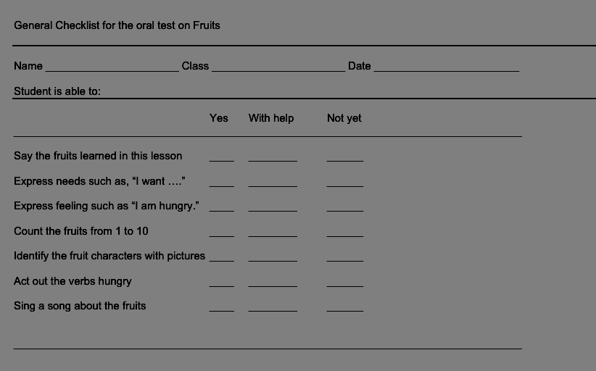
Oral assessment

Slide 13
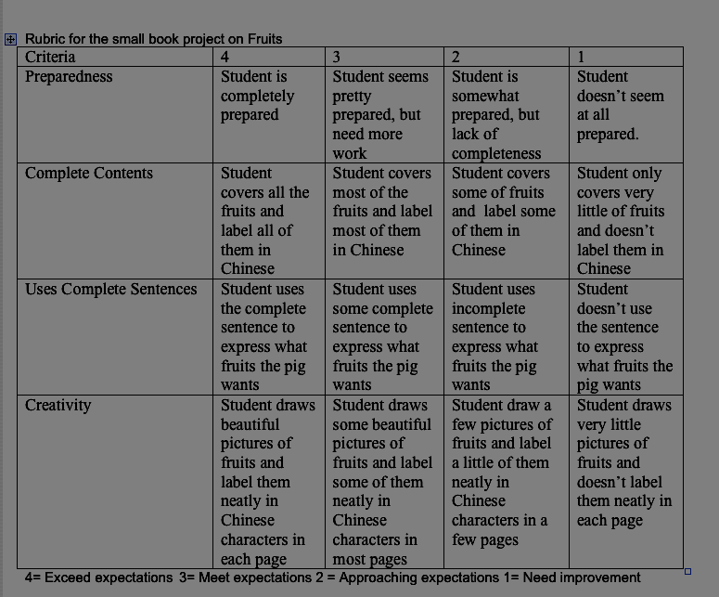
Small book rubric

Slide 14
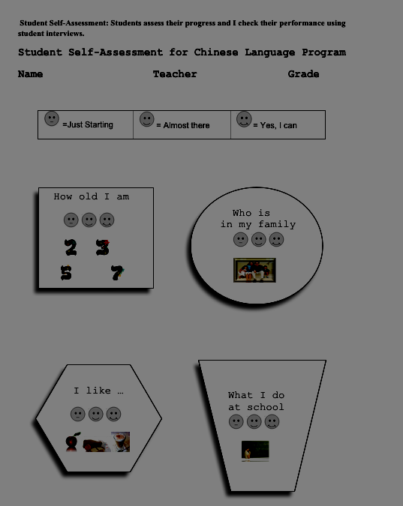

Slide 15
Group task
Take one element of your unit/ any activity we have brainstormed
Create an assessment for it – a can-do, performance
Create a rubric for how you would “grade” the performance
Share with class

Slide 16
What is proficiency?
functional language ability
what someone can DO in the language
unrehearsed

Slide 17
What is proficiency?
The OPI “assesses language proficiency in terms of the ability to use the language effectively and appropriately in real-life situations”
“The OPI is not an achievement test”
The OPI assesses “each individual performance to the assessment criteria”

Slide 18
The “old” scale
Inverted pyramid
Major categories
Novice
Intermediate
Advanced
Superior

Slide 19
Which major level?
Can communicate minimally with formulaic and rote utterances, lists and phrases.
May be difficult to understand, even for speakers accustomed to dealing with non-native speakers.

Slide 20
Which major level?
Can narrate and describe in major time frames and deal effectively with an unanticipated complication.
Understood without difficulty by speakers unaccustomed to dealing with non-native speakers

Slide 21
What’s the requirement to be certified in WA?
Advanced low – WPT and OPIc

Slide 22
Credit for proficiency
http://www.k12.wa.us/WorldLanguages/CompetencyBasedCredits.aspx
Novice Mid – 1 credit (Carnegie Unit)
Novice High – 2 credits
Intermediate Low – 3 credits
Intermediate Mid – 4 credits

Slide 23
CEFR
Common European Framework of Reference
http://www.coe.int/t/dg4/linguistic/source/framework_en.pdf

Slide 24
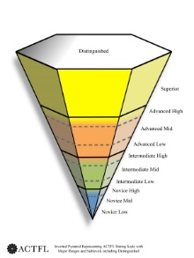
2012 Guidelines
http://actflproficiencyguidelines2012.org/
additional category of Distinguished
multimedia samples in English
Glossary

Slide 25
Proficiency Assessment Tools
STAMP
Standards-Based Measurement of Proficiency
OPI/OPIc
Oral Proficiency Interview
WPT
Writing Proficiency Test

Slide 26
Proficiency Assessment Tools
SOPA
Student Oral Proficiency Assessment (for Grades 2-8)
ELLOPA
Early Language Listening and Oral Proficiency Assessment (for Grads PreK-2)
AAPPL
ACTFL Assessment of Performance toward Proficiency in Languages

Slide 27
Proficiency self-assessments
Linguafolio
https://linguafolio.uoregon.edu/
iCan
http://www.avantassessment.com/

Slide 28
Tasks
Moodle Response #8
Review resources in TELL: Performance and Feedback

