Slide 1
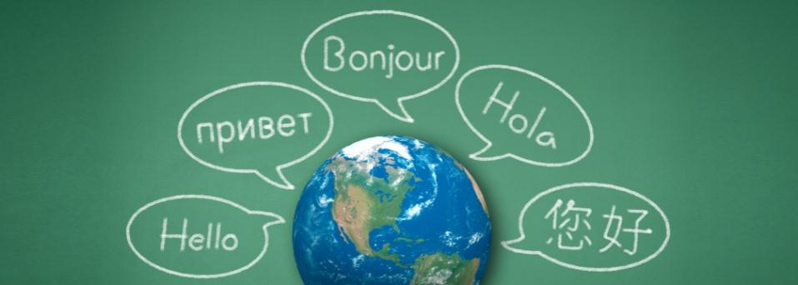
World Language Summit: The High School to College Connection
Saturday, January 23, 2016
University of Washington Mary Gates Hall

Slide 2
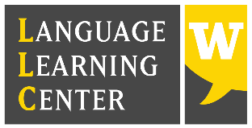
Thank you to our Sponsors
Notes:
I just wanted to take a moment to thank our sponsors. They not only provided financial support for refreshments, linch and printing, but with their involvement showed us that this topic is important to the University and the community.

Slide 3
Agenda
9:00-12:00 Session 1: High School Connections
High School-based Programs
Programs for High School Students Outside of School
Competency-Based Credits and the Seal of Biliteracy
12:00-1:00 Lunch (downstairs) and Resource Tables (Room 241)
1:00-2:20 Session 2: Meeting the needs of Heritage Language Learners and Dual Language Students… in College 2:20-3:00 Session 3: Interactive Session: Where do we go from here?

Slide 4
Session 1: High School Connections
High School-based Programs
Facilitated by Paris Granville, Bellevue School District
Advanced Placement (AP)
Meitsu Chuang Mendel, Chunqing Ge, Rhonda Eastman
International Baccalaureate (IB)
Joshua Hansell
College in the High School
Hedwige Meyer, Laura Christman, Adi Carlyle

Slide 5
Session 1: High School Connections
Programs for High School Students Outside of School
Running Start at the Community College
UW Russian STARTALK Summer Program
Anatoliy Klots, Svetlana Abramova
UW Summer Intensive Language Programs
Eloise Boyle, Sabrina Tatta
One World Now!
Sarah Standish, Laura Stahl

Slide 6
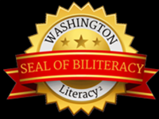
Session 1: High School Connections
Competency-Based Credits and the Seal of Biliteracy
Michele Anciaux Aoki, Jennifer Wittenberg, Marta Burnet

Slide 7
12:00-1:00 Lunch & Resource Tables
Please pick up your lunch
Then, come back during the hour to visit the Resource Tables in Room 241
Thank you to our lunch sponsors: Confucius Institute of the State of Washington and Julie Kang, UW PCE

Slide 8
Session 2: Meeting the needs of Heritage Language Learners and Dual Language Students… in College
Facilitated by Alejandro Lee, Central Washington University
Panel of students from CWU
Video clips from Maria Gillman’s Heritage Spanish classes at the UW
Flipped classroom by Eduardo Silva, UW Portuguese
Russian STEM Class for UW Heritage Students by Svetlana Abramova

Slide 9
Session 3: Interactive Session: Where do we go from here?
What have we learned today?
What questions do we still have?
What’s working in the high school to college connection?
What’s not?
What are some next steps we could take?

Slide 10
Break-out Topics
How to advocate for more Early Language Learning (including at middle school).
Credit/Non-credit classes at middle/high school (including grading Q’s).
Resources not available for LCTL’s or for some topics. What is needed?
Accessing family and community resources for language.
Proposal group for National Heritage Language Research Institute in June 2016.
Dual language and Heritage language pathways.

