Slide 1
PORTUGUESE FOR HERITAGE SPEAKERS OF SPANISH
Eduardo Viana da Silva, Ph.D. Lecturer and Portuguese Program Coordinator
Contact: evsilva@uw.edu
World Language Summit, Jan 2016

Slide 2
Course: PORT 105 – An accelerated Portuguese class for Spanish speakers that covers the content of two regular Portuguese classes.
Course Format: It follows a task-based approach and the flipped-class concept.
Heritage speakers of Spanish can understand more than 50% of Portuguese texts without any previous knowledge.

Slide 3
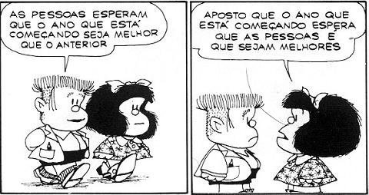

Slide 4
PODCASTS OF PORTUGUESE FOR SPANISH SPEAKERS – TÁ FALADO
Podcasts are assigned as homework.
Students learn by comparing and contrasting the differences and similarities between Portuguese and Spanish.

Slide 5
Class Description
Tuesday:Na livraria, na universidade, Estrutura 1 (Talking about people), Estrutura 2 – Talking about academic life and daily occurences – (PE pp. 34-40)
BP –Tá Falado - Grammar Lesson 1: Gostar vs. Gustar,
Sitting on the grass
Podcast – Gostar vs Gustar
http://www.coerll.utexas.edu/brazilpod/tafalado/lesson.php?lt=gra&p=01

Slide 6
SPANISH HERITAGE SPEAKER
STUDENT TESTIMONY
MARCELO RAMIREZ

Slide 7
THANK YOU!
¡GRACIAS!
OBRIGADO
Contact us at: evsilva@uw.edu
EduardoViana da Silva

