Slide 1
STEM-based Russian for Advanced Heritage and Non-heritage Students: Challenges and Overcomes
Dr. Svetlana Abramova
World Language Summit,
January 23, 2016 University of Washington

Slide 2
RUSS 316 Extended Russian Through STEM
Fall 2015

Slide 3
Extended Russian Through STEM: The Course Overview
2-credit course, meets once a week;
Designed based on UW STARTALK Russian in the Sky and Outer Space (2011-2015) experiences ;
First time offered in the Slavic Department of UW in the fall 2015;
For mixed group of students: heritage and non-heritage, working in either technical fields or the humanities;
For students who are already relatively proficient in spoken Russian (Intermediate High) and can read and write (no less then Novice High).

Slide 4
The Main Goal
To start using Russian for professional purposes
To extend the language to the STEM fields and gain proficiency in academic style;
To develop social stylistic registers available to educated native speakers;
Advanced Mid-High (depend on students’ current language skills).

Slide 5
Challenges
How to set a goal and select a linguistic minimum of course content (only 20 hrs!)?
Where to find resources and materials?
How to design helpful and interesting course for every student?
How to meet needs heritage and non-heritage students?

Slide 6
Standards

Slide 7
Selecting Topics
Chemistry: Elements and compounds, Periodic table of elements. Dmitry Mendeleev
Astronomy: The structure of the Solar system
Math: Physical quantities and their measurement. How to read a graph
Physics: Forces acting on a body. Bernoulli's principle and lifting force. Aerodynamics of airplanes. Nikolay Zhukovsky
Engineering: How to describe and compare objects based on their technical characteristics

Slide 8
Chemistry: Elements and compounds, Periodic table of elements. Dmitry Mendeleev

Slide 9
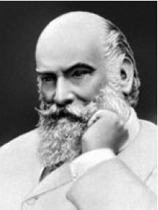
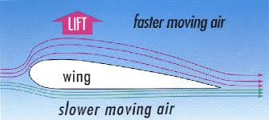
Physics: Forces acting on a body. Bernoulli's principle and lifting force. Aerodynamics of airplanes. Nikolay Zhukovsky

Slide 10
Resources and Materials
Authentic materials: Scientific articles, websites, dictionaries, documentary films, video lectures, and business cards
Textbooks and dictionaries for references:
Callaham's Russian-English dictionary of science and technology by Ludmilla Ignatiev Callaham; Patricia E Newman; John R Callaham. 1996
Russian context: The culture behind the language. Eloise M Boyle, Genevra Gerhart, ch. 12. 2002
Russian for Russians. Olga Kagan, Tatiana Akishina, Richard Robin. 2002
Научный стиль речи. Технический профиль. Пособие по русскому языку для иностранных студентов. Т.Е. Аросева, Л.Г. Рогова, Н.Ф. Сафьянова. 2010 (2012)
UW Language Learning Center MOODLE

Slide 11
Tasks and the Final Performance Assessment
Authentic tasks: reading and discussing articles, filling out conference registration form, describing graphs and diagrams, solving and explaining problems;
Academic Reading: 2 articles (read, work on vocabulary and STEM terms, write summaries and use them for a Final Oral Presentations);
Project-based task: the Final Oral Presentation on a STEM topic of students’ choices.

Slide 12
How to Motivate and Engage Students?
Select topics they already know;
Add some new interesting information from current research and news;
Use authentic resources and focus on cultural context;
Give them an opportunity to work on topics of professional interest.

Slide 13
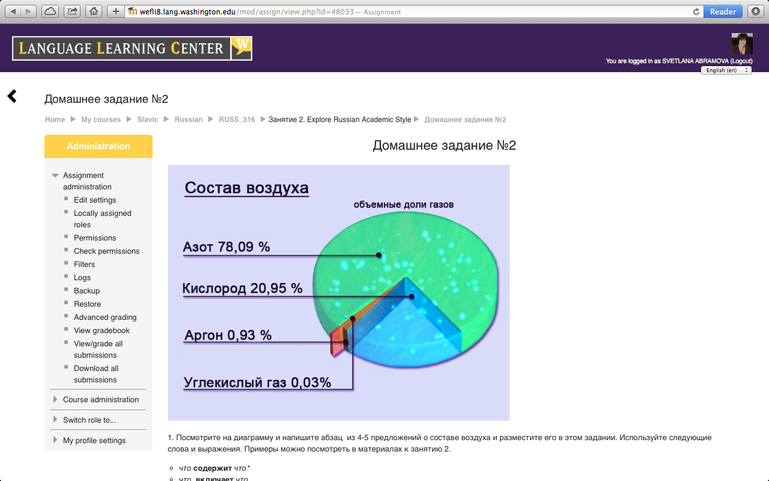
What Works for HLL and Advanced SLL
Content-based, task-based curriculum;
Authentic materials and tasks;
Using 99% of the target language.

Slide 14
RUSS-316 Course Outcomes
By the end of the course, students demonstrate the ability to:
Express ideas and opinions when engaged in conversation related to their professional fields;
Ask questions and exchange general information on STEM topics outside their professional fields of interest;
Understand the main ideas and some details on STEM topics that are presented through documentary films, video lectures and presentations;
Understand the main idea and a few supporting facts about famous scientists and scientific discoveries on STEM fields from short articles and summarized descriptions;
Read and understand the main ideas in nonliterary texts, such as articles, reviews, and summaries on STEM topics;
Describe their professional interests with clarity and details;
Deliver an oral presentation on STEM topics in academic style;
Write a summary based on articles in academic style language.

Slide 15
Student’s presentation: 3D-Printed Open-Source Hand Orthosis for Individuals with Spinal Cord Injury

Slide 16
Moving from 2 to 5-credit Course
More time for
Absorbing authentic materials;
Interviewing native Russian professionals;
Polishing presentational skills (writing and oral forms);
Exploring cultural context, using academic style words and expressions in non-academic settings.

