Slide 1
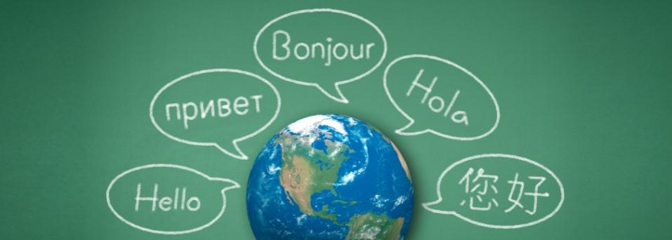
World Language Summit: Seal of Biliteracy & Competency-Based Credits
Saturday, January 23, 2016
University of Washington Mary Gates Hall

Slide 2
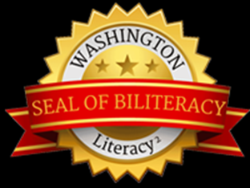
What is the Seal of Biliteracy?
The Seal of Biliteracy is an award made by the state to recognize a student who has attained proficiency in both English and one or more other world languages by high school graduation.
The Seal of Biliteracy takes the form of a seal on the diploma and a notation that appears on the transcript of the graduating senior. It is a statement of accomplishment that helps to signal evidence of a student’s readiness for career and college, and to engage as a global citizen.
Notes:
Michele

Slide 3
Brief National History of the Seal of Biliteracy
California, passed 2011
New York, passed in 2012
Illinois and Texas, passed in 2013
Louisiana, Minnesota, New Mexico, Rhode Island, Washington, passed in 2014
Oregon piloting in some districts
National Guidelines released March 2015
Utah plans for Gold Seal (Intermediate Mid) and Platinum Seal (Advanced)
New Jersey passed in January 2016
Notes:
Michele -

Slide 4
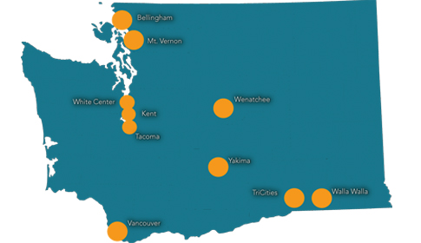
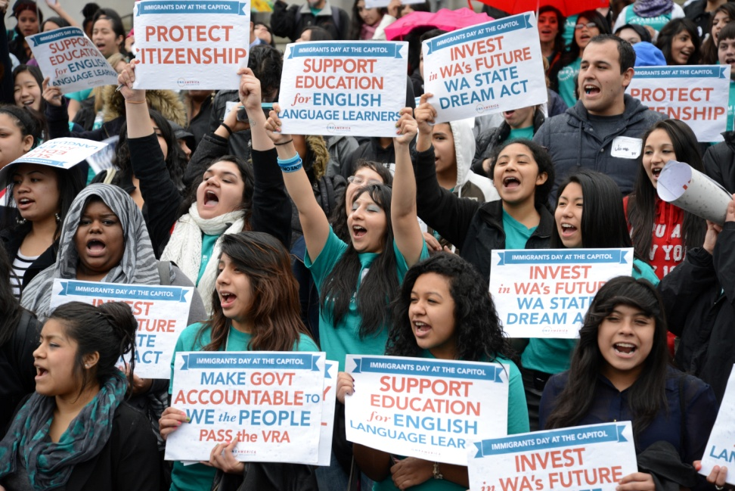
OneAmerica
Passing the WA State Seal of Biliteracy legislation
Organizing Power: Community base groups across Washington State developing development
Policy Advocacy: Local, state, and federal policy change to improve opportunities for immigrants
Notes:
OA Intro: We organize immigrant communities around WA state with significant representation in the areas indicated above. With over 1500 members statewide we build leadership use this power to shift policies.
Bridging grassroots power with grasstops advocacy makes us effective in areas like CIR, Citizenship/VRA/DREAM , OIRA,
OneAmerica has been in a unique position to bring our community organizing and our policy expertise to the education field with a focus on English Language learners.
Leverage local innovation to state changes
Organized ELL WG as we would our base

Slide 5
SENATE BILL 6424
“[T]he legislature's intent is to promote and recognize linguistic proficiency and cultural literacy in one or more world languages in addition to English through the establishment of a Washington state seal of biliteracy.”
Passed by the Senate March 10, 2014: YEAS 49 NAYS 0
Passed by the House March 6, 2014: YEAS 69 NAYS 27
Signed by the Governor March 27, 2014

Slide 6
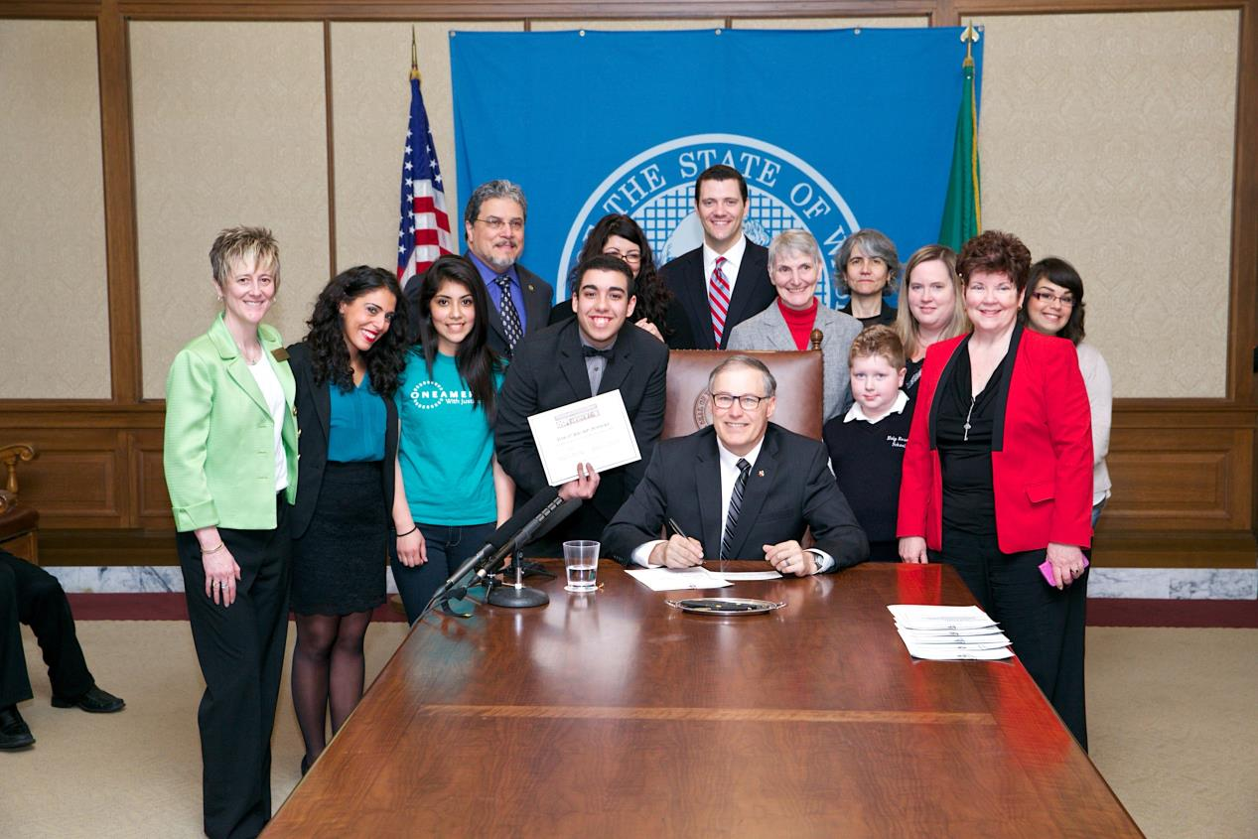

Slide 7
Provisions
“Participating school districts shall place a notation on a student's high school diploma and high school transcript indicating that the student has earned the seal.”

Slide 8
Criteria
“The office of the superintendent of public instruction shall adopt rules establishing criteria for award of the Washington state seal of biliteracy. The criteria must require a student to demonstrate proficiency in English by meeting state high school graduation requirements in English, including through state assessments and credits, and proficiency in one or more world languages other than English. The criteria must permit a student to demonstrate proficiency in another world language through multiple methods including nationally or internationally recognized language proficiency tests and competency-based world language credits awarded under the model policy adopted by the Washington state school directors' association.”

Slide 9
Concerns about Equity
“For the purposes of this section, a world language other than English must include American sign language and Native American languages.”

Slide 10
Languages of Students in Transitional Bilingual Programs
“By December 1, 2017, the office of the superintendent of public instruction shall submit a report to the education committees of the legislature that compares the number of students awarded the Washington state seal of biliteracy in the previous two school years and the languages spoken by those students, to the number of students enrolled or previously enrolled in the transitional bilingual instruction program and the languages spoken by those students.”

Slide 11
Increasing the Methods for Demonstrating Proficiency
“The office of the superintendent of public instruction shall also report the methods used by students to demonstrate proficiency for the Washington state seal of biliteracy, and describe how the office of the superintendent of public instruction plans to increase the number of possible methods for students to demonstrate proficiency, particularly in world languages that are not widely spoken.”

Slide 12
Criteria Established by OSPI
Proficiency in English
Proficiency in a world language other than English
Passing AP Exam (3 or higher)
Passing IB Exam (SL or HL 4 or higher)
Demonstrating Intermediate Mid (or higher) using assessments provided by OSPI
Earning 4 Competency-Based Credits (Intermediate Mid or higher on OSPI approved assessments)
Demonstrating proficiency comparable to Intermediate Mid on OSPI approved national/international tests
WAC 392-415-070 Mandatory high school transcript contents
WAC 392-410-350 Seal of Biliteracy

Slide 13
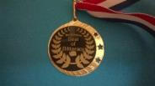
Highline Public Schools Awards the Seal of Biliteracy
193 Seal of Biliteracy recipients in 23 languages in Spring 2015
How students were identified:
Report in student database system
Verify with AP / IB coordinators students who received 3 and 4 or higher on language test
Verify with all H.S. counselors for meeting ELA requirements
Recognition at graduation, School Board meeting, school assemblies
Medallions at graduation, certificates, seal foil
Next steps/ideas – Bilingual teacher pipeline, starting with Seal of Biliteracy recipients

Slide 14
Process for World Language Credit by Proficiency [Highline SD]
Year –long testing window schedule for all high schools
High schools identify WLCbyP site coordinator
Schools promote opportunity via flyers, PPT, video
Students pre-register at school
1st meeting – WLCbyP overview, writing sample, self assessment
2nd meeting – permission form, sample test, details about proficiency levels and Seal, students commit to test
3rd meeting – test day
6-8 weeks, results and letter sent to schools (principal, counselor, registrar, student)
Blue = central office supported
Red = school site supported

Slide 15
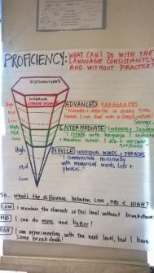
Getting the Word Out! [Highline SD]
Explanation and promotion of the Seal with WL teachers and School Counselors (survey)
PPT with information about WLCbyP and Seal and video to be used in H.S. advisory classes and Open Houses
Explanation of Seal at every WLCbyP meeting at all high schools
WL teachers talk with students about
ACTFL proficiency scale and Seal of Biliteracy

Slide 16
Challenges and Next Steps [Highline SD]
Graduating seniors taking AP or IB test, results back in summer (43 in 2015)
Messaging about the Seal with ELL Lead teachers and College and Career Access Specialists
Posters about the Seal and WLCbyP and benefits for counseling offices

Slide 17
Seattle SD Recognizes 195 students in June 2015
84 for AP (level 3+) Chinese, French, Japanese, Spanish
52 for IB (level 4+) French, Japanese, Spanish
59 for 4 Competency-Based Credits in Amharic, Dutch, German, Mandarin, Oromo, Persian, Punjabi, Somali, Spanish, Swahili, Tagalog, Thai, Tigrinya, Vietnamese
How?
Letters with assessment results
Seal stickers (for diplomas)
Medallions to wear at graduation
Notes:
Michele – I’ll bring examples of our letters, Seal stickers, and Medallions and examples of how we communicated with the counselors.

Slide 18
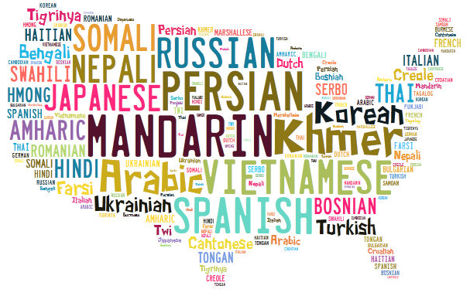
What the Seal means to students, especially ELLs
“I am extremely excited because I have never gotten the chance to put my language to use at school or to something that will benefit me in the future.”
“Having an opportunity where cultural skills learned outside of school are recognized is fantastic!”
Notes:
In the 2012 & 2013 school years, a combined total of 2,364 students participated in 56 different languages
The students qualified for a total of 7,271 credits
72% qualified for three or four out of a total of four possible credits
Students reported gaining the chance to focus on what they needed to graduate or enroll in advanced-level courses to improve their college eligibility
Over 1500 students, 30 diff/diverse languages and 4000 credits
Strengths based approach what do ELL students bring
Operationalizing competency based system-no seat time needed
Helped students graduate (opp gap closing)
Implications for parent engagement
Highline 2026 goal and seal of biliterarcy
https://youtu.be/tgCMhiM1N-o

Slide 19
Video about Competency-Based Credits & the Seal
https://youtu.be/tgCMhiM1N-o
http://www.k12.wa.us/WorldLanguages/CompetencyBasedCredits.aspx
Notes:
Roxana…

Slide 20
Education NW Reports
The Impact of the Road Map World Language Credit Program on Student Attitudes Toward Bilingualism and School (Oct 2014)
The Impact of Competency-Based World Language Credits on Graduation (June 2015)
http://www.k12.wa.us/worldlanguages/RoadMap/default.aspx
Notes:
Roxana – feel free to edit this. I just stuck it in.

Slide 21
What World Language Teachers Can Do
Make sure your AP and IB students know about the Seal of Biliteracy. (Students who pass AP/IB exams in spring of 12th grade can still receive the Seal after graduation.)
Encourage students who have a first language other than English (or the language you teach) to earn credits in their home language too and earn the Seal for that language.
For students who speak a language, but lack literacy skills, help them find a way to learn to read and write in their home language and earn credits and the Seal.
Notes:
Michele plus Jennifer and Paris

Slide 22
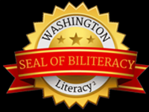
For more information, visit:
http://www.k12.wa.us/WorldLanguages/ SealofBiliteracy.aspx

