Slide 1
UW Russian Summer Program Russian in the Sky and Outer Space
World Language Summit
January 23, 2016, University of Washington
Dr. Svetlana Abramova
Anatoly Klots

Slide 2
Mission
To provide summer language learning opportunities for students and professional development opportunities for teachers in critical languages
https://startalk.umd.edu

Slide 3
UW Russian Student Program
Russian in the Sky and Outer Space
Since 2011, 5 years (over 100 students!)
Designed for high-school age Russian Heritage Language Learners (HLLs)
Int.H. proficiency level in Speaking and Listening, Int.L. in Reading and Writing.

Slide 4
Russian in the Sky and Outer Space
4-week intensive (5 hours/day) language program at the University of Washington;
Focus on STEM (Science, Technology, Engineering, Math) and academic language to increase language proficiency;
Collaboration with the Museum of Flight.

Slide 5
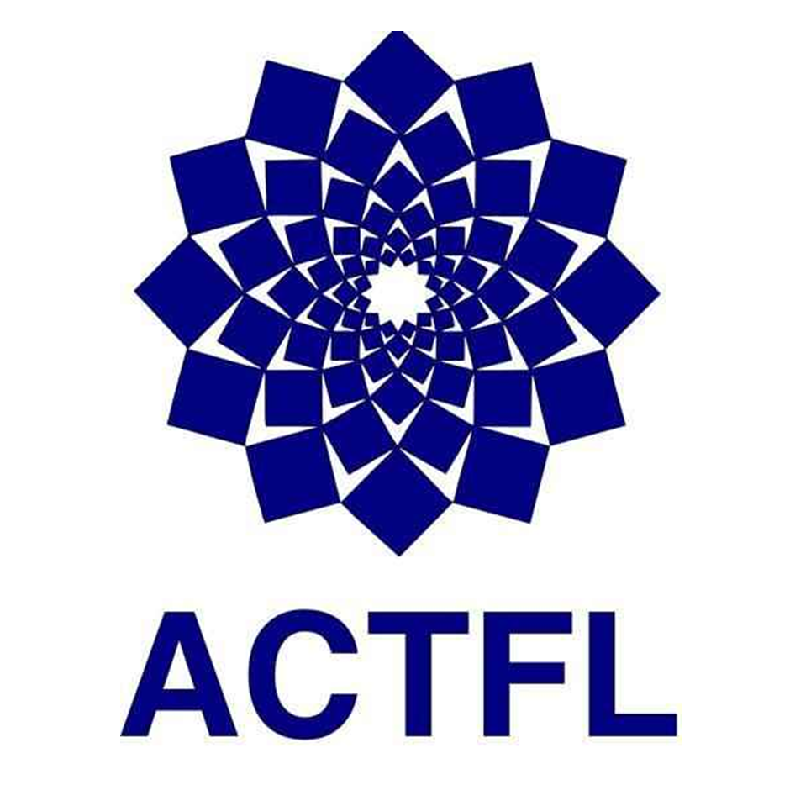
Credits
5 UW credits by enrolling in RUSS 499 through the Slavic Department
Earn up to 4 competency-based credits for high school world languages based on results of ACTFL OPIc and WPT
Scholarship Assistance for test takers.

Slide 6
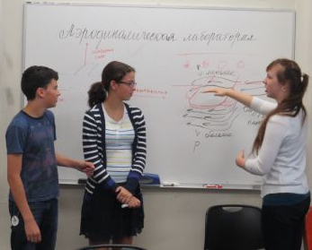
Program Goals
Target language proficiency
(according to ACTFL Proficiency Guidelines):
Intermediate Mid or higher in Reading/Writing
Advanced Low or higher in Speaking/Listening;
Increase students’ proficiency in all three modes of communication:
Interpersonal, Interpretive, and Presentational

Slide 7
Program Goals
Increase sensitivity to cultural norms: social register and linguistic forms not typically encountered in intimate family speech;
Strengthen students’ skills in Russian, especially in academic language across disciplines;
Sharpen students general communication skills in varied disciplines by meeting with Russian-speaking professionals.

Slide 8
Components in UW STARTALK Russian Program
STEM Unit Lessons
Voyage to Mars
Airplanes
Role plays and labs at the Museum of Flight
Voyage to Mars
Pilot for a day
Interviews with professionals
From Boeing Company
From Microsoft Company
Alaska Airline
Elective Projects
History
Linguistics
Lego Robotic

Slide 9
Assessments
At the end of the units assessments;
At the end of the program integrated final performance assessment (group presentations on STEM topics);
At the end of the program student research projects conference;
ACTFL OPIc and WPT.

Slide 10
Collaboration with the Museum of Flight
Visit the Museum: View and research museum artifacts and exhibits;
Use Russian in Museum learning centers
Challenger Learning Center: “Voyage to Mars”
Aviation Learning Center: “Pilot for a Day”;
Return to the Museum for Astronomy Day
Present project findings in Russian in real-life setting
Tell Russian community about the program.

Slide 11
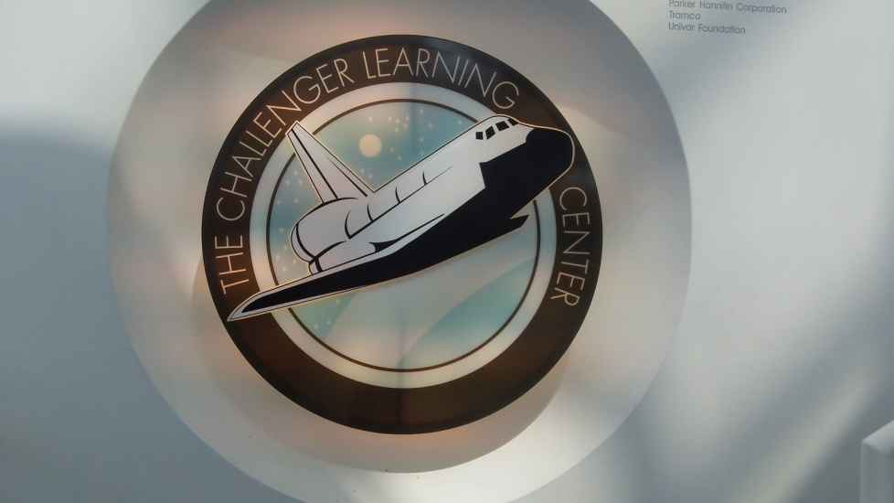
Integrated Performance-based Assessments at the Museum of Flight
Introduction of specific vocabulary and structures students need to understand and use to complete the simulation and labs;
Role-play communication during flight simulation and labs;
Post-activities reflection.

Slide 12
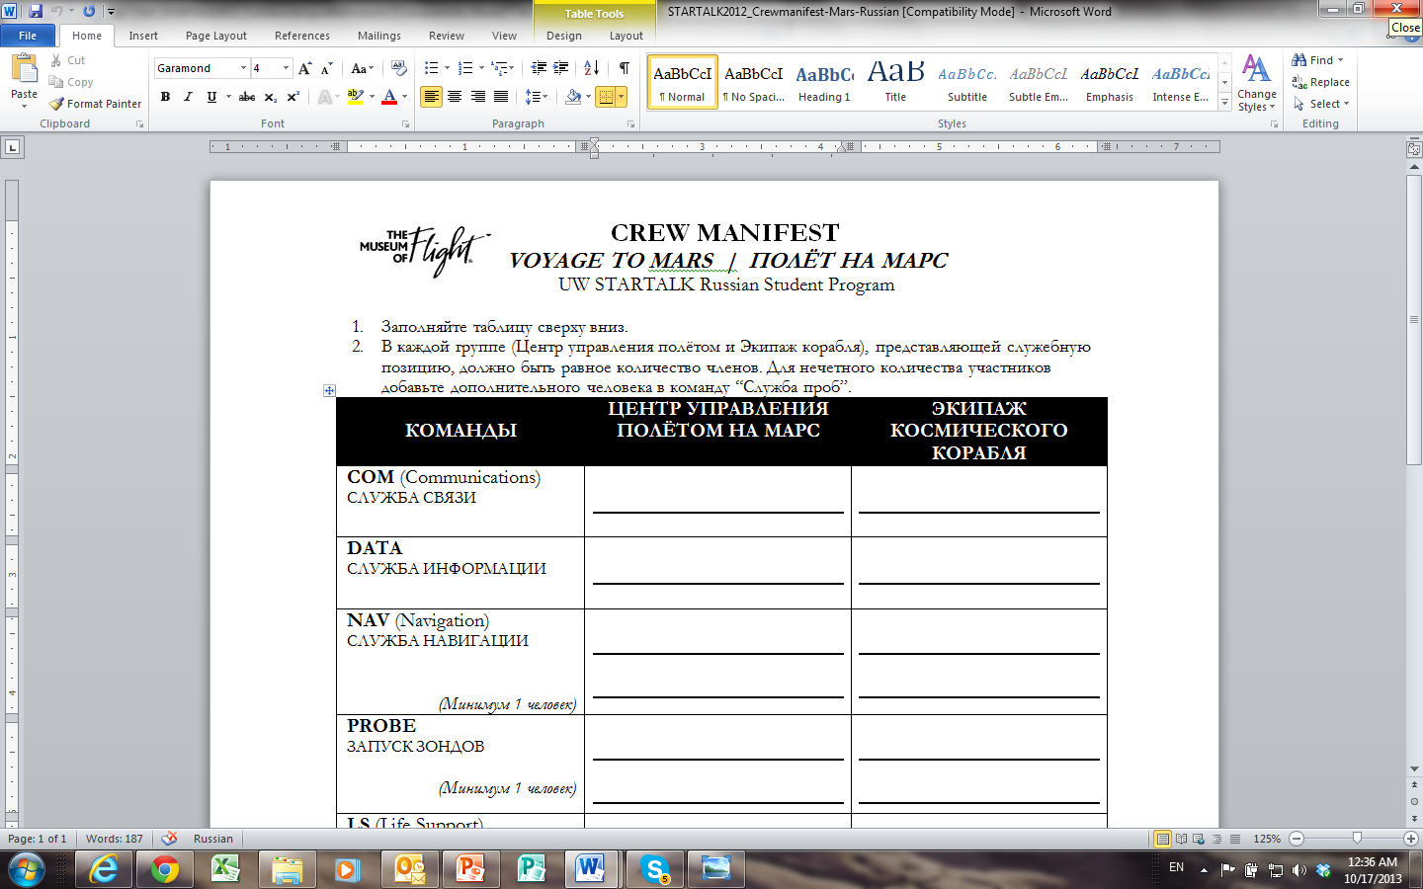

Slide 13
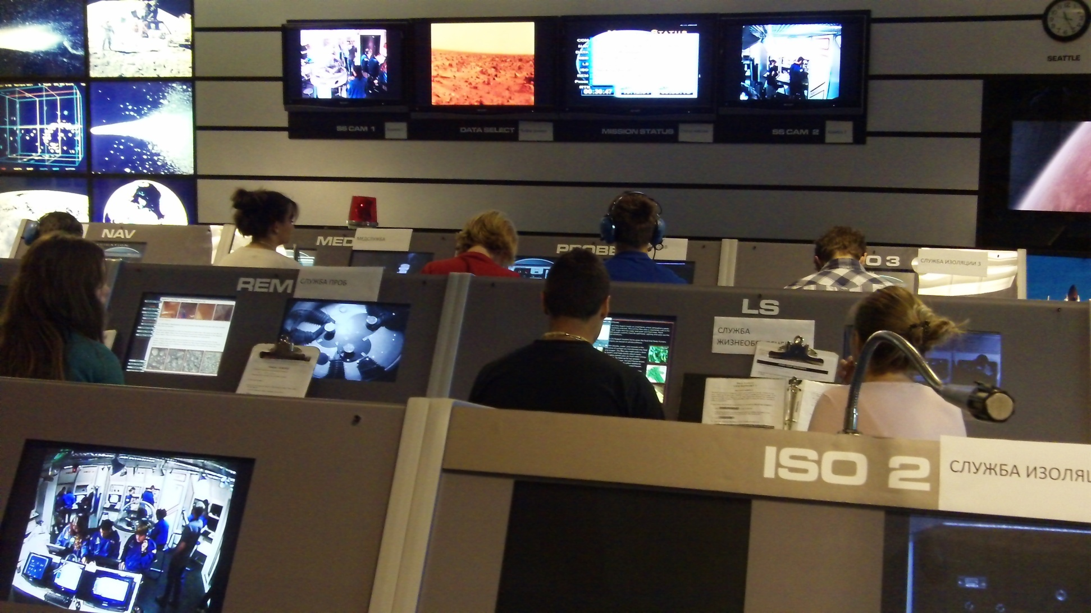
In Mission Control

Slide 14
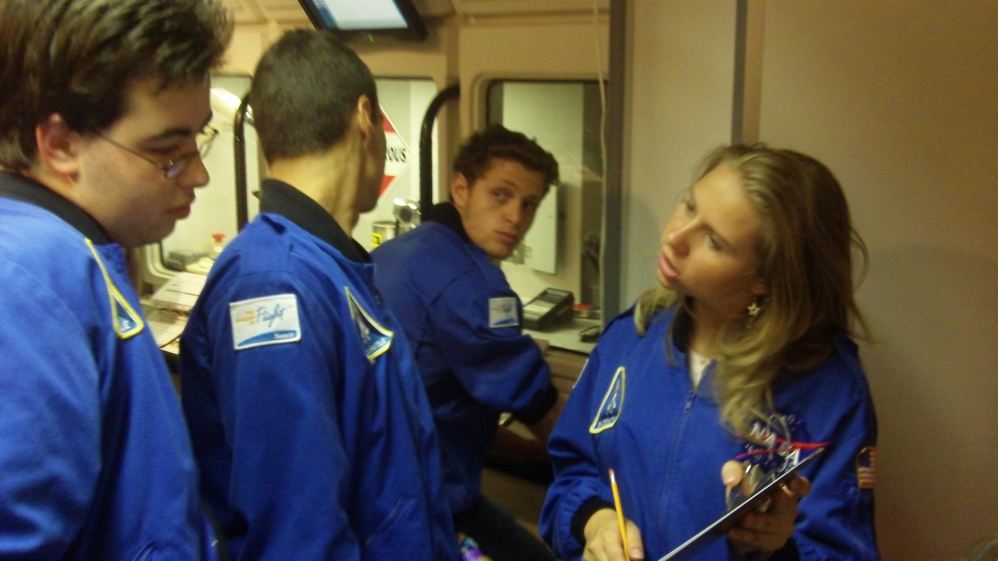
In the Spacecraft

Slide 15
Предполетный осмотр
Основные части самолета Cirrus SR-20

Slide 16
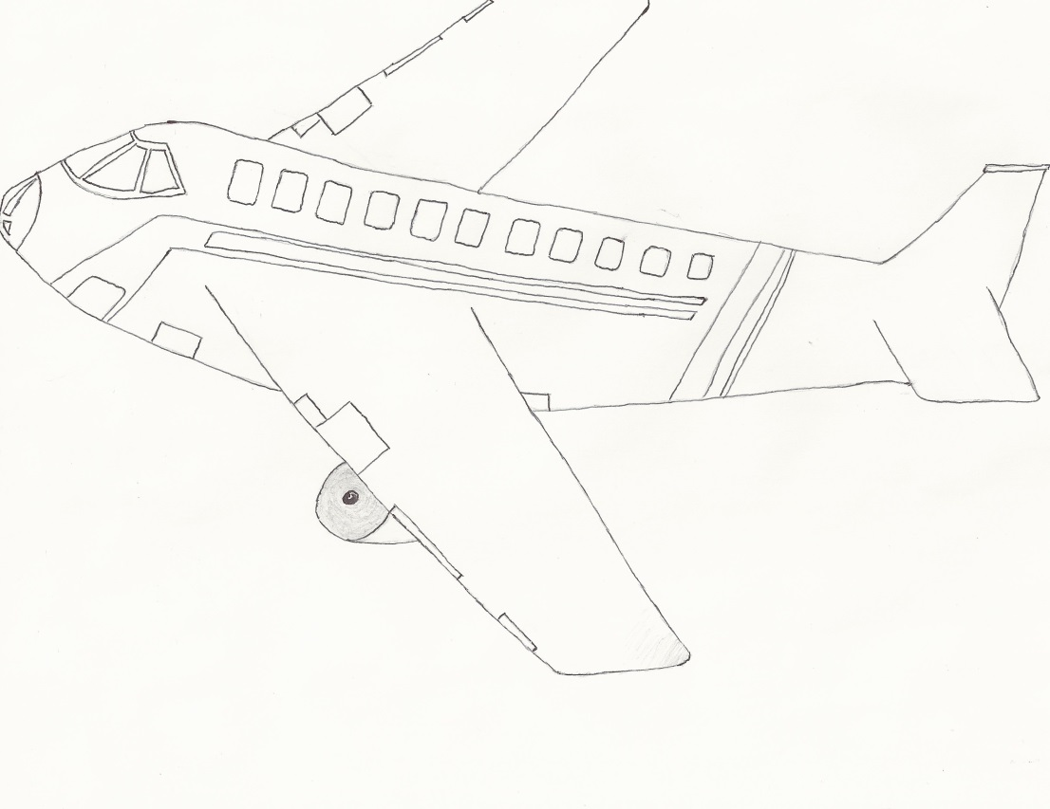
Основные аэродинамические силы, действующие на самолет в полете
Подъемная сила (Lift, Cl)
Сила сопротивления (Drag, Cd)
Подъемная сила
Сила сопротивления
Тяга, создаваемая двигателем
Набегающий поток
Сила гравитации

Slide 17
Student Activities: Pre-Flight Check

Slide 18
Student Activities: Wind Tunnel Lab at the Museum of Flight

Slide 19
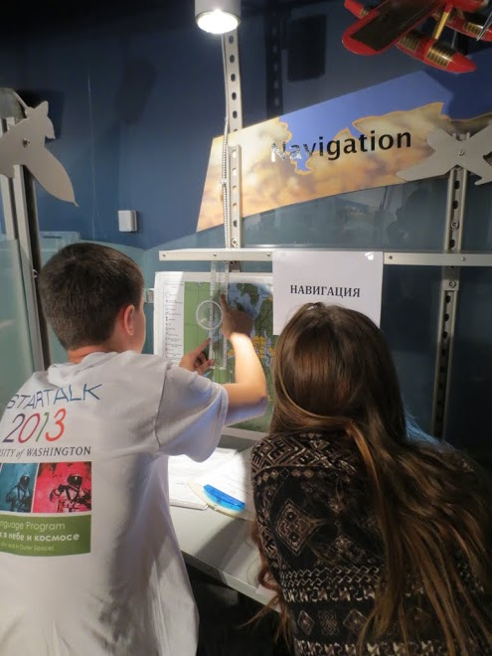
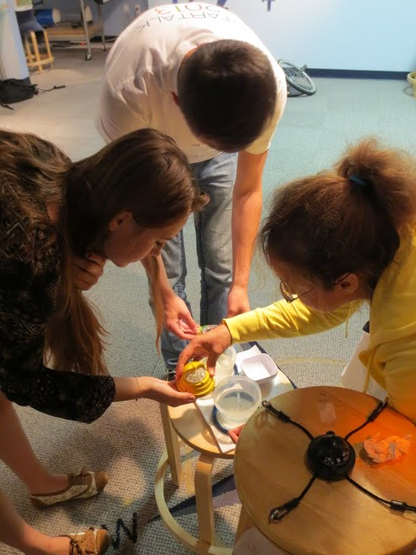

Slide 20
Student Activities: Navigation

Slide 21
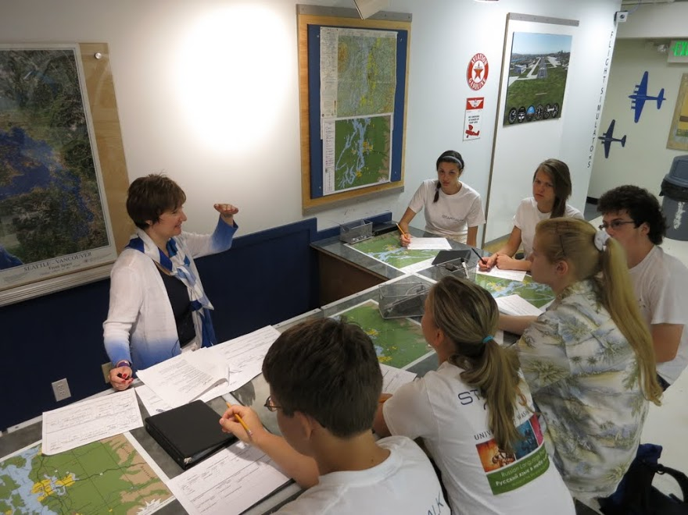

Slide 22
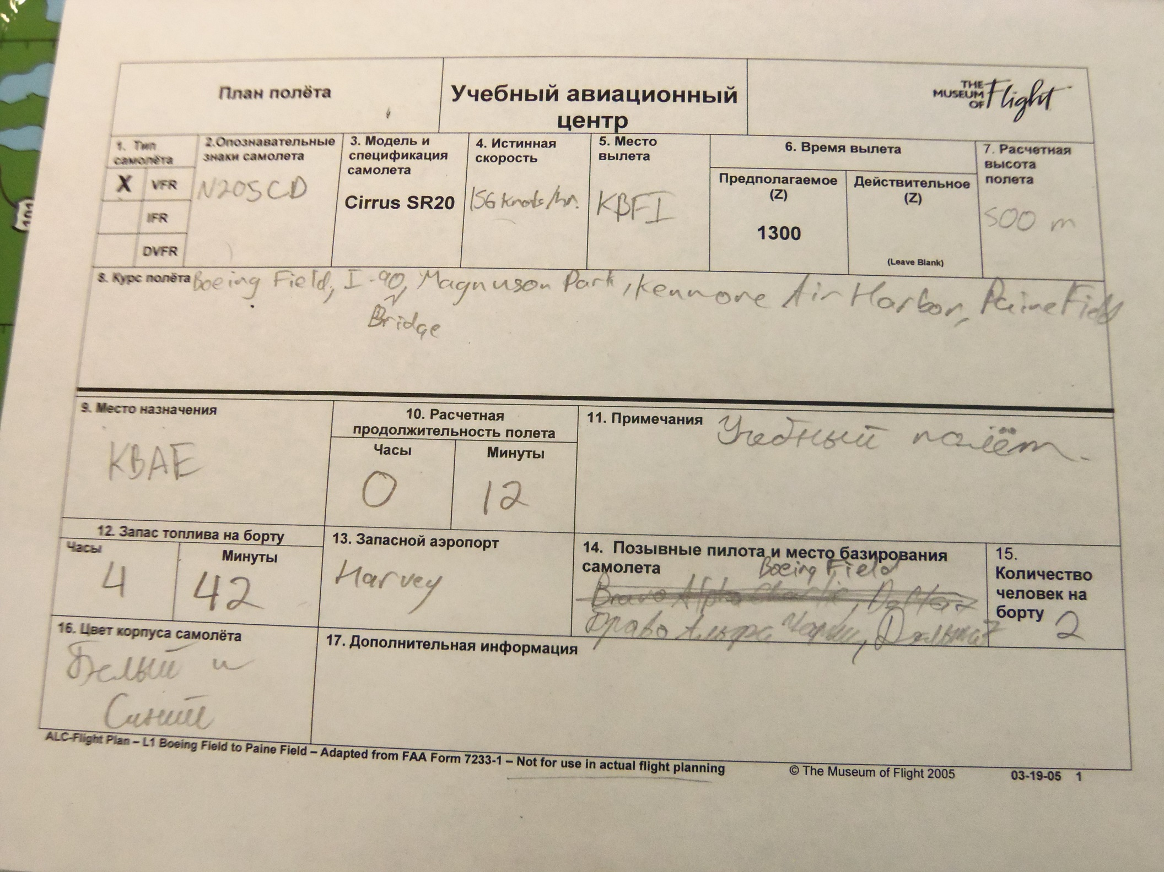

Slide 23
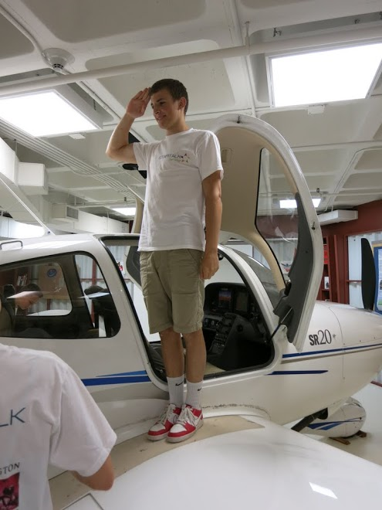
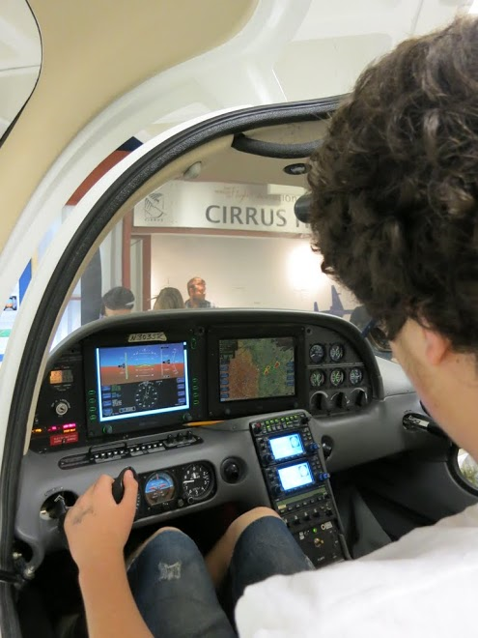

Slide 24
Interviews with Professionals

Slide 25
Interviews with Professionals: Standards and Expected Outcomes
Meet, greet and introduce people in formal and informal settings (Communication: Interpersonal);
Listen to and understand oral presentation about STEM topics (Communication: Interpretive);
Begin to use social registers and academic language style in discussing STEM topics with peers and a guest speaker (Communication: Interpersonal);
Ask questions and understand answers about history of aircraft building and aerodynamics (Communication: Interpersonal);
Recognize differences in Russian and American educational approaches for studying scientific disciplines through interviews with Russian professionals (Culture, Comparisons);
Express post-activity feelings and experiences in short reflections using Moodle and thank-you letters (Communication: Presentational).

Slide 26
Student Research Projects Conference
• Choose elective projects from Linguistic, Robotic & Astronomy, and History;
• Explore research topics through the use of various authentic materials in Russian;
• Create a PowerPoint presentation in the target language;
• Present orally their research findings in front of their classmates, parents, teachers, and experts;
• Compete to be the best presenter of the project;
• Get feedback from the Russian-speaking experts from the community.

Slide 27
Community Connection
Student conference featuring Russian experts;
Astronomy Day at the Museum of Flight;
Collaboration with Local Russian mass media;
Post program activities during the school year.

Slide 28
Astronomy Day at the Museum of Flight

Slide 29
Collaboration with Local Russian Newspaper “Russkiy Mir” (Russian World)
Tell Russian community about the program
Advertise the program
to attract students
Publish students’ articles

Slide 30
Students’ Articles
Город на Марсе
Алексей Быкович, студент программы 2013г.
Планета Марс была загадкой для ученых многие годы, но мы все ближе к тому моменту, когда человеческая нога станет на эту красную планету. Люди всегда мечтали о человеческом поселении на Марсе, но могли ли эти сказки стать реальностью? Всего 40 лет назад такие вещи как смартфон были фантазией, и мы продвигаемся в развитии технологий каждую минуту. Что может принести нам будущее?
Чтобы человек жил на другой планете, ему нужны кислород, вода, еда… Проблема в том, что на Марсе существует нехватка всего этого. А также там очень низкое давление, ядовитая атмосфера, нет кислорода и повышенный уровень радиации.
Поскольку свинец хорошо поглощает γ-излучение, он используется для радиационной защиты в рентгеновских установках и в ядерных реакторах. Поэтому на первом этапе наш город будет под свинцом. Потом под городом можно будет строить туннели. Второй этап – терраформирование. Биосфера планеты будет защищать людей от солнечной и галактической космической радиации
Также для жизни на Марсе нужно электричество, которое предполагается получать из солнечных батарей и ветряных мельниц.
Ниже приведен проект города на Марсе, в котором будут электростанции, оранжереи, научные лаборатории, квартиры для людей…
http://russianworldnewspaper.org/

Slide 31
You Can See and Use Our STEM Materials
Program and lesson plans
Scenarios and texts
PowerPoint presentations
Videos of the lessons
UW STARTALK website https://depts.washington.edu/startalk/

Slide 32
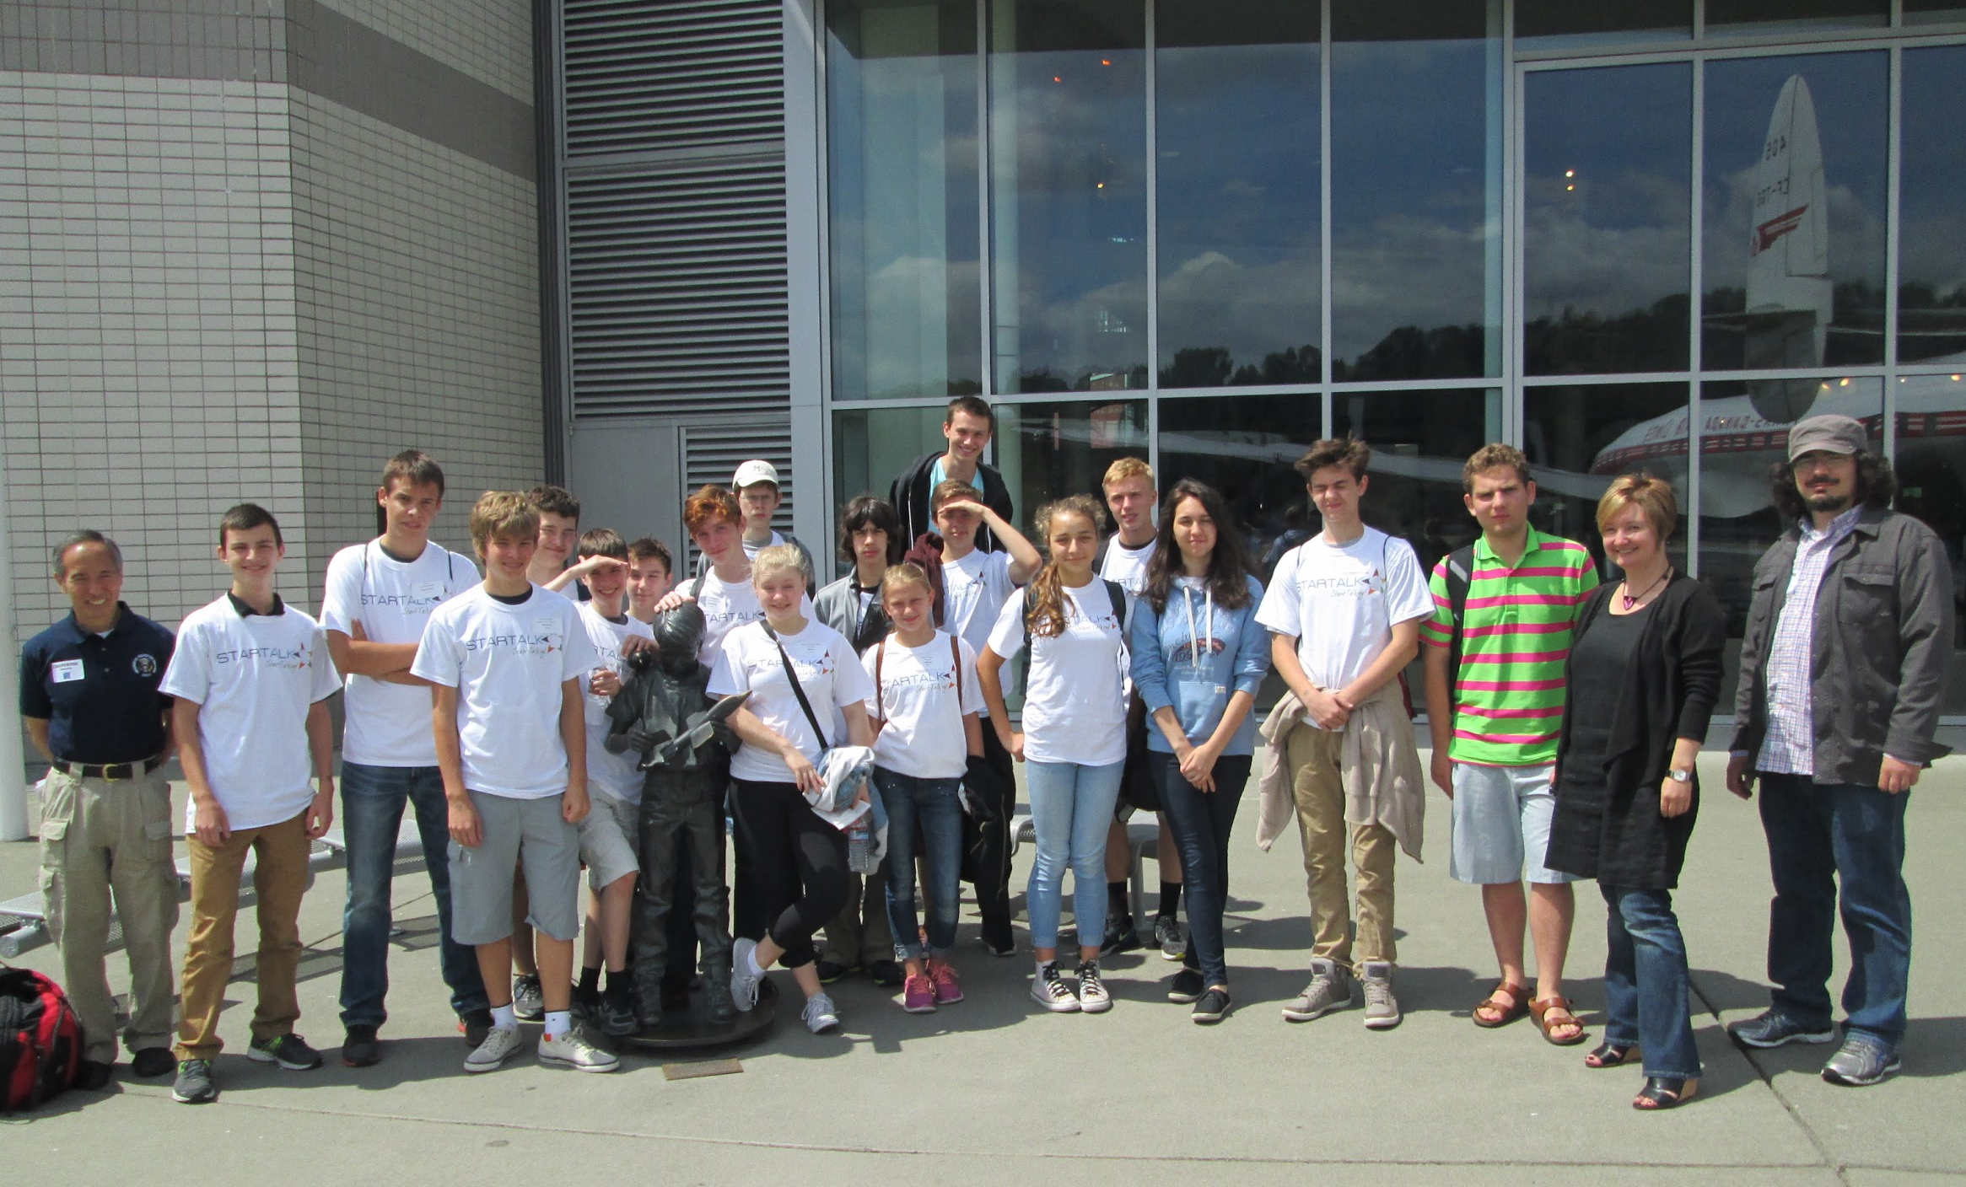
Спасибо за внимание!
Learn more about UW STARTALK
https://depts.washington.edu/startalk
https://www.facebook.com/StartalkUW

