Slide 1
UW in the High School

Slide 2
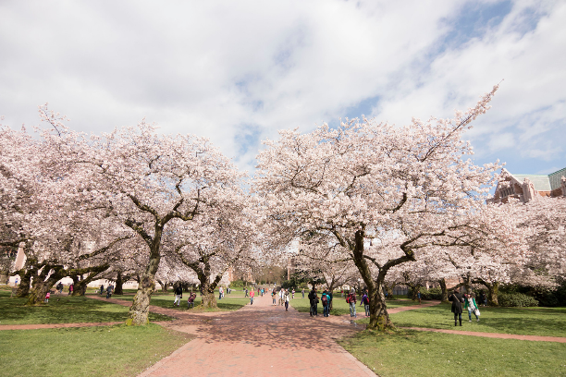
How the Program Works
Highly qualified teachers
Approved, trained, and supported by UW departments
Teach UW courses
In the high school
Eligible students can register to earn UW credit
Partnership!

Slide 3
Program Highlights
Oldest such program in Washington (1981)
Available to all Washington high schools
Stats for 2014-15
18 subject areas
92 high schools
201 teachers
3,555 students

Slide 4
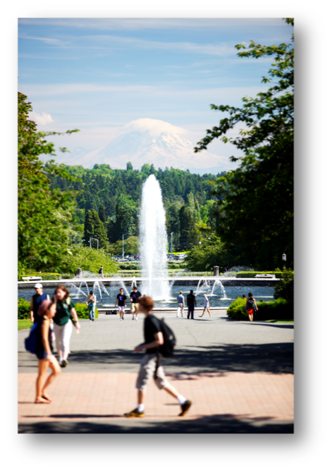
Benefits to Students
Engage in a UW course in the high school classroom
Access the UW libraries
Establish a UW transcript
Earn UW credit at a fraction of on-campus rates

Slide 5
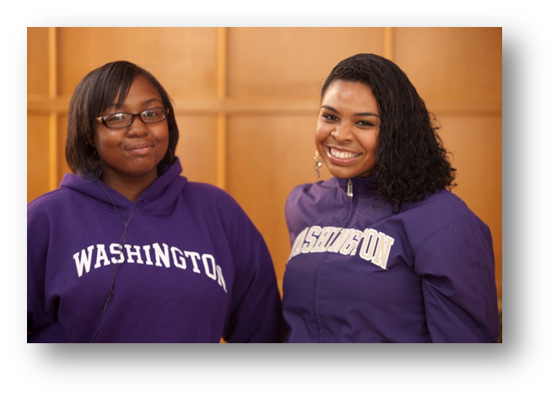
Student Eligibility
10th, 11th and 12th grade students are eligible to register for UW credit
B+ in subject area, or permission of teacher
Some courses have prerequisites
Ex: French 103 requires completion of two years of high school-level French

Slide 6
Registration Fees and Deadlines
Registering for UW credit is optional
For 2015-16, at least 4 students must register for UW credit
There are no payment plans, reduced fee options, or deadline extensions
Fees | 2015-16
Course Fee | $325
Registration Fee | $45
TOTAL | $370
Course Start | Registration Deadline
Fall-start (year-long and first semester only courses | October 30, 2015
Second semester only courses | February 29, 2016

Slide 7
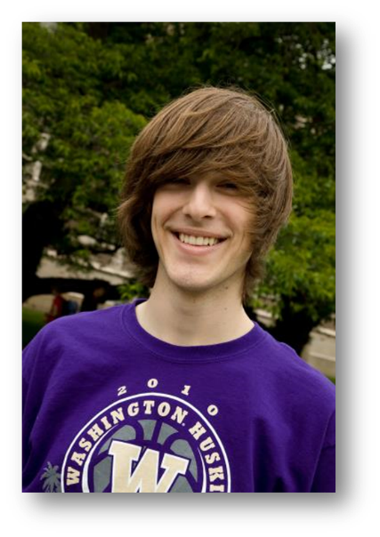
UWHS Student Performance
Average grade 3.2 (B+)
% of UWHS grades > 2.0 93%
% of students to UW 10%
Their average UW GPA 3.3
Note: No specific UW admission advantage for UWHS students.

Slide 8
Transferring Credit in Washington
Generally DO Accept Credit:
Bellevue College
Central Washington University
Eastern Washington University
Evergreen State College
Gonzaga University
Heritage University
Pacific Lutheran University
Saint Martin’s University
Seattle Pacific University
Seattle University
Walla Walla University
Washington State University
Western Washington University
Whitworth University
All Community Colleges
Generally DON’T Accept Credit:
University of Puget Sound
Whitman College
For out-of-state institutions, students should contact their prospective college or university to inquire. Most public and many private institutions accept the credits.

Slide 9
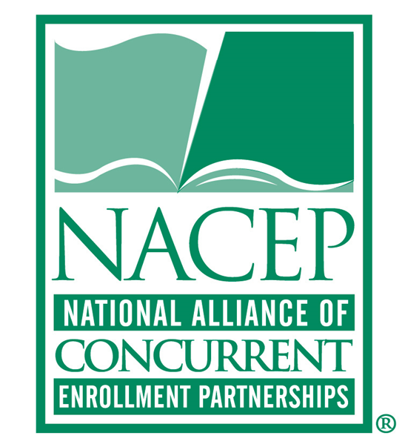
National Standards and Accreditation
17 Standards established to ensure program quality
UWHS accredited 2007-2014, reaccredited 2014-2021
Examples of Standards:
End-of-course evaluations
Faculty site visits
Surveys of student alumni

Slide 10
World Languages
ASL 103
Elementary American Sign Language III
FRENCH 103
Elementary French
GERMAN 103
Elementary German
GERMAN 201
Second-Year German
LATIN 103
Elementary Latin
JAPAN 113
First-Year Japanese
JAPAN 211
Second-Year Japanese
KOREAN 101, 102, &103
First-Year Korean
SPAN 103
Elementary Spanish
SPAN 201
Intermediate Spanish
New!

Slide 11
Requirements for UWHS Teachers
Program orientation
Discipline-specific training every other year
UW course syllabus
Conduct the UW course to UW standards
UW end-of-course evaluations
UW grades

Slide 12
Adding UW Courses for 2016-17
Course openings announced in January
Teacher applications accepted January-April
Training date varies by course, May-August

Slide 13
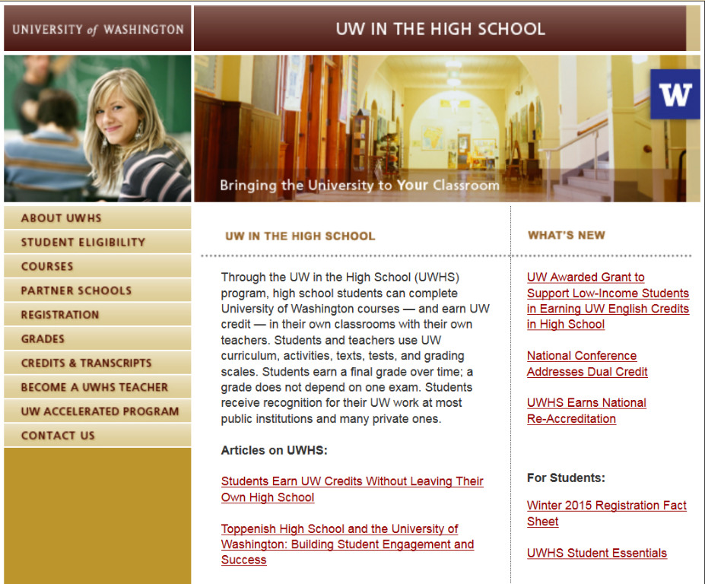
UWHS Website
http://www.uwhs.washington.edu/

Slide 14
Questions?

