Slide 1
Immersive Stories for Drupal 8
How the College of Engineering Manages Rich Content Experiences for the Web
Jon Shilling, Web Developer
College of Engineering Dean’s Office
jshill@uw.edu

Slide 2
About Us - College of Engineering
Al Brower, Associate Director of Computing
Claudia Aguirre, Associate Director Online Communications

Slide 3
About Us - College of Engineering
Drupal 7 Multisite Installation
Drupal 8 Multisite Installation
www.engr.washington.edu, plus 13 department sites
Shared and unique configuration with Config Split (https://www.drupal.org/project/config_split)
Shared theme across all sites (custom Boundless implementation)
Site Users
Mainly Claudia and her team from the Dean’s Office Marketing and Communications web team
Other staff with little web experience

Slide 4
The Problem
Request: a tool for constructing visually compelling and engaging stories across the suite of College of Engineering websites
Drive Engagement
Spotlight certain stories
Needed the following
Strong design language, consistent look and feel
Highly Customizable
Simple enough for people to use with very little knowledge of CMS software

Slide 5
UMAC Storytelling Wordpress Plugin
https://github.com/uweb/uw-storytelling-modules
Maintained by University Marketing & Communications
Allows users to build web pages with a configurable ‘modules’
Minimal user input
No need for users to worry about styles
Easy interaction with media (images, videos, etc.)
No Drupal version

Slide 6
The Solution
Keep the same general idea, fit to our needs
Drupal provides all the features we need in Core, we just need to put the pieces together
Use the following:
Layout API
Block API
Form API
Media Module

Slide 7
Layout Builder
https://www.drupal.org/docs/8/core/modules/layout-builder
“Drupal's Layout Builder allows content editors and site builders to create visual layouts for displaying content. Users can customize how content is arranged on a single page, across types of content, or even create custom landing pages with an easy to use drag-and-drop interface.”
Now part of Core
works out-of-the-box with any content type
Custom functionality via Drupal 8 Plugins
Layout plugins
Block plugins

Slide 8
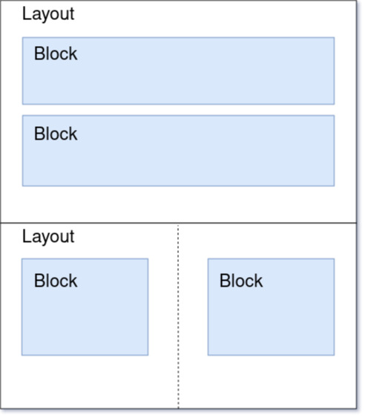
Layout Builder
Layouts define structured regions
choose number of regions
what they look like
Regions confine the content within them
Fields
Blocks (most relevant to us)
Regions and content can be added/removed at any time
All content is draggable, and reorderable

Slide 9
Demo

Slide 10
Wrapping Up
Code on UW CoE Github: https://github.com/uw-coeweb/immersive-stories

