Slide 1
Evidence-Based Case Management in Child Welfare
Mark Chaffin
University of Oklahoma Health Sciences Center

Slide 2
An Example
Family X
  Mother, age 34
    Homemaker
    History of “personality disorder,” unverified
  Father, age 34
    Stable but low-income employment
    History of sexually abusing a sibling when he was a teenager (18 years ago)
  Paternal grandmother
    Provides substantial economic support

Slide 3
An Example
4 Children, ages newborn to 6 (oldest by prior marriage)
  Newborn is medically fragile
Referral to Child Welfare was made by physician because of Failure to Thrive concern regarding newborn
  Newborn not gaining weight, mother has poor caregiving skills; medical neglect
  No evidence of any other maltreatment

Slide 4
Here is the Service Plan
Mother will attend parenting class to learn child discipline skills
Father will enroll in, and pay for, 3-years of sex offender counseling with polygraph monitoring
Mother will attend non-offending group program for wives of sex offenders

Slide 5
Here is the Service Plan
Mother is to demonstrate that she is not dependent on her husband’s mother so that she is not tied to a sex offender
Individual play therapy for two older children
All children placed in foster care until compliance

Slide 6
Here is the Service Plan
Marital counseling
Open-ended individual psychotherapy for mother to “deal with her early trauma issues”
Counseling for mother “to clarify what she was thinking when she decided to bring this man (i.e. a sex offender) into her life”

Slide 7
Here’s the Service Plan
Mother mandated to take psychotropic medication
Father not allowed to be around children unsupervised
Termination of parental rights being considered—non-compliance
  Mother states “CW is trying to break up my marriage” interpreted as FTP

Slide 8
What Went Wrong Here
Failure to prioritize and match
  What is the focus here?—failure to thrive and caregiving skills/resources, or “everything”
  Too many services (16+ hrs. / week)
  The wrong services
  Intrusion into personal non-CW concerns
  None of the services are evidence-based

Slide 9
Who Made This Plan?
A CW worker and supervisor
A CASA worker
A judge
What are some possible sources for their reasoning
  Defensive practice?
  Current standard
  A set of general operative ideologies

Slide 10
Operative Ideologies
Viewed the plan as taking a holistic family centered focus
More is better
The “underlying” problems are more important than the surface problems
“Mission creep” in services
  The “What about?” factor

Slide 11
Operative Ideologies
CFSR
  Emphasis on “comprehensive services”
  The assumption is that “the most fundamental needs of children, such as needs for nurturing, belonging and safety, cannot be addressed effectively without attending to the entire family’s needs”
  In short, “a program for every problem”

Slide 12
Operative Ideologies
Coordinated multi-provider service case management ideologies
  Wraparound
  Systems of Care
  FGDM
Emphasize multiple services, multiple providers and increasing the dose of services received by improving access and buy-in

Slide 13
Operative Ideologies
What do we know about comprehensive multi-provider services
  Clearly increase the volume or dose of services received, the dollars expended, and raise consumer engagement with services
  But, they do not necessarily yield better outcomes for children of families

Slide 14
Why
Why would a case-management approach that improves engagement and service dose not improve outcomes?
  Maybe the services being coordinated and managed were ineffective
    Widely considered
  Maybe stacking services (aka “poly-services”) has an associated downside
    Not widely considered

Slide 15
Untested Assumptions
“Strengths based,” “Family focused,” “Child centered”
  Hard to know if these really yield better outcomes because they tend to be slogans more than clear procedures. Never really evaluated
Service plans must be highly individualized
  This is a paradox. It is widely believed, yet many CW service plans look alike!

Slide 16
EBCM
What is evidence-based case management?
  A concept that is a work in progress
  The application of what we have learned from outcome research applied to how individual service plans are developed
We will focus on psychosocial services, not all child welfare services

Slide 17
EBCM
What is evidence-based case management?
  Extends beyond favoring EBT’s over services with less support
  Using emerging knowledge about service benefit, dose, selection, and matching to obtain optimal child welfare outcomes efficiently and effectively

Slide 18
Learning From EBT
Ultimately EBT refers only the level of rigor supporting service outcomes, not service means or methods
But, there are some consistent threads that seem to run through the current crop of child welfare relevant EBT’s, and these may be relevant to case management
Both content elements and process

Slide 19
Why Do EBT’s Work?
Poorly supported points offered by EBT opponents
  The studies only recruited easy clients, not multi-problem families
  The therapists were all highly experienced expert ringers
  Only the developers themselves really get results
  EBT’s only work with non-minority clients and cultures

Slide 20
Cross-Cutting EBT Traits
Short term (around 12 - 20 sessions)
Tend to use behavioral strategies
  Behavioral skill oriented
  Modeling, practice and direct feedback
  “In-depth” approaches → often negative
Structured, planned, very active
Focused more than comprehensive
Follow the K.I.S.S. principle

Slide 21
Cross-Cutting EBT Traits
Elements? In fact, when you look at the elements of EBT’s, they are hardly unique or even new
  EBT’s may actually have fewer, but more salient elements than usual care
  The elements are often shared across EBT’s (e.g. most EB parenting models)
  The elements are hardly novel, although they may be delivered in a far more structured and effective manner

Slide 22
Cross-Cutting EBT Traits
Less is sometimes more
  Parenting
  Attachment interventions
  Exposure based trauma therapy
Less is sometimes just as good
  General dose-benefit curve, including for reunification and other CW outcomes
This doesn’t imply that zero is more, or that sufficiency isn’t required

Slide 23
Cross-Cutting EBT Traits
Assessment driven
  Symptom→outcome match
  Include clients who need the outcomes that the EBT yields
Target specific intermediate factors that likely drive the ultimate outcome
  Established risk factors or mediators
  Not just a “logic model”

Slide 24
Cross Cutting EBT Traits
The number one hallmark of EBT’s---
Extensive Quality Control
  Must demonstrate specific competencies with the EBT
  Direct practice observation, feedback, skill monitoring and practitioner growth
  Possibly unfortunately, in psychosocial services, quality control is tending to be pursued by the “Inc-ing” of EBT’s.

Slide 25
Cross-Cutting EBT Traits
To some extent, a rising tide of benefit lifts multiple boats, even those not directly targeted by the service
  For example, a model like PCIT which is targeted at reducing behavior problems
    Reduces parent-to-child violence and abuse
    Also improves non-treated siblings and improvements generalize to school
    Reduces parent depression (equal or better than randomized addition of MH services)

Slide 26
Cross-Cutting EBT Traits
The “rising tide” phenomenon
Study of 2100+ parents receiving home visiting services
  Tracked parent-child relationship, family problems, extrafamilial interpersonal conflicts, parental depression, sufficiency of basic needs, social support—many of which were not directly targeted by services
  Change found to be parallel

Slide 27
Rising Tide
X1₁
X2₁
X3₁
I
ix₁
sx₁
S
X1₂
X2₂
X3₂
ix₂
sx₂
X1_{J}
X2_{J}
X3_{J}
ix_{n}
sx_{n}

Slide 28
EBCM Framework
Assess
  Clear, objective child welfare-relevant behaviors and goals
  But probably not “psych evals”
Prioritize
  Child welfare relevant priorities (child safety, child wellbeing, family wellbeing)
Triage

Slide 29
EBCM Framework
Match to EBT’s
Quality, not volume, is the service emphasis
Fewer cooks
Emphasis on CW purchasing pressures to create demand for EBT’s in the community
Emphasis on support services to get the EBT delivered

Slide 30
Menu of Services
Parenting
  Single most common CW service (around half of all families)
  Little evidence of benefit with many non-EBT models
  But evidence of substantial effects using EBT models (e.g. PCIT studies)
  Focal problems: Child behavior problems, discipline skills, parent-child relationship, parent-to-child violence

Slide 31
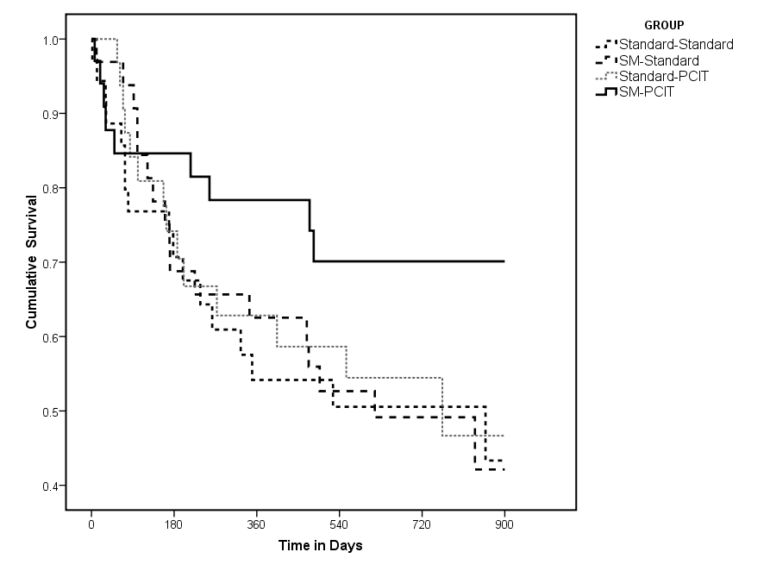
Some New PCIT Findings

Slide 32
Menu of Services
Home-based family preservation
  Also a common CW service
  Not a great track record of benefit to date, but not all bad either, and an area of significant ongoing scientific work
  Focal problems: Preventing imminent removal, environmental neglect, health and safety problems, basic caregiving skills

Slide 33
Menu of Services
TF-CBT and related CBT models
  For internalizing child problems (PTSD, depression, etc.)
  Short-term, good evidence of benefit
  Currently, around 80% of sexually abused children are referred (compared to around 40% with a clinical level elevation); only 20% of physically abused are referred (compared to same 40% with a clinical elevation)

Slide 34
Treatment Resistant Cases?
What are the response trajectories among parents in CW services
Again, analysis of over 2100 parents receiving home-based CW services
Pre-treatment, post-treatment, followup
Identified different services change trajectories, related to chronicity

Slide 35
Service Response
Prior
Events
Class
ψp²
Ф_{Δ}
Ф_{Δ1}²
∆l y1
Ф_{Δ2}²
∆ ly2
β₁
1
β₂
1
Ф₁²
ly1
1
ly2
1
ly3
1
λ_{b}
λ_{c}
λ_{d}
1
λ_{b}
λ_{c}
λ_{d}
1
λ_{b}
λ_{c}
λ_{d}
Ya1
Yb1
Yc1
Yd1
Ya2
Yb2
Yc2
Yd2
Ya3
Yb3
Yc3
Yd3
ψa²
ψb²
ψc²
ψd²
ψa²
ψb²
ψc²
ψd²
ψa²
ψb²
ψc²
ψd²
Baseline
Post-Treatment
Follow-Up

Slide 36
Service Response Classes

Slide 37
Service Response
Child welfare service planning is based on an episodic service model
  A case comes in
  Services are delivered
  The case exits
  Rinse and repeat
Episodic services models are a mismatch with chronic, unresponsive or relapsing conditions

Slide 38
Chronic Cases
Unresponsive Cases
  By definition, do not respond much to services (so forget about throwing more services at the case)
  But, may be helped and more stretched-out monitoring, management, stepped-care or harm-reduction approaches
Rapid Relapse Cases
  Might suggest booster approaches

Slide 39
Chronic Cases
Who would provide the sorts of harm-reduction, monitoring or booster services?
  Probably not child welfare—too married to the episodic service model
  Primary care, schools, community services programs, prevention networks
How would they engage clients?
Who would pay for it?

