Slide 1








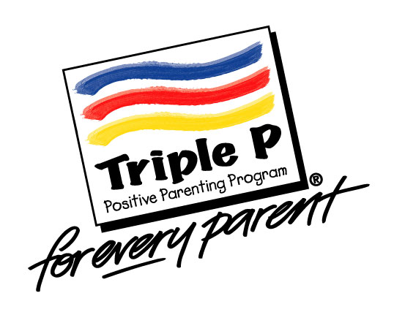
Triple P – Positive
Parenting Program
Suzanne Kerns, Ph.D.
Assistant Professor
Division of Public Behavioral Health and Justice Policy
University of Washington

Slide 2
Goals for Today
What is Triple P?
  Overview of the Triple P Positive Parenting Program
  Brief overview of research base
Moving beyond managing misbehavior: Program components that may be particularly helpful for youth in foster care
Common elements: Common elements across evidence-based parenting interventions
Q&A

Slide 3
What is Triple P?
Overview of the Triple P Positive Parenting Program
Brief overview of research base

Slide 4
Triple P – Positive Parenting Program
Based on 30+ years of research and implementation
Developed by Dr. Matt Sanders and colleagues
  U. of Queensland
Addresses a wide range of parenting strategies
  Programs available for children birth-16
California Evidence-Based Clearinghouse for Child Welfare:
  Triple P Scientific Rating= Level 1 Well-supported, effective practice (highest rating).
  Relevance to Child Welfare= Level 2 (likely applicable)
Notes:
Matt Sanders is affiliated with the Parenting and Family Support Centre at the University of Queensland
Note – the rating of 2 for Child Welfare was made prior to the study in South Carolina. This rating indicates that the intervention appears to be applicable for children in the child welfare system but has not yet been explicitly tested on this sample. The South Carolina study found a positive impact for families involved in various aspects of the child welfare system, including decreases in out of home placements and CPS referrals, and a favorable impact on hospitalization rates for intentional injury.

Slide 5
What makes TRIPLE P unique?
Public health model of a parenting intervention
Suite or coordinated system of evidence based programs (not a single program):
  Multi-level programs of increasing intensity
  Parenting across developmental periods from infancy through adolescence
  Based on core principles of positive parenting, which provides continuity
Information available at: www.triplep.net
Notes:
Main points:
Public Health model – intended to address issues of ‘reach,’ to be available to all families at the time when they could most benefit from services, preferably at the earliest indications of problem behavior.
Suite of programs – Triple P is most efficient and cost effective when the full range of intervention services are available, from prevention through intervention. The key here is that there is a synergy between the levels of intervention, so that families experience continuity when needing to use different intensity levels.

Slide 6
What makes TRIPLE P unique?
Blending of universal and targeted programs
Uses self-regulatory framework
Can be flexibly delivered in multiple settings, by different types of service providers
Notes:
Self-regulatory framework – the idea here is that professionals and the families with whom they work are the best problem solvers. Goal directed behaviors are most effective when they are self-initiated. The self-regulatory framework provides a structure for Triple P practitioners and their families to continually challenge themselves and work towards fully achieving their goals.
Flexibility of settings and providers – There are no requirements that Triple P be delivered in an office setting. While many practitioners do use it in that way, many also use it as a home visiting model or within other settings (such as schools or faith-based organizations) that parents typically gather. Additionally, there are no hard and fast educational or vocational requirements to be a Triple P provider. Trainees often come from a range of disciplines, including social work, nursing, education, outreach workers, psychologists, family counselors, etc.

Slide 7
Levels of Intervention
Universal Triple P
Level One
Selected Triple P
Level Two
Primary Care Triple P
Level three
Standard Triple P
Level four
Enhanced Triple P
Level five
Notes:
There are five ‘levels’ of Triple P, that vary in intensity and potential for reach.
1. Universal Triple P
Media-based parenting information campaign
2. Selected Triple P
Information/advice for a specific parenting concern
3. Primary Care Triple P
Narrow focus parenting skills training
4. Standard/Group/Self-Directed Triple P
Broad focus parenting skills training
5. Enhanced Triple P
Behavioral family intervention

Slide 8
Child Welfare: Supporting the needs of foster parents
Applications across all levels of the Triple P system:
  Some foster/adoptive parents need a lot of intervention
  Some need a little
  Some need information only (at most)
Many challenges faced by foster parents are addressed by the parenting strategies that are useful to all parents
  Parenting programs may not solve every emotional or behavioral issue
  The skills and strategies remain useful and can help stabilize situations and create more harmonious living arrangements
Difficult to avoid the stresses associated with separation from family of origin; however, can reframe challenges into treatment targets
Notes:
RP

Slide 9
Principle of Sufficiency
A key public-health concept driving Triple P:
What is the “minimally sufficient” intervention needed to address and solve the problem at hand?
  Meets family needs
  Avoids creating dependence
  Cost efficient, better able to disseminate to the population
Notes:
Key point – minimally sufficient means that the families needs are met with the lowest level of program intensity. Not only is this the most cost effective delivery model, but it makes the most clinical sense. It avoids creating dependence and encourages independence from professional involvement.

Slide 10
Intervention Impact on Family Functioning
Parents/caregivers get on better with their children
More positive interactions with their children
More confident in their parenting role
More realistic expectations of children
More consistent with discipline
Less likely to blame child
Less negative
Less verbally and physically abusive

Slide 11

Parents/Caregivers Function Better
Better communication over parenting
More resilient in coping with adversity
Better quality of life
Function better at work
Less conflict with partners
Less stressed, depressed, angry

Slide 12

Children benefit greatly from growing up in a more positive, harmonious family
Higher quality of family life
Improved self esteem
More sociable with peers and siblings
More cooperative
Fewer internalizing symptoms (worry, anxiety)
Fewer conduct problems
Fewer ADHD symptoms
Less at risk for substance abuse

Slide 13
Triple P – Positive Parenting Program
Promote social competence and emotional regulation in children
Core principles
  Ensuring a safe, engaging environment
  Promoting a responsive learning environment
  Using assertive discipline
  Maintaining reasonable expectations
  Taking care of oneself as a parent

Slide 14
17 Specific Parenting Skills
Promoting a
positive
relationship
Brief quality time
Talking to children
Affection
Teaching new skills
and behaviors
Modeling
Incidental teaching
ASK, SAY, DO
Behavior charts
Specific
skills
Managing misbehavior
Ground rules
Directed discussion
Planned ignoring
Clear, calm instructions
Logical consequences
Quiet time
Time out
Encouraging
desirable
behavior
Praise
Positive attention
Engaging activities
Notes:
These are the specific parenting skills that are emphasized within Triple P. Depending on the level of intervention, families may or may not learn all of these skills.

Slide 15
Other Variants of Triple P
Program for parents of young children with developmental disabilities
  Stepping Stones
Enhancement program for parents who have abused or at elevated risk to abuse
  Pathways
Programs for parents of teenagers
  Selected Teen, Primary Care Teen, Standard Teen, & Group Teen
Notes:
In addition to the ‘standard’ suite of services, several program variants have been developed to address the unique needs of parents who have children with developmental delays, who either have or at risk for abusing their children, and parents of teenagers. There are several more program variants under development, and they will become available once the evidence-base for their effectiveness has been established.

Slide 16
Other Parenting Skills
Stepping Stones (for children with developmental delays)
  Providing other rewards
  Setting up activity schedules
  Using physical guidance
  Teaching backwards
  Using diversion to another activity
  Teaching children to communicate what they want
  Blocking
  Using brief interruption
Pathways (for parents at risk for child abuse and neglect)
  Identifying and understanding parent traps
  How to get out of a parent trap
  Understanding anger
  Coping with anger
Notes:
Here are some examples of other skills or concepts that are introduced in other Triple P program variants. Stepping Stones includes the basic parenting strategies but adds the skills listed on this slide to provide some specific ideas for common behavioral concerns of parents with children with developmental disabilities. The skills for Pathways Triple P include attribution retraining and anger management strategies, two areas found to influence parental propensity for abuse or neglect.

Slide 17
Specific Parenting Skills for Teens
Increasing desirable behavior | Descriptive praise Positive attention | Engaging activities
Developing a positive relationship | Spending quality time Talking together | Showing appropriate affection
Teaching new skills and behaviors | Setting a good example Coaching problem solving | Behavior contracts Family meetings
Managing problem behavior | Family rules Directed discussion Clear, calm requests | Logical consequences Acknowledging emotional behavior Behavior contracts
Dealing with risky behavior | Identifying risky situations Obtaining useful information Explaining concerns and risks | Risk reduction strategies Holding a review session Monitoring teenagers
Notes:
For teens, the specific parenting skills are adapted to be more developmentally appropriate. For example, because teens have more cognitive abilities, strategies for teaching new skills include a focus on problem solving. While star charts and stickers are no longer developmentally appropriate, more appropriate behavior contracts are introduced to promote responsibility-taking and managing problem behavior.

Slide 18

Key flexibilities within Triple P model
Parent determines the specific goals for child and family
Provider uses examples that are consistent with the family’s circumstance and preferences
Triple P offers a menu of parenting strategies and facilitates the parent making informed choices
  Triple P has been successfully implemented across many cultural and ethnic groups, SES levels, countries, and languages
Notes:
Parent determines the specific goals for child and family: It is important to note, here, that it is largely parent-driven. The provider does not select the goals for the family, rather works in collaboration with the family to identify reasonable and realistic goals.
Provider uses examples that are consistent with the family’s circumstance and preferences: The training emphasizes flexibility on the part of the provider to offer relevant exemplars
Triple P has been successfully deployed across many cultural and ethnic groups, SES levels, countries, and languages

Slide 19
Multiple Delivery Formats of Triple P
Mass media communication
One-time parenting seminar (large group)
Brief and flexible consultation with individual parents
Program with small group of families
Self-directed program
Extended intervention with individual family
Notes:
Program with small group of families: typically 6-12 families
Self-directed: self-paced with a workbook
Extended intervention with individual family: This could be a 10-session, individualized intervention or, perhaps additional sessions to address specific family needs, such as coping.

Slide 20
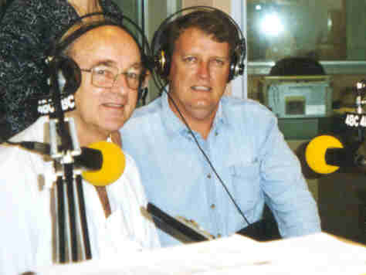
Level 1: Universal Triple P
Print
  Newspaper editorials/features, positive parenting column, posters, brochures
Television
  Current affairs stories, 15-30 sec positive parenting CSAs, television news coverage
Radio
  Interviews, 1-2 minute CSAs, weekly call-in shows
Internet
  Parent direct web sites, e-journals
Notes:
Level 1: Universal Triple P
Universal Triple P aims to use health promotion and social marketing strategies to:
promote the use of positive parenting practices in the community;
increase the receptivity of parents toward participating in the program;
increase favourable community attitudes toward Triple P and parenting in general;
increase the visibility and reach of parenting and family support services; and
counter alarmist, sensationalized, or parent-blaming messages in the media.
This level of intervention involves using health promotion and social marketing strategies to make available to parents information about how they can promote their child’s development and deal with commonly encountered behaviour issues, many of which are best viewed as part of normal development.
Information may be accessed through a community wide media strategy that includes the use of print, television and other electronic media to increase community awareness, acceptance and support for the importance of parenting. The aim of this level of intervention is to facilitate parents' access to information about how to deal with common child-rearing issues.
A carefully planned media campaign has the potential to reach a broad cross section of the population and to mobilize community support for the initiative. For some families, a brief universal exposure to parenting and family support messages is all the participation they will have in the system.
A Triple P promotional campaign is coordinated locally by a Triple P coordinator. Promotional materials can include:
Press releases, newspaper columns on Triple P dealing with common parenting issues and topics of general interest to parents (52 are currently available).
Printed advertising materials (e.g., posters, brochures, business cards, coffee mugs, positive parenting t-shirts, fridge magnets).
Local television current affairs stories, brief positive community service announcements (CSAs).
Local radio interviews, brief community service announcements (forty 60-second audio sound capsules on positive parenting are currently available).
Parent-direct web sites and email newsletters.

Slide 21
Level 2
brief, selective intervention
Level 2 Options
Seminar Series
Birth-12
Teen
Individual Support
Birth-12
Teen

Slide 22
Level 2: Selected Triple P
(Individual Support)
Brief parenting consultation through many settings
Anticipatory developmental guidance
Brief consultation format (e.g., 10 mins)
  clarify problem / explain resources / tailor information to family
  possible brief follow-up
Invitation to return if more intensive services are indicated
Notes:
Level 2: Selected Triple P
The Level 2 parenting information and support strategy involves primary care professionals (such as general practitioners and child health nurses / health visitors), who are in regular contact with families, having periodic discussions with parents about developmental and behavioral issues, and providing parents' with access to information about how to cope with specific child-rearing issues.
Parenting tip sheets and videos can be used as part of anticipatory developmental guidance provided by the practitioner. Agencies can display available resource material to prompt parents to request information from their practitioner.
Information is provided within a brief consultation format (one or two 10-minute sessions), which clarifies the presenting problem, explains the materials and tailors the information to the family’s needs. Families are invited to return for further help if they have any difficulties.

Slide 23
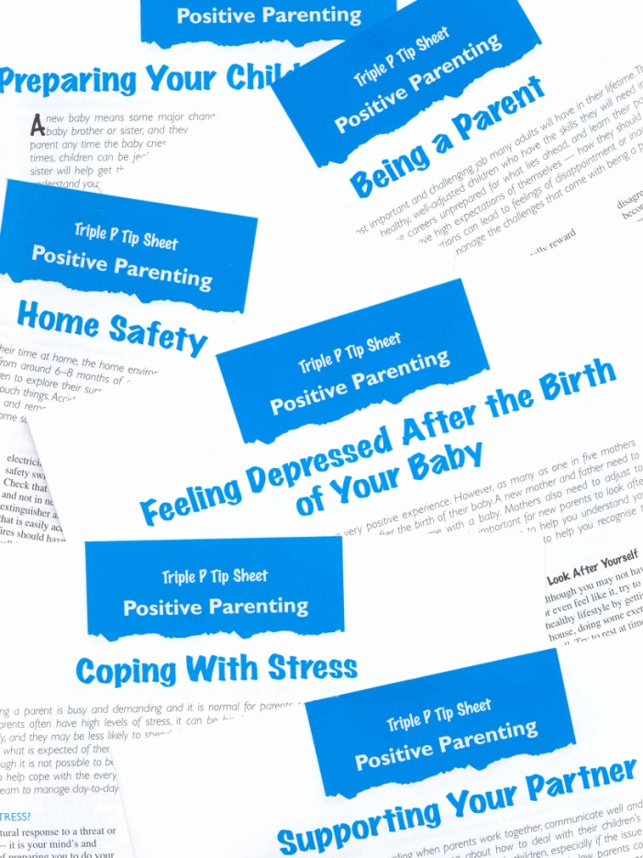

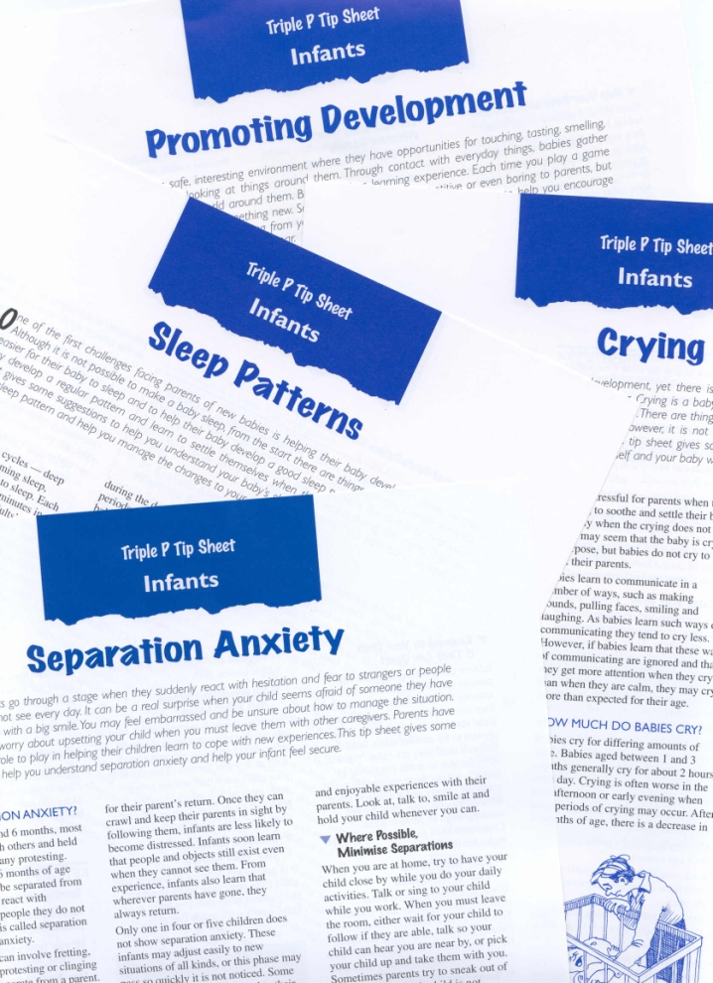
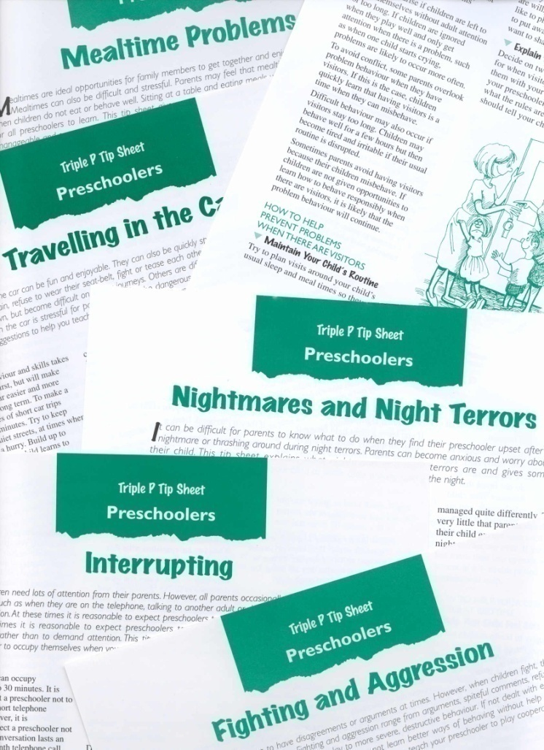
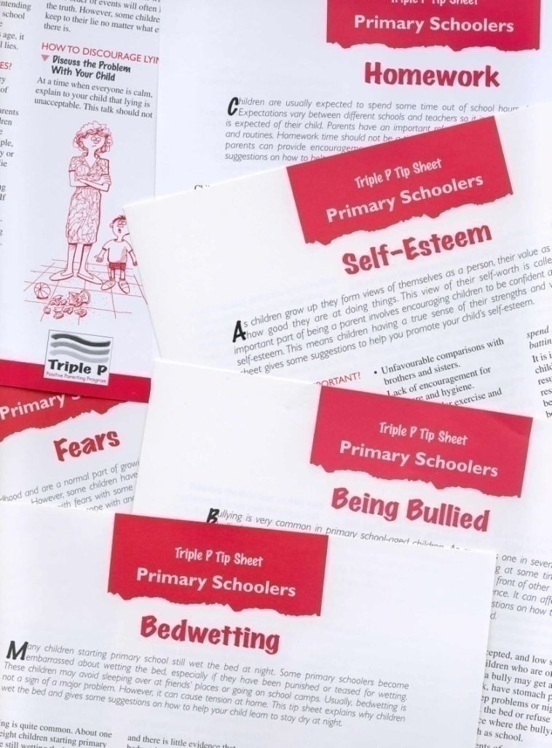
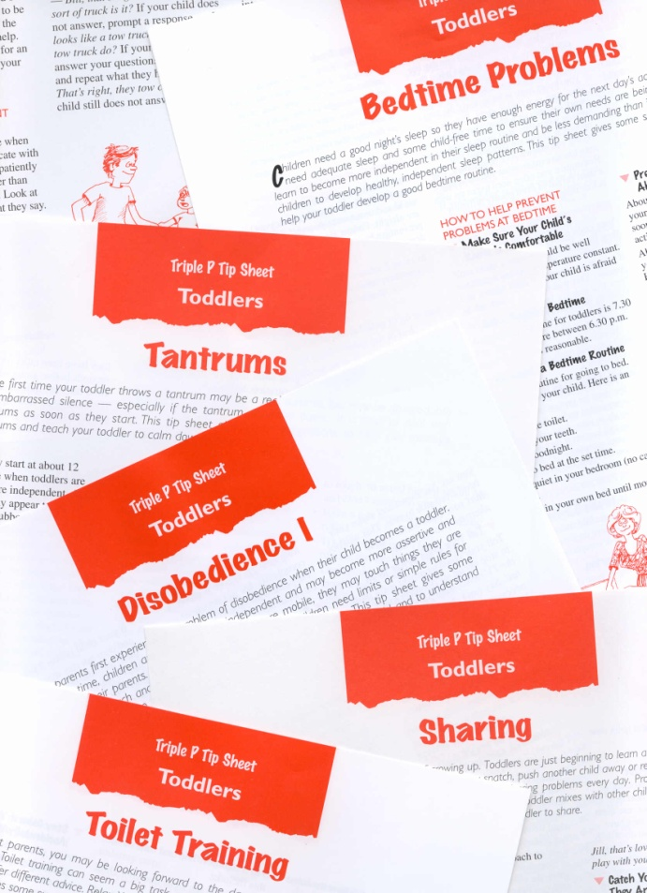
Notes:
Here are some examples of the tip sheets and Positive Parenting brochure that may be given to parents receiving a level 2 Triple P intervention.
Tip sheets are specific to common behavioral problems and are organized to be developmentally relevant (e.g., a tip sheet for infants might introduce ideas for promoting healthy sleeping patterns, a tip sheet for preschoolers might address whining or interrupting, and a tip sheet for school-age children might address bedwetting or how to help with homework)

Slide 24
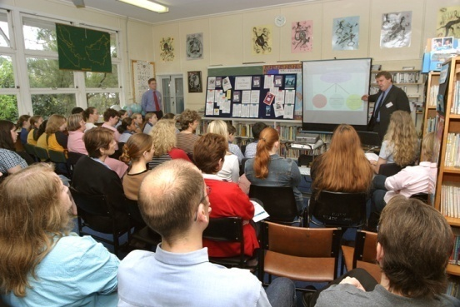
Level 2: Selected Triple P
(Seminar Series)
Seminar 1
The Power of
Positive
Parenting
Seminar 2
Raising
Confident,
Competent
Children
90 minute large group
parenting seminars
Invitation to return
Seminar 3
Raising
Resilient
Children
Notes:
The parenting seminar series is designed for large groups of parents who are interested in receiving information about the power of positive parenting, raising confident, competent children, and raising resilient children. While many families find these seminars to be useful and informative in their own rite, for many it raises their awareness and motivation to seek assistance for child behavior challenges that they are having difficulty managing on their own.

Slide 25



Level 2: Selected Triple P Teen
(Seminar Series)
Seminar 1
Raising
Responsible
Teenagers
Seminar 2
Raising
Competent
Teenagers
Seminar 3
Getting
Teenagers
Connected
Notes:
The seminars for Selected Teen are responsive to the evolving parenting demands of raising teens.

Slide 26
Benefits of brief-consultation interventions
Early detection
Consultation about developmental issues
Prevent parenting difficulties based on what the parent identifies as child issues
Brief behavioral counseling for child behavioral/emotional problems
Referral to specialized services if needed
Notes:
Early detection: of significant deviations from normal development
Provision of consultation to parents seeking information about developmental issues
Opportunity to prevent parenting difficulties based on what the parent identifies as child issues
Provision of brief behavioral counseling for child behavioral/emotional problems
Referral of moderate to severe child behavior problems to specialized services
Benefits of primary care intervention
Primary care services refer to those services and programs that have wide reach in the community and are therefore readily accessible to parents. They traditionally include maternal and child health services, health visitors, family doctors, childcare centers, kindergartens, preschools, schools and other community agencies which offer parent support.
These services are well positioned to provide preventively oriented parenting programs because parents use them frequently, see them as credible sources of information about children, and do not associate them with the stigma often attached to seeking specialist mental health services. For example, family doctors and teachers are the most likely source of professional assistance sought by parents of children with behavioral and emotional problems (Sanders et al., 1999).

Slide 27
Level 3
narrow focus parent consultation and training
Level 3 Options
Primary Care
Birth-12
Teen
Primary Care Stepping Stones

Slide 28
Level 3: Primary Care Triple P
Practical consultation for discrete behavioral or developmental issues
May involve active skills training procedures
Four 15-30 minute consultations
  Nature and history of problem / monitoring
  Formulation / parenting plan / obstacles
  Review / rehearsal / new parenting plan
  Follow-up / trouble shooting
Referral to (or provision of) more intensive intervention if appropriate
Notes:
Level 3: Primary Care Triple P
This level of intervention involves four 15-30 minute consultations with the parent/s. This information-based strategy incorporates assessment of the presenting problem, identification of possible causes of the presenting problem, and the selective use of parenting tip sheets and video resources covering common developmental and behavioral problems of preadolescent children .
Level 3 interventions may also incorporate active skills training procedures such as behavioral rehearsal. This involves modeling and then coaching parents in the implementation of specific parenting strategies or routines using rehearsal, constructive feedback, and goal setting.
In the first session the history and nature of the presenting problem are clarified (through interview and direct observation), goals for the intervention negotiated and a baseline monitoring system set up to track the occurrence of problem behaviors.
Session 2 involves a review of the initial problem to determine whether it is still current; discussing the results of the baseline monitoring, including the parent/s’ perceptions of the child’s behavior; sharing with the parent/s conclusions about the nature of the problem (i.e. the diagnostic formulation) and its possible etiology; and negotiating a parenting plan (using a tip sheet or designing a planned activities routine). This plan may involve the introduction of specific positive parenting strategies through discussion, modeling or presentation of video segments. This session also involves identifying and countering any obstacles to implementation of the new routine by developing a personal coping plan with each parent. The parent/s then implement the program.
Session 3 involves monitoring the family’s progress and discussing any implementation problems, it may also involve introduction of additional parenting strategies and more intensive active skills training exercises. The aim is to refine the parents’ implementation of the routine as required and provide encouragement for their efforts.
Session 4 involves a progress review, trouble shooting for any difficulties the parent/s may be experiencing, positive feedback and encouragement, and termination of contact.
If no positive results are achieved after 4–6 weeks, the family may be referred to a higher level of intervention.

Slide 29
Level 4
broad focus parent training
Level 4 Options
Group Triple P
Birth-12
Teen
Stepping Stones
Standard Triple P
Birth-12
Teen
Stepping Stones

Slide 30
Level 4: Standard Triple P
Broad focus parent skills training (office or home)
Active skills training
Generalization enhancement strategies
10 sessions
  Assessment and feedback
  Causes of children’s behavior problems
  Positive parenting strategies
  Practice
  Planned activities for high-risk settings
  Maintenance
Notes:
Level 4: Standard Triple P
This 10 session program incorporates sessions on causes of children’s behavior problems, strategies for encouraging children’s development, and strategies for managing misbehavior. Active skills training methods used in the sessions include modeling, rehearsal, feedback, and homework tasks. Segments from Every Parent’s Survival Guide [video] may be used to demonstrate positive parenting skills.
Several generalization enhancement strategies are incorporated into the program (e.g. training with sufficient exemplars, training loosely) to promote the transfer of parenting skills across settings, siblings and time.
Home visits or clinic observation sessions are also conducted in which parents self-select goals to practice, are observed interacting with their child and implementing parenting skills, and subsequently self-evaluate their progress toward meeting their goals, as well as receive feedback from the practitioner.
Further sessions in the clinic then cover identifying high-risk situations and developing planned activities routines. Finally, maintenance and relapse issues are covered.
Sessions last about 60 minutes each (with the exception of practice which should last about 40 minutes each).

Slide 31
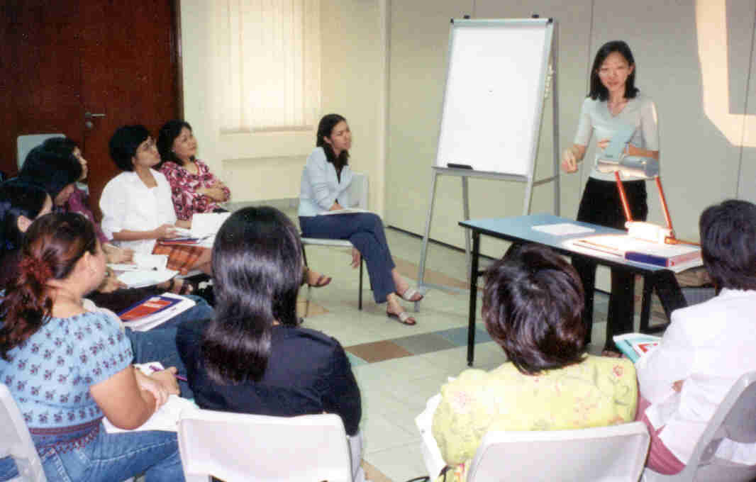
Level 4: Group Triple P
Groups of ~10-12 parents
Active skills training in small groups
8 session group program
  4 x 2 hour group sessions
  3 x 15-30 minute telephone sessions
  Final group / telephone session options
Supportive environment
Normalize parenting experiences
Notes:
Level 4: Group Triple P
Group Triple P is an eight session program, ideally conducted in groups of 10–12 parents. It employs an active skills training process to help parents acquire new knowledge and skills.
The program consists of four 2 hour group sessions which provide opportunities for parents to learn through observation, discussion, practice and feedback. Segments from Every Parent’s Survival Guide [video] are used to demonstrate positive parenting skills. These skills are then practiced in small groups.
Parents receive constructive feedback about their use of skills in an emotionally supportive context. Between sessions, parents complete homework tasks to consolidate their learning from the group sessions.
Following the group sessions, three or four 15-30 minute follow-up telephone sessions provide additional support to parents as they put into practice what they have learned in the group sessions.
Although delivery of the program in a group setting may mean parents receive less individual attention, there are several benefits of group participation for parents. These benefits include support, friendship and constructive feedback from other parents as well as opportunities for parents to normalize their parenting experience through peer interactions.
Population trial results –
$A250 per child (excluding evaluation costs)
If applied at a population level it would result in a 37% decrease in severe conduct problems in children

Slide 32
Level 5
intensive family intervention
Level 5 Options
Enhanced Triple P
Pathways Triple P

Slide 33

Level 5: Enhanced Triple P
Adjunct to Level 4 Triple P
Review and feedback
Negotiation of additional modules tailored to family’s needs
  Additional Practice Module
  Coping Skills Module
  Partner Support Module
Maintenance and closure
Notes:
Level 5: Enhanced Triple P
Following participation in a Level 4 program, families requesting or deemed to be in need of further assistance may be invited to participate in this individually tailored program. This level extends the focus of intervention to include home-based skills training, mood management and stress coping skills for parents, and marital communication skills as required.
The first session is a review and feedback session in which parents' progress is reviewed, goals are elicited and a treatment plan negotiated. Three enhanced individual therapy modules may then be offered to families individually or in combination: Home Visits, Coping Skills and Partner Support.
Each module is ideally conducted in a maximum of three sessions lasting up to 90 minutes each (with the exception of home visits which should last 40-60 minutes each). Within each additional module, the components to be covered with each family are determined on the basis of clinical judgement and needs identified by the family (i.e. certain exercises may be omitted if parents have demonstrated competency in the target area).
All sessions employ an active skills training process to help parents acquire new knowledge and skills. Parents are actively involved throughout the program with opportunities to learn through observation, discussion, practice and feedback. Parents receive constructive feedback about their use of skills in an emotionally supportive context. Between sessions, parents complete homework tasks to consolidate their learning.
Following completion of the individually tailored modules, a final session is conducted which aims to promote maintenance of treatment gains by enhancing parents' self-management skills and thus reduce parents’ reliance on the clinician.

Slide 34


Brief Overview of Research

Slide 35
Building an evidence base
Criteria for gauging strength of evidence | Supporting evidence
Efficacy trials have been conducted using i) randomized controlled trial (RCT) methodology ii) a series of single case experiments | 29 peer-reviewed publications 11 peer-reviewed publications
Effectiveness trials have been conducted under conditions of usual service delivery that demonstrate positive outcomes for children and parents | 9 peer-reviewed publications
Dissemination trials have been conducted demonstrating successful transfer of skills to service providers | 6 peer-reviewed publications

Slide 36
Triple P – Positive Parenting Program
Numerous randomized clinical trials
Studies conducted on each intervention level and delivery format with consistent results
Average effect sizes large
  .92 for improved child behavior
  .77 for improved parenting style
Notes:
Triple P and the strategies and tools within the program have benefitted from extensive research across a range of populations and within multiple different treatment contexts. Reliable findings include those listed on this and the subsequent slides.
Across studies, findings reveal that participation in Triple P results in:
Increases parenting skills
Decrease in parental stress and depression
Decrease in child maltreatment
Decrease in child injuries
Decrease in out-of-home placements
Decrease in child behavior problems
Increases parent anger management skills
Decreases social isolation

Slide 37
Prevention of child maltreatment:
U.S. Triple P System Population Trial
Funded by the CDC
  Ron Prinz and Matt Sanders, Principal Investigators
Primary outcomes: Indicators of prevention of child maltreatment
  Substantiated child maltreatment cases
  Out of home placements
  Hospitalization for intentional injury
Conducted independently from the child welfare system, but had an impact on subsequent involvement
Notes:
RP

Slide 38
Population-level Trial
18 participating counties randomized to:
  9 received the Triple P system
  9 continued with usual services
Trained 697 service providers across multiple settings
  daycare and preschools; mental health system; social services system; elementary schools; churches; NGOs (e.g., First Steps, Prevent Child Abuse); healthcare system
Made Triple P readily accessible to parents throughout the communities through a range of different strategies
Coordinated media strategies with concurrent program delivery

Slide 39
Results from US Population Trial
Prevent child maltreatment under periods of stress
Prinz et al., 2009
Notes:
In this slide, the Triple P counties stayed fairly level while the control counties experienced increases in CM.
SO ON THIS SLIDE I WOULD ADD THAT “IN THE US POPULATION TRIAL CONDUCTED…..” TO HELP THEM MAKE THE TRANSITION….FROM THEIR PROBLEM TO “OUR” SOLUTION.

Slide 40
Prinz et al., 2009
Notes:
For out of home placements and intentional injuries, prevalence rates in Triple P counties decreased while prevalence rates in control counties increased.

Slide 41
Research on Cultural Acceptability
Continually evolving area
Research to date indicates high levels of acceptability and satisfaction across diverse families.

Slide 42
Connecting Communities Project
Brisbane, Australia
Cultural background of participating parents
Caucasian Australian | 27.9%
South-East Asian | 24.3%
European | 12.5%
African | 10.3%
Pacific Islander | 9.6%
Southern/Central Asian | 7.4%
South/Central American | 3.7%
Middle Eastern | 2.9%
North-East Asian | .7%
Notes:
Connecting communities project being run in Brisbane.

Slide 43
Acceptability of Triple P parenting strategies

Slide 44
How acceptable are Triple P parenting strategies for practitioners?
Notes:
Here practitioners had not done triple p training, asked to review the different strategies
CALD – English as a second language
The practitioners who say that this won’t work with my family

Slide 45
Parenting and important developmental outcomes
Parental influence is pervasive
Language, communication
Sustained attention and problem solving
Social skills and peer relationships
Physical health and well being
Emotion regulation
School achievement
Brain injury and adverse effects of exposure to violence
Reduced social, emotional, behavioral and health problems

Slide 46
Moving beyond managing misbehavior
Importance of developing a positive relationship
Power of positive reinforcement
Strategic use of planned ignoring
Teaching new skills
OVERVIEW OF SOME OF THESE SKILLS……

Slide 47



Developing a Positive Relationship

Slide 48


Tips for building a positive relationships
Quality time
Talking with your child
Showing affection

Slide 49

Quality Time
Occurs in brief moments a few times during the day
Parents stop what they are doing
Parents focus on what their child is doing
Let him/her take the lead
Parents find something to compliment their child on
Show enthusiasm

Slide 50
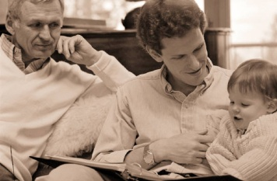
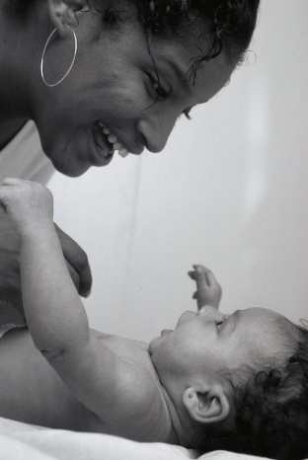
Talking with your child
Ask questions about their day or something they are interested in
Tell your child about something important or interesting to you
“Running dialogue”
Research shows that children’s accomplishments at age 9 can be predicted by:
  Children’s language accomplishments at age 3 (rate of vocabulary growth, vocabulary use and IQ)
  Early family experience (feedback tone, symbolic emphasis, and guidance style) were even better predictors than child’s early accomplishments
  These factors were more important than how much money the family made or other socioeconomic factors
Hart & Risley (1995)

Slide 51




Showing affection
Can include:
  Hugs, snuggles, high five, pat on the back, wink, holding hands, a million others!
Appropriate affection may depend on:
  Culturally appropriate expressions
  Child age
  Setting
Goal is to express warmth and teach children to give and receive affection

Slide 52


Power of Positive Reinforcement

Slide 53
Child Behavior Graphs
Amount
of Child
Behavior
?
?
?
?
?
?
?
?
?
?
“OK”
Behavior
“NOT OK”
Behavior
“OK”
Behavior
“NOT OK”
Behavior
Current Situation
Desired Situation
McMahon & Forehand: Helping the Noncompliant Child

Slide 54
B is for behavior
Kids are always behaving!
  But… are they behaving ‘OK’ or ‘not OK’?
What are the behaviors you want to see less of?
  Whining
  Quitting a game when they know they are going to lose
  Saying ‘no’ all the time
Identify behaviors you want to see more of
  Speaking in a pleasant voice (not whining)
  Being a good sport
  Complying with requests

Slide 55
C is for consequence
If it is a behavior you want to see more of…
  Praise, praise, praise
    Specific and descriptive
  Consider reasonable rewards, especially at first
  Star charts for lower-frequency behaviors
If it is a behavior you want to see less of…
  Set a reasonable consequence and stick with it
  Consider logical consequences most often
  Consider time out as needed
  Timing is important

Slide 56
Then, hopefully….
“OK”
Behavior
“NOT OK”
Behavior
New Situation
McMahon & Forehand: Helping the Noncompliant Child

Slide 57

When to use planned ignoring
Annoying but not dangerous behaviors
Behaviors where attention is the main purpose
Examples:
  Whining
  Minor tantrums
  “Baiting”
Helps avoid parenting traps (escalation, coercive interactions, accidental reinforcement)
Needs to be paired with positive attention for desirable behaviors (often, opposite of examples above)

Slide 58
Video
Planned Ignoring

Slide 59

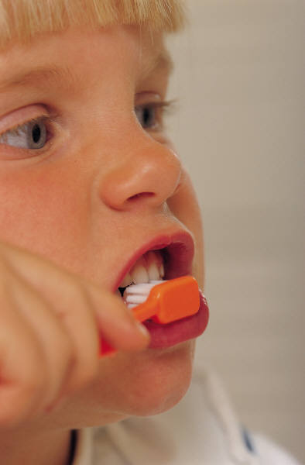
Teaching new skills and behaviors
Sometimes ‘misbehavior’ or frustrating behavior is a result of the child not having the skills
Strategies for teaching new skills and behaviors help slow things down and set children up for success
Examples of such strategies include:
  Ask Say Do
  Modeling
  Incidental Teaching
Notes:
Could be used for social skills such as playing nicely, using good manners
or for living skills such as brushing teeth, cleaning their room
Or for academic skills such as completing homework or figuring out answers to questions

Slide 60
Video
Incidental Teaching

Slide 61
A word about Time Out
Time Out Context
Has been used and misused, stakes are high!
General principle:
High
Low
Context behavior occurred
“Time In”
TO has no impact
OK behavior increases
High
Not OK behavior increases
TO has no impact
Low

Slide 62
Other Key TO Principles
Reinforce keeping it calm, firm and consistent
Briefly explain to the child why they are going to time out and for how long
  Shorter times work just as well (if not better) than longer times
Don’t negotiate or let the child out of the consequence
Don’t let them out of TO if they are still upset or are misbehaving
Avoid ‘double jeopardy’
Ideally, give the child another chance for success right afterwards.
If TO was given for ‘non-compliance,’ be sure to make the request again and praise for compliance.
  TO is not a strategy for children to get out of doing things they don’t want to do

Slide 63
Common Evidence-based Parenting Interventions
 | Triple P | PCIT | Incredible Years | Helping the Non-compliant Child | Defiant Child
Individual/ Group | Group/Indiv | Indiv | Mostly Group | Indiv | Group/Indiv
Performance Criteria | No | Yes | No | Yes | No
Child Present | Partial | Partial | No | Yes | No/Partial
Booster Sessions | No | Yes | No | No | Yes
Empirical Support | Yes | Yes | Yes | Yes | Minimal
Partially reproduced from McMahon & Forehand, 2003

Slide 64
Common elements across established evidence-based parenting interventions
Primary focus on enhancing positive parent-child relationships
  Positive interactions (child-focused play, warmth and affection)
  Increase use of positive reinforcement (praise/rewards)
  Ignore minor misbehavior (pick your battles)

Slide 65
Common elements across established evidence-based parenting interventions
Managing misbehavior
  Consider both antecedents and consequences
A
B
C
Antecedents:
What happens before your child complies/does not comply
Behavior: Compliance or non-compliance with request or rules
Consequences: what happens after your child complies/does not comply

Slide 66
A
Antecedents:
What happens before your child complies/does not comply
Giving effective instructions
Consideration for setting
Tone of interaction

Slide 67
C
Consequences: what happens after your child complies/does not comply
Praise/reward positive behavior
Logical consequences or Time Out for misbehavior

Slide 68
Back to Triple P
Clarifying some common misperceptions of the Triple P program
Notes:
RP

Slide 69
Misconceptions:
Triple P is solely a home-visiting program
In reality:
Triple P can be delivered in flexible settings, such as…
at a clinic
in the home
at a school
in a non-clinic community location
Notes:
RP

Slide 70
Misconception:
Triple P is not appropriate for severe levels of problematic parent-child interactions
In reality:
Triple P reduces coercive patterns of parent-child interaction (several studies have supported this)
More research is needed with regard to impact for children with severe levels behavioral or emotional problems
Notes:
RP

Slide 71
Misconception:
Triple P is too brief for families involved in the child welfare system
In reality:
  Some families need more, and some need less
  Triple P adopts the public health principle of minimal sufficiency
  Use of Triple P as the parenting intervention does not preclude:
    Longer –term, low level support
    Economic assistance
    Improvement of access to adequate food, shelter, healthcare, and education
Notes:
RP

Slide 72





Questions?

Slide 73
Thank you for your attention!
Suzanne Kerns, Ph.D.
sekerns@uw.edu
(206)685-2766

