Slide 1
Verbal De-escalation
Presented by: Rebecca Sauls, MSW

Slide 2

Welcome
^{Introductions}
^{Name/Pronoun}
What service do you provide in your organization?
Something interesting about you?
Notes:
2. What do you hope to get out of this training?

Slide 3
LEARNING OBJECTIVES

Slide 4
Learning Objectives
UNDERSTAND Verbal De-escalation and the escalation cycle
GROUND When is it a crisis and how to prepare as a caregiver?
DE-ESCALATE learn verbal, physical and general strategies for de-escalation
PHONE DE-ESC Learn to manage escalation over the phone

Slide 5
What is Verbal De-Escalation
A method of using verbal communication and body language to stabilize, slow or reduce the intensity of a conflict to prevent potential violence
communicating with an agitated person with the intent to understand, manage and resolve their concerns without use of physical force.
Notes:
https://www.nuemblog.com/blog/verbal-de-escalation
https://www.slideshare.net/mcchinmd/de-escalation-techniques
https://www.youthaodtoolbox.org.au/5-recognising-warning-signs-potential-aggressive-behaviour-violence
Relies on communication and interpersonal skills
recognizing subtle clues and intervening early.
Controlling the fear response
Easier said than done considering how scary these situations can be.
”it is important to understand the underlying reasons for the person feeling anger and potentially becoming violent.”
De-esc
Understand – the risk, yourself, the persons experience
Manage – yourself/model calm assertive compassion
Resolve – Provide the support available

Slide 6
Understanding Escalation

Slide 7
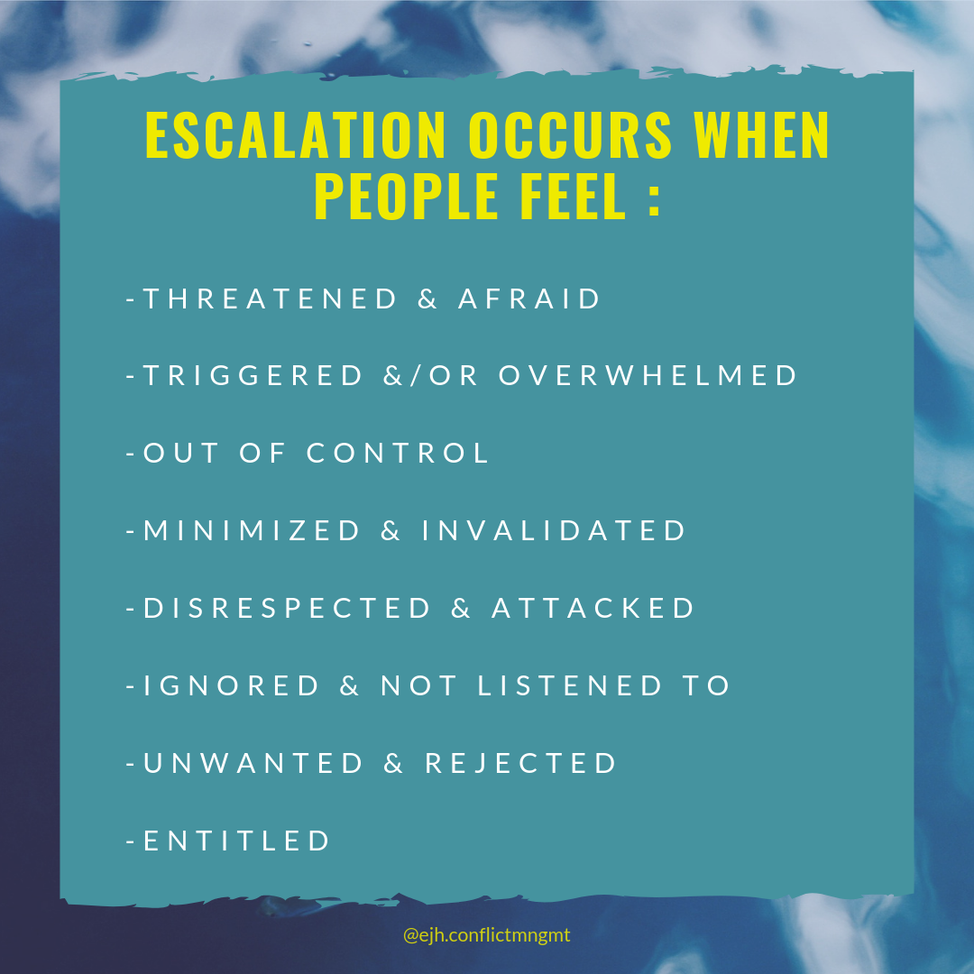
Notes:
http://eddiejudehareven.com/here-are-some-of-the-main-causes-of-escalation/

Slide 8
Signs of Escalation
Verbal
Behavioral
Unkept
Closed body language
Aggressive
Heavy breathing
Pacing
Fear (expression )
Sudden changed in behavior
Substance abuse
Raised voice/yelling/swearing
Mumbling to themselves
Threatening
Aggressive tone
Notes:
Signs of a disruptive human in Escalated state
Behavioral Cues
Unkept
Closed body language
Aggressive
Heavy breathing
Pacing
Trembling
Fear (expression )
Fixed face
Sudden changed in behavior
Substance abuse
Verbal Cues
Raised voice/yelling/swearing
Mumbling to themselves
Threatening
Aggressive tone

Slide 9
What are common triggers for escalation in the clients you work with?

Slide 10
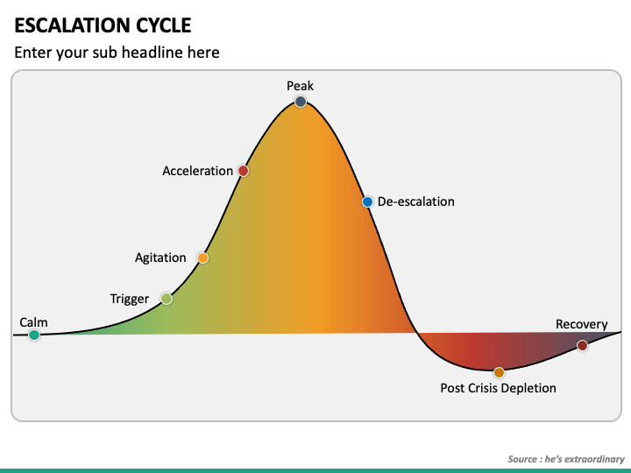
Notes:
https://www.sketchbubble.com/en/presentation-escalation-cycle.html

Slide 11
Before you engage - Grounded Caregiving

Slide 12
Before Engaging
Calm/ground yourself
Assess the environment for safety and exits
Remove bystanders or relocate the client
Use non-threatening body language (respect personal space)
Know your limits, triggers and warning signs
Ask for help when needed
disengage when you feel unable to manage your reactivity
Practice grounding techniques based on your crisis response
Process the experience and debrief with the appropriate people

Slide 13


Ground & Self-Regulate
Ground yourself!
3 deep breaths
Orient
Where are you?
What do you hear, smell, taste, see, touch (what are you sitting on)
Who are you?
Debrief with appropriate people
I have done all I can, and it is enough!

Slide 14


Slide 15
Types of Grounding
1. Mental (focusing your mind)
2. Physical (focusing your senses)
3. Soothing (talking to yourself in a very kind way)
List 3 grounding strategies you are committed to learning, practicing, and applying.

Slide 16

Deep Listening
Fully focus on the speaker
Set the intention to understand
Clarify / reflect / restate
Validate feeling
Avoid
Interrupting – keep lips closed – take notes
Suspend Judging
Sending Solutions
Avoiding uncomfortable emotions (changing the subject)

Slide 17
How does listening Help
to understand the persons’ story and experiences
Provides support (the person feels understood)
Fosters connection & builds rapport
Makes a person more receptive to guidance
Fosters empathy (understand and feel the pain)
and compassion (taking action to make a positive Impact)

Slide 18

Verbal Strategies for De-escalation
Tone – speak calmly withing being condescending
Volume – avoid raising your voice
Rate of speech – Speak at a slower soothing pace
Inflection – notice the words you emphasize and how they shift meaning
Notes:
Address the person by name (grounding)
Listen with curiosity
Find empathy (understanding

Slide 19
Mind your Body Language
Do’s
Don’t
Keep a relaxed and alert stance at an angle
Open body language and hand visible
Use slow and deliberate movement
Neutral and attentive facial expression
Stand directly in front of a person with ridged posture or turn your back
Pointing
Pace or fidget
Fake smile or expression
Allow physical space
Soften eye-contact
Notes:
https://www.cisa.gov/sites/default/files/publications/De-Escalation_Final%20508%20%2809.21.21%29.pdf

Slide 20
Notes:
https://www.sketchbubble.com/en/presentation-escalation-cycle.html

Slide 21
CALM – baseline behavior safe to talk and problem solve
TRIGGERED –experiences that evoke uncomfortable emotions
AGITATION – warning signs present, rational reasoning is decreasing, coping skills needed
ACCELERATION – behaviors intensify,
PEAK/CRISIS – Highly disruptive and dangerous

Slide 22
When is it a Crisis?

Slide 23
01
CRISIS TYPES
Developmental | results from normal life changes
Puberty
Leaving Home
Marriage
Childbirth
Retirement
Situational | results of unexpected trauma
Loss
Illness
Being Displaced
Lack of Resources to meet demand

Slide 24


Slide 25
crisis
A disruption or breakdown in a person’s or family’s normal or usual pattern of functioning. A crisis cannot be resolved by a person’s customary problem-solving resources/skills.
stressful situation
difficulty in coping
the timing of intervention.
Each crisis situation is unique and will require a flexible approach to the client and situation.
Notes:
https://www.dshs.wa.gov/book/export/html/490#:~:text=Definition%20of%20a%20Crisis%3A%20A,a%20problem%20or%20an%20emergency

Slide 26

De-Escalation Explored
De-escalation – Calming, provide space
Post-Depletion – Rest – self-soothing
Recovery – Debrief, return to task

Slide 27

De-escalation strategies

Slide 28
De-escalation
REMAIN CALM
AVOID JUDGEMENT (EMPATHIZE)
RESPECT PERSONAL SPACE
USE NON-THREATING NONVERBALS
FOCUS ON FEELING
AVOID POWER STRUGGLES (agree where possible)
BE CONCISE
SET LIMITS
CHOOSE WISELY WHAT YOU INSIST UPON
ALLOW SILENCE FOR REFLECTION & DECISION MAKING
Crisis Prevention Institute’s Top 10 De-Escalation Tips
Notes:
In 2012 the American Association for Emergency Psychiatry offered a consensus statement on verbal de-escalation and created ten key domains to guide care of agitated patients. These domains offer a great framework for how to approach the agitated patient before the situation escalates [7].
https://www.youtube.com/watch?v=MOeuoNP-fyQ
https://www.crisisprevention.com/en-CA/Blog/CPI-s-Top-10-De-Escalation-Tips-Revisited
Be Empathic and Nonjudgmental Do not judge or be dismissive of the feelings of the person in distress. Remember that the person’s feelings are real, whether or not you think those feelings are justified. Respect those feelings, keeping in mind that whatever the person is going through could be the most important event in their life at the moment.
Respect Personal Space Be aware of your position, posture, and proximity when interacting with a person in distress. Allowing personal space shows respect, keeps you safer, and tends to decrease a person’s anxiety. If you must enter someone’s personal space to provide care, explain what you’re doing so the person feels less confused and frightened.
Use Nonthreatening Nonverbals The more a person is in distress, the less they hear your words—and the more they react to your nonverbal communication. Be mindful of your gestures, facial expressions, movements, and tone of voice. Keeping your tone and body language neutral will go a long way toward defusing a situation.
Keep Your Emotional Brain in Check Remain calm, rational, and professional. While you can’t control the person’s behavior, how you respond to their behavior will have a direct effect on whether the situation escalates or defuses. Positive thoughts like “I can handle this” and “I know what to do” will help you maintain your own rationality and calm the person down.
Focus on Feelings Facts are important, but how a person feels is the heart of the matter. Yet some people have trouble identifying how they feel about what’s happening to them. Watch and listen carefully for the person’s real message. Try saying something like “That must be scary.” Supportive words like these will let the person know that you understand what’s happening—and you may get a positive response.
Ignore Challenging Questions Engaging with people who ask challenging questions is rarely productive. When a person challenges your authority, redirect their attention to the issue at hand. Ignore the challenge, but not the person. Bring their focus back to how you can work together to solve the problem.
Set Limits As a person progresses through a crisis, give them respectful, simple, and reasonable limits. Offer concise and respectful choices and consequences. A person who’s upset may not be able to focus on everything you say. Be clear, speak simply, and offer the positive choice first.
Choose Wisely What You Insist Upon It’s important to be thoughtful in deciding which rules are negotiable and which are not. For example, if a person doesn’t want to shower in the morning, can you allow them to choose the time of day that feels best for them? If you can offer a person options and flexibility, you may be able to avoid unnecessary altercations.
Allow Silence for Reflection We’ve all experienced awkward silences. While it may seem counterintuitive to let moments of silence occur, sometimes it’s the best choice. It can give a person a chance to reflect on what’s happening, and how they need to proceed. Silence can be a powerful communication tool.
Allow Time for Decisions When a person is upset, they may not be able to think clearly. Give them a few moments to think through what you’ve said. A person’s stress rises when they feel rushed. Allowing time brings calm.

Slide 29
Verbal De-escalation is NOT
Stopping the person from being anger or feeling
Controlling the persons behaviors (you can influence behavior)
Not a physical model

Slide 30
Activity

Slide 31


Slide 32
de-escalation over the phone

Slide 33
The Conversation
Identify Purpose
Identify Support
Conversation
Closing
Summarize Call
Determine Follow up

Slide 34
02
The Conversation
Identify what support the caller is wanting based on how they communicate
Ventilation calls - Wants to be heard
Information and referrals - Wants the information requested
Life-threatening call - Risk of harm to themselves or others
Identify Purpose
Identify the caller’s purpose for calling
What is the ask?
Identify Support

Slide 35
The Conversation
Identify Purpose
Identify Support
Conversation
Closing
Summarize Call
Determine Follow up

Slide 36
02
The Conversation
The wrap up/termination/closing/empathic close
Ask how they feel?
Affirm for taking the step to get support
Conversation
Closing
Use verbal de-escalation skills
Notes:
Ask how they would close it. How do you close it?

Slide 37
The Conversation
Identify Purpose
Identify Support
Conversation
Closing
Summarize Call
Determine Follow up

Slide 38
02
The Conversation
Summarize Call
Determine Follow up
Review where the call started.
Report on progress
Identify self-care
Determine if you need follow-up with caller and if it’s appropriate to do so

Slide 39
Rebecca Sauls, MSW
Thank You!
QUESTIONS
training@rebeccasauls.com

