Slide 1


Be REAL
Megan Kennedy & Kizz Prusia
UW Resilience Lab
January 12, 2024 @ 10-11:30am
Notes:
3:15 – introduction by Monika

Slide 2

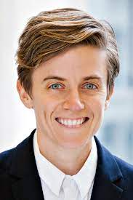
Today’s Presenters
Kizz Prusia, MPA
Megan Kennedy, MA, LMCH
Notes:
KP and MK

Slide 3
Learning Objectives
Participants will learn about the UW’s Be REAL program, including its content, delivery, and research.
Participants will be introduced to several examples of mindfulness, self-compassion, and cognitive-behavioral strategies from the Be REAL program.
Participants will learn how the Be REAL implementation strategy is successfully reaches under-represented student communities at the UW.

Slide 4
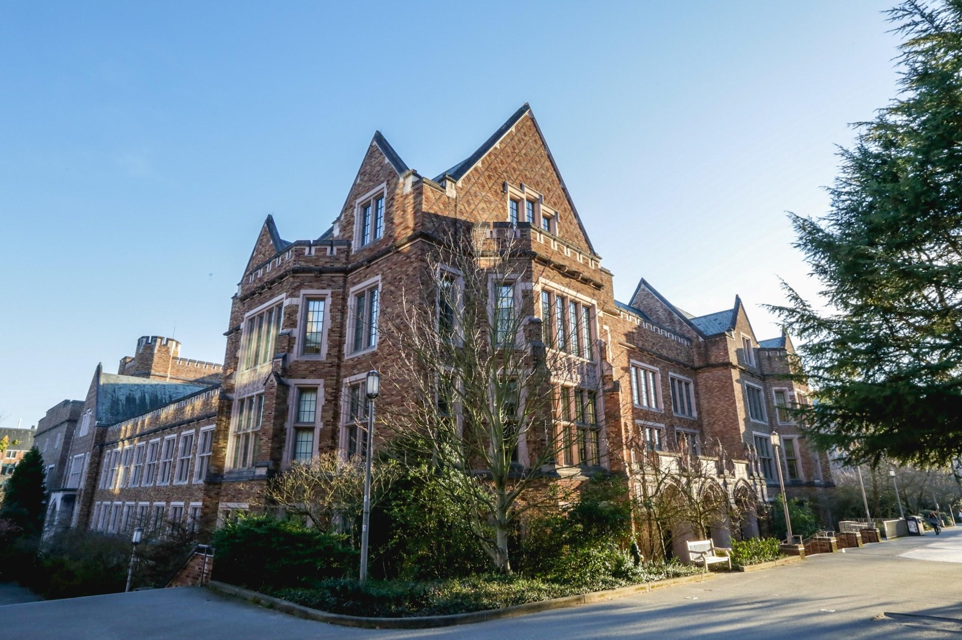
The UW Resilience Lab is promoting well-being at the UW through education, research partnerships, and our core programs and initiatives.
Notes:
MK

Slide 5

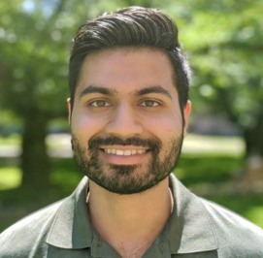
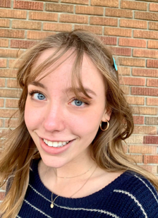





Student & Alumni Centered Vision
Notes:
MK

Slide 6
Redefining Resilience
Common definitions of resilience do not take into account the toll of racism and other forms of oppression.
People with marginalized identities are expected to be “tough” to deal with the systemic oppression that exists within institutions and organizations.
Focusing on stress-coping strategies alone only makes sense if we are addressing the conditions, factors, and structures that cause the stress in the first place.
Notes:
The first two points on this slide ae from: Reimagining Critical Race Theory in Education: Mental Health, Healing, and the Pathway to Liberatory Praxis by Ebony O. McGee and David Stovall in 2015.
MK

Slide 7
Redefining Resilience
The Resilience Lab is focused on initiatives that promote collective/organizational resilience (our ability to adapt and learn together); shifting the onus of responsibility from individuals to the whole system.
We are interested in building a culture of collective resilience – and resistance. One way we enact this is by applying contemplative practice (e.g., mindful awareness) to racial and environmental justice work. We also teach resilience-based practices to apply in one’s own life, as well organizationally.
The Resilience Lab leads through Collective Impact – a process for supporting a system to work interdependently toward common outcomes. Through this we provide pathways for constituents to co-envision and co-create a compassionate University. This requires that we learn strategies that support us to work really well together.
As such, we believe the way we work matters. We focus on leading in contemplative ways – individually and collectively – to support our ability to work on challenging adaptive issues and thrive.
Notes:
MK

Slide 8
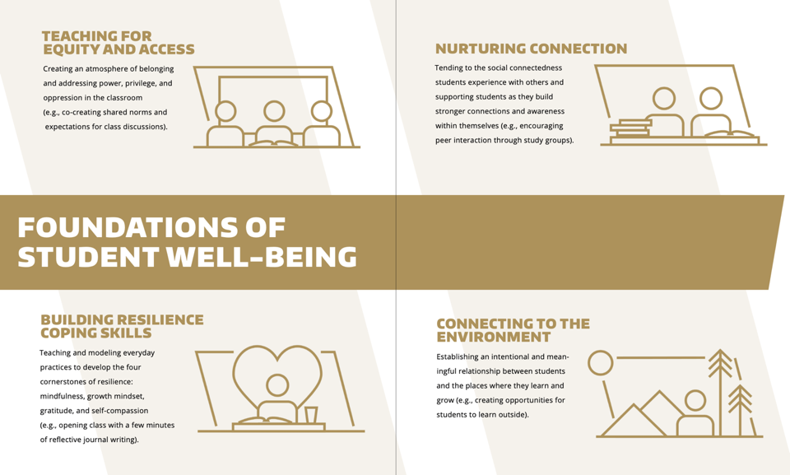
Notes:
How can skills and mindsets such as mindfulness, self-compassion, growth mindset, and gratitude support the resilience, focus, productivity, and sense
of connectedness of graduate students?
In this interactive session, UW Resilience Lab members will provide an overview of concepts and practices that promote resilience and well-being.
The workshop will include experiential components, time for question and answer, and resources for ongoing learning.
MK

Slide 9
Two theories that inform our leadership practice.
Notes:
MK

Slide 10
Systems Perspective
Self
Interpersonal
Group
Organization
Society
Notes:
MK

Slide 11
Adaptive Leadership
Technical problems often have a clear solution and can be solved by a few professionals.
Adaptive problems are usually vague and complex. These problems require input from a variety of people within the organization and often take longer to solve.
Notes:
MK

Slide 12
Share your reflections of the Resilience Lab’s framework. What thoughts - reactions, questions, connections – are coming up for you?
Notes:
3:20

Slide 13
Pause for Q&A

Slide 14






Center for Child & Family Well-Being (CCFW)
CCFW transforms innovative research in child and family well-being into practical solutions to ensure all children, youth and families are resilient and thriving.
Promoting Resilience & Well-Being
Supporting
Parents
Addressing Adversity & Inequity
Cultivating Mindfulness & Compassion
Dr. Liliana Lengua
Professor of Psychology
CCFW Director
Notes:
One of the benefits of the UW is its strong research focus – advantage of working there is partnering with research centers
Research focus; 2017 story
KP

Slide 15
Be REAL Skill Areas
Resilience + Well-being
Reducing Stress: Managing acute and chronic stress through contemplative practices
Coping with Challenging Situations: Learning strategies to change a situation or one’s response
Managing Emotions: Building skills and practices to become aware of and regulate emotions
Building Connections & Compassion: Cultivating kindness for others and ourselves
Notes:
KP

Slide 16
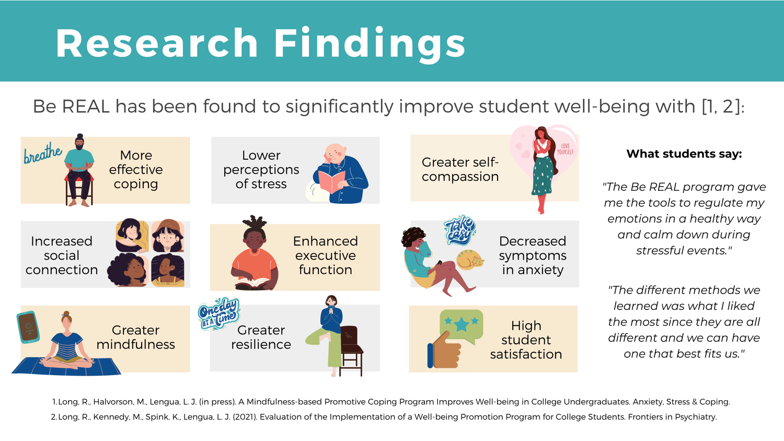
Notes:
KP

Slide 17
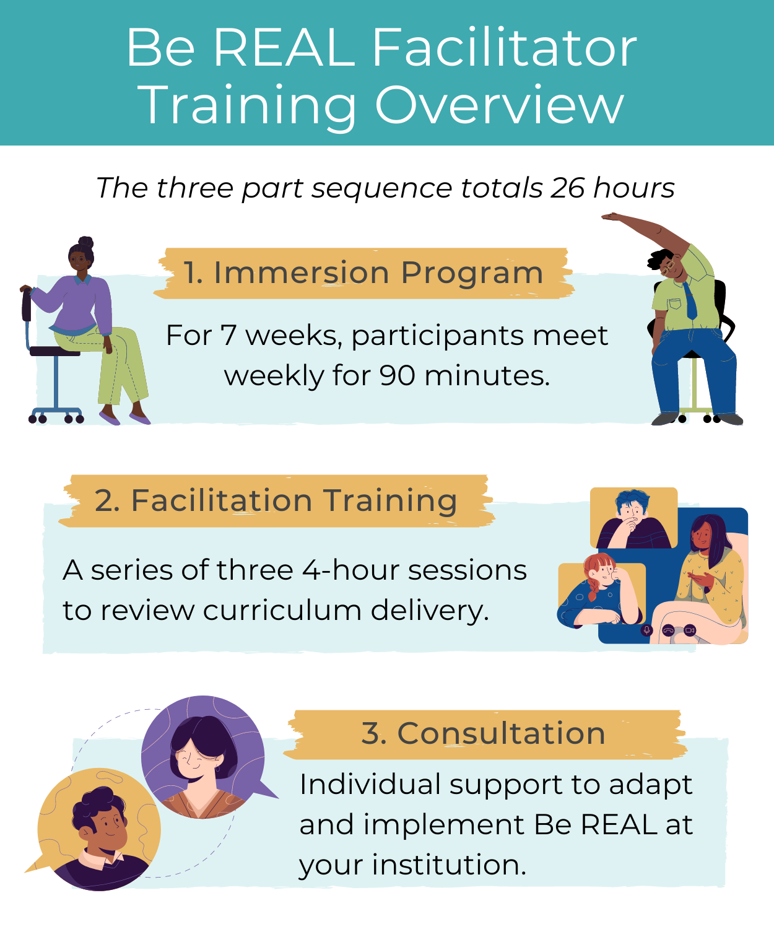
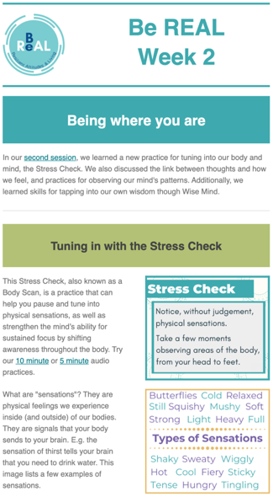
Notes:
Be REAL is designed to be delivered by University staff (non-clinical or clinical).
KP

Slide 18
Aspects of Be REAL
Be REAL aims to provide participants with tools to:
Tuning into oneself and tending to one’s emotions
Navigating challenging situations
Enhancing relationships with friends, family, and more
Building a culture of compassion among staff and students
Grounded in research from:
Mindfulness
Psychology
Neuroscience
Cognitive Behavioral Therapy
Dialectical Behavioral Therapy
Cultural Humility
Trauma Aware & Sensitive
Key Values
Culturally Inclusive & Affirming
Reciprocal Learning & Collective Wisdom
Responsive & Adaptive to Group Needs
Notes:
KP

Slide 19
Staff Professional Development and Well-Being
Be REAL consistently receives outstanding feedback from students and staff who report that it is supportive to their well-being and inclusive of their cultural and personal beliefs;
Staff report that Be REAL provides them with tools to manage the stress of working in educational settings, especially in the ongoing COVID pandemic;
Staff report feeling more competent in supporting students with the skills they gained from the program;
Be REAL provides staff with everything needed to immediately launch a group, including a fully scripted manual and professionally developed resources to support a variety of student learning needs.
Notes:
KP

Slide 20
Pause for Q&A

Slide 21
Be REAL: Mini-Module

Slide 22
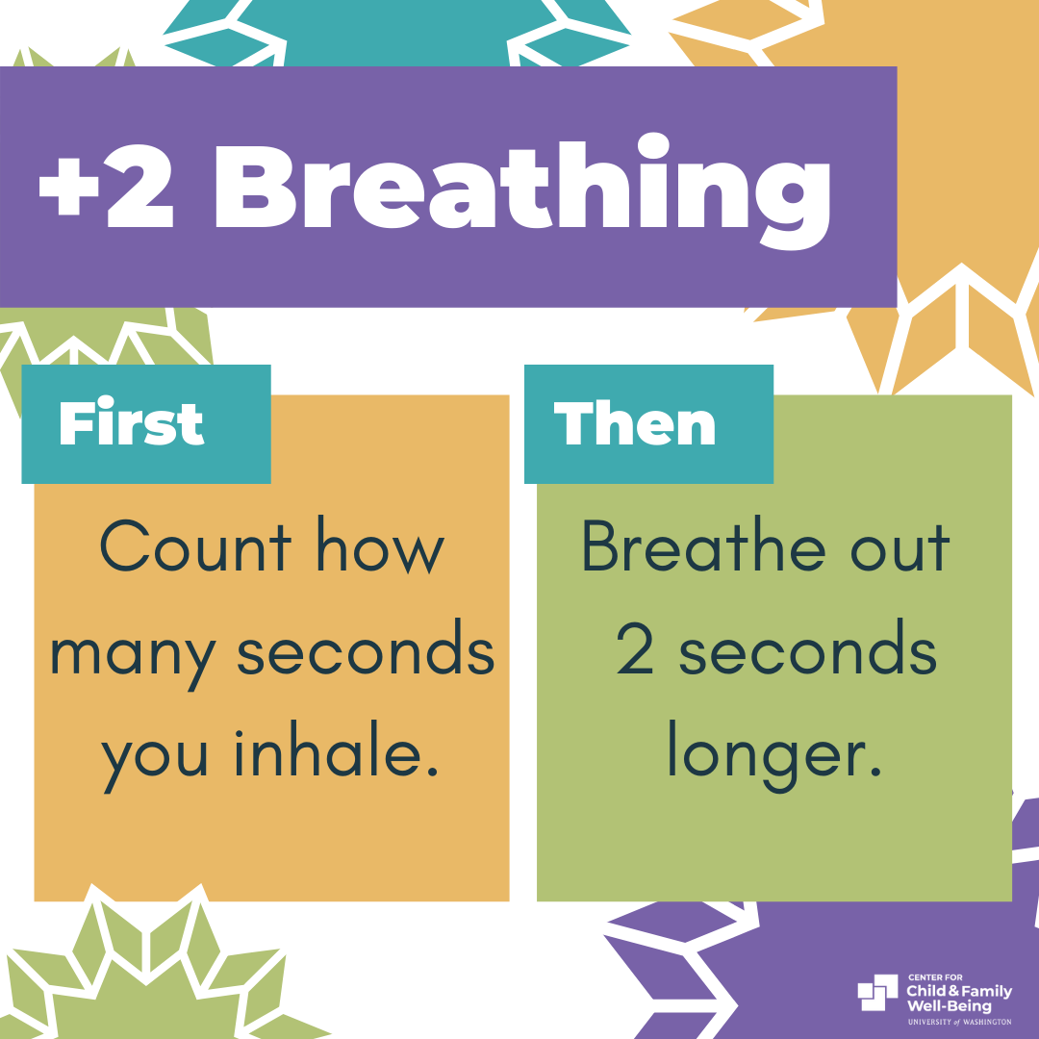

Slide 23
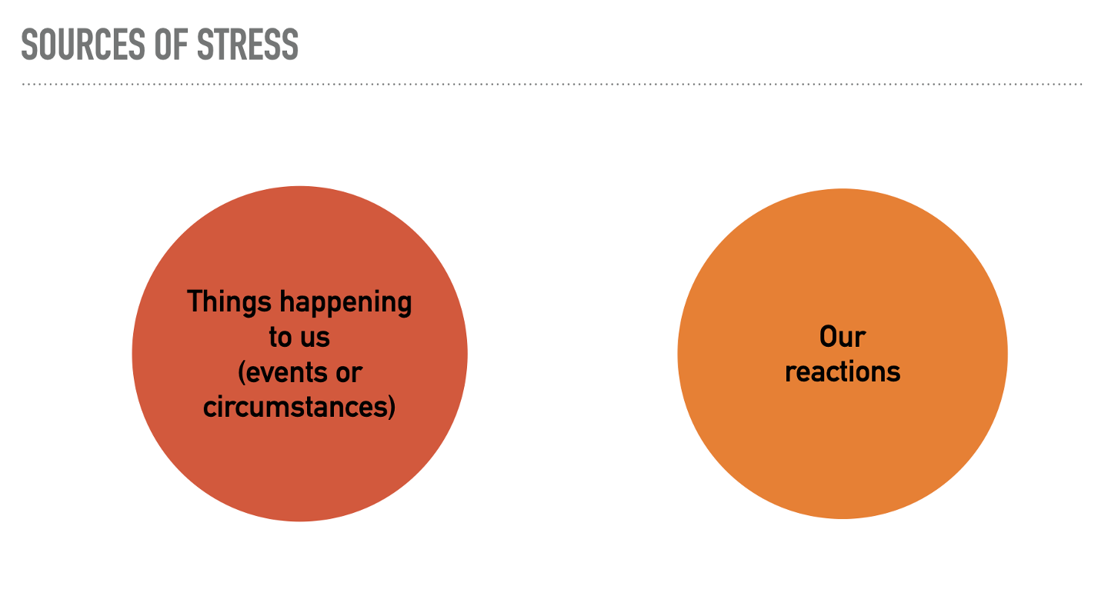

Slide 24
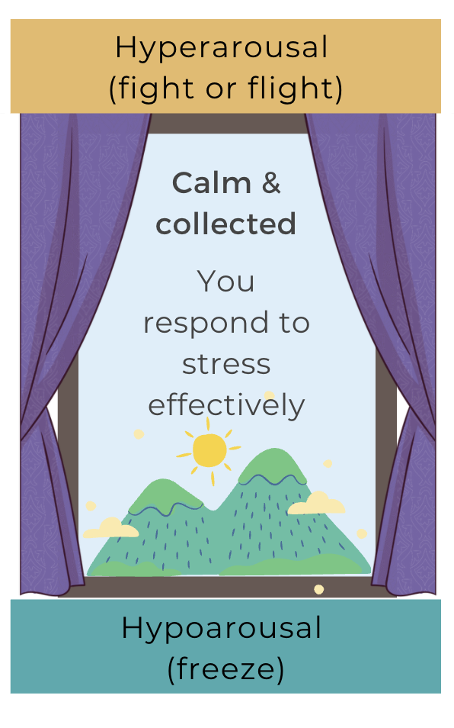
Hyper-aroused (fight or flight)
Automatic stress response
Hypo-aroused (freeze)

Slide 25
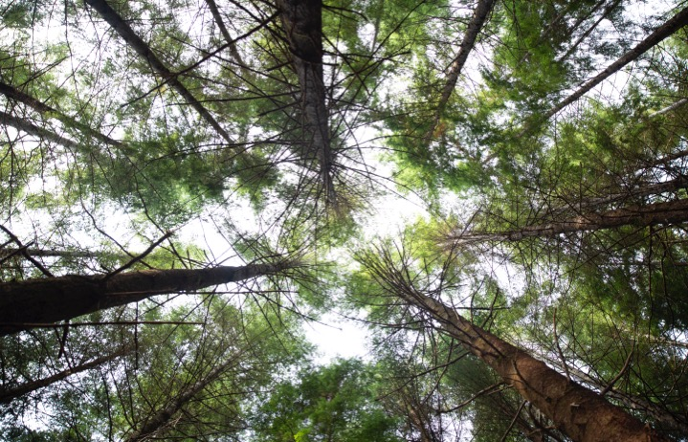
Mindfulness
“Between stimulus and response, there is a space. In that space lies our freedom and power to choose our response. In our response lies our growth and freedom.” Victor Frankl

Slide 26
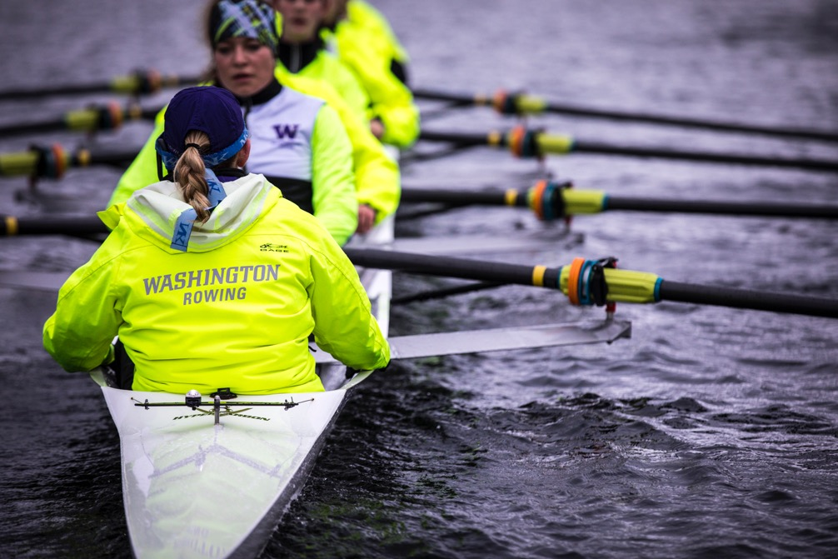
Mindfulness
Awareness of the present moment, with a kind and open attitude.

Slide 27
Mindfulness allows us to pause
Present Moment
Stop ruminating about the past
Stop worrying about the future
Tune into ourselves
Tune into students and each other
Awareness
Kind +
Curious
Compassionate with ourselves
Compassionate with others
Notes:
Mindfulness helps us accurately identify our emotions as they arise. (“Name it to tame it”
Mindfulness allows us to notice our thoughts, judgements, biases, inferences, stories, reels, etc..
Mindfulness makes way for understanding another’s point of view through listening, paraphrasing, attuning to feelings, and not jumping to solutions.

Slide 28


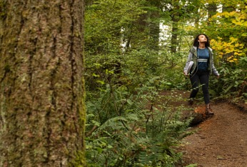

Mindfulness
Reflective
Breath
Sensory
Body

Slide 29
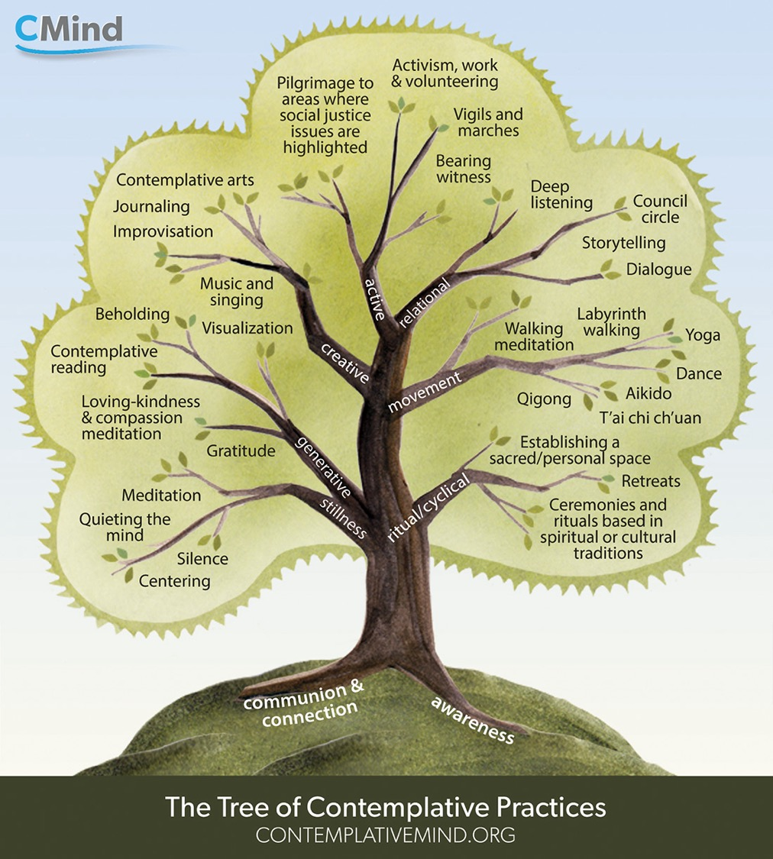

Slide 30
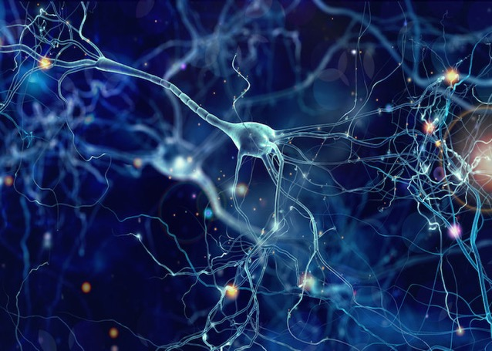
How does mindfulness work?
Neurons that
fire together,
wire together
Building new habits for resilience

Slide 31

Mindfulness in Organizations
Shifting from automatic pilot to a more aware state of being. Attending to your quality of presence (e.g., listening).
Scheduling time each day for short, intentional breaks.
Taking or inviting a “moment to arrive” at the beginning of meetings and closing meetings with intention.
Practicing concentration (e.g., focusing on one task, being present with others).
Zooming-out – or perspective-taking. Holding a more balanced perspective.
Maintaining daily/weekly reflective practice.

Slide 32

Having an “exquisite quality of presence” will interrupt the systemic oppression that we know is causing so much harm and can transform the trauma that is arising.
Laura van Dernoot Lipsky
Author: Trauma Stewardship

Slide 33

“We don’t always realize that we must work continuously to make real the promise of liberating human interrelationship. Even less often do we have the skills to do this work together. Indeed, we have lacked the consciousness necessary to see our potential together and to lift ourselves up to a new plane for being in relationship with one another in ways that do not depend on power-over, but rejoice in power-with.” (10)
Rhonda V. Magee
Professor, University of San Francisco
Author: The Inner Work of Racial Justice
Notes:
This quote from Rhonda V. Magee comes from an article from the Skoll Foundation in 2020 called, “Social change starts with personal justice: Rhonda Magee on the role of self-care in movement building.”
In early December the UWRL/CCDE brought Rhonda V. Magee to campus via livestream to talk about how mindfulness and compassion based practices can support us in addressing racism. Talk available on YouTube.
In her book, the Inner Work of Racial Justice, Rhonda talks about how mindfulness of thoughts, emotions, listening support that work.

Slide 34
Discussion Questions
How does mindfulness support your resilience to stress? How does mindfulness support your sense of connection to yourself and others?
How could mindfulness promote collective or organizational resilience?
Notes:
4:05pm (Facilitation: Kizz lead, MK back-up) – 10 minutes

Slide 35
Pause for Q&A

Slide 36
EXAMPLES & PRACTICE
With Kizz Prusia
Notes:
4:15 – Practices (Kizz as lead, MK model) – 15 minutes

Slide 37
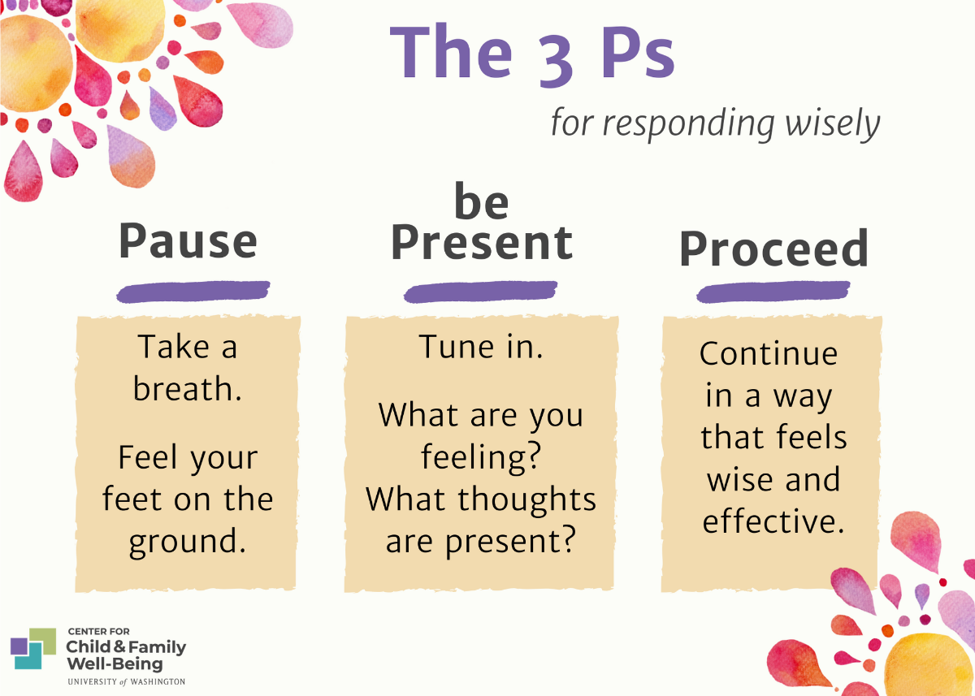

Slide 38
Discussion Questions
Share any observations about your experience in each of the practices. Is there a practice you would try again? In what setting (e.g., at home, at work, with colleagues)?
What other personal practices support your resilience to stress?
What personal practices could you imagine integrating at work?
What is one takeaway from today’s discussion (e.g., redefining resilience, stress response system, mindfulness, radical acceptance, etc.).
Notes:
4:30pm (Facilitation: Kizz as lead, MK as back-up) – 15 minutes

Slide 39
Be REAL: Implications for Work
Supports cultivating a work culture that is more spacious and adept at addressing stress – individually and collectively
Supports a culture of compassion and anti-racism
Be REAL skills, such as setting group norms and mindfulness, foster psychological safety (e.g., giving and receiving feedback)
Improves our interpersonal skills and ability to relate to others we work with

Slide 40
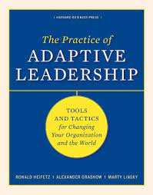
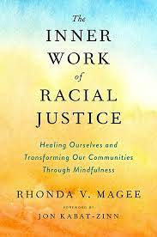
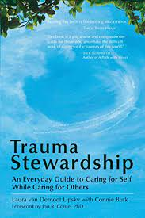
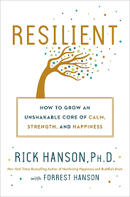
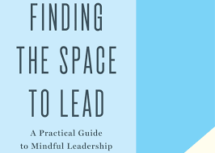

Mentioned Resources

Slide 41
Pause for Q&A

Slide 42




THANK YOU
uwreslab@uw.edu
@uwresiliencelab
@uwresilience
@uwresilience
wellbeing.uw.edu/unit/resilience-lab

