Slide 1
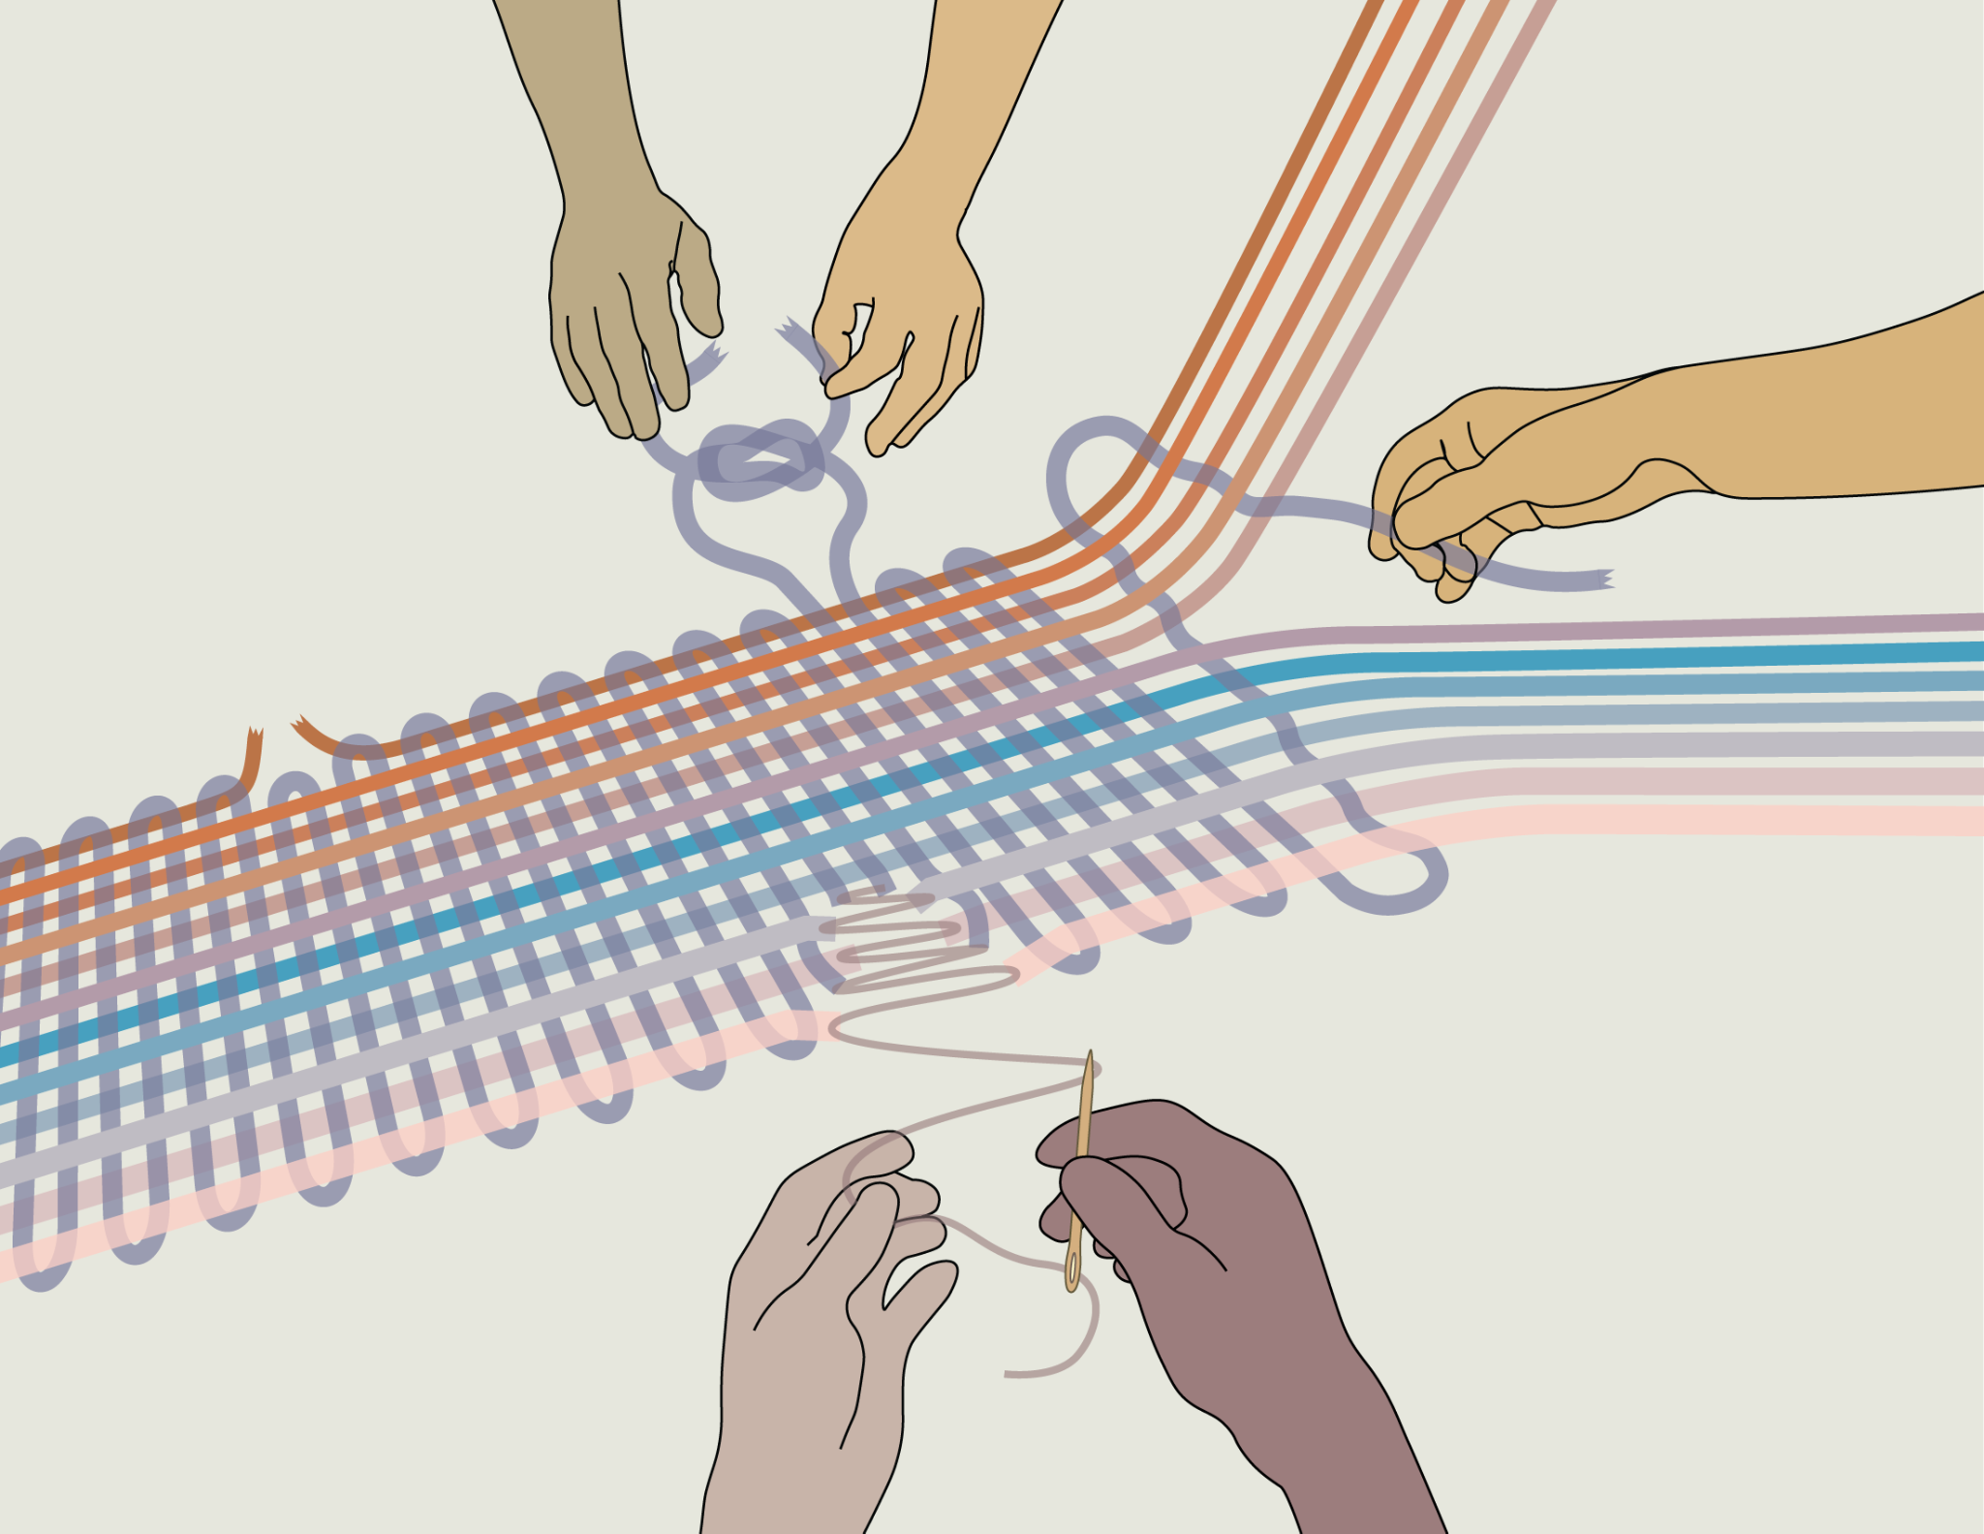
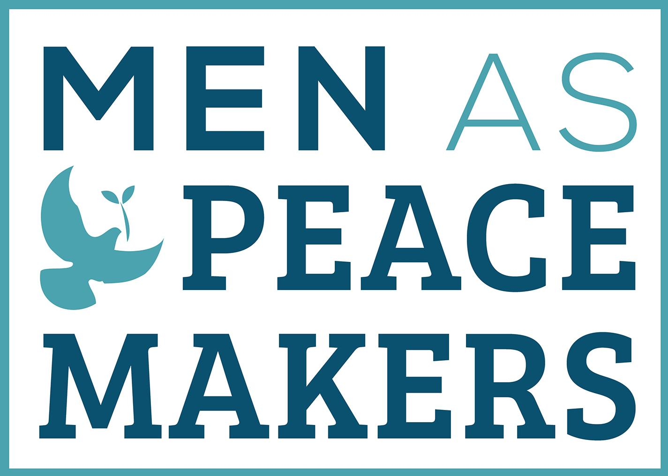
Sean Elmquist
Assistant Director of Training & Technical Assistance

Slide 2
weaving
Innovation
Prevention
Connectedness
Restorative
Intact Communities
Men As Peacemakers

Slide 3
weaving
Innovation
Prevention
Connectedness
Restorative
Intact Communities
Men As Peacemakers

Slide 4
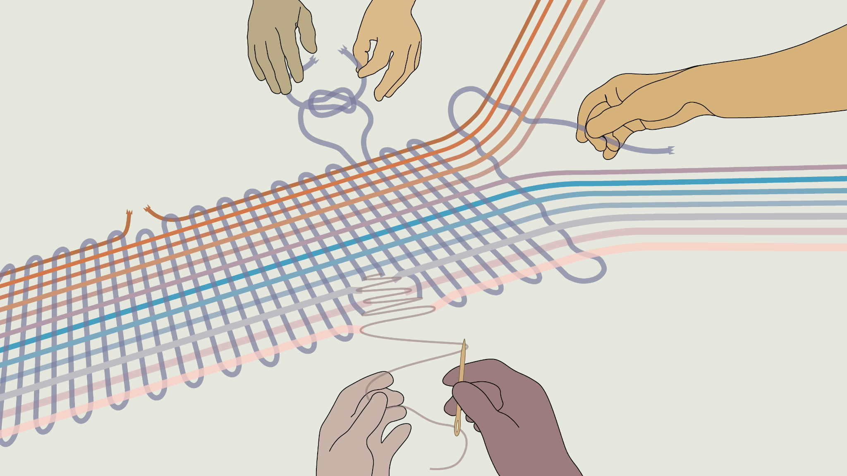
weaving
Innovation
Prevention
Connectedness
Restorative
Intact Communities
Men As Peacemakers

Slide 5
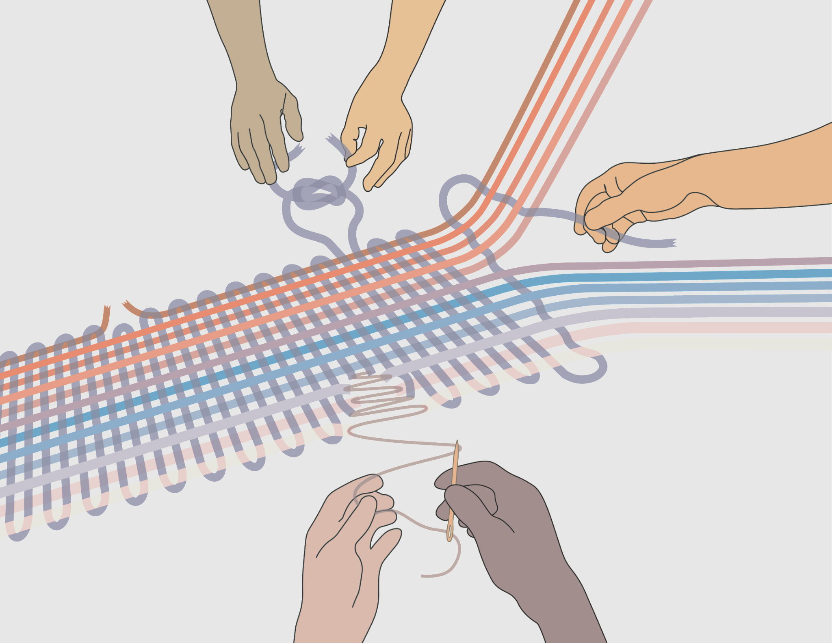
Innovation
Innovation
Prevention
Connectedness
Restorative
New Pathways to Community Healing
Community Mapping
The most effective solutions are not a checklist or curriculum, but rather, a process of engaging the elements of community that are intact, weaving together individual, organizational, and collective gifts and strengths, embedding community wisdom and healing traditions into best practices in prevention, advocacy, and restorative justice, centering those most impacted by violence, and together, building a holistic community of healing.

Slide 6
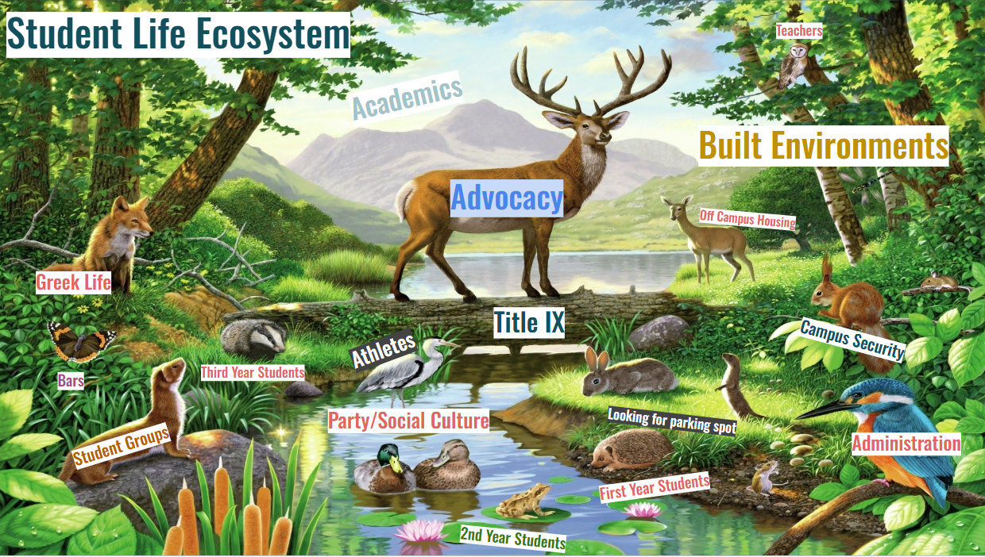
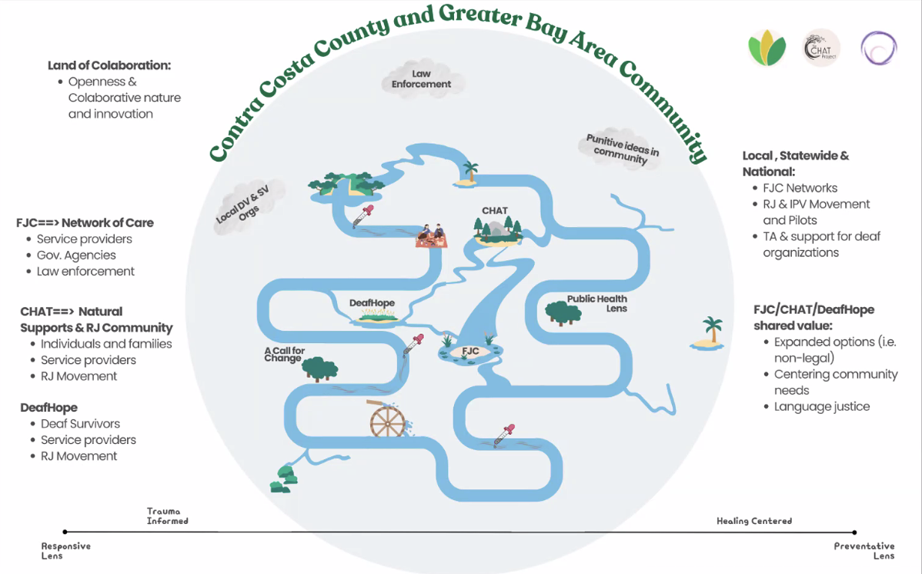
Innovation
Innovation
Prevention
Connectedness
Restorative
Community Mapping
In order to weave communities back together, build resilience and reduce alienation, we must innovate new strategies to build a holistic community of healing. In order to identify the elements of community that are intact, we must meet the community where they are at. This means working in partnership to identify key individuals and organizations to map out pathways to healing.

Slide 7
weaving
Innovation
Prevention
Connectedness
Restorative
Intact Communities
Men As Peacemakers

Slide 8
Prevention
Innovation
Prevention
Connectedness
Restorative
Weaving Resilience
Future Casting to Prevent Violence
Preventing violence requires navigating the present with both practical intentionality and a hopeful vision for the future. Weaving in response to the present moment, MAP works with communities to incorporate innovations derived from experience. A new pattern begins to emerge over time, creating the conditions for a safer, more resilient, and more tightly woven community.

Slide 9
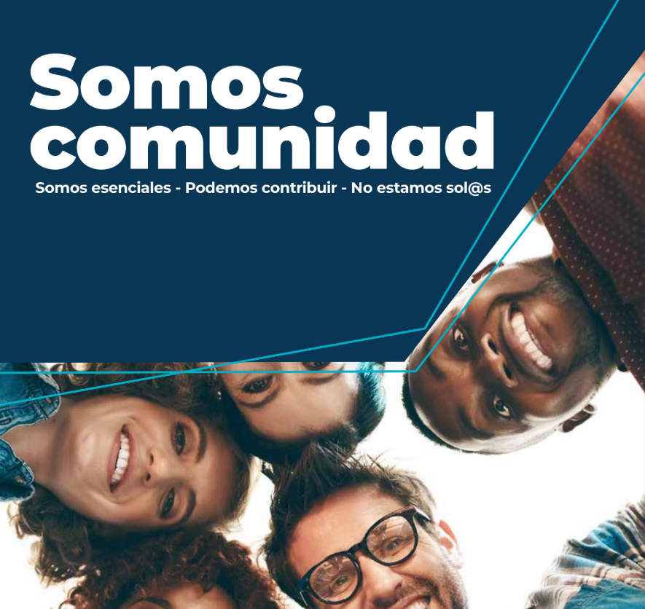
Prevention
Innovation
Prevention
Connectedness
Restorative
Community Mapping
In order to weave communities back together, build resilience and reduce alienation, we must innovate new strategies to build a holistic community of healing. In order to identify the elements of community that are intact, we must meet the community where they are at. This means working in partnership to identify key individuals and organizations to map out pathways to healing.

Slide 10
weaving
Innovation
Prevention
Connectedness
Restorative
Intact Communities
Men As Peacemakers

Slide 11
Connectedness
Innovation
Prevention
Connectedness
Restorative
Stronger Communities Through Interconnection
Practicing Interdependence
Connected communities are stronger communities. Connected communities are safer communities. Connectedness is a protective factor against a spectrum of harm and violence - in connected communities, members are less likely perpetrate or experience violence. When an individual thread becomes disconnected from the interwoven tapestry of community, it affects the safety and integrity of the whole. `MAP works with communities to identify the individuals and elements that have become disconnected, creating mechanisms that tie these threads back into a network of community supports, bringing healing, building resilience, and strengthening the whole.

Slide 12
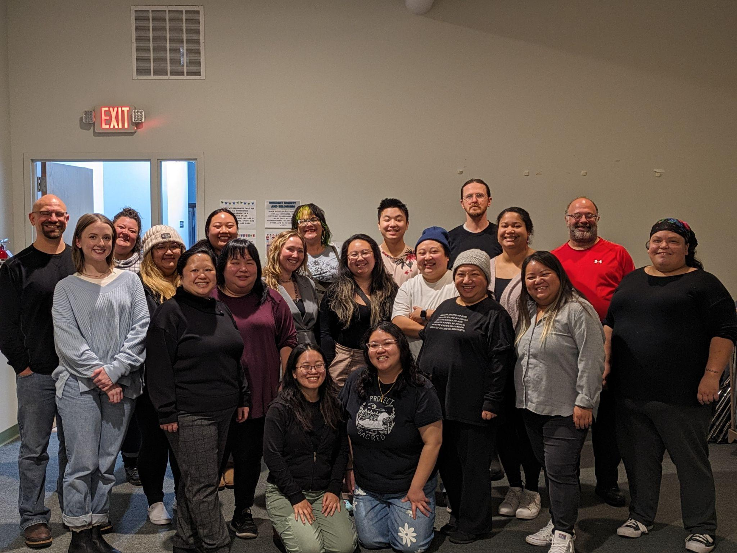
Connectedness
Innovation
Prevention
Connectedness
Restorative
Community Mapping
In order to weave communities back together, build resilience and reduce alienation, we must innovate new strategies to build a holistic community of healing. In order to identify the elements of community that are intact, we must meet the community where they are at. This means working in partnership to identify key individuals and organizations to map out pathways to healing.

Slide 13
weaving
Innovation
Prevention
Connectedness
Restorative
Intact Communities
Men As Peacemakers
.

Slide 14
Restorative
Innovation
Prevention
Connectedness
Restorative
Repairing the Tears in the Fabric of Community
Restorative Practices for Gender Based Violence
Gender-based violence rends the fabric of a community, impacting not only the immediate victim, but their families and the broader community. What survivors ask for most is an end to the violence, and a clear pathway to healing and wholeness. Mainstream systems fall short of meeting that need, and those who have caused harm remain alienated and disconnected from the people and resources that can help end patterns of violence and bring restoration. MAP works with intact elements of community, weaving harm-doers back into connection with others, facilitating a process of healing and accountability, and mending the fabric so that all can heal and thrive.

Slide 15
Restorative
Innovation
Prevention
Connectedness
Restorative
“So I was able to pick up little tidbits as I moved along. It was a completely different view. I never had to carry the, she did this to me. I'm mad about this, I'm mad about that. We broke all that stuff down. And I no longer had to carry that anger anymore. We put it together. I was accountable for my own actions, and I moved forward with my life. I no longer had to carry that baggage. And that's because of the Circle.”

