Slide 1
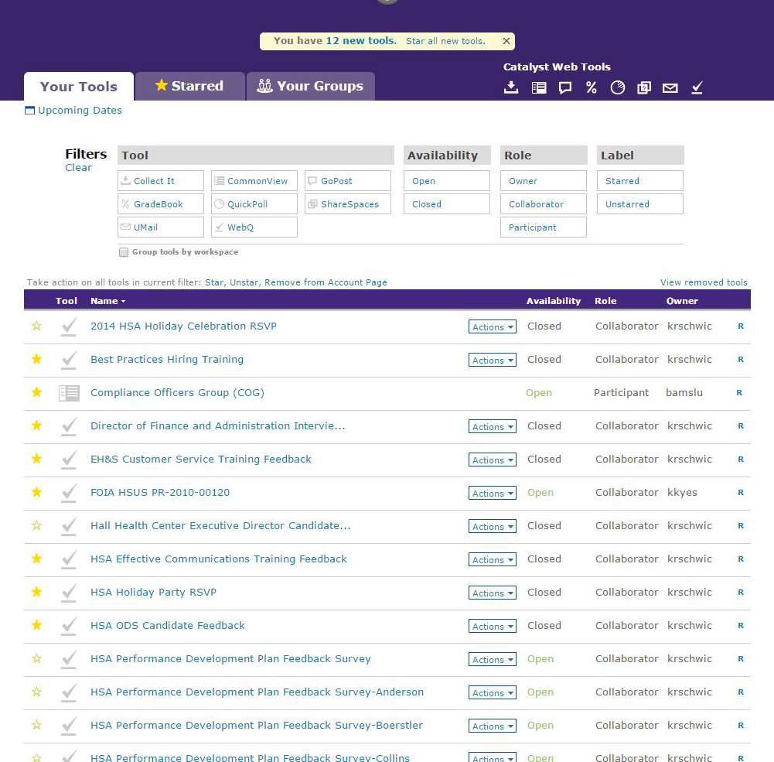
Log in to Catalyst :
https://catalyst.uw.edu
Select the survey you want to view

Slide 2
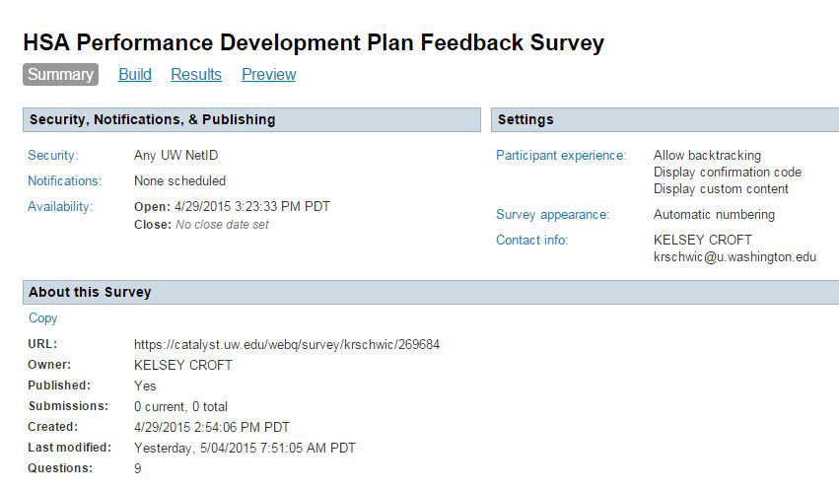
The selected survey will look like this:

Slide 3
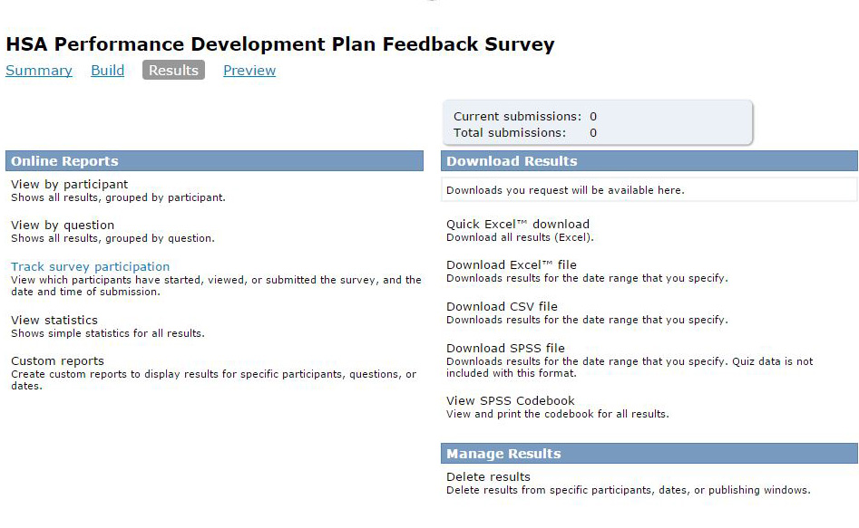
To view the survey results, Select the ‘Results’ tab

Slide 4
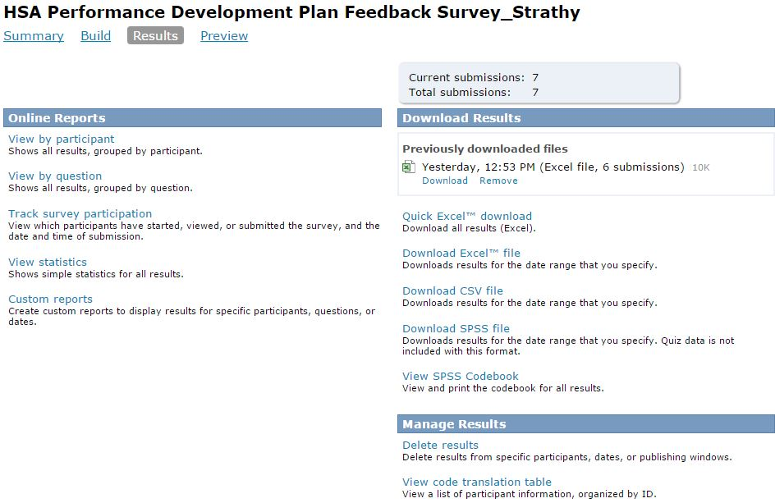
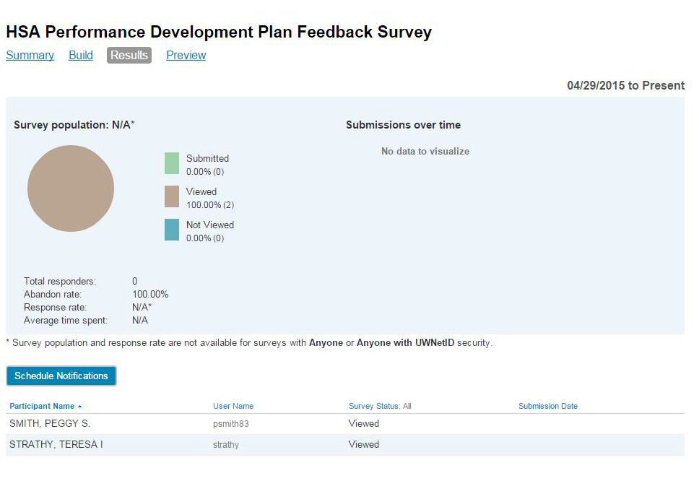
VIEWING AND TRACKING SURVEY PARTICIPATION
Select ‘Track Survey Participation’
This will show you who has either viewed or participated in the survey

Slide 5
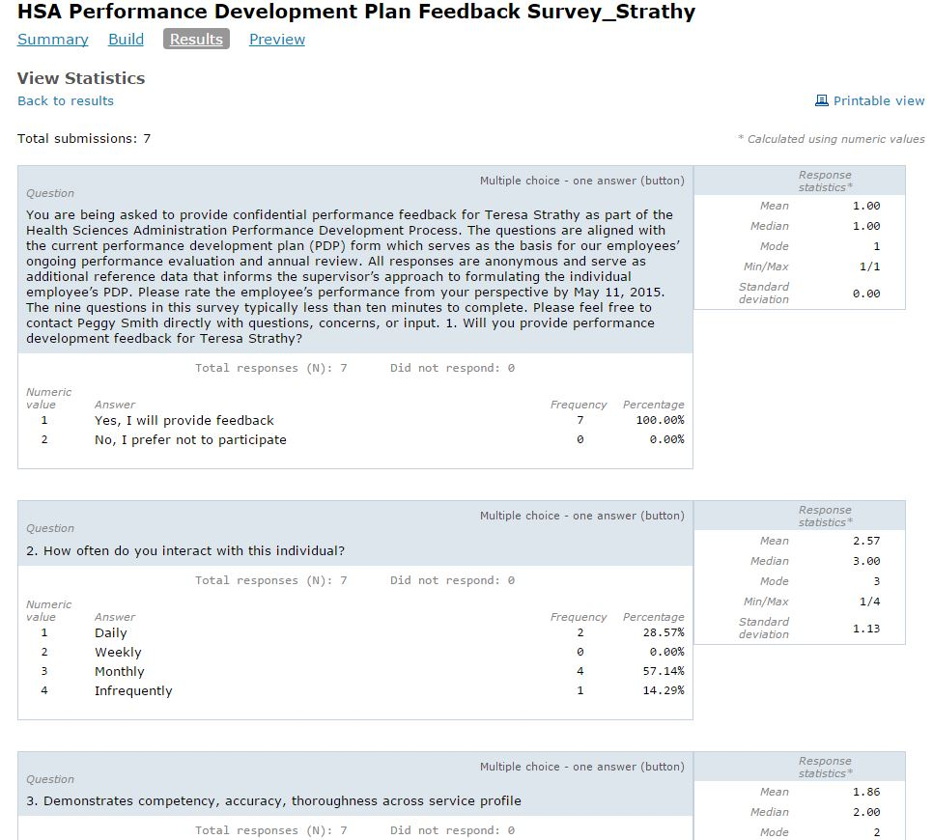
VIEWING THE SIMPLE STATISTICS OF EACH SURVEY
On the Results tab, select ‘View Statistics’
This will bring up the survey with simple participation data – no names attached

Slide 6
VIEWING THE SURVEY ON AN EXCEL SPREADSHEET
On the Results tab, select ‘Quick Excel Download’
Once the file updates, you can download the Excel spreadsheet

Slide 7
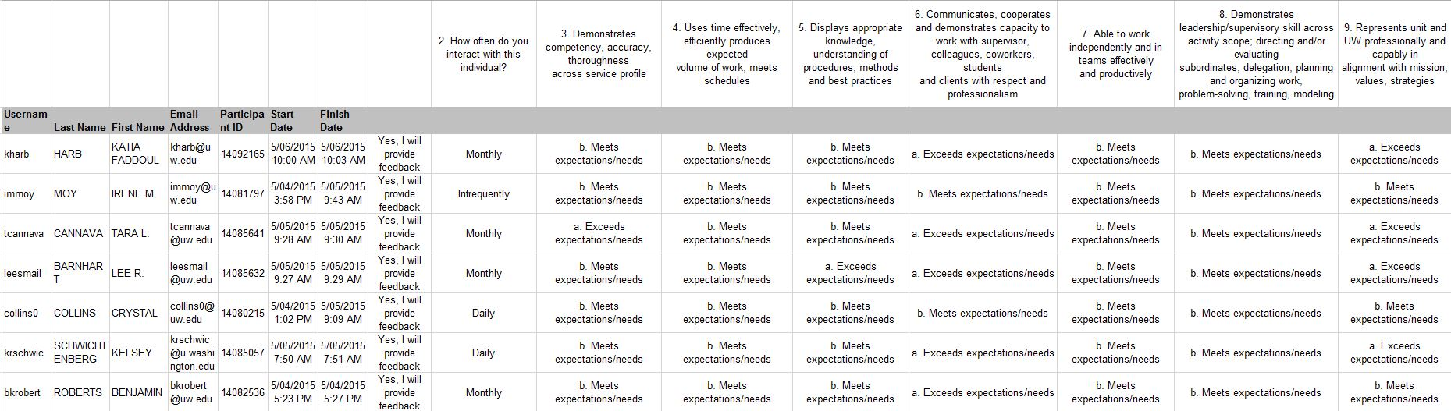
When you first open the Excel file, it will be a condensed version – if you want to see all of it, you’ll need to reformat your spreadsheet.

Slide 8
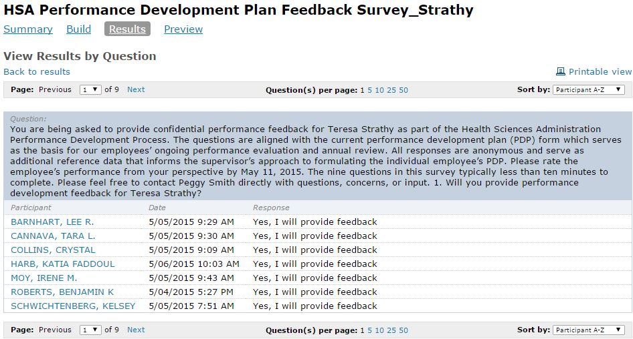
VIEWING EACH SURVEY QUESTION SEPARATELY
On the Results tab, select ‘View by Question’

