Slide 1
Performance Development Plan
HSA
Performance Management Program
2014

Slide 2
Overview
Why now?
  It’s required
  Feedback, roadmap
  Better metrics
What is Performance Management & Development?
  Streamlined version of a simplified process
  Now and what’s ahead
Notes:
Describe Definitions – PMP PD
CULTURE CHANGE – expecting high performance of all staff
Organizational flexibility and agility
Better, meaningful metrics yield better decisions, justify growth and further development
Driven by Provost timeline
History of HS Directors/HSA decisions/Supervisor post-training feedback
Streamlined version now - future: all staff, PMP CYCLE, 360 survey (e-sample), coaching, cycle with full tools, incorporating feedback
Current UW HR Status
Inconsistent performance mgt. culture
Inconsistent emphasis/support on the role of managing/supervising
Inconsistent performance mgt. coaching skillsets
Wide variability and effectiveness across tools/practices

Slide 3


Why do Performance Development?
Improve performance and positive, sustainable outcomes
  Supports strategic goals
  Link position/responsibilities to:
  You Team Unit HSA UW
Effective, efficient organizations require
  Agility
  Flexibility
Set the stage for success
  Identify organizational needs, employee contributions
  Identify supervisor support for employee success
Notes:
Unit goals translate to each person
Promotes ongoing communication that ensures employees understand unit goals
Purpose and alignment – world class education, research, service
Supports strategy, resource allocation, personnel actions (positive and negative)
New PDP states relationship to mission
SUCCESS: we want employees to have the highest likelihood of success
Assumes: JDs are available and current (HS Units’ JD audits) strategic goals communicated

Slide 4
What is Performance Development?
Performance is evaluated by
  Continually comparing actual results to desired results
  Performance Development Plan (PDP) evaluation tool
Performance development involves continual:
  Communication
  Planning
  Coaching
  Evaluation – streamlined version focus
Notes:
See PDP copy in handout

Slide 5
It’s a cycle…..
Performance development is a continuous cycle
  No surprises
  Shared responsibility
  Evaluation (PDP) is a specific phase of the cycle
Keep the focus on the specific job and mission(s)
    Individual performance against job expectations
Use well-written source material
  Job description
  Professional Staff Position Description Form
  Unit Strategic Plan/Goals, Exit Interview Feedback
Notes:
In research you need feedback and data as quickly and often as you can get it, right? – it’s the same with performance
Importance of understanding the value of their position, and how it fits into the team and organization
Frequency varies (annual, biannual, quarterly …goal is that it’s constant)
Roles and responsibilities clarified. Focus on paper not personalities unless…
Similar to best practices hiring; comparing each candidate against the position requirements
Comparing this person to current job, not others in similar position (Program Coordinators, Research Scientists, Assistant Directors)
Shared: Supervisor is accountable for PDP but the employee is responsible for performance and communicating need for tools, training
Source material: HSA Exec Director mandated Strategic Plans/Goals – if it is not available, ask or look to HSA, UW overriding mission, vision, values Per DA 10-22-14 Exit Interview Feedback
PSPDF, Grant language (consistency)

Slide 6
Performance Management Cycle
Set Performance Expectations & Goals
Performance Check-Ins
Review Performance
Review Job Description
Agree on performance goals & expectations
Agree on training & development needs
Communication
& Feedback
Monitor performance
Recognize positive results
Provide ongoing feedback/coaching
Identify additional training needs
Close-out performance evaluations
Assess performance & development
against goals & expectations
Recognize positive results
Start planning new performance
goals & expectations

Slide 7
New PDP Process
What’s the point?
  It’s required
  Feedback
  Better metrics
  Supervisor/employee may not know everything
Simplified and standardized
  Doing what you’re supposed to do – it’s a plan
  Emphasis on ongoing communication, clarity
  Cultural shift - expecting high performance
Notes:
Cultural shift in meeting expectations – high performance expected of all employees
Meeting expectations does not mean that I am doing mediocre week – it is not a “C” grade
Introduce 3 point rating system (PDP handout) Previous 5 pt. rating included Outstanding - Unsatisfactory
Avoiding A-F grading syndrome
Employees need to understand the unit goals and how they apply
Supervisors need to communicate and set context for goals and expectations

Slide 8
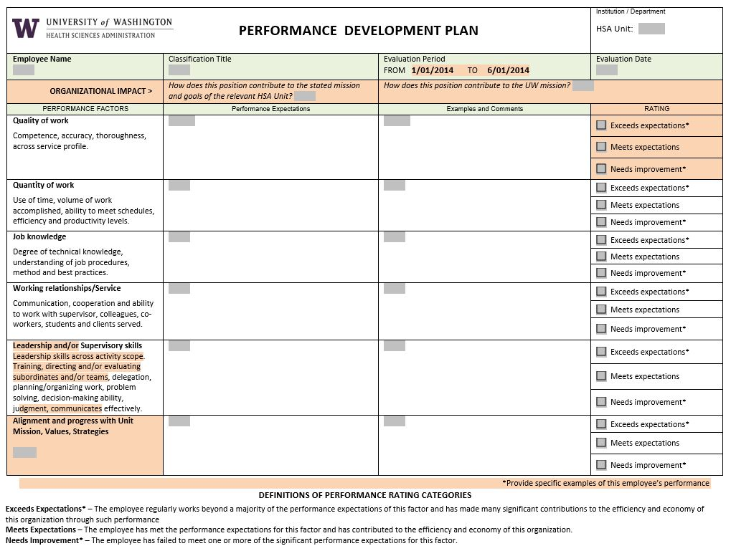
Notes:
Organizational impact (Row to identify impact)
Changes to familiar classified form
Explain highlights starting with org impact row
Adjusts to level of responsibility ; front line through Director
Point out the pre-filled evaluation period HR defined eval phase, confirmed with Provost
June is not get out of jail free
BE HONEST and FAIR in the evaluation – more later

Slide 9
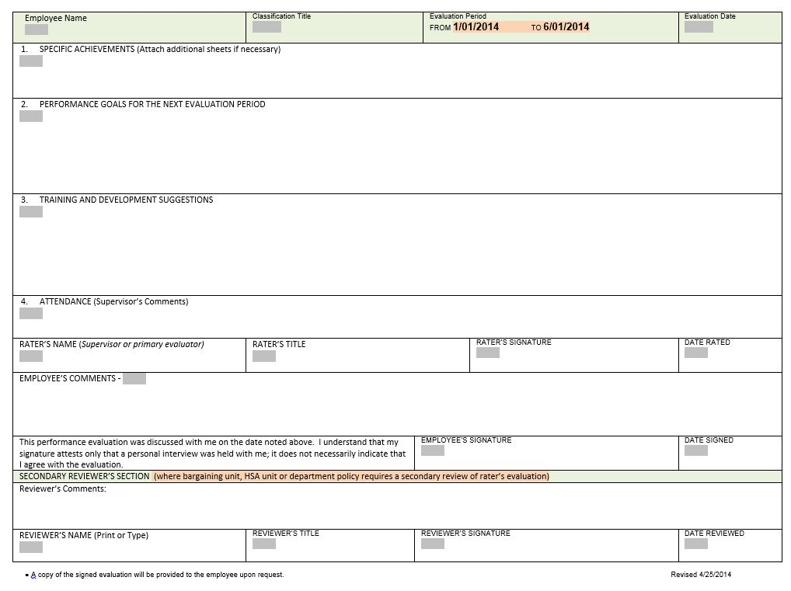
Notes:
Pg 2 to post on wall, desktop as reference document
Emphasis on Planning, Employee input
Reasonable, strategic goals SMART
For PG 2 – introduce HSA development funds available in FY15
…..

Slide 10
PDP Process Steps
Unit PDP practices communicated
Supervisor establishes PDP schedule for team
Supervisor develops PDP form
Employee self-evaluates
Supervisor provides employee with draft PDP
Employee and supervisor meet to review
  Goals, expectations
  Current performance ratings
  Discuss and further develop plan for next performance period
Finalize PDP, sign – next steps
Notes:
Unit PDP Practice or SOP may transfer from existing processes or establish
Timelines
Rater - Reviewer policy
Employee self-eval process, format, training parameters or availability
Any HR actions (disciplinary or promotion, FMLA or extended absences)
Standardized terms/language to be included (i.e. org impact statement; ways to address attendance/delegation)
2. Volume and time available – individual schedule variances
3. Creates on this first go-around but existing information should translate or format
4. If applicable, Employee completes perf factors and ratings, specific achievements, training and development needs
5. Unit establishes/communicates timeline (3 days prior, 1 day prior)
Protocol slide – are we on the same page, same book?
Current ratings include supervisor’s and employee’s of performance
Sign and submit or schedule a revisit (slide 13 coming)

Slide 11
From Source docs to PDP
Source docs: Job description, PSPDF, Unit Strategic Goals
Significant performance expectations
Determine key goals
What the employee needs to accomplish and…
  what supervisor needs to clearly communicate
Meaningful metrics
Address linear vs. concurrent goals
Be aware of emerging priorities
Notes:
Sources: performance portfolio, lean report outs, other strategy visuals, stakeholders feedback, PSPDF, Grant language, HR appointments, issues
FUTURE 360◦ catalyst survey
Consistency from Source Docs re: HR action (Dave’s examples of returning employee RFD to work based on prior evaluations)
Significant: see PDP handout pg 1
Examples of emerging priorities; lean leadership, initiatives, absence of co-worker
Stress Significant (PDP page 1)
What employee needs to accomplish and what supervisor needs to clearly communicate
Meaningful metrics slide ahead For PG 2 – reiterate HSA development funds available in FY15
Job Descriptions should be updated and revised if there are significant changes to the employee’s responsibilities
Have a discussion about how their individual goals influence other goals (group/team, department/division, organization) new PDP frames this
The goals are where you want the primary focus to be – this does not mean the employee ignores the rest of their job

Slide 12
Setting Goals
Quality key goal
  What is the intended result or outcome?
    How does it strategically contribute to mission?
  When will it be met?
  How will it be met?
  Is it transparent?
SMART test
  Specific
  Measurable/Observable
  Action
  Realistic and relevant
  Timely
Notes:
GOALS ARE THE REFERENCE POINT (remind people of Effective Communications Training)
Are the supervisor and employee on the same page? Clearly communicated and understood
Specific – clear and focused
Measurable/observable – actions/behaviors that can be measured, observed, documented, tracked
Action-oriented – something must be done
Realistic/Relevant – within the employee’s control & abilities, resources available
Timely – establish time frames, turnaround/processing times, deadlines
Goal Example – implement new technology to allow for streamlined response to protocol inquiries.
A responsibility – ensure that best fit technology is in place, training conducted, implementation measured as successful by Dec 1
A task – delegates track training compliance and report out

Slide 13
Meaningful Metrics
  The purpose of metrics
  Translate strategy into plans
  Measure and assess progress
  Plan for - and drive - improvements
  Make better data-based decisions
  Justify future plans
Notes:
The point isn’t to simply measure something – the point is to make things “better”
Your source documents, report outs, grant specific aims, previous evaluations may have built-in metrics
Again – example of FY 15 HSA training dollars

Slide 14
PDP Meeting Protocol
Be prepared - docs and ducks in a row
Be honest - work together
Supervisors guide a conversation, not control a discussion
Identify and discuss what…
  Supervisor will do to help the plan succeed
  Employee needs from the supervisor
Next steps
  Incorporate new information
  Develop a plan to address
    Resources – time, money
    Employee needs and team equity
    Alignment
Notes:
Use effective communication techniques
Honesty:
it is a disservice to everyone to avoid difficult conversations; actions you are planning may be delayed (pitch to Kelly)
“everything was perfect – and then I got fired” “I inherited this person and her last supervisor said she was terrific”
The employee should end up doing most of the talking, since he or she is likely to know their needs best
Refer to documents; paper not personality unless the personality is overriding component (should not be a surprise)
The employee should end up doing most of the talking, since he or she is likely to know their needs best
Alignment
From ee perspective (under/over performer bias in ratings) widely different perceptions
From supervisor (with goals, with current capabilities, with team)

Slide 15
HSA Strategy
OD Specialist as HSA shared service
Units’ organizational culture aligned to support performance
Elevate capacity
  Best practice models
  Tools, training and implementation
High Performing Individuals and Teams
  Best Practices Hiring
  Performance Management – Performance Development
  Recognition – Retention - Reward
Notes:
Refer to strategy map
High performance linked to processes, tools, programs
Agility, Flexibility

Slide 16
PMP Future State HSA - UW
Culture aligned to support high performance
  Consistent, ongoing feedback for all personnel
  Supports strategic goals
  Drives linkage to Unit, HSA and UW missions
Standardized, effective, efficient systems tools
  Established, relevant
  Accessible
Systems for accountability and recognition
Web-based processes with delegated access to:
  Performance data
  PMP activities

Slide 17
QUESTIONS?
Notes:
Peggy can moderate, field
FAQ

Slide 18
3 Point Rating Scale
Meets Expectations
Performance fully meets job requirements and expectations on a consistent basis. Performs tasks/functions and meets performance factors:
performs and sustains the function at a high quality level
in alignment with strategic goals
initiates and/or volunteers
consistent, thorough, timely
√
Notes:
The new normal, our cultural shift
All HSA personnel expected to meet expectations with high performance
Need good metrics to support
Performance development is
Designed to provide a reflection of actual performance, current expectations/goals
Designed to support ongoing performance communication around progress, growth, goals – not supplant it
Not designed as corrective or recognition ; there are other systems for that

Slide 19
Exceeds Expectations
Performance consistently exceeds requirements, reaching a very high level found only in a small percentage of people; with minimum supervision or directions, achievements are well beyond those expected at this level. Has a unique, positive, and outstanding impact on the organization.
Qualifies for recognition, reward and active
measures to retain and/or advance this employee
Needs Improvement
Performance sometimes meets requirements, but not consistently; improvement necessary. Unsatisfactory; consistently failed to meet the performance expectations for this factor(s)
Qualifies for immediate follow-through, feedback,
coaching, possible corrective action; supervisor provides timely, specific documentation and appropriate planning
Notes:
Ongoing communication, coordination

Slide 20
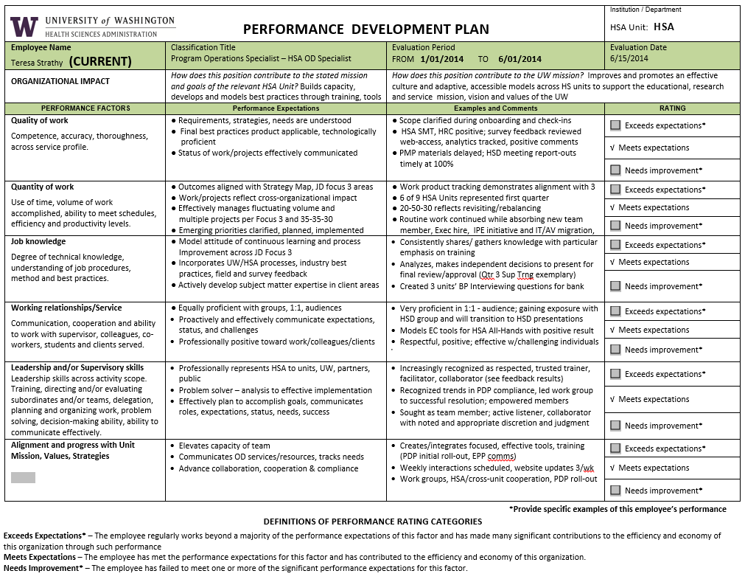

Slide 21
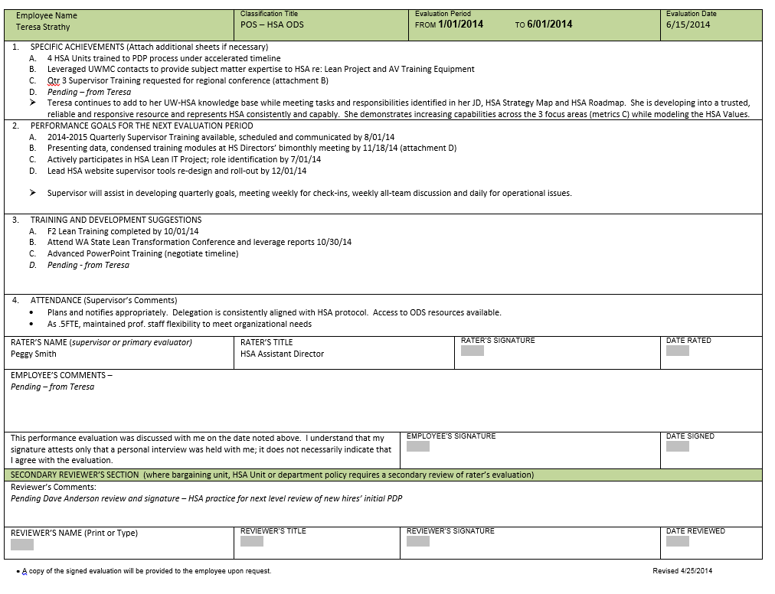

Slide 22
Avoid
References to health conditions
References to HR or legal proceedings
All-encompassing language
Halo or horn effect
Rating against other peers
Ignoring performance based on anticipated events or perception of compensation
Notes:
Health
Late due to chemo treatment
Project delayed due to approved leave
Mental health counseling schedule
Carelink
Legal
UCIRO, Ombud, Union, Mediations……
Language - vague
“Always late”
“Never does it”
“Outstanding at every aspect of her job”
Provide specific examples,
“late to senior mgt meeting 3 times in June and July, impacting agenda”
“Assigned 10 benchmark tasks, completed 5 with no extenuating circumstances communicated”
“Accurately delegated responsibilities, prepared staff, communicated 1 week prior to departure re: 5 approved leaves”
HALO
So expertly managed national conference or Lean Initiative that rest of performance not accurately measured
One pinnacle achievement overshadows underperformance
Supervisor reacts to one outstanding characteristic which influences our total judgment about person and performance
Ascribe a range of related traits that may not now or ever exist
HORN
Flip side – lacking in one trait ( or one spectacular failure) influences all others
Rate against others
Style
Scope
Personality
Relationships
AVOID
Planned events may not occur, lose the opportunity to address immediately
Ignoring…lame ducks, retirement, vacation
Perception or culture that assumes UW employees are underpaid

Slide 23
Who to contact…
Your supervisor
Your administrator
HSA
  Teresa Strathy
  Peggy Smith
  Bob Ennes
  HSA website or Kelsey Croft at 206-543-7202
HRC Kelly Johnson
Ombud call Chuck
Notes:
Start local – unit practices, policies
FAQ – questions that can be extrapolated to all units will be added to website FAQ
Given timeline:
We can help you or field your question more effectively if you’re as specific as possible, cite a slide or item on PDP form; 1 business day response
Teresa .5 FTE M-Th 8:30 – 2:30

