Slide 1
UW MEDICINE PANEL MANAGEMENT SUPERUSER TRAINING
Uw medicine primary care & population health
April 29 & May 1, 2020
Notes:
Vicky - Welcome

Slide 2
Background
Goal: Integrate pop health activities across UW Primary Care
1. Empanelment & Panel Maintenance
2. Panel & Gap Management
3. Care Management & Coordination
4. Ambulatory Care Pathways
Population Health Design Sessions occurred in early 2019, as a next step with UW Primary Care & Population Health Integration
Assessed overall population health activities and resources, including the four categories shown at right
Empanelment & Panel Maintenance workgroup occurred May – October 2019
Panel & Gap Management workgroup occurred September – December 2019
Notes:
Vicky

Slide 3
Panel Management Workgroup
EXECUTIVE SPONSORS
Van Chaudhari, FACHE, MHA
Administrator
Population Health Management
Pete McGough, MD
Medical Director
UWNC Primary Care
FALL 2018
Population Health and Primary Care integration
WINTER 2019
Population Health Design Sessions
SPRING 2019
Empanelment and Panel Maintenance Workgroup
FALL 2019
Panel Management Workgroup
WINTER/ SPRING 2020
Panel Management Training & Implementation
PROJECT LEAD
Vicky Fang, MD
Associate Medical Director,
UWNC Southeast Region
CORE TEAM
Chesna Briceno| Assistant Director, UWNC Southeast Region
Jake Berman, MD, MPH | Medical Director, UWMC General Internal Medicine Clinic
Sara Jackson, MD, MPH | Medical Director, Adult Medicine, HMC
Susana Orozco | Business Operations Manager, HMC Adult Medicine
Ellen Broweleit, MHA | Assistant Director, Primary Care Northwest Region
Kathryn Harris, MD| Physician Lead Transition NWH/UWP Primary Care
Diane Salvesen| Practice Manger, NWH
PROJECT STAFF
Lauren Drake, LICSW| Program Manager, Population Health Management
Doug Donaldson| Process Improvement Program Manager, UWNC
Notes:
Vicky

Slide 4
Review: What is Panel Management?
Panel Management
A proactive approach to health care in which the care team is concerned with the health of the entire population of its patients, not just those who come into the clinical setting for visits.
Elements of Panel Management
Proactive care
Identifying patients with care needs
Population-based care – focus on both patients who are AND aren’t coming in to clinic
Addresses unmet preventative & chronic care needs
Team-based approach
Tools and processes applied systematically to panel
Empanelment + Team-Based Panel Management = Better Population Health
Notes:
Vicky

Slide 5
Review: What is Gap Management?
Gap Management: a collaborative, deliberate effort to oversee, track and analyze primary care quality metrics and performance to identify, and then actualize a team-based approach to closing gaps in care.
Gaps Include:
Preventive measures
Chronic conditions measures
HCC updates (risk gaps)
Information gaps
Annual Wellness Visits
Examples of Success Metrics
% of panels with care gaps closed
% of preventive screenings and immunizations complete
% of panels with chronic disease management states that are “controlled”
Notes:
Vicky

Slide 6
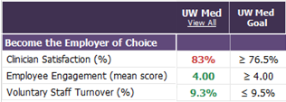
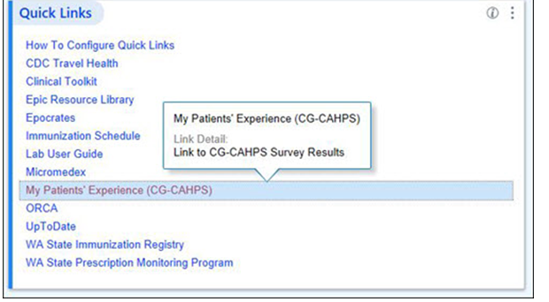
WHY PANEL & GAP MANAGEMENT?
Contractual agreements
Better outcomes at lower cost
Provider satisfaction
Improved panel
metrics
Patient Satisfaction
Notes:
Vicky

Slide 7
How do we achieve Panel & Gap Management?
Team-based care
Population Health support –
central resources
Empower the Clinic Team
“It’s everyone’s responsibility!”
“Every patient, every time!”
Panel Management meetings to consult on ‘difficult cases’
Notes:
Vicky

Slide 8
GOALS & OUTCOMES OF PANEL MANAGEMENT WORKGROUP
Notes:
LAUREN

Slide 9
Panel and Gap Management Workgroup Goals
2019 Workgroup Goals:
Devise an approach for systematic and sustainable Panel Management across all entities of UW Primary Care
Establish best practices for Panel Management
Develop new, more efficient tools
Recommend roles for UW Medicine Primary Care central and local teams
Completed a five-week sprint cycle of meetings
Included input from 28 staff across UWM Primary Care entities
Notes:
Lauren

Slide 10
Workgroup Outcomes
#1: Selected focus areas for Panel Management in 2020
Diabetes Care Gaps (A1C, Blood Pressure, Microalbumin, Retinal eye exam)
Annual Wellness Visits
Excel at MA AWVs and address ‘Welcome to Medicare - IPPE’ visits for Medicare traditional
Focus on AWVs for all Medicare traditional
#2: All entities developed will soon implement individual Panel Management Plans in May 2020
#3: Each clinic identified a “Panel Manager” to:
Become an expert in panel management workflows and best practices
Support panel management efforts within the clinic
Notes:
Lauren

Slide 11
Workgroup Outcomes
#4: Primary Care and Population Health clarified roles of Local (clinic) vs. Central (Population Health) Teams
#5: IT & Epic built new system-wide tools to standardize and optimize panel management
#6: New .DIABETESAVS SmartPhrase to include in After Visit Summary
Informs patients of their health maintenance items and how often to address care gaps
#7: “Standing Order” for Microalbumin and A1C at UWNC Labs
Notes:
Lauren

Slide 12
Outcome: New Epic Diabetes Panel Report
Notes:
Lauren

Slide 13
Recommendations for Future State
Workgroup recommendation to leadership that additional FTE be dedicated toward “Panel Manager” role, as resources allow
Continuing to explore Epic enhancements including additional standardized panel management reports and documentation tools
Panel Management becomes a key part of the culture of all UW Medicine Primary Care clinics
Notes:
Lauren

Slide 14
BEST PRACTICES FOR PANEL MANAGEMENT
Notes:
VICKY

Slide 15
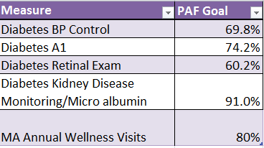
2020 Focus: Diabetes Gap & AWV Targets
All clinics will focus on panel management for Diabetes Care Gaps & AWVs in order to ‘move the needle’ on outcome metrics
Diabetes Metrics PAF metrics (on right)
Annual Wellness Visits
Excel at MA AWVs and address ‘Welcome to Medicare - IPPE’ visits for Medicare traditional
Focus on AWVs for all Medicare traditional
Clinic-level data on current performance in comparison to goals is located on the Patients are First (PAF) and/or HBI Dashboards
Notes:
Vicky

Slide 16
Best Practice: Panel Management Meetings
Scheduled 1x per month per PCP; ideally for 1 hour
Clinic Managers should block 1 hour per month per PCP, starting May 2020
Required Meeting Attendees:
PCP
Panel Manager (Health Navigator, MA, RN, Lead PSR, or other role)
Additional Meeting Attendees (depending on clinical area of focus):
PCP’s Medical Assistant
Registered Dietician (RD)
Registered Nurse (RN)
Social Worker
Clinic Chief*
Clinic Manager*
Notes:
Vicky

Slide 17
Roles of the Panel Manager
Point person in-clinic for questions related to panel management workflows, best practices, reports, and documentation
Train other support staff on running panel reports, as needed
Before Panel Management Meetings
Work with clinic manager to ensure all team members are available to attend
Prepare report(s) to organize panel management meetings
For Diabetes focus: see Job Aid for running “Diabetes Panel Report” in Epic
For AWV focus: see “Due for AWV” list sent monthly by Pop Health.
For other focus: Run “Patients on <X> Provider’s Panel” Epic report; set custom filters
Notes:
Vicky

Slide 18
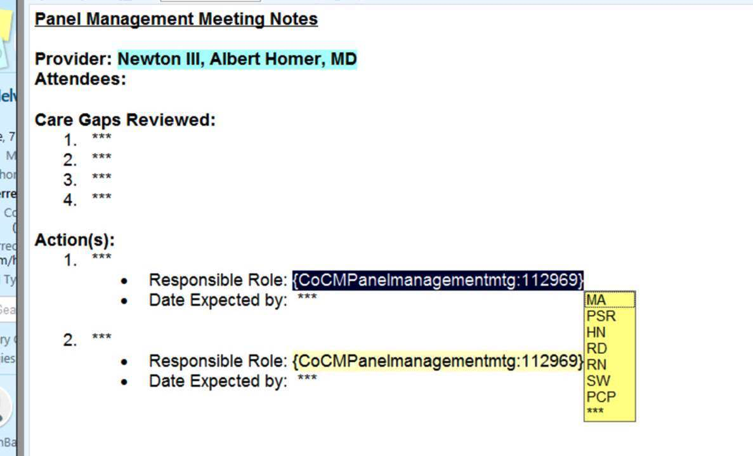
Roles of the Panel Manager, cont.
During Panel Management Meetings
Pull up reports on shared screen
Keep time during meeting to ensure diabetes panel & due for AWV patients are reviewed with PCP and team
Document meeting discussion and clinical decisions in Epic (not MS Word)
Create a Telephone Encounter for each individual patient reviewed
Use new standard SmartPhrase .PANELMANAGEMENTMTG
.PANELMANAGEMENTMTG
Notes:
Vicky

Slide 19
Roles of the Panel Manager, cont.
Documentation Guidelines:
If there is individual review of a specific patient and clinical decision-making involving provider, please document in Epic.
For batch review of a group of patients, TE documentation is not required.
Ex: Discussion that ends with decision to “Send eCare/Letter to all patients who are overdue for retinal exam”
In these cases, the letter/eCare will serve as documentation
After Panel Management Meetings
Route Panel Management note to staff responsible for follow-up (MA, PSR, RD, RN, PCP, HN)
Clinic Managers will work with Panel Manager to allow time for documentation after each meeting
Notes:
Vicky

Slide 20
Roles of the Primary Care Provider (PCP)
Champion team-based panel management for their practice
Work with clinic team on empanelment and panel maintenance to ensure that panel is up-to-date
Daily huddle with MA to review forecasting how to close care gaps in clinic that day
Emphasis on Diabetes Gaps (A1C, BP, Microalbumin, Retinal Exam)
“Manage up” other members of the care team and encourage patients to engage with team-based care services
Notes:
Vicky

Slide 21
Roles of the Primary Care Provider (PCP) cont.
During Panel Management Meeting:
Attend all panel management meetings as scheduled
Provide team with clinical guidance on best follow-up action(s) for the patient
Offer feedback on how to best engage specific patients on panel
After the Panel Management meeting:
Follow-up on closing care gaps as discussed during next appointment with patient
Example: if patient is brought up for Diabetes visit with PCP, follow plan to prescribe insulin and place Referral to Nutrition Counseling
Partner with patients to identify barriers to gap closure, and inform care team of patient’s needs (i.e. transportation, anxiety)
Notes:
Vicky

Slide 22
Roles of the Clinic Chief
Champion process of team-based panel management and encourage use of standardized workflows and tools
Announce roll-out of new panel management practices and UW Medicine Primary Care priority focus areas, beginning May 2020
Diabetes Care Gaps
Annual Wellness Visits (Medicare Advantage first, then Medicare traditional)
Review quality and gap closure data with individual providers, on a monthly basis
Ensures PCPs participate in panel management meetings and activities
Notes:
Vicky

Slide 23
Roles of the Clinic Manager
Coordinate scheduling of monthly panel management meetings and blocking schedules of attendees at the designated time
Pull and share monthly quality data, by clinic and provider level.
Use HBI Tool or Patients are First Dashboard as data source (new job aid available)
Review regularly with Clinic Chief and share with back office staff.
Ensure clinic staff participate in panel management meetings and activities
Ensure Panel Manager role has sufficient dedicated time for panel management tasks (i.e. meeting prep, documentation, and tracking follow-up items)
Ensure Clinic Lab is following new lab protocols for Diabetes Care Gaps
Notes:
Vicky

Slide 24
Roles of other Team Members at PM Meetings
Recommended additional attendees at Diabetes Panel Management meetings:
Registered Dietician (RD)
Give input on treatment plan for diabetic patients
Recommended referral to Nutrition Counseling and/or Diabetes Education classes
Registered Nurse (RN)
Give input on treatment plan for diabetic patients
Recommend for Chronic Care Management or RN Diabetes Management
Furnish some of the AWVs
Social Worker (SW)
Give input on treatment plan for behavioral health patients
Recommend community resources to support complex patients
Recommend Referral to BHIP or Referral to Social Work as indicated
Notes:
Vicky

Slide 25
TRACKING OUTCOME & PROCESS METRICS
Notes:
LAUREN

Slide 26
Rollout & Measurement
Hypothesis: We believe these changes will lead to better outcomes for our patients
But how will we know for sure? How will we test this assumption?
In 6 months, if we don't see the outcomes we expect, what can we conclude?
If all we have is data on outcomes, it will be hard to conclude anything
We need to keep both process and outcome in view in order to improve
PROCESS
OUTCOME
Improvement
Notes:
Lauren

Slide 27
Outcome Metrics
Outcome Metrics:
Data on the clinical outcomes that are impacted by new workflows and initiatives
Outcome Metrics for Panel Management Pilot:
Clinic and provider progress toward meeting Patients are First goals for Diabetes Care Gap goals
80% target for AWVs for Medicare Advantage patients
Notes:
Lauren

Slide 28
Process Metrics
Process Metrics:
The HOW behind the WHAT
Data on activities, actions, and behaviors that lead to a certain set of outcomes
Process Metrics for Panel Management will capture clinic activities and time spent in support of panel management:
Each clinic is asked to manually collect data using standard tools
By tracking what is being done at the clinic and provider level, we will gather evidence to learn which strategies are most effective.
This is a key piece of the Plan-Do-Study-Act (PDSA) cycle
Collecting process metrics in this way is temporary, depending on how well we can demonstrate cause & effect
Notes:
Lauren

Slide 29
Process Metrics for Panel Management
Panel Managers
Number of panel management meetings per month, per provider
Monthly time spent by Panel Managers on panel management-related work
Clinic Managers & Chiefs
Track download and method of sharing of clinic panel data from PAF/HBI dashboard
i.e. Email Distribution; Posting in-clinic; 1:1 with individual provider/MA dyad; Provider Meetings; All Staff Meetings
Panel Management Process Metrics tracking forms are available online
Submit forms monthly to Doug Donaldson dmdonald@uw.edu
Notes:
Lauren

Slide 30
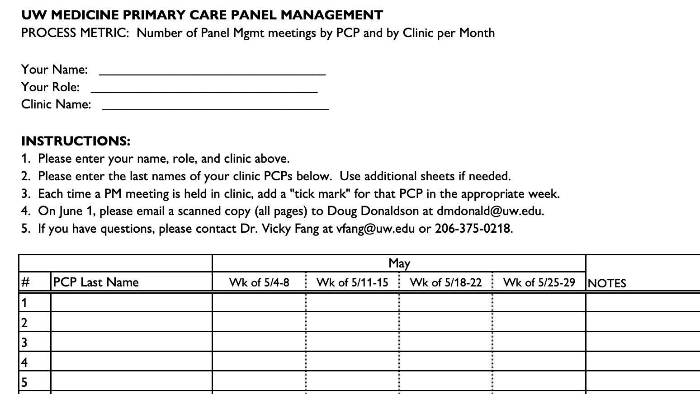
Notes:
LAUREN

Slide 31
NEXT STEPS & TRAINING RESOURCES
Notes:
LAUREN

Slide 32
Where can I find these new tools and resources?
All Panel Management Job Aids, Resources, Workflows, Tip Sheets, and today’s presentation are posted on the UW Medicine Care Transformation Page
https://depts.washington.edu/uwmedptn/strategies-programs/population-health/panel-gap-management/2020-panel-management-training-materials/
Notes:
LAUREN

Slide 33
Notes:
LAUREN

Slide 34
Timeline for Panel Management Roll-out
Late April/Early May 2020
Trainings with clinic chiefs, clinic managers, and Panel Managers from UWNC, NWH & Harborview
Panel Management Training Toolkit posted is on UW Medicine Intranet
Please visit the website to review and download all Job Aids and Resources
Clinic Managers: work with PCPs & staff to block time for focus on panel management
Beginning May 4, 2020
All entities/clinics go-live with Panel Management implementation plans, PCP meetings, and tracking of Process Metrics
Clinics should follow evolving UW Medicine ambulatory care guidelines regarding scheduling of in-person vs. telehealth visits during the time of COVID-19
Notes:
LAUREN

Slide 35
PM RESOURCES
After today – please review: UW Medicine Panel Management Tools & Resources
Did you know there is a central resource available to all UW Medicine staff, that provides the tools needed to answer and perform population health activities?
It includes clinical toolkits, workflows, Job Aids, and much more to support Panel Management activities.
Notes:
LAUREN

Slide 36
Vicky Fang, MD
Associate Medical Director, UWNC SE Region
vfang@uw.edu
Lauren Drake, LICSW
Program Manager, Population Health Management
lbdrake@uw.edu
*out on parental leave mid-May – early November 2020
Notes:
Vicky & Lauren

Slide 37
APPENDIX: EMPANELMENT & PANEL MAINTENANCE
Notes:
LAUREN

Slide 38
METRICS
SAMPLES: CURRENT EMPANELMENT METRICS
UWNC Ravenna empanelment rate*
% EMPANELED PATIENTS, ACTIVE
- Numerator: # of patients seen at least twice in the last 2 years with an empaneled PCP in the Gen PCP field
- Denominator: total # of patients seen at least twice in the last 2 years at a UW Medicine primary care clinic location
% UN-EMPANELED PATIENTS, ACTIVE
- Numerator: # of patients assigned to a UW Medicine primary care location but not assigned to a UW Medicine PCP
- Denominator: total # of patients seen at least twice in the last 2 years at a UW Medicine primary care clinic location
93%
by end of FY2020
UWMC GIMC empanelment rate*
<7%
by end of FY2020
Empaneled
Un-empaneled
*as of 6-15-19

Slide 39
PANEL MAINTENANCE CYCLES
DAILY
Clinic staff: Verify and update Gen PCP field
Clinic staff: PCP continuity patient education
MONTHLY
Population Health: Patient outreach to empaneled, less engaged
Population Health: Patient outreach to un-empaneled, engaged
QUARTERLY
Clinic leadership: Monitor clinic empanelment metrics
Population Health: Track, assess and report clinic->system empanelment metrics
ANNUALLY
Clinic leadership: Resident transitions
Population Health: Verify Gen PCP and route changes to clinic
PRN
Clinic leadership: Provider transitions
Clinic staff: Bulk PCP re-assignment for departing providers
Entity contact: All panel updates to pcpupdates@uw.edu
Clinic staff: Panel management meetings and organic panel clean up
Clinic/entity leadership and Pop Health: Patients Are First metric year-end data

Slide 40
A TEAM APPROACH
Population Health
Centralized patient outreach letters
Telephonic and electronic patient outreach
Contact Center
Identify Gen PCP field inaccuracies
Front Desk
Verify and update the Gen PCP field
Help educate patients on importance of establishing PCP and continuity
Clinical Staff
Monitor metrics and data
Performance reporting
Verify and update the Gen PCP field
Help educate patients on importance of establishing PCP and continuity
Between visit care

Slide 41
A TEAM APPROACH
Providers
Panel audits
Clinic Leadership
Plan for successful provider transitions
Super User
Run panel reports
Organic updating of the Gen PCP field
Resources for others in clinic
Handle higher complexity cases
Identify patients who need personalized outreach or care plans
Change location field

Slide 42
CLINICAL STAFF: UPDATING THE GENERAL PCP
1
It is expected that all primary care clinical staff should, with each patient visit, review, verify and update the Gen PCP field with the patient, to ensure:
[1] Maintenance and accuracy of General (‘gen’) PCP field
[2] Patients who use our primary care services are assigned to a PCP
[3] Maintain and improve performance on key population health metrics impacted by panel metrics
Click here to find:
Empanelment Clinic Toolkit
Front desk workflows
Scripting
More information about updating the PCP field

Slide 43
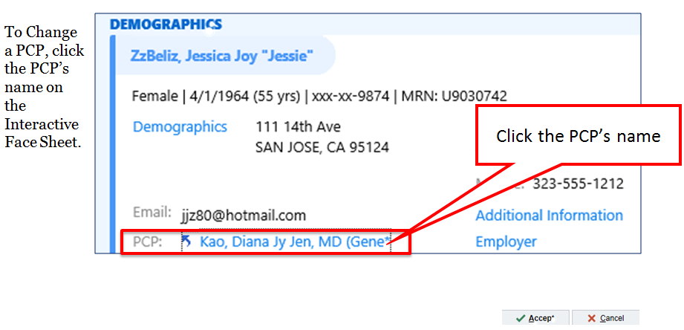
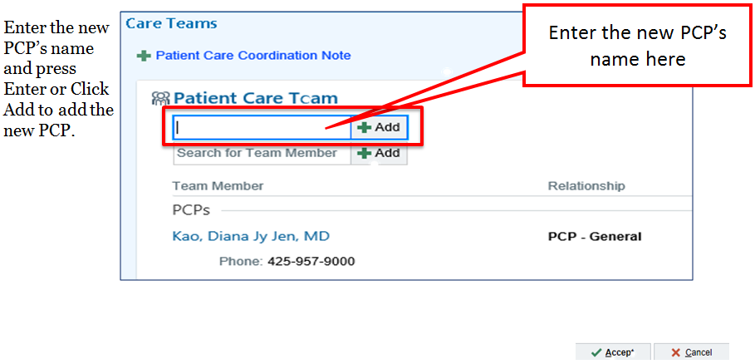
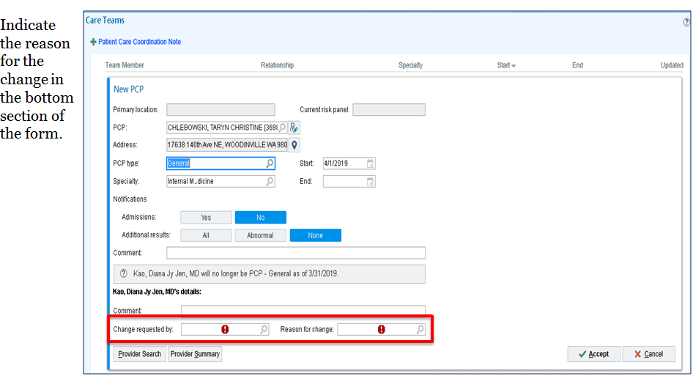
UPDATING PCP FIELD in EPIC: HOW TO (part 1)
1
2
3
Notes:
This slide and the following two slides provide the step-by-step how to for updating the Gen PCP field and Primary Location fields in Epic. These detailed instructions can also be found in the clinical toolkits, available via a link that we will share at the end of this presentation.

Slide 44
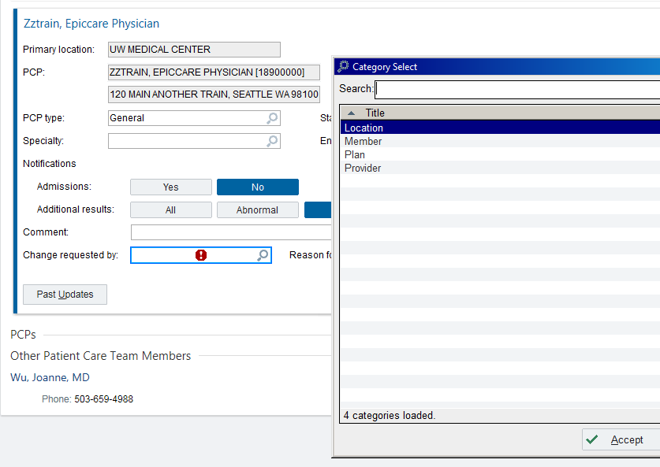
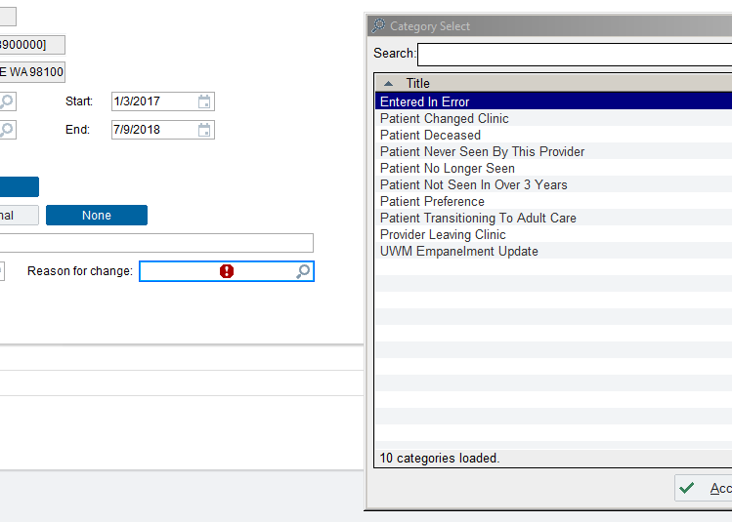
UPDATING PCP FIELD in EPIC: HOW TO (part 2)
4
5
Notes:
Member = patient --- working to change this to patient, instead of member

Slide 45
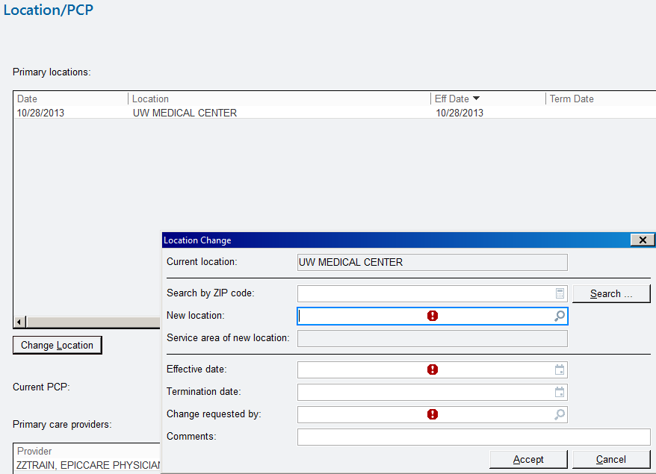
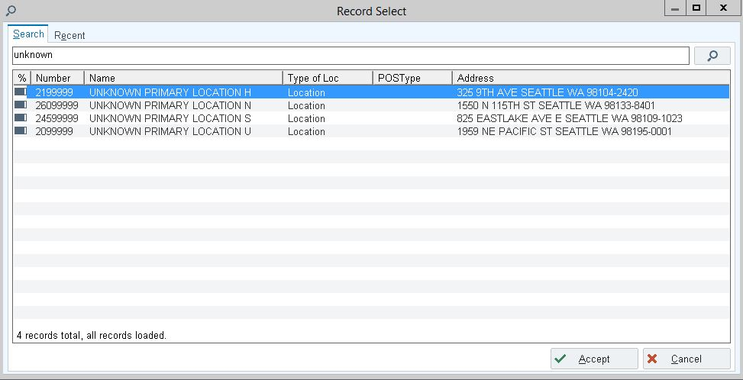
UPDATING PRIMARY LOCATION in EPIC
1
Click on Primary Location in patient side bar to activate Location Update Activity
Why is it important to change the Primary Location, in addition to the Gen PCP?
To ensure patients do not remain on a clinic’s panel
To ensure and maintain integrity of patients who are truly un-empaneled to a PCP, but do belong to a UW Medicine Primary Care location (Reports BO0337)
2
3
If known: Search and select specific, known UW location
If unknown: Search ‘Outside or Unknown’, select any 1 of 4 UW campuses
Notes:
Updating the primary location

Slide 46
CARE TEAM: BETWEEN VISIT CARE
[1] Epic InBasket message received re: patient’s PCP needs to be changed
Patient's PCP need to be changed
[2] Determine if the requested PCP has an open panel
YES, panel is open – Update PCP field
NO, panel is closed or limited
[3] Send a message to the requested PCP
Determine if patient will be accepted onto panel
Click here to find:
Empanelment Clinic Toolkit
Front desk workflows
Scripting
More information about updating the PCP field

